Slide 1


Talk2Invoice: AI Powered Voice Assistant for Food Ordering and Invoicing
Paper ID: 315
Ms. Bandi Poorna Sri Sailaja
Sri Vasavi Engineering College
International Conference on Artificial Intelligence and Cybersecurity 2026
Organized by
Sankalchand Patel University, Visnagar
6–7 March 2026

Slide 2
Introduction
AI-Driven Service Transformation: Modern quick-service environments need intelligent automation to manage high customer volumes efficiently while keeping service accurate and scalable.
Limitations of Existing Ordering Systems: Manual counters and touchscreen kiosks face challenges during peak hours, including order inaccuracies, limited support for multiple languages, and poor backend synchronization.
Proposed Framework, Talk2Invoice: A new AI-powered voice ordering and invoicing system designed for real-world settings using deep learning models.
Core Technical Innovation: The system integrates Whisper for strong multilingual speech recognition and fine-tuned DistilBERT for intent detection and entity extraction. It is supported by real-time inventory and billing automation.
Research Contribution & Impact: It improves order accuracy, enables contactless transactions, and introduces secure, clear billing. This shows how AI can provide a scalable solution for smart food service systems.

Slide 3
Problem Statement
Fragmented Operations: Fast-food restaurants have disconnected order systems, inventory systems, billing systems, and analytics systems. This leads to inefficiencies and poor coordination.
Peak-Hour Bottlenecks: Metros, airports, kiosks, and similar places are often busy. They experience delays, long lines, and difficulty coordinating kitchen tasks.
Weaknesses of Existing Voice Systems: Current voice-ordering systems struggle understanding multiple languages, and recognizing intent in real-life situations.
Absence of Real-Time Backend Integration: Most platforms do not provide real-time stock checks, smart kitchen load balancing, or automatic billing.
Lack of Secure and Transparent Transactions: Current systems do not offer end-to-end transaction tracking, scalability, or reliability. These features are essential in today’s smart food service environments.

Slide 4
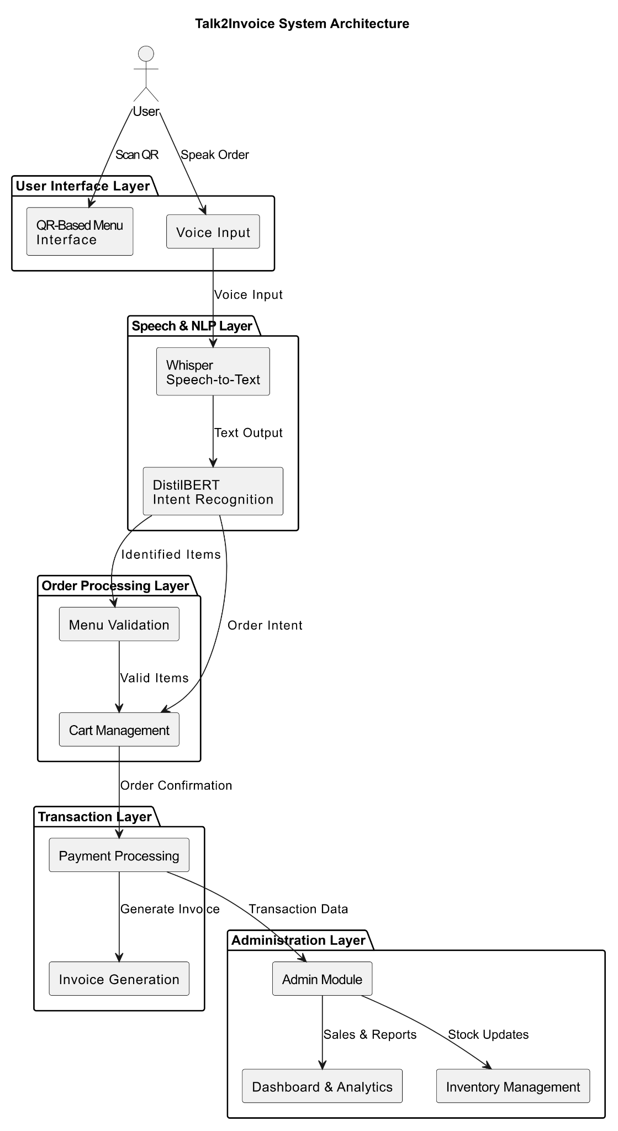
Proposed Methodology
Voice Interaction and Intent Processing:
The QR-based web interface allows for app-free access. User speech is converted to text with Whisper, and a fine-tuned DistilBERT model handles intent recognition and item extraction with voice confirmation.
Order Processing and Smart Processing:
The backend performs real-time inventory audits and analyzes kitchen workload. Only verified orders receive a unique ID and are processed to improve efficiency during busy times.
Secure Backend and Administration:
Orders are stored in a central database, and transaction metadata is recorded on a blockchain ledger to ensure transparency and permanence. An electronic invoice is generated automatically.
Model Training and Evaluation:
DistilBERT was trained with the AdamW optimizer (learning rate: 2e-5 to 5e-5, batch size 32) and used early stopping. It achieved 96.30% accuracy in intent recognition.

Slide 5
Experimental Setup
Evaluation Environment
Test Scenario: A real restaurant simulation with an intermediate level of noise.
Access Mode: QR-based browser interface for app-free voice ordering.
Speech Processing: Whisper-based Speech-to-Text engine.
Intent Recognition Model: DistilBERT classifier.
Validation Dataset: There are several single-item and multi-item spoken food order samples.
Evaluation Procedure
Capture and transcribe voice orders.
Forecast intent by extracting items and quantities.
Backend validation:
Real-time inventory check.
Kitchen workload evaluation.
Confirmation of orders and e-invoices.
Safe authentication on the database and blockchain ledger.

Slide 6
Results & Analysis
Model Performance
Validation Accuracy: ~96%
Stable learning curve with consistent improvement across epochs.
The confirmation layer removed finalization errors.
Functional Results of the Validation
Accurate extraction of items and quantities .
Successful handling of:
- Single-item orders
- Sequential orders (Multi-item).
Online rejection of out-of-stock products.
Effective kitchen load balancing during peak simulation.
Practices of Administrative and Transaction Transparency
Store order records are kept asymmetrically at the back end.
The administrative dashboard allows real-time monitoring of:
- Orders in progress
- Inventory levels
- Kitchen workload
- Transaction history

Slide 7
Conclusion & Future Scope
Conclusion
Created Talk2Invoice, an automated voice-based food ordering and billing service.
Integrated Whisper for speech-to-text and fine-tuned DistilBERT for intent recognition, achieving 96% accuracy.
It features real-time inventory checks, balanced kitchen loads, and secure blockchain logging of transactions.
Future Scope
Smart Personalization and Recommendation:
Use AI-driven recommendation engines to provide tailored meal suggestions, combo offers, and promotions based on trends. This leverages past order data and time-based patterns to improve customer engagement and demand forecasting.
Conversational Intelligence:
Implement context-aware multi-turn dialogue management with adaptive, sentiment-aware interactions. This will support natural conversational ordering and create personalized user experiences.
Security, Privacy, and Ethical AI:
Strengthen data encryption and access control. Ensure compliance with regulations while maintaining transparent AI decision-making, informed consent, and bias reduction across different languages and accents.

Slide 8
References
[1] Srinivasan, S., Raghavan, A., & Balaji, V. (2024). Voice assistant for fast food restaurants using DistilBERT. International Journal of Advanced Computer Science and Applications, 15(2), 412–419.
[2] Kim, J., Park, S., & Lee, H. (2020). System and method for providing voice assistance service. IEEE Access, 8, 145321–145330.
[3] Zhang, Y., Liu, H., & Chen, X. (2020). Research and application of intelligent voice food ordering system. Journal of Intelligent Systems, 29(1), 1123–1134.
[4] Shirode, A., Rathod, T., Wanjari, P., & Halbe, A. (2020). Speech oriented virtual restaurant clerk using web speech API and natural language processing. In Proceedings of the International Conference on Computing, Communication and Automation (pp. 1–6). IEEE.
[5] Kumar, A., Verma, S., & Singh, R. (2022). A review on voice assistants in our daily life. International Journal of Computer Applications, 174(12), 1–7.
[6] Ashfaq, M., Yun, J., Yu, S., & Loureiro, S. M. C. (2021). “It’s on its way”: Chatbots applied for online food delivery services—social or task-oriented interaction style? Journal of Retailing and Consumer Services, 62, 102596.
[7] Patil, S., Kulkarni, A., Deshmukh, R., & Joshi, P. (2021). Vocalicious: Voice-assisted food ordering web application. In Proceedings of the International Conference on Smart Computing and Informatics (pp. 455–463). Springer.
[8] Rathod, T., Shirode, A., Wanjari, P., & Halbe, A. (2020). Speech oriented virtual restaurant clerk using web speech API and natural language processing. International Journal of Engineering and Advanced Technology, 9(5), 2871–2876.
[9] Huang, L., Zhao, Y., Wang, J., & Wu, Z. (2025). HYLR-FO: Hybrid approach using language models and rule-based systems for on-device food ordering. IEEE Transactions on Artificial Intelligence, 6(1), 98 110.

Slide 9
Thank You

