Slide 1

Major Project Review-I
Batch No: AB1
Project Title: Talk2Invoice: AI-Powered Voice Assistant for Food Ordering Using Whisper and DistilBERT
S.No | Reg.No | Student Name
1 | 22A81A6170 | BANDI POORNA SRI SAILAJA
2 | 22A81A61D0 | YAMANA BALAJI AKSHAY KUMAR
3 | 22A81A61B3 | PULAGAM SANTHOSHINI
4 | 22A81A6173 | BORRA VIKASH
5 | 22A81A6174 | CHITTIDI KAVYA LIKHITA
6 | 23A85A6114 | YERUWAKA RAM DURGA PRASAD
Project Guide:
Dr. Aswani Kumar E

Slide 2
MAJOR PROJECT REVIEW 1-CONTENTS
Abstract
Introduction
Literature Survey
Problem Statement in Existing System
Proposed System
Objective
Project domain
Requirement analysis
- Functional Requirements
- Non-Functional Requirements
- Software Requirements
- Hardware Requirements
System Architecture
Methodology

Slide 3
Abstract
The integration of artificial intelligence into fast-food eateries environment is transforming order placement and fulfillment, especially in high-traffic urban areas such as metro stations, airports, and kiosks. Despite technological advancements, there is a lack of comprehensive, AI-based systems that combine voice recognition, real-time inventory checks, and backend analytics into a single, scalable platform tailored for fast-paced environments. Talk2Invoice, an AI-powered voice assistant designed to enable seamless, contactless food ordering via natural speech, while also managing backend operations such as inventory filtering, kitchen load balancing, and automated invoicing. The system integrates QR code-based menu access, OpenAI’s Whisper for multilingual speech-to-text conversion, and a fine-tuned DistilBERT model for intent recognition and food item extraction. A blockchain-supported backend is planned for managing real-time stock availability, queue optimization, and secure digital transactions. After order confirmation, the system will automatically generate digital invoices and send them to users. Additionally, backend automation will generate daily analytics reports on sales, service patterns, and system performance. The system is expected to enhance order accuracy even in noisy environments, reduce wait times through real-time load balancing, and ensure operational transparency using blockchain. It also aims to continuously learn from user interactions to improve recognition and response accuracy. Talk2Invoice could serve as a model for future AI-driven food ordering systems that are scalable, efficient, and user-friendly. The design emphasizes the potential of integrating speech processing, NLP, and secure backend technologies to address real-world automation challenges in the food service industry.
Keywords— Voice Assistant, Whisper, DistilBERT, Natural Language Processing (NLP), Speech-to-Text, Blockchain, Real-Time Inventory, Digital Invoice

Slide 4
Introduction
In today’s fast-paced food service industry, placing an order can sometimes be time-consuming. With traditional ordering methods requiring manual input or physical interaction, customers may experience delays. Moreover, the need for hygienic and contactless solutions has become more important than ever.
This is where Talk2Invoice comes in – an AI-powered voice assistant designed to simplify and enhance the food ordering process. The system uses a combination of speech recognition and natural language processing (NLP) to understand customer voice commands and respond accurately. Talk2Invoice takes into account the spoken order, processes it seamlessly, and automatically generates the invoice, eliminating the need for manual intervention. The goal of this system is to make ordering faster, easier, and contact-free, while also improving efficiency in busy environments such as restaurants, food counters, and delivery services

Slide 5
Literature Survey
S.NO | TITLE | YEAR | INTRODUCTION | METHOD | RESULTS | DRAWBACKS
1 | Voice Assistant for Fast Food Restaurants using DistilBERT | 2024 | This study explores the use of fine-tuned DistilBERT-based voice assistants to enhance order speed, accuracy, and user interaction in fast-food environments. | The voice assistant employs a fine-tuned DistilBERT model for intent recognition using fast-food menu data. Google TTS/STT libraries enable speech conversion, while MongoDB stores inputs and menu data, supporting both order processing and model updates. The system achieved 95% accuracy post-tuning. | The voice-activated fast-food ordering assistant, powered by a fine-tuned DistilBERT model, achieved 95% accuracy in understanding customer queries—demonstrating its effectiveness in streamlining the order-taking process. | No explicit limitations discussed; focuses solely on system functionality without addressing drawbacks or challenges.
2 | Speech Oriented Virtual Restaurant Clerk using Web Speech API and Natural Language Processing | 29 May 2020 | Presents a voice-enabled virtual restaurant clerk using speech recognition, NLP, and biometrics to improve ordering workflows and enhance customer experience. | Implements a voice-based web app using Web Speech API, CNNs for speech and face recognition, and NLP via NLTK and spaCy; integrates a SQLite database and collaborative filtering for personalized food recommendations. | Demonstrates successful digitization of restaurant services with 89% face recognition accuracy, effective speech recognition, hands-free voice navigation, order tracking, and flexible payment options to enhance user experience and accessibility. | Relies on predefined dialogues with limited NLP flexibility, uses Web Speech API instead of native ASR, lacks mobile support,
3 | HYLR-FO: Hybrid Approach Using Language Models and Rule-Based Systems for On-Device Food Ordering | 2025 | The paper proposes HYLR-FO, an on-device food ordering system that combines lightweight language models with a rule-based system (RBS) to improve order accuracy ,flexible NLP handling, and order verification without relying on large LLMs or strong network connections. | Hybrid method using BERT/BART for order extraction, RBS for ASR error handling, tested on-device with 4000/1000 sample dataset, benchmarked vs GPT-4 & Gemini. | HYLR-FO combines a lightweight LM and RBS to achieve 86% order accuracy and 48× faster processing than LLMs, offering a fast, reliable on-device food ordering system suitable for resource-limited environments. | Relies on a custom dataset, which may limit generalizability; rule-based system may struggle with highly varied inputs; less accurate than LLMs in some cases.

Slide 6
Problem Statement In Existing System
In fast-food restaurants, especially in busy locations like metro stations, airports, and kiosks, order management often struggles to keep pace with high demand. Many outlets still rely on separate systems for order taking, inventory management, and analytics, leading to delays, and difficulty in coordinating kitchen operations. Voice ordering technologies, where used, often lack integration with real-time backend processes and can struggle to maintain accuracy in noisy environments. Most current platforms do not provide intelligent load balancing, instant stock checks, or secure, transparent transaction tracking. As a result, these systems fail to deliver a fully connected, efficient, and scalable solution that meets the needs of fast-paced food service environments.

Slide 7
Proposed System
The aim is to develop an advanced and intelligent food ordering system that overcomes the limitations of existing solutions in fast-food environments.
In the existing system, voice ordering platforms often work in isolation, with limited integration between order placement, inventory management, and backend analytics.
Talk2Invoice combines multilingual voice recognition, real-time inventory checks, kitchen load balancing, and secure transaction management into a single, scalable platform. It uses OpenAI’s Whisper for accurate speech-to-text conversion and a fine-tuned DistilBERT model for precise intent recognition and food item extraction. The system generates automated digital invoices and provides daily analytics reports, enabling restaurants to optimize operations, improve order accuracy, reduce wait times, and enhance customer satisfaction in high-traffic locations.

Slide 8
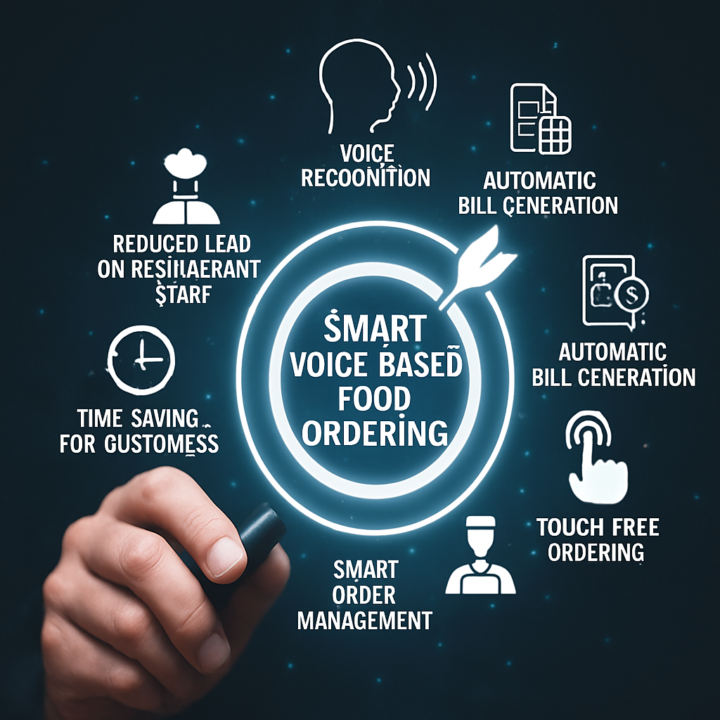
Objective
To transform the food ordering experience in fast-food environments by providing an intelligent, voice-enabled ordering service. The system delivers fast, accurate, and personalized order processing by leveraging multilingual speech recognition, natural language understanding, and real-time backend operations. It empowers both customers and restaurant operators with a seamless, efficient, and transparent ordering process, ultimately improving customer satisfaction, reducing wait times, and enhancing operational performance in high-demand locations.

Slide 9
Project domain
Domain: Artificial Intelligence (AI) with Blockchain Integration
The core domain of this project is Artificial Intelligence (AI), specifically focusing on Natural Language Processing (NLP) and Speech Recognition to enable accurate, multilingual voice-based food ordering. The project also incorporates Blockchain as a supporting domain to ensure secure, tamper-proof transaction management and operational transparency.
Key Areas within the Project Domain:
Speech Recognition (OpenAI’s Whisper): Converts multilingual speech into text with high accuracy, even in noisy environments.
Natural Language Processing (DistilBERT): Identifies user intent and extracts food order details from transcribed text.
Blockchain Integration: Provides a decentralized, secure ledger for transaction logging, inventory updates, and queue management.
AI-Driven Backend Automation: Handles real-time inventory checks, kitchen load balancing, and automated invoice generation.

Slide 10
Requirement Analysis
Functional Requirements
Voice Order Collection – Capture and process user voice orders along with preferences.
Speech-to-Text Processing – Use Whisper to convert multilingual speech to text accurately.
Intent Recognition – Apply DistilBERT to detect order intent and extract food items.
Inventory & Load Check – Verify stock and balance kitchen load in real time.
Blockchain Integration – Ensure secure order tracking and transaction logging.
Order Confirmation & Payment – Confirm order and enable secure QR-based payments.
Invoice Generation – Auto-create and send digital invoices to users.
Analytics & Learning – Generate daily reports and improve accuracy via feedback.
Non-Functional Requirements
Performance – Process multiple voice orders with low latency
2.Security – Encrypt user/order data; blockchain ensures secure transactions.
3.Reliability – Operate without crashes even under heavy load.
4.Usability – Provide a simple, natural voice interface for all users.

Slide 11

Software Requirements
Programming Language:
Python (core development and ML implementation)
Libraries/Frameworks:
OpenAI Whisper – Multilingual speech-to-text conversion
Transformers (HuggingFace) – For fine-tuned DistilBERT intent recognition
Flask / FastAPI – Backend REST API development
scikit-learn – Additional NLP or ML tasks
Web3.py – Ethereum blockchain integration
Matplotlib– Analytics dashboard visualization
Development Environment:
Jupyter Notebook
Google Colab
VS Code / PyCharm
Database:
MongoDB (Order, inventory, user management)
Hardware Requirements
Processors: Multi-core CPUs or GPUs for faster Whisper and NLP model execution
Memory (RAM):
Minimum 8 GB or Recommended 16 GB or more (for parallel processing and inference in real time)
Networking:
Stable internet for real-time Whisper API or self-hosted models
Local network (for deployment in kiosks or metro stations)

Slide 12

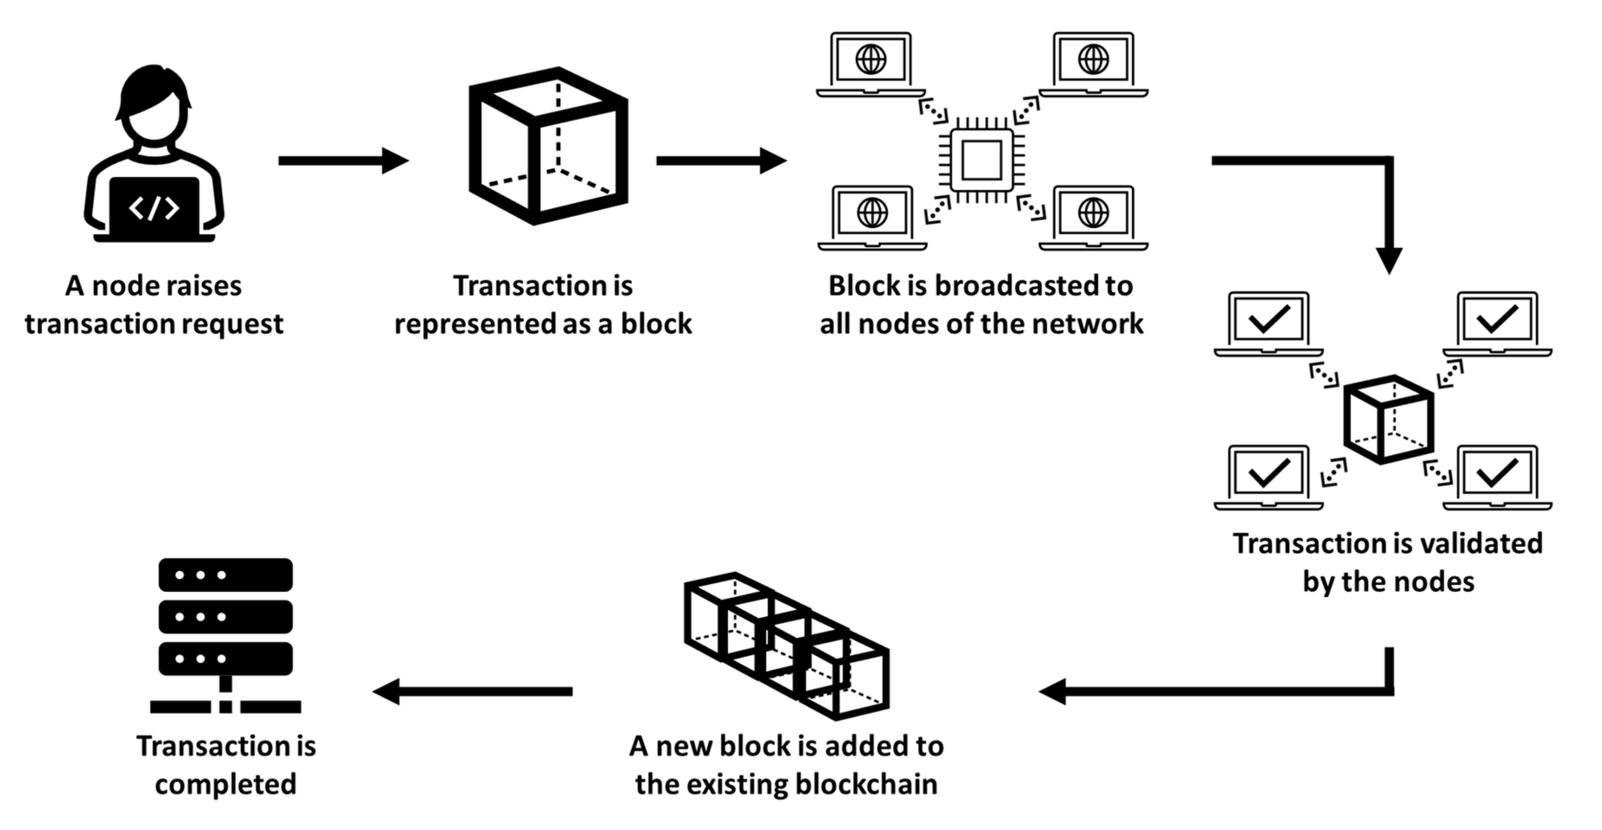
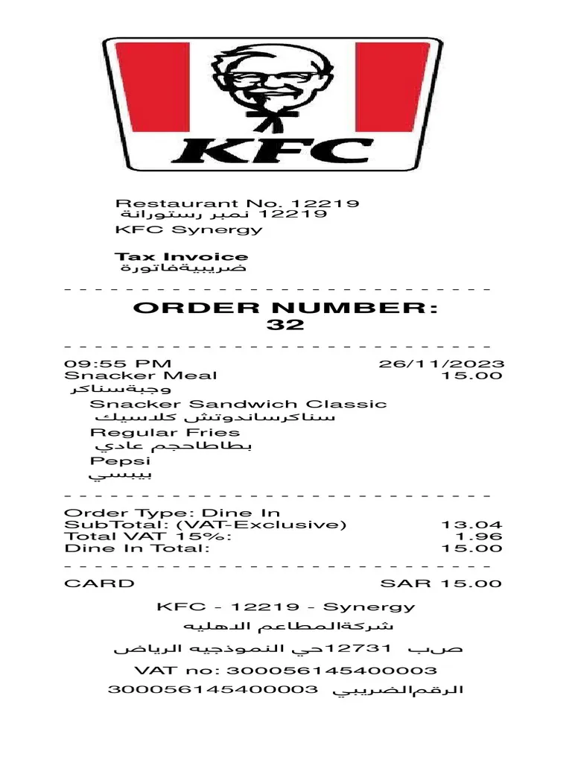
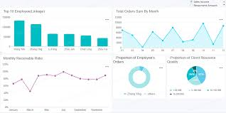



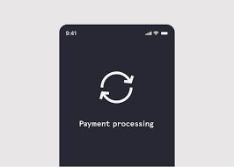



System Architecture
Inventory &
kitchen load check
Admin
Blockchain transaction management
Daily analysis
Voice input
Scan me

Slide 13
Methodology
QR Code Access – Customers scan a QR code (generated via Python qrcode) to access the digital menu.
Dynamic Menu Display – Menu updates in real-time using Flask with live inventory status.
Voice + Manual Ordering – Orders placed via voice (Whisper + DistilBERT for NLP) or manually through the interface.
Inventory & Load Check – Backend verifies stock availability and balances kitchen load using blockchain for secure tracking.
Digital Invoice Generation – Itemized invoices automatically created with reportlab and sent to users.
Secure Payments – Supports blockchain payments (web3.py), gateways with tamper-proof logging.
Unique Order Tracking – UUIDs assigned for each order, enabling real-time tracking.
Order Time Estimation – Preparation time dynamically calculated and displayed.
Admin Panel & Analytics – Staff manage orders and inventory via Flask-Admin; daily analytics reports generated automatically.

Slide 14

Thank You

