Slide 1



Refactoring Kaiaulu Architecture
github.com/sailuh/kaiaulu
By: Cohen Ruport, Colby Fuke, Gi Young (Michelle) Back and John Flinn

Slide 2
What is Kaiaulu?
Kaiaulu is an R package and common interface that helps developers in mining software repositories to better understand the evolving software development communities and the artifacts they produce.
Problem Statement:
With many short term contributors (e.g. ICS students at UHM), Kaiaulu has grown with many added features. This, in turn led to Kaiaulu accruing technical debt and inconsistent internal interfaces, motivating the need for architectural refactoring.
Notes:
APIS are not standardized, these inconsistencies make it difficult to maintain Kaiaulu and add new features while working together cleanly.

Slide 3
Technical Solution Overview
Config(.yml files)
Data Schema
Table Layer Connection
Immutable Data
Analysis Specific
Git Module
Other Modules
vignettes/git_*
test/test-git.R
*.Rmd
exec/git.R
gitlog_showcase.Rmd
R/git.R
gitlog_entity_showcase.Rmd
git.R
Git Log Submodule
Git Command Submodule
‹#›

Slide 4
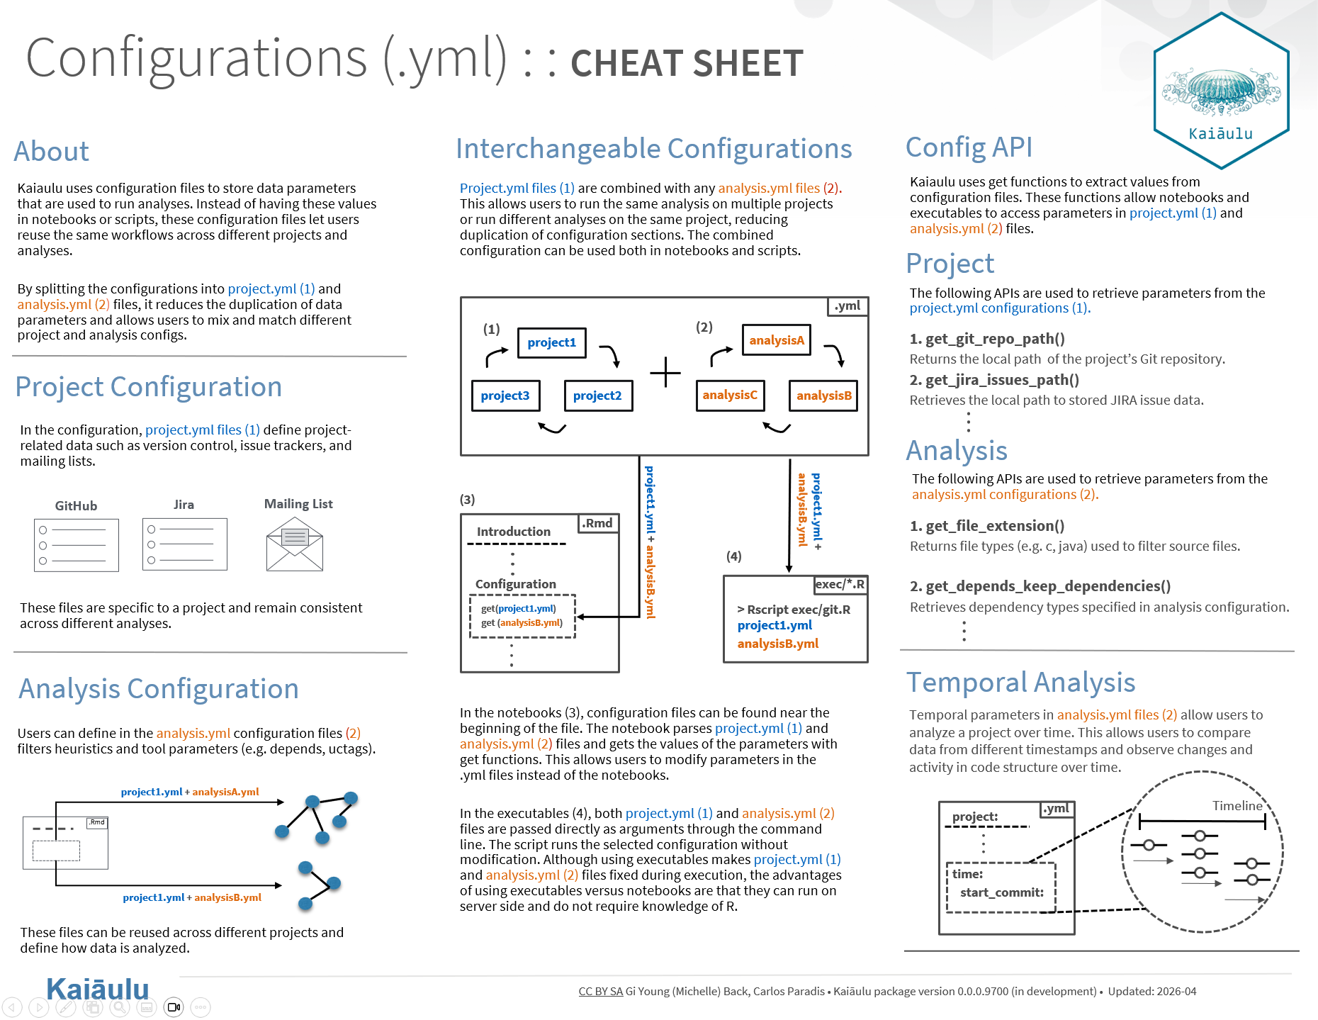
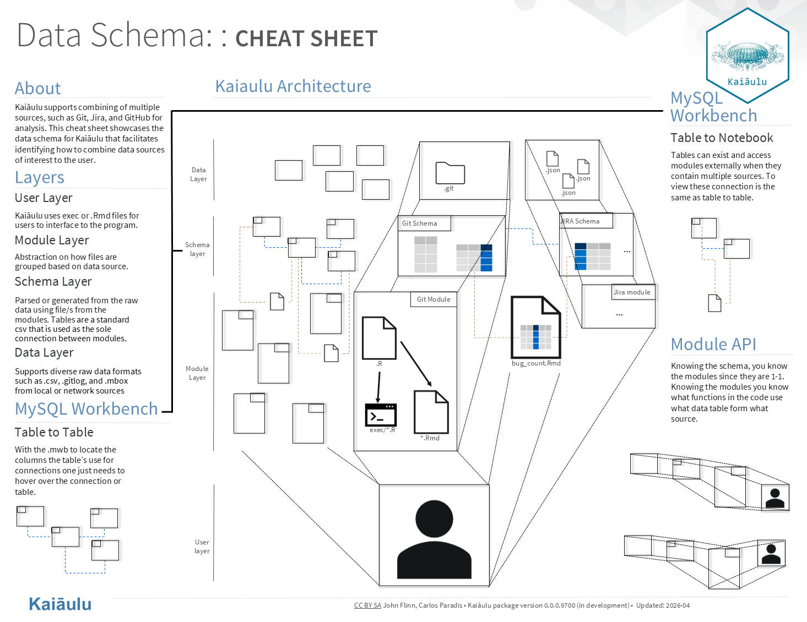
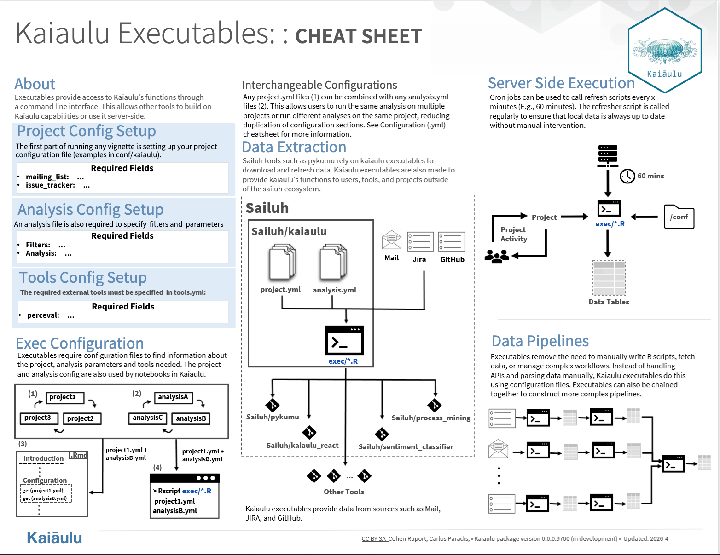
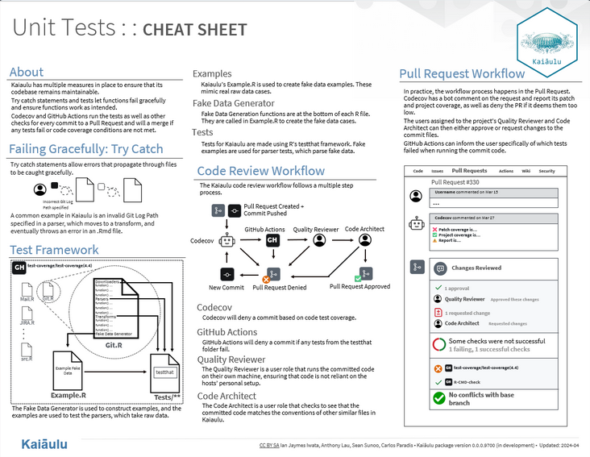
Major Accomplishments
01
Project Refactoring
Cheatsheets
Config Files
  Split configuration .yml files into project and analysis
Data Schema
  System for documenting tables and their merges
Executable Files
  Created new executables and standardized existing ones
Unit Tests
  Created new tests, and implemented new types of tests
We each created our own cheatsheets and saved them to Kaiaulu’s cheatsheet repo
This helps users and developers understand how Kaiaulu works

Slide 5
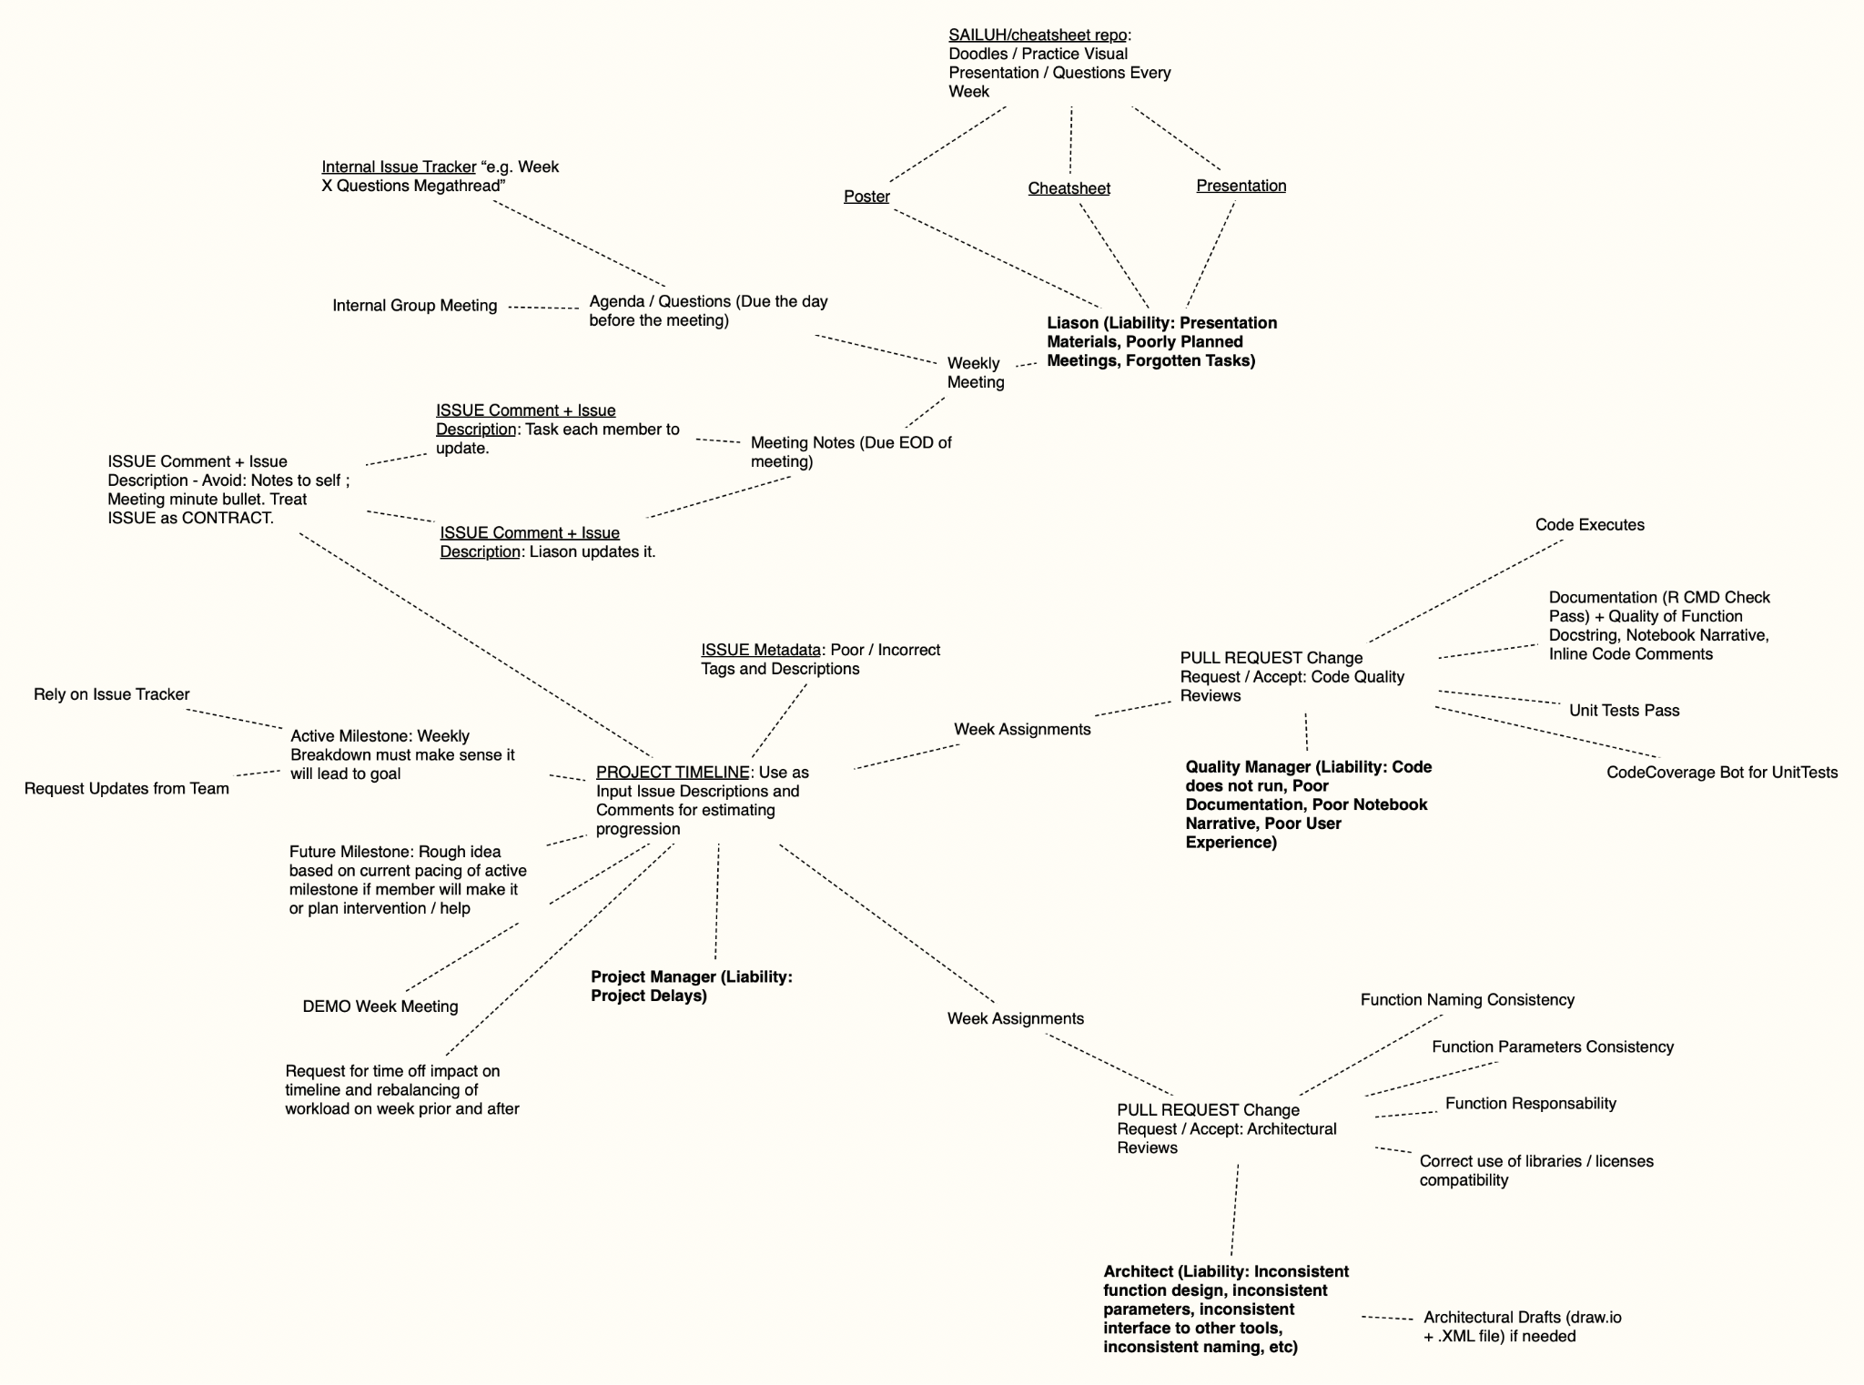
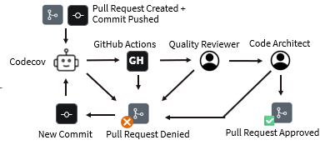
Quality Assurance Metrics
02
Roles
Code Architect: Design and style consistency in the codebase
Quality Manager: Runs code with unit tests
Project Manager: Timeline management
Liaison: Communication with the sponsor and group members
Roles can be transferred to other members of the group depending on their background and the specific section of the code

Slide 6
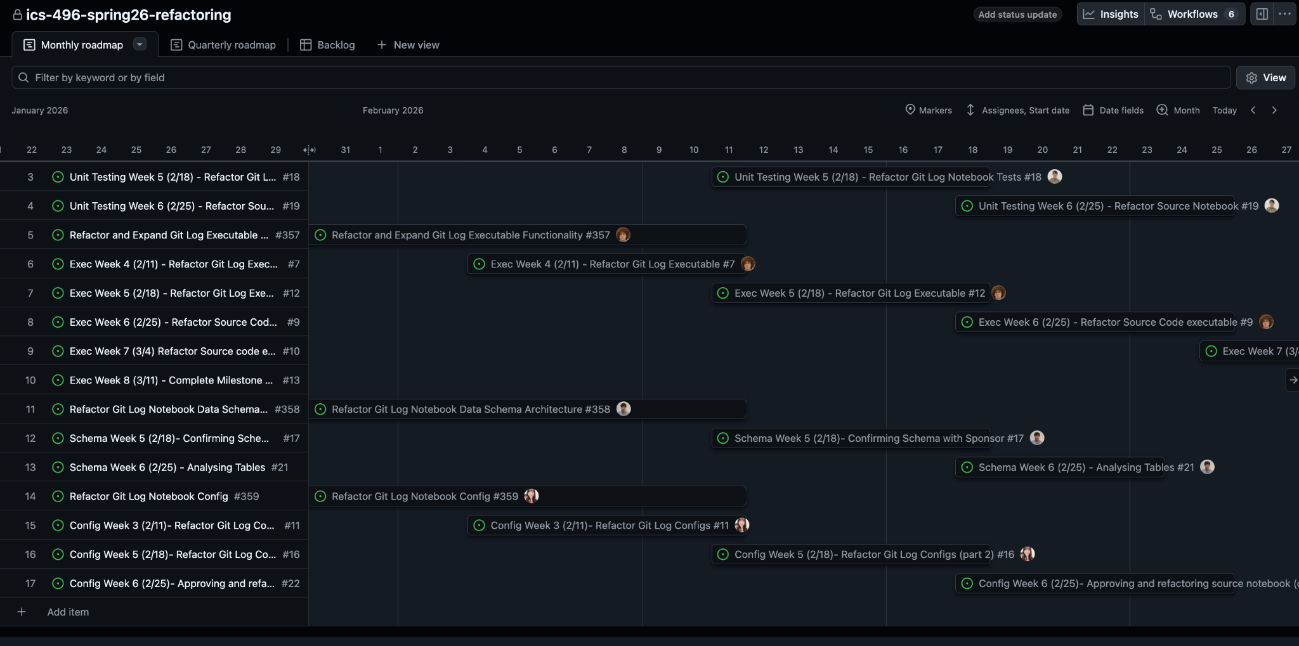
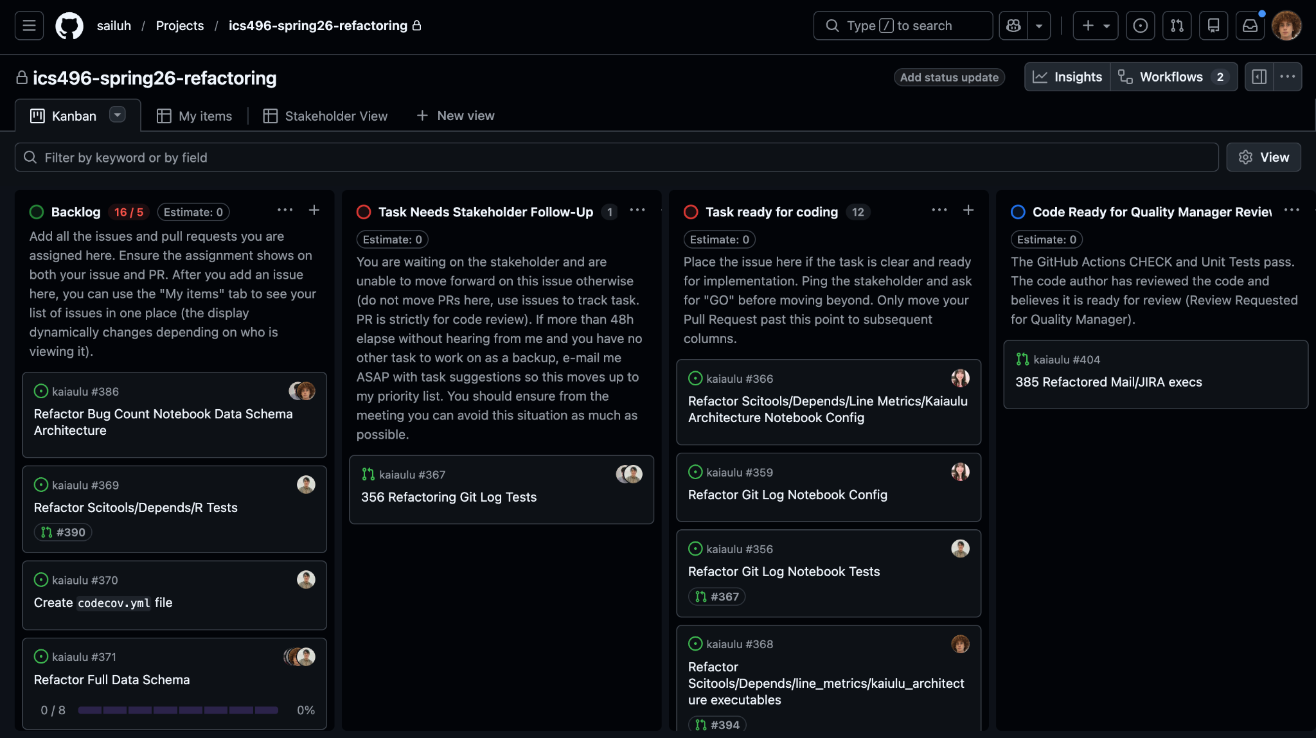
PM and Delivery
03
Calendar Milestone Tracker
Overcomplicated milestones by having separate issues to track progress
Kanban Issue Tracker
Linked directly to issues
Easy to track progress

Slide 7
Reflections
04
Challenges
Key Takeaways
Communication
Time zones
Vague project specifications
Team mates
Effective teamwork
Project work is disconnected from each other
Timeline management
Falling behind on deadlines
without a end product
Meeting preparedness
Detailed note taking
Specific questions with context
Effective teamwork
Moving through modules as a group
Timeline management
A collaborative effort to support one another and stay on track with project timelines

Slide 8




Next Steps
05
Configs
The configurations have been split into project and analysis .yml files so the next step is to fully integrate this new system across all the remaining Kaiaulu notebooks.
Data Schema
Expanding the schema to additional modules in Kaiaulu, using the documentation system laid out in the main branch.
Exec
Continue expanding Kaiaulu’s data pipelines through creating more exec files
Unit Testing
Expanding the tests into more .R files to test their functionality, and implement other code stability features into Kaiaulu

Slide 9


Acknowledgements
06
Thank you to our sponsors Carlos and Rick for their guidance, feedback, and support throughout this project! 😊
Carlos Paradis
Rick Kazman
Data Scientist at KBR, Inc.
Graduate of UHM
Professor in Shidler School of Business

Slide 10

THANK YOU!

