Slide 1
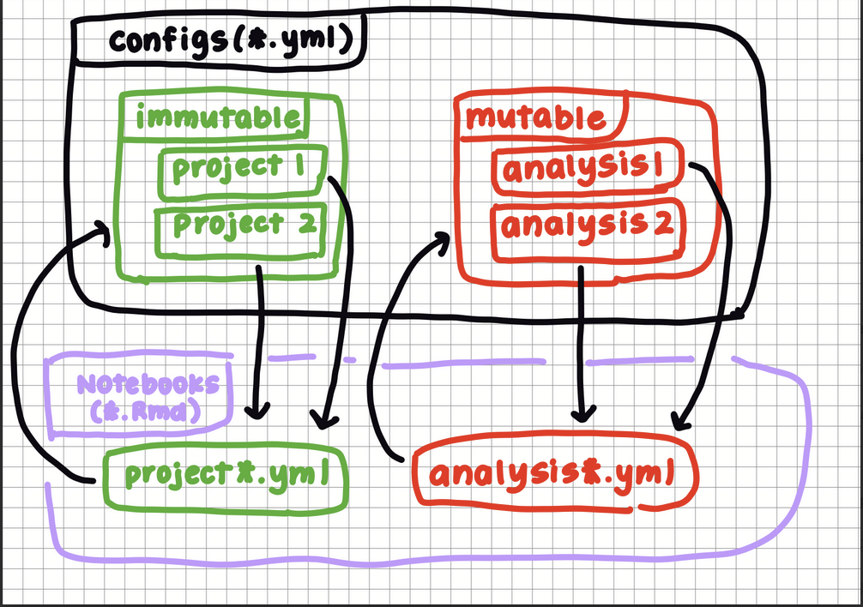

Slide 2
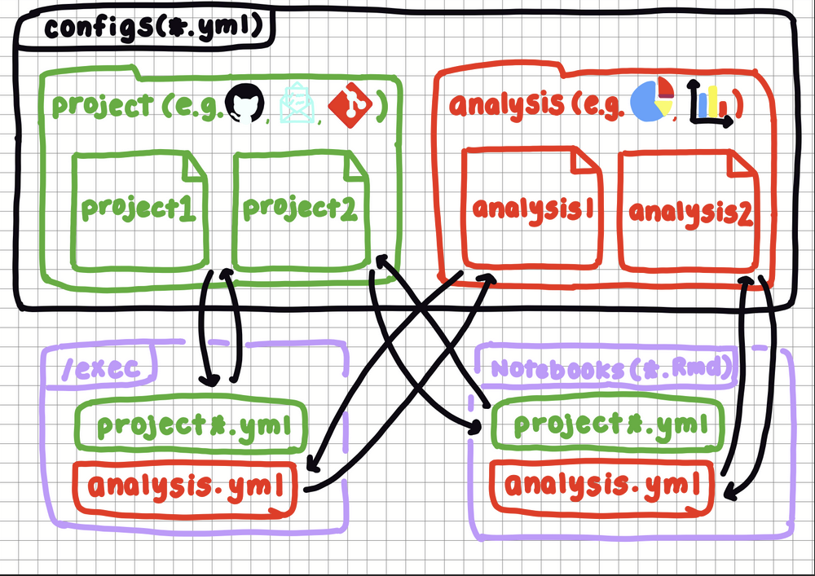

Slide 3
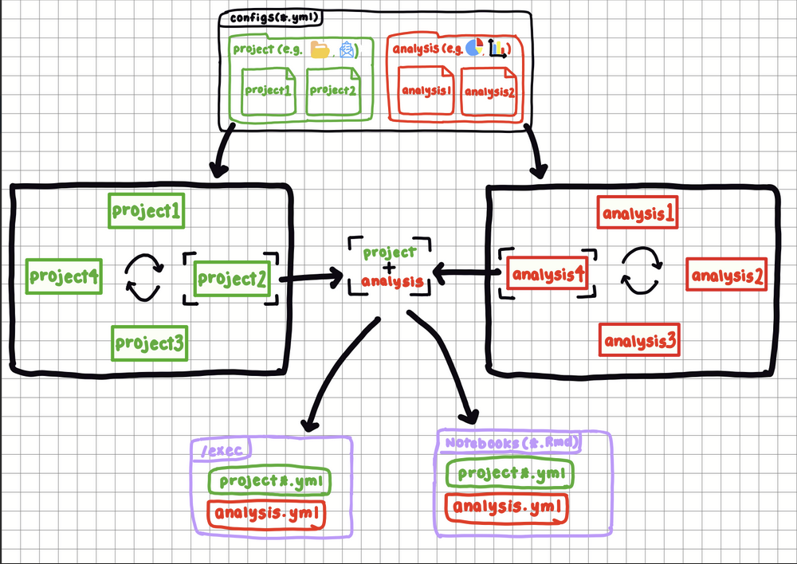

Slide 4
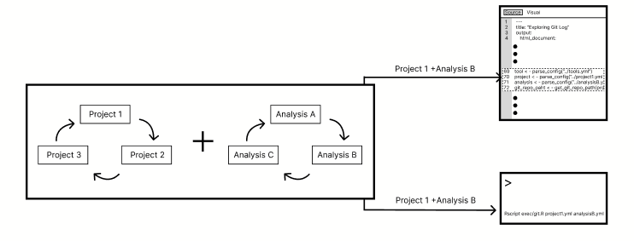

Slide 5
(1)
(2)
Project 1
Analysis A
Project 3
Project 2
Project 3
Project 2
(3)
Project 1 + Analysis B
Introduction
Project 1 + Analysis B
(4)
Project Configurations
> Rscript exec/git.R project1.yml
analysisB.yml

Slide 6


Configurations : : CHEAT SHEET
  About
  Interchangeable Configurations
  Config API
Kaiaulu uses configuration files to store data parameters that are used to run analyses. Instead of having these values in notebooks or scripts, these configuration files lets users reuse same workflows across different projects and analyses.
By splitting the configurations into project and analysis .yml files, it reduces the duplication and allows users to mix and match different project and analysis configs.
.yml
Kaiaulu uses get functions to extract values from configuration files. These functions allow notebooks and executables to access parameters in (1) and (2).
(1)
project1
(2)
analysisA
  Project
project3
project2
analysisB
analysisB
Here are some common APIs found in (1).
1. get_git_repo_path()
Returns the local path of the project’s Git repository.
2. get_git_branches()
Retrieves the branches specified in the config.
3. get_jira_project_key_name()
Identifies the project key used to query issues in Jira.
  Project Configurations
(3)
In the configuration, project .yml files define immutable data such as version control, issue trackers, and mailing lists.
Introduction
project1.yml + analysisB.yml
(4)
project1.yml + analysisB.yml
Project Configurations
  Analysis
GitHub
Jira
Mailing List
> Rscript exec/git.R project1.yml
analysisB.yml
Here are some common APIs found in (2).
1. get_file_extension()
Returns file types (e.g. c, java) used to filter source files.
2. get_substring_filepath()
Returns keywords used to exclude certain file paths.
3. get_dependencies_type()
Specifies which types of dependencies (e.g. imports, function calls).
These files are specific to a project and remain consistent across different analyses.
Project configuration .yml files (1) can be combined with any any analysis configuration .yml files (2). This allows users to run the same analysis on multiple project or run different analyses on the same project. It reduces duplication of immutable sections of the .yml files and make both project and analysis configurations interchangeable.
In the notebooks (3), configuration files can be found near the beginning of the file. The notebook parses (1) and (2) and gets the values of the parameters with get functions. This allows users to modify parameters in the .yml files instead of the notebooks.
In the executables (4), both (1) and (2) are passed directly as arguments through the command line. The script runs the selected configuration without modification. Although using executables make (1) and (2) fixed during execution, the pros to using it versus notebooks is that it can run on server side and doesn’t require knowledge of R.
  Analysis Configurations
In the configuration, analysis .yml files define mutable data, such as filters and tool parameters (e.g. depends, uctags).
  Temporal Analysis
Temporal parameters in (2) allows users to analyze a project over time. Instead of analyzing a dataset at one time or frame, now users can select a specific time frame. This allows users to compare data from different time stamps and observe changes and activity of code structure over time.
These files can be reused across different projects and define how data is analyzed.
Kaiāulu
CC BY SA Gi Young Back, Carlos Paradis • Kaiāulu package version 0.0.0.9700 (in development) • Updated: 2026-04

Slide 7

Configurations (.yml) : : CHEAT SHEET
  About
  Interchangeable Configurations
  Config API
Kaiaulu uses configuration files to store data parameters that are used to run analyses. Instead of having these values in notebooks or scripts, these configuration files lets users reuse same workflows across different projects and analyses.
By splitting the configurations into project (1) and analysis (2) .yml files, it reduces the duplication of data parameters and allows users to mix and match different project and analysis configs.
Project .yml files (1) can be combined with any analysis .yml files (2). This allows users to run the same analysis on multiple projects or run different analyses on the same project. It reduces duplication of immutable sections of the .yml files and makes both project and analysis configurations interchangeable.
Kaiaulu uses get functions to extract values from configuration files. These functions allow notebooks and executables to access parameters in project (1) and analysis (2) files.
  Project
Here are some common APIs found in project (1) .
(1)
(2)
1. get_git_repo_path()
Returns the local path of the project’s Git repository.
2. get_git_branches()
Retrieves the branches specified in the config.
3. get_jira_project_key_name()
Identifies the project key used to query issues in Jira.
project1
analysisA
  Configurations
project3
project2
analysisC
analysisB
In the configuration, project .yml files (1) define immutable data such as version control, issue trackers, and mailing lists.
GitHub
Jira
Mailing List
(3)
  Analysis
Introduction
.Rmd
project1.yml + analysisB.yml
Here are some common APIs found in analysis (2).
(4)
1. get_file_extension()
Returns file types (e.g. c, java) used to filter source files.
2. get_substring_filepath()
Returns keywords used to exclude certain file paths.
3. get_dependencies_type()
Specifies which types of dependencies (e.g. imports, function calls).
project1.yml + analysisB.yml
Configuration
These files are specific to a project and remain consistent across different analyses.
get(project1.yml)
get (analysisB.yml)
> Rscript exec/git.R project1.yml
analysisB.yml
  Analysis Configurations
Users can define in the analysis .yml configuration files (2) filter heuristics and tool parameters (e.g. depends, uctags).
In the notebooks (3), configuration files can be found near the beginning of the file. The notebook parses project (1) and analysis (2) files and gets the values of the parameters with get functions. This allows users to modify parameters in the .yml files instead of the notebooks.
In the executables (4), both project (1) and analysis (2) files are passed directly as arguments through the command line. The script runs the selected configuration without modification. Although using executables makes project (1) and analysis (2) files fixed during execution, the advantages of using executables versus notebooks are that they can run on server side and do not require knowledge of R.
  Temporal Analysis
project1.yml + analysisA.yml
Temporal parameters in analysis.yml files (2) allow users to analyze a project over time. This allows users to compare data from different timestamps and observe changes and activity in code structure over time.
.Rmd
project1.yml + analysisB.yml
Jan- Mar
Apr-Jun
These files can be reused across different projects and define how data is analyzed.
Kaiāulu
CC BY SA Gi Young (Michelle) Back, Carlos Paradis • Kaiāulu package version 0.0.0.9700 (in development) • Updated: 2026-04

Slide 8
Configurations (.yml) : : CHEAT SHEET
  About
  Interchangeable Configurations
  Config API
Kaiaulu uses configuration files to store data parameters that are used to run analyses. Instead of having these values in notebooks or scripts, these configuration files let users reuse the same workflows across different projects and analyses.
By splitting the configurations into project.yml (1) and analysis.yml (2) files, it reduces the duplication of data parameters and allows users to mix and match different project and analysis configs.
Project.yml files (1) can be combined with any analysis.yml files (2). This allows users to run the same analysis on multiple projects or run different analyses on the same project. It reduces duplication of immutable sections of the .yml files and makes both project and analysis configurations interchangeable.
Kaiaulu uses get functions to extract values from configuration files. These functions allow notebooks and executables to access parameters in project.yml (1) and analysis.yml (2) files.
  Project
The following APIs are used to retrieve parameters from the project.yml configurations (1).
(1)
project1
(2)
analysisA
1. get_git_repo_path()
Returns the local path of the project’s Git repository.
2. get_git_branches()
Retrieves the branches specified in the config.
  Configurations
project3
project2
analysisC
analysisB
In the configuration, project.yml files (1) define immutable data such as version control, issue trackers, and mailing lists.
  Analysis
GitHub
Jira
Mailing List
(3)
The following APIs are used to retrieve parameters from the analysis.yml configurations (2).
Introduction
.Rmd
project1.yml + analysisB.yml
1. get_file_extension()
Returns file types (e.g. c, java) used to filter source files.
2. get_substring_filepath()
Returns keywords used to exclude certain file paths.
(4)
project1.yml + analysisB.yml
Configuration
These files are specific to a project and remain consistent across different analyses.
get(project1.yml)
get (analysisB.yml)
> Rscript exec/git.R project1.yml
analysisB.yml
  Analysis Configurations
  Temporal Analysis
In the notebooks (3), configuration files can be found near the beginning of the file. The notebook parses project.yml (1) and analysis.yml (2) files and gets the values of the parameters with get functions. This allows users to modify parameters in the .yml files instead of the notebooks.
In the executables (4), both project.yml (1) and analysis.yml (2) files are passed directly as arguments through the command line. The script runs the selected configuration without modification. Although using executables makes project.yml (1) and analysis.yml (2) files fixed during execution, the advantages of using executables versus notebooks are that they can run on server side and do not require knowledge of R.
Temporal parameters in analysis.yml files (2) allow users to analyze a project over time. This allows users to compare data from different timestamps and observe changes and activity in code structure over time.
Users can define in the analysis.yml configuration files (2) filters heuristics and tool parameters (e.g. depends, uctags).
project1.yml + analysisA.yml
.yml
Timeline
.Rmd
project:
time:
start_commit:
project1.yml + analysisB.yml
These files can be reused across different projects and define how data is analyzed.
Kaiāulu
CC BY SA Gi Young (Michelle) Back, Carlos Paradis • Kaiāulu package version 0.0.0.9700 (in development) • Updated: 2026-04

Slide 9
Configurations (.yml) : : CHEAT SHEET
  About
  Interchangeable Configurations
  Config API
Kaiaulu uses configuration files to store data parameters that are used to run analyses. Instead of having these values in notebooks or scripts, these configuration files let users reuse the same workflows across different projects and analyses.
By splitting the configurations into project.yml (1) and analysis.yml (2) files, it reduces the duplication of data parameters and allows users to mix and match different project and analysis configs.
Project.yml files (1) are combined with any analysis.yml files (2). This allows users to run the same analysis on multiple projects or run different analyses on the same project, reducing duplication of configuration sections. The combined configuration can be used both in notebooks and scripts.
Kaiaulu uses get functions to extract values from configuration files. These functions allow notebooks and executables to access parameters in project.yml (1) and analysis.yml (2) files.
  Project
.yml
The following APIs are used to retrieve parameters from the project.yml configurations (1).
(1)
project1
(2)
analysisA
1. get_git_repo_path()
Returns the local path of the project’s Git repository.
2. get_jira_issues_path()
Retrieves the local path to stored JIRA issue data.
  Project Configuration
project3
project2
analysisC
analysisB
In the configuration, project.yml files (1) define project-related data such as version control, issue trackers, and mailing lists.
. . .
  Analysis
(3)
The following APIs are used to retrieve parameters from the analysis.yml configurations (2).
GitHub
Jira
Mailing List
.Rmd
1. get_file_extension()
Returns file types (e.g. c, java) used to filter source files.
2. get_depends_keep_dependencies()
Retrieves dependency types specified in analysis configuration.
Introduction
project1.yml + analysisB.yml
(4)
project1.yml + analysisB.yml
Configuration
exec/*.R
These files are specific to a project and remain consistent across different analyses.
get(project1.yml)
get (analysisB.yml)
> Rscript exec/git.R project1.yml
analysisB.yml
. . .
  Analysis Configuration
  Temporal Analysis
In the notebooks (3), configuration files can be found near the beginning of the file. The notebook parses project.yml (1) and analysis.yml (2) files and gets the values of the parameters with get functions. This allows users to modify parameters in the .yml files instead of the notebooks.
In the executables (4), both project.yml (1) and analysis.yml (2) files are passed directly as arguments through the command line. The script runs the selected configuration without modification. Although using executables makes project.yml (1) and analysis.yml (2) files fixed during execution, the advantages of using executables versus notebooks are that they can run on server side and do not require knowledge of R.
Temporal parameters in analysis.yml files (2) allow users to analyze a project over time. This allows users to compare data from different timestamps and observe changes and activity in code structure over time.
Users can define in the analysis.yml configuration files (2) filters heuristics and tool parameters (e.g. depends, uctags).
project1.yml + analysisA.yml
.yml
Timeline
.Rmd
project:
time:
start_commit:
project1.yml + analysisB.yml
These files can be reused across different projects and define how data is analyzed.
Kaiāulu
CC BY SA Gi Young (Michelle) Back, Carlos Paradis • Kaiāulu package version 0.0.0.9700 (in development) • Updated: 2026-04

Slide 10
Configurations (.yml) : : CHEAT SHEET
  About
  Interchangeable Configurations
  Config API
Kaiaulu uses configuration files to store data parameters that are used to run analyses. Instead of having these values in notebooks or scripts, these configuration files let users reuse the same workflows across different projects and analyses.
By splitting the configurations into project.yml (1) and analysis.yml (2) files, it reduces the duplication of data parameters and allows users to mix and match different project and analysis configs.
Project.yml files (1) are combined with any analysis.yml files (2). This allows users to run the same analysis on multiple projects or run different analyses on the same project, reducing duplication of configuration sections. The combined configuration can be used both in notebooks and scripts.
Kaiaulu uses get functions to extract values from configuration files. These functions allow notebooks and executables to access parameters in project.yml (1) and analysis.yml (2) files.
.yml
  Project
(1)
(2)
The following APIs are used to retrieve parameters from the project.yml configurations (1).
project1
analysisA
1. get_git_repo_path()
Returns the local path of the project’s Git repository.
2. get_jira_issues_path()
Retrieves the local path to stored JIRA issue data.
  Project Configuration
project3
project2
analysisC
analysisB
In the configuration, project.yml files (1) define project-related data such as version control, issue trackers, and mailing lists.
. . .
  Analysis
GitHub
Jira
Mailing List
(3)
The following APIs are used to retrieve parameters from the analysis.yml configurations (2).
Introduction
.Rmd
project1.yml + analysisB.yml
(4)
1. get_file_extension()
Returns file types (e.g. c, java) used to filter source files.
2. get_depends_keep_dependencies()
Retrieves dependency types specified in analysis configuration.
project1.yml + analysisB.yml
Configuration
exec/*.R
These files are specific to a project and remain consistent across different analyses.
get(project1.yml)
get (analysisB.yml)
> Rscript exec/git.R project1.yml
analysisB.yml
. . .
  Analysis Configuration
  Temporal Analysis
Users can define in the analysis.yml (2) configuration files filters heuristics and tool parameters (e.g. depends, uctags).
In the notebooks (3), configuration files can be found near the beginning of the file. The notebook parses project.yml (1) and analysis.yml (2) files and gets the values of the parameters with get functions. This allows users to modify parameters in the .yml files instead of the notebooks.
In the executables (4), both project.yml (1) and analysis.yml (2) files are passed directly as arguments through the command line. The script runs the selected configuration without modification. Although using executables makes project.yml (1) and analysis.yml (2) files fixed during execution, the advantages of using executables versus notebooks are that they can run on server side and do not require knowledge of R.
Temporal parameters in analysis.yml files (2) allow users to analyze a project over time. This allows users to compare data from different timestamps and observe changes and activity in code structure over time.
project1.yml + analysisA.yml
.Rmd
project:
.yml
Timeline
project1.yml + analysisB.yml
time:
start_commit:
These files can be reused across different projects and define how data is analyzed.
Kaiāulu
CC BY SA Gi Young (Michelle) Back, Carlos Paradis • Kaiāulu package version 0.0.0.9700 (in development) • Updated: 2026-04

