Slide 1


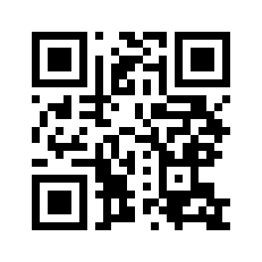

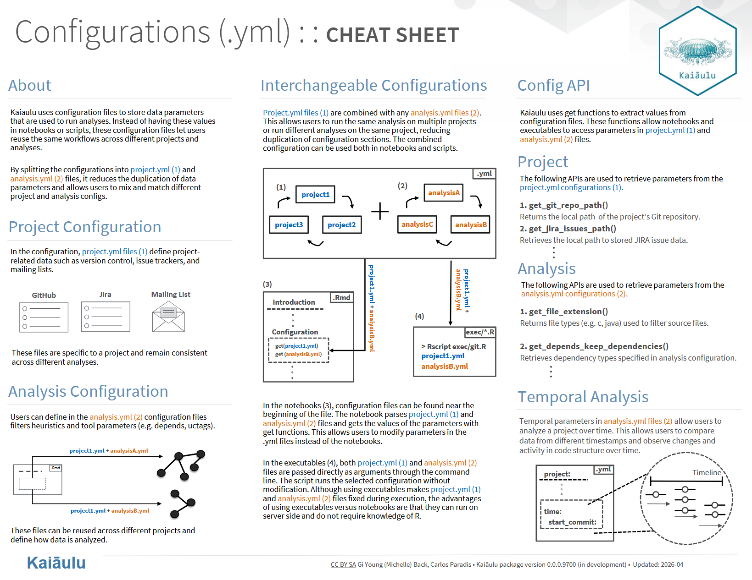
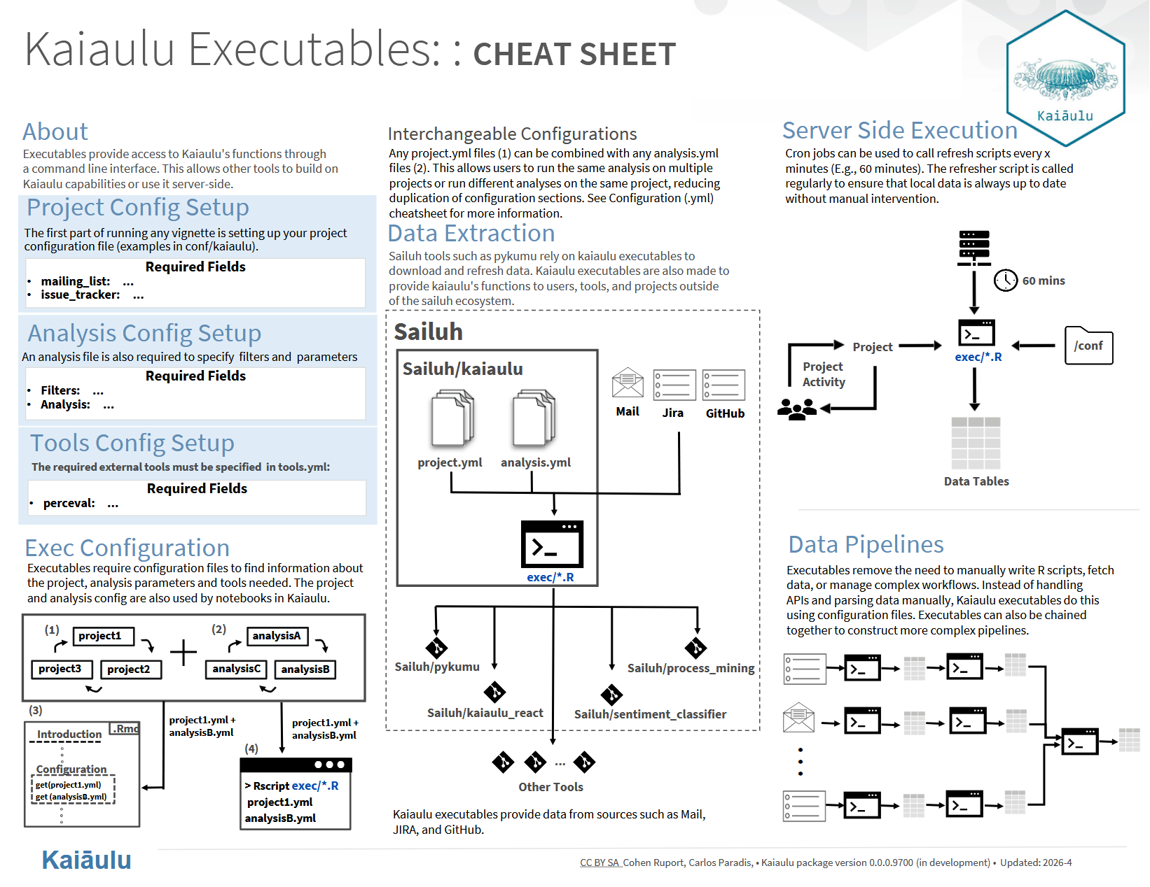
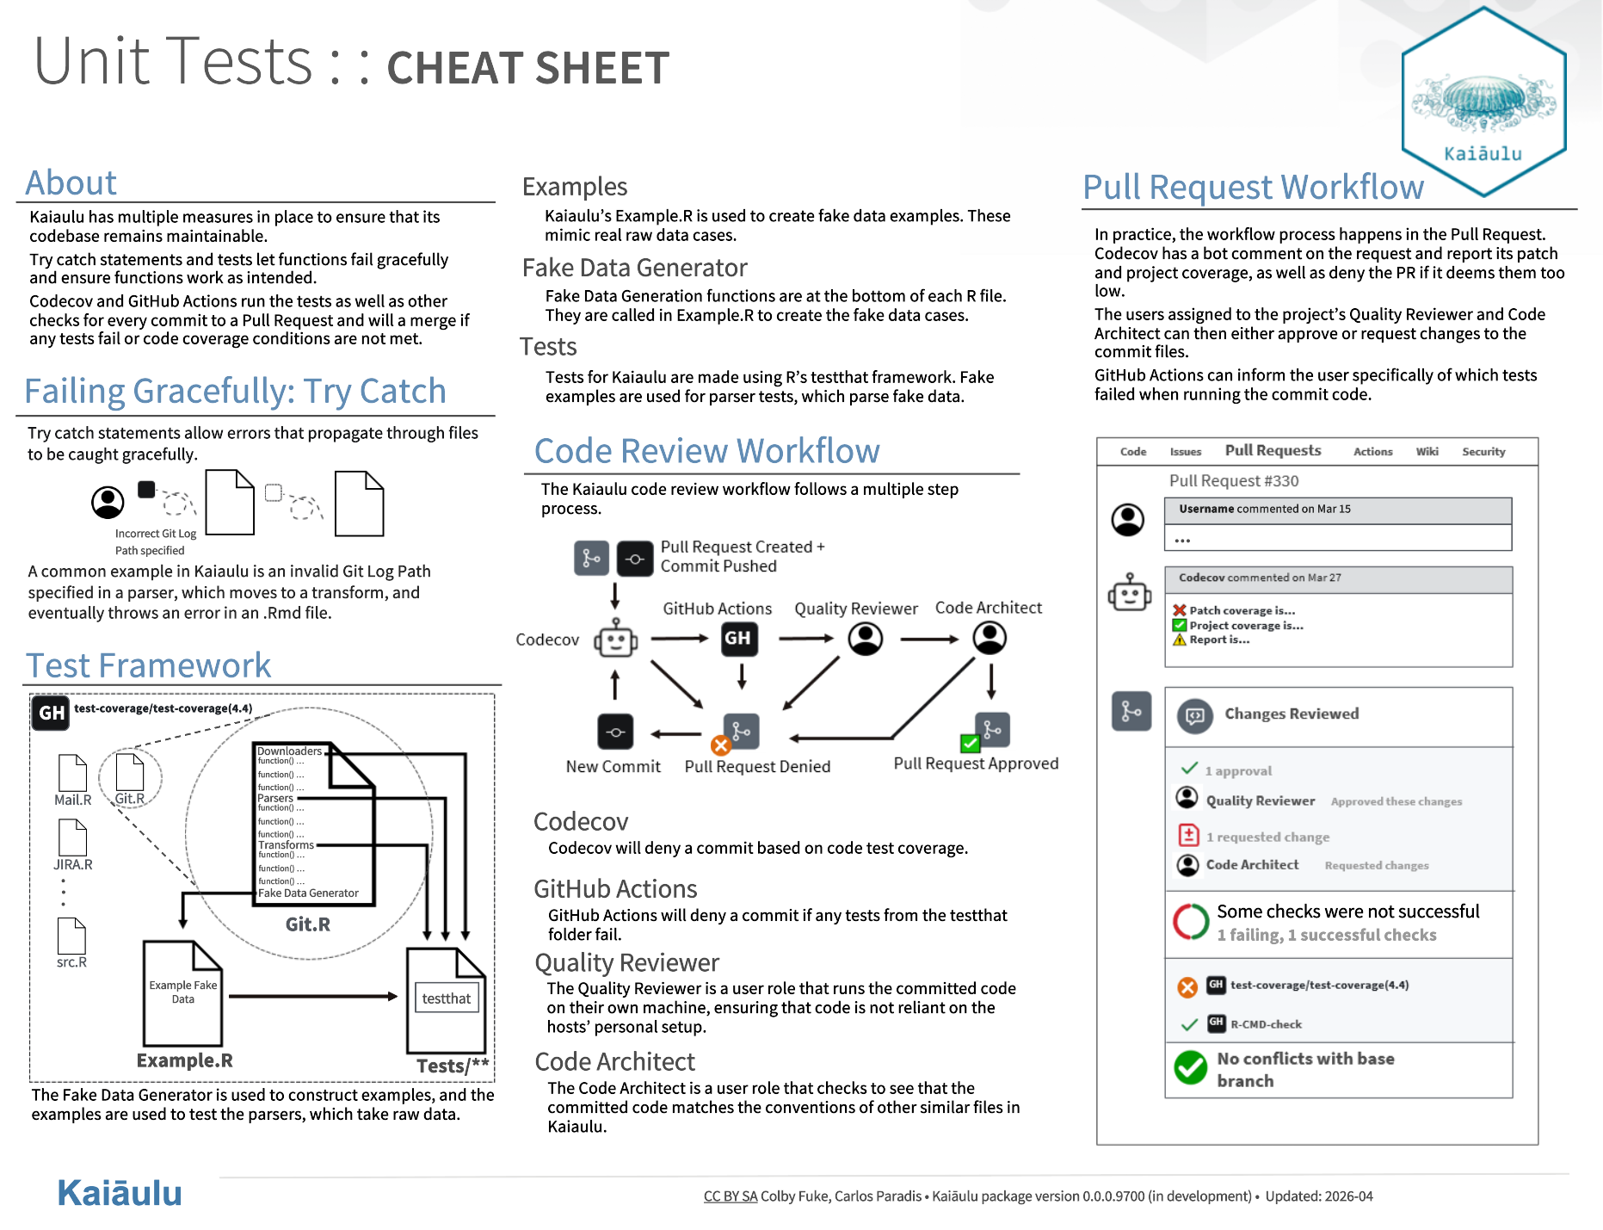
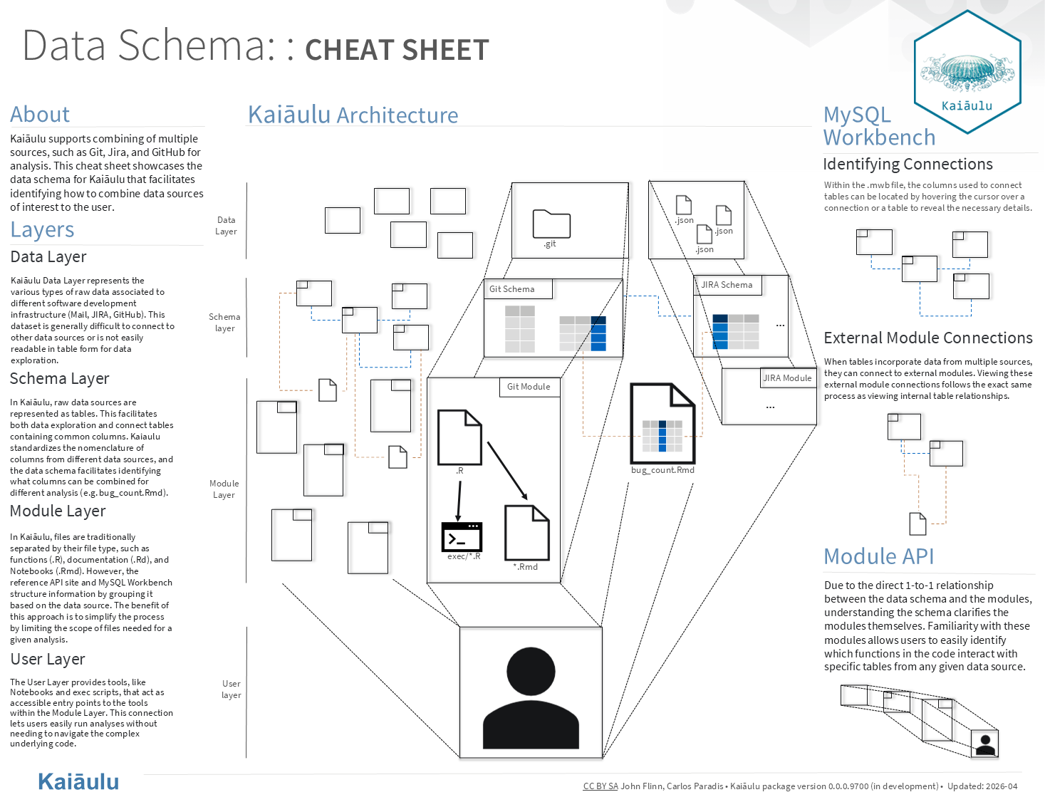
Kaiaulu Config, Executable,
Unit Test, and Data Schema Refactoring
Cohen Ruport, Gi Young (Michelle) Back, Colby Fuke, John Flinn
Sponsors: Carlos Paradis and Rick Kazman
ICS 496 Capstone Project - Spring 2026
github.com/sailuh
What is Kaiaulu?
Kaiaulu is an R package and common interface that helps developers in mining software repositories to better understand the evolving software development communities and the artifacts they produce.
Objectives
Refactor Kaiaulu's configurations into reusable project and analysis .yml files.
Refactor/create executables which provide command line access to the functions which Kaiaulu has.
Refactor/create new unit tests as well as contribute to the already existing stability measures in place
Create a MySQL Workbench diagram to document table and module connections, along with a guide for future contributors to follow
Methodology
Project Management
Both weekly group meetings internally as well as with our sponsor
Documentation with GitHub Issues + PRs + Kanban Project Manager
Group Roles
Project Manager: Cohen
Liaison: Michelle
Quality Manager: Colby
Code Architect: John
Tech Used
Developer Tools:
Rstudio,
MySQL Workbench, GitHub,
Codecov, Git
Languages:
R, Python
Third-Party Tools:
Perceval, Depends, Scitools, Understand, Jira, SCC, DV8
Challenges
Clearly defining the scope and detail of our refactoring work
Becoming familiar with how Kaiaulu was built and documented
All team members were unfamiliar with the R language
Ensuring clear communication and collaboration between all team members
Tasks Accomplished
Config Refactoring: Separated configurations into project and analysis .yml files, enabling users interchangeable use across notebooks and execs.
Executable Refactoring: Standardized executables and created new executable files which provide users access to Kaiaulu's functions through a command line interface.
Unit Test Refactoring: Proposed and created new unit tests, fake data example functions, try catch statements, and created a new type of test to test the third-party tools that Kaiaulu uses.
Data Schema Refactoring: Developed and implemented a documentation system for module tables and their corresponding merges.
Cheatsheet Creation: Each member of the group created a cheatsheet that encapsulates the entirety of our work, allowing users to quickly become familiar our contributions.
Learnings & Conclusion
We learned how to more effectively work in a group setting with clearly defined roles and responsibilities, as well as assisting each other when necessary
We gained project management experience by using multiple different scheduling methods
Iterating with our sponsor gave us invaluable experience with professional communication
By the end of the semester, we were familiar with R, RStudio, and Python notebooks, and the process of how quality code makes its way into an open-source project

