Slide 1
Home automation system
Welcome to Our presentation

Slide 2
Group members
Malik Zubayer Ul Haider [ 152-15-5902 ]
Sayma Afrin [ 152-15-5905 ]

Slide 3
introduction
Refers to the automatic and electronic control
Household features, activity, and appliances
Various control systems are utilized
Centralized control of appliances, windows, lighting, surveillance cameras and security locks.

Slide 4
Project goal
Creating a system to remotely control home electronics
Control of light bulb via smartphone
Automated light with light detection
Control of fan via smartphone
Bluetooth connectivity for remote control

Slide 5
Hardware components
Arduino Uno R3
Breadboard
HC-05 serial Bluetooth Module
LED
LDR
16*2 LCD
Variable Resistor
Jumper cables
220 ohm and 1k ohm Resistors
USB cable
DC Motor
L293D Motor driver IC
Android App

Slide 6
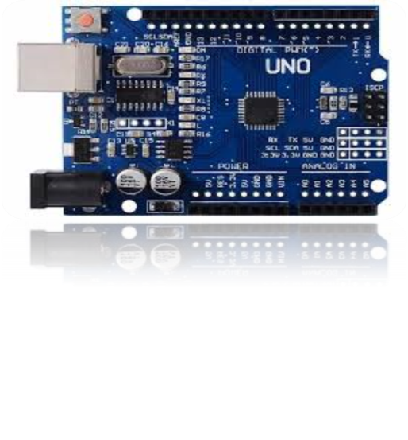
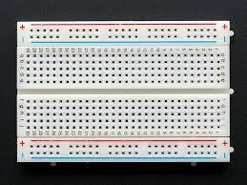
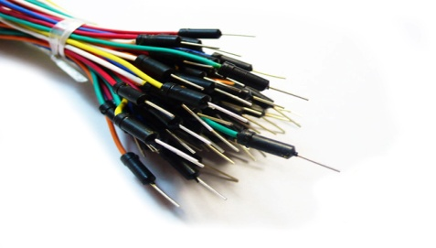
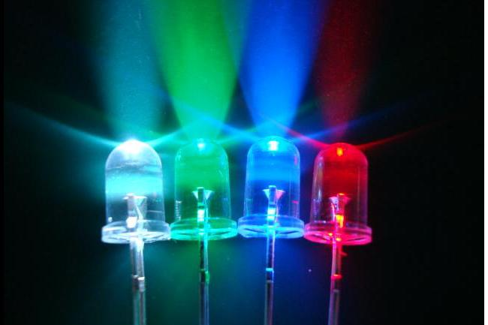
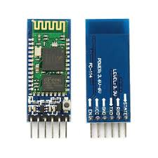
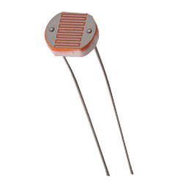
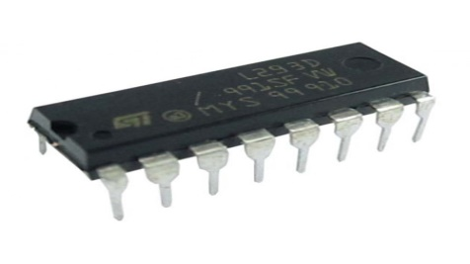
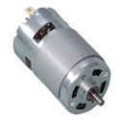
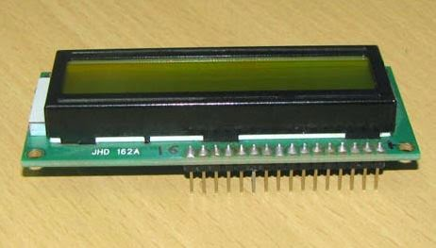
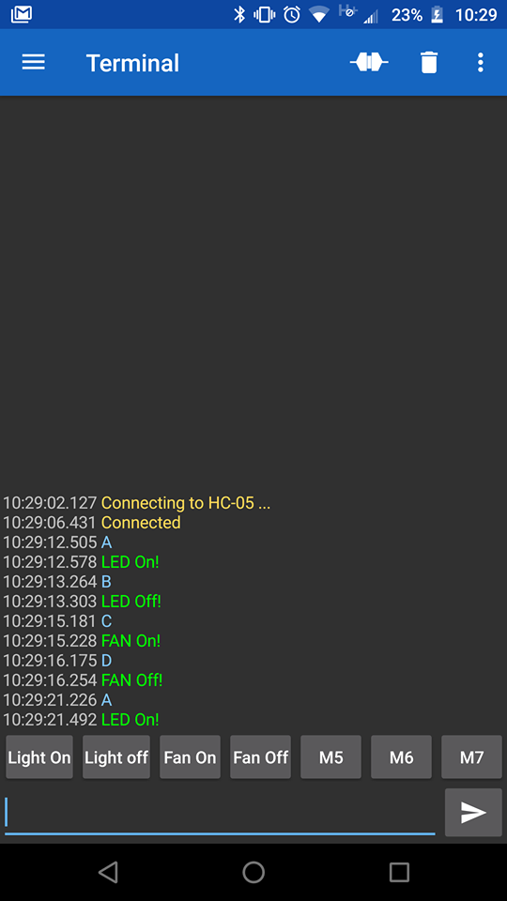
Arduino Uno R3
Bread board
Jumper cable
LED
LDR
HC-05
L293D Motor driver Ic
DC Motor
LCD
Android App

Slide 7
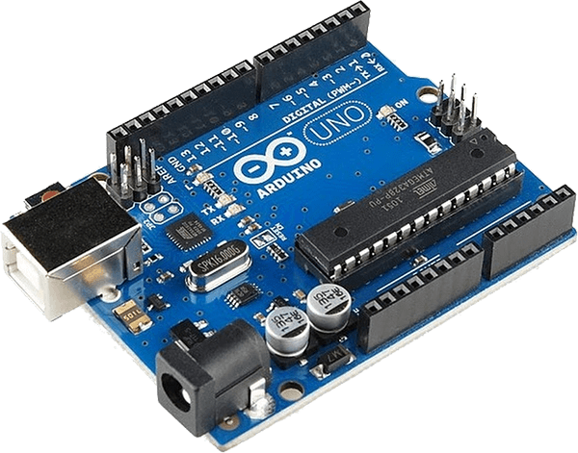
Arduino Uno
A microcontroller board based on the ATmega328(datasheet)
14 digital input/output pins
6 analog inputs
A 16 MHz crystal oscillator
A USB connection
A power jack
An ICSP header, and a reset button

Slide 8
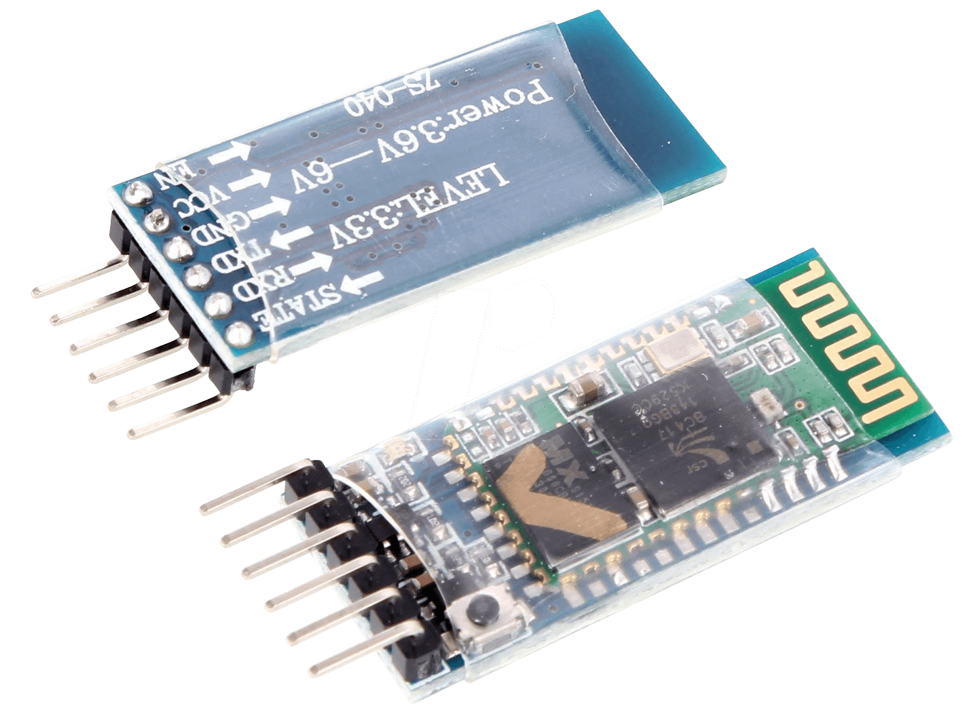
HC-05 Serial Bluetooth Module
Bluetooth SPP (Serial Port Protocol) module
Designed for transparent wireless serial connection setup.
Uses CSR Bluecore 04-External single chip Bluetooth system
Can be used in a master or Slave configuration
Great solution for wireless communication.

Slide 9
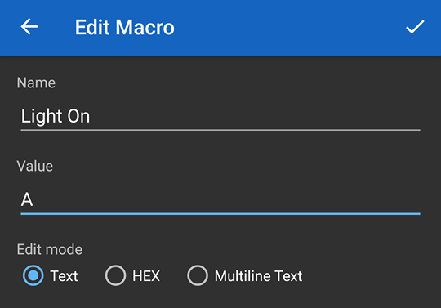
Android app

Slide 10
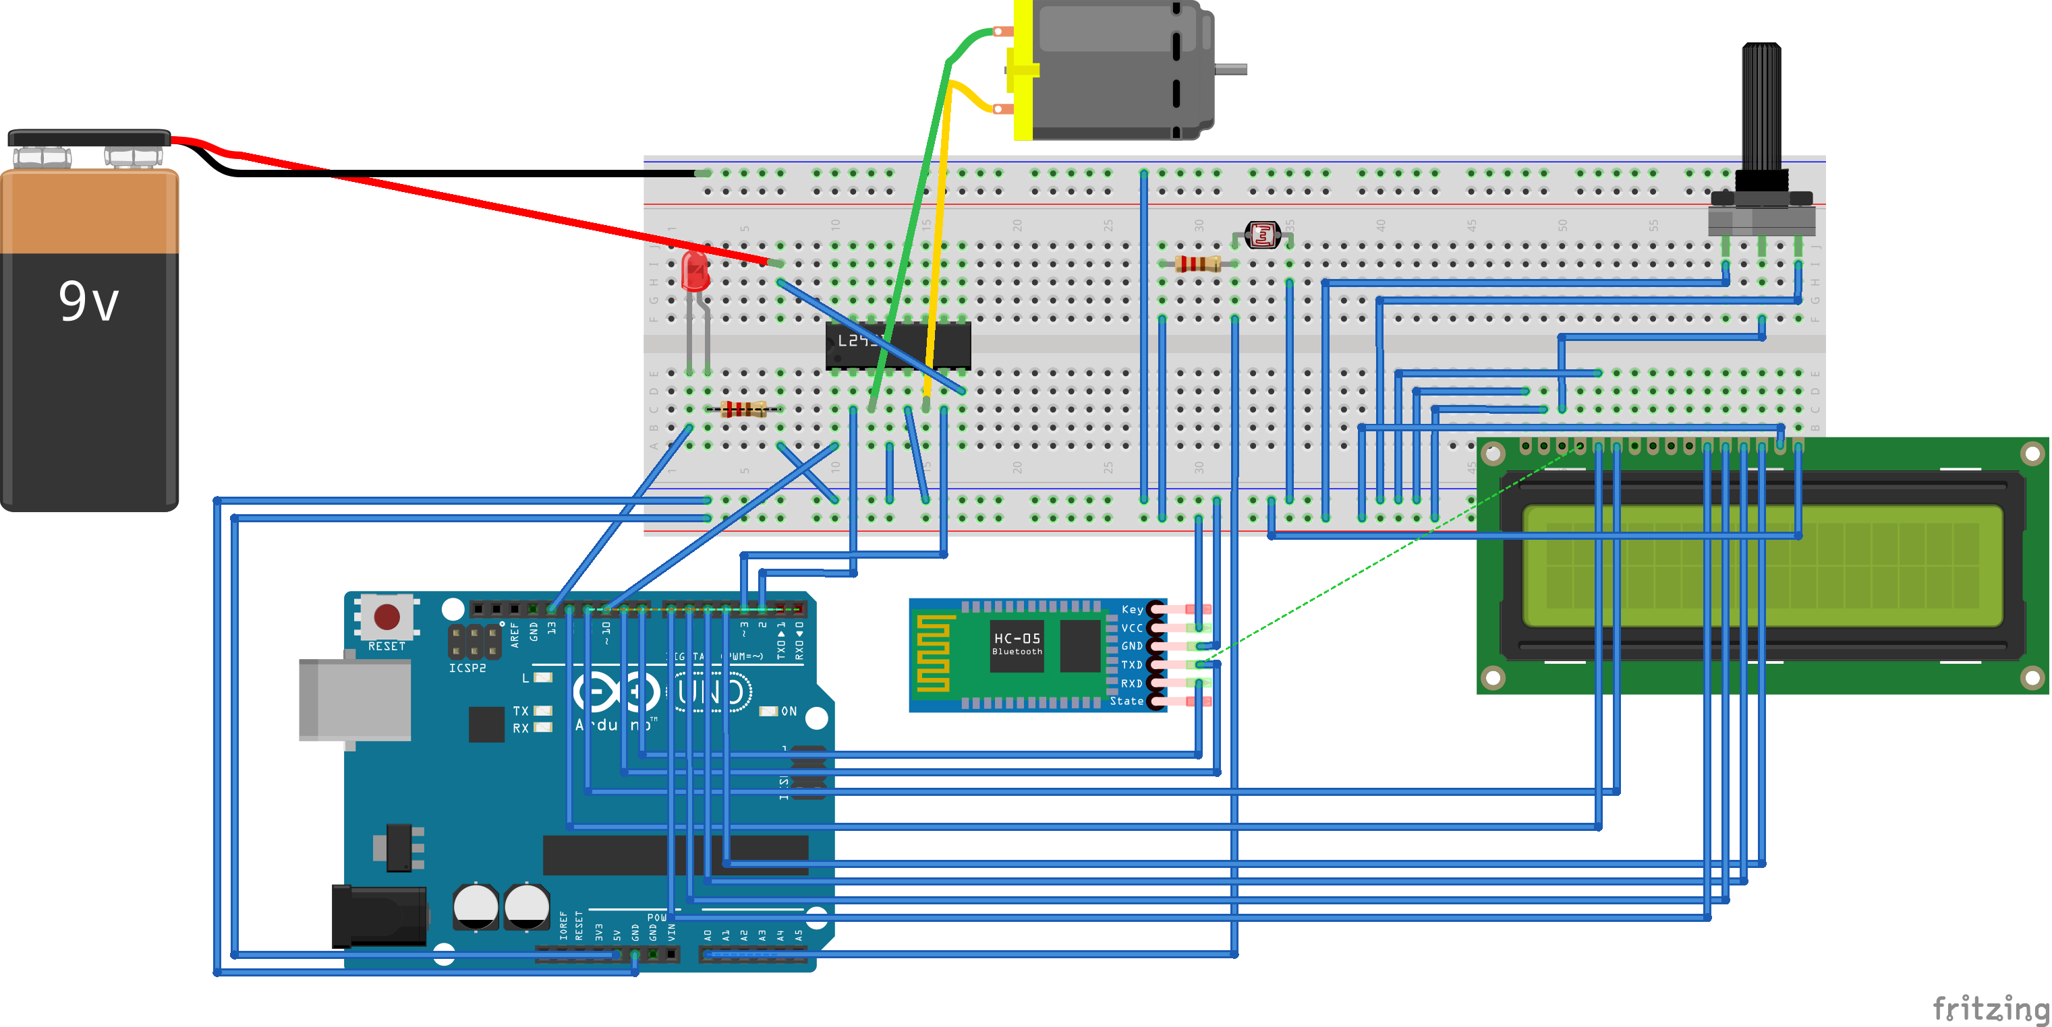
Circuit diagram

Slide 11
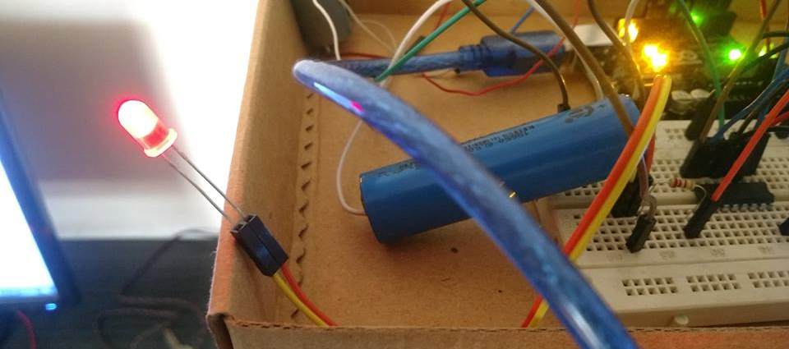
Controlling LED

Slide 12
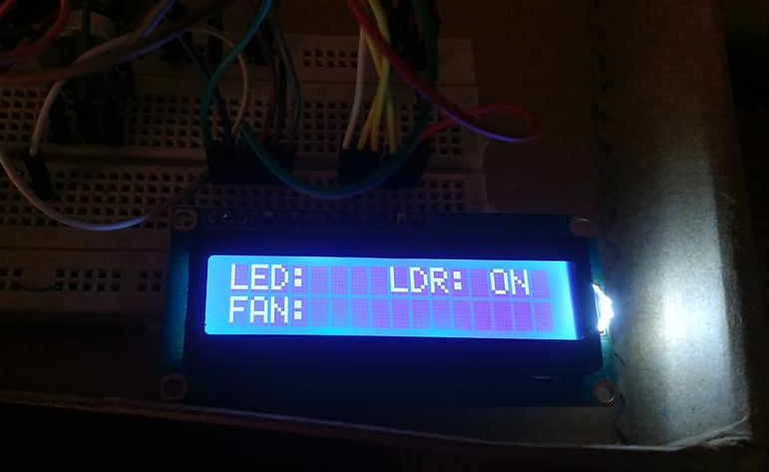
Showing the status

Slide 13
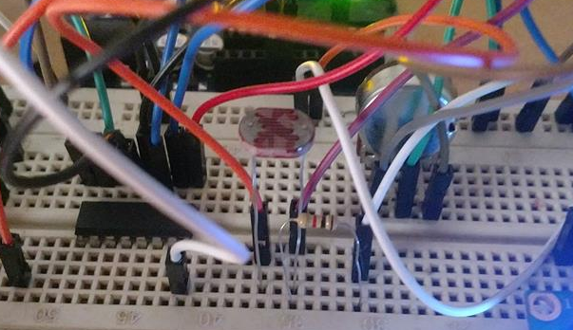
Light automation with Ldr

Slide 14
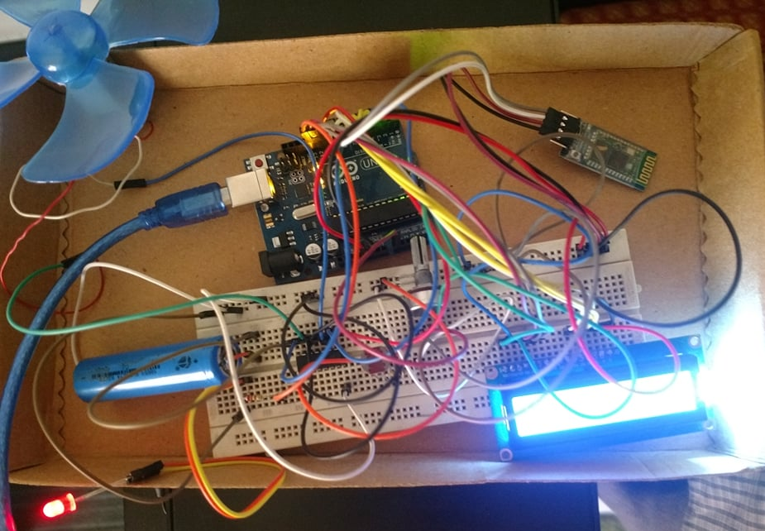
The Whole Project

Slide 15
Sketch
#include <SoftwareSerial.h>
#include <LiquidCrystal.h>
SoftwareSerial Bluetooth(8,9);
LiquidCrystal lcd(12,11,7,6,5,4);
int Data, LDR;
bool ldr_on = false;
void setup() {
Bluetooth.begin(9600);
lcd.begin(16,2);
pinMode(A0, INPUT);
pinMode(13,OUTPUT);
pinMode(10, OUTPUT);
pinMode(2, OUTPUT);
pinMode(3, OUTPUT);
Serial.begin(9600);

Slide 16
Sketch
lcd.setCursor(0, 0);
lcd.print("LED: ");
lcd.setCursor(8,0);
lcd.print("LDR: ");
lcd.setCursor(0, 1);
lcd.print("FAN: ");
}
void loop() {
digitalWrite(10,HIGH);
digitalWrite(2,HIGH);
digitalWrite(3,LOW);
LDR = analogRead(A0);
Serial.println(LDR);
delay(100);

Slide 17
Sketch
if( LDR < 150 && ldr_on == false ) {
digitalWrite(13,HIGH);
Bluetooth.println("LDR On! ");
lcd.setCursor(13, 0);
lcd.print("ON ");
ldr_on = true;
} else if ( LDR >= 150 && ldr_on == true ) {
digitalWrite(13 , LOW);
Bluetooth.println("LDR Off! ");
lcd.setCursor(13, 0);
lcd.print("OFF");
ldr_on = false;
}
if ( Bluetooth.available() ) {
Data = Bluetooth.read();
if(Data == 'A') {
digitalWrite(13,HIGH);
Bluetooth.println("LED On! ");
lcd.setCursor(5, 0);
lcd.print("ON ");
} else if(Data == 'B') {
digitalWrite(13 , LOW);
Bluetooth.println("LED Off! ");
lcd.setCursor(5, 0);
lcd.print("OFF");
}

Slide 18
Sketch
if(Data=='C'){
digitalWrite(2,HIGH);
Bluetooth.println("FAN On!");
lcd.setCursor(5, 1);
lcd.print("ON ");
delay(100);
}}
if(Data=='D'){
digitalWrite(2,LOW);
Bluetooth.println("FAN Off! ");
lcd.setCursor(5, 1);
lcd.print("OFF");
delay(100);
}
}

Slide 19
Future Plan
Implementing in large scale
Adding voice control
Adding IOT based control
Control of other home appliances

Slide 20
Thank You
THAT WILL BE ALL

