Slide 1
Kalderos Platform Data Analysis
Analyst: Sai Madhuri Kandula

Slide 2
Agenda
Nose Dive into Current Situation
The Appointment Crisis
Understanding our Users
By Age
By Region
Through Diagnosis
Final Thoughts

Slide 3
Present State
Customer Behavior:
80% of all the registered patients are engaging with the platform.
Patients are using the educational content on the platform - “CREATE MORE”
We need more “DATA” to find patterns and predict behavior.

Slide 4
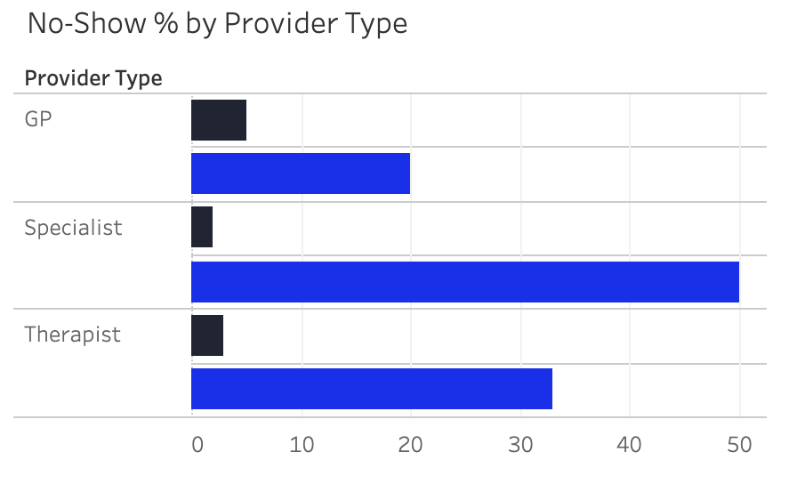
The Appointment Crisis
The Cost of No-Shows:
Idle capacity, lost revenue: Provider time and clinic slots go unused.
Clinical risk: Delayed specialty care increases complications and downstream costs.
Recommendations:
Make Specialist no-shows a top priority for immediate intervention.
Launch a targeted improvement program (navigator call at T-24h)
Relative patients
Percentage no-shows

Slide 5
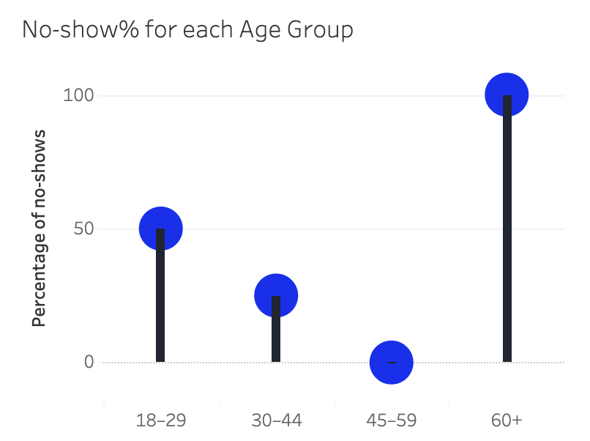
Age Demographics Challenge
“Engaged but not Showing up” Reality:
18–29 miss ~50% of appointments despite frequent logins and checking.
30-59 often show-up and follow through with future appointments.
Recommendations:
Prioritize 18–29 with mobile-first, 1-tap confirm or reschedule, and flexible slots.
Replace one-size outreach with age-specific journeys.

Slide 6
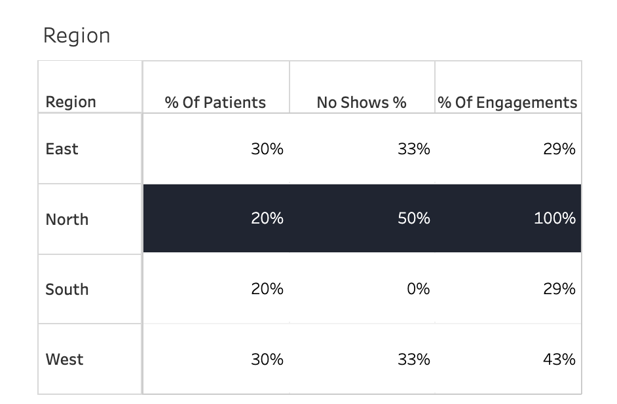
Regional Performance Insights
Regional Reality:
North: 100% engaged, 50% no-shows → most engaged, least reliable.
South: 25% engaged, 0% no-shows → opposite problem.
East & West: solid engagement, ~33% no-shows.
Recommendations:
Regions need customized intervention strategies, not standardized approaches.
North needs retention programs, South needs engagement activation.

Slide 7
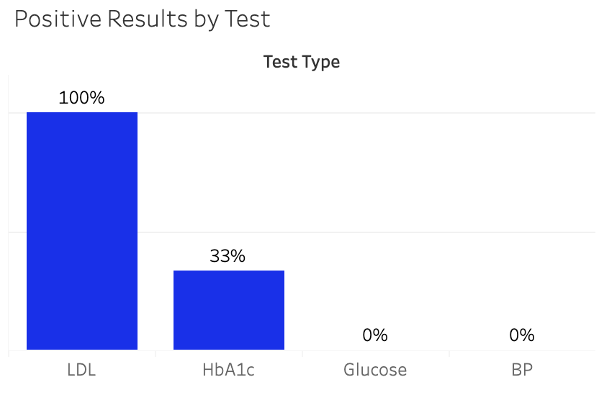
Health Risk Factor Analysis
Lab Result Analysis:
100% of LDL results were elevated, indicating increased cardiovascular risk.
33% of HbA1c results were flashing, indicating elevated diabetes risk.
Patients tested positive interact with articles, videos and messages
Recommendations:
High-risk conditions require consistent monitoring and medication adjustments.
Dedicated strategy and outreach programs for positively tested patients.

Slide 8
Final Thoughts
Better
Engagement
Multiple Charts
Same story
Less No-Shows

Slide 9
THANK YOU :)

Slide 10
