Slide 1
Medical Chatbot Using LLaMA-2 Model
This project presents an AI-powered chatbot designed to assist users with medical queries. Leveraging the capabilities of the LLaMA-2 language model and FAISS vector search, the chatbot delivers accurate, natural-language responses by retrieving relevant treatments and disease information from a specialized dataset.
Team Name: Saima-Chandrakant

Slide 2
Requirements
LLaMA-2 Model (Quantized - GGML Format): Efficient, runs on standard CPU machines.
CTransformers: Python library for loading quantized models, supports CPU-based inference.
Sentence Transformers: Used to create vector embeddings for queries and data.
FAISS (CPU Version): Vector store for storing and searching embeddings efficiently.

Slide 3
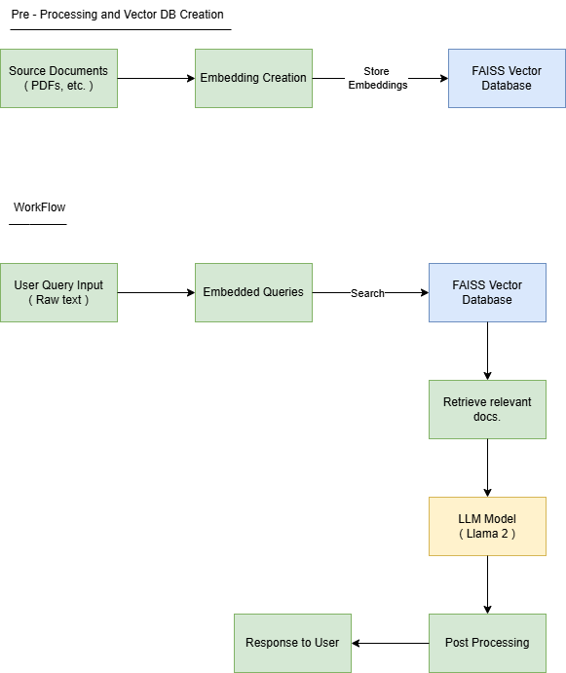
High-Level Architecture

Slide 4
About Vector Store (FAISS)
Built-in Similarity Algorithms:
- Cosine Similarity
- Jaccard Score
- Levenstein Distance
Performance:
- Fast and low latency.

