Slide 1
INTRODUCTION TO DIGITAL MANUFACTURING
Optimization and Machine Learning Prediction of Tensile and Compressive Strengths for Additively Manufactured ABS Automotive Components
Replication and extension of Munshi et al. (Next Materials, 2026), with nine ML models, complete metrics, SHAP explainability and robust process optimisation
REFERENCE PAPER
G.A. Munshi, V.M. Kulkarni, S. Yargatti
"Computation of tensile and compressive strengths of additively manufactured ABS material for automotive applications using ANN algorithms"
Next Materials 10 (2026) 101420
KEY RESULTS
383-sample ABS dataset, 5 FDM parameters
Best model: Histogram Gradient Boosting, CV R² = 0.9995
SHAP explanations in MPa
Robust optimum: 50.4 / 63.0 MPa
TEAM
Roll numbers: 016, 021, 028, 035
[add team member names]
Final Review

Slide 2
INDUSTRY CONTEXT
Problem Statement & Objectives
Why it matters
• FDM/MEX prints ABS parts bead by bead and layer by layer, so strength depends on how well beads fuse and how much material fills the part.
• Five coupled parameters (nozzle & bed temperature, speed, layer height, infill) interact non-linearly.
• Trial-and-error printing and ASTM testing is slow and wastes material.
Automotive case studies (from the paper)
• Brake pedal: high compressive load, so we require σc ≥ 45 MPa.
• Door handle: repeated pulling, so we require σt ≥ 30 MPa.
• Goal: meet the strength requirement with the shortest print time.
Project objectives
1. Replicate the paper's ANN models on its dataset and compare with its Tables 4 and 7.
2. Evaluate 9 models with all regression metrics (hold-out + 5-fold CV).
3. Explain individual predictions (SHAP, in MPa).
4. Find optimal parameters formally, with sensitivity analysis, case studies and a Pareto front.
2

Slide 3
DATASET
Reference Paper & Dataset (383 samples)
Provenance (Section 2.5 of the paper)
• 383 tensile/compressive strengths of virgin ABS compiled by the authors from peer-reviewed studies and test reports (ASTM D638 / D695 specimens); outliers beyond 3σ removed.
• The paper's own PRATI_AP prints were only used for its 15-run Taguchi L15 validation.
• 0 missing values, 0 duplicate rows.
• Compressive ≈ 1.25 × tensile in every record (r = 1.000).
• Each parameter takes only a few discrete levels; layer height only 0.2 and 0.8 mm. The optimiser therefore stays inside this window.
Variable | Min | Max | Mean | Std | Levels
Nozzle temp. (°C) | 200 | 250 | 223.97 | 17.44 | 6
Bed temp. (°C) | 50 | 110 | 79.19 | 22.49 | 4
Print speed (mm/s) | 10 | 70 | 40.23 | 22.36 | 4
Layer height (mm) | 0.2 | 0.8 | 0.51 | 0.30 | 2
Infill density (%) | 20 | 100 | 58.12 | 27.85 | 5
Tensile strength (MPa) | 5.8 | 50.6 | 23.11 | 11.99 | 57
Compressive strength (MPa) | 7.3 | 63.3 | 28.91 | 14.98 | 57
3

Slide 4
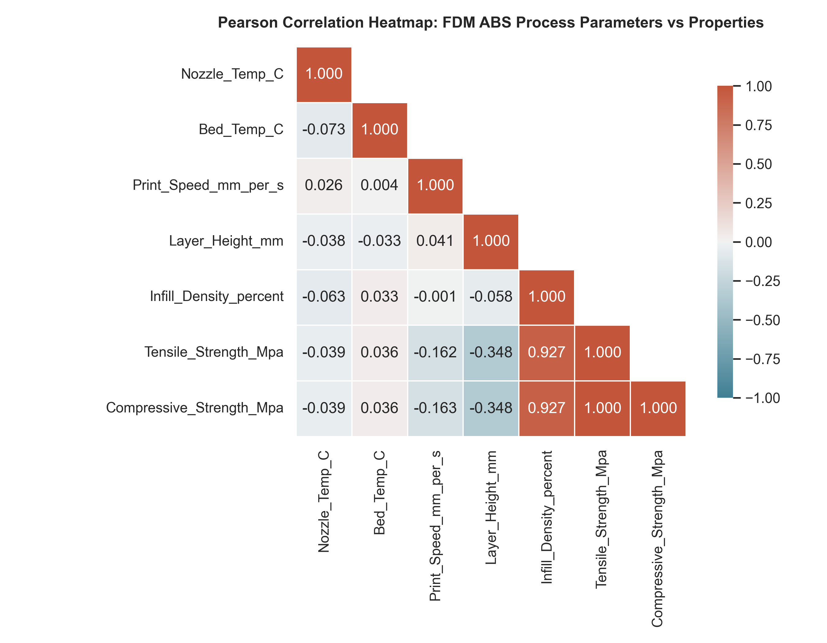
EXPLORATORY ANALYSIS
Pearson Correlation: Which Parameters Drive Strength?
Findings (paper Tables 8 & 9 agree)
1. Infill density r = +0.927: the dominant driver; a larger solid load-bearing area.
2. Layer height r = −0.348: thicker layers leave larger inter-bead voids and less bonding area.
3. Print speed r = −0.162: less time for interlayer diffusion.
4. Nozzle / bed temperature |r| < 0.04: no linear effect inside 200–250 °C / 50–110 °C.
5. Parameters are mutually uncorrelated (|r| ≤ 0.07), consistent with a designed factor space.
4

Slide 5
METHODOLOGY
Models, Validation & Pipeline
Paper replications
• Adam ANN: 2 tanh hidden layers (20-20), lr 1e-3, batch 32, 1000 epochs (paper §2.6.1).
• Bayesian-regularised ANN: 2×20 tanh, linear output; MATLAB trainbr approximated by L-BFGS + L2 weight decay.
• Literature comparators: SVR, Decision Tree, AdaBoost.
Proposed ensembles
• Histogram Gradient Boosting (300 iterations, lr 0.05, depth 6)
• Random Forest (300 trees), Extra Trees (300 trees)
• XGBoost (350 trees, lr 0.04, depth 5)
Leakage-free evaluation pipeline
• Min-max scaling of inputs and targets inside each model pipeline, re-fitted on the training part of every split.
• 80/20 hold-out (306/77, seed 42) + shuffled 5-fold CV with a fresh model per fold; mean ± std of 9 metrics.
• Best model chosen by 5-fold CV R², then re-fitted on all 383 samples for SHAP and optimisation. Selected: Histogram Gradient Boosting.
5

Slide 6
REVIEW 1 FEEDBACK
How the Professor's Review 1 Feedback Was Addressed
# | Feedback | What we implemented | Evidence (slides)
1 | All regression metrics | MSE, RMSE, MAE, MAPE, R², Adjusted R², Explained Variance, Max Error, Median AE for 9 models; hold-out + 5-fold CV (mean ± std); normalised errors for comparison with the paper | 7, 8, 10, 11
2 | Explainability of a prediction | SHAP (exact TreeExplainer) in MPa for both strengths; additivity verified; waterfalls for the optimum, case-study recipes and the weakest test specimen | 12, 13
3 | Optimal parameters | Robust differential evolution (worst case within ±5 units), cross-checked by exhaustive search of 960 tested combinations; sensitivity analysis, constrained case studies, Pareto front | 14, 15, 16
Also fixed: search window now matches the data, model-reuse bug in CV, corrected paper values & citation
6

Slide 7
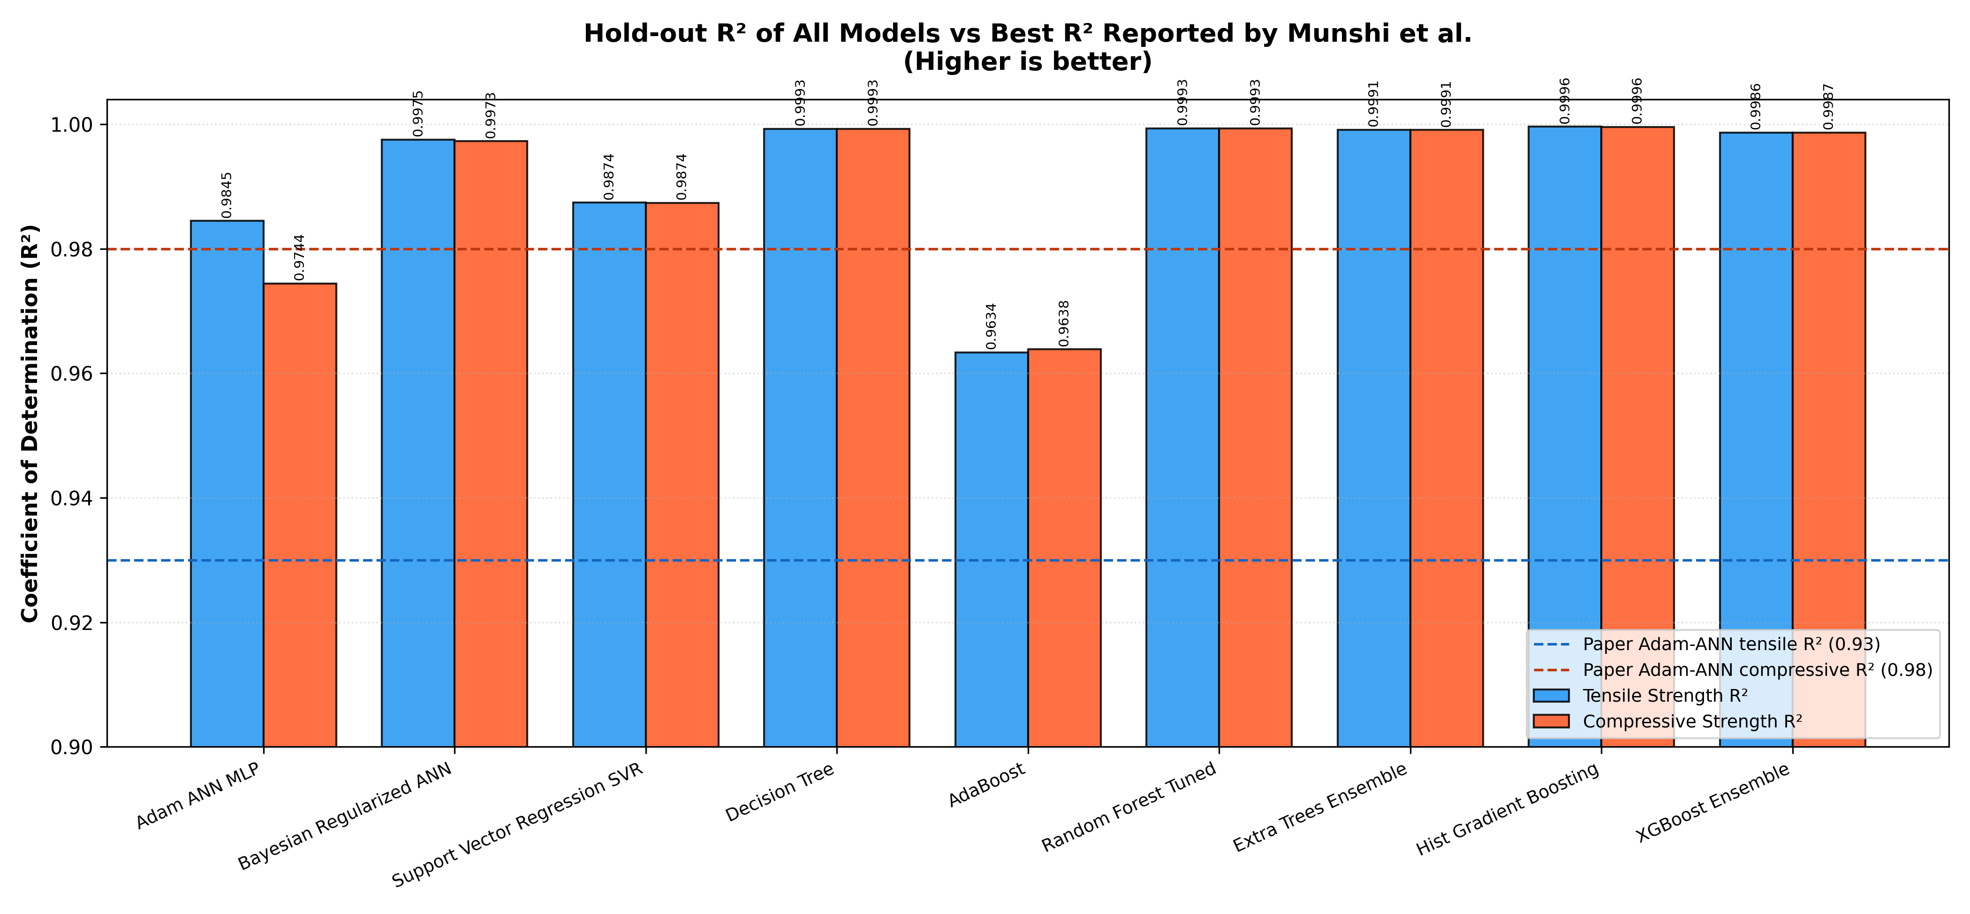
FEEDBACK #1 · ALL METRICS
Model Performance: Hold-out R² of All Nine Models
Model | CV R² | CV RMSE
Hist. Gradient Boosting (proposed) | 0.9995 | 0.28
Extra Trees (proposed) | 0.9985 | 0.51
Decision Tree | 0.9984 | 0.51
Random Forest (proposed) | 0.9982 | 0.54
XGBoost (proposed) | 0.9982 | 0.55
Bayesian ANN (replication) | 0.9979 | 0.60
SVR | 0.9804 | 1.85
Adam ANN (replication) | 0.9795 | 1.91
AdaBoost | 0.9557 | 2.80
Mean of both targets, 5-fold CV. RMSE in MPa.
7

Slide 8
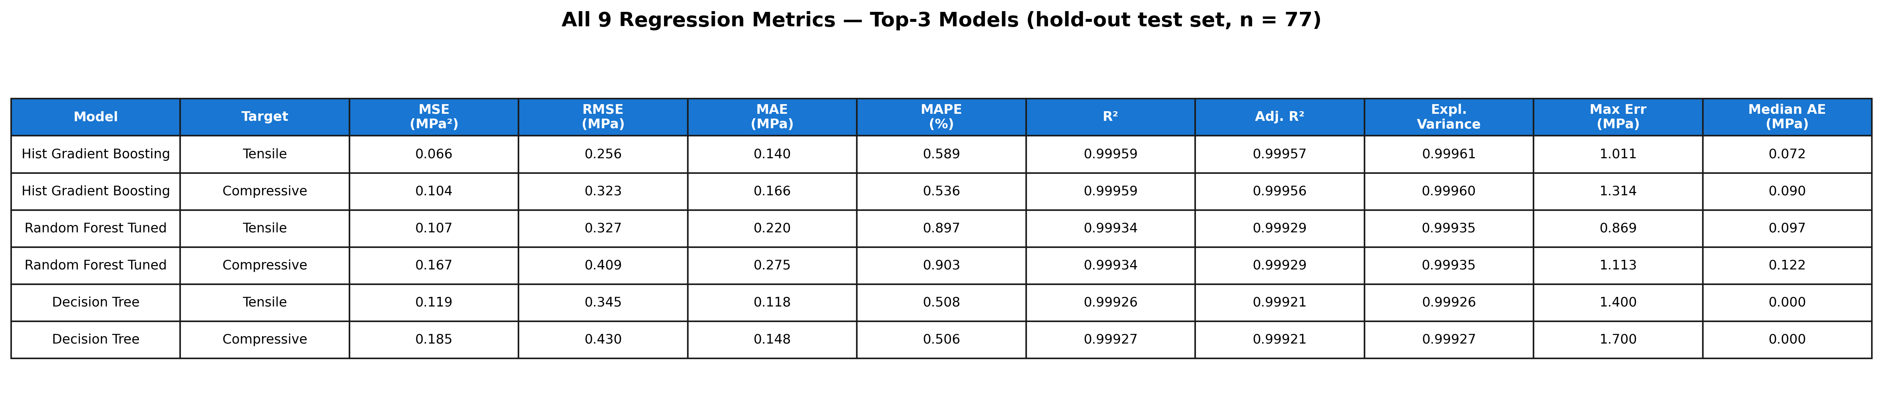
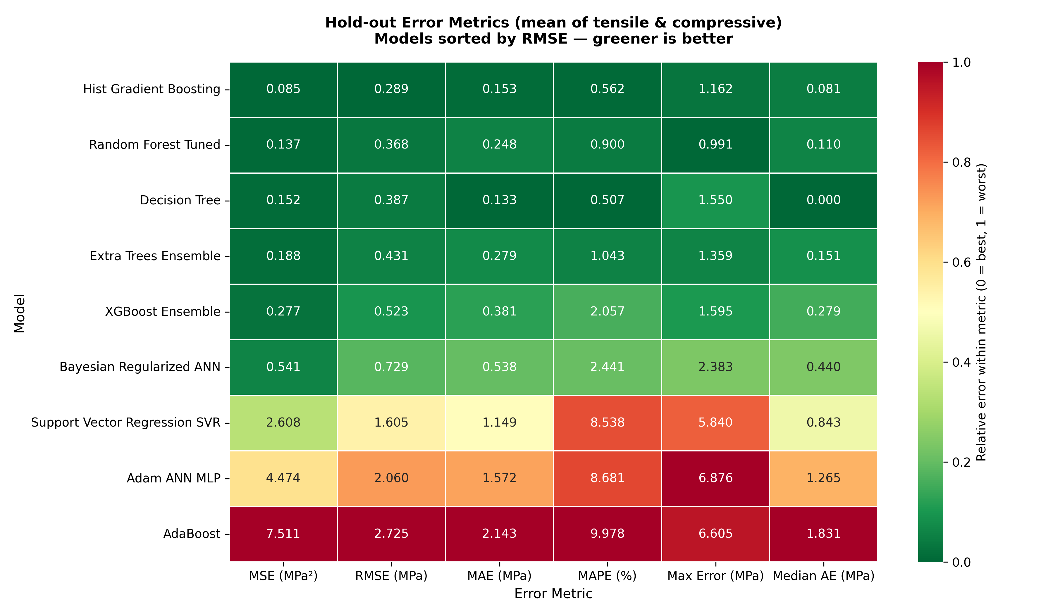
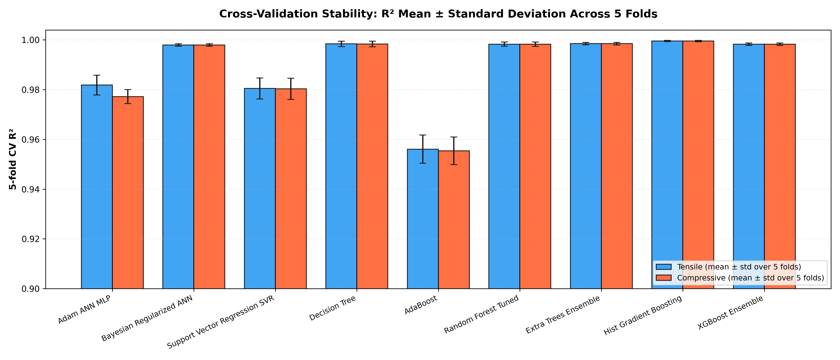
FEEDBACK #1 · ALL METRICS
All 9 Metrics & Cross-Validation Stability
8

Slide 9
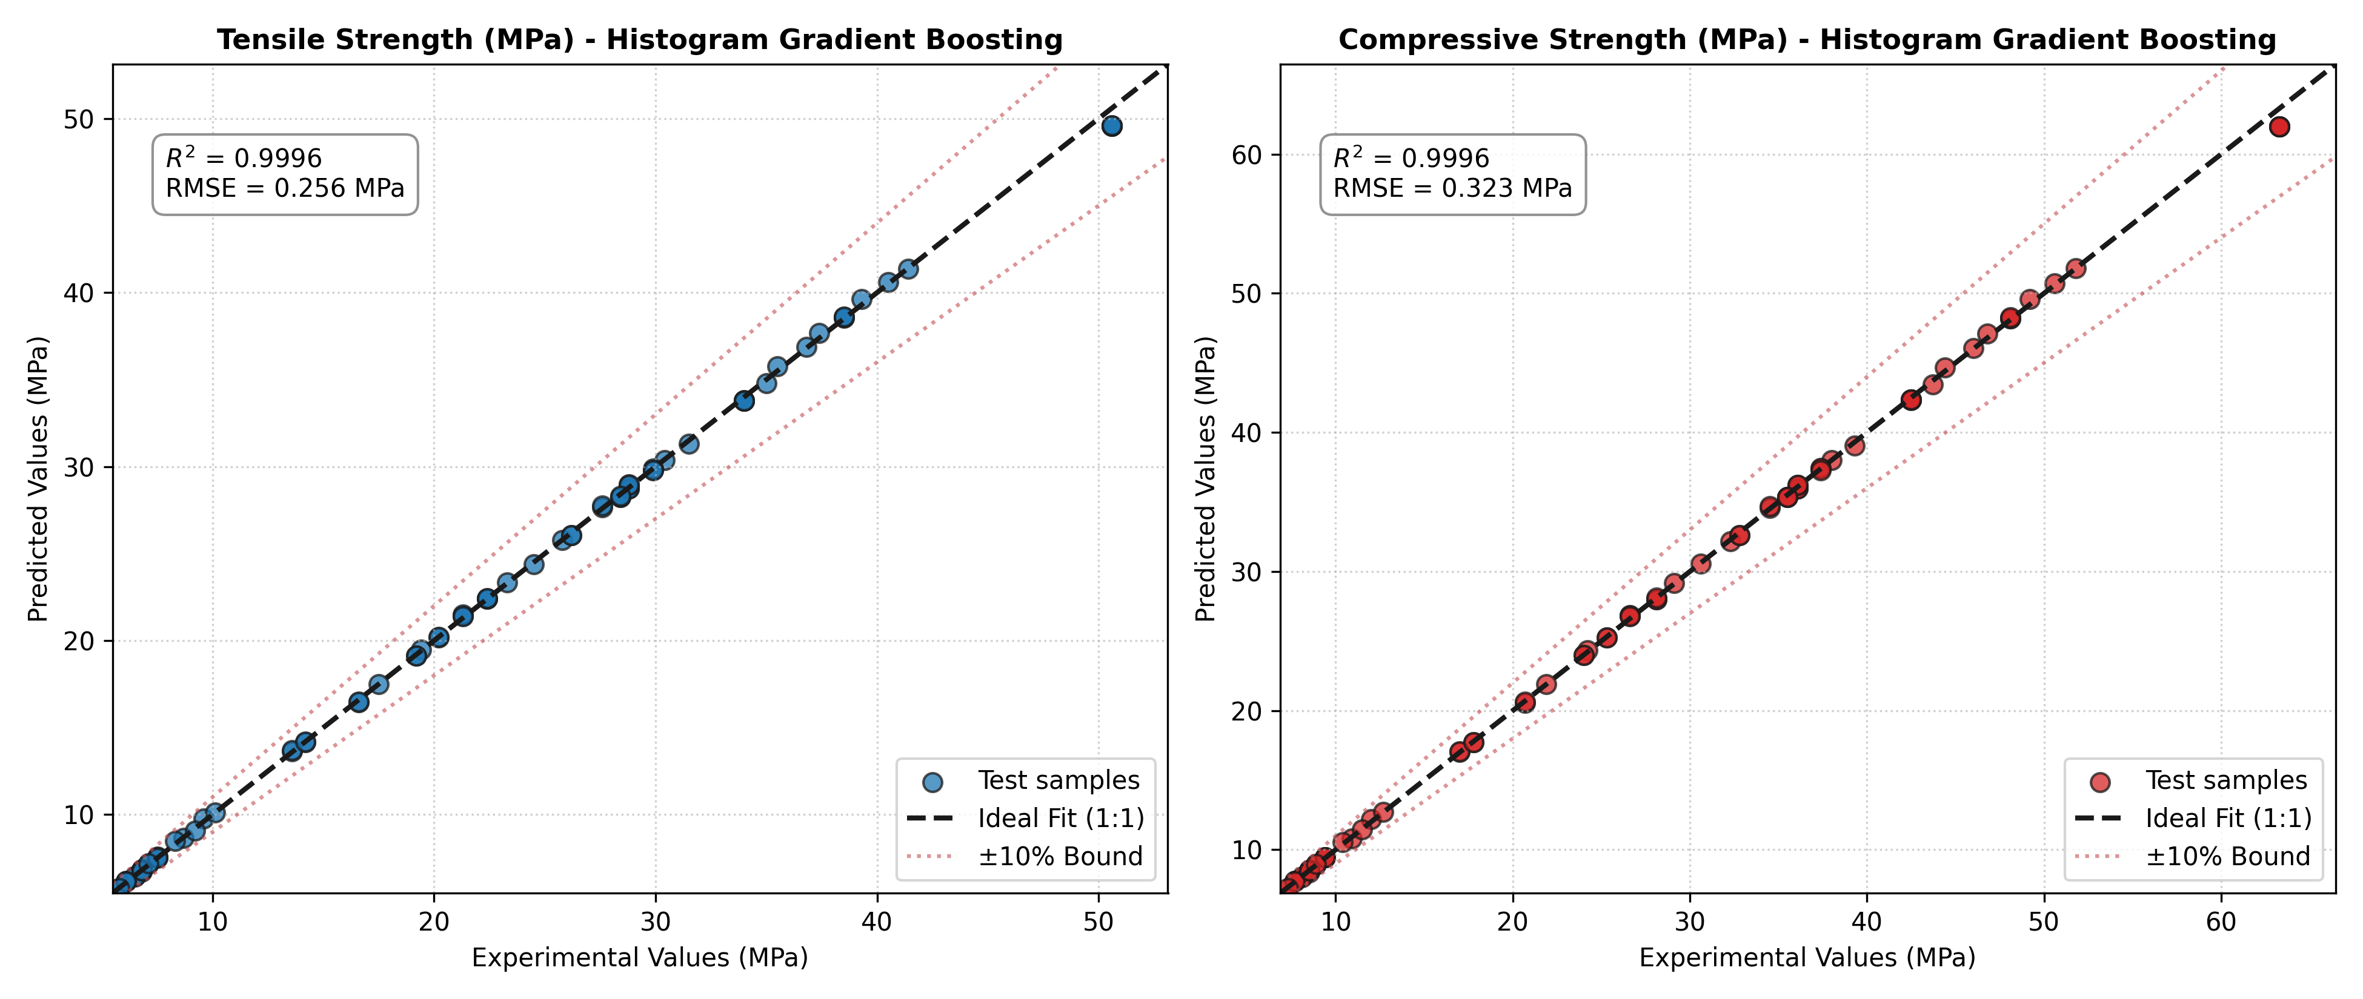
BEST MODEL
Histogram Gradient Boosting: Predicted vs Measured (Hold-out)
Best model accuracy
• Hold-out R²: 0.9996 / 0.9996
• Hold-out RMSE: 0.26 / 0.32 MPa
• 5-fold CV R²: 0.9995 ± 0.0003
• CV MAPE: 0.66 % / 0.64 %
• Max error: 1.01 / 1.31 MPa
• All test samples lie inside the ±10 % band.
(tensile / compressive)
9

Slide 10
⭐ COMPARISON WITH PUBLISHED WORK
R² Comparison with Table 7 of Munshi et al.
Model | Source | Tensile R² | Compressive R²
Adam-optimised ANN | Paper (L15 validation) | 0.93 | 0.98
Bayesian-regularised ANN | Paper (L15 validation) | 0.9 | 0.95
Decision Tree | Paper Table 7 (other studies) | 0.66 | 0.8741
SVM | Paper Table 7 (other studies) | 0.8 | 0.943
Random Forest | Paper Table 7 (other studies) | 0.74 | 0.8747
XGBoost | Paper Table 7 (other studies) | 0.8962 | 0.9208
SVR | Paper Table 7 (other studies) | 0.9215 | 0.8359
k-NN | Paper Table 7 (other studies) | 0.8443 | 0.934
AdaBoost | Paper Table 7 (other studies) | 0.8893 | 0.9126
Adam-optimised ANN | This work (hold-out) | 0.9845 | 0.9744
Bayesian-regularised ANN | This work (hold-out) | 0.9975 | 0.9973
Histogram Gradient Boosting | This work (hold-out) | 0.9996 | 0.9996
Tuned Random Forest | This work (hold-out) | 0.9993 | 0.9993
XGBoost | This work (hold-out) | 0.9986 | 0.9987
Reading the comparison
• Our Adam-ANN replication (0.984 / 0.974) reaches the same level as the paper (0.93 / 0.98).
• Histogram Gradient Boosting reaches 0.9996, above every R² in Table 7.
• The paper's DT/SVM/RF/XGB/SVR/k-NN/AdaBoost rows come from other studies and datasets.
• The paper's ANN R² is on its 15 Taguchi L15 prints; ours is on the 77 held-out records.
10

Slide 11
⭐ COMPARISON WITH PUBLISHED WORK
Error Comparison with Table 4 of Munshi et al.
Model | Validation | Property | MSE | RMSE | MAE | MAPE % | RMSE (norm.)
Adam ANN (Paper) | Hold-out | Tensile | 0.0523 | 0.2031 | 0.1601 | 0.850 | –
Adam ANN (Paper) | Hold-out | Compressive | 0.0523 | 0.2516 | 0.1973 | 0.840 | –
Adam ANN (Paper) | 5-Fold CV | Tensile | 0.0586 | 0.2126 | 0.1541 | 0.740 | –
Adam ANN (Paper) | 5-Fold CV | Compressive | 0.0586 | 0.2661 | 0.1931 | 0.720 | –
Bayesian ANN (Paper) | Hold-out | Tensile | 0.0001 | 0.0100 | 0.0020 | 0.010 | –
Bayesian ANN (Paper) | Hold-out | Compressive | 0.0001 | 0.0077 | 0.0019 | 0.010 | –
Bayesian ANN (Paper) | 5-Fold CV | Tensile | 1.7543 | 0.0125 | 5.5000 | 0.030 | –
Bayesian ANN (Paper) | 5-Fold CV | Compressive | 1.6458 | 0.0120 | 5.5263 | 0.025 | –
Adam ANN (ours) | Hold-out | Tensile | 2.5038 | 1.5823 | 1.1805 | 7.136 | 0.0353
Adam ANN (ours) | Hold-out | Compressive | 6.4443 | 2.5386 | 1.9634 | 10.225 | 0.0453
Bayesian ANN (ours) | 5-Fold CV | Tensile | 0.2960 | 0.5380 | 0.4062 | 2.021 | 0.0120
Bayesian ANN (ours) | 5-Fold CV | Compressive | 0.4580 | 0.6680 | 0.4956 | 1.930 | 0.0119
HGB (ours) | Hold-out | Tensile | 0.0655 | 0.2560 | 0.1401 | 0.589 | 0.0057
HGB (ours) | Hold-out | Compressive | 0.1042 | 0.3228 | 0.1659 | 0.536 | 0.0058
HGB (ours) | 5-Fold CV | Tensile | 0.0686 | 0.2493 | 0.1497 | 0.658 | 0.0056
HGB (ours) | 5-Fold CV | Compressive | 0.1086 | 0.3117 | 0.1806 | 0.636 | 0.0056
Notes
• Our values are in MPa; "norm." is on min-max scaled targets (the paper's values appear to be normalised).
• HGB normalised RMSE ≈ 0.0056, lower than all Adam-ANN values in the paper.
• The paper's values are internally inconsistent (e.g. MSE 1.75 with RMSE 0.0125), so they are compared with caution.
• Our 5-fold CV is stable for every model (R² std ≤ 0.006); the paper reports MAE 5.5 for its Bayesian 5-fold run.
11

Slide 12
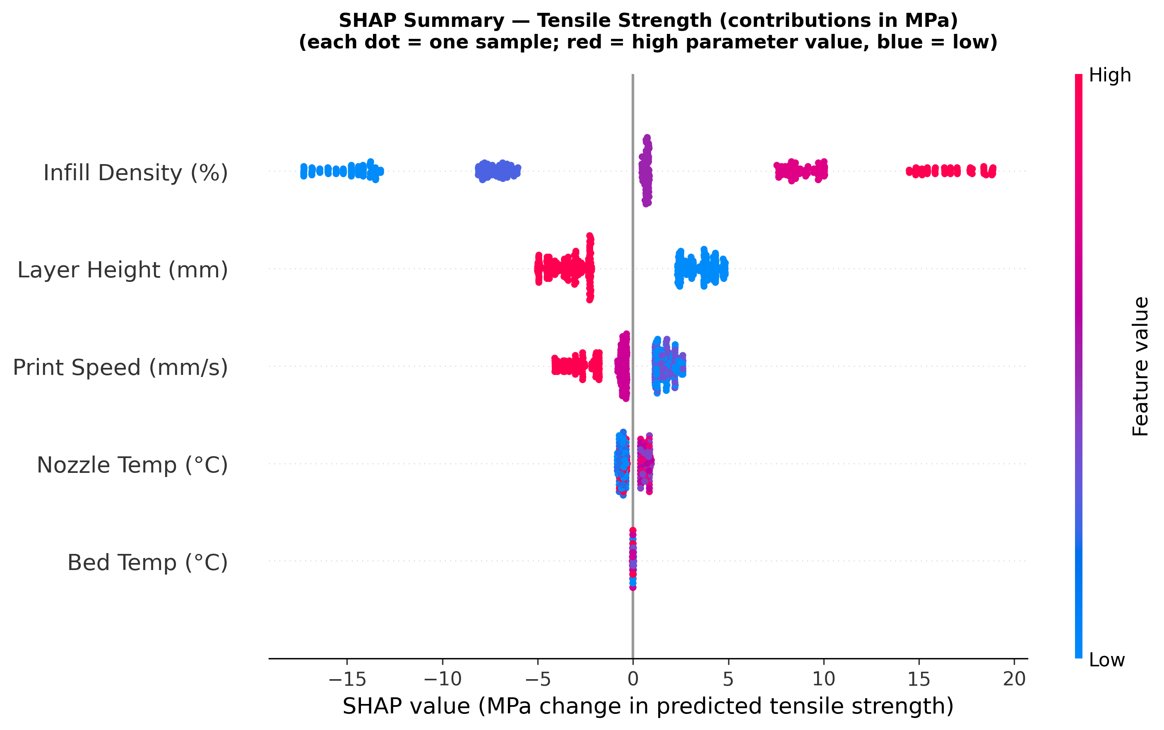
FEEDBACK #2 · EXPLAINABILITY
SHAP: How Each Parameter Moves the Prediction (MPa)
Parameter | Mean |SHAP| (MPa) | Share
Infill Density (%) | 9.47 | 62.2 %
Layer Height (mm) | 3.49 | 22.9 %
Print Speed (mm/s) | 1.67 | 11.0 %
Nozzle Temp (°C) | 0.59 | 3.9 %
Bed Temp (°C) | 0.01 | 0.1 %
Tensile strength (compressive is identical in share)
• High infill: up to +19 MPa; low infill: down to −17 MPa.
• 0.2 mm layers: about +2.5 to +5 MPa; 0.8 mm layers: about −2 to −5 MPa.
• Speed above about 40 mm/s lowers strength.
• Bed temperature has no effect, as in the paper's conclusion.
12

Slide 13
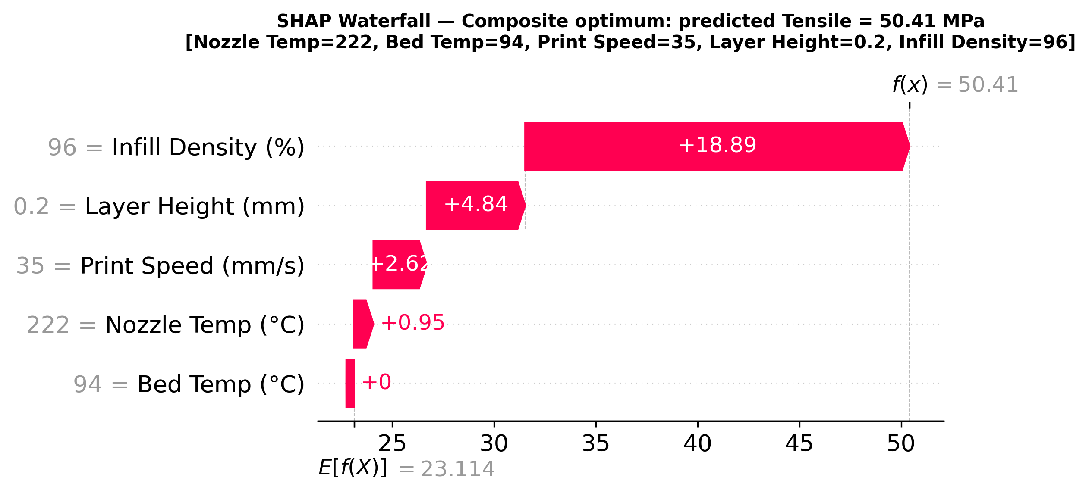
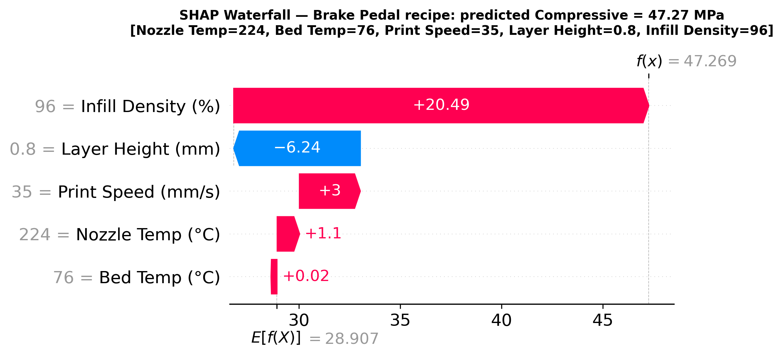
FEEDBACK #2 · EXPLAINABILITY
Explaining ONE Prediction: Why Does This Recipe Give This Strength?
Exact decomposition of the optimal recipe's tensile strength
23.11 (dataset average) + +18.89 (infill) +4.84 (layer) +2.62 (speed) +0.95 (nozzle) +0.00 (bed) = 50.41 MPa
• Additivity verified for all 383 samples (max error 1.4e-13 MPa). Waterfalls are also provided for the door handle and the weakest test specimen.
13

Slide 14
FEEDBACK #3 · OPTIMAL PARAMETERS
Formal Optimisation: Robust Differential Evolution
Objective | Nozzle °C | Bed °C | Speed mm/s | Layer mm | Infill % | σt MPa | σc MPa | Print-time τ
Max tensile | 228 | 86 | 35 | 0.2 | 96 | 50.41 | 63.04 | 138.9
Max compressive | 226 | 73 | 35 | 0.2 | 96 | 50.41 | 63.04 | 138.9
Max composite | 222 | 94 | 35 | 0.2 | 96 | 50.41 | 63.02 | 138.9
Exhaustive check (960 tested combos) | 230 | 90 | 30 | 0.2 | 100 | 50.41* | 63.02* | 166.7
Method
• scipy differential_evolution, 4 continuous parameters × 2 layer levels.
• Robust: each recipe is scored by its worst case within ±5 °C, ±5 mm/s, ±5 % infill.
• Ties broken by shortest print time; rounded to machine resolution.
Result
• Layer 0.2 mm, infill ≥ 95 %, speed ≤ 35 mm/s
• Worst case: 50.41 / 63.02 MPa
• All 3 objectives give the same optimum (σc ≈ 1.25·σt).
• Same strength as the best tested combination, with a shorter print time.
Why robust?
• Tree models are step functions; the steps lie half-way between tested levels.
• A naive optimum sits on a step edge, where a 1 mm/s drift loses 4 MPa.
• The robust optimum keeps its strength under process scatter.
* worst-case strengths within the tolerance band (MPa); optimiser rows show nominal predictions
14

Slide 15
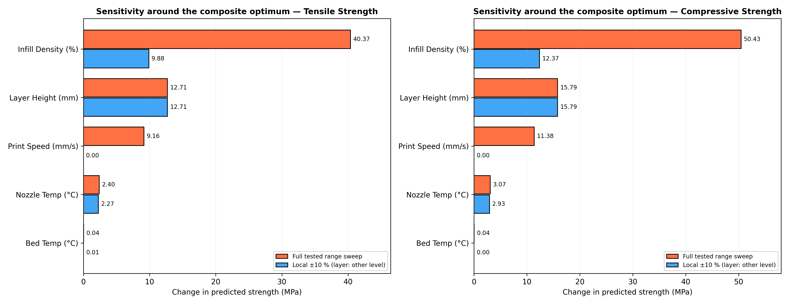
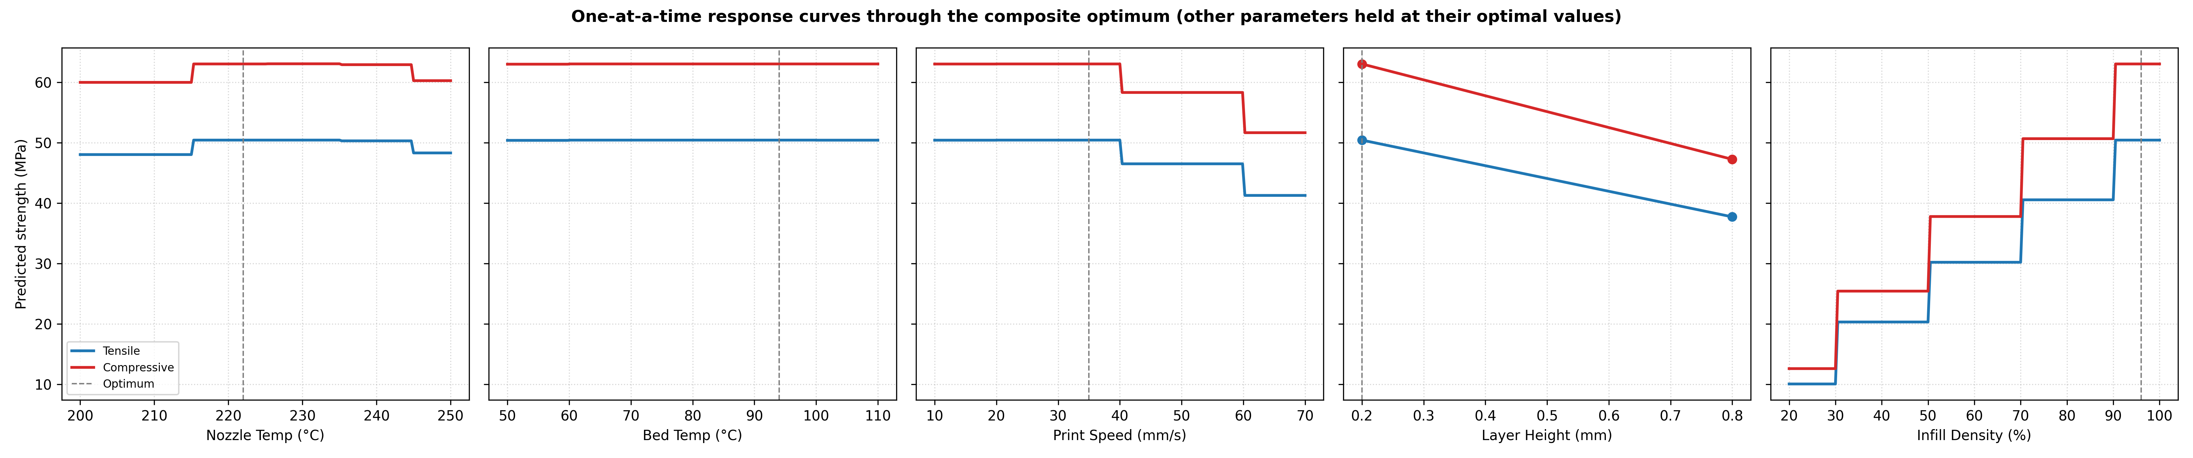
FEEDBACK #3 · SENSITIVITY
Sensitivity Analysis around the Optimum
Parameter | Full-range σt swing | Near-optimal window
Infill Density (%) | 40.37 MPa | 90.5 - 100.0
Layer Height (mm) | 12.71 MPa | 0.2
Print Speed (mm/s) | 9.16 MPa | 10.0 - 40.0
Nozzle Temp (°C) | 2.40 MPa | 215.3 - 244.7
Bed Temp (°C) | 0.04 MPa | 50.0 - 110.0
Engineering reading
• Very sensitive: infill, layer height.
• Moderate: print speed (keep ≤ 35–40 mm/s).
• Insensitive: nozzle 215–245 °C; bed has no effect, so choose it for warp control.
15

Slide 16
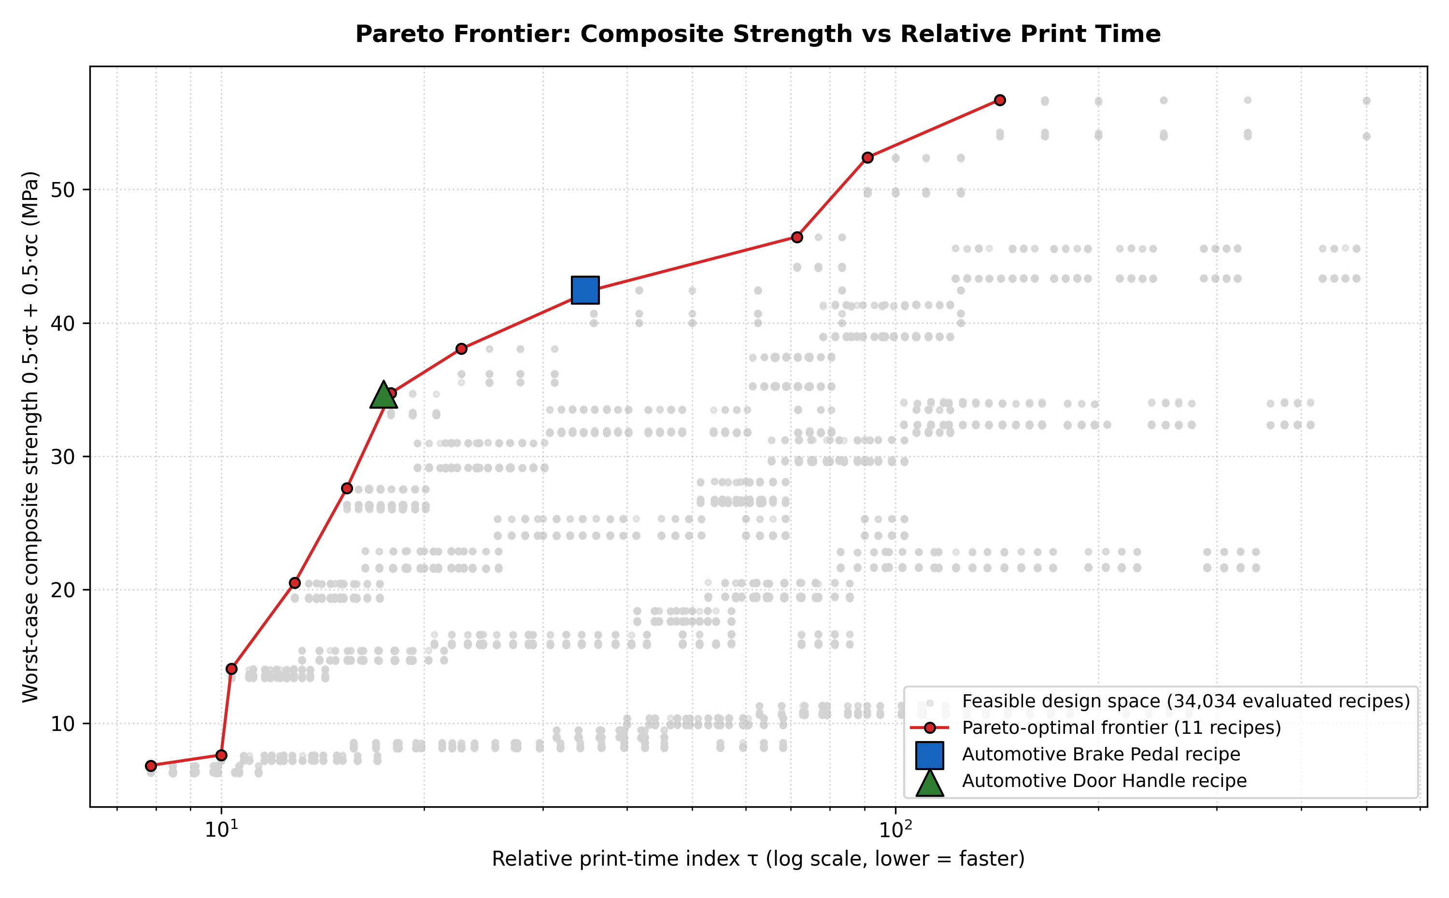
AUTOMOTIVE CASE STUDIES
Fastest Recipes that Meet the Requirement + Pareto Front
 | Brake pedal | Door handle
Requirement | σc ≥ 45 MPa | σt ≥ 30 MPa
Safety margin (2×CV RMSE) | +0.62 MPa | +0.50 MPa
Nozzle / Bed (°C) | 224 / 76 | 225 / 85
Speed (mm/s) | 35 | 70
Layer (mm) / Infill (%) | 0.8 / 96 | 0.8 / 96
Predicted σt / σc (MPa) | 37.72 / 47.27 | 30.78 / 38.55
Worst-case key strength | σc = 47.23 | σt = 30.78
Print time vs max-strength recipe | −75.0 % | −87.5 %
Thick 0.8 mm layers with high infill meet both requirements about 4–8× faster. Switching to 0.2 mm layers is only worth it when > 43 MPa composite strength is needed.
16

Slide 17
CRITICAL ASSESSMENT
Taguchi L15 Check & Limitations
Taguchi L15 combinations (paper Table 3)
• Predicted all 15 combinations; the 5 with 0.5 mm layers are flagged (0.5 mm is not in the data).
• Combination 6: predicted 50.4 / 63.0 MPa vs paper about 37 / 52 MPa.
• Combination 13: predicted 50.4 / 63.0 MPa vs paper about 35 / 47 MPa.
• Same ranking (6 and 13 are the strongest), but the paper's own prints are about 25–30 % weaker than the compiled dataset (C/T ratio ≈ 1.4 vs 1.25).
Limitations
• The dataset is nearly deterministic (σc = 1.25·σt, no bed effect), so R² ≈ 0.9995 is not the accuracy expected on new prints.
• No external validation set: the L15 measurements are only shown graphically in the paper.
• Values between tested levels are interpolations; robust optimisation and safety margins reduce this risk.
• The print-time index is relative (assumed 30 % shell fraction).
• Next step: confirm the recipes with physical ASTM D638/D695 prints.
17

Slide 18
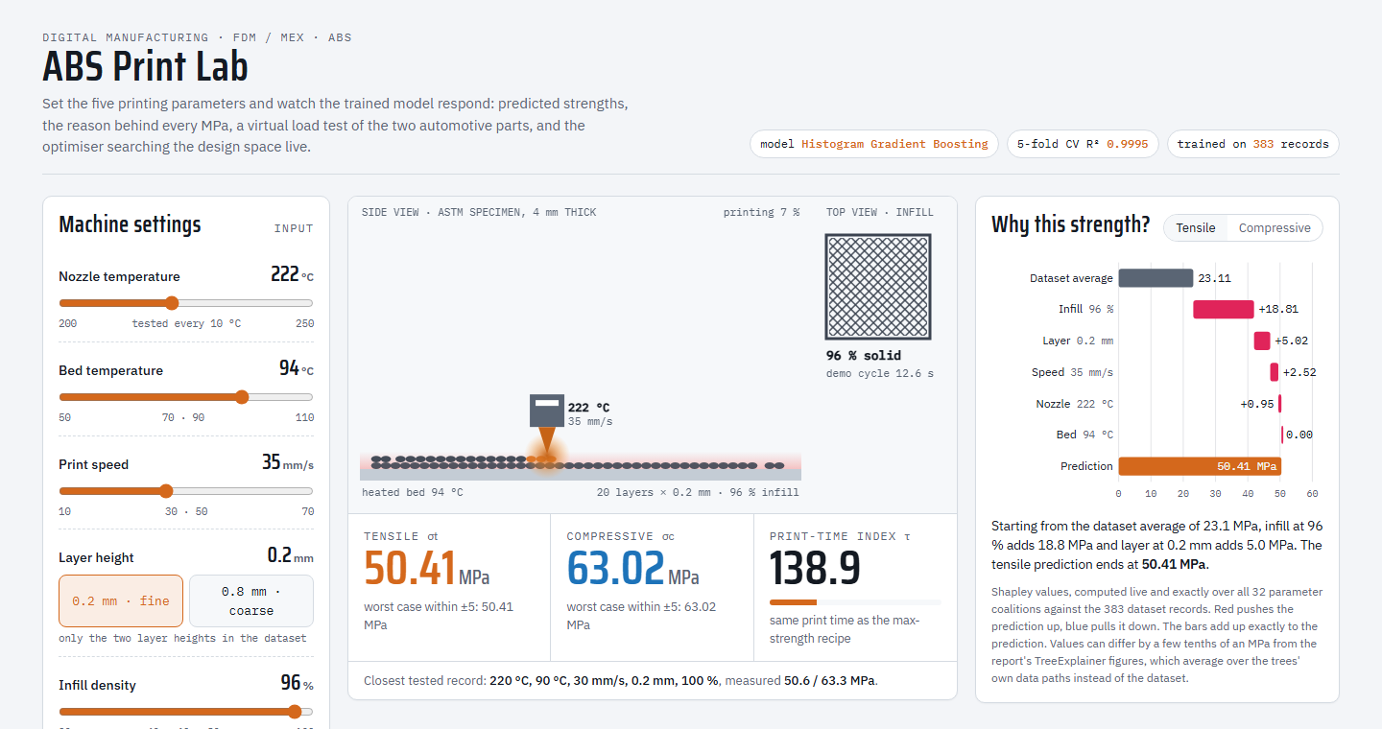
LIVE DEMO
ABS Print Lab: Interactive Simulator of Our Model
What the audience can try
• Move the 5 printing parameters; the exact trained model predicts σt and σc instantly.
• The animated printer shows layer height, infill and print time.
• "Why this strength?" shows live Shapley values in MPa (feedback #2).
• Load-test the brake pedal and the door handle with any recipe.
• Run differential evolution live and watch it converge on the Pareto map (feedback #3).
Open simulator/ABS_Print_Lab.html in any browser (works offline).
18

Slide 19
CONCLUSIONS
Conclusions & Submission Checklist
Key conclusions
1. The paper's ANNs were replicated (Adam R² ≈ 0.98, matching the reported 0.93 / 0.98).
2. Histogram Gradient Boosting is the best and most stable model: CV R² 0.9995, RMSE 0.25 / 0.31 MPa.
3. SHAP: infill ≈ 62 %, layer ≈ 23 %, speed ≈ 11 % of the effect; bed temperature has none.
4. Robust optimum: 0.2 mm, ≥ 95 % infill, ≤ 35 mm/s, giving 50.4 / 63.0 MPa.
5. Brake pedal / door handle recipes print 75 % / 88 % faster than the max-strength recipe.
Submission folder
✔ Reference paper (reference_paper/)
✔ Source code: src/ + run_project.py (+ notebook, README, requirements)
✔ Report in research-paper format (report/Project_Report.docx / .md)
✔ PowerPoint presentation (this deck) + interactive simulator (simulator/)
✔ Comparison with published work (slides 10–11, report §3.3)
☐ Plagiarism report (to be generated by the team)
☐ AI-generated content report (to be generated by the team)
19

