Slide 1
Solution for Electric Vehicle’s usage and development in India
Name: Sai Manohar Boidapu
Team: SoloWarrior
Hackathon: IncubateIND

Slide 2
Factors to keep in mind while designing solution for India
Accessibility: The electric vehicles and charge stations should be easily accessible. Distance between the two charge stations and average mileage you get on single charge.
Affordability: The vehicle cost and running cost needs to be affordable
Advantage: There has to be an advantage to customer on buying electric vehicle instead of combustion vehicle (Could be incentives, offers)
Decent Designs: Design of the vehicles should be as good as their combustion peers.

Slide 3
Stakeholders in the solution
EESL
Electric vehicle manufacturers
Government
Electric vehicle customers

Slide 4
Prerequisites for the Indian dream of EVs
Cleaner Energy generation from renewable sources
Availability of sufficient charge stations to cater the upcoming electrical vehicles on road

Slide 5
Major problem to address for charging EVs
Time taken for charge filling!!
We cannot take the same approach as petrol refilling as people cannot wait to get their batteries charge refilled as India is always in hurry!!

Slide 6
EV Manufacturing and power distribution companies
Provision of incentives to the customer on purchase, maintenance and charge refills.
To disrupt Indian market, the solutions should be designed keeping affordability and customer profitability in mind.
Make the solution cheaper. People will automatically buy when there is savings involved.

Slide 7
Solution-1: Charging of vehicles should be done when the vehicles are not in use
Hence, EESL should install EV charge stations at places where people go and park their vehicles idle for some time like below:
Tech parks where thousands of employees come to work
Movie theatres
Shopping Malls
Etc. wherever people are expected to spend some time leaving their vehicles in parking.

Slide 8
Solution-2: EESL should start with public bus transport in city
Many of the city buses run during the day and are parked idle in bus depots for hours during night. Use this time to refill the batteries with the charge station in bus depot
Direct beneficiaries:
Government transport department will be saving cost per km by running these.
Public transport users as less cost to government would lead to cheaper tariffs.

Slide 9
Solution-3: Demand and Supply Management of Charge Stations based on Peak time analysis
There can be 20% or decided minimum number of charge stations which can be mobile in city which can be routed/made available to the high demand places on peak times.
EESL would be the direct beneficiary saving the upfront location setup cost.

Slide 10
Peak time demand management system
The peak time demand management system will be a system which will be taking out the required input parameters and give us the patterns showing where there is more demand on what time.
Based on this, we can route our additional mobile charge stations to fill up the gap and their by providing hassle free customer service.

Slide 11
Required Data
EVs has to be categorized into availability zones and the following data can be monitored:
Average no of EVs each charge station servicing at a time (Service utilization capability of Charge Station)
Charge Station’s Capacity
Location of Mobile Charge Stations

Slide 12
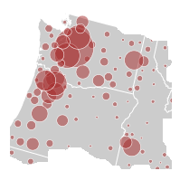

Sample real time dashboards can be graph built to check the areas of high demand
Electric vehicle commute patterns to identify the places to setup Charge stations

Slide 14
Solution-3: Efficient usage of unused power balance available at Charge stations
The Fixed Electric Charge Stations can record the average extra abundance power getting unutilized at the station and can be routed back to the Central Charge hub the availability zone to utilize the power else where.
The data of charge stations will be analyzed to come at average abundancy and routing can be triggered.
In this way, Electric charge stations in an availability zone work together in a swarm like an co-operative ecosystem.
This can be applied between the availability zones as well.

Slide 15
What else can be done (Sky is the limit!)
EESL can collaborate and contribute with Ministry of Road Transport & Highways, Government of India to build the upcoming roadways/highways facilitating charge points access.
This will open market to a large number of carrier vehicles which can boost up the growth of Electric vehicles in India.
Wireless charging is one more place to explore more..

Slide 16
If we create a shared data collaboration between EV manufacturers and EESL?

Slide 17
Usecase-2: Electric Charge Station Recommendation System
Based on the estimated discharge time of battery calculated based on the customer’s past usage patterns and driving conditions on route (such as traffic during the time of commute, driver driving style (Rash/Smooth driving) and the data of Electric charge stations nearby, their availability at that time and their occupancy, we can recommend the user the best fit Electric charge station to refill
One we know the best fit, all we need to do is to use Maps an guide the user to the location
Classification algorithm is required to classify the users based on the driving/vehicle usage patterns

Slide 18
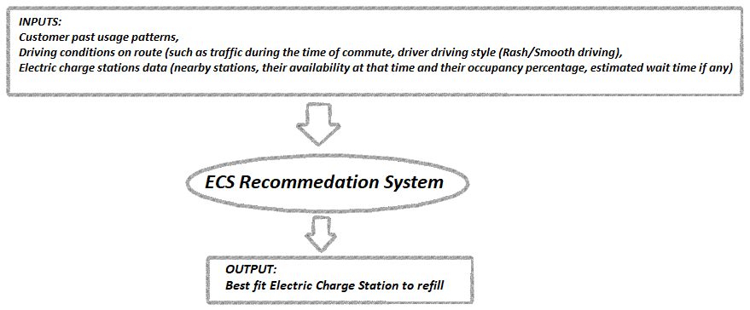

Slide 19
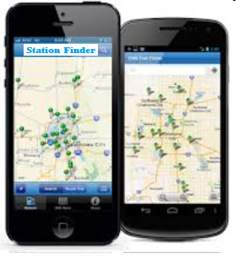

Slide 20
Usecase-1: Customer Data Predictive Data Analysis
Electric vehicles can be equipped with multiple sensors monitoring different parameters for statistics like battery charge available, battery health, location co-ordinates of the vehicle etc.
Predictive data analytics: Alerts can be made to customer based predicting the estimated fault occurrence based on specific conditions like critical battery condition.

Slide 21
Customer Centric Perspective
Vehicle needs sensors to track the statistics related to battery usage, battery health/life condition etc. and send to the server maintained by the EV manufacturer.
Alert notifications include following information for the customers:
> Battery discharge percentage.
> Estimation time to get completely discharged.
> Route to Nearby charging stations to get the filling based on the traffic and current occupancy of the charge station.
> Critical alerts on battery health status in case of fault/repair like condition.

Slide 22
Customer Centric Perspective (Continued)
Vehicle trip planner application:
With this facility, customers can plan with the vehicle by entering the destination place there by allowing the vehicle to do the following:
1) Check the battery statistics and estimate the charge required to reach the destination.
2) Check the nearest/best suited charge station using the map and guide the customer.

Slide 23
Sample data that can be extracted from Electric vehicle
Vehicle No., Vehicle Name, Vehicle Type, Vehicle Battery, Vehicle Battery Type/Model, Battery Charge Percentage, Battery Health Condition, Location Coordinates(latitude, longitude)

Slide 24
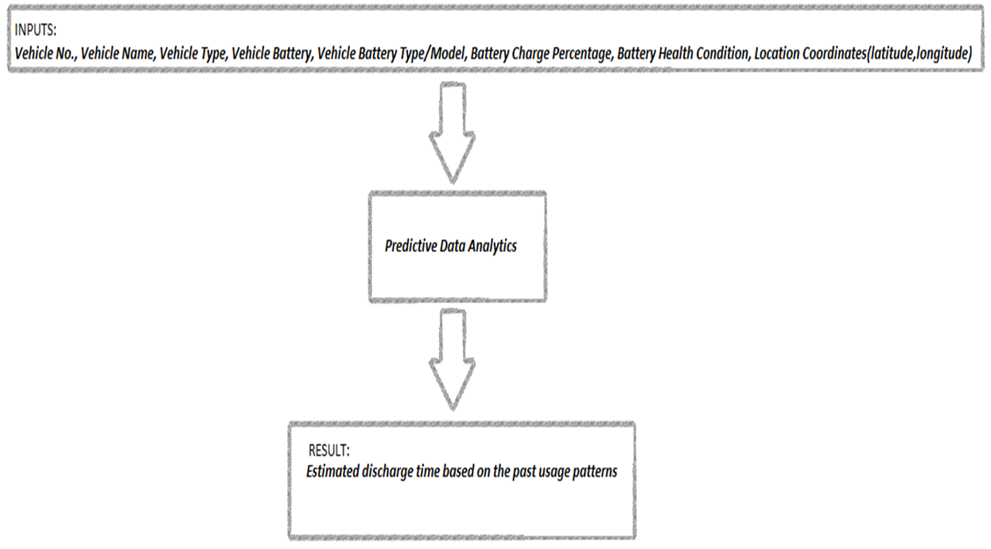

Slide 25
Thank you! ☺

