Slide 1
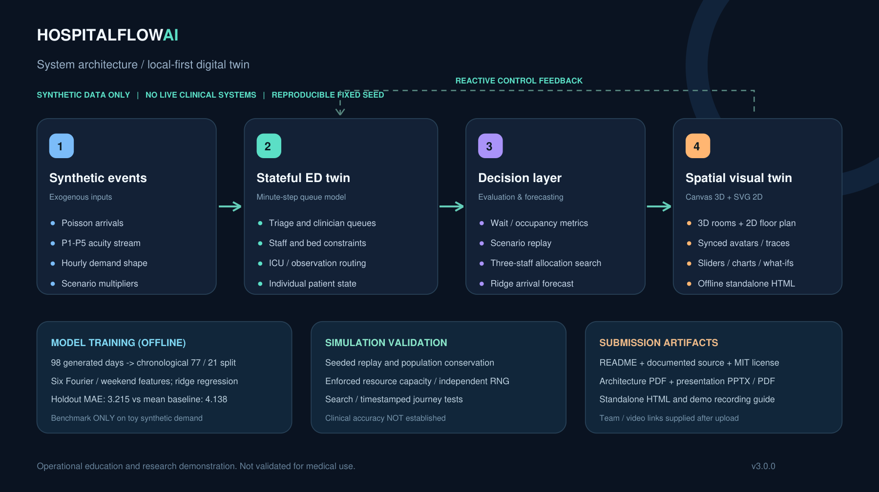
HOSPITALFLOW
AI
01 / INTRODUCTION
HEALTHCARE DIGITAL TWIN · CASE COMPETITION
What if we could
rehearse the surge?
HospitalFlow AI
An interactive Emergency Department twin for exploring patient flow, bottlenecks, and staffing decisions.
Team : sai.manoj.260101103 (SynapseX)
Etcherla Sai Manoj
Parameswara Meena Peddakotla
Madhavaneni Vivek Rao
Valivarthi Bhargava Varma
SYNTHETIC PROOF OF CONCEPT · NOT FOR CLINICAL USE
01

Slide 2
HOSPITALFLOW
AI
02 / PROBLEM STATEMENT
THE PROBLEM
Bottlenecks emerge before dashboards explain them.
ED demand, triage capacity, clinicians and downstream beds interact as one system.
01. Demand is stochastic
02. Queues are coupled
03. Policies need testing
Arrival surges compound waiting times as limited resources compete for attention.
A bottleneck at one step can influence triage, treatment and critical-care queues.
A static census cannot show how a different staffing allocation might change future states.
OUR QUESTION: Can a virtual ED rehearse disruptions and evaluate resource choices transparently?
SYNTHETIC PROOF OF CONCEPT · NOT FOR CLINICAL USE
02

Slide 3
HOSPITALFLOW
AI
03 / SOLUTION
THE SOLUTION
From live state to counterfactual decisions.
A digital twin connects incoming events, a stateful model, metrics and intervention tests.
01
02
03
04
SYNTHETIC EVENTS
VIRTUAL ED STATE
SCENARIO ENGINE
HUMAN-IN-THE-LOOP UI
→
→
→
Seeded Poisson arrivals and patient acuity.
Priority queues, service capacities and patient pathways.
Replays, constrained allocation search and forecasting.
3D / 2D rooms, patient inspector and scenario controls.
FEEDBACK LOOP: USER CHANGES INPUTS → TWIN UPDATES → NEW SCENARIOS
SYNTHETIC PROOF OF CONCEPT · NOT FOR CLINICAL USE
03

Slide 4
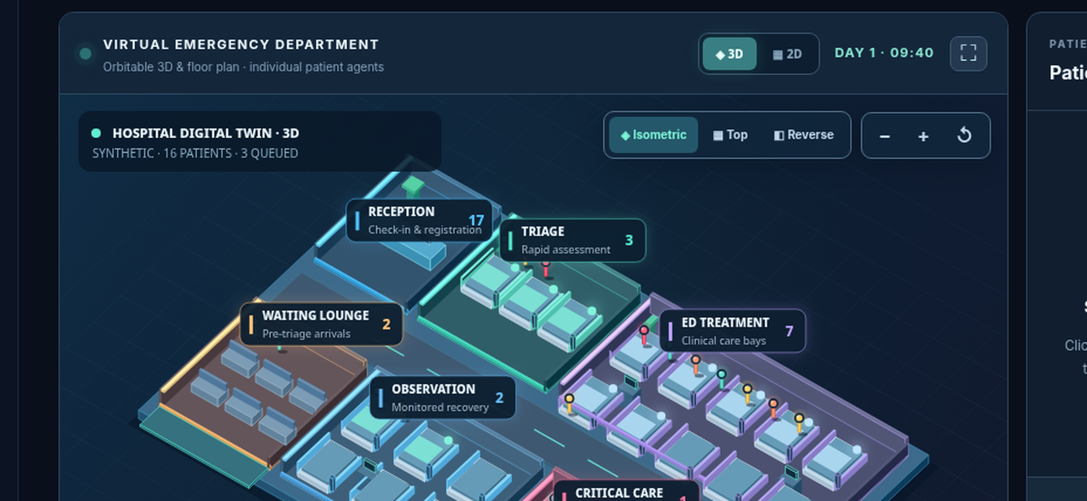
HOSPITALFLOW
AI
04 / WORKING PROTOTYPE
LIVE PRODUCT
Explore a hospital in 3D — and follow every patient.
Orbit, zoom, click a patient or switch to 2D. Both views reflect the same simulation state.
3D hospital
Orbitable rooms + live beds
2D / 3D toggle
Same patients + journey trace
What-if controls
Staff, beds, arrivals, surge
SYNTHETIC PROOF OF CONCEPT · NOT FOR CLINICAL USE
04

Slide 5
HOSPITALFLOW
AI
05 / VIRTUAL SYSTEM
MODEL MECHANICS
A patient-level model with constrained resources.
Each synthetic patient carries an acuity, arrival timestamp, stage and remaining service time.
ARRIVAL
TRIAGE
TREATMENT
OBSERVATION
EXIT
→
→
→
→
↳ ICU
Priority: P1 first
Constraints: nurses, physicians, treatment beds, ICU beds
SYNTHETIC PROOF OF CONCEPT · NOT FOR CLINICAL USE
05

Slide 6
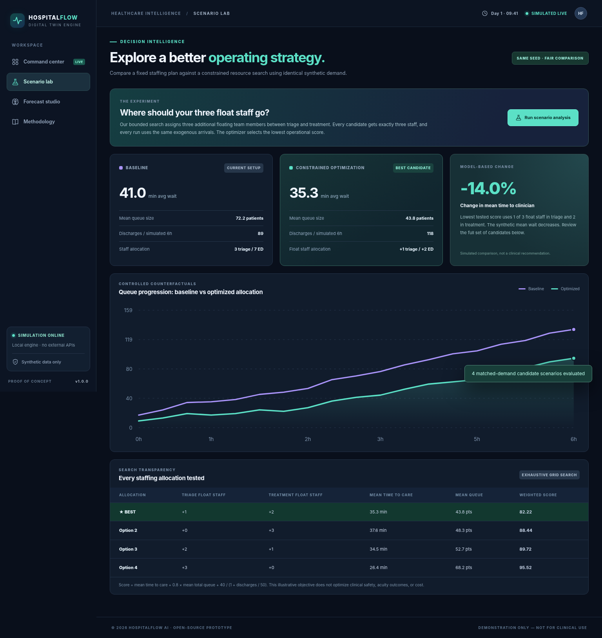
HOSPITALFLOW
AI
06 / SCENARIO LAB
INTERACTIVE EXPERIMENTS
Run the same surge under different staff allocations.
All four candidate configurations are constrained to three additional float staff.
EXPERIMENT
3
floating staff
4
staff allocations
SYNTHETIC PROOF OF CONCEPT · NOT FOR CLINICAL USE
06

Slide 7
HOSPITALFLOW
AI
07 / SIMULATED FINDINGS
SIMULATION RESULTS
Adding flexible capacity changes modeled congestion.
Illustrative deterministic six-hour evaluation · 90-minute warmup · fixed seed 34071.
STANDARD ARRIVAL RATE
SURGE ARRIVAL RATE
17 base arrivals / hour
×1.8 demand multiplier
BASELINE
WITH 3 FLOAT STAFF
BASELINE
WITH 3 FLOAT STAFF
14.36 min
8.22 min
32.26 min
30.07 min
MEAN QUEUE: 2.00 → 0.05 patients
MEAN QUEUE: 70.11 → 42.70 patients
These are SIMULATED comparisons, not real hospital performance gains or validated clinical policies.
SYNTHETIC PROOF OF CONCEPT · NOT FOR CLINICAL USE
07

Slide 8
HOSPITALFLOW
AI
08 / DECISION LOGIC
EXPLAINABLE OPTIMIZATION
No black-box recommendations.
Exhaustively test all valid splits of the same three floating staff.
PLAN 01
PLAN 02
LOWEST TESTED SCORE
0 nurses + 3 physicians
1 nurse + 2 physicians
PLAN 03
PLAN 04
2 nurses + 1 physician
3 nurses + 0 physicians
COMPOSITE OBJECTIVE
mean wait + 0.8 × mean queue + 40 / (1 + discharges / 50)
SYNTHETIC PROOF OF CONCEPT · NOT FOR CLINICAL USE
08

Slide 9
HOSPITALFLOW
AI
09 / MACHINE LEARNING
FORECASTING COMPONENT
A real trained model. A transparent synthetic benchmark.
Ridge regression on Fourier seasonality features; no hospital dataset or protected patient information.
TRAINING SET
CHRONOLOGICAL HOLDOUT MAE
1,848
Constant-mean baseline
4.138
77 synthetic days
Harmonic ridge model
3.215
HOLDOUT: 504 OBSERVATIONS
All metrics are synthetic observations per hour; cannot generalize to real facilities.
FEATURES: HOUR-OF-DAY FOURIER TERMS + WEEKEND FLAG
SYNTHETIC PROOF OF CONCEPT · NOT FOR CLINICAL USE
09

Slide 10
HOSPITALFLOW
AI
10 / ENGINEERING ARCHITECTURE
ENGINEERING ARCHITECTURE
A local-first architecture with no deployment dependencies.
SYNTHETIC PROOF OF CONCEPT · NOT FOR CLINICAL USE
10

Slide 11
HOSPITALFLOW
AI
11 / LIMITATIONS & VALIDATION
CREDIBILITY BEFORE HYPE
What we tested — and what remains unproven.
Our architecture is reproducible; operational and clinical validity require future real-world study.
VERIFIED INSIDE THE PROTOTYPE
NOT CLAIMED
10 automated tests: reproducibility, conservation of patient state, resource caps, matched arrivals and acuity, surge sensitivity, optimizer completeness, edge cases.
No real patient data; no clinical validation; no safe staffing prescription; no live hospital integration; no demonstrated real-world improvement.
NEXT: event-log calibration → prospective validation → clinical governance → operational integration
SYNTHETIC PROOF OF CONCEPT · NOT FOR CLINICAL USE
11

Slide 12
HOSPITALFLOW
AI
12 / CONCLUSION
PROOF OF CONCEPT
Rehearse the Surge. Improve the Response.
2D / 3D hospital twin • seeded simulation • trained forecast • scenario optimization • tests • documentation
QUICK START
Launch Application
TEAM SynapseX • MEMBERS [Etcherla Sai Manoj , Parameswara Meena Peddakotla , Madhavaneni Vivek Rao , Valivarthi Bhargava Varma]
SOURCE: [https://github.com/saimanoj22/hospitalflow-ai] DEMO VIDEO: [https://youtu.be/gJRL3qPQtG0]
SYNTHETIC PROOF OF CONCEPT · NOT FOR CLINICAL USE
12

