Slide 1
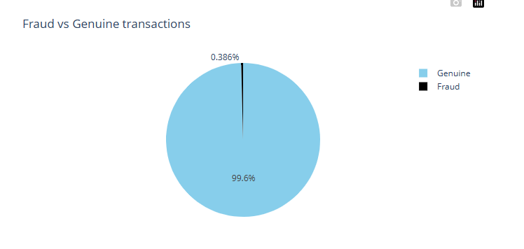
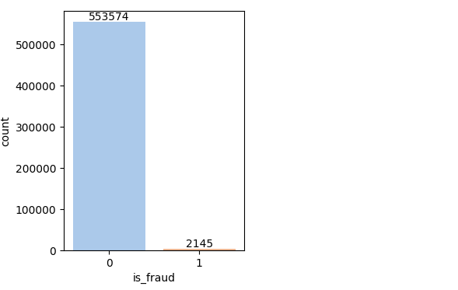
Credit Risk Fraud Detection

Slide 2
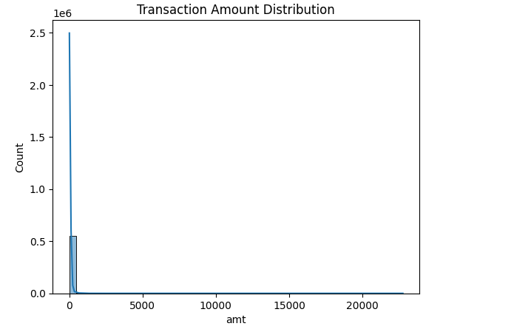
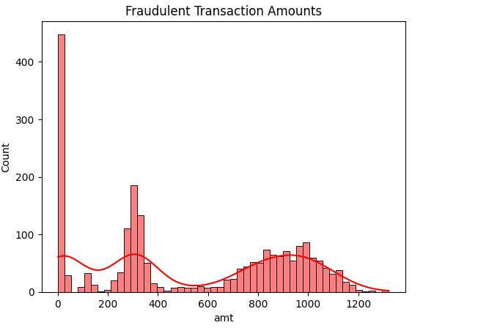
Credit Risk Fraud Detection

Slide 3
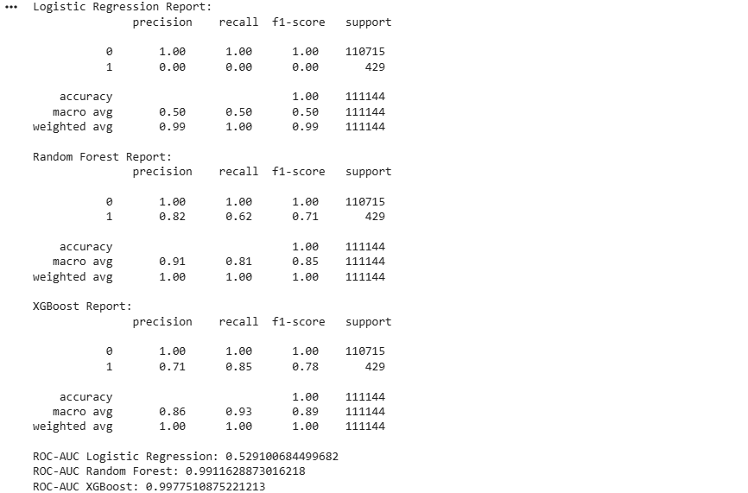
Credit Risk Fraud Detection

Slide 4
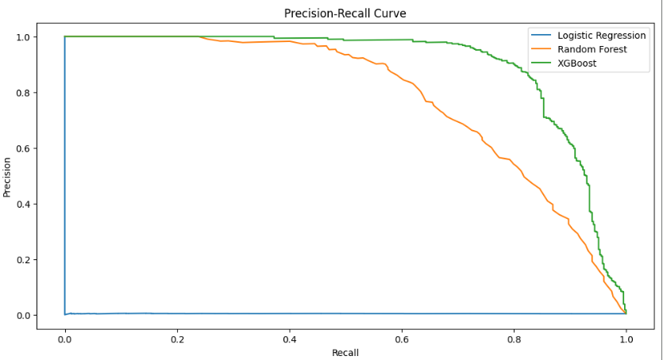
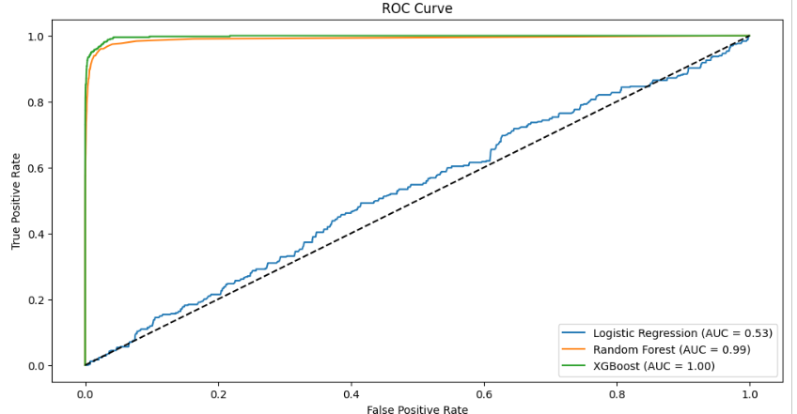
Credit Risk Fraud Detection
Cost per month before deployment: 1133324.68
Cost per month after deployment: 169177.2956643357
Final monthly savings: 964147.3843356642
Best model based on ROC-AUC: XGBoost

