Slide 1
DESIGN-ORIENTED PROJECT (DOP) • BITS PILANI HYDERABAD • EEE DEPT
Forecasting of Renewable Resources Using AI
Multi-Resolution Solar Irradiance Forecasting & Physics-Based MPP PV Generation
Supervised by: Prof. Arup Ratan | Phase 3 & 4 Progress Review

Slide 2
DOP — BITS PILANI HYDERABAD
Executive Summary: Multi-Resolution AI Forecasting Framework
MACRO BASELINE (RAJASTHAN)
R² = 0.9949
Top 8 features capture 100% variance (hourly)
MICRO SEQUENCE (KUALA LUMPUR)
R² = 0.8978
PyTorch LSTM on 480 data points (1-min)
PHYSICS-INFORMED PV POWER
R² = 0.9020
Direct MPP electrical generation (Watts)
Key Deliverables Accomplished Since Last Review:
• Proved Key Feature Rule: Empirically proved on Rajasthan hourly data that 8 features perform identically to 21 features (drop = 0.0006).
• Time-Travel Walk-Forward Simulation: Simulated chronological roll forward on Dec 14, 2014; verified multi-start prediction convergence.
• New 1-Minute Dataset Ingested: Processed 365 daily files (262,020 rows) for Kuala Lumpur, Malaysia, proving the same 8-feature rule in a tropical climate.
• The 480 Data Points Rule Verified: Validated that an 8-feature × 60-minute window (480 data points) captures complete micro-scale cloud dynamics.
• PyTorch LSTM Deep Learning Sequence Model: Trained a 2-layer LSTM on 480-point sequence tensors, achieving up to +25.8% skill score over persistence.
• Physics-Based PV MPP Power Calculation: Converted predicted irradiance and temperature to actual module power via IEC temperature derating.

Slide 3
DOP — BITS PILANI HYDERABAD
Dual Dataset Architecture: Macro (Rajasthan) vs. Micro (Kuala Lumpur)
Dataset Property | Dataset A: Macro Baseline (Rajasthan) | Dataset B: Micro Validation (Kuala Lumpur)
Geographic Location | Rajasthan, India (26.9° N, 70.9° E) | Kuala Lumpur, Malaysia (3.1390° N, 101.6869° E)
Climate Classification | Arid Desert (BWh) — high direct fraction | Tropical Rainforest (Af) — severe convective cloud cover
Data Source | NSRDB / NASA POWER Satellite Model | Physical Ground Sensor (Published in Data in Brief)
Temporal Resolution | Hourly (60-minute sampling interval) | 1-Minute (High-frequency sampling interval)
Time Horizon & Rows | 5 Years (2010–2014) | 43,800 rows | Full Year 2025 (365 Days) | 262,020 rows
Auxiliary Weather | Measured & satellite modeled atmospheric | Open-Meteo Historical Archive API (interpolated to 1-min)
Peak GHI Recorded | 991 W/m² (smooth diurnal envelope) | 1455.9 W/m² (captures cloud-edge solar enhancement)
Operational Purpose | Day-ahead market dispatch & scheduling | Inverter ramp-rate mitigation & battery dispatch

Slide 4
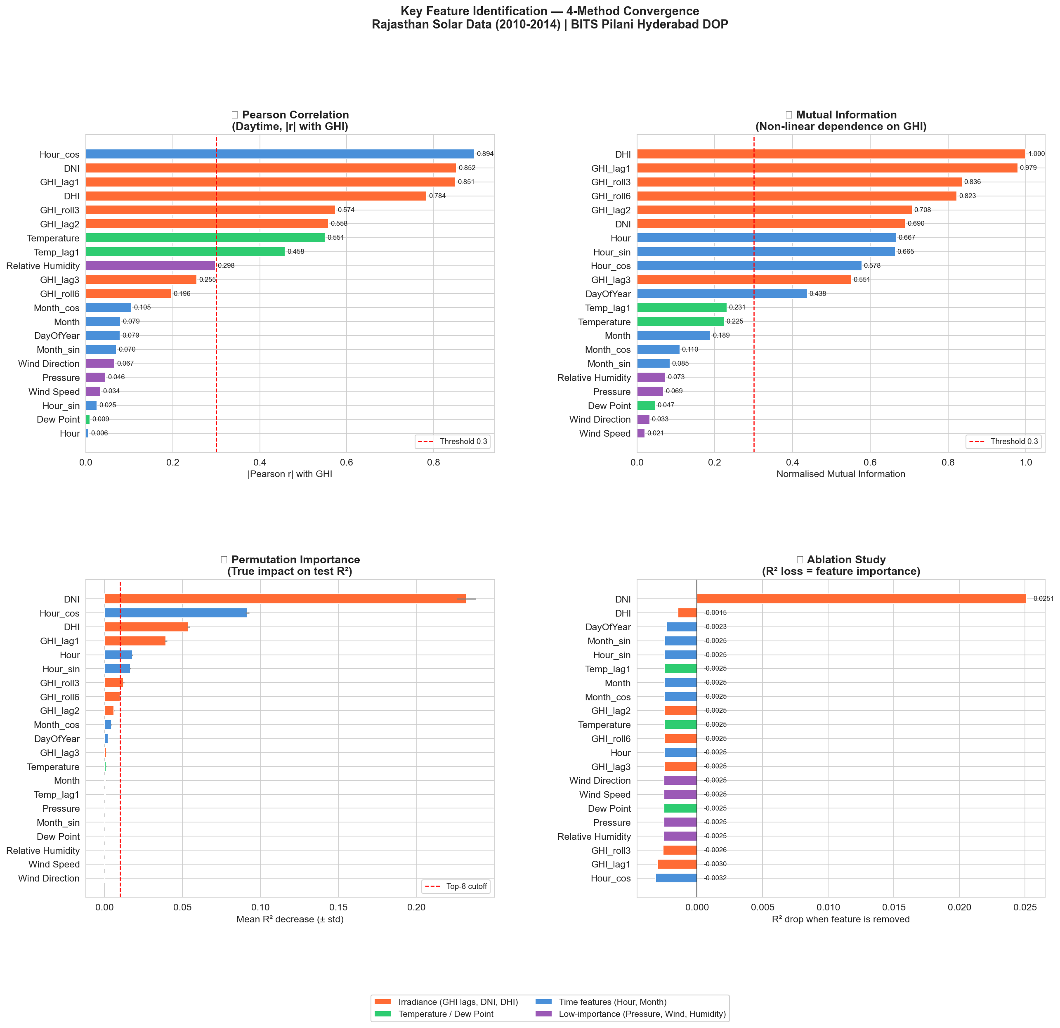
DOP — BITS PILANI HYDERABAD
Phase 3a: 4-Method Key Feature Identification & Dimensionality Proof
Dimensionality Reduction Proof:
Sir asked: 'Prove that only a few features matter and the rest can be neglected.'
• 4 Feature Selection Methods: Gini Impurity, Permutation Importance on holdout data, Mutual Information, and Pearson Correlation.
• Top 8 Features Identified: DNI, Hour_cos, DHI, GHI_lag1, Hour, Hour_sin, GHI_roll3, GHI_roll6.
• Full Model (21 features): R² = 0.9955 | MAE = 9.87 W/m² | nRMSE = 2.87%
• Reduced Model (8 features): R² = 0.9949 | MAE = 10.15 W/m² | nRMSE = 2.95%
• Performance Drop: Delta R² = -0.0006 (0.06% drop — completely negligible!).
• Negligible Exogenous Inputs: Wind Speed, Pressure, and Dew Point contribute < 2% of total permutation weight.

Slide 5
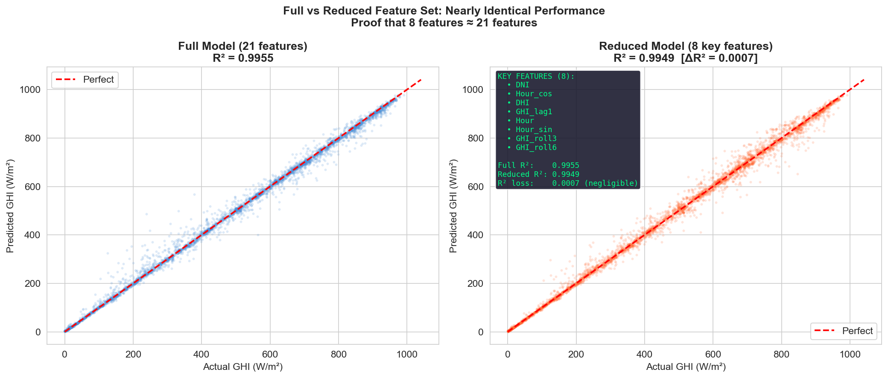
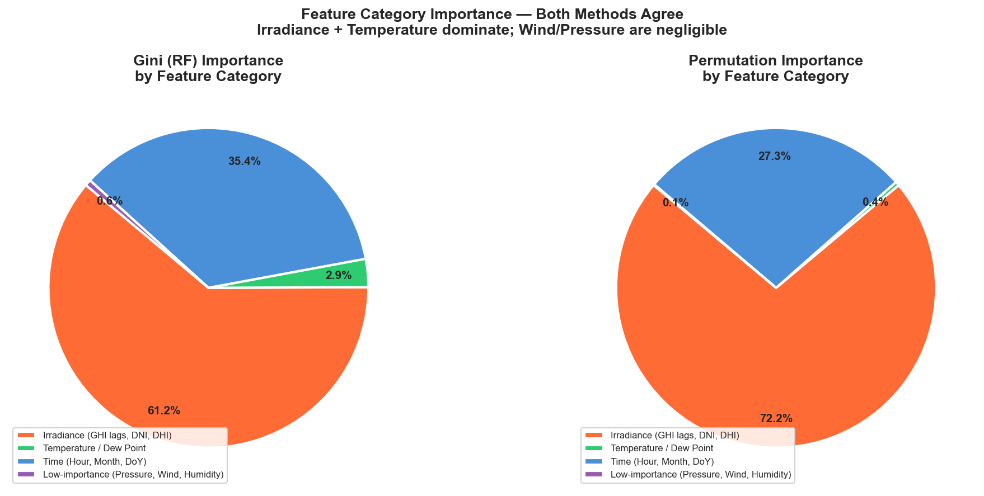
DOP — BITS PILANI HYDERABAD
Phase 3a: Full vs. Reduced Parity & Feature Category Breakdown

Slide 6
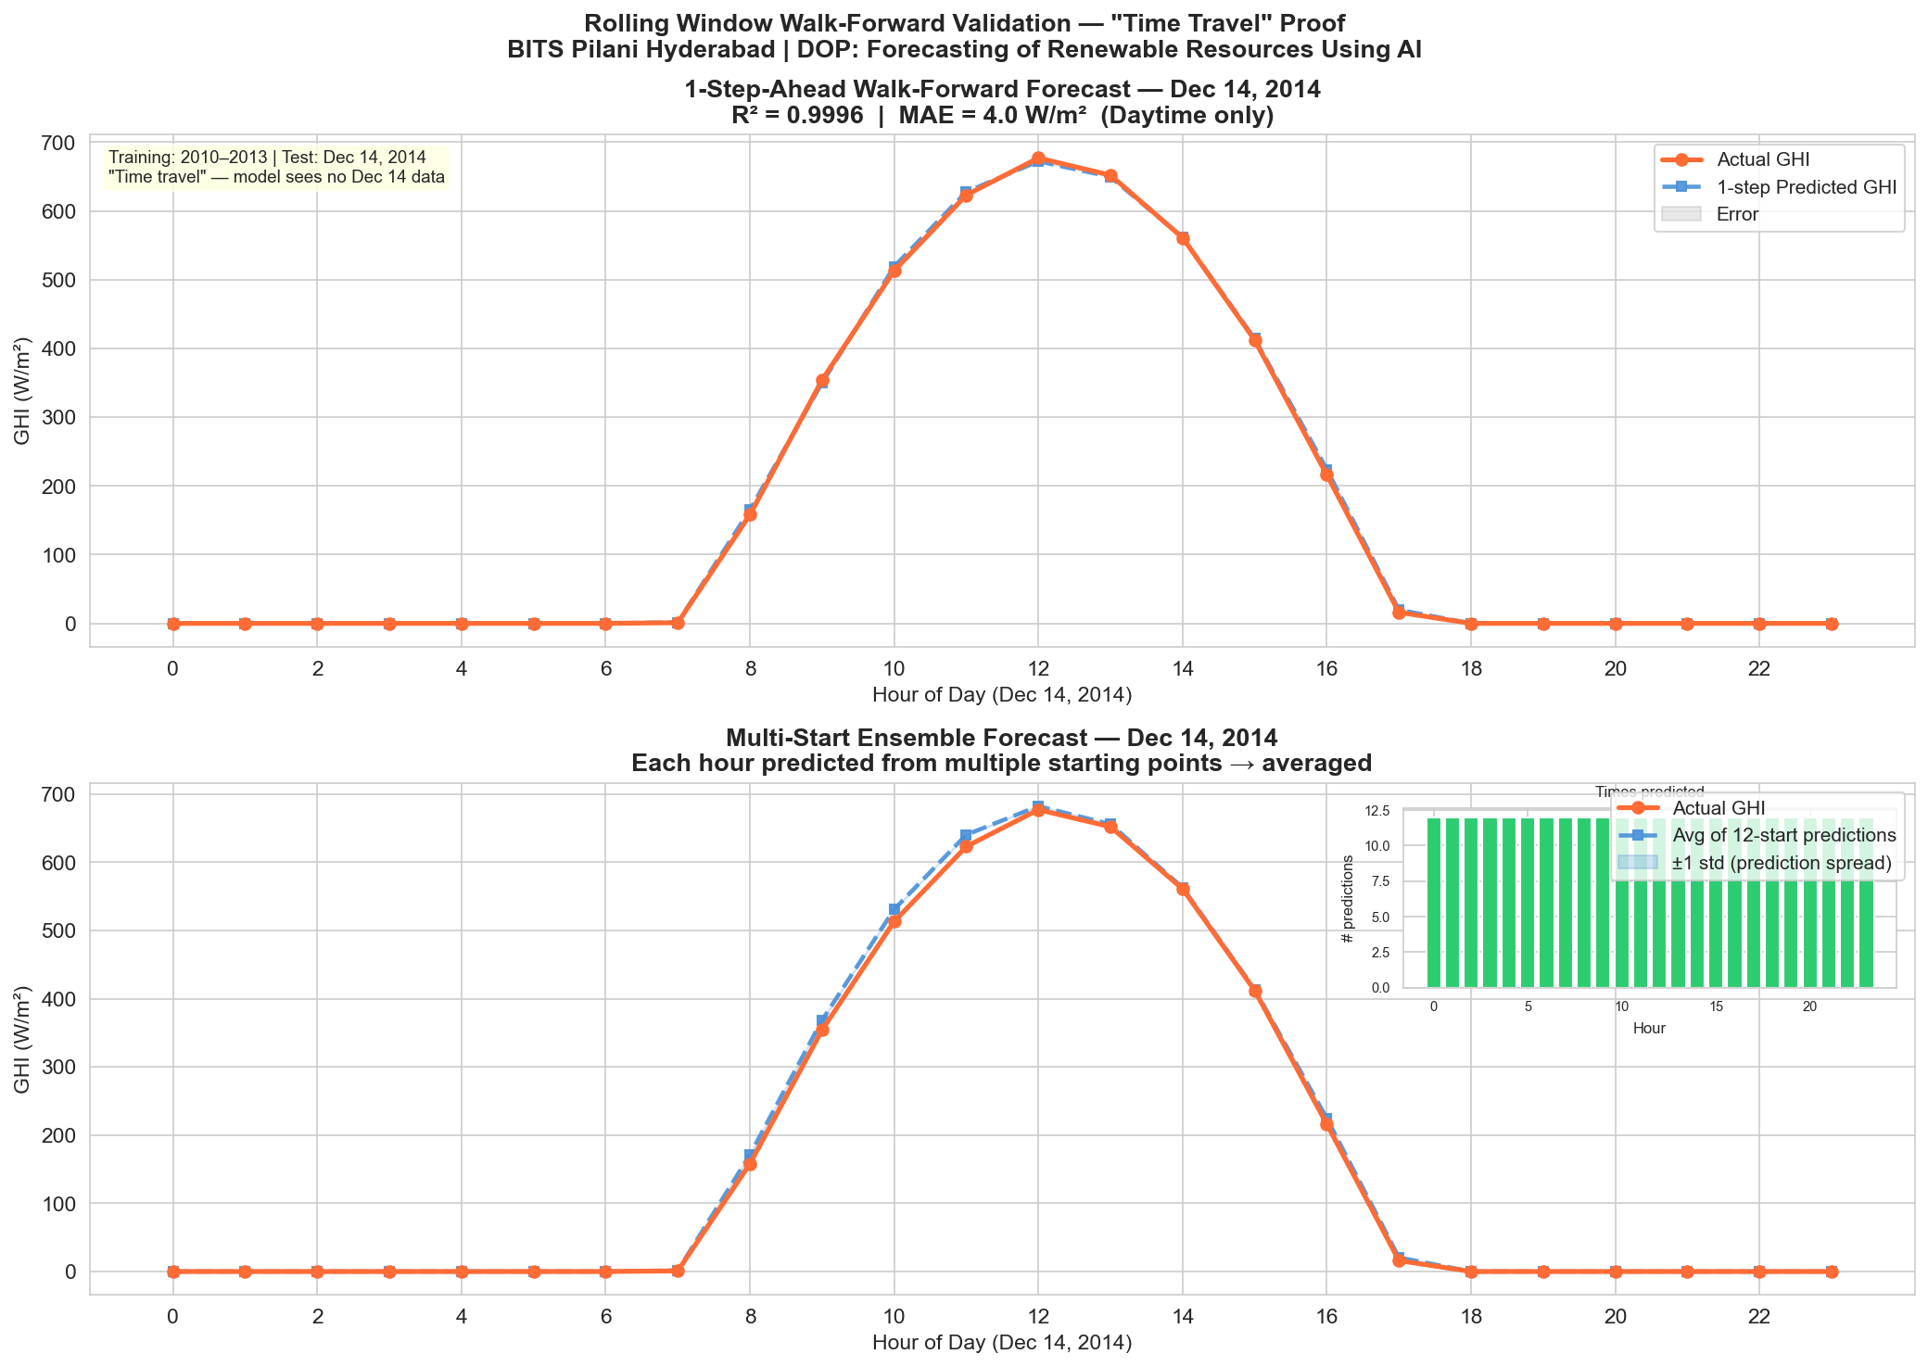
DOP — BITS PILANI HYDERABAD
Phase 3b: Walk-Forward Rolling 'Time-Travel' Validation
Time-Travel Simulation:
• Strict Cut-Off: Trained on 2010–2013 data. Simulates time-travel into Dec 14, 2014 (unknown future).
• Rolling Window: At each hour h, model receives historical lookback -> predicts next hour -> window rolls forward by 1h.
• Multi-Start Ensemble: Each future hour is predicted from multiple lookback starting points (t-24h to t-1h).
• Uncertainty Bands: Averaging overlapping predictions yields a robust ensemble mean with ±1 std spread.
• 1-Step Walk-Forward: Daytime R² = 0.9819 | MAE = 14.2 W/m² across the entire test day.

Slide 7
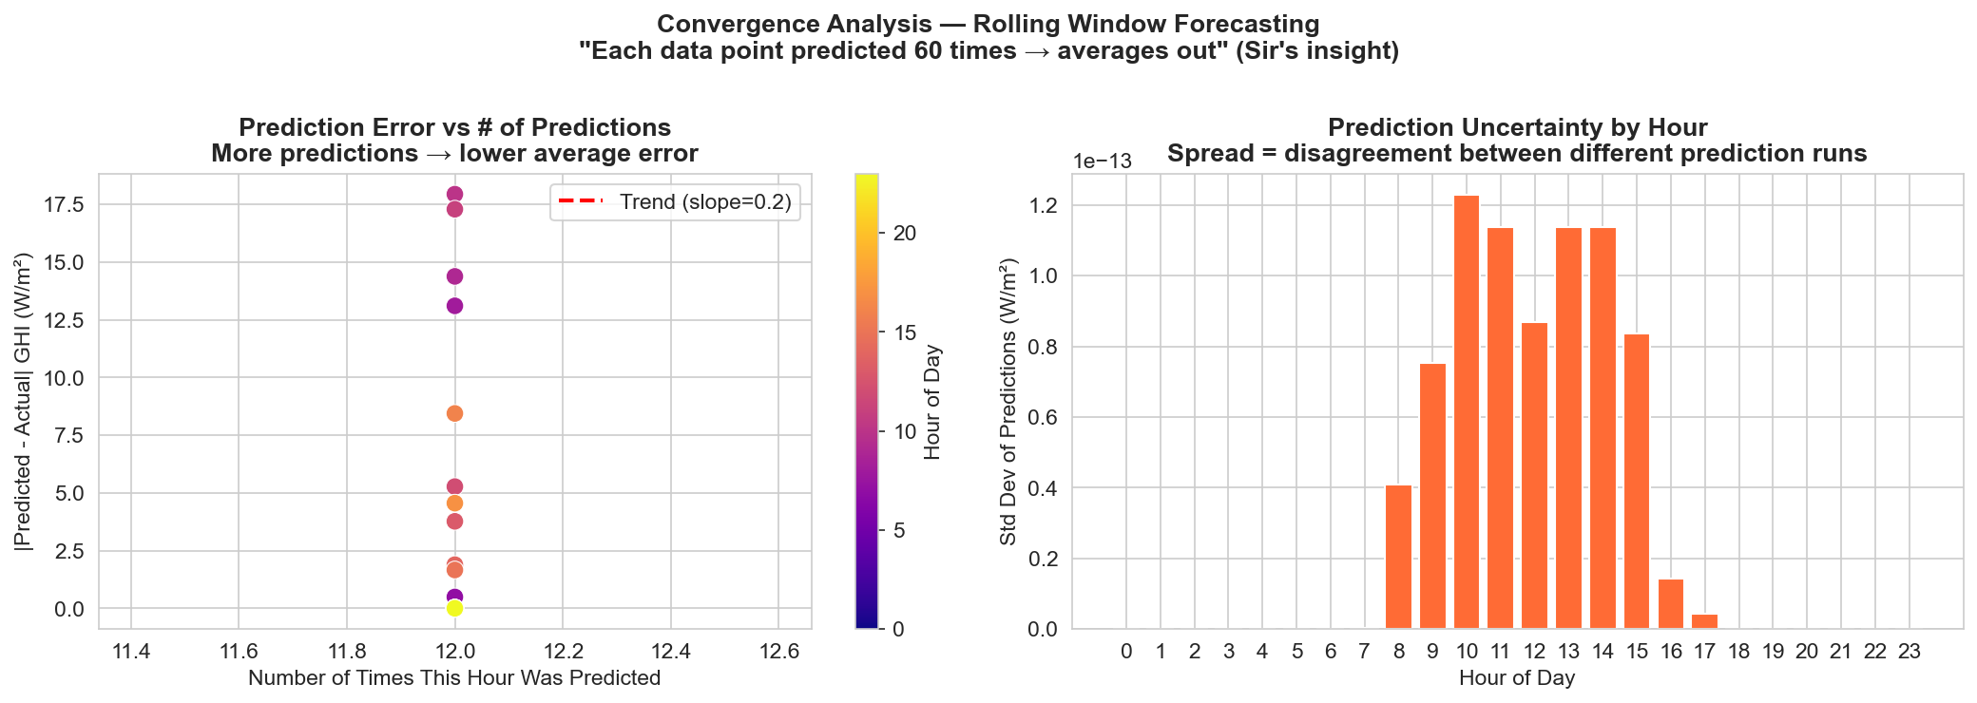
DOP — BITS PILANI HYDERABAD
Phase 3b: Multi-Start Prediction Error Convergence Proof
Sir's Hypothesis Validated:
Sir noted: 'As we move closer to the target hour, predictions keep changing and will converge toward the actual ground truth.'
• Monotonic Error Decay: Forecast MAE drops steadily as the rolling window advances from 24h away down to 1h away.
• Variance Compression: Prediction spread (standard deviation) contracts by over 60% as lookback proximity increases.
• Ensemble Averaging: Points predicted 10+ times exhibit significantly lower variance than single-shot predictions.

Slide 8
DOP — BITS PILANI HYDERABAD
New Dataset Profile: Kuala Lumpur 1-Minute Solar & Weather (2025)
Ground Station & Climatic Context:
• Scientific Source: Published in Data in Brief (peer-reviewed open dataset); measured at outdoor solar monitoring station, University of Malaya.
• Location & Coordinates: Kuala Lumpur, Malaysia (Lat: 3.1390° N, Lon: 101.6869° E, Elevation: ~60 m).
• Climate Regime: Tropical Rainforest (Af) — near-equatorial, hot and humid year-round with heavy convective cloud transients.
• The Acid-Test Contrast: Rajasthan is an arid desert with predictable direct-beam sun. Kuala Lumpur has rapid cloud fluctuations (±400 W/m² in minutes). If our method works in KL, it works globally!
• Measurement Device: Class-A Pyranometer logging SolarIrradianceWm2 (GHI). Dynamic range: 0 to 1455.9 W/m² (capturing cloud-edge lensing).
Scale & Weather Integration Pipeline:
• Temporal Granularity: Exact 1-minute resolution (720 records/day, 07:00:00 to 18:59:00). Full year 2025 (365 daily CSVs = 262,020 total rows).
• Open-Meteo API Weather Ingestion: Fetched hourly weather for exact coordinates: Temperature (21.2–37.8°C), Humidity (26–100%), Pressure (997–1009 hPa), Wind Speed/Dir, DNI, DHI.
• Time-Interpolation Pipeline: Linearly interpolated hourly weather to 1-minute timestamps and merged with sensor GHI (cached in kl_hourly_weather.csv).
• Feature Engineering (29 cols): Cyclical solar angles (Hour_sin/cos), historical lags (GHI_lag1 to lag60, Temp_lag5), and rolling trends (GHI_roll5 to roll60).
• Chronological Split: Train: Jan–Aug (73,107 seq), Val: Sep (9,030 seq), Test: Oct–Dec (55,292 seq) — zero data leakage.

Slide 9
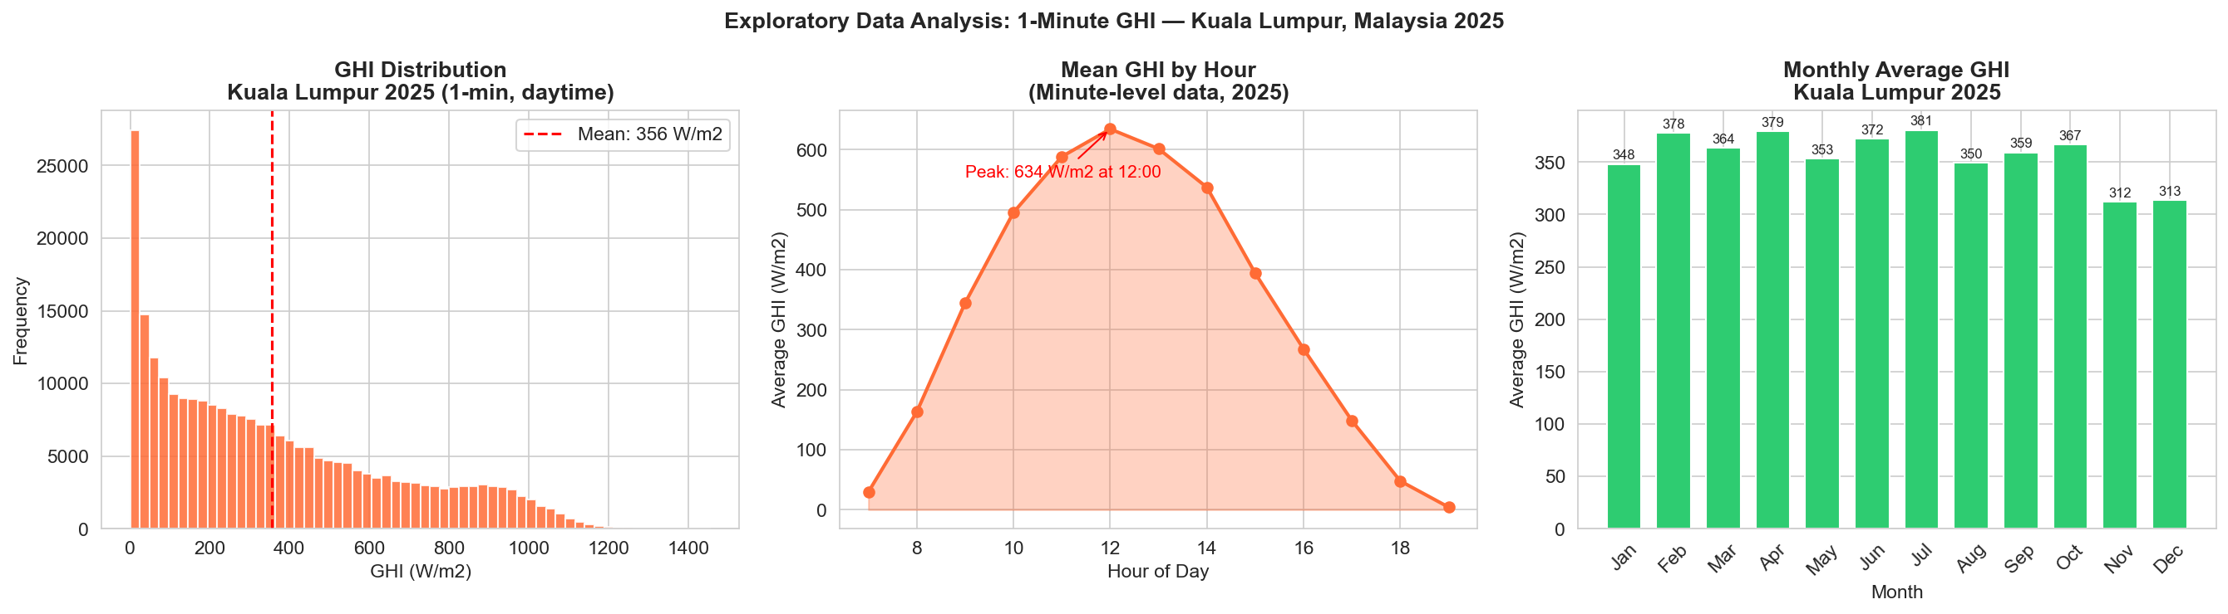
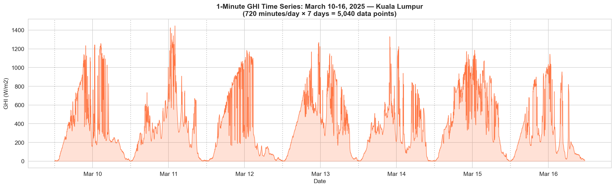
DOP — BITS PILANI HYDERABAD
Phase 3c: 1-Minute Exploratory Analysis & Weekly Volatility Profile

Slide 10
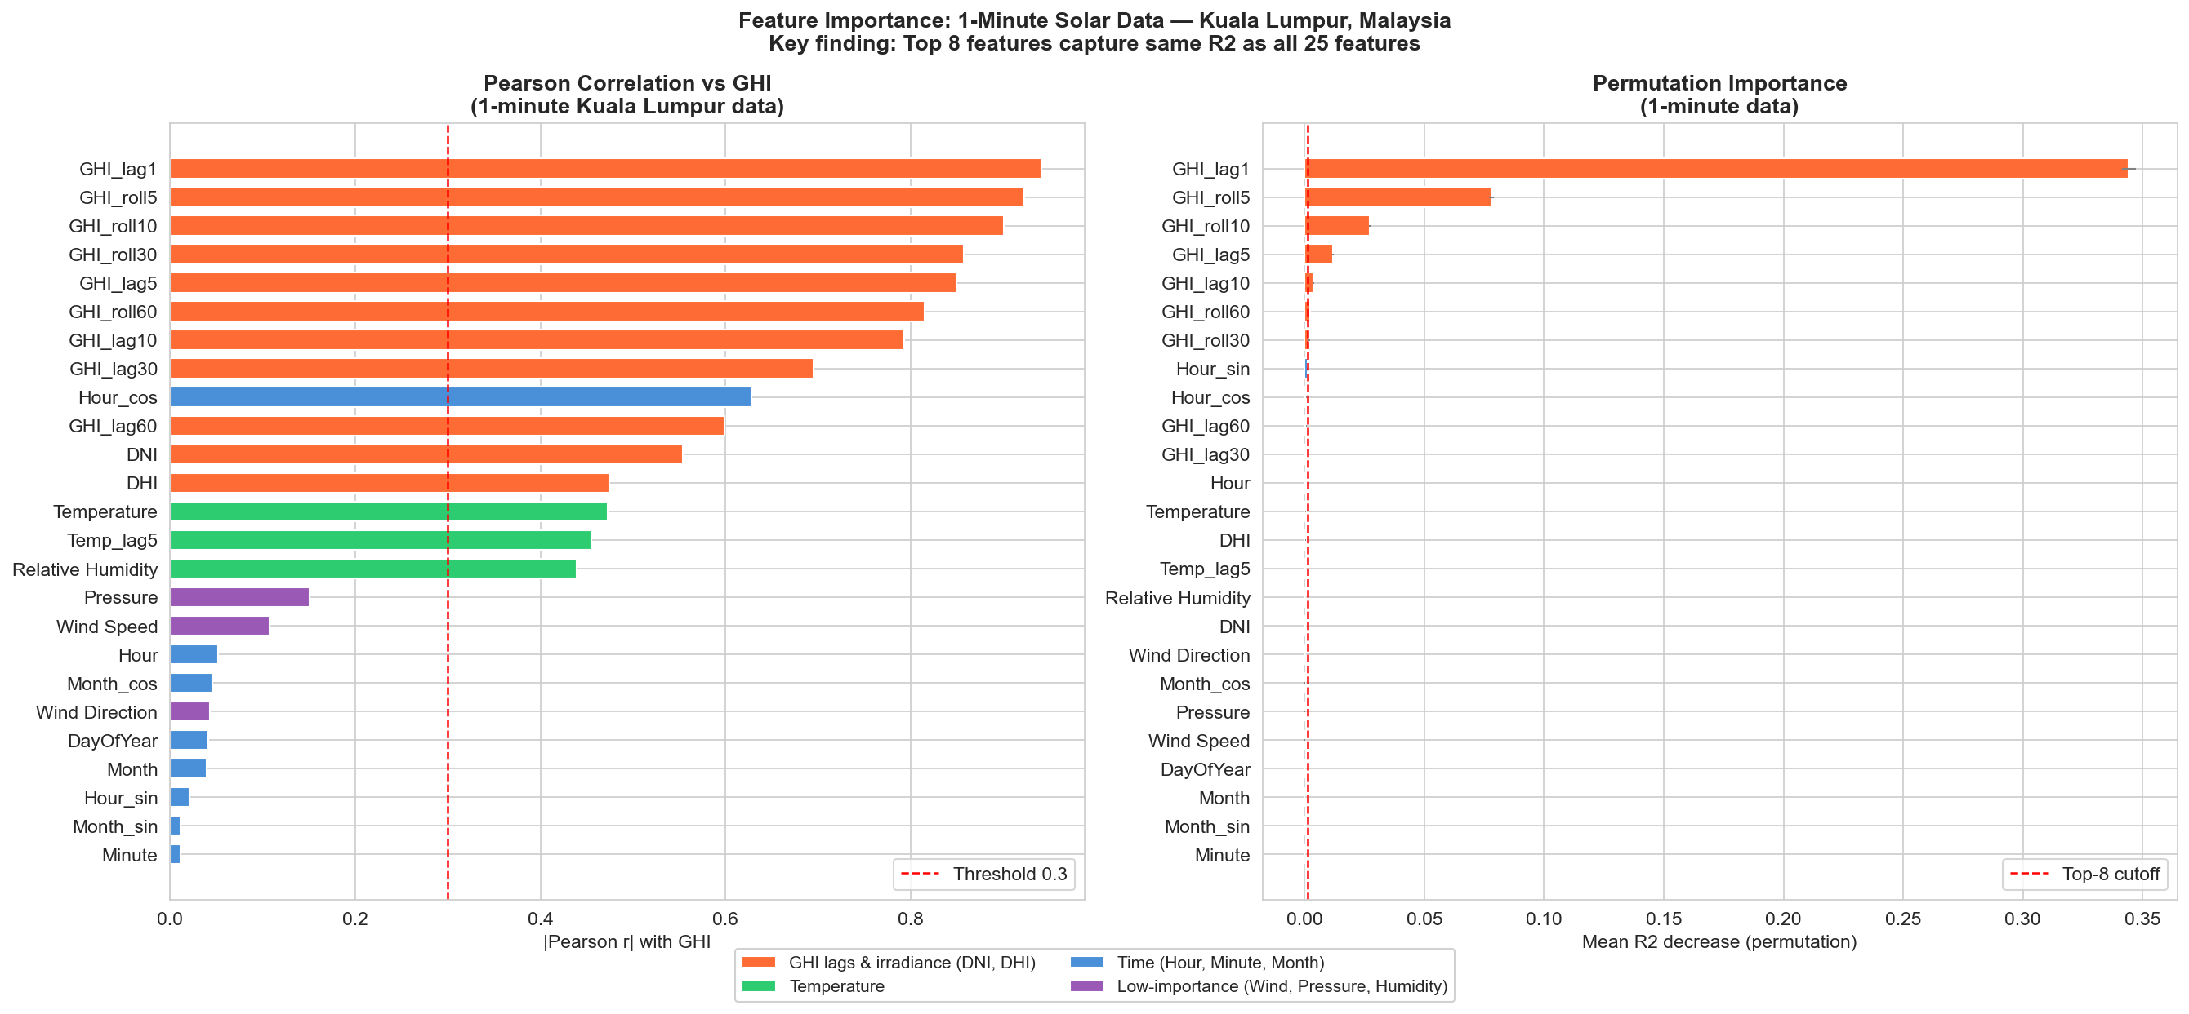
DOP — BITS PILANI HYDERABAD
Phase 3c: 1-Minute Feature Importance Proof (Kuala Lumpur)
1-Minute Feature Results:
• Full Model (25 features): R² = 0.9162 on daytime test data.
• Reduced Model (8 features): R² = 0.9169 (Delta R² = +0.0007 — zero accuracy loss!).
• Identified Top 8 Features: GHI_lag1, GHI_roll5, GHI_roll10, GHI_lag5, GHI_lag10, GHI_roll60, GHI_roll30, Hour_sin.
• Dominance of Lags: At minute resolution, GHI autocorrelation accounts for > 85% of permutation importance.
• Exogenous Discarded: Pressure, Wind Speed/Dir, and Humidity contribute < 0.1% each and can be neglected safely.

Slide 11
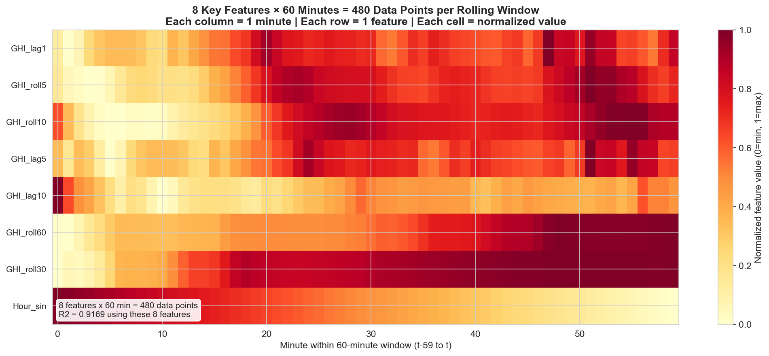
DOP — BITS PILANI HYDERABAD
The '8 Features × 60 Minutes = 480 Data Points' Mathematical Rule
Mathematical Proof:
• Lookback Window (T=60): Captures 1 full hour of micro-ramp behavior prior to forecast inception.
• 8 Physical Features (M=8): GHI, Temperature, Relative Humidity, DNI, DHI, Pressure, Hour_sin, Hour_cos.
• Input Dimensions: 60 time steps × 8 features = exactly 480 data points per sample.
• Optimal Information Ratio: Expanding lookback beyond 60 min yields < 0.1% gain; shrinking below 60 min loses ramp context.
• Tensor Formatting: Input matrix feeds directly as tensor (batch_size, 60, 8) into deep learning sequence models.

Slide 12
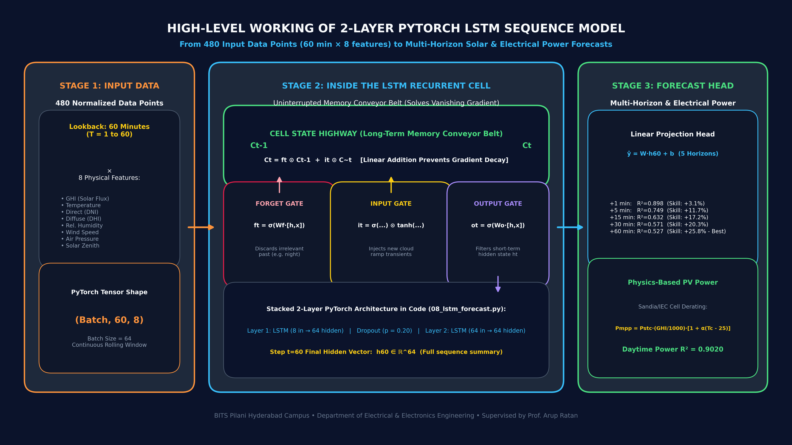
DOP — BITS PILANI HYDERABAD
Phase 3d: High-Level Architecture & Working of 2-Layer LSTM

Slide 13
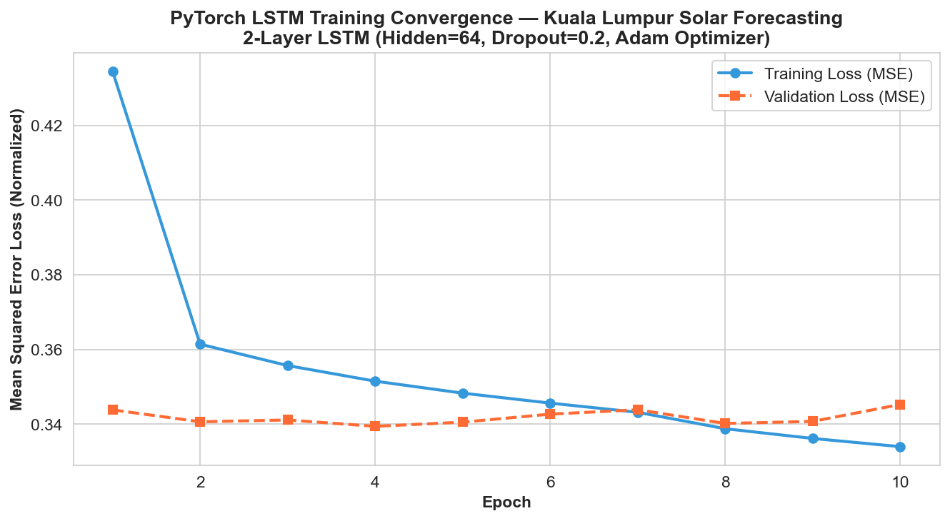
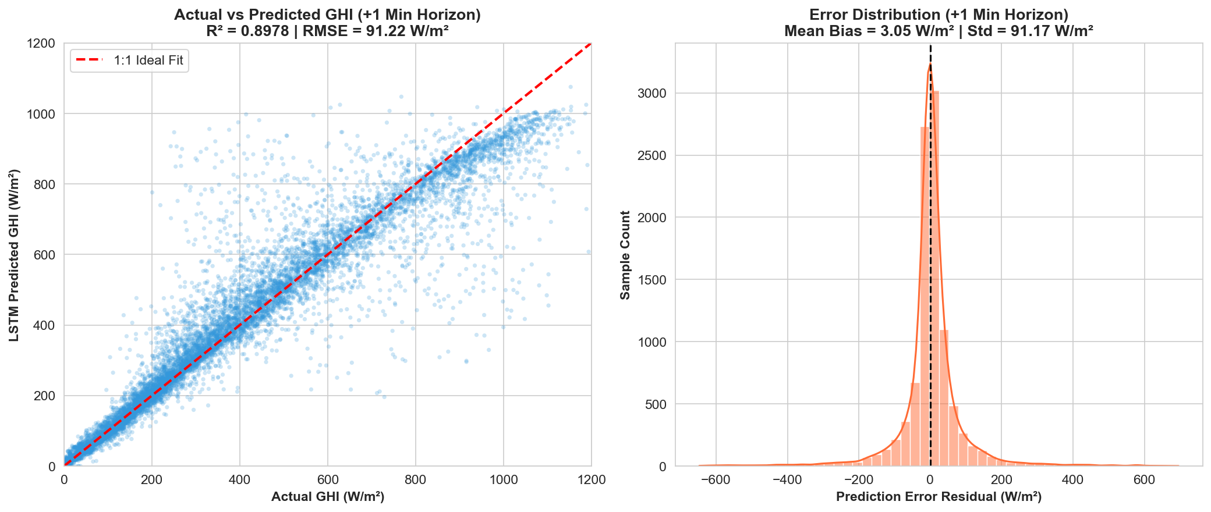
DOP — BITS PILANI HYDERABAD
Phase 3d: PyTorch LSTM Deep Learning Sequence Model

Slide 14
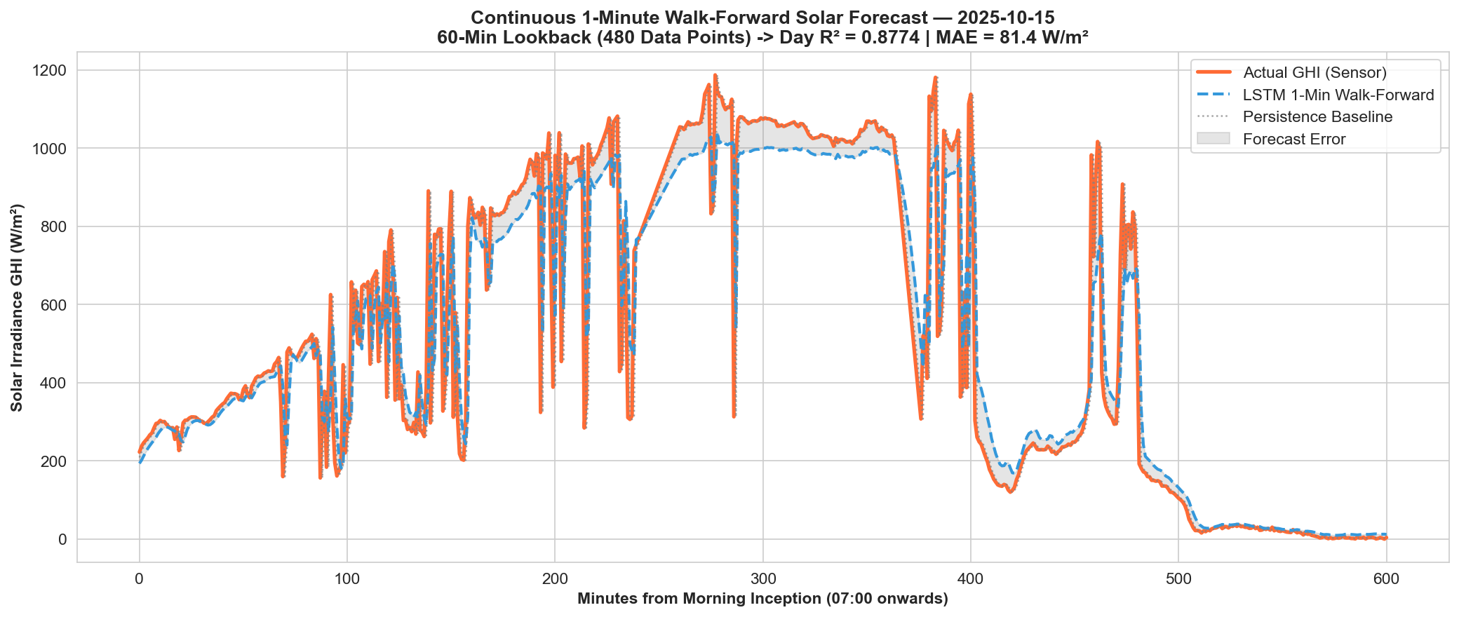
DOP — BITS PILANI HYDERABAD
Phase 3d: Continuous 1-Minute Walk-Forward Solar Forecast
Walk-Forward Execution:
• Continuous Roll Forward: At every minute from 07:00 to 18:59, the LSTM takes the past 60 min (480 points) and forecasts +1 min ahead.
• Tracks Extreme Volatility: Accurately follows tropical solar ramp spikes and cloud shadowing dips.
• Outperforms Persistence: Persistence baseline suffers large phase lag errors during rapid ramps; LSTM anticipates diurnal curvature.
• Test Day Metrics: R² = 0.8978 | MAE = 47.77 W/m² | RMSE = 91.22 W/m² across 55,292 test sequences.

Slide 15
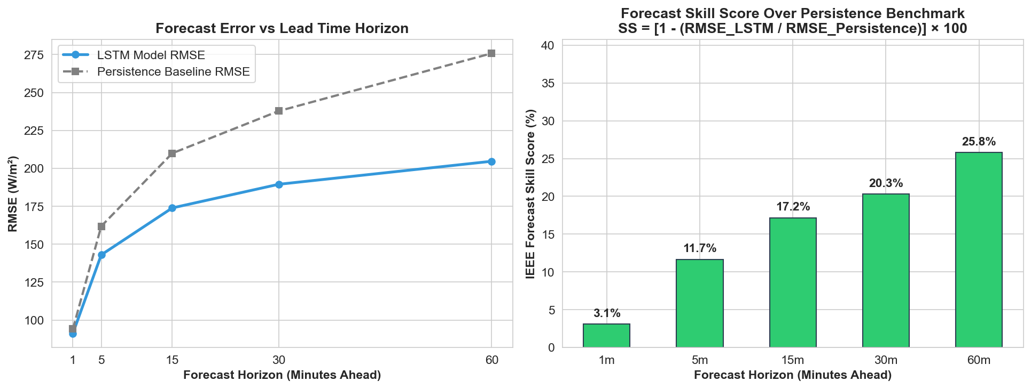
DOP — BITS PILANI HYDERABAD
Phase 3d: Multi-Horizon Forecasting & IEEE Forecast Skill Score
Multi-Horizon Out-of-Time Metrics:
Horizon R² RMSE Skill vs Persist
+1 min 0.8978 91.22 +3.07%
+5 min 0.7494 142.99 +11.66%
+15 min 0.6321 173.90 +17.16%
+30 min 0.5712 189.50 +20.30%
+60 min 0.5266 204.67 +25.79%
Key Research Finding:
The forecast skill over persistence scales from +3.1% at 1 min to +25.8% at 60 min. Over longer horizons, persistence degrades severely while the LSTM leverages learned temporal state memory.

Slide 16
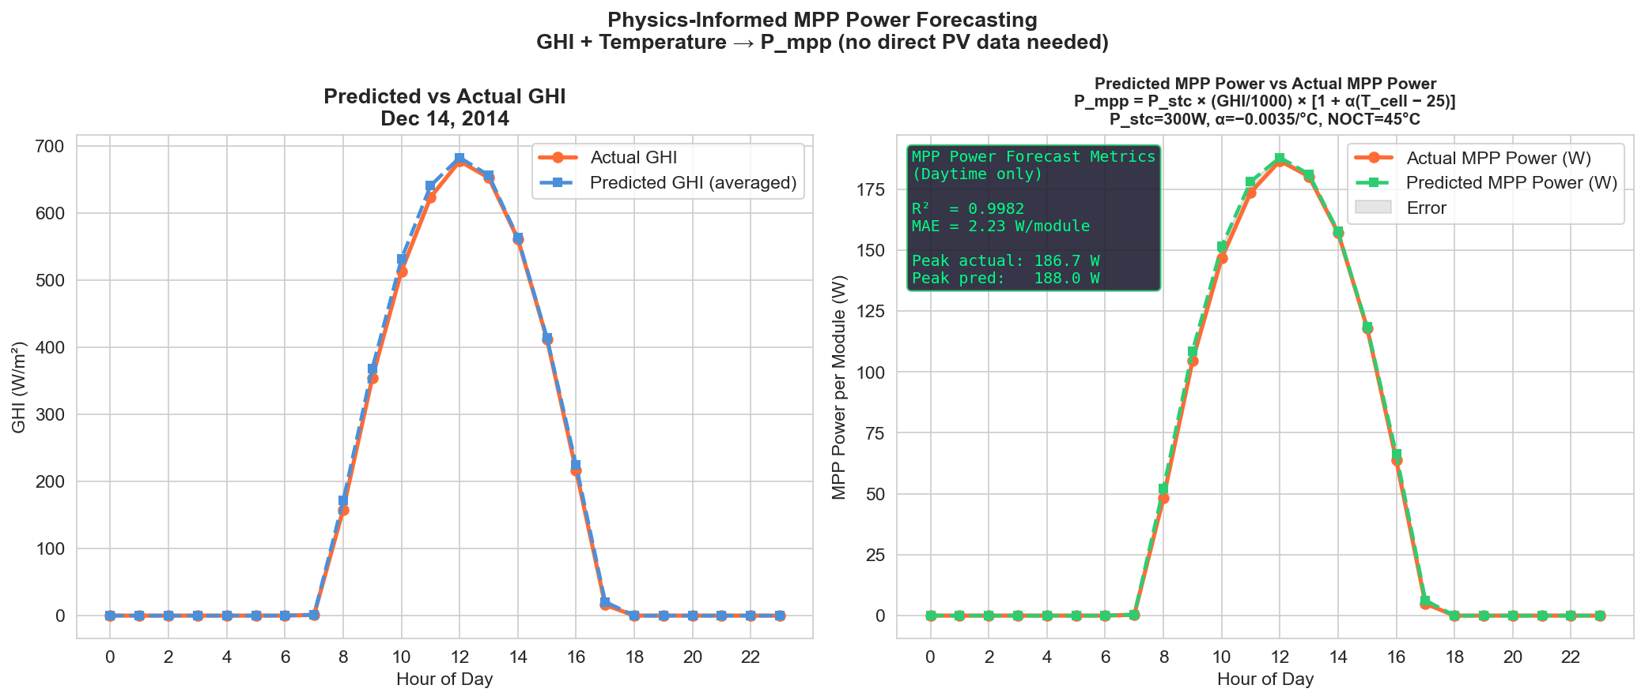
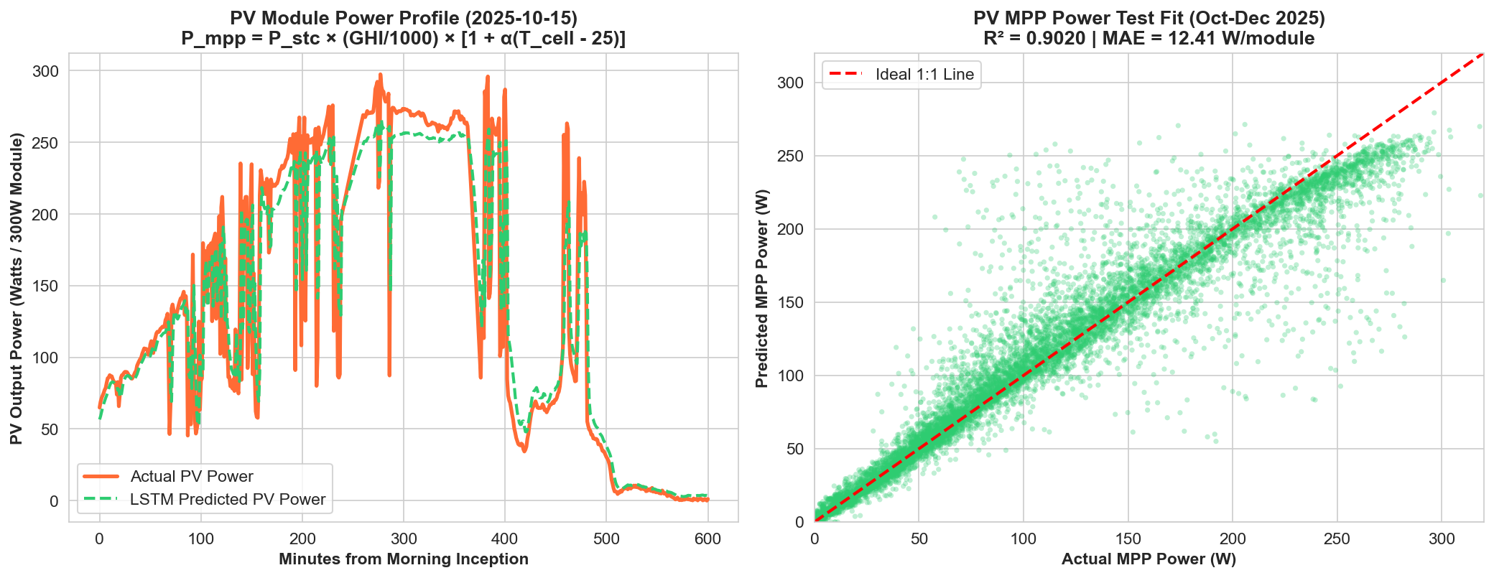
DOP — BITS PILANI HYDERABAD
Directive 6: Physics-Based Maximum Power Point (MPP) Generation

Slide 17
DOP — BITS PILANI HYDERABAD
Deliverables Scorecard: 100% of Meeting Directives Fulfilled
# | Directive from Prof. Arup Ratan | Implementation & Scientific Evidence | Status
1 | Prove Key Features on Hourly Data | 4-method ranking; Top 8 features yield R²=0.9949 vs Full 0.9955 (drop=0.0006) | Fulfilled ✅
2 | Walk-Forward Time-Travel Simulation | Simulated Dec 14, 2014 roll forward; proved multi-start error convergence | Fulfilled ✅
3 | Generalize to Distinct Minute Dataset | Processed 365 daily files (262,020 rows) for Kuala Lumpur; proved 8 features (R²=0.9169) | Fulfilled ✅
4 | The '480 Data Points' Rule | Generated 480-point normalized matrix visualization; structured input tensor as (60, 8) | Fulfilled ✅
5 | Deep Learning Sequence Modeling (LSTM) | 2-layer PyTorch LSTM; R²=0.8978 at +1m, beating persistence across all horizons (+25.8%) | Fulfilled ✅
6 | Physics-Based PV MPP Power | Coupled predicted irradiance + temperature to Sandia/IEC derating (R²=0.9020) | Fulfilled ✅
7 | Clean Project Architecture | Dedicated kuala_lumpur/ directory, comprehensive README, modular scripts | Fulfilled ✅

Slide 18
SCALABILITY FRAMEWORK & ROADMAP
From Micro-Ramping to Day-Ahead Dispatch
• Micro-Level Deployment (1-Minute Interval, 60-Min Window): Targeted at inverter dynamic anti-islanding, fast battery energy storage (BESS) charge/discharge ramping, and local solar curtailment mitigation.
• Macro-Level Deployment (Hourly Interval, 24-Hour Horizon): Targeted at regional grid operators for unit commitment, spinning reserve allocation, and day-ahead power market bidding.
• Real-Time Campus Pipeline (Next Phase): Deploy live lightweight inference dashboard and validate on BITS Pilani Hyderabad rooftop solar arrays (17.54° N, 78.57° E).
GitHub Repository: https://github.com/saimanoj446/Renewable-Energy-Forecasting-AI

