Slide 1
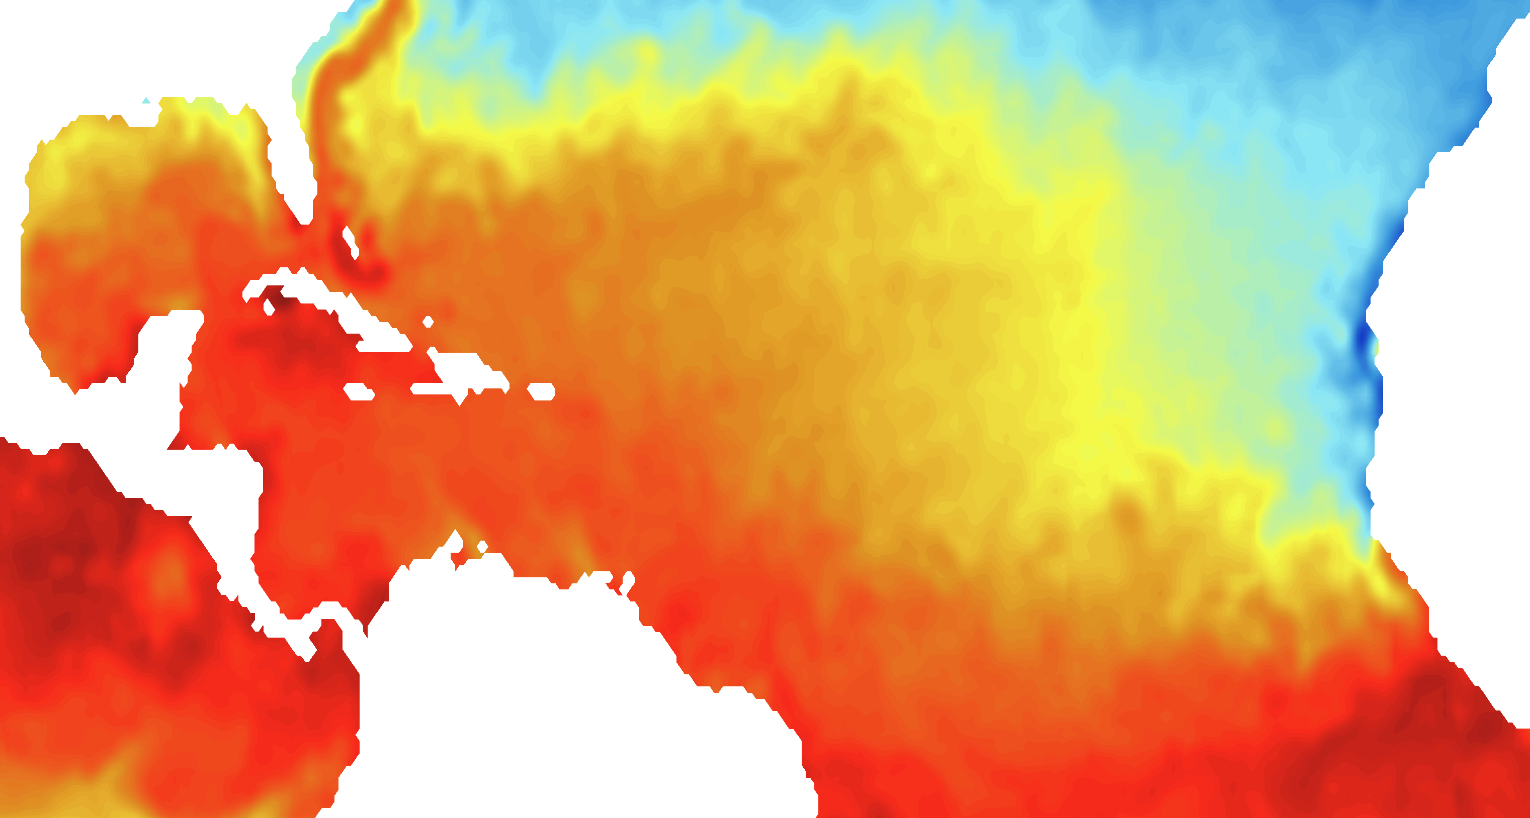
Results: Sea Surface Temperature Forecasting using Deep Learning Models- CNN, LSTM, LSTM-CNN
Saima Sanjida Shila
sshila1@lsu.edu
Louisiana State University

Slide 2
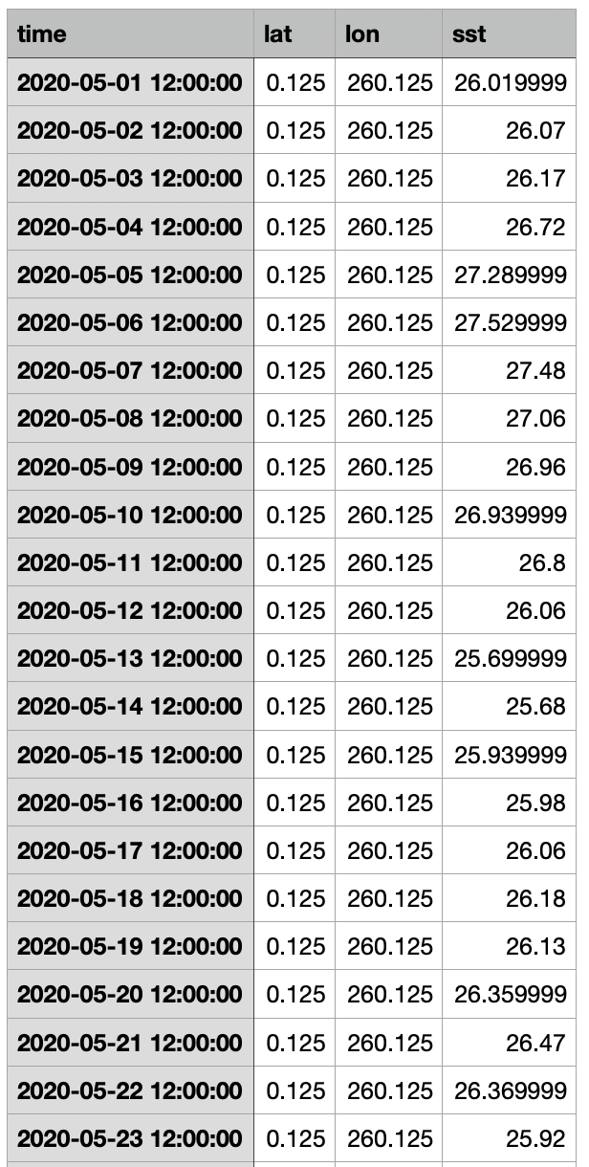
Data Preprocessing:
Train data (2020-2022) (May-August)
Test data (2023) (May-August)
Validation data (2024) (May-August)
Features (time, latitude, longitude, SST)
Training each model by Creating sequences of matrix using Latitude, Longitude and SST value for each (Lat, Lon). **Suitable for Temporal and spatial dependencies. **

Slide 3
Results:
Model | Train MAE | Test MAE | Validation MAE | Train MSE | Test MSE | Validation MSE | Train R² | Test R² | Validation R²
CNN | 0.367 | 0.453 | 0.453 | 0.405 | 0.509 | 0.579 | 0.930 | 0.907 | 0.908
LSTM | 0.168 | 0.150 | 0.151 | 0.145 | 0.138 | 0.152 | 0.975 | 0.975 | 0.975
LSTM-CNN | 1.894 | 2.123 | 2.095 | 4.107 | 5.00 | 4.946 | 0.296 | 0.093 | 0.2146

Slide 4
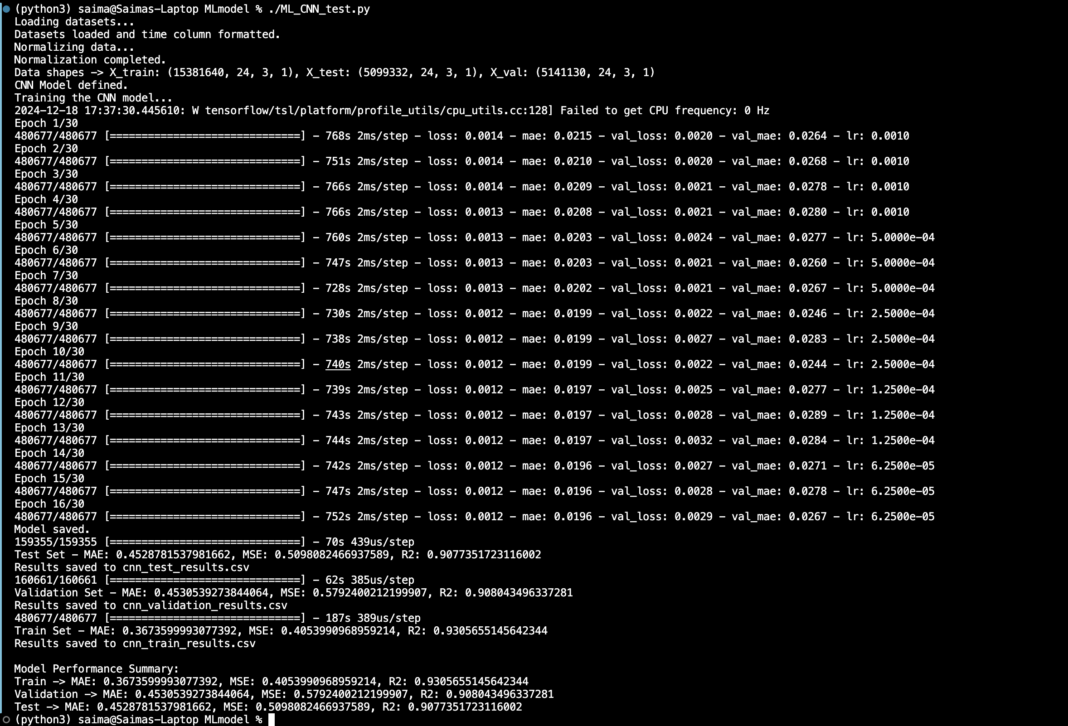
CNN (Convolutional Neural Network)
Epoch=30

Slide 5
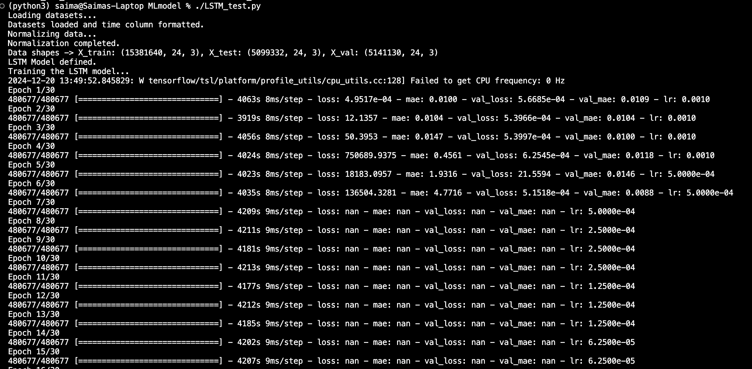
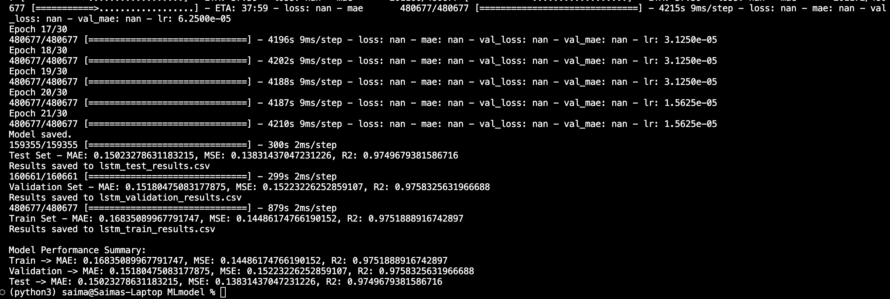
LSTM (Long Short-Term Memory)
Epoch=30
Early Stop to avoid overfitting

Slide 6
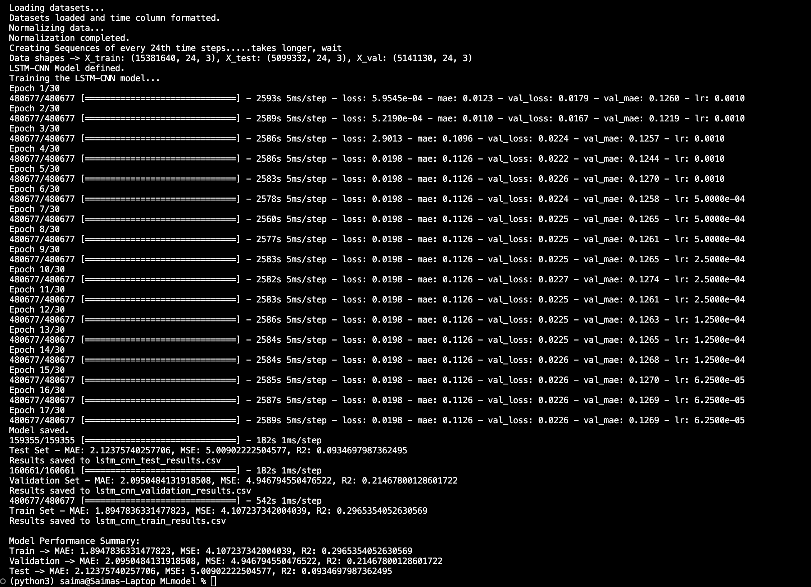
LSTM-CNN
Epoch=30

Slide 7
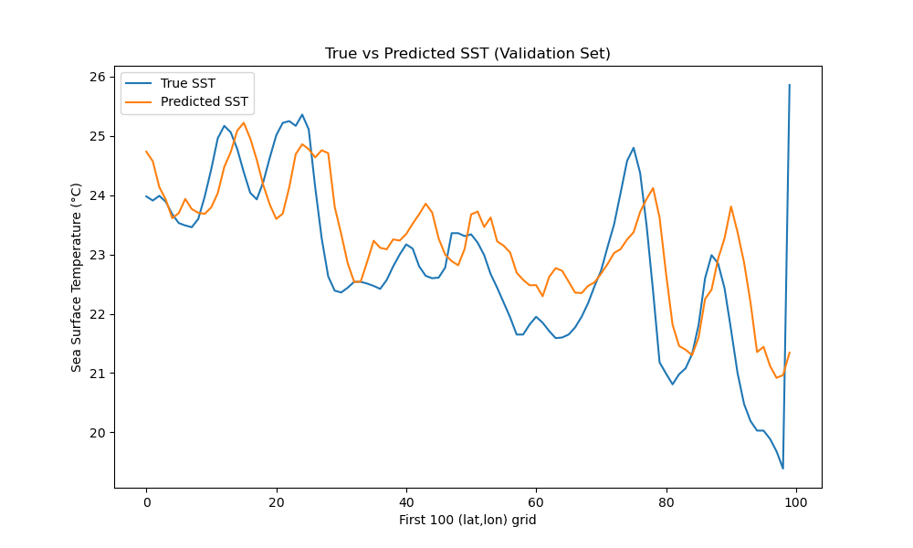
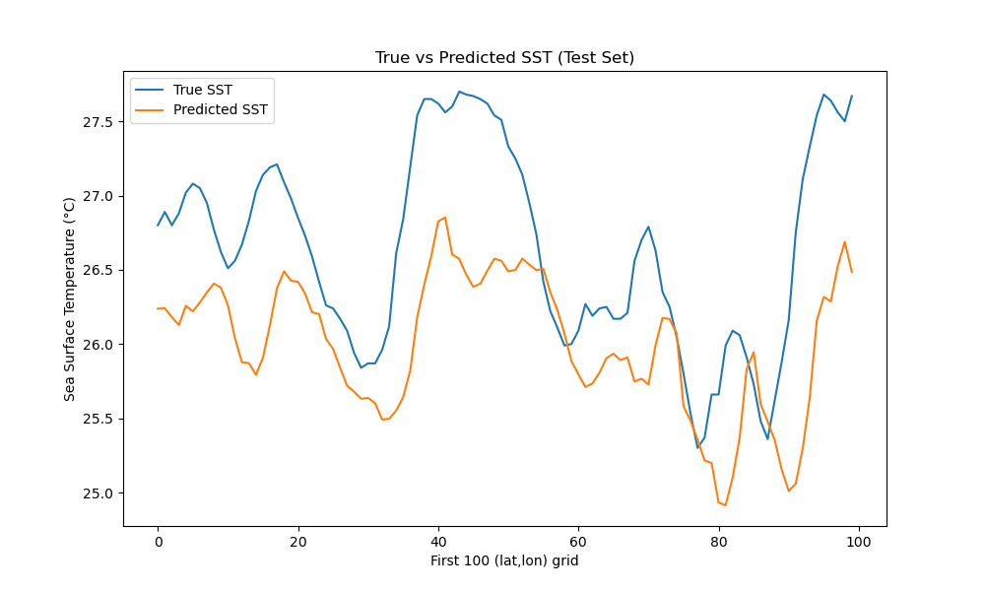
Visualization of CNN Model:

Slide 8
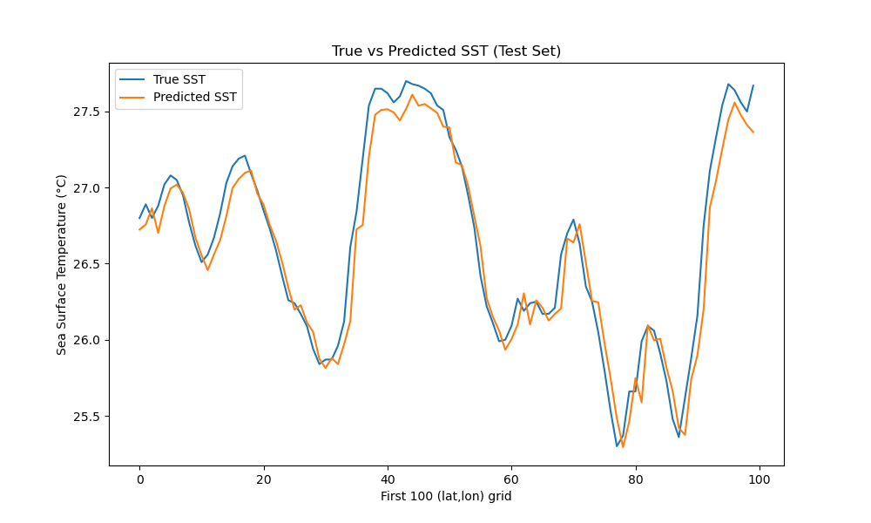
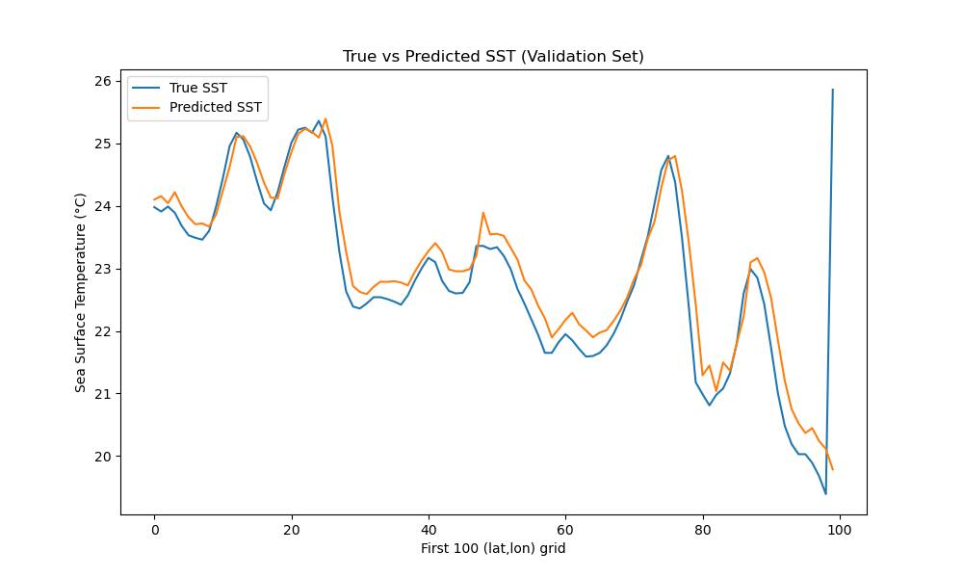
Visualization of LSTM Model:

Slide 9
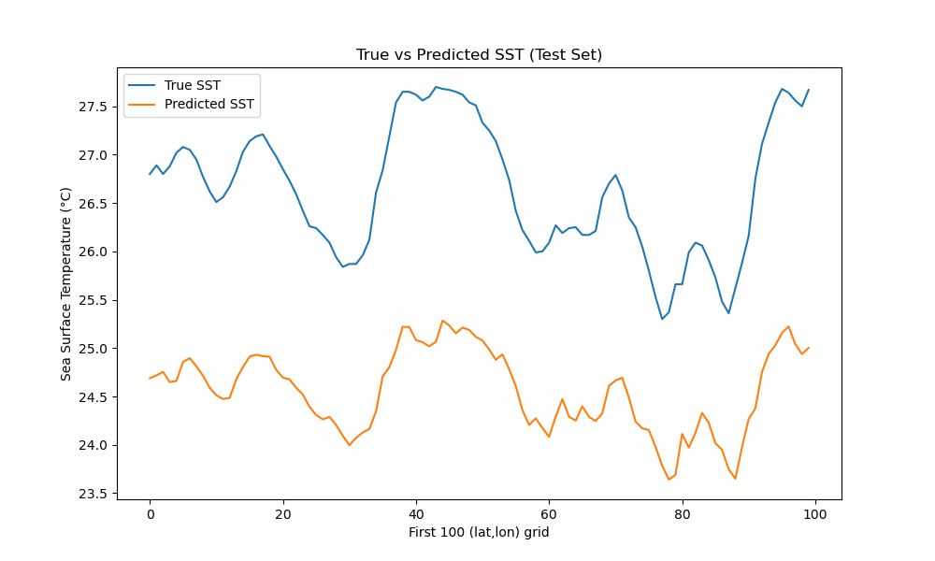
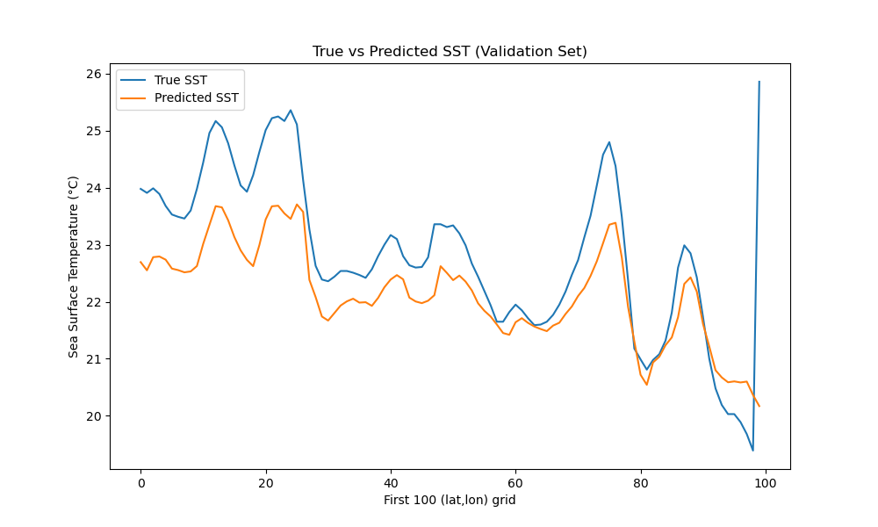
Visualization of LSTM-CNN Model:

Slide 10
Results:
LSTM outperforms CNN and LSTM-CNN models in all metrics by achieving the lowest MAE and MSE and higher R2 scores which indicates excellent predictive accuracy.
LSTM is the best model for SST prediction, given its ability to effectively capture temporal dependencies.

Slide 11
Future Work:
Analyze performance of CNN, LSTM and LSTM-CNN model after adding feature dust data.
Choose Model which works best for forecasting Sea surface temperature.
Analyze ratio of SST: Dust.
Development of Interface that will portray SST prediction.

