Slide 1

A Comparative Analysis of Machine Learning and Deep Learning Tools and Frameworks
Saima Sano
ItAI 2376 Deep Learning AI
Anna Devarakonda
Date June 14th, 2025

Slide 2
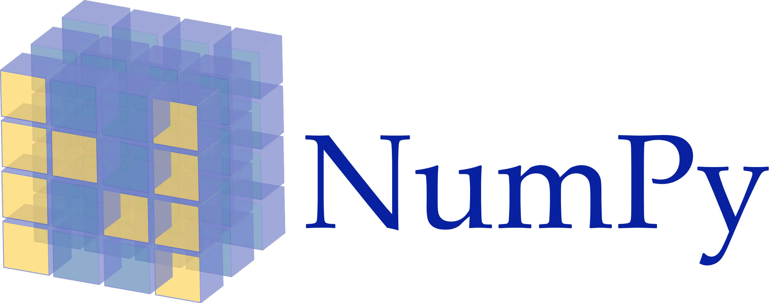
Origin of NumPy
NumPy is a fundamental open-source Python library that provides powerful support for working with large, multi-dimensional arrays and matrices. It also offers a wide range of high-level mathematical functions designed to efficiently operate on these data structures.
Originally, NumPy's precursor, Numeric, was developed by Jim Hugunin and other contributors. In 2005, Travis Oliphant significantly enhanced Numeric by integrating features from a rival library called Numarray, leading to the creation of what we now know as NumPy. Numerous contributors continue to maintain and develop this open-source project.

Slide 3

Origin of JAX
JAX is a Python library developed by Google in 2018, with contributions from Nvidia and the community, that's built for high-performance numerical computing and large-scale machine learning. It's specifically designed for accelerator-oriented array computation and program transformation, meaning it excels at leveraging specialized hardware like GPUs and TPUs.
What makes JAX powerful is its combination of a modified version of Autograd (for automatic differentiation, which helps in calculating gradients) and OpenXLA's XLA (Accelerated Linear Algebra).

Slide 4
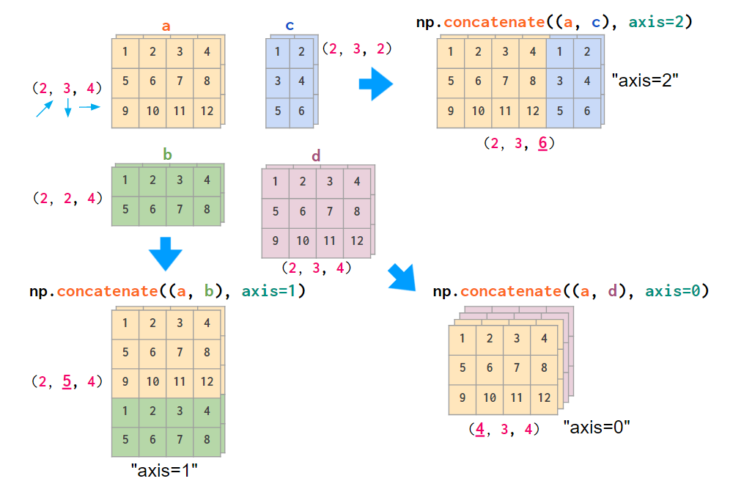
Key Features of NumPy
Rich N-dimensional array operations.
Well-integrated in Python scientific stack.
Easy-to-use API for mathematical and statistical functions.
Extensive community and ecosystem.

Slide 5
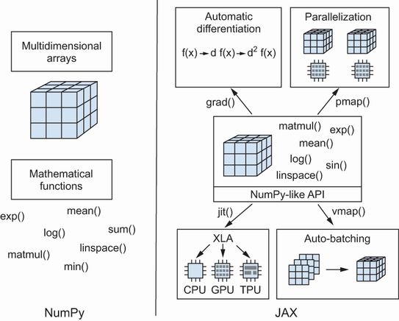
Key Features of JAX
NumPy-compatible syntax.
Automatic differentiation
Just-In-Time (JIT) compilation with XLA.
Native GPU/TPU support.
Pure functional programming: vMap, pMap, JIT

Slide 6
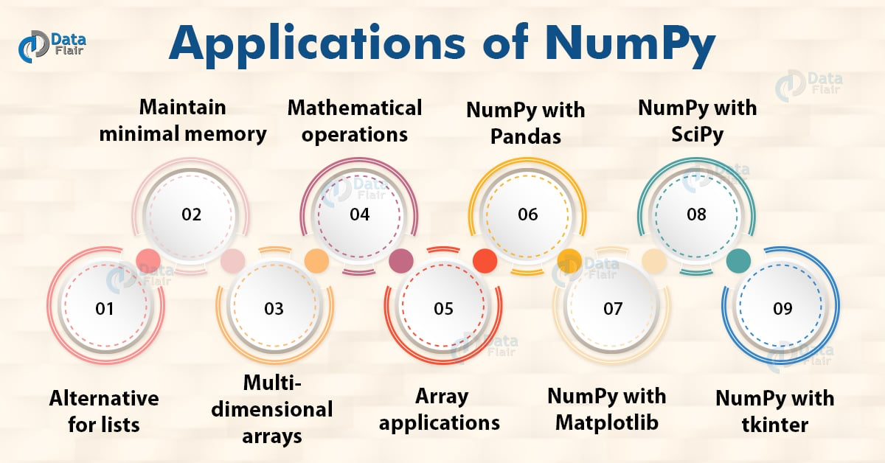
Real World Application of Numpy
NumPy serves as a fundamental library in various real-world applications, underpinning the landscape of scientific computing by providing the essential backbone for tools such as SciPy, Pandas, and Matplotlib. Beyond its role in foundational libraries, NumPy is extensively utilized in fields like astronomy and physics, where it powers complex simulations and enables robust data analysis at leading research institutions including NASA and CERN. Its capabilities also extend to the finance sector, where it is instrumental in developing sophisticated risk models, performing pricing calculations, and conducting various statistical analyses.

Slide 7
Real World Application of JAX
JAX is widely applied in advanced machine learning and scientific computing. DeepMind uses it for AI agents like AlphaFold and AlphaStar, while Google Research leverages it for rapid ML model prototyping. It's also key in robotics for differentiable physics engines and simulators. Libraries like Flax, Optax, and Haiku are built on JAX, expanding its reach across various fields.

Slide 8
Comparative Perspective
Criteria | NumPy | JAX
Primary Use | General numerical computing, scientific computing, data analysis | High-performance machine learning, deep learning research, differentiable programming
Usability | Simple, Stable API | Functional, NumPy Comatible
Performance | Fast on CPU | Accelerated with GPU/TPU
Support | Community-driven, widely contributed to | Backed and Maintained by Google
Scalability | Moderate; primarily single-device/CPU focused | Excellent for Machine Learning Workloads
Differentiation | Foundation for much of the Python scientific stack | Built-in autograd and JIT Compilation for performance
Learning Curve | Relatively low for basic operations, well-documented | Moderate; requires understanding of functional programming concepts and JAX's transformations

Slide 9
References
https://numpy.org
https://jax.readthedocs.io
https://github.com/google/jax
https://deepmind.com/research/highlighted-research/alphafold
https://ai.googleblog.com/2020/10/jax-fast-and-flexible-ml-library-for.html
https://data-flair.training/blogs/numpy-applications/
https://deepmind.google/discover/blog/alphastar-mastering-the-real-time-strategy-game-starcraft-ii/

