Slide 1

A05 Analyzing “Arrival” through the lens of nlp
Saima Sano
ITAI-2376
Anna Devarakonda
July 5th, 2025

Slide 2

introduction
In Arrival, Louise Banks, a leading linguist, is tasked with breaking the complex, non-linear Heptapod language, and extraterrestrial people. This fundamental concept echoes much of the inherent Natural Language Processing (NLP) issues. Like Banks attempts to figure out the semantic and syntactic structure in the Heptapods' logograms, NLP experts work on creating models that can analyze and generate human language. The film focuses on the difficulties of disambiguation, contextual understanding, and the iterative hypothesis testing and revision process, all standard challenges in developing effective NLP solutions to machine translation, sentiment analysis, and information retrieval.

Slide 3

From symbols to sense: decoding meaning beyond language

Slide 4

Ambiguity in language
Teaching “Human” to Heptapods:
In Arrival, Louise Banks faces a core linguistic challenge: teaching fundamental human words like "human" or "Ian" to the Heptapods. Their non-linear, context-dependent language makes even simple concepts profoundly ambiguous without shared understanding.
The Polysemy Problem in NLP:
This mirrors a critical hurdle in Natural Language Processing (NLP): Polysemy, where a single word possesses multiple meanings. For example: Is “bat” a flying mammal, or a piece of sporting equipment? For AI, this is not immediately obvious, it need context to understand in what sense the word bat is being used.
Word Sense Disambiguation:
NLP tackles this ambiguity using Word Sense Disambiguation (WSD). This technique analyzes the surrounding words, grammatical structure, and broader context to infer the correct meaning of a word, just as humans instinctively do.

Slide 5
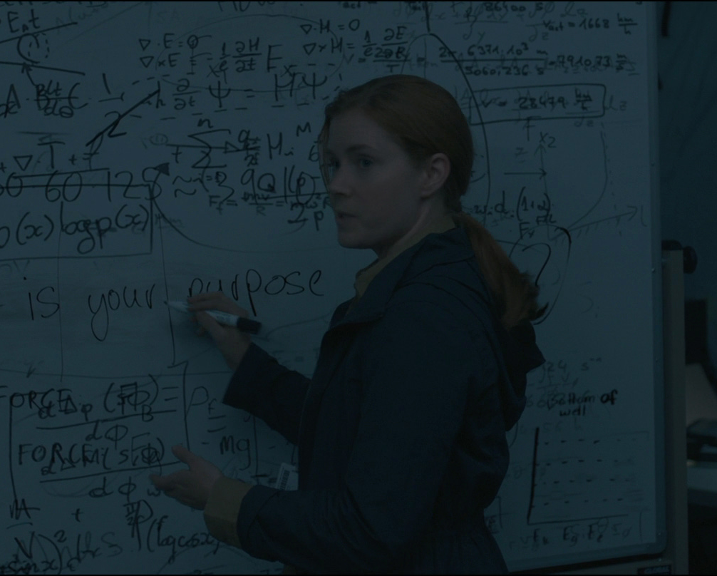
When Words don’t mean what they say: idioms & nlp
Beyond Literal Purpose:
In Arrival, Louise Banks' explanation of the nuanced question "What is your purpose on Earth?" to the Heptapods highlights how human communication often transcends literal translation. The aliens struggle with the implied intent and cultural context behind the query, much like understanding an idiom.
Defying Dictionary Meanings:
This mirrors a significant challenge in Natural Language Processing (NLP): Idiomatic Expressions. These are phrases where the meaning cannot be deduced from the literal meanings of their individual words (e.g., "kick the bucket" doesn't mean to literally kick a pail). They are culturally embedded and defy simple word-for-word interpretation.
Deep Learning's Contextual Grasp:
Traditional NLP struggled with idioms. Modern NLP leverages Deep Learning models, trained on vast text corpora, to learn the complex, non-literal patterns where idioms occur. These models infer the intended meaning by understanding the context in which the idiom is used, rather than relying on direct definitions. Groundbreaking models like Google's BERT (Bidirectional Encoder Representations from Transformers) and OpenAI's GPT series (Generative Pre-trained Transformers) are particularly adept at capturing these nuanced meanings due to their advanced contextual understanding and pre-training on massive amounts of human language.

Slide 6

The Nuance of Intent: Tone, Sarcasm & AI
A Fatal Misinterpretation:
In Arrival, a pivotal scene sees the Heptapods' phrase, understood as "offer weapon," tragically misinterpreted by human forces as a direct threat. This highlights how critically important tone and true intent are in communication, often overriding literal word meanings.
Decoding True Sentiment:
For Natural Language Processing (NLP), detecting sarcasm, irony, or the underlying tone of a statement is immensely difficult. Sarcasm, for instance, often uses positive words to convey a negative or mocking sentiment ("Oh, that's just brilliant!"). Machines struggle to identify this inverted meaning.
Contextual & Sentiment Modeling:
NLP tackles this through advanced Sentiment Analysis and sophisticated Contextual Modeling. Rather than merely assigning positive or negative labels to words, models analyze the entire sentence, surrounding dialogue, and even common linguistic patterns to infer the speaker's true emotional state and intent. Cutting-edge Transformer-based models, such as RoBERTa (A Robustly Optimized BERT Pretraining Approach), are particularly effective. Their deep understanding of word relationships within a broader context allows them to capture subtle cues, negative polarity, and the often-inverted meaning of sarcasm.

Slide 7

Beyond Borders: Navigating Cultural Language Variations
Divergent Global Interpretations:
In Arrival, a crucial plot point revolves around how different nations interpret the Heptapods' messages uniquely. Despite receiving the same alien communication, their distinct cultural backgrounds, political agendas, and linguistic frameworks lead to vastly different conclusions, showcasing the profound impact of human cultural variation on understanding.
The Dialect & Context Divide
This mirrors a significant challenge in Natural Language Processing (NLP): Cultural and Regional Language Variations. Even within the same human language (e.g., English, Spanish), meanings of words, idiomatic expressions, slang, and conversational norms can vary drastically by region, demographic, or cultural group. A model trained for one region might fail for another.
Building Multilingual Models:
To overcome this linguistic fragmentation, NLP develops Multilingual Models. These models are not merely separate language translators; they are trained simultaneously across numerous languages and dialects. This approach allows them to learn shared linguistic structures while also recognizing and adapting to culture- or region-specific nuances. Leading examples include mBERT (Multilingual BERT) and XLM-R (Cross-lingual Language Model - RoBERTa). These powerful Transformer-based models are pre-trained on text from hundreds of languages and dialects, enabling them to transfer knowledge across linguistic boundaries and adapt effectively to regional specificities, making them invaluable for global NLP applications.

Slide 8
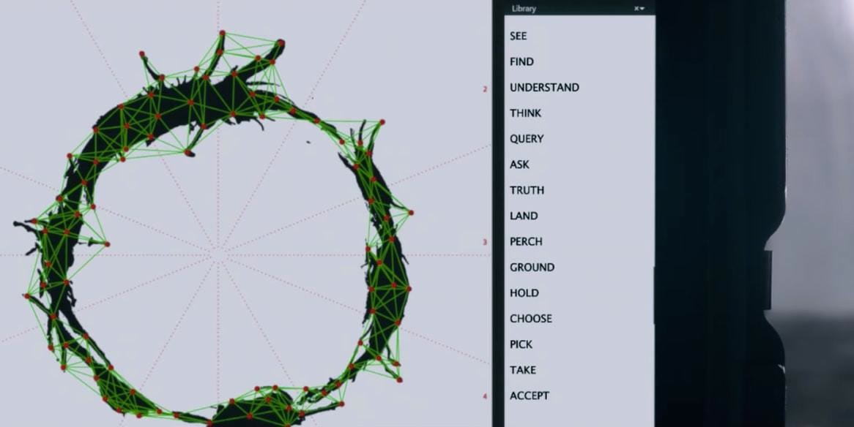
The Power of Multimodal NLP
Decoding Visual Language:
In Arrival, the Heptapods communicate through intricate, circular logograms – a language that is inherently visual. Louise Banks' journey involves interpreting these complex images that convey entire concepts, demonstrating how deeply intertwined visual and linguistic meaning can be in profound communication.
Bridging Image and Text:
This mirrors a core challenge in modern NLP: deriving comprehensive meaning from both images and text simultaneously. Traditionally, NLP focuses on text while Computer Vision handles images. However, true human understanding often integrates both, making it complex for AI to align concepts across these disparate data types..
Integrated Multimodal NLP:
The field of Multimodal NLP aims to bridge this gap. It develops models that can learn joint representations of information from multiple modalities (e.g., text, images, video). These models don't treat data in silos; they learn how visual cues inform textual meaning, and vice-versa, building a more holistic, human-like comprehension. Pioneering models in this space include OpenAI's CLIP (Contrastive Language-Image Pre-training), which learns strong connections between images and text descriptions, and DeepMind's Flamingo, which can process interleaved sequences of images and text for rich conversational understanding. These tools are revolutionizing applications like image captioning and visual question answering.

Slide 9
Tools/Technologies Analogy
Movie Element | NLP Tool/Concept
Rule-based translation | Rule-Based NLP
Symbol frequency & repetition | Statistical NLP
Learning through immersion | Deep NLP and transfer learning
Decoding Circular Symbols / Circular Language Structure | Sequence modeling (Transformers-based models), Contextual Embeddings
Visual Symbols | Multimodal NLP

Slide 10
Conclusion
Arrival isn't merely an enthralling sci-fi picture. It's a cinematically wrought solution to the ultimate classical problems and dreams at the heart of NLP. The film brings home a scenic drama of how significant context, iteration, and deep immersion truly are to linguistic understanding, simulating how AI evolves to comprehend human communication.
The film stands as a stiff metaphor wondering the evolution of NLP from ambiguity and idiomatic expression to tones, multimodality, and the entire cultural and regional language literacies. Every hurdle faced by Louise Banks toward understanding Heptapod language stands for tough nuts AI developers have to crack on the brink of their daily existence.
With Arrival, the intelligible alien gives us that universal message: the very word "weapon" forfeited for use in sustaining human existence and prosperity is communication and understanding. This affirms the notion that the future of dawning human interaction and artificial intelligence lies in our endless quest toward mastering speech by erecting bridges of comprehension across one dialogue and one deciphered symbol at a time.

Slide 11
References
Villeneuve, Denis. Arrival. Paramount Pictures, 2016.
Vaswani et al. "Attention is All You Need." (2017)
Devlin et al. "BERT: Pre-training of Deep Bidirectional Transformers for Language Understanding." (2018)
Brown et al. "Language Models are Few-Shot Learners." (GPT-3 paper, 2020)

