Slide 1
APEXPLANET · DATA ANALYTICS INTERNSHIP
Data Storytelling &
Statistical Validation
Task 4 | ApexPlanet E-Commerce Dataset
Jan 2025 – Jan 2026 | 1,000 Orders | ₹139.4 M Revenue
Notes:
Welcome everyone. Today I'll walk you through a full data analytics story — from raw e-commerce data to validated business insights — covering cleaning, EDA, statistical testing, and strategic recommendations.

Slide 2
Agenda
Business Objective
Statistical Validation
01
04
What question are we answering?
T-Test · Chi-Squared · ANOVA
Dataset Overview
Business Recommendations
02
05
1,000 orders · 5 categories · 8 cities
5 data-backed actions
Key Findings & Charts
Conclusion & Next Steps
03
06
Revenue, trends, demographics
Call to action for ApexPlanet
Notes:
Here is the roadmap for today's presentation — six sections taking you from objective to action.

Slide 3
Business Objective
ApexPlanet is an e-commerce platform selling products across five categories to customers in eight Indian cities. Management needs a data-driven view of one full year of transactions to answer three critical questions:
🔍 Which categories and cities drive the most revenue?
📅 When does demand peak — and how can we prepare?
👥 Which customer segments should we target with marketing?
Methodology: Data cleaning → EDA → Visualisation → Hypothesis Testing → Recommendations
Notes:
We start with three core business questions. Every chart and test in this deck is designed to answer one of these directly.

Slide 4
Dataset Overview
1,000
₹139.4M
₹1,39,399
Total Orders
Total Revenue
Avg Order Value
5
8
12 mo
Categories
Cities Covered
Data Period
Categories: Electronics · Fashion · Furniture · Grocery · Education
Notes:
The dataset contains 1,000 rows with 12 columns. We found 20 missing Age values (filled with median) and 13 missing City entries (filled with 'Unknown'). No duplicate rows were present.

Slide 5
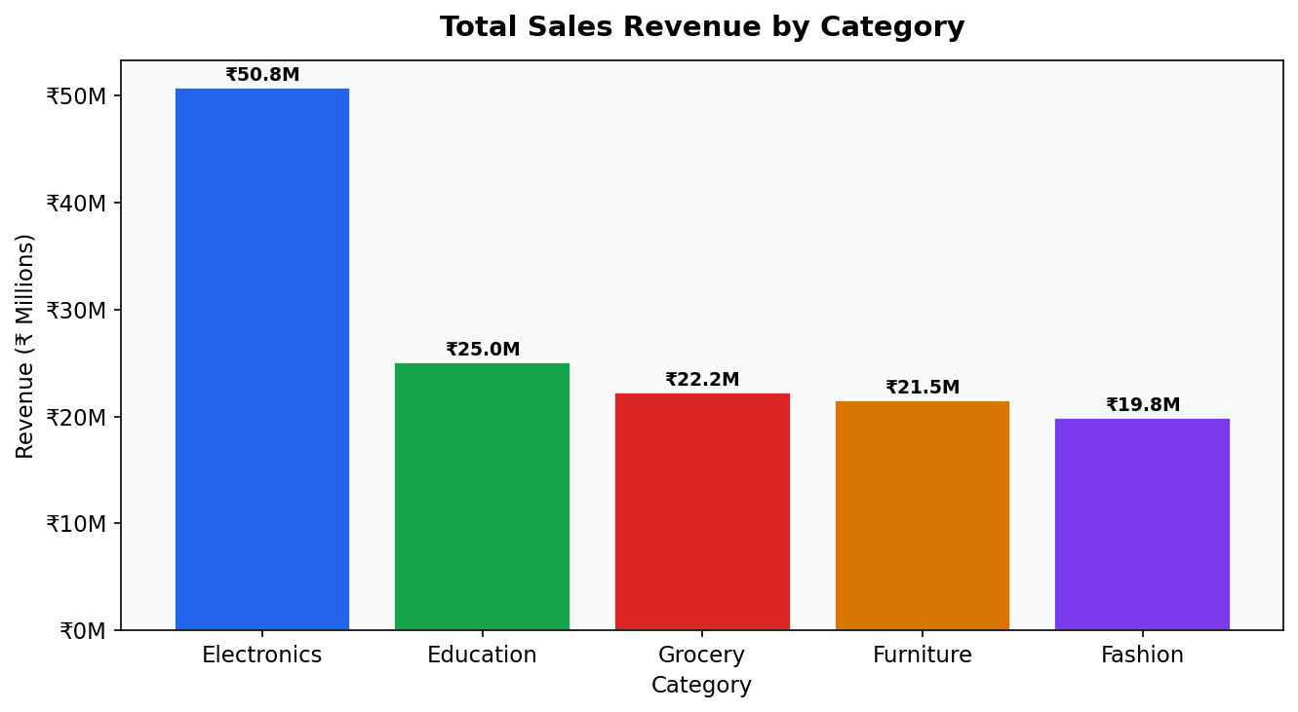
Finding 1 — Category Revenue
Electronics leads
₹50.8M — 36.4% of all revenue
Fashion is 2nd
Strong brand-driven purchases
Grocery is steady
High frequency, lower ticket size
Action: Increase inventory & ad spend on Electronics 2 months before peak season.
Notes:
Electronics alone accounts for over a third of all revenue. This is the single most important category for ApexPlanet and should receive priority in both inventory planning and marketing budgets.

Slide 6
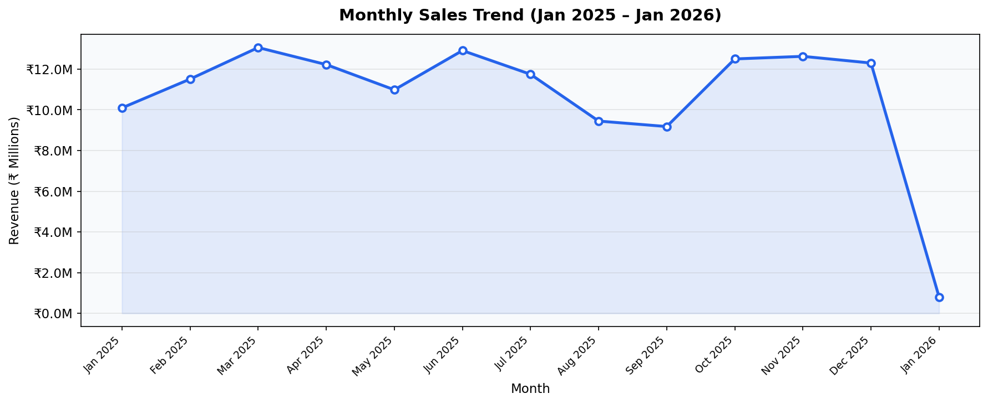
Finding 2 — Seasonal Sales Trend
📈 Peak: March 2025
📉 Dip: Jan 2026
Pre-stock by January. Launch spring campaigns in Feb.
Post-holiday slowdown — use discount offers to revive demand.
Notes:
The data reveals a clear seasonal spike in March 2025. Businesses that pre-plan inventory and promotions two months before this window will capture the most revenue.

Slide 7
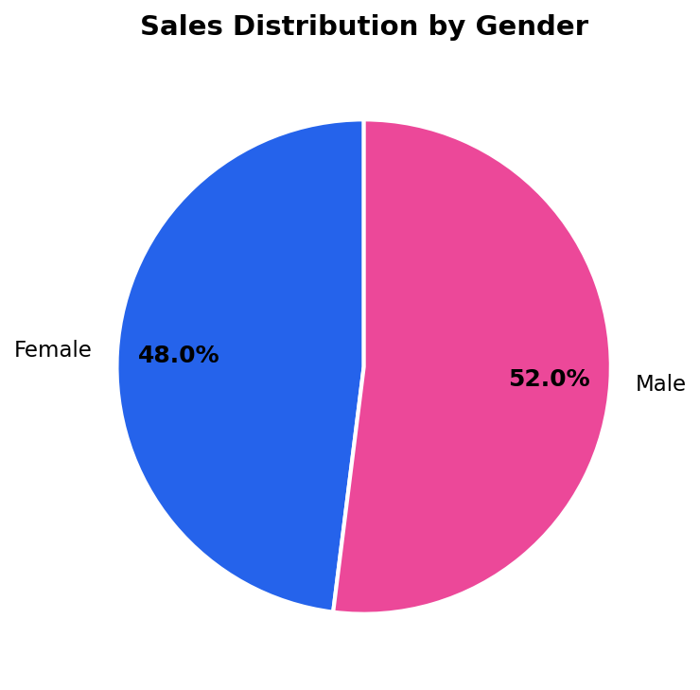
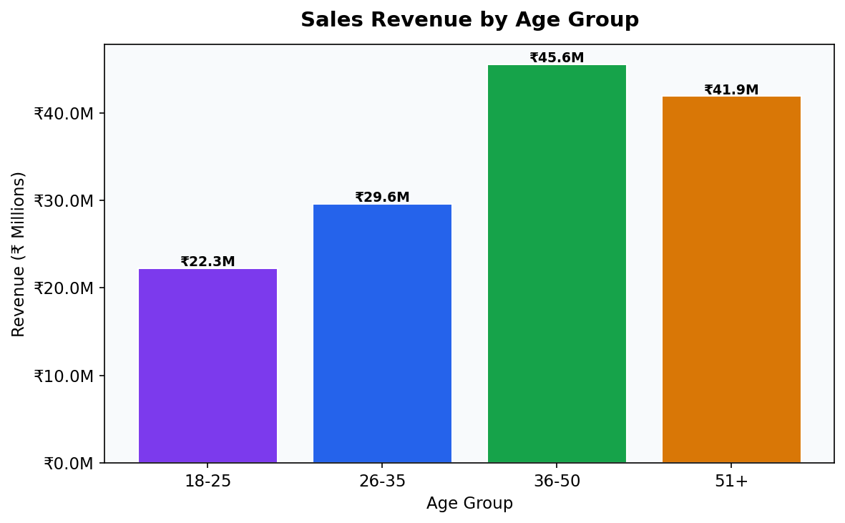
Finding 3 & 4 — Customer Demographics
Sales by Gender
Sales by Age Group
Near-equal gender split (52% M / 48% F) — both audiences matter equally.
36–50 age group generates the highest revenue — the core target segment.
Notes:
Gender is almost perfectly balanced, confirming that gender-specific campaigns would be wasteful. However, the 36-50 age bracket consistently generates the highest revenue and should be the primary audience for loyalty programs.

Slide 8
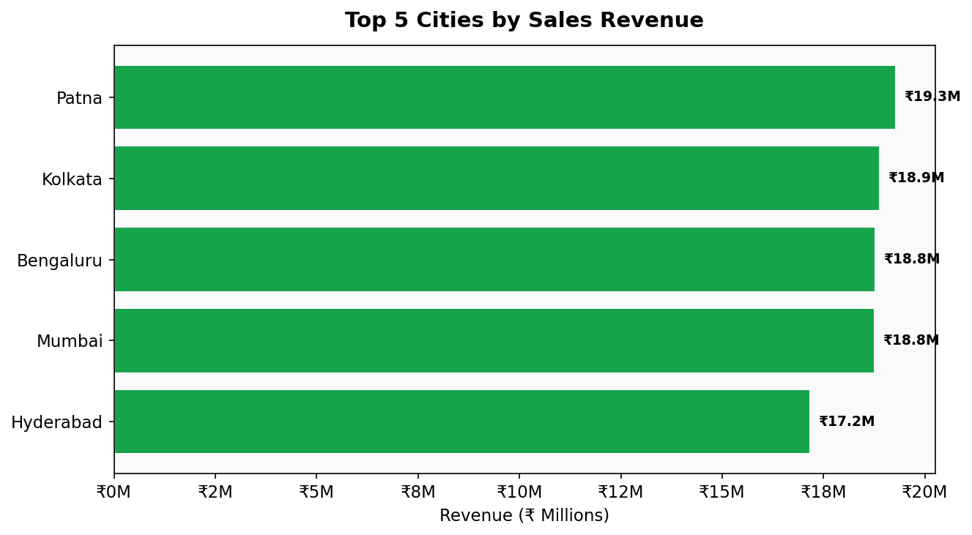
Finding 5 — Geographic Performance
Patna leads
13.8% of total revenue
8 cities covered
Tier-1 & Tier-2 mix
Growth opportunity
Lower-ranked cities show potential
Action: Launch first-order discount campaigns in Tier-2 cities to unlock untapped demand.
Notes:
Patna is the top city but represents less than 14% of revenue alone — the remaining cities collectively dominate. This suggests geographic expansion is both possible and necessary for growth.

Slide 9
Statistical Validation
All three hypotheses tested at α = 0.05 significance level
T-Test (Welch)
p = 0.495 · 95% CI: [–₹9,214 , +₹19,063]
01
No significant gender spending gap.
H₀: Male avg order value = Female avg order value
✔ FAIL TO REJECT H₀
Chi-Squared Test
χ² = 9.09 · df = 4 · p = 0.059
02
Both genders shop similarly across all categories.
H₀: Category preference is independent of gender
✔ FAIL TO REJECT H₀
One-Way ANOVA
F = 0.717 · p = 0.580
03
Average spend is consistent across categories.
H₀: Mean order value is equal across all categories
✔ FAIL TO REJECT H₀
Notes:
Three rigorous statistical tests confirm our findings. Importantly, gender does NOT drive spending differences — allowing the business to focus resources on universal campaigns rather than segmenting by gender.

Slide 10
Business Recommendations
R1
Invest in Electronics & Furniture
R4
Run Gender-Neutral Campaigns
These two categories command the highest revenue. Increase inventory 2 months before March peak.
Statistical tests prove no spending gap — universal product-centric ads maximise ROI.
R2
Target the 36–50 Age Segment
R5
Pre-plan Around the March Peak
Launch loyalty programs and personalised email campaigns for this highest-spending cohort.
Forecast-driven inventory stocking and promotional launches should begin by January.
R3
Expand into Tier-2 Cities
First-order discounts and localised delivery deals can unlock significant untapped demand.
Notes:
Five clear, data-validated recommendations. Each one maps directly to a finding and a statistical test, giving management confidence that these are evidence-based decisions — not guesswork.

Slide 11
Conclusion
ApexPlanet has a healthy, diversified revenue base of ₹139.4 Million with clear growth levers waiting to be activated.
Electronics is the dominant revenue driver — protect and grow this category.
March is the peak demand month — seasonal planning is essential.
The 36–50 age group is the highest-value customer segment.
Gender spending parity enables cost-efficient universal campaigns.
Tier-2 city expansion represents the next major growth frontier.
🎯 Implementing these recommendations targets a 20–30% revenue uplift in 2026
Notes:
In summary, this analysis moves ApexPlanet from raw transaction data to an actionable strategy. The five recommendations are statistically grounded and can be prioritised immediately by the product and marketing teams.

Slide 12
Thank You!
Questions & Discussion
ApexPlanet Data Analytics Internship · Task 4 · 2025–2026
Notes:
Thank you for attending. I'm happy to dive deeper into any of the statistical tests or business recommendations. All code and output files are available on GitHub.

