Slide 1

DESIGN AND SIMULATION OF A MATERIALS IN COMSOL SOFTWARE EC5512- SUMMER INTERNSHIP/SUMMER PROJECT(JULY-DEC 2023) TEAM MEMBERS: GOVINDA RAJ.S (2021105318) SAIMOHAN.R (2021105328)
GUIDED BY:
DR.S.SHANMUGAPRIYA
ASSISTANT PROFESSOR/ECE

Slide 2
BASICS OF COMSOL SOFTWARE
COMSOL Multiphysics is a software package that can be used to create and solve models involving different physics domains, such as mechanics, acoustics, electromagnetics, fluid dynamics, heat transfer, and more. It can be applied to various fields of engineering, science, and industry.
To use COMSOL Multiphysics, you need to follow these basic steps:
- Define the geometry of your model
- Choose the physics interfaces and equations
- Specify the material properties and boundary conditions
- Mesh the geometry and solve the model
- Analyze and visualize the results

Slide 3
GEOMETRY:
In the Geometry toolbar, click Circle.
In the Settings window for Circle, locate the Size and Shape section.
In the Radius text field, type 0.5. 4 Click Build All Objects.
MATERIAL:
Go to the Add Material window.
In the tree, select Built-in>Copper.
Click Add to Component in the window toolbar.
In the Home toolbar, click Add Material to close the Add Material window

Slide 4
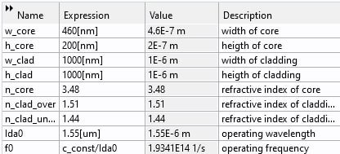
PARAMETERS

Slide 5
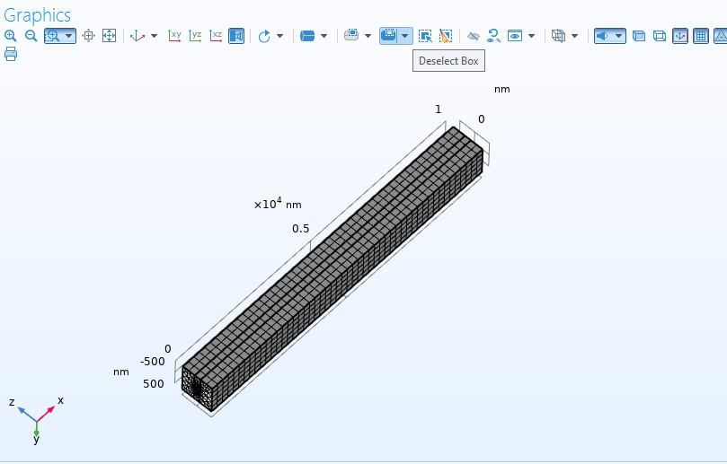
MESH OF SILICON RIB
After selecting required parameters and materials mesh process will be introduced to the particular material (silicon rib)
After mesh process steady step will be implemented
Step1: boundary mode analysis
Step 2: boundary mode analysis 1
Step 3: frequency domain

Slide 6
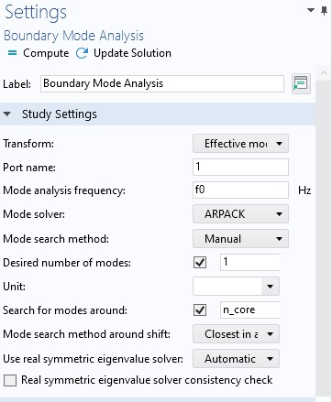
BOUNDARY MODE ANALYSIS:
After Completing The
Boundary Mode Analysis
Frequency Domain And
Solver Configuration
Should Be Done By
Selecting Particular
Option And Then Derived
Value Will Be Observed.

Slide 7
After the mesh and study process the derived value of the material will be
Frequency | 193.41hz
Reflectance | 4.7264E-2D
Transmitance | 1000
Absorptance | 13856E-13

Slide 8
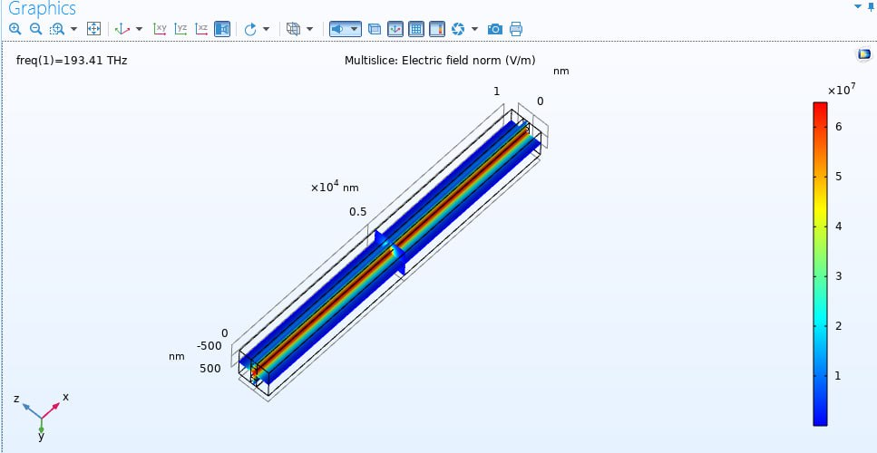
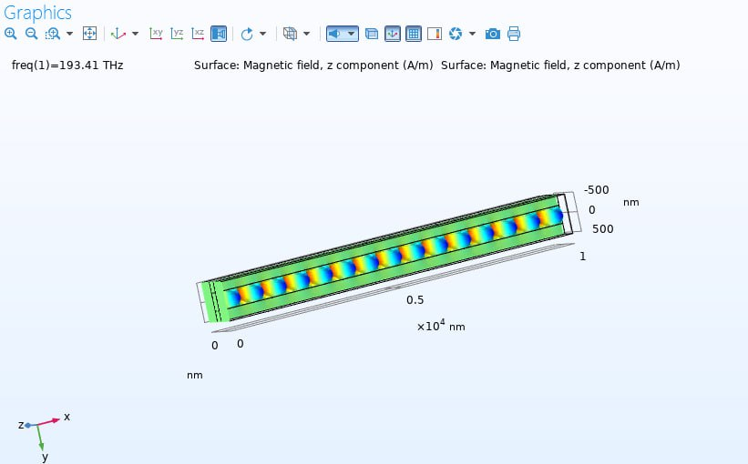
RESULT : [Electric field]
THIS SHOWS THE FLOW OF ELECTRIC FIELD IN THE PARTICULAR MEDIUM. RESULT CAN BE CHANGED ACCORDING TO THE INPUT AND DIFFERENT PARAMETERS .

Slide 9
DESIGN AND SIMULATION OF RECTANGULAR
WAVE GUIDE
MODE ANALYSIS:
When analyzing an arbitrary 3D waveguide structure, it is important to understand which types of electromagnetic waves are allowed to propagate at a given frequency. These wave regimes are determined by the resonant modes, which can be excited in a 2D transverse cross section of a waveguide.
Such modes can be fully described by the global complex-valued propagation constants and the space distributions of all three components of electric field (so-called mode shape). Transmission regimes in waveguides with a constant cross section can be defined completely based on these electromagnetic characteristics.
Mode analysis should not be confused with the more general modal analysis. The latter is referred to as eigen frequency and can be used for finding resonant or natural modes and eigenfrequencies in a system of any possible dimension, including 2D, 2D axisymmetric, and 3D.

Slide 10
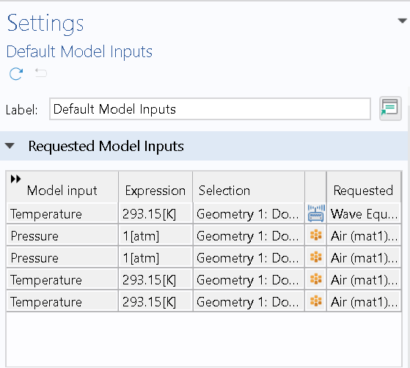
MODEL INPUTS:
The Input For Designing The Rectangular Waveguide Are Temperature And Pressure.
The Default Setting Is Given In The Comsol Software
Where The User Can Change According To Their
Convenience.
For Different Materials The Input Selected Can Be
Changed.

Slide 11
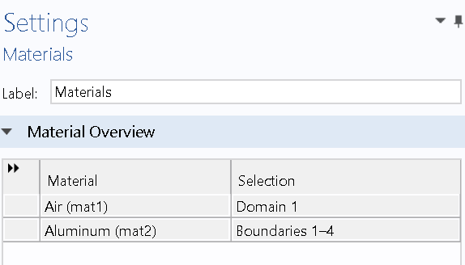
MATERIALS TO DESIGN RECTANGULAR WAVEGUIDE:
The Material Used To Design Rectangular Wave
Guide Is Air And Aluminum.
According to the design material selection in the
Comsol can also be altered.
PHYSICS SETTINGS:
The Goal Is To Find A Wave That Is Propagating In The Out-of-plane Direction. To Do So Using The Electromagnetic Waves, Frequency Domain Physics Interface In 2D, Open The Setting Window For The Physics Interface And Make Sure The Three Component Vector Option Is Selected In The Component Section.

Slide 12
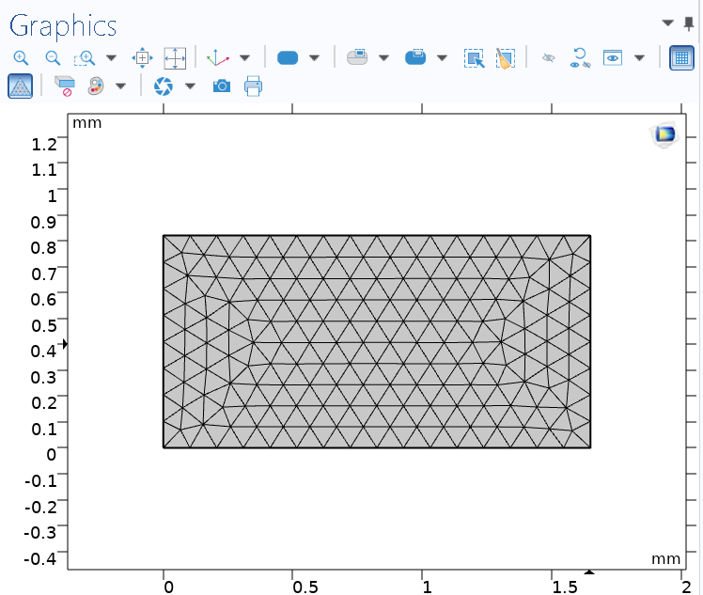
MESH AND STUDY SETTING:
A Variant Of The Mode Analysis Is Study Settings For Electromagnetics. By Default, The Effective Mode Index Transform Is Selected, Which Is Usually The Best Choice For Electromagnetic Waves. With Such A Transform, You Can Assume That The So-called Effective Index Of Mode Will Be Used As A Declarative Characteristic Of The Mode.
In The Mode Analysis Frequency Field, You Should Enter The Frequency At Which You Want To Find Resonant Modes. As You Can See Below, The Next Study Setting Listed Is Mode Search Method. If Manual Search Is Selected Here, You Should Set The Initial Guess In Terms Of The Effective Index Of Mode In The Search For Modes Around Field And The Desired Number Of Modes. The Solver Will Search For Modes Near That Guess And Return The Expected Number Of Different Modes If Possible. For The Region Search, You Should Specify The Approximate Number Of Modes And The Region Of The Complex Effective Index.

Slide 13
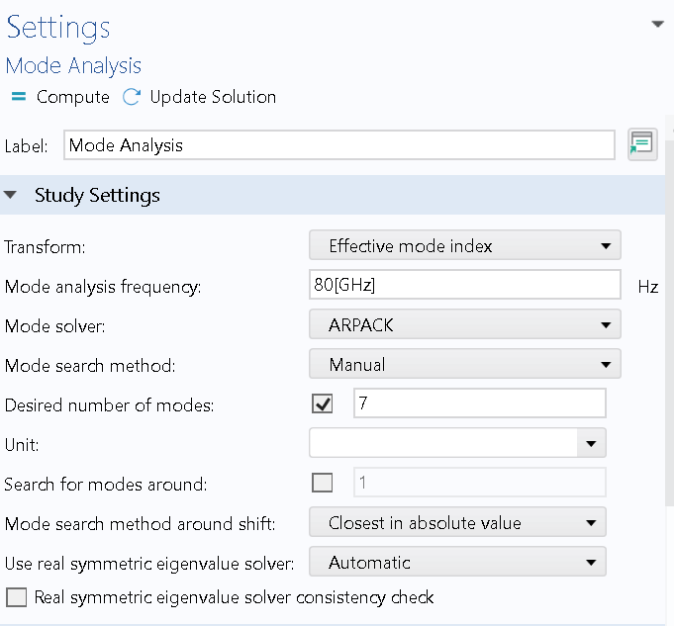
STUDY:
The above displayed option should be choosen and process the material for next stage.
Step1: boundary mode analysis
Step 2: boundary mode analysis 1
Step 3: frequency domain
After this study process derived values of the particular material will be displayed by clicking on the results we can observe the derived value.

Slide 14
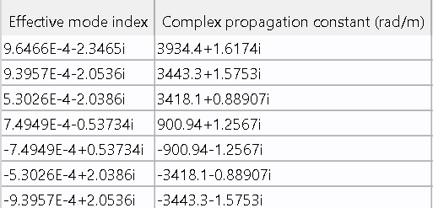
Derived values:
The above mensioned values are the effective index and propagation constant
Of the rectangular wave guide
After this we can analyse the electric field and magnetic field in the rectangular wave guide , graphical representation can be seen through this software.

Slide 15
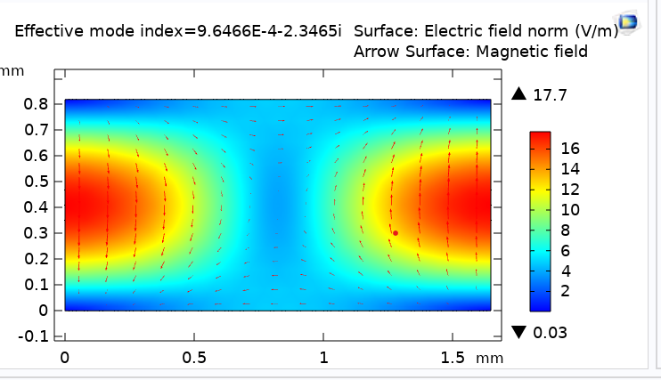
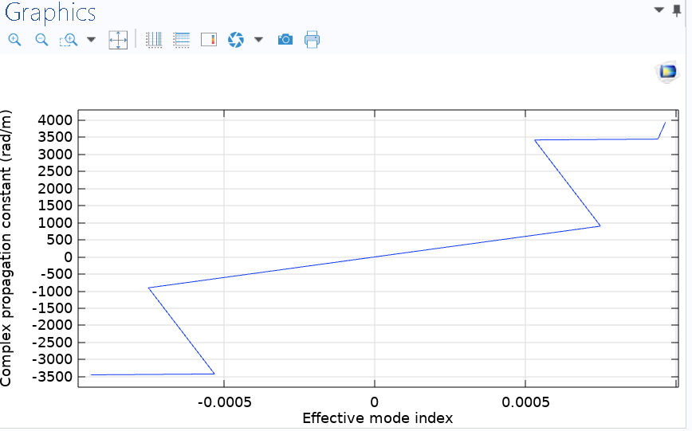
RESULT: GRAPHICAL REPRESENTATION:
This shows the flow of electric field in the medium

Slide 16
DESIGN AND SIMULATION OF PHOTONIC CRYSTAL
PHOTONIC CRYSTAL:
Photonic Crystal Devices Are Periodic Structures Of Alternating Layers Of Materials With Different Refractive Indices. Waveguides That Are Confined Inside Of A Photonic Crystal Can Have Very Sharp Low-loss Bends, Which May Enable An Increase In Integration Density Of Several Orders Of Magnitude. This Is A Study Of A Photonic Crystal Waveguide.
The Crystal Features A Grid Of Gaas Pillars. Depending On The Distance Between The Pillars, Waves Within A Certain Frequency Range Will Be Reflected Instead Of Propagating Through The Crystal. This Frequency Range Is Called The Photonic Band Gap.
When Some Of The Gaas Pillars In The Crystal Structure Are Removed, A Guide For The Frequencies Within The Band Gap Is Created. Light Can Then Propagate Along The Outlined Guide Geometry.
Photonic crystal is a low-loss periodic dielectric medium constructed using a periodic array of microscopic air holes that run along the entire fiber length.

Slide 17
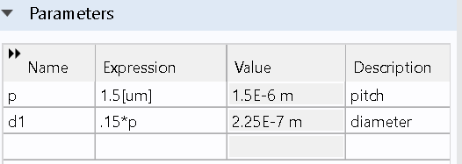
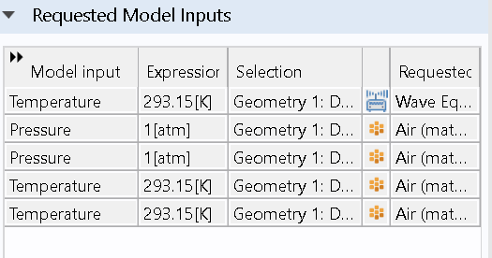
PARAMETERS TO DESIGN PHOTONIC CRYSTAL:
Here Pitch And Diameter Are The Main Parameters Use To Design
A Photonic Crystal
MODEL INPUT REQUIRED TO DESIGN A MATERIAL:
The Main Input For Designing The Photonic Crystal Is
The Same As The Rectangular Wave Guide Both The
Temperature And Pressure Is Used.

Slide 18
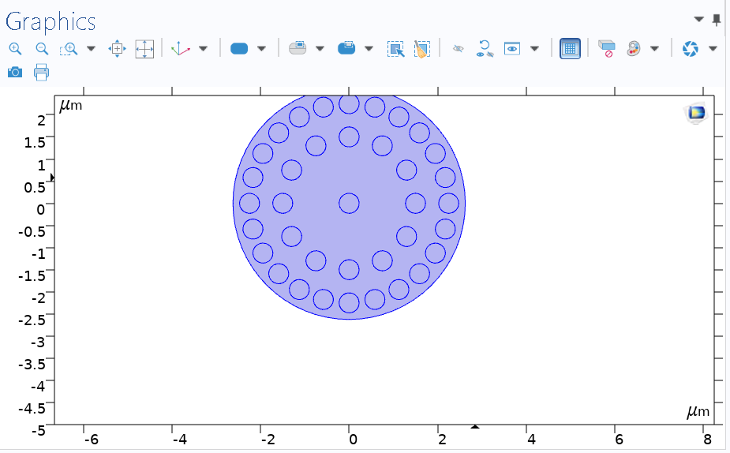
ELECTROMAGNETIC WAVE FREQUENCY :
By Electromagnetic Wave Frequency The Photonic Crystal Will Be In The Above Mentioned Form.
MESH AND STUDY:
After Mesh State Study State Will Be Applied It Contains Both Mode Analysis And Solver Configuration.
Choose An Appropriate Solver Simulation As The Frequency Domain Or Time Domain Solver, Depending On Your Requirements.

Slide 19
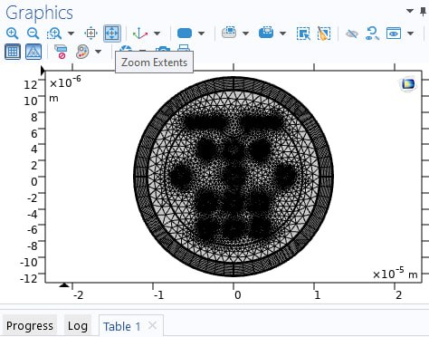
MESH:
By This Process The Photonic Crystal Will Be Divided Into Tiny Parts So We Can Calculate The Heat Transfer From One Part And The Other Can Be Multiplied.
After This Process Study Process Can Be Done By The Mode Analysis And Solver Configuration . Then The Final Result Can Be Observed.

Slide 20
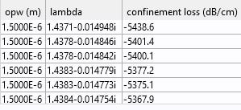
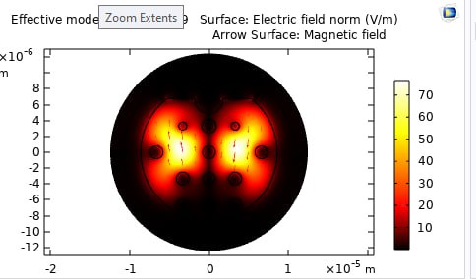
DERIVER VALUE FLOW OF ELECTRIC FIELD
The Above Values Are The Appropriate Value
Of The Photonic Crystal Fiber

Slide 21
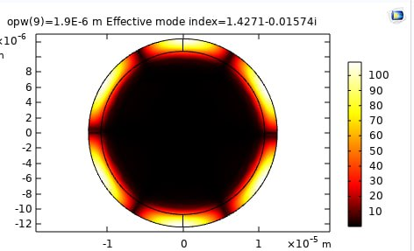
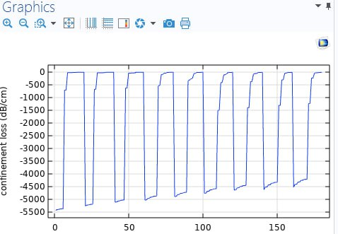
RESULT: GRAPHICAL REPRESENTATION
By Changing The Effective Mode Index The Electric
Field Can Be Changed . The Above Picture Is The
Electric Field Flow For Another Effective Index.

Slide 22
THANK YOU

