Slide 1

PRESENTED BY
SAI MOHIT VANAPALA

Slide 2
Agenda
Demo
Architecture
Web Scraping
Data Ingestion
Custom Tools
RAG
Future Work
Questions

Slide 3
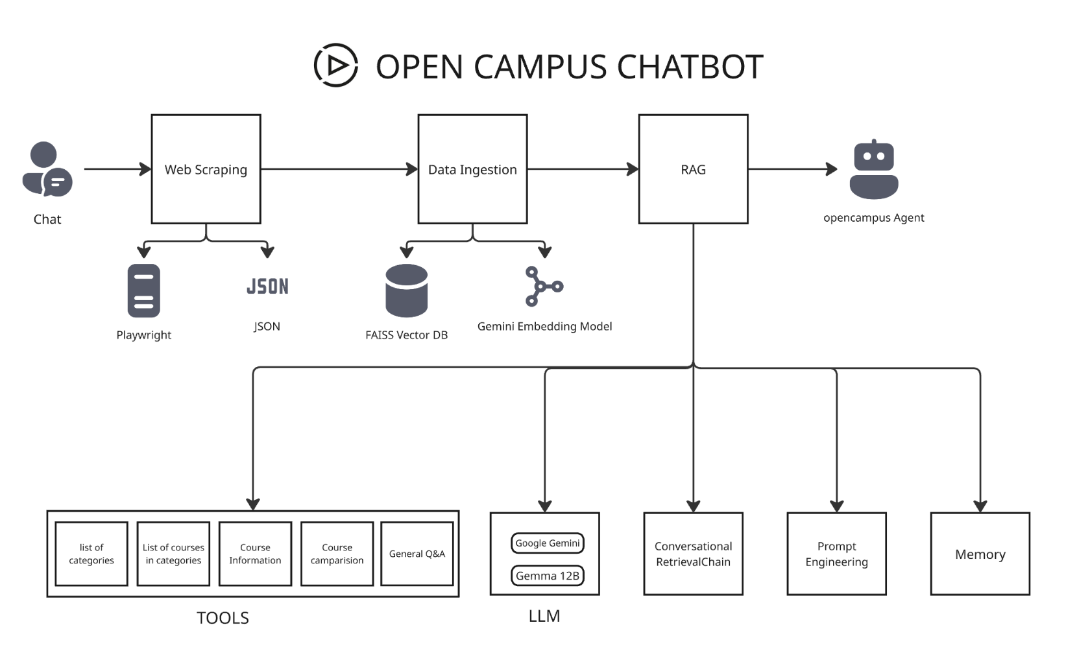

Architecture

Slide 4
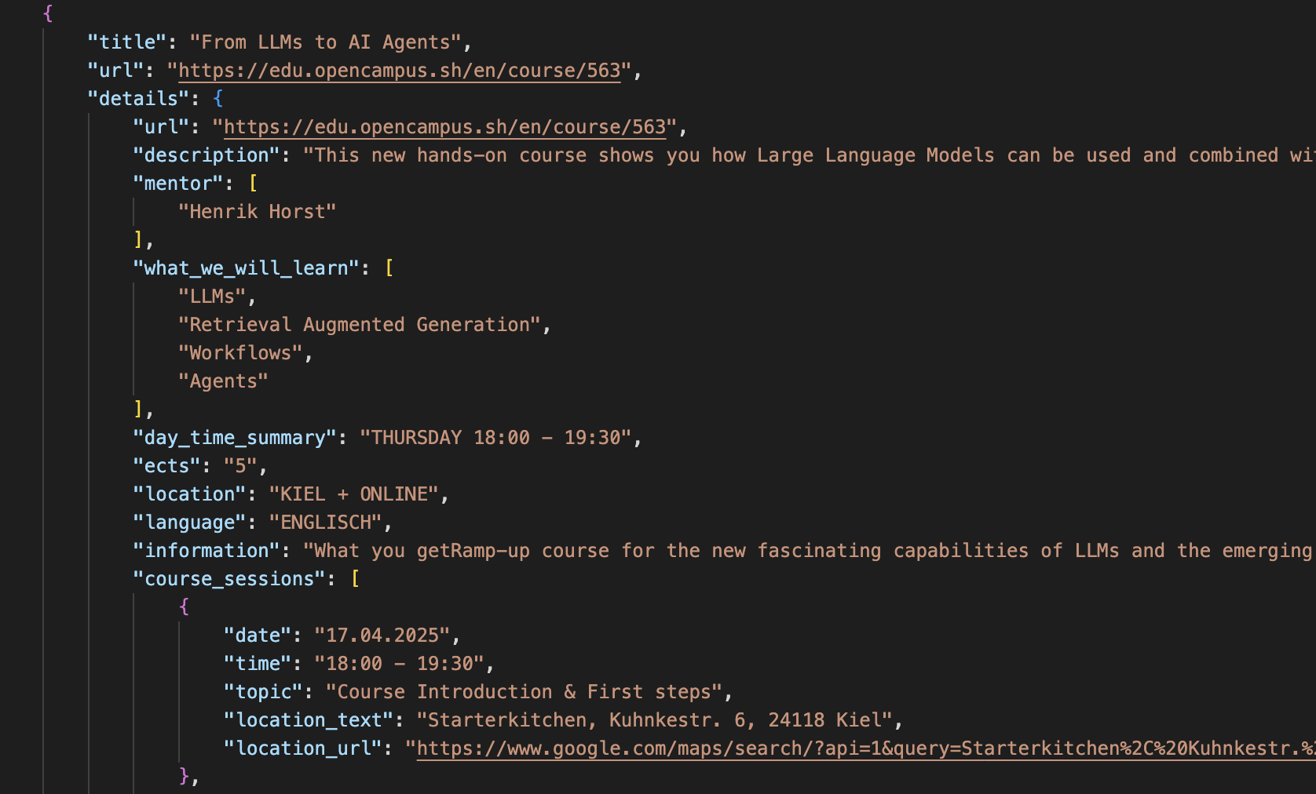


Web Scraping
Open Campus Courses Categories
1. Creative, Social & Sustainable
2. Business & Startup
3. Tech & Coding
4. Degrees
PYTHON
Playwright

Slide 5


Data Ingestion
Data Loading
Document Preparation
Text Splitting & Chunking
Embedding
FAISS
FAISS
text-embedding-004

Slide 6
CUSTOM TOOLS
l
Provides a comprehensive list of all available course categories.
List Categories
Provides lists all individual courses available within a specified identified category.
List Courses
Course Details
Provides detailed information for a specific course.
Compare courses
Provides a side-by-side comparison of two courses.
Handles other queries that do not directly map to specific tools mentioned above.
General Q&A

Slide 7
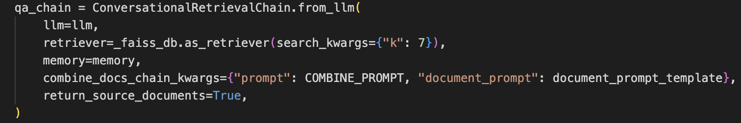
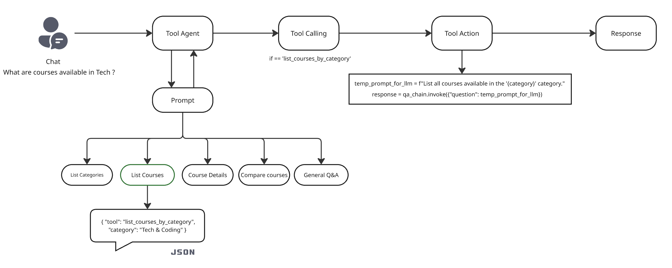
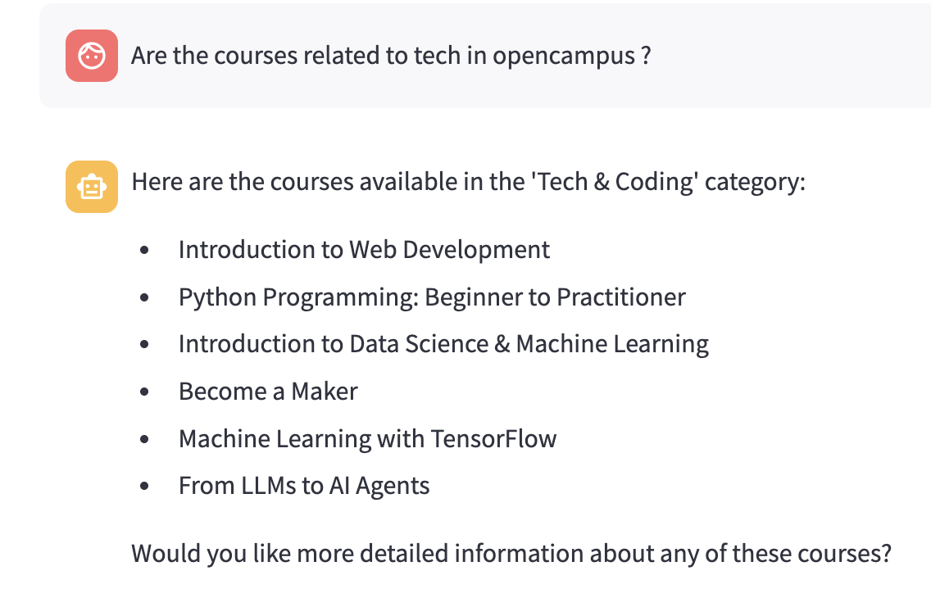

Slide 8

DEMO

Slide 9
Future Works
Build End-End pipeline which automatically fetches data from website or run schedule jobs to fetch data monthly / weekly.
Enable course registration through chatbot itself.
Integrate with other Large Language Models.
Integrate with our channel to get updates and answer common questions which are related to course.

Slide 10

QUESTIONS

Slide 11

THANK YOU

