Slide 1
Принципы работы, внутренняя структура, Java bean.

Slide 2
Литература
https://spring.io/
Spring in Action(Craig Walls)
Java Persistence API and Hibernate(Christian Bower)

Slide 3
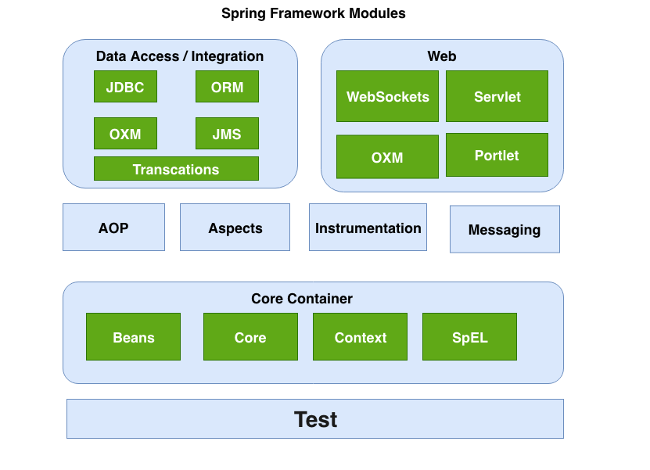

Slide 4
Задачи
Упрощение кода приложения
Слабое связывание компонентов
Декларативное программирование

Slide 5
Основные понятия
Plain Old Java Object(POJO)
Java Bean
Dependency Injection(DI)
Inversion of Control(IoC)

Slide 6
POJO
public class Cat { private String color; private String breed; public void voice(){ } //Getters and Setters } | public class Cat implements Component{ private String color; private String breed; public Cat getComponentInstache(){ return new Cat(); } public void voice(){ } //Getters and Setters }

Slide 7
DI
public class Main { private Animal dog; private Animal cat; public Main(Animal dog, Animal cat) { this.dog = dog; this.cat = cat; } public static void main(String[] args) { Main main = new Main(new Dog(), new Cat()); main.cat.voice(); main.dog.voice(); } }

Slide 8
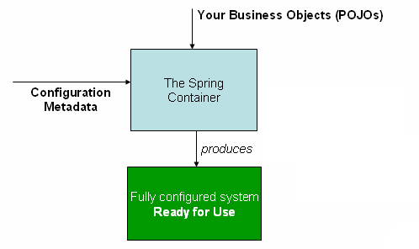
IoC
ClassPathXmlApplicationContext
FileSystemXmlApplicationContext
XmlWebApplicationContext

Slide 9
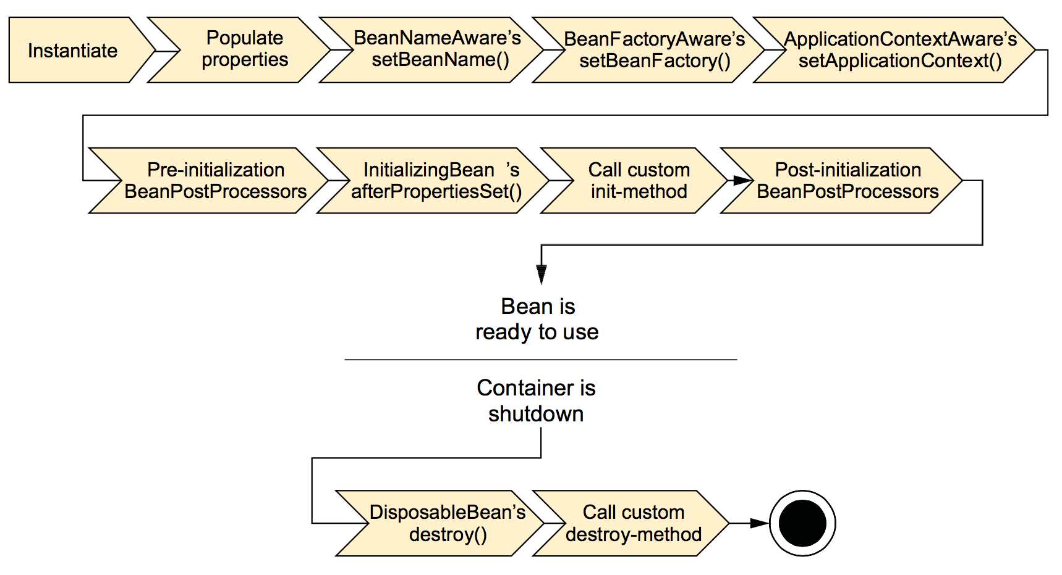
Bean life circle

Slide 10
Bean scopes
singleton
prototype
request
session
application

Slide 11
Events
ApplicationEvent
ApplicationListener

Slide 12
Tools
Intellij Idea
Build tool(Maven/Gradle)
Database(Mysql/Posgress)
Discord

