Slide 1
Category review: Chips
June 2026
Retail Analytics
Saimoon Adnan
Brand note: If client logo is not required, use alternate title page layout right click slide thumbnail > Layout > Title

Slide 2
Notes:
To view Privacy video explaining how important data privacy is to Quantium, please click here: https://www.youtube.com/watch?v=Zq1QDAkoRzU
or here Q:\Company Reference\Brand & Design\Brand videos\Q Privacy.mp4
At Quantium, we believe that data is the behavioural footprint of humanity and that it has to be treated with the utmost care and responsibility.
Histories, attitudes, indeed lives are stored within it in ways that aren’t always apparent – and that’s what makes its potential so powerful.
To work with it responsibly, sensitively, we set ourselves the highest data privacy protection and governance standards.
We have spent 17 years perfecting privacy-by-design and secure-by-design principles. Central to this is not holding any personally identifiable information about people –
we neither receive it, and put the necessary protections in place to be unable to decipher it.
Every aspect of handling data is safeguarded: from its de-identification, to its encryption – data security is paramount and of the highest grade.
We pride ourselves on gaining the trust of iconic organisations around the world through years of securely working with their data,
and in turn the trust that builds with their stakeholders.

Slide 3
Executive summary
Budget Older Families generated the highest total sales ($156.9K)
Mainstream Young Singles/Couples represented the largest customer segment (7,917 customers)
Mainstream Young Singles/Couples paid the highest average unit price ($4.07 per pack)
Kettle, Pringles and Doritos were the most preferred brands
01
Task 1
02
Task 2
Store 77 achieved a 29.1% sales uplift during the trial period
Store 86 achieved a 9.8% sales uplift
Customer counts increased in both trial stores
Store 88 requires further investigation due to control store matching issues

Slide 4
01
Category
The chips category is primarily driven by Budget Older Families and Mainstream Young Singles/Couples. While Budget Older Families generate the highest overall sales, Mainstream Young Singles/Couples represent the largest customer base and pay the highest average price per packet, making them the most valuable target segment for future growth.

Slide 5
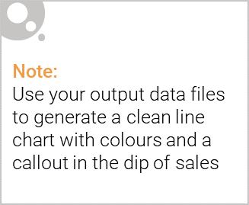
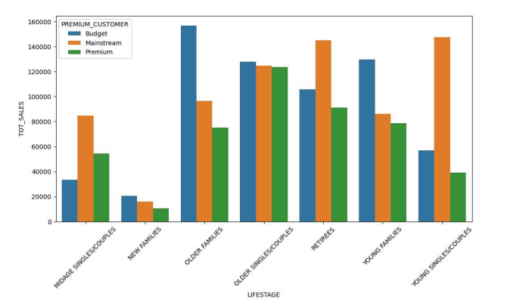
The chips category is primarily driven by Budget Older Families and Mainstream Young Singles/Couples. While Budget Older Families generate the highest sales revenue, Mainstream Young Singles/Couples represent the largest customer base and pay the highest average price per pack, making them a strategically valuable segment for future growth.
Total Sales by Segment chart

Slide 6
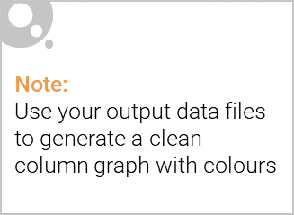
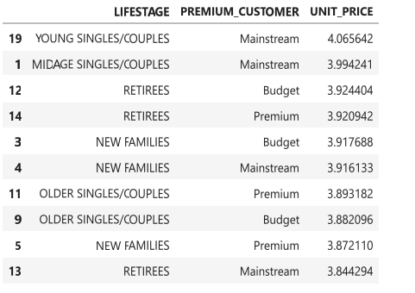
Affluence & Consumer Buying Behaviour
Mainstream customers demonstrate a greater willingness to pay for premium chip products. Young Singles/Couples in the Mainstream segment paid the highest average unit price across all customer groups, indicating stronger engagement with premium brands and products.
Average Unit Price = $4.07
Value = 1.48 × 10^-260
Statistically Significant Difference
Average Unit Price Table
Mainstream Young Singles/Couples paid the highest average unit price per pack ($4.07), indicating stronger engagement with premium products.

Slide 7
02
Trial store performance
Control stores were selected based on similarity in historical sales performance during the pre-trial period.

Slide 8
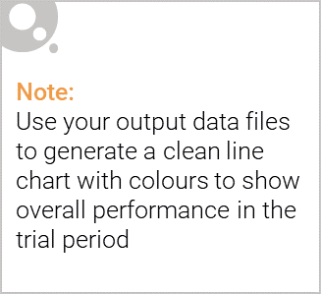
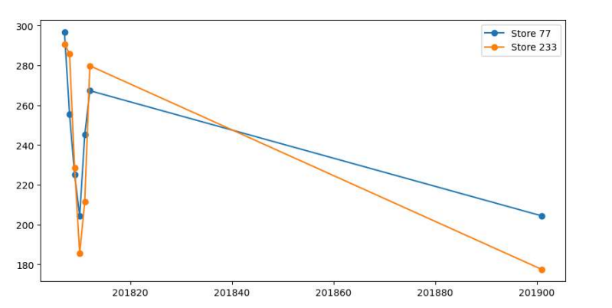
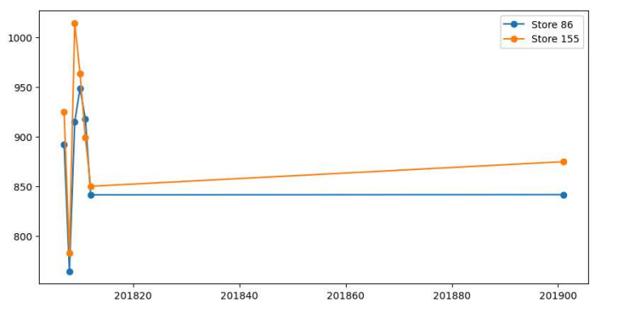
Control stores were selected based on similarity in historical sales performance during the pre-trial period.
Store 77
Sales Uplift: +29.1%
Customers: 142 vs 115
Strong positive trial performance
Store 86
Sales Uplift: +9.8%
Customers: 327 vs 288
Moderate positive impact

Slide 9
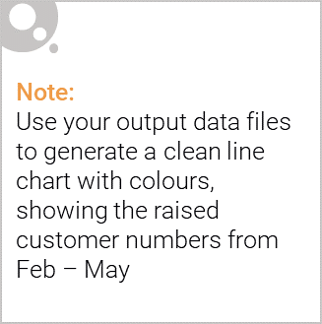
Recommendation
Recommendation 1
Focus future marketing activity on:
Mainstream Young Singles/Couples
Recommendation 1
Focus future marketing activity on:
Mainstream Young Singles/Couples
Recommendation 3
Expand successful Store 77 trial learnings to similar stores.
Recommendation 4
Conduct further analysis for Store 88 using a better matched control store.

