Slide 1

BSC Company Revenue Analysis
Done By
Naga Pooja Kilaru
Sai Mounika Lingampally
Rahul Raj Alluri
Vinuth Dachepally
Likhitha Sunkavalli
Som Sairam Bejawada

Slide 2
Overview of Product Category
Books
Electronics
Music
Movies

Slide 3

Variance Analysis

Slide 4
Every year, the Electronics segment has the highest revenue. In Electronics, this suggests strong market demand or a competitive advantage.
Region revenue variance percentages are highest in the Northwest and South, suggesting significant sales performance or market conditions changes over the analyzed period.
Variance analyses for each product category show revenue growth year-over-year. Efficient marketing, expansion, or product market growth could be behind this consistent increase across categories.

Slide 5
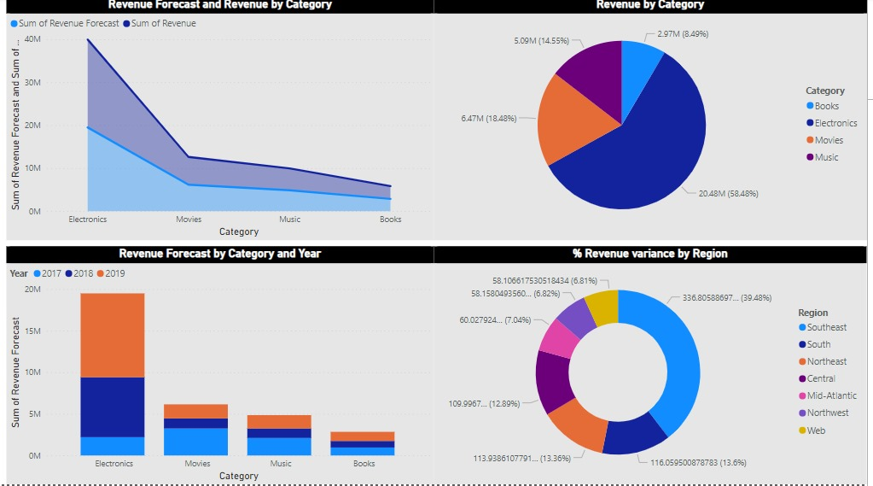

Slide 6
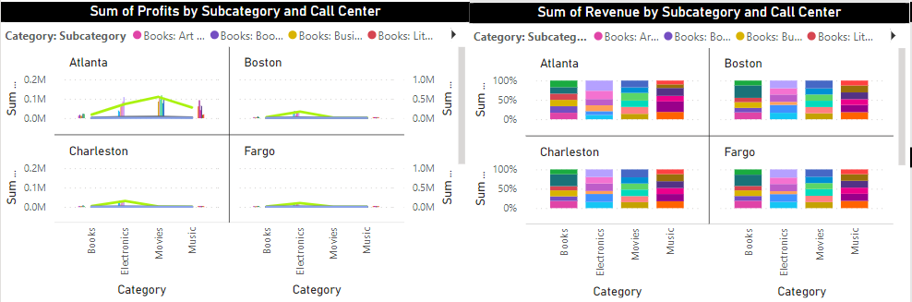
Variance Analysis : Subcategory & Call Center

Slide 7
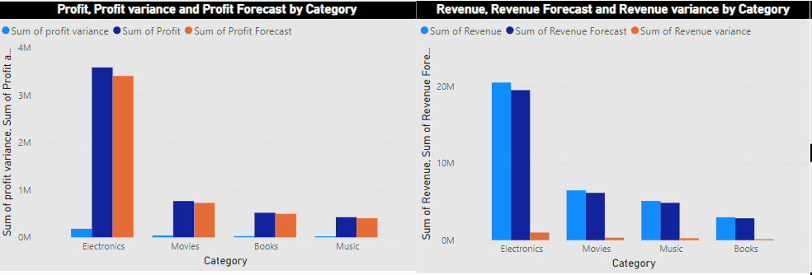
Profit and Revenue By : Category

Slide 8

Baseline Budgeting

Slide 9
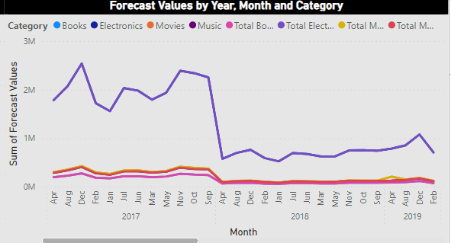
Forecast By Year and Category

Slide 10
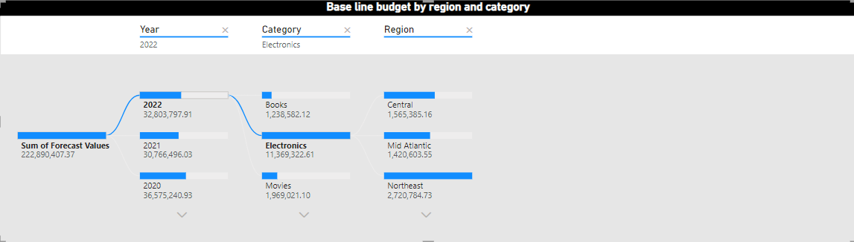
Baseline Budget Region & Category

Slide 11
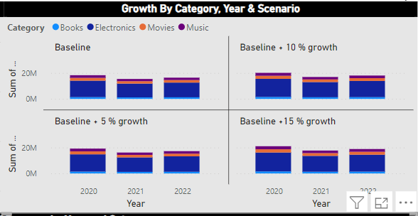
Growth Analysis

Slide 12
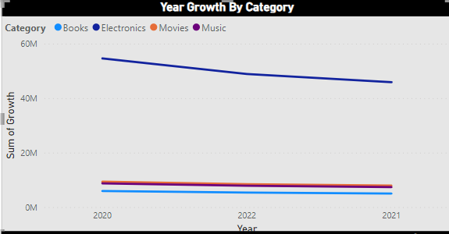
Growth Analysis

Slide 13
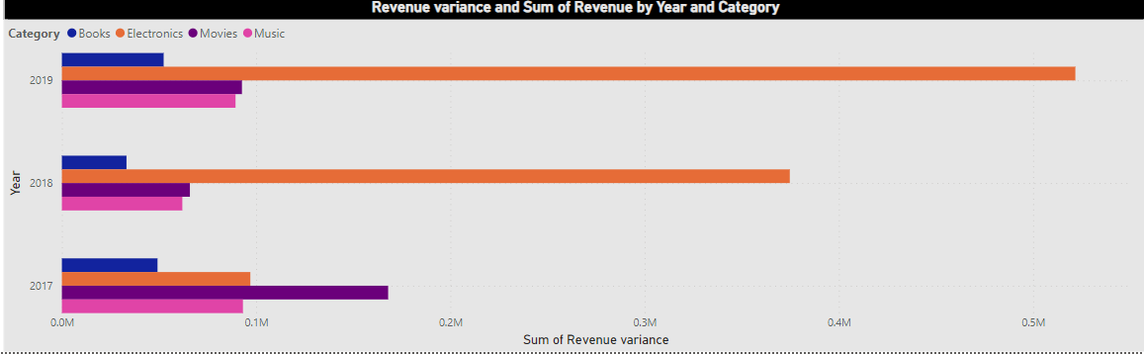
Revenue : Year & Category

Slide 14
Recommendations
BSC has to market its best-selling products and enter new markets such as electronics as loudspeakers and tablets to reach growth scenarios.
This strategic expansion for BSC will increase market competitiveness and long-term growth. However, market research is needed to determine what people want, what's happening, and what's blocking them.
This research will help create and launch new products that reach their target market and stand out. Due to their effective marketing campaigns, BSC will be able to strengthen its position and grow in the ever-changing market after the product launches.

Slide 15
Risks
The biggest risk for BSC's new products comes from well-known competitors with well-known brands.
To fight this, BSC can offer special packages that include deals on music, movies, and books along with electronics.
This new idea raises the value of the product and brings in customers, reducing the advantage of the competition.

Slide 16
Thank You!

