Slide 1
Interface Intelligence
Elevating Designs With AI Tools
Muhammad Saim Hameed

Slide 2
Prologue
Interaction of AI and UX design.
Use of AI to make UX and UI development more efficient/less time taking.
Making interfaces simpler yet more engaging.
Introduce impact of AI generative tools.
Aims & Objectives:
To examine how AI can speed up and improve interface design.
To assess AI's role in creating interfaces that everyone finds easy to use.
Reasoning:
With AI, interfaces can adapt to user needs automatically.
Interfaces are our gateway to digital tools and information

Slide 3
Approach
Generative AI generates new content based on a patterns it learns from existing datasets.
Creating UI’s from various generative AI tools/websites using the same theme (furniture website).
Implementing analytical AI tools on generative UIs.
Compiling results in a presentable manner.
Evaluation and discussion of results.
Uizard | Webador | ChatGPT 3.5 & 4.0
Open-source tool. | Free and paid plans. | Free and paid plans.
Develops UI. | Develops UI and webpages. | Generates custom codes.
Includes AI automation. | Includes AI automation. | Troubleshooting abilities.
Smart content suggestion, automated design optimization, personalised user interaction. |  | Supports multiple languages. E.g. React, JS, HTML, etc.
Continues next page…

Slide 4
Tools mentioned in the previous slide provided various forms of UI.
Following are the evaluation tools used.
Saliency Tool | Aalto Interface Metrics(AIM) | NIMA SCORES
Open source(Open cv-library) | Available on Website, created by Aalto University. | One of AIM metrics.
Generates Heat Maps | It contains total 17 metrices | Calculated overall Nima score.
Highlights area of attraction | Examines usability and various factors | Important metrics to examine visuals and aesthetics
Gives overall saliency average score. | Each metrics is based on pre trained AI model. | Based on pre trained model.

Slide 5
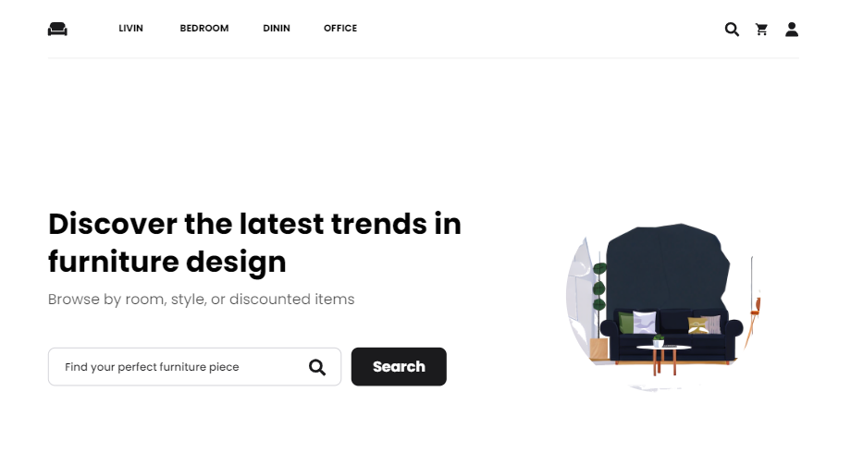
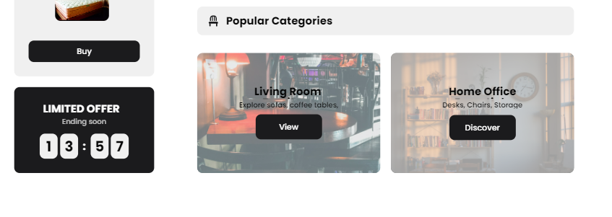
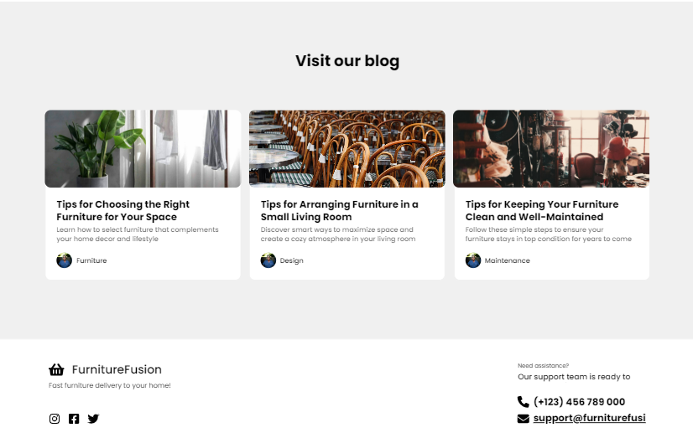
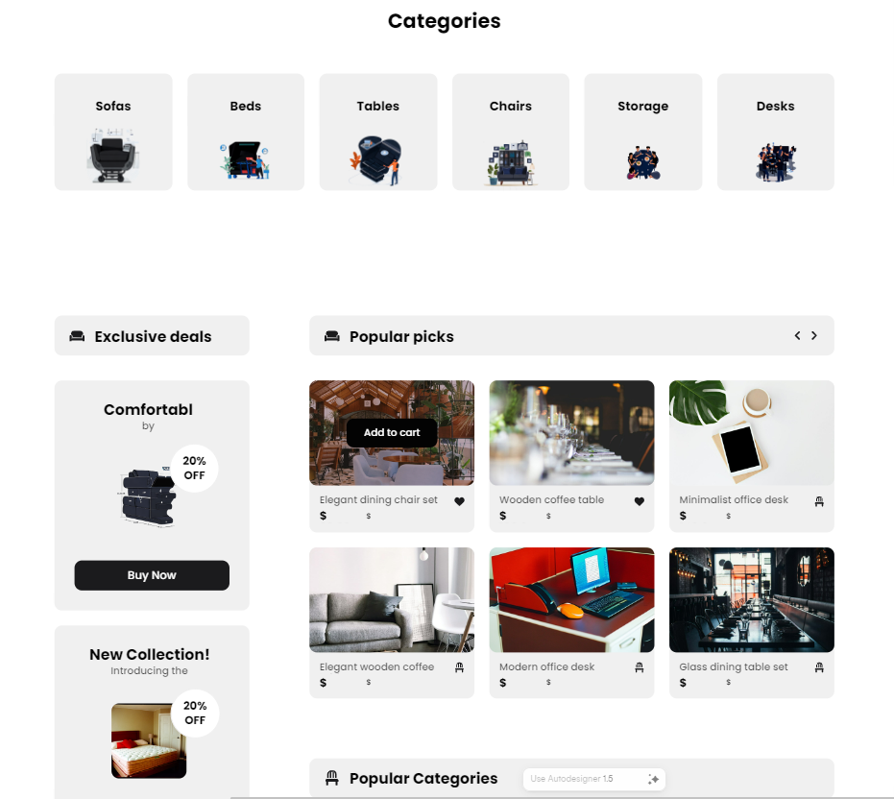
UIzard Output

Slide 6
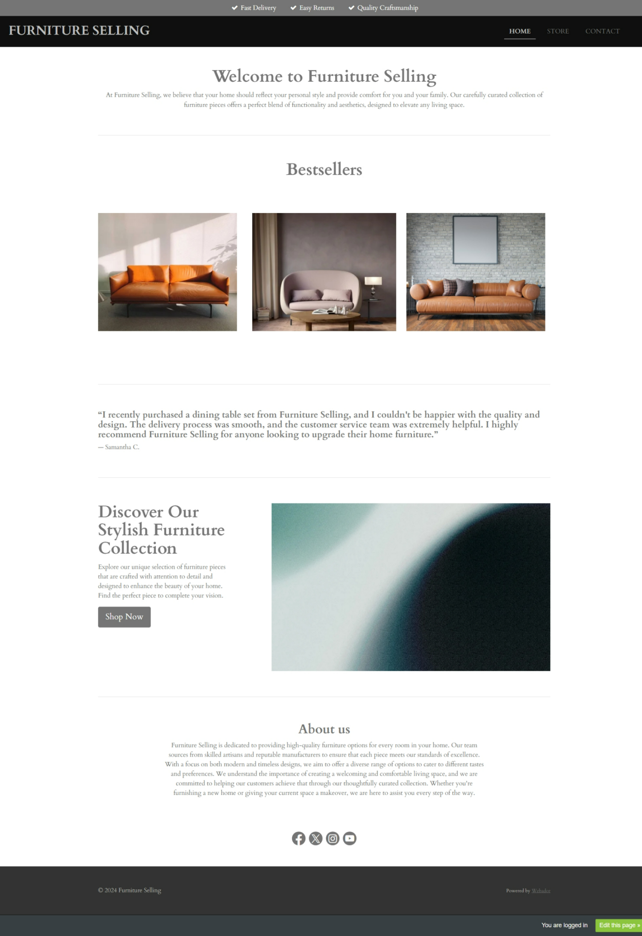
Webador Output

Slide 7
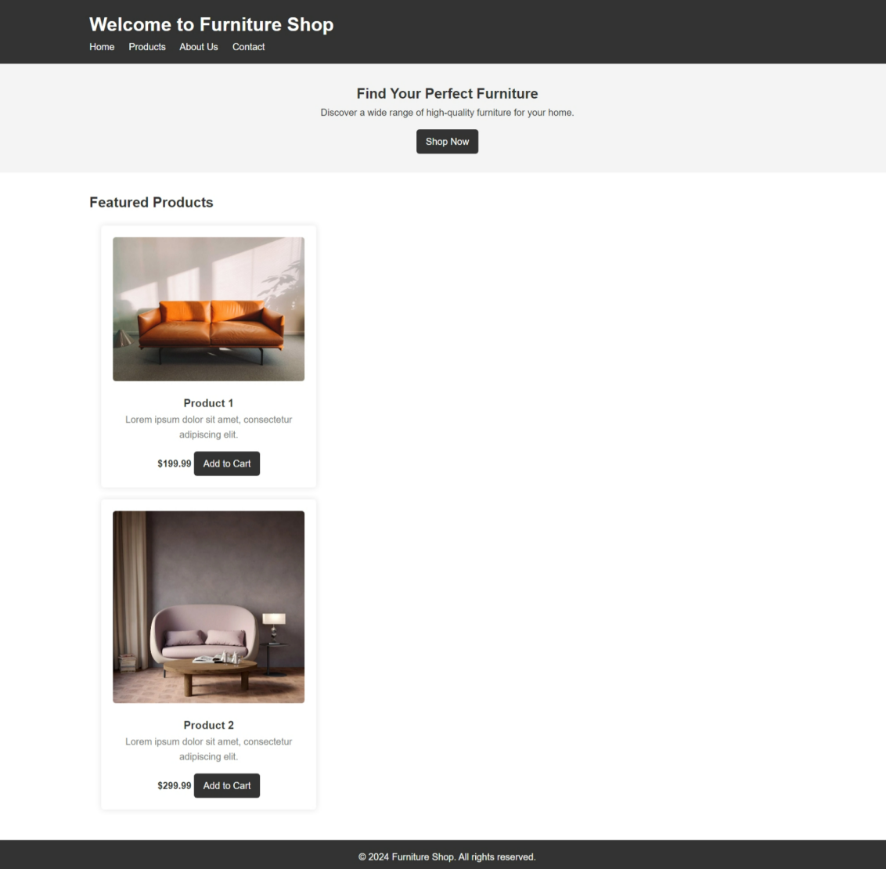
ChatGPT 3.5 Output

Slide 8
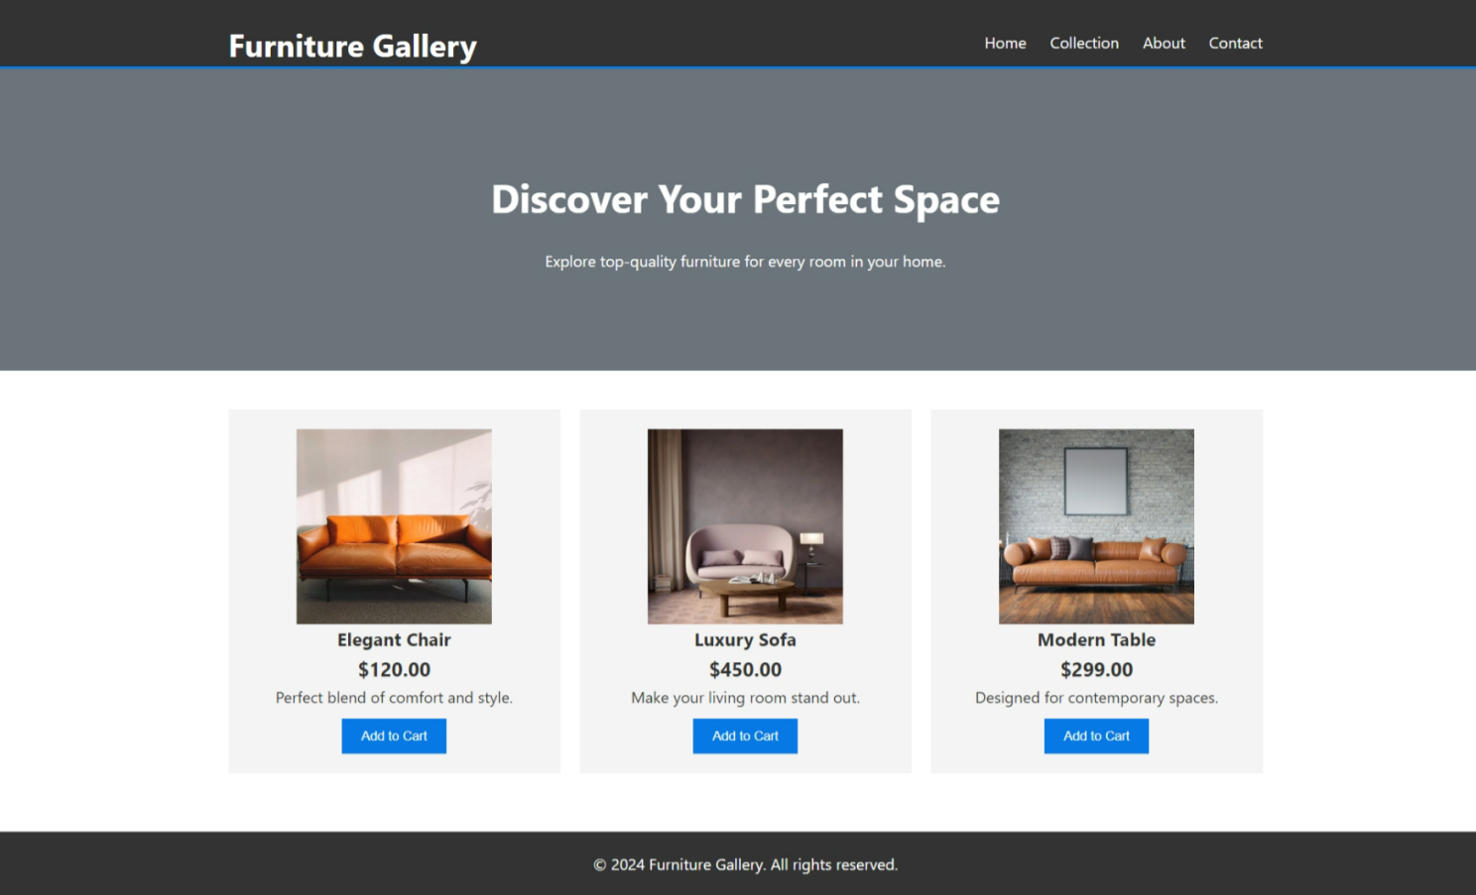
ChatGPT 4.0 Output

Slide 9
Performance Metrics of UIzard Output
The spider charts illustrates the eight AIM metrics used to assess the visual appeal and aesthetics of UIzard’s outputs.
REPRESENTS;
Clean and simple design.
Good balance of colors.
Not too busy or crowded.
Needs more standout elements to catch the eye.
Other design features weren't checked or shown.

Slide 10
Performance Metrics of UIzard Output
Represents:
Color harmony is high, meaning the colors look good together.
The page is lively, with a variety of colors.
It's not too packed with features, making it easier to use.
Contrast is strong, which helps important things stand out.
The layout isn't too dense, so it's clear where to look or click.

Slide 11
Performance Metrics of Webador Output
REPRESENTS;
Nicely balanced colors.
Simple and not too busy.
Good basics but could use more vivid colors and contrast.

Slide 12
Performance Metrics of ChatGPT 3.5 Output
REPRESENTS;
Harmonious color use.
Clarity in design with minimal feature clutter.
Could improve on color richness and contrast details.

Slide 13
Performance Metrics of ChatGPT 4.0 Output
REPRESENTS;
Good color coordination.
Design is straightforward with few distractions.
More vibrancy and contrast might be needed.

Slide 14
Key points from AIM results
Uizard 1: Simple, user-friendly, but needs more visual appeal, Best balance; clear and appealing with a good color mix.
Webador: Solid usability; could be more vibrant to engage users.
ChatGPT 3.5: Easy to use, but not as engaging due to low colorfulness.
ChatGPT 4.0: Slightly better color harmony than 3.5 but still needs more visual pop.

Slide 15
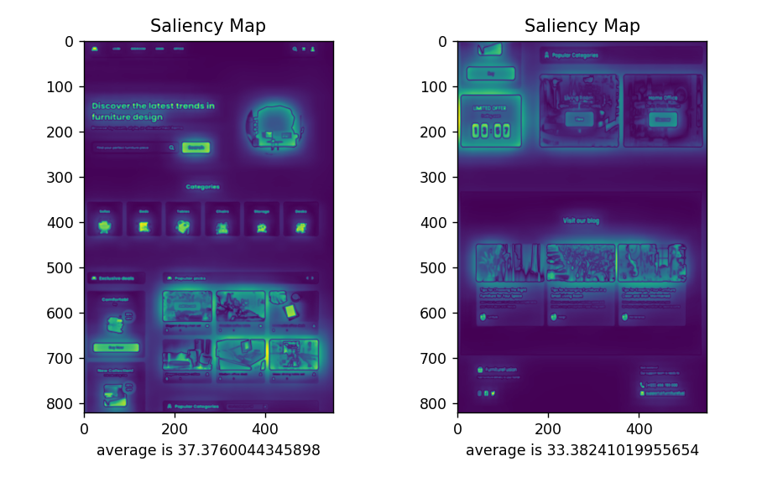
Saliency Outcome of UIzard
Left design has a higher saliency score, grabbing more attention.
Right design balances attention across the page.
Saliency scores are close, indicating both are effectively designed.
It highlights areas that the customer will find attractive.

Slide 16
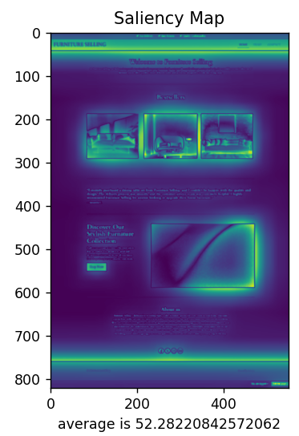
Saliency Outcome of Webador
Main content and call-to-action are the focus points.
Moderate attention on the top menu and images
Saliency score: 52.28, indicating effective design.

Slide 17
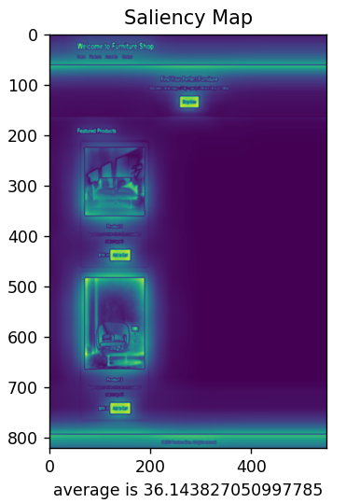
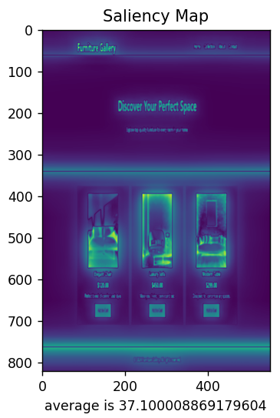
Saliency Outcome Chat GPT 3.5/4.0
OUTCOME OF 3.5
Focus is on the central part of the page.
Upper and lower sections draw less attention.
Saliency score: 36.14, suggesting a clear focal area.
OUTCOME OF 4.0
Highlights are on the headline and product images.
Even focus distribution across featured items.
Saliency score: 37.10, indicating effective design for engagement.
CHATGPT 3.5
CHATGPT 4.0

Slide 18
Nima Score Outcome
All UI designs rated 'Fair' by NIMA.
Webador has the highest score (6.0816), suggesting better visuals.
Uizard Home Page 1 scores lowest (5.0127), indicating most potential for improvement.
ChatGPT 3.5 slightly outperforms 4.0 in visual assessment.
Uniform ratings suggest uniform scope for design enhancements.
No. | UI Versions of Furniture Home Page | NIMA Score | Evaluation
1 | Uizard Home page 1 | 5.0127 | Fair
2 | Uizard Home page 2 | 5.6425 | Fair
3 | Webador | 6.0816 | Fair
4 | Chat Gpt 3.5 | 5.8081 | Fair
5 | Chat Gpt 4.0 | 5.5859 | Fair

Slide 19
How This Research Makes a Difference?
New Evaluation Methods:
I was able to replace old methods with AI tools like AIM, NIMA, and saliency.
Gave detailed insights on design and usability compared to traditional methods.
AI for Faster Design:
Showed how AI can speeds up making interfaces.
Used AI to refine designs and in-depth analysis for better user experience.
Mixing AI with Humans:
Balancing AI's help with human desire.
Possibility of training AI with datasets that fit people's needs.
AI Critical Feedback:
Used AI insights to analyse improvements needed to be made and discovered each factor of UI in depth.
Spotted chances for making designs more personal and customised.

Slide 20
Highlighting Limitations of Tools
Analytical Tools Limitations:
AIM, NIMA, and saliency tools may miss cultural or user-specific aspects.
Quantitative metrics might not grasp the whole picture of user interactions.
Generative Tools Drawbacks:
Uizard's fixed templates may limit unique designs.
Webador's simplicity might not allow for complex changes.
ChatGPT versions could struggle with understanding detailed design needs.
Lack of customization options may hinder creating standout designs.

Slide 21
How Can We Enhance Such Tools?
Tool Development:
Update AI tools (Uizard, Webador, ChatGPT) for flexibility.
Introduce customization options for unique designs since they are based on limited templates.
User-Centered Design:
Understand user preferences for tailored designs.
Use feedback loops to refine interfaces.
Comprehensive Analysis:
Enhance AI tools (AIM, NIMA, saliency maps) for qualitative insights.
Develop tools for holistic user interaction assessment (user-system interaction).

