Slide 1
SEMINAR
EEG-Based Guilty Knowledge Testing
Methods, Evidence, Limitations, and Future Directions
From Psychophysiological Recognition to Brain-Based Concealed-Information Detection
Saim Rasheed
Department of Information Technology
Faculty of Computing and Information Technology
King Abdulaziz University
Public edition v1.7 · October 2026
Notes:
1. What is GKT? Guilty Knowledge Testing (GKT), also known as Concealed Information Testing (CIT), is a technique used to assess whether a person recognizes specific information related to an investigated event.
2. How does it work? The person is presented with crime-relevant information (probe) mixed with plausible alternatives (irrelevants). Physiological responses, such as skin conductance or EEG-based P300 responses, are compared to identify evidence of recognition.

Slide 2
The Fundamental Question
THE FUNDAMENTAL QUESTION
Why start here: every method in this seminar is an attempt to answer this one question — and only this one.
“Can the brain reveal whether a person recognizes information they are trying to conceal?”
The scientific version
Not the question
Can physiological, behavioral, and particularly neural responses reveal recognition of information that a person may be attempting to conceal?
“Can EEG detect lies?” — the test probes recognition, not deception.
Notes:
The seminar starts from one question: can the brain reveal whether a person recognises information that the person is trying to conceal? In scientific form, the question is whether physiological, behavioural and especially neural responses differ between a meaningful probe item and comparable irrelevant items in a way that indicates recognition. The concealed information test answers it by comparison: responses to the probe are compared with responses to plausible alternatives within the same person. The measures are physiological signals such as skin conductance, heart rate and respiration, behavioural measures such as reaction time, and neural responses such as the EEG-based P300. A differential response can be evidence of recognition; it does not directly detect deception or establish an intention to conceal. The question is therefore not whether EEG can detect lies. Answering it requires one distinction first: recognition, deception and guilt are related concepts, but they are not equivalent.

Slide 3
Recognition ≠ Deception ≠ Guilt
CONCEPTUAL ANCHOR
Why first: every later claim depends on keeping these three levels apart.
Recognition
Deception
Guilt
Information appears familiar or cognitively significant
An intentional act of communicating something believed to be false
Responsibility for an act — a legal and investigative conclusion
≠
≠
What the CIT is designed to probe
An act — not a single physiological signal
Never an EEG measurement
EEG-based CIT investigates concealed recognition. A differential response to crime-relevant information can also arise from legitimate familiarity, media exposure, previous questioning, investigator leakage or incidental exposure.
Sources: [1], [11], [14], [53]
Notes:
This distinction comes first because every later claim in the seminar depends on keeping three levels apart. Consider the running example: a stolen diamond is hidden inside a red toolbox. Recognition means that the red toolbox appears familiar or significant to a person, which may produce a differential P300 response; recognition alone does not reveal how that knowledge was acquired. Deception is a further step: a person who recognises the toolbox and intentionally denies knowing it is deceiving, but an EEG recognition response cannot establish that intention on its own. Guilt is a further step again: even deliberate concealment does not prove that the person committed the theft, because the knowledge may come from legitimate familiarity, media exposure, previous questioning, investigator leakage or incidental exposure. Recognition, deception and guilt can be related, but they are not equivalent, and EEG-based GKT investigates recognition. The roadmap shows how the seminar answers the fundamental question in six steps.

Slide 4
Six Questions, Six Sections
SEMINAR ROADMAP
Why a roadmap: each section answers one question, and each builds on the assumptions of the one before.
I
What is EEG-based GKT, and why is it needed?
II
How does it work?
III
What does a real experiment look like?
Traditional measures · Lykken's logic · why EEG
EEG · preprocessing · stimuli · ERP · P300 · decisions
Mock theft · six images · files · first look at the data
IV
What can computation add?
V
What prevents real-world use?
VI
What is needed next?
Features · ML · deep learning · validation · results on real data
Recognition ≠ guilt · memory · countermeasures · ethics
Better experiments · better computation · a translation ladder
Each layer inherits the assumptions of the one before: a classifier cannot repair a badly chosen probe
Notes:
The seminar answers the fundamental question in six steps, and each section builds on the one before. Section I asks what EEG-based GKT is and why it is needed: the traditional measures, Lykken's recognition logic, and what EEG adds. Section II asks how the method works: the EEG signal, preprocessing, the three stimulus types, event-related potentials, the P300 and decision rules. Section III makes the methods concrete with one real experiment and its public dataset, from the mock theft to the files and a first look at the data. Section IV asks what computation adds: data structure, features, classical machine learning, deep learning, validation and person-level decisions, and then tests four models against a classical P300 test on the real dataset. Section V asks what still prevents real-world use, and Section VI asks what research is needed next. Every later layer inherits the assumptions of the earlier ones: a sophisticated classifier cannot repair a badly chosen probe, and deep learning cannot turn recognition into guilt. The next slide explains how to read the deck.

Slide 5
How to Read This Deck
OPENING · HOW TO READ THIS DECK
Why first: the deck mixes literature, simulations and real data, and every slide says which one it shows.
Learning objectives
Source legend
Explain why the CIT probes recognition, not deception
Describe how a P300 probe effect is measured and decided
Read a real public EEG-CIT dataset and its limits
Judge a computational result by its validation design
Schematic
illustration of an idea; no data
Real data
own analysis of the Dryad files
Reported [n]
stated in a cited paper
Prerequisites
Verified
checked directly in the released files
Basic statistics: mean, variability, resampling
No EEG background needed; ML basics help in Section IV
Assumed
not documented; inferred and labelled
Notation
Citations
µV microvolt · ms millisecond · Hz samples per second
L09 / H09 = participant 9 in the lying / honest folder
d* group-level effect size · AUC area under the ROC curve
[1]–[59] published studies · [S1]–[S3] supplementary AI-architecture papers · “Own analysis · data [37]”: newly computed from the public dataset
Notes:
This slide explains how the deck is meant to be used before the content begins. Four learning objectives frame it: to explain why the concealed information test probes recognition rather than deception, to describe how a P300 probe effect is measured and turned into a decision about one person, to read a real public EEG-CIT dataset together with its limits, and to judge a computational result by its validation design. No EEG background is required; basic statistics, such as means, variability and resampling, are enough, and basic machine-learning ideas help in Section IV. The legend on the right explains the labels used on figures and facts. Schematic or simulated figures illustrate an idea and contain no data. Real-data figures come from an own analysis of the public Dryad files: descriptive in Section III, and classification results at the end of Section IV. Facts marked as reported come from a cited paper; facts marked as verified were checked directly in the released files; anything assumed or inferred is labelled as such. Citations follow one convention: numbers from 1 to 59 identify published studies in the reference list, S1 to S3 identify supplementary papers on deep-learning architectures, and the label own analysis with data from reference 37 marks figures and results newly computed from the public dataset, not numbers reported by Gao et al. The notation key lists the units and codes that recur, including the L and H codes for participants in the lying and honest folders. Section I begins with the traditional measures from which the CIT emerged.

Slide 6
SECTION I OF VI
From Traditional Psychophysiological Methods to EEG-Based GKT
Understanding the foundations of concealed-information testing and the motivation for EEG-based approaches.
I · What & why
II · Methods
III · Experiment & data
IV · Computation
V · Limitations
VI · Future
Notes:
Section I asks what EEG-based GKT is and why it is needed. It starts with the traditional psychophysiological measures and the recognition logic that Lykken introduced, then sets out the running red-toolbox example and the mechanisms behind a probe response, and ends with why EEG adds a useful measurement and what makes a concealed information test EEG-based.

Slide 7
Traditional Psychophysiological Detection
I · FROM TRADITIONAL DETECTION TO GKT/CIT
Why start here: the CIT inherited its measures from this tradition — and its central inferential problem.
Electrodermal activity
Respiration
Cardiovascular
Behavioral
GSR / SCR / skin conductance
Breathing pattern, e.g. respiration line length
Heart rate; blood pressure where recorded
Reaction time and response patterns
MEASURED
INFERRED
A physiological change in response to a stimulus or question
Deception or knowledge — a conclusion that depends on the test logic, not on the signal alone
Sources: [1], [7], [16], [34]
Notes:
Before EEG, the concealed information test relied on traditional measures of responses to meaningful information.
First, electrodermal activity measures changes in the skin's electrical conductance. GSR (Galvanic Skin Response) is the traditional term, while SCR (Skin Conductance Response) refers to a brief increase in conductance caused by sweat gland activity. But how does this help in GKT? When a person recognizes a meaningful or crime-related item, it may trigger an orienting response, meaning increased attention to that item, and autonomic arousal, producing a stronger SCR than responses to irrelevant items.
Next, respiration measures changes in breathing patterns, including rate, depth, and respiration line length. In GKT, recognition of a significant item may produce temporary breathing suppression or reduced respiration line length, compared with irrelevant items. This provides another physiological indicator of differential responding.
Similarly, cardiovascular measures monitor changes in heart rate and blood pressure. When a meaningful item is presented, the person may exhibit temporary heart-rate deceleration, associated with orienting and attention. These changes can provide additional evidence when compared with responses to irrelevant items.
Finally, behavioral approaches examine reaction time and response patterns. For example, a person may take longer to respond to a recognized crime-related item because of increased cognitive processing or response conflict. However, these effects depend on the task and are not universal.
So, what is the common principle behind all these approaches? They measure physiological or behavioral responses, not deception itself. GKT uses the difference between responses to meaningful probes and irrelevant items to investigate possible recognition.
The next four slides examine each family of measures in turn, starting with electrodermal activity.

Slide 8
Electrodermal Activity: GSR, SCR and EDA
I · TRADITIONAL MEASURES · 1 OF 4
Why first: electrodermal recording is the measure the GKT was built on, and still the most studied CIT channel.
EDA
Electrodermal activity: the umbrella term
GSR
Galvanic skin response: Lykken's historical term
SCR
Skin conductance response: phasic, stimulus-evoked
SCL
Skin conductance level: slow tonic baseline
How it works
SCR to probe vs irrelevant
How it supports the GKT
Two electrodes on fingers or palm
stimulus
Recognized probe → larger SCR than irrelevants [1]
Behaves most like an orienting response [39]
Scored per item, e.g. amplitude or area [55]
Small constant voltage across the skin
ΔSC (µS)
Sympathetic activation fills eccrine sweat glands
-1
0
1
2
3
4
5
6
7
8
Limits
Conductance rises → SCR a few seconds later
Time from stimulus onset (s)
Slow responses need long intervals; habituates with repetition [10]; some people barely respond [38]; reduced by a mental countermeasure [9].
Probe
Irrelevant
General physiological background
Schematic — timing approximate; amplitude not to scale
Group-level synthesis: mean d* = 1.55 for SCR in laboratory CIT studies [34] — not an individual accuracy
Sources: [1], [9], [10], [34], [38], [39], [55]
Notes:
Electrodermal recording deserves the first close look because the guilty knowledge test was built on it and it remains the most studied CIT channel. EDA, electrodermal activity, is the umbrella term; GSR, galvanic skin response, is the historical name used by Lykken; SCR, skin conductance response, is the phasic change evoked by a stimulus; and SCL, skin conductance level, is the slow tonic baseline on which responses ride. Two electrodes on the fingers or palm apply a small constant voltage, and sympathetic activation of eccrine sweat glands raises conductance, producing a response a few seconds after the stimulus. In the CIT a recognized probe tends to produce a larger SCR than irrelevants, and fractionation studies show that it behaves most like an orienting response. The limits are practical: responses are slow and need long intervals, habituate with repetition, are weak in some individuals, and were reduced by a mental countermeasure in one study. The multimodal meta-analysis reports a mean group-level effect of 1.55 for SCR in laboratory studies, which is not an individual accuracy. The chart shows skin conductance in microsiemens relative to the pre-stimulus level; responses typically begin one to three seconds after onset, and the curves are schematic, not data. Respiration provides a second channel that behaves differently.

Slide 9
Respiration: RLL and Breathing Suppression
I · TRADITIONAL MEASURES · 2 OF 4
Why separately: respiration responds to the probe in the opposite direction from SCR — and for a different reason.
RLL
Respiration line length: total length of the breathing trace in a window
Pneumograph
Elastic belt sensor around chest or abdomen
Suppression
Shallower, slower breathing → shorter RLL
How it works
Breathing to probe vs irrelevant
How it supports the GKT
Elastic belts around chest and abdomen
stimulus
Recognized probe → breathing suppression (shorter RLL)
More consistent with arousal inhibition than orienting [39], [41]
Objective scoring compared with human evaluation [7]
Belt stretch tracks breathing movement
Chest expansion (rel. units)
Trace length summed over a post-stimulus window
-2
0
2
4
6
8
10
12
14
Limits
Shorter line = suppressed breathing
Time from stimulus onset (s)
Sensitive to speech and movement; depends on motivation to conceal; lab–field differences examined [40].
Probe
Irrelevant
General physiological background
Schematic — timing approximate; amplitude not to scale
Group-level synthesis: mean d* = 1.11 for RLL [34]; in one study a mental countermeasure affected EDA but not RLL [9]
Sources: [7], [9], [34], [39], [40], [41]
Notes:
Respiration needs its own treatment because it changes in the opposite direction from skin conductance and appears to reflect a different process. RLL, respiration line length, is the total length of the breathing trace over a fixed window after the stimulus; shallower or slower breathing produces a shorter line. A pneumograph, an elastic belt around the chest or abdomen, records the breathing movements. In knowledgeable examinees the probe tends to produce respiratory suppression, and fractionation studies indicate that this is more consistent with arousal inhibition, linked to the motivation to conceal, than with orienting. Respiration is sensitive to speech and movement, and its laboratory–field differences have been examined directly. The multimodal meta-analysis reports a mean group-level effect of 1.11 for RLL, and in one countermeasure study the mental strategy reduced electrodermal detection but not RLL detection, which shows why several channels can be informative. The chart shows chest expansion in relative units over roughly fifteen seconds, because respiration line length is scored over a window of several breaths; the curves are schematic, not data. The cardiovascular channel adds a third pattern.

Slide 10
Cardiovascular Measures: HR, ECG and BP
I · TRADITIONAL MEASURES · 3 OF 4
Why include it: heart rate adds a third response pattern, and its direction surprises many audiences.
HR
Heart rate: beats per minute
ECG
Electrocardiogram: electrical record of each heartbeat
IBI
Inter-beat interval: time between successive beats
BP
Blood pressure: recorded in polygraph practice
How it works
ECG → inter-beat interval → heart rate
How it supports the GKT
ECG electrodes on chest or limbs
IBI (ms)
R-peak
Recognized probe → heart-rate deceleration, not acceleration
Grouped with respiration: arousal inhibition [39], [41]
Orienting vs defensive responses distinguished [17]
R-peak detected in each heartbeat
ECG (mV) → HR (bpm) = 60 000 / IBI (ms)
stimulus
Inter-beat intervals → heart rate over time
ΔHR (bpm)
0
2
4
6
8
Limits
Probe: heart rate tends to slow
Time from stimulus onset (s)
Smallest pooled autonomic effect [34]; reactivity differs between individuals [19]. BP is not a focus of the reviewed literature.
Probe
Irrelevant
General physiological background
Schematic — timing approximate; amplitude not to scale
Group-level synthesis: mean d* = 0.89 for HR in laboratory CIT studies [34] — not an individual accuracy
Sources: [17], [19], [34], [39], [41]
Notes:
The cardiovascular channel adds a third response pattern, and its direction often surprises audiences: the heart slows rather than speeds up. HR is heart rate in beats per minute; ECG, the electrocardiogram, records the heart's electrical activity; IBI, the inter-beat interval, is the time between successive beats from which heart rate is computed; and BP, blood pressure, is recorded in polygraph practice but is not a focus of the reviewed literature. In knowledgeable examinees the probe tends to produce a heart-rate deceleration, and fractionation studies group this with respiratory suppression as more consistent with arousal inhibition than with orienting. Earlier work distinguished orienting from defensive responding to concealed information. Heart rate shows the smallest pooled effect of the three autonomic measures, a mean group-level effect of 0.89, and reactivity varies between individuals. The inset shows how heart rate is derived: the ECG is recorded in millivolts, R-peaks are detected, each inter-beat interval in milliseconds is converted to beats per minute, and the CIT scores the change from the pre-stimulus level; the curves are schematic, not data. The fourth family of measures needs no physiological sensors at all.

Slide 11
Behavioral Measures: RT and the RT-CIT
I · TRADITIONAL MEASURES · 4 OF 4
Why include behavior: reaction times detect concealed information without physiological sensors, so they are cheap and scalable.
RT
Reaction time: ms from stimulus onset to key press
RT-CIT
Reaction-time Concealed Information Test
aIAT
Autobiographical Implicit Association Test
How it works
Mean RT: probe vs irrelevant
How it supports the GKT
Stimulus appears on screen
longer RT ↑
Denying a recognized item creates response conflict → slower RT [12], [26]
Validity compared with the polygraph [26]
Combined with P300: CTP [24]; with the aIAT [30]
Participant presses a key, e.g. ‘no’ to every item
Software logs the response time per trial
Limits
Probe: responses tend to be slower
Probe
Irrelevant
Responses are under voluntary control, so strategies can alter them; resistance must be tested per protocol.
General physiological background
Schematic — timing approximate; amplitude not to scale
Behavioral evidence is cited qualitatively; the meta-analytic d* values cover SCR, RLL, HR and P300 only [34]
Sources: [12], [24], [26], [30]
Notes:
Behavioral measures matter because they detect concealed information without physiological sensors, which makes them inexpensive and scalable. RT is reaction time, the interval from stimulus onset to a key press; the RT-CIT is the reaction-time version of the test; and the aIAT, the autobiographical Implicit Association Test, is a related reaction-time procedure that has been combined with the P300. The participant typically gives the same denial response to every item, targets require a different response, and software logs each response time. Denying a recognized probe creates response conflict, so responses to the probe tend to be slower than responses to irrelevants, and the validity of the approach has been compared directly with the polygraph. Because responses are under voluntary control, strategies can alter them, and resistance must be tested for each protocol. The meta-analytic effect sizes cited for the other channels cover the autonomic measures and the P300 only, so behavioral evidence is described qualitatively here. The test logic these measures serve goes back to Lykken's guilty knowledge test.

Slide 12
Lykken (1959): The Guilty Knowledge Test
I · THE HISTORICAL ORIGIN
Why it matters: the GKT redefined the problem — from finding a lying signature to testing differential recognition.
Before: search for a lying signature
Lykken's shift: test differential recognition
Is there a physiological pattern unique to lying?
Inference depends on reactions being specific to deception
Does this person respond differently to the correct detail?
Inference depends on equivalence of the alternatives
Why several items strengthen the logic
1
Single item
2
Several independent items
3
Equivalent alternatives
An uninformed person can single out the correct alternative by chance
Consistent selection of correct alternatives by chance becomes progressively less likely
Alternatives must look equally plausible to an uninformed examinee
Sources: [1], [16]
Notes:
After the traditional measures comes the origin of the Guilty Knowledge Test itself.
In 1959, David Lykken introduced a different testing logic. Rather than searching for a physiological response unique to lying, he proposed examining whether a person responds differently to information they recognize.
To make the comparison meaningful, the test presents a correct, event-related detail among plausible alternatives, allowing physiological responses to be compared.
To strengthen this approach, multiple independent details can be tested. Consistent differential responses across several items provide stronger evidence of recognition than a single response.
However, the alternatives must be comparable. If the correct detail stands out for unrelated reasons, a stronger response may not reflect concealed knowledge.
Therefore, Lykken's key contribution was a shift from detecting deception to testing recognition. This principle remains central to modern EEG-based GKT/CIT.

Slide 13
The Red Toolbox
I · RUNNING EXAMPLE
Why one example: a single scenario keeps every later method comparable.
Red toolbox
Blue suitcase
Black backpack
Green storage box
PROBE
IRRELEVANT
IRRELEVANT
IRRELEVANT
What makes it a usable probe
What can break it
Nonpublic detail of the investigation
Alternatives equally plausible to an uninformed person
Media reports, questioning or leaked case files
Alternatives that differ in salience from the probe
Sources: [11], [44], [51]
Notes:
To understand how GKT works in practice, consider a theft investigation in which a stolen diamond was hidden inside a red toolbox.
Here, the red toolbox is the probe, the actual crime-related detail, while the blue suitcase, black backpack, and green storage box serve as irrelevant alternatives.
The basic principle is to compare responses. If a person recognizes the red toolbox, they may respond differently to it than to the other items.
However, this comparison is meaningful only under certain conditions. The correct detail must not be publicly known, and the alternatives must be equally plausible to an uninformed person.
Otherwise, information leakage or an unusually distinctive probe could produce a differential response unrelated to concealed knowledge.
This raises an important question: Why might a recognized probe produce a stronger or different physiological response in the first place?

Slide 14
Why Does the Probe Elicit a Different Response?
I · MECHANISMS
Why ask: if the mechanism is unknown, the meaning of a positive result is unknown.
Orienting
Recognition
Stimulus significance
Response fractionation
Attention captured by a significant item
Memory match to a known detail
Personal or task relevance of the item
Skin conductance: more consistent with orienting
Respiration and heart rate: more consistent with arousal inhibition
Pupil vs fixations/blinks show a similar split [54]
Inhibition
Conflict
Attention
Effort to suppress arousal while concealing
Tension between knowledge and required response
Allocation of processing resources
Different measures can reflect different mechanisms
Sources: [17], [39], [41], [45], [50], [53], [54]
Notes:
Building on the red toolbox example, why might a probe produce a different physiological response?
First, orienting occurs when a significant item captures a person's attention.
Next, recognition occurs when the item matches information already stored in memory.
Furthermore, stimulus significance makes the item personally meaningful or relevant to the task.
In addition, inhibition may occur when someone attempts to suppress their reactions.
Similarly, conflict may arise between what a person knows and how they are required to respond.
Finally, attention determines how much cognitive processing is allocated to the item.
Importantly, these mechanisms may contribute differently to physiological responses. Skin conductance is more closely associated with orienting, while respiration and heart-rate changes may also reflect arousal inhibition.
Therefore, a differential response may reflect several interacting mechanisms, not a unique signal of deception.

Slide 15
Why EEG for Concealed-Information Research?
I · WHY EEG?
Why ask: EEG's value lies in timing — matching brain activity to each individual stimulus.
1
Non-invasive
Trade-off
Scalp electrodes; no injection or radiation
Limited spatial precision: scalp EEG does not localize cortical sources directly.
2
High temporal resolution
Activity tracked at the millisecond scale
3
Event / stimulus locking
Responses aligned to each probe or irrelevant
4
Cognitive processing
Next
Sensitive to attention, memory and significance
One ERP component became particularly influential: the P300.
5
ERP extraction
Averaging or single-trial analysis isolates components
Sources: [3], [47]
Notes:
Traditional autonomic CIT has demonstrated promising results, particularly through skin conductance responses. However, these responses are relatively slow, vary across individuals, and can be affected by countermeasures. This motivates exploring EEG as an additional approach.
First, EEG is non-invasive, recording electrical activity through electrodes placed on the scalp.
More importantly, EEG offers high temporal resolution, capturing brain activity at the millisecond scale.
This allows stimulus locking, where brain responses are aligned with each probe or irrelevant item to examine differences.
Furthermore, EEG provides insights into cognitive processing, particularly attention, memory, and stimulus significance.
Finally, Event-Related Potentials (ERPs) allow recognition-related brain responses to be examined with averaging or single-trial analysis.
However, EEG also has limitations, including limited spatial precision, individual variability, and susceptibility to countermeasures.
Among the ERP components investigated in concealed-information research, the P300 has received particular attention. The next slide defines what makes a concealed information test EEG-based.

Slide 16
What Makes a CIT EEG-Based?
I · DEFINITION
Why define it: the title promises EEG-based GKT, so its ingredients should be explicit before the methods.
The five ingredients
CIT paradigm: probe · target · irrelevants
→
Stimulus-locked EEG: every item marked in the recording
→
Neural marker: P300 (also N200 and feedback-related ERPs)
→
Within-person comparison: probe vs irrelevants
→
Decision rule: bootstrap test or classifier
What it measures
A recognition-related cortical response: the probe is processed as significant
Not a deception signal, and never guilt
A simple test of the definition
Remove the EEG: it is an autonomic or behavioural CIT
Remove the probe–irrelevant comparison: it is no longer a CIT
EEG-based GKT = CIT logic + stimulus-locked EEG + a within-person probe–irrelevant decision
Sources: [3], [24], [33], [47], [48], [56]
Notes:
With the value of EEG established, the next step is to define what makes a concealed information test EEG-based. Five ingredients are needed. The first is the CIT paradigm: a meaningful probe presented among plausible irrelevant items, with targets included in many protocols. The second is stimulus-locked EEG, with the onset of every item marked in the recording so that its neural response can be examined. The third is a neural marker, above all the P300, which can reflect recognition, attention and stimulus significance; N200 and feedback-related ERPs have also been used. The fourth is a within-person comparison, especially the difference between probe and irrelevant responses. The fifth is a decision rule, a statistical test such as the bootstrap or a classifier, that evaluates whether the difference is evidence consistent with recognition. Removing the EEG leaves an autonomic or behavioural CIT; removing the probe–irrelevant comparison leaves no CIT at all. EEG-based GKT therefore combines the recognition logic of the traditional CIT with stimulus-locked neural measurement and an appropriate decision rule, and it does not directly establish deception or guilt. Section II examines the EEG and P300 methodology in detail.

Slide 17
SECTION II OF VI
Methods: How Does EEG-Based GKT Work?
EEG and ERP foundations · the P300 · experimental design · acquisition and preprocessing · quantification and decision rules.
I · What & why
II · Methods
III · Experiment & data
IV · Computation
V · Limitations
VI · Future
Notes:
Section I established the recognition logic of the concealed information test and why EEG adds a useful measurement. Section II shows how EEG-based GKT works: the EEG signal and its artifacts, the three stimulus types and the structure of one trial, how event markers and averaging turn continuous EEG into event-related potentials, the oddball origin of the P300, and how a P300 difference is measured and turned into a decision about one person. The section begins with a map of the whole method.

Slide 18
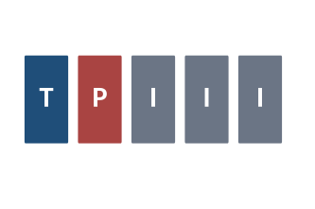
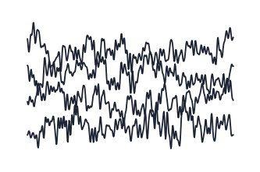
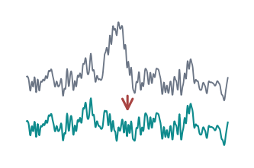
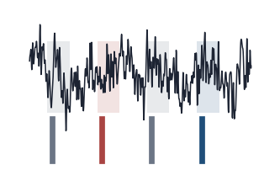
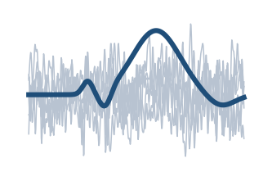
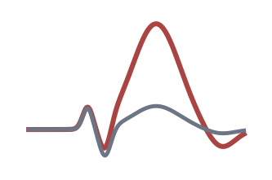
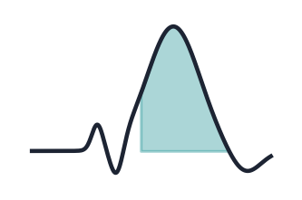
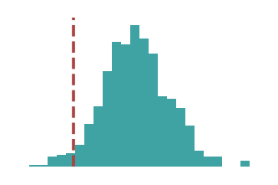
From Scalp to Decision: The Method in Eight Stages
II · METHODS AT A GLANCE
Why a map first: every stage is a methodological choice, and an error at any stage propagates to the conclusion.
1
Present stimuli
2
Record EEG
3
Clean
4
Epoch
Target · probe · irrelevants
Markers written as items appear
Filter · remove artifacts
Window around each marker
5
Average
6
P300 response
7
Quantify
8
Decide & interpret
ERP emerges from noise
Larger to rare, meaningful items
Amplitude · latency · area
Within-person test → recognition?
Two routes after stage 4: averaging → statistical CIT tradition (this section) · single trials → machine learning (Section IV)
Sources: [21], [37], [47]
Notes:
This slide is the map for the rest of the section, read from left to right across the top row and then across the bottom. Stimuli are presented while the EEG is recorded, and the presentation software writes a marker into the recording at the onset of every item; acquisition and stimulus synchronization therefore happen together. The recorded data are then cleaned, cut into epochs around each marker, averaged by stimulus type, inspected for a P300-related pattern, quantified, and finally submitted to a decision rule. The two routes along the bottom are especially important. Averaged responses support traditional statistical P300-CIT analyses, while single-trial representations lead naturally toward machine learning in Section IV. At every step, choices can change the final result. The section starts with the EEG signal itself, before any cleaning.

Slide 19
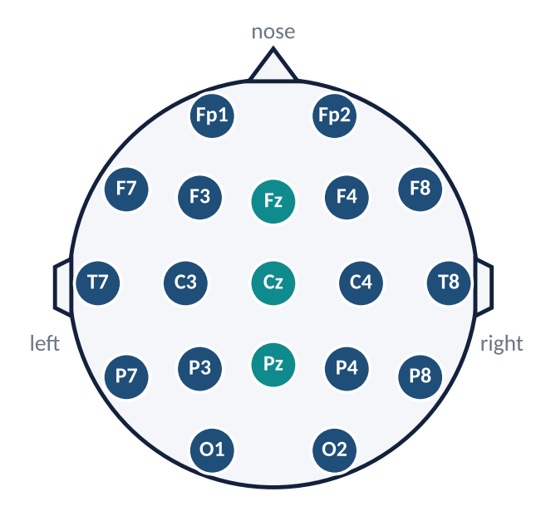
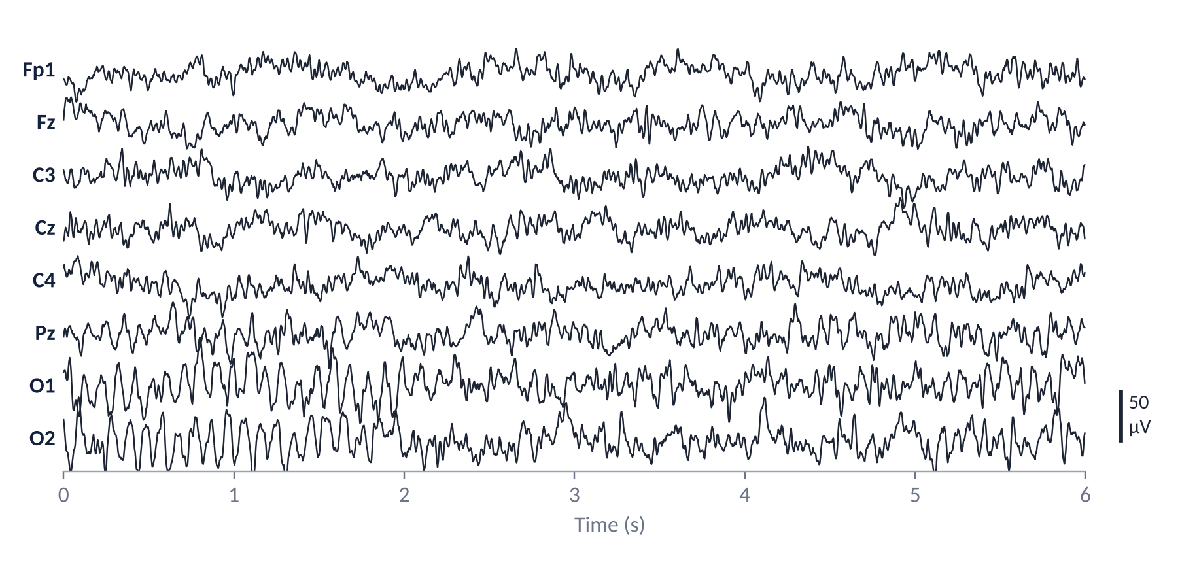
What Is EEG?
II · EEG, ERP AND P300 FOUNDATIONS
Why only the essentials: the CIT needs three properties of EEG — scalp voltage, continuity and millisecond timing.
International 10–20 system (subset)
teal = midline sites (z)
Simulated signals for illustration — typical scalp magnitudes, not recorded data. Posterior channels show ~10 Hz alpha.
Scalp voltage: µV-scale differences from synchronized cortical activity
Continuous: Background activity is larger than any single stimulus response
Millisecond timing: Sampled hundreds of times per second
Notes:
EEG measures tiny voltage differences at electrodes placed on the scalp. The diagram on the left shows a subset of the international 10–20 system. Electrode names indicate positions: F is frontal, C central, P parietal, and O occipital; z marks the midline. On the right are simulated continuous recordings from several channels. Notice that the signals fluctuate all the time, even when no specific test item is being presented. The posterior channels also illustrate an approximately ten-hertz alpha rhythm. Three properties make EEG useful here: microvolt-scale sensitivity, continuous recording, and millisecond timing. The last is essential because a P300-related response develops over hundreds of milliseconds after an event. A raw trace, however, cannot simply be read as evidence that a person recognized an item. Background neural activity is substantial, and the electrodes also pick up non-neural signals. The next slide shows what those artifacts look like.

Slide 20
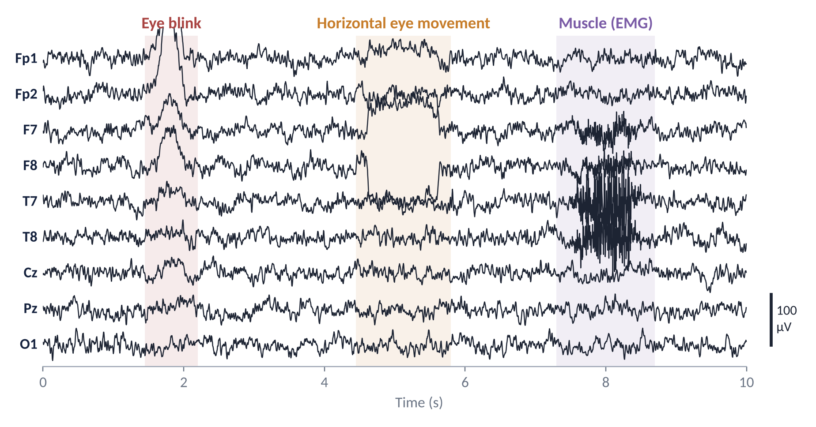
EEG Artifacts: Blinks, Eye Movements, Muscle
II · ARTIFACTS
Why now: artifacts are often far larger than the P300, so every preprocessing and modelling step must deal with them.
Eye blink
Frontal: Fp1 / Fp2
Large positive deflection, ~hundreds of ms
Shrinks towards posterior sites
Horizontal eye movement
Lateral frontal: F7 / F8
Box-shaped step
Opposite polarity left vs right
Muscle (EMG)
Temporal: T7 / T8
High-frequency bursts
Jaw clench, swallowing, tension
Simulated signals for illustration — typical scalp magnitudes, not recorded data.
Why it matters: artifacts can be time-locked to stimuli and mimic an ERP difference; a model can learn artifacts instead of recognition. Handled by EOG monitoring, rejection or correction (e.g. ICA [37]).
Sources: [37]
Notes:
Before any peak is interpreted as brain activity, common artifacts must be recognised. The traces here are simulated examples, not recorded observations. At the first shaded region, a blink produces a large slow deflection, particularly at frontal electrodes Fp1 and Fp2. The next region illustrates a horizontal eye movement, often showing opposing patterns over lateral frontal sites. The final region shows high-frequency muscle activity, such as jaw tension, which can contaminate temporal electrodes. These effects may be much larger than the P300 itself. More importantly, if participants blink or tense their muscles systematically when the probe appears, the artifact may become stimulus-linked and mimic a probe–irrelevant difference. A classifier can learn that shortcut just as readily as a genuine neural pattern. Eye activity is therefore monitored, and justified correction or rejection procedures are applied. The next slide shows how preprocessing reduces these contaminants.

Slide 21
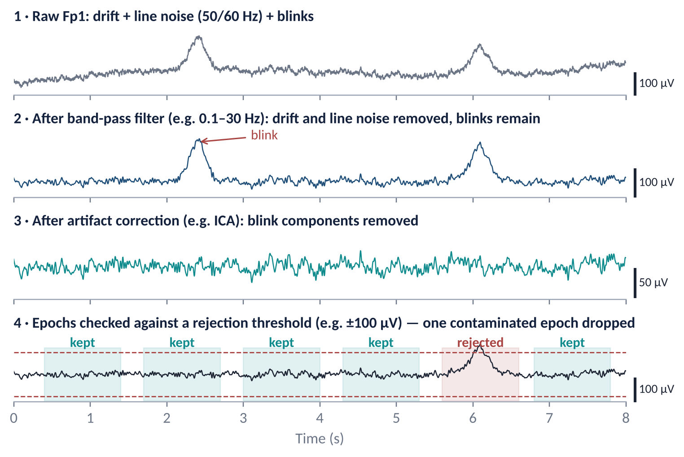
Preprocessing in Practice: Four Cleaning Steps
II · PREPROCESSING
Why show the signal: each step visibly changes the data, so each must be justified and fixed before outcomes are inspected.
Filter
Removes drift and line noise; must preserve the slow P300
Correct
ICA separates and removes blink components [37]
Reject
Epochs beyond a threshold are dropped — report how many
Caution
ICA does not inherently improve accuracy; ML implications in Section IV
Simulated signals for illustration — typical scalp magnitudes, not recorded data. Filter band and threshold are examples.
Sources: [21], [25], [37]
Notes:
This slide follows one simulated recording through four stages. At the top, the raw frontal signal contains slow drift, electrical line noise, and large blink deflections. After filtering, drift and line-frequency interference are reduced, but the blinks remain; filtering alone does not solve every artifact. The third trace illustrates correction, for example using independent component analysis to identify and remove blink-related components. ICA is a separation method, not a guarantee of improved accuracy. Finally, the epoch-rejection example shows that some segments may still be too contaminated and should be excluded according to a defined criterion. The example band of 0.1–30 hertz and the amplitude threshold are illustrative, not universal prescriptions. Parameters and numbers of rejected trials must be reported, and procedures should not be chosen after seeing the desired result. With the recording and its cleaning defined, the next slide introduces the three kinds of stimuli that give the CIT its meaning.

Slide 22
Three Stimulus Types: Target, Probe, Irrelevant
II · EXPERIMENTAL DESIGN
Why three: the target keeps attention on every item, the irrelevants give each person a baseline, and the probe carries the question.
TARGET
PROBE
IRRELEVANTS
White crate
Red toolbox
Blue suitcase · black backpack · green storage box
Role
Task-relevant for everyone
Role
Nonpublic crime detail
Role
Plausible alternatives
Frequency
≈ 20% — infrequent
Frequency
≈ 20% — infrequent
Frequency
≈ 20% each · ≈ 60% together
Response
“Target” key (e.g. YES)
Response
“No” key — the concealment
Response
“No” key
Expected
P300 in everyone → attention check
Expected
P300 may be enhanced if recognised
Expected
Each person's baseline
Target and probe are equally infrequent; only the irrelevants as a class are frequent. Proportions follow this five-item example; paradigms differ [24].
Sources: [3], [20], [24], [47]
Notes:
The same five-item example runs throughout. The white crate is the target: everyone is instructed to recognize it and make a special target response, so it provides a task-engagement check. The red toolbox is the probe, a supposedly nonpublic detail that is meaningful only to someone who knows it. The blue suitcase, black backpack, and green storage box are plausible irrelevant alternatives. Each individual item appears about twenty percent of the time in this illustration; together, the irrelevants form sixty percent of the trials. This is why the target and probe can be equally infrequent while having very different experimental roles. The target is explicitly known to everyone, whereas the probe's significance is what the test examines. A recognized probe may elicit a larger P300 than irrelevants, but this is an expectation, not a guaranteed response or proof of concealment. The target also encourages attention but cannot ensure it on every trial. With the item categories defined, the next slide shows how one item is presented in time.

Slide 23
Anatomy of One Trial
II · TRIAL STRUCTURE
Why timing matters: every analysis is defined relative to stimulus onset at 0 ms.
0 ms = stimulus onset
Fixation
Stimulus: RED TOOLBOX
Participant response
Inter-stimulus interval
time
Analysis epoch: pre-stimulus baseline → several hundred ms post-onset
Event synchronization
Illustrative durations
Stimulus onset is written as a marker into the EEG; timing errors blur the averaged response.
Segment lengths are schematic; real protocols differ in timing and response requirements.
Sources: [24], [47]
Notes:
Imagine a participant sitting in front of a screen. A fixation period comes first, followed by the red-toolbox stimulus, the participant's response, and an interval before the next item. The crucial time point is stimulus onset, labelled zero milliseconds. The analysis window reaches backward into a pre-stimulus baseline and forward into the period when an ERP may develop. The boxes are schematic: actual stimulus durations, response timing and inter-stimulus intervals depend on the protocol, and the response may overlap the analysis epoch. Accurate timing matters because even a real P300 becomes blurred if trials are aligned to the wrong moment. Notice that the EEG continues recording throughout; it does not restart for each stimulus. A marker stream is therefore needed to connect the experimental software to the continuous EEG. The next slide shows where such markers sit in the full chain from continuous EEG to an ERP.

Slide 24
From Continuous EEG to Event-Related Potentials
II · FROM EEG TO ERP
Why this pipeline: the CIT compares responses to events, so the signal must first be organized by events.
Continuous EEG
Stimulus / event marker
Pre-processing
Epoch
Repeated trials
Averaging or single-trial
ERP
Averaging
Single-trial analysis
Background activity unrelated to the stimulus tends to cancel
Consistent stimulus-related activity remains
Requires many repetitions per stimulus type
Analyzes individual epochs
Retains trial-to-trial variability
Common input for classifiers; lower signal-to-noise ratio
Sources: [21], [37], [47]
Notes:
EEG is recorded continuously, but a concealed information test asks about responses to particular events, such as seeing the red toolbox. This slide shows the whole chain from the continuous recording to an event-related potential. Stimulus markers identify exactly when each item appeared. The continuous recording is cleaned first, and then a short epoch is cut around each marker, including a pre-stimulus baseline and the response afterward. Many repeated epochs are then organised by stimulus category. The final boxes show two analysis routes. Averaging trials of the same type reveals a stable event-related potential, or ERP, because unrelated background activity tends to cancel. Single-trial analysis keeps the variability of individual epochs and is the usual input for classifiers, but it is noisier. An ERP is the averaged, stimulus-locked response; a single epoch is not itself an ERP. The next two slides take the two key steps in detail: event markers, then averaging.

Slide 25
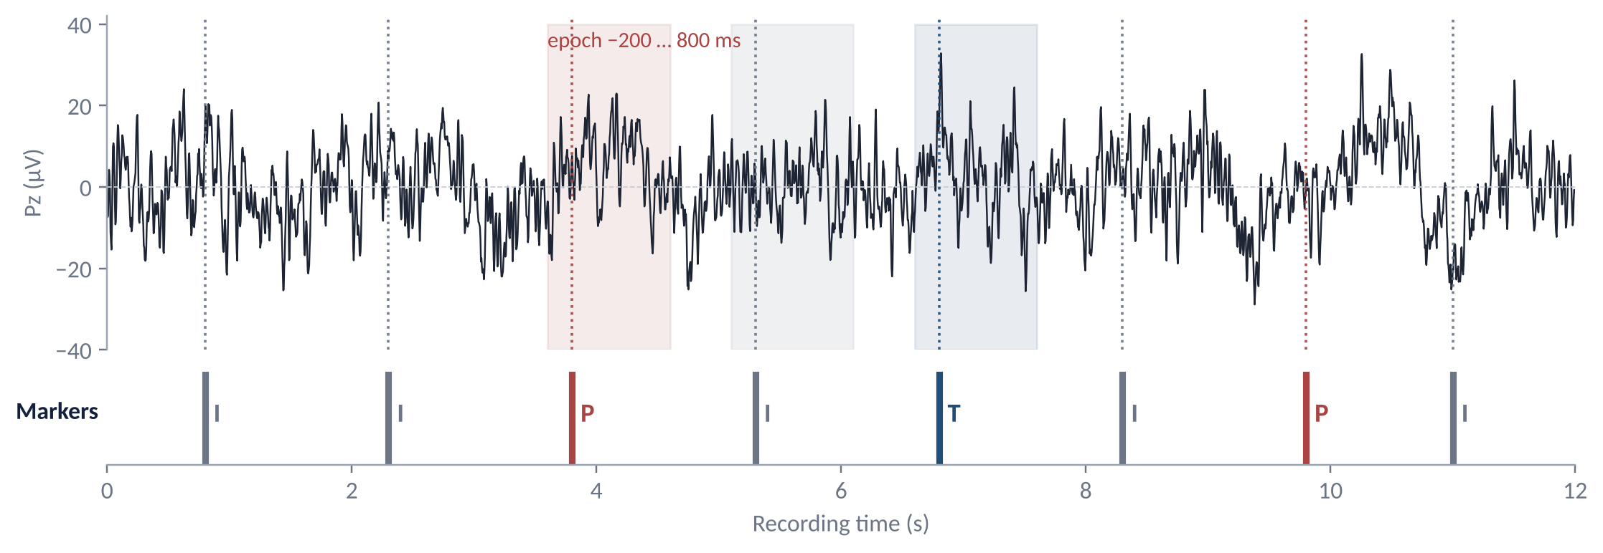
Event Markers: Linking Each Stimulus to the EEG
II · FROM EEG TO ERP · 1 OF 2
Why markers: the EEG itself does not record when a stimulus appeared; the marker track supplies that timing.
Simulated signals for illustration — typical scalp magnitudes, not recorded data. Markers: I = irrelevant (gray) · P = probe (red) · T = target (blue).
Marker
Epoch
Single trial
Event code + sample index, e.g. P at sample 950 (3.8 s × 250 Hz)
Fixed window around each marker, here −200 to 800 ms
P300 not visible by eye — background activity dominates
Sources: [21], [37], [47]
Notes:
The figure shows a continuous simulated Pz trace and, underneath it, the event-marker track. The gray markers are irrelevants, the red markers probes, and the blue marker a target. The EEG signal by itself does not reveal when the red toolbox appeared. The event code and its sample index provide that information. In the highlighted example, a window is extracted from two hundred milliseconds before the probe to eight hundred milliseconds after it. The same operation is repeated for every occurrence of each item type. The marker must correspond to actual stimulus onset, not merely an approximate software timestamp; synchronization errors smear the average. Also notice that there is no obvious P300 standing out in this single raw segment. This is normal because the stimulus-related response is small relative to ongoing activity. The next slide shows why repeated trials and averaging are so useful.

Slide 26
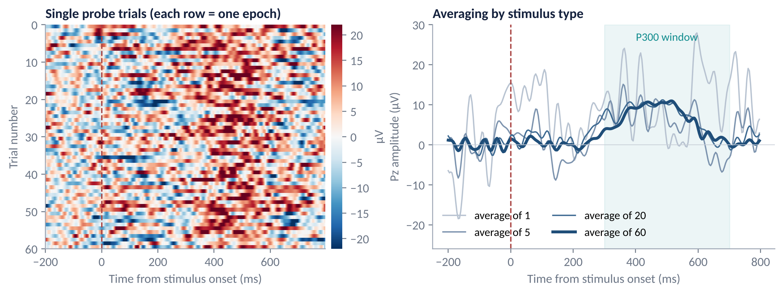
Averaging: How the ERP Emerges From Noise
II · FROM EEG TO ERP · 2 OF 2
Why average: the P300 is a few µV inside tens of µV of background activity; averaging epochs of one type reveals it.
Simulated signals for illustration — typical scalp magnitudes, not recorded data. Each epoch baseline-corrected to the pre-stimulus interval.
Cancels
Improves with N
An estimate
Activity not time-locked to the stimulus averages towards zero
Residual noise falls roughly with 1/√N
An ERP comes from many trials; single-trial models face the noisy rows
Sources: [21], [37], [47]
Notes:
On the left, each row is one simulated probe epoch, aligned at stimulus onset. The colors show voltage, and the individual rows look noisy and inconsistent. Yet a broad region of similar activity becomes easier to see when many trials are combined. On the right, compare the thin curves based on one or a few epochs with the darker average based on sixty epochs. The later positive component becomes more stable. Under approximately independent, zero-mean noise, the noise level decreases roughly with one over the square root of the number of trials. This does not mean averaging removes every artifact: anything systematically locked to the probe can survive. It also means that the resulting ERP is an estimate of an event-related response, not a direct image of a single person's thought. With the ERP explained, the component central to EEG-based CIT can be introduced: the P300, and the oddball task in which it was characterised.

Slide 27
What Is the P300?
II · THE P300
Why define it carefully: popular accounts attribute meanings to the P300 that the evidence does not support.
Broad positive deflection; latency varies
Associated with
Stimulus probability
Task relevance and attention
Stimulus significance
Context updating
Recognition and memory
P300 IS NOT A LIE SIGNAL
Conceptual illustration — positive plotted upward; not a universal waveform
Sources: [3], [29], [47]
Notes:
The P300 is a broad positive-going ERP component often observed several hundred milliseconds after an informative or task-relevant event. The illustrated waveform is conceptual; it is not a universal shape, and its peak does not have to occur exactly at three hundred milliseconds. The associations on the right explain why it is scientifically interesting: stimulus probability, attention, task relevance, significance, context updating, and memory can all influence it. The key caution is in the red box: the P300 is not a lie signal. A person can produce a P300 while responding truthfully to a familiar name or a rare target. Why a probe might produce a larger response than other items follows from the experimental principle from which much P300 research developed: the oddball paradigm.

Slide 28
The Oddball Paradigm
II · THE ODDBALL PARADIGM · 1 OF 2
Why introduce it: the P300 was characterised in oddball tasks, and the CIT inherits this structure.
stimulus onset asynchrony, e.g. ~1 s (varies by study)
X
X
X
O
X
X
X
X
O
X
X
X
rare
rare
time
Probabilities (example)
Standard X · ~80%
Rare O · ~20%
1 · Task
2 · Processing
3 · Response
Count, or press a button for, the rare stimulus
Rare + task-relevant → context updating
Larger P300 to the rare stimulus — shown next
The P300 indexes rarity, task relevance and context updating — not deception [47]
Sources: [3], [47]
Notes:
In a conventional oddball task, frequent standard stimuli, shown as X, are interrupted by rarer events, shown as O. A participant may be asked to count the rare items or press a button when they appear. The example probabilities are eighty percent standard and twenty percent rare. A rare event that matters to the task often produces a larger P300-related response, partly because it is less expected and requires attention or context updating. But rarity alone is not a complete explanation, and not every rare event generates the same response. This is important because in the CIT example the probe and target are individually just as infrequent as each irrelevant item. What differs is the probe's potential personal meaning to a knowledgeable participant. The next slide compares the ordinary oddball effect with the concealed-information situation.

Slide 29
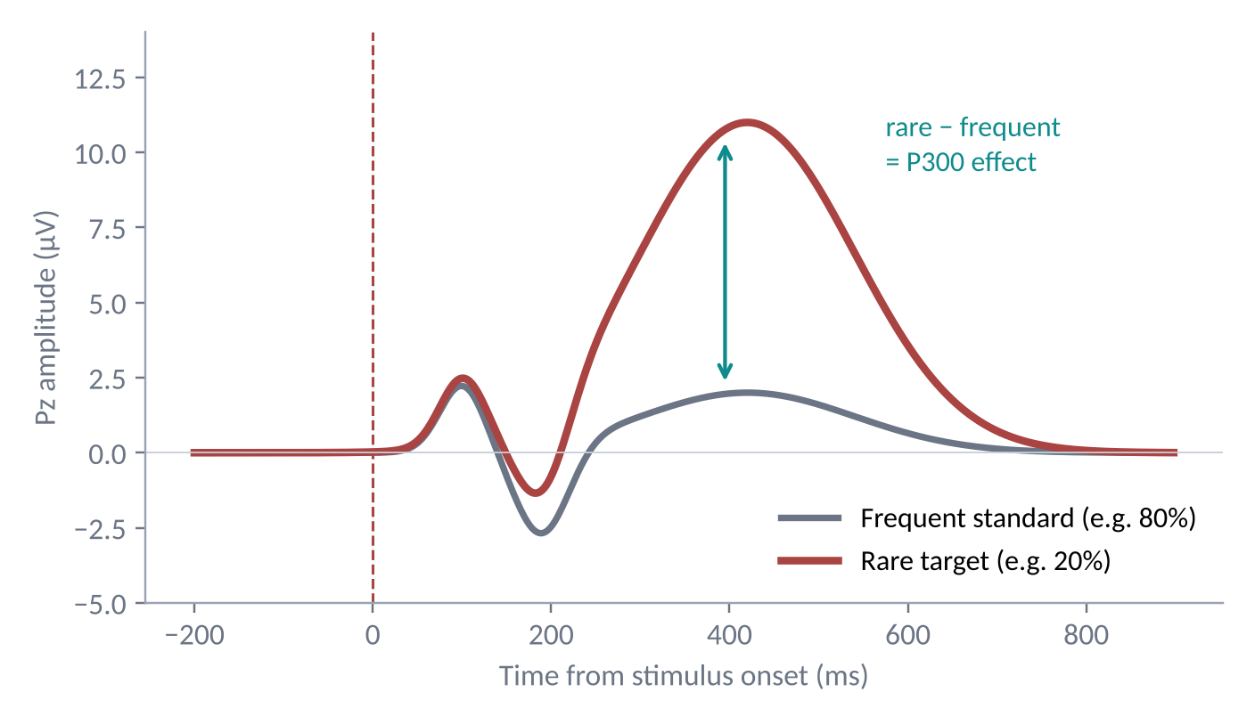
Rare Stimuli Evoke a Larger P300
II · THE ODDBALL PARADIGM · 2 OF 2
Why it matters: the CIT recreates an oddball — the probe can stand out for someone who recognises it.
Same structure in the CIT (running example)
Target
white crate
Probe
red toolbox
Irrelevants: blue suitcase · black backpack · green storage box
each item ≈ 20% of trials · irrelevants together ≈ 60%
Knowledgeable person
Probe may be meaningful → can stand out from the frequent irrelevants → larger P300 likely
No knowledge
Probe is just another irrelevant → response resembles irrelevants
Simulated signals for illustration — typical scalp magnitudes, not recorded data.
Classic three-stimulus design; protocols such as the CTP restructure trials [24].
Equal frequencies, different subjective significance: recognition may enhance the probe P300 — not a deception signal [47]
Sources: [3], [24], [47]
Notes:
The left panel shows a conceptual oddball contrast: a larger positivity for a rare task-relevant stimulus than for a frequent standard. On the right, the example returns to the white crate, red toolbox and three alternatives. For a knowledgeable participant, the red toolbox may carry special meaning and stand out from the class of irrelevant items. For someone without that knowledge, it should behave more like another plausible alternative. This is the conceptual bridge from oddball research to P300-based CIT. One phrase at the bottom needs careful interpretation: it is not that physical frequency changes with knowledge. The frequencies remain fixed; what changes is the stimulus's subjective significance and possibly attention. The comparison therefore concerns a probe response relative to irrelevant responses within the same person, not a universal P300 threshold. The expected waveforms for knowledgeable and unknowledgeable participants follow side by side.

Slide 30
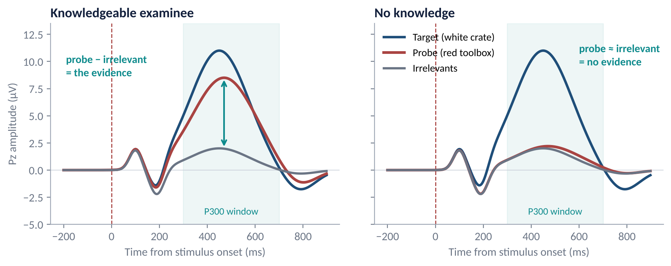
Expected ERPs: Knowledgeable vs No Knowledge
II · EXPECTED RESPONSES
Why show this: the prediction is explicit and testable — the evidence is the probe–irrelevant difference, not the presence of a P300.
Simulated signals for illustration — typical scalp magnitudes, not recorded data. Not a universal waveform or diagnostic threshold.
Target: Large P300 in everyone → attention check
Probe: may be enhanced if recognised
Irrelevants: Baseline for the comparison
Evidence = PROBE − IRRELEVANT difference
Sources: [3], [24], [47]
Notes:
The two panels make the central prediction explicit. On the left, the knowledgeable participant shows a relatively large response to the target, as expected, and also a larger response to the recognized red-toolbox probe than to irrelevant items. On the right, the target can still produce a strong response because everyone knows the target, but the probe and irrelevants are similar when the person has no relevant knowledge. The critical quantity is therefore probe minus irrelevant, within the same participant. A P300 by itself is not evidence of concealed information; even the innocent control can show a large target P300. These are simulated curves, not diagnostic templates. Individual responses may overlap, vary in latency, or even reverse, and recognition may come from innocent exposure. Testing the predicted contrast first requires a decision about how to measure the waveform.

Slide 31
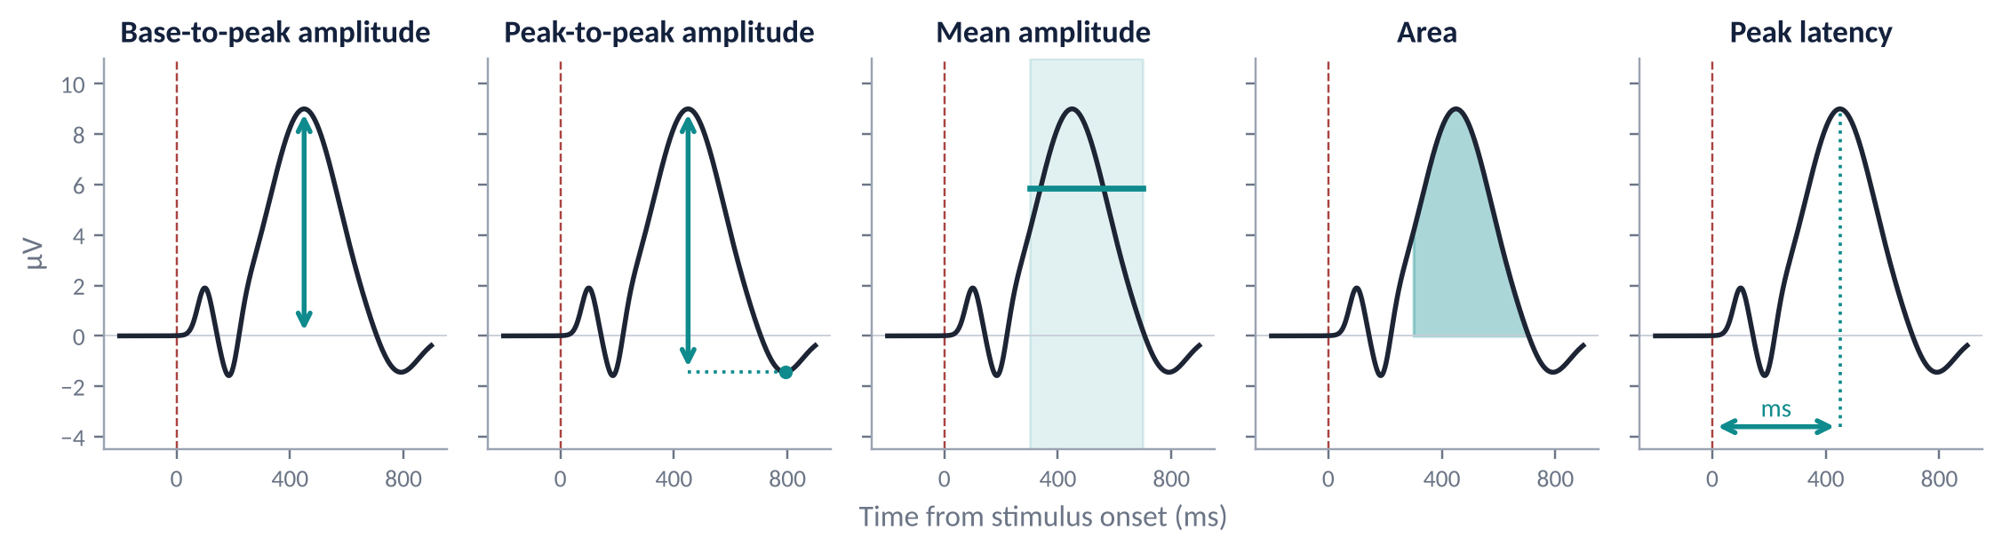
Measuring the P300: Five Waveform Measures
II · QUANTIFICATION · 1 OF 2
Why it matters: different measures of the same waveform can lead to different decisions about the same person.
Simulated waveform; window shown 300–700 ms as an example.
Base-to-peak
Peak-to-peak
Mean amplitude
Area
Latency
Largest value in a window, relative to the pre-stimulus baseline
Peak minus the following trough; common in P300-CIT work [24], [47]
Average over a fixed window; less sensitive to noise
Integrated positivity in the window
When the peak occurs — timing, not size
Fix the window and measure before inspecting results — methods have been compared directly [21]
Sources: [21], [24], [47]
Notes:
All five panels show the same simulated waveform, but each extracts a different number. Base-to-peak amplitude measures a positive maximum relative to baseline. Peak-to-peak amplitude compares a positive peak with a following negative trough, an approach used in some P300-CIT protocols. Mean amplitude averages voltage over a defined time window; it is often less sensitive to one noisy sample. Area summarizes integrated positivity, while peak latency measures when the peak occurs rather than its size. These quantities are not interchangeable, and they can lead to different conclusions for the same participant. The highlighted three-hundred-to-seven-hundred-millisecond interval is an example, not a universal window. Crucially, the electrode, time window and measure should be specified independently of the outcome to avoid optimistic bias. Once a measure has been selected, probe and irrelevant responses still have to be compared and the reliability of that contrast assessed.

Slide 32
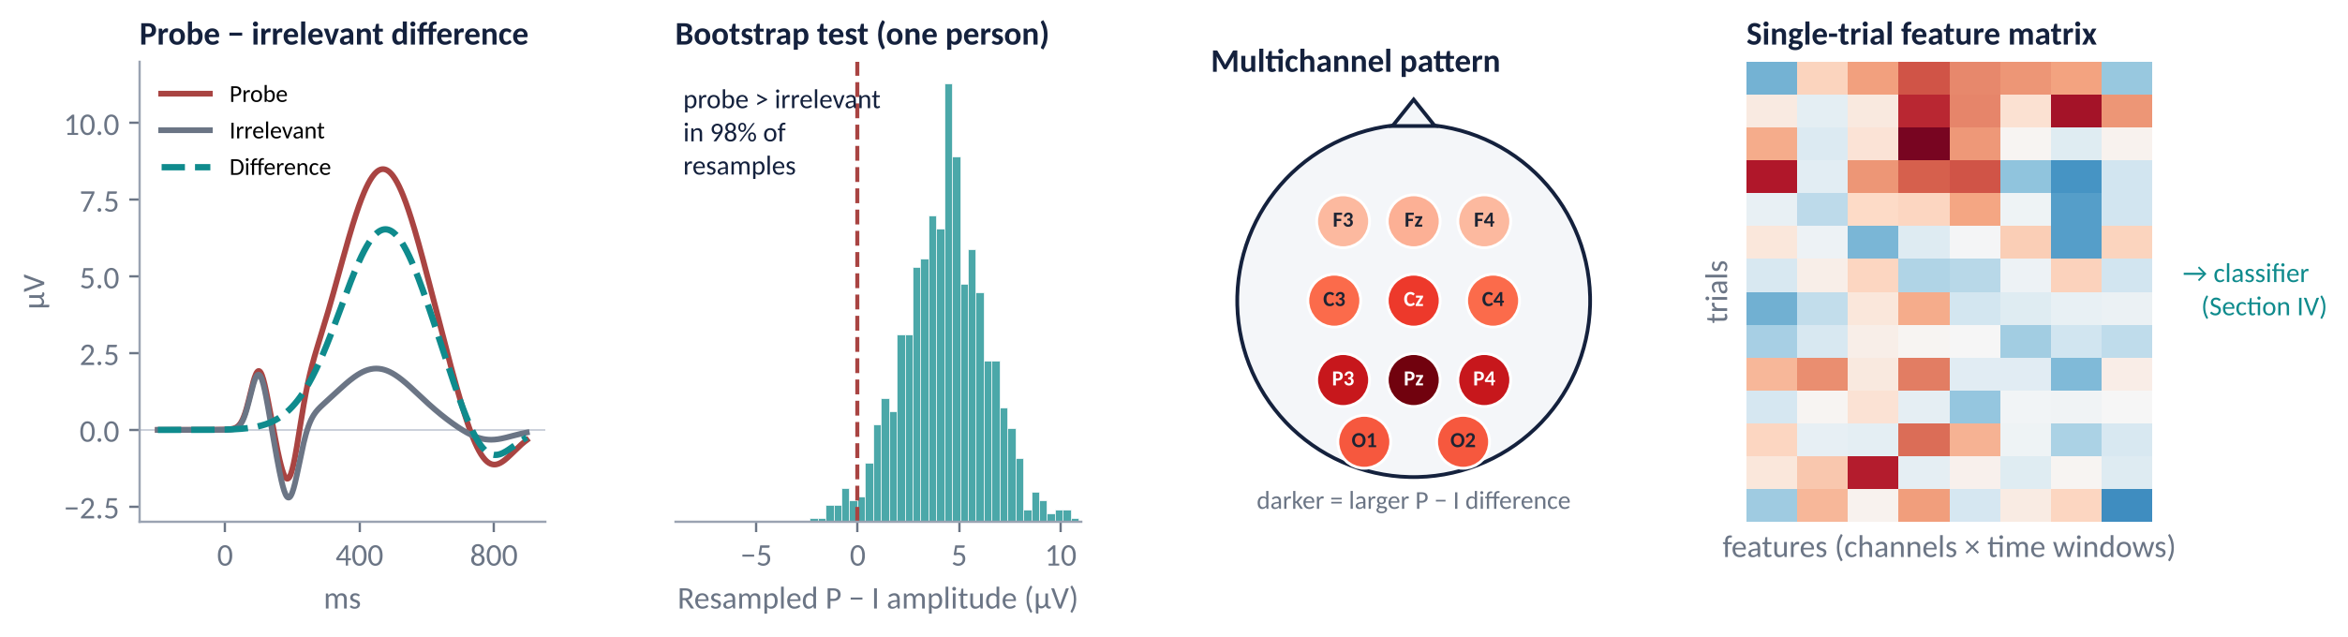
From Waveform to Decision: Four Approaches
II · QUANTIFICATION · 2 OF 2
Why: a decision about one person needs a within-person contrast and an estimate of how reliable it is.
Simulated illustrations.
Difference
Bootstrap
Multichannel
Single trial
The within-person contrast that carries the inference
Resample trials; e.g. probe > irrelevant in ≥ 90–95% of resamples (criterion varies) [21], [24]
Spatial pattern across sites, not one electrode
Feature rows for classifiers — Section IV [37]
Sources: [21], [24], [37], [47]
Notes:
This slide moves from a measured waveform to evidence about an individual. First, the probe-minus-irrelevant difference isolates the within-person contrast that CIT depends upon. Second, a bootstrap approach resamples trials to assess how consistently that contrast appears; the histogram here is illustrative, and any decision criterion must be specified and validated rather than chosen after viewing the result. Third, multiple electrodes may reveal a spatial pattern, often with a centroparietal emphasis, rather than relying on one channel. Fourth, single-trial features can be organized into a matrix for machine-learning methods, which Section IV covers. These are related analysis strategies, not four independent proofs. In particular, the fact that a resampled difference is usually positive does not itself establish a calibrated probability of guilt or even universal diagnostic accuracy. A worked number example follows; the final slide of the section then separates the observed signal, extracted feature, decision rule and interpretation so that none is confused with the next.

Slide 33
A Worked Number Example: Probe − Irrelevant
II · QUANTIFICATION · WORKED EXAMPLE
Why compute it once: the decision rule becomes concrete when the numbers are small enough to follow.
1 One person's epochs (µV, Pz, 300–800 ms)
2 How stable is +2.18 µV?
3 Decision depends on the criterion
Probe
5.2
1.1
6.4
1
Draw 3 probe and 4 irrelevant values with replacement
Criterion 90%
mean = 4.23 µV
94.1% ≥ 90% → consistent with recognition
2
Recompute probe mean − irrelevant mean
Irrelevant
1.9
3.0
0.6
2.7
mean = 2.05 µV
3
Repeat for every possible draw (6,912)
Criterion 95%
Difference = 4.23 − 2.05 = +2.18 µV
94.1% of resampled differences > 0
94.1% < 95% → not decided (≠ not knowledgeable)
Illustrative numbers, not data. Fix the criterion before seeing the result — the same epochs pass at 90% and fail at 95%.
Sources: [21], [24]
Notes:
This slide works through the within-person decision with numbers small enough to follow; the numbers are invented for teaching and are not data. Suppose one person has three probe epochs whose mean amplitudes at Pz between 300 and 800 milliseconds are 5.2, 1.1 and 6.4 microvolts, and four irrelevant epochs with 1.9, 3.0, 0.6 and 2.7 microvolts. The probe mean is 4.23 microvolts, the irrelevant mean is 2.05 microvolts, and the difference is plus 2.18 microvolts. The bootstrap asks how stable that difference is. It draws three probe values and four irrelevant values with replacement and recomputes the difference. With so few values, every possible draw can be listed: 3 to the power 3 probe draws times 4 to the power 4 irrelevant draws gives 6,912 equally likely combinations, and 6,502 of them, 94.1 percent, give a positive difference. A random simulation with 10,000 draws approximates the same share, with small changes from one random seed to another. Under a 90 percent criterion the result is consistent with recognition; under a 95 percent criterion it is not decided, which is different from showing that the person does not know the item. The same data can therefore lead to different decisions, which is why the criterion has to be fixed before any result is seen. With real data each person contributes far more epochs, which makes the estimate more stable but does not change the logic. The next slide opens up one single draw.

Slide 34
How One Bootstrap Draw Is Generated
II · QUANTIFICATION · WORKED EXAMPLE
Why show one draw: the 94.1% summarises thousands of draws, and each draw is a simple calculation.
Step
Values (µV)
Result
A draw can reverse the sign
Original
Probe 5.2, 1.1, 6.4 · irrelevant 1.9, 3.0, 0.6, 2.7
+2.18
Probe 1.1, 1.1, 1.1 vs irrelevant 3.0 × 4 → −1.90 µV
Resample probe
5.2, 5.2, 1.1 (with replacement) → 11.5 / 3
3.833…
Exact vs simulated
Resample irrelevant
1.9, 1.9, 0.6, 2.7 (separately) → 7.1 / 4
1.775
All draws: 94.1% exactly · random simulation: ≈ 94%; the estimate varies with the seed
New difference
3.833… − 1.775, before rounding
+2.058… ≈ +2.06
What 94.1% is not
Repeat
all 3³ × 4⁴ = 6,912 equally likely draws
6,502 > 0 = 94.1%
Not a probability of guilt · not a p-value · “not decided” ≠ “not knowledgeable”
94.1% = share of resampled differences above zero: stability of the effect, not a probability of guilt
Sources: [21], [24] · illustrative numbers, not data
Notes:
The percentage on the previous slide summarises many resampled differences, so this slide opens up a single one. The original values stay the same: three probe values and four irrelevant values. A draw resamples the probe values with replacement, which means that a value can appear more than once while another is left out; here 5.2, 5.2 and 1.1 sum to 11.5, and 11.5 divided by 3 gives a probe mean of 3.833 microvolts. The irrelevant values are resampled separately, keeping their own count of four; 1.9, 1.9, 0.6 and 2.7 sum to 7.1, and 7.1 divided by 4 gives a mean of 1.775 microvolts. The new difference is 3.833 minus 1.775, which is plus 2.058, rounded to plus 2.06 microvolts; the difference is calculated before rounding, which is why the rounded means 3.83 and 1.78 would suggest 2.05. Repeating this for every one of the 6,912 possible draws gives 6,502 positive differences, 94.1 percent. A draw can also reverse the sign: probe values 1.1, 1.1 and 1.1 against four values of 3.0 give minus 1.9 microvolts, which shows how most, but not all, resampled differences can be positive. In practice, with many more epochs, a random simulation replaces the full listing; a random simulation gives approximately 94 percent here, and the exact estimate varies with the random seed, so a reported simulation value should state its seed. Three readings are wrong. The 94.1 percent is not the probability that the person recognises the item or is guilty; it is the share of resampled differences above zero, a measure of the effect's stability. It is not a p-value, because no null model is defined. And a result that is not decided at a criterion is insufficient evidence, not evidence of absence. The worked inference on the next slide separates signal, feature, decision and interpretation.

Slide 35
From Measurement to Inference: A Worked Example
II · FROM EEG TO INFERENCE
Why separate the levels: an error at any level propagates, and only the last step is an interpretation.
SIGNAL
FEATURE
DECISION RULE
INTERPRETATION
✓ Consistent with recognition of the red toolbox
✗ not: Deception
Pz voltage while the red toolbox, irrelevants and target appear
Probe − irrelevant mean amplitude, 300–700 ms
Bootstrap: is the difference reliable for this person?
✗ not: Guilt
Recognition may be innocent [11], [14]
A strong decision rule cannot rescue an invalid interpretation
Sources: [11], [14], [21], [47]
Notes:
The section ends by following the red-toolbox example through four levels. First is the signal: voltages recorded while different items appear. Second is the feature: for example, the probe-minus-irrelevant mean amplitude over a prespecified P300 window. Third is the decision rule: perhaps a validated bootstrap criterion indicating that the contrast is sufficiently consistent for this person. Only the fourth level is an interpretation. Under a properly designed test, a positive result may be consistent with recognition of the red toolbox. It does not establish that the person lied, concealed it deliberately, or committed an offense. The same recognition might arise through media coverage, legitimate familiarity, or accidental disclosure of the supposedly nonpublic detail. The sentence at the bottom summarizes the methodological lesson: even a statistically strong rule cannot rescue an invalid inference. This completes how EEG-based CIT is constructed. Section III makes these methods concrete with one real experiment and its public dataset.

Slide 36
SECTION III OF VI
Experimental Design and Dataset
One public P300-CIT study: the mock theft, the participants, the six images and the data files
I · What & why
II · Methods
III · Experiment & data
IV · Computation
V · Limitations
VI · Future
Notes:
The seminar now moves from the principles of concealed-information testing to the anatomy of a real experiment. Up to this point, terms such as probe, target, P300, and recognition have been largely conceptual. This section shows exactly how those ideas become instructions to participants, photographs on a screen, electrical recordings, and ultimately numerical data.
Section three makes the methods concrete with one real experiment and its public dataset. It explains who took part and in which role, how the mock theft was staged, which images were shown and how, how the EEG was recorded, how the released files are organised and what their numbers mean, and it ends with a first descriptive look at the data. The same data are used in the computational section that follows.
There are two questions to keep in mind throughout: what information did each person actually possess, and how can the released recordings preserve enough of that distinction to support a valid analysis?

Slide 37
One Experiment, One Dataset: Why and How
III · EXPERIMENTAL DESIGN
Why this section: methods become concrete only in a real experiment, and the same data feed the machine-learning section.
Why this dataset
SECTION ROADMAP
Public: downloadable from Dryad
Genuine three-stimulus P300-CIT: probe · target · irrelevants [37]
Two groups: knowledgeable and control
Already used for a machine-learning pipeline [37] — the bridge to Section IV
1
The study at a glance
2
Participants, groups and roles
3
The mock theft and the six images
4
Stimulus presentation and EEG recording
5
The files on disk: what the numbers are
6
A first look at the data
Sources of every fact: the paper [37] · the Dryad README · inspection of the files. Anything added for clarity is marked Assumed.
Sources: [37] · Dryad doi:10.5061/dryad.2qc64 (README and data files)
Notes:
The Gao study is not presented as a definitive forensic validation study. It serves as a transparent worked example, because its experimental protocol and released data allow the complete chain from stimulus design to EEG interpretation to be followed.
This section replaces abstract description with one real experiment, because the methods of the previous section become concrete only when a specific design, specific stimuli and specific data files are on the table. The same data are used again in the machine-learning section. The dataset comes from Gao and colleagues, 2014, and was chosen for four reasons. It is publicly available on Dryad. It uses a genuine three-stimulus P300 concealed information test with a probe, a target and irrelevant items. It contains both a knowledgeable group and a control group. And the original authors already applied a machine-learning pipeline to it, which makes it a natural bridge to the next section. The section runs in six steps: the study at a glance, the participants and their roles, the mock theft and the stimuli, the presentation and the recording, the files on disk and what their numbers mean, and finally a first descriptive look at the data. Every statement comes from the paper, the Dryad readme or direct inspection of the files; the few points that had to be assumed for clarity are labelled as assumptions on the slides.
The roadmap establishes the experimental ground truth first, then inspects the file structure, and only then looks at the signals. That order prevents an interesting waveform from being treated as self-explanatory.

Slide 38
The Study at a Glance
III · EXPERIMENTAL DESIGN
Why first: every later slide refers back to these numbers, so they are collected in one place with their source.
Study
Gao et al. (2014), PLOS ONE [37]
paper
Data
Dryad (2015): one 568 MB RAR archive + README
Dryad
Participants
Abstract: 34 · Methods section and release: 30 (unresolved)
paper · files
Groups
15 in folder lying (knowledgeable) · 15 in folder honest (control)
files
Paradigm
Mock theft → three-stimulus P300-CIT with 6 object photographs
paper
Presentation
0.5 s per image · ISI 1.6 s · each object 30× per session
README
Sessions
5 per participant → max 150 probe · 150 target · 600 irrelevant
README
Recording
14 channels (12 EEG + 2 EOG) · 500 Hz · 0.1–30 Hz · right-earlobe reference
paper · files
Released form
Cut, baseline-corrected epochs: −300 to +1298 ms = 800 samples
files (verified)
Right-hand tags show where each fact comes from.
Sources: [37] · Dryad doi:10.5061/dryad.2qc64 (README and data files)
Notes:
A small set of numbers anchors the procedure. They return later in the discussion of how many trials are available, what constitutes an independent observation, and why a large EEG matrix does not imply a large sample of people.
This slide collects every key number of the study in one place, with the source of each, because later slides refer back to them. The study is Gao and colleagues, 2014, published in PLOS ONE; the data were deposited on Dryad in 2015 as one compressed archive of about 568 megabytes plus a short readme. The abstract reports 34 participants, whereas the Methods section and the public release indicate 30: 15 in a folder named lying and 15 in a folder named honest. No reason for the difference is confirmed, so it is treated as unresolved. The experiment is a mock theft followed by a three-stimulus P300 concealed information test using photographs of six objects. According to the readme, each image stayed on screen for 0.5 seconds, the inter-stimulus interval was 1.6 seconds, each object appeared 30 times per session, and each participant completed five sessions. That gives at most 150 probe, 150 target and 600 irrelevant presentations per participant. Fourteen channels were recorded at 500 hertz, twelve EEG channels and two eye channels, with a 0.1 to 30 hertz online filter and a right-earlobe reference, as reported in the article. The released files contain epochs that are already cut and baseline-corrected, each 800 samples long, from minus 300 to plus 1298 milliseconds around stimulus onset; this last point was verified directly in the files and against the one raw recording in the release, as shown later in the section.
The descriptive analysis concerns the 30 released participants; the abstract's figure of 34 is not reconciled with the Methods section.

Slide 39
Key Terms: Groups, Roles and Stimulus Types
III · EXPERIMENTAL DESIGN
Why define them: the paper, the folders and this seminar use different words for the same things.
PAPER
FOLDER
TERM IN THIS SEMINAR
MEANING IN THIS STUDY
Group
guilty
lying
Knowledgeable (experimental) group
Committed the mock theft; knows the stolen object; conceals it
Group
innocent
honest
Control group
Same procedure, no theft: never saw the probe; nothing to conceal
Stimulus
probe
probe
Probe
Crime-relevant object: stolen (knowledgeable) · never seen (control)
Stimulus
target
target
Target
Object seen in the safe; known to everyone; keeps attention on the task
Stimulus
irrelevant
irrelevant
Irrelevant (×4)
Objects never linked to the event; the comparison baseline
Why a control group?
Labels ≠ measurement
It goes through everything except learning the probe, so it shows the probe response without knowledge.
‘Guilty’ and ‘lying’ name the assigned role. The EEG can at most show recognition of the probe.
Sources: [37] · Dryad doi:10.5061/dryad.2qc64 (README and data files)
Notes:
The terminology of this literature can mislead. A folder called 'lying' sounds as though it contains a measured psychological state. In fact, it identifies an experimentally assigned condition. This seminar consistently uses 'knowledgeable' and 'control' so that the language does not assume what the EEG is supposed to establish.
The paper, the data folders and this seminar use different words for the same groups, so the terms are aligned before the design is explained. The first group is called guilty in the paper and lying in the folder names. This seminar calls it the knowledgeable, or experimental, group: these participants committed the mock theft, know which object was stolen and are asked to conceal it. The second group is called innocent in the paper and honest in the folders. This seminar calls it the control group. A control group goes through the same procedure as the experimental group except for the one manipulation of interest, which here is acquiring knowledge of the probe. Its role is to show what the brain response to the probe looks like when the person does not know it, so that any extra response in the knowledgeable group can be attributed to that knowledge rather than to the object or the procedure. The three stimulus types are defined per participant. The probe is the crime-relevant object: stolen by a knowledgeable participant, never seen by a control participant. The target is an object every participant saw and knows; it keeps attention on the task. The irrelevants are four objects never associated with the event and serve as the comparison baseline. The group labels guilty and lying describe the role assigned in the experiment, not what the EEG measures. The EEG can at most show recognition of the probe.
The most useful comparison is always probe versus irrelevant within a person, interpreted in light of whether that person encountered the probe during the mock event. A target response, on its own, is expected in both groups.

Slide 40
Participants: Who Is in Which Folder?
III · EXPERIMENTAL DESIGN
Why ask: the folder names suggest one person might appear twice; the design rules that out.
30 participants
Methods [37]; abstract: 34
Random
assignment
Knowledgeable (‘guilty’)
Same person twice?
No: groups are between subjects
A thief cannot later be unaware of the theft
Numbering restarts per folder: lying/subject9 ≠ honest/subject9
Seminar codes: L09 and H09
Control (‘innocent’)
Public release: 30 participants — 15 in lying/ · 15 in honest/ (the abstract reports 34; the difference is unresolved)
EACH PARTICIPANT IN THE RELEASE
5
3
15
450
sessions
files per session
files per person
files in total
Sources: [37] · Dryad doi:10.5061/dryad.2qc64 (README and data files)
Notes:
One ambiguity in the folder names can easily lead to serious analytical mistakes. The same numerical subject identifier appears in both group folders, but those are different people. This is a between-participant experiment, not a crossover in which the same person first lies and then becomes innocent.
The folder layout raises a natural question, because both folders contain subjects numbered one to fifteen: did each person play both roles? The design rules that out. Participants were randomly divided into a guilty and an innocent group; the abstract reports 34 participants, whereas the Methods section and the release indicate 30, a discrepancy that remains unresolved. Group membership is therefore between subjects: each person belongs to exactly one group. A within-subject version would also be impossible in this design, because a person who has stolen an object cannot later be unaware of it. The public release contains 30 participants, 15 in the lying folder and 15 in the honest folder. Numbering restarts at one inside each folder, so lying subject nine and honest subject nine are two different people. To avoid confusion, this seminar codes them L09 and H09, with L for the lying folder and H for the honest folder. Each participant has five session folders, and each session has three files, one per stimulus type, so each person contributes fifteen files. Demographic details are not included in the release.
In model validation this distinction is crucial: sessions and trials from one participant must not be mistaken for new independent participants.

Slide 41
The Mock Theft, Step by Step
III · EXPERIMENTAL DESIGN
Why start here: a probe effect can mean recognition only if the two groups had different exposure to the probe.
Knowledgeable (experimental-guilty)
Resulting stimulus roles
Operator places 2 random objects in a safe
Participant opens the safe and ‘steals’ one
Writes down style and colour of the safe's objects
Probe
the stolen object
Target
the other object seen
Irrelevants
4 objects never seen
Control (innocent)
Resulting stimulus roles
Operator places 1 random object in a safe
Participant only watches the object
Writes down style and colour of the safe's object
Probe
drawn at random from the 5 unseen — never seen
Target
the watched object
Irrelevants
remaining 4 objects
EEG test: all six objects appear repeatedly in random order; knowledgeable participants conceal the stolen object. Same probe role, different history: seen and stolen vs never seen.
Sources: [37] · procedure as depicted in Fig. 2 of [37]
Notes:
This is the causal core of the experimental design. The researchers did not simply show people pictures and ask whether they were lying. They created different exposure histories for the two groups and then examined whether the brain response distinguished those histories.
A probe response can be read as recognition only if the procedure gave the two groups different histories with the same item, so the procedure comes first. In the knowledgeable, or experimental-guilty, group the operator placed two randomly drawn objects in a safe. The participant opened the safe, chose one object and stole it. That stolen object became the probe; the other object seen in the safe became the target; the four objects never seen became the irrelevants. In the control, or innocent, group the operator placed one randomly drawn object in the safe and the participant only watched it. That watched object became the target. The probe was drawn at random from the five unseen objects, so the control participant never saw it, and the remaining four served as irrelevants. Both groups wrote down the style and colour of the objects in their safe. During the EEG test, all six objects appeared repeatedly in random order, and knowledgeable participants concealed the stolen object. The key design property is that the probe has the same role in both groups but a different history: seen and stolen in one group, never seen in the other. The target, by contrast, was seen in both groups, which predicts a target P300 in both. The next slide shows what each participant then did during the EEG test.
In the two columns, the probe is defined separately for each participant. 'Probe' is an experimental role, not the name of one fixed photograph across the entire dataset.

Slide 42
What Each Participant Did During the Test
III · EXPERIMENTAL DESIGN
Why it matters: the instruction decides what a probe response can mean — recognition with concealment, or no recognition at all.
Knowledgeable participant
Control participant
Knows two objects: the stolen one (probe) and the other one in the safe (target)
Instructed to conceal the theft: treats the probe as unfamiliar
Probe = recognized and concealed
Knows one object: the watched one (target)
Nothing to conceal: responds truthfully
Probe = just another unfamiliar object
Reported in [37]: YES for the known target, NO for every other object, so a knowledgeable participant's NO to the probe is the concealing response. The raw event table shows the two response codes.
Prediction: knowledgeable → probe behaves like the target (larger P300 than irrelevants) · control → probe behaves like an irrelevant
Sources: [37] (Experimental Protocol; Fig. 2) · event table of the raw .cnt file (L12, session 1)
Notes:
The response instructions complete the experimental manipulation. Knowledge alone does not define the task: it also matters which stimulus requires an overt response and which stimulus the knowledgeable participant is supposed to conceal.
The instruction given to each group determines what a probe response can mean, so the two roles are set side by side. A knowledgeable participant enters the test knowing two objects: the stolen object, which is the probe, and the other object seen in the safe, which is the target. The task is to conceal the theft, so the participant behaves as if the probe were unfamiliar; Fig. 2 of the paper marks the probe as the stimulus the participant lies about. A control participant knows only one object, the watched target. The probe is just another unfamiliar object, so this participant has nothing to conceal and responds truthfully throughout. The article's experimental protocol states the response mapping: participants press YES for the known target and NO for every other object, so a knowledgeable participant's NO to the probe is the concealing response. The event table of the one raw recording in the release contains two response codes, one after targets and one after probes and irrelevants, which matches this mapping. The prediction follows directly. In knowledgeable participants the probe should behave like the target and elicit a larger P300 than the irrelevants; in control participants the probe should behave like an irrelevant item. The first look at the data, at the end of this section, tests exactly this prediction.
The two response categories are assigned by the task itself, which is what turns a NO to the probe into concealment for a knowledgeable participant.

Slide 43
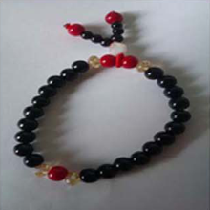

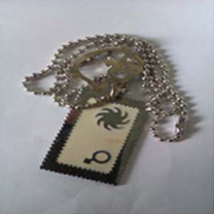
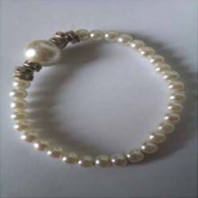
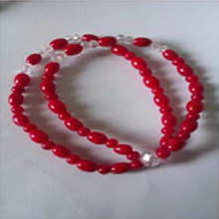
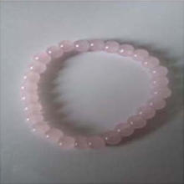
The Six Stimulus Images
III · EXPERIMENTAL DESIGN
Why look: a probe should stand out only because it is recognized, not because it looks different from the alternatives.
What the objects are
Five bead or pearl bracelets
One metal chain pendant: visually distinctive
How roles were assigned
Object 1
Object 2
Object 3 · pendant
Drawn at random for every participant
Spreads, but does not remove, item effects [44]
What the files do not say
Which object was probe, target or irrelevant for each person
Object 4
Object 5
Object 6
Sources: [37], [44] · Images: Gao et al. (2014), PLOS ONE 9(11): e109700, Fig. 2, CC BY licence
Notes:
The actual photographs replace the abstract word 'stimuli'. This visual inspection matters because an ideal irrelevant item should be a plausible alternative to the probe. If one picture is intrinsically more novel or distinctive, the EEG might respond to its appearance as well as to its remembered meaning.
The six photographs used as stimuli are shown so that the comparability of the alternatives can be judged directly. A concealed information test assumes that, for a person without knowledge, the probe is just one of several equally plausible alternatives. Five objects are bead or pearl bracelets in different colours; the sixth, a metal chain pendant with a tag, is visually distinctive. Roles were drawn at random for every participant, so any object could be the probe, the target or an irrelevant item. Random assignment spreads the effect of the distinctive pendant across roles but does not remove it. Two practical facts follow for the data. The display time was 0.5 seconds, as stated in the readme. And the files do not record which object served which role for which participant: the role of every epoch is known from its folder name, but its object identity is lost, so object-specific effects cannot be checked.
The slide does not claim that the pendant caused a bias. Without per-participant object identity in the release, that explanation cannot be tested directly. The correct interpretation is that visual comparability is a design consideration and a limitation of this particular release.

Slide 44
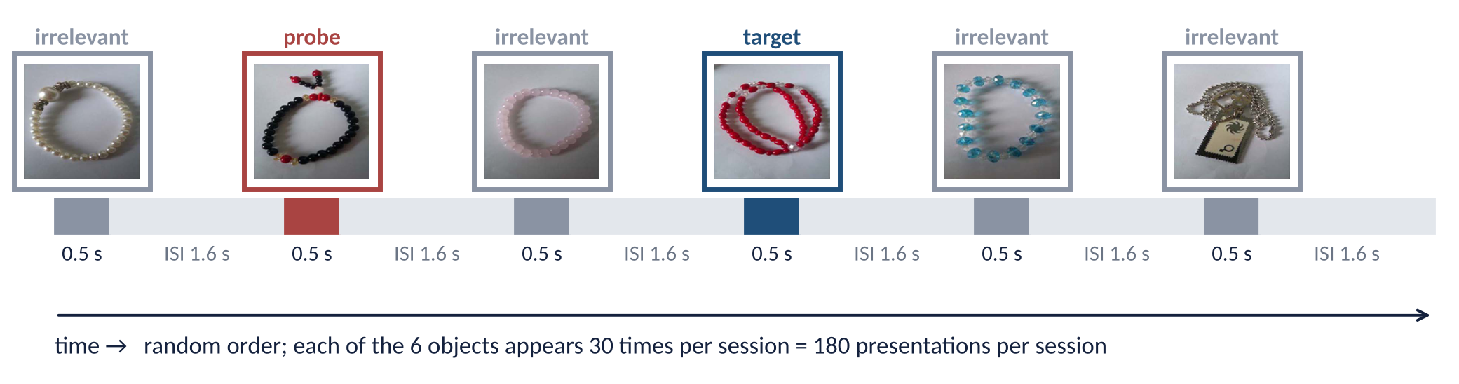
One Session: How the Images Were Presented
III · EXPERIMENTAL DESIGN
Why it matters: rarity drives the P300, so the number and order of presentations define the comparison.
Order and roles in the strip are illustrative; the actual trial order is not stored in the files.
180
× 5
1/6
≈ 5–6 min
presentations per session
sessions
probe = target rarity
per session (Assumed)
30 probe · 30 target · 120 irrelevant
→ 150 · 150 · 600 per person
rarity alone cannot separate them
ISI onset vs offset not stated
Sources: [37] · README of Dryad doi:10.5061/dryad.2qc64 (README and data files)
Notes:
The presentation schedule shows how the experiment generates repeated observations. One appearance of an object produces one event-locked EEG segment, and repeating the object allows an average response to be estimated despite substantial single-trial noise.
The P300 depends on how rare and how meaningful a stimulus is, so the presentation schedule defines what the comparison can show. According to the readme, each image stayed on screen for 0.5 seconds and was followed by an inter-stimulus interval of 1.6 seconds. Each of the six objects appeared 30 times per session in random order, giving 180 presentations per session: 30 probe, 30 target and 120 irrelevant presentations. Over five sessions this adds up to at most 150 probe, 150 target and 600 irrelevant presentations per participant. The probe and the target each appear on one sixth of trials, so they are equally rare; rarity alone therefore cannot explain a probe-target difference, and a larger probe response than irrelevant response must come from the probe's meaning to the person. One session takes roughly five to six minutes; the exact duration depends on whether the 1.6 seconds is counted from image offset or from onset, which the readme does not specify. The sequence in the figure is illustrative: the true order of trials is not stored in the files.
The one-sixth probability applies to both probe and target, whereas the four irrelevant objects together account for two-thirds of presentations. Equal probe and target frequency simplifies the reasoning about rarity, but it does not eliminate differences in attention, memory, or task significance.

Slide 45
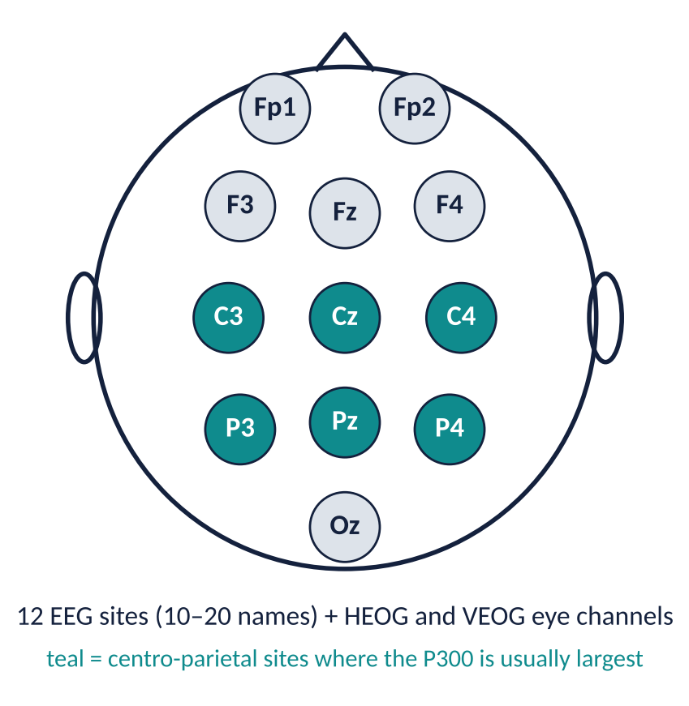
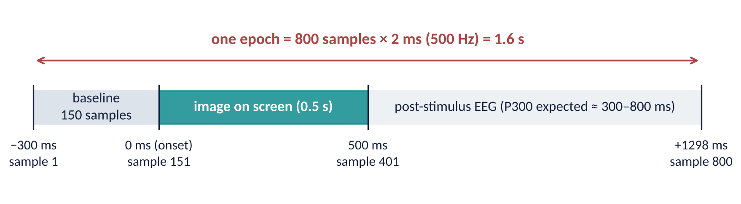
EEG Recording and the Epoch Window
III · EXPERIMENTAL DESIGN
Why both: the montage says where the signal comes from; the epoch window says which part of it was kept.
Recording
Released epochs
14 channels: 12 EEG + HEOG, VEOG
500 Hz = 1 sample every 2 ms
Right-earlobe ref., online 0.1–30 Hz [37]; not in README
Cut by the authors around each image
Contaminated trials already removed
300 ms baseline already subtracted
Sources: [37] · Dryad doi:10.5061/dryad.2qc64 (README and data files) · baseline, epoch length and time zero verified against the raw .cnt file
Notes:
This slide connects the physical recording to the analysis window. The electrode montage is a spatial description of where voltage was measured. The epoch is a temporal description of which samples were retained around each picture's onset. These are complementary pieces of information, not two separate experiments.
The recording is described from two angles: where on the head the signal was measured, and which stretch of time around each image was kept. Fourteen channels were recorded at 500 hertz, that is one sample every two milliseconds: twelve EEG sites in standard 10–20 positions and two electro-oculogram channels for horizontal and vertical eye movements. The centro-parietal sites, highlighted in teal, are where the P300 is usually largest. The readme gives no reference or filter settings, but the article reports a right-earlobe reference and a 0.1 to 30 hertz online filter. The released data are not a continuous recording. The authors cut an epoch around every image and removed trials they judged contaminated. Each epoch is 800 samples, or 1.6 seconds, long: 150 samples before image onset, from minus 300 milliseconds, and 650 samples after it, up to plus 1298 milliseconds. The average of the first 150 samples of every epoch is exactly zero, which shows that a 300-millisecond baseline correction has already been applied. The image itself is on screen for the first 500 milliseconds after onset, and the P300 is expected roughly between 300 and 800 milliseconds.
On the time axis, zero means image onset. Negative time is the pre-stimulus baseline; positive time captures the developing response. The archive contains pre-cut, corrected epochs plus one raw continuous file; the raw file confirms where zero lies, but not every preprocessing choice can be reconstructed for the other recordings.

Slide 46
The Dataset on Disk: Folder Structure
III · DATASET
Why start with folders: the files contain only numbers, so every label — group, person, session, stimulus — lives in the folder path.
All data for 14 electrodes and 30 subjects/
└─ 14 electrodes-30 subjects/
├─ honest/ ← control group, 15 people
│ ├─ subject1/ … subject15/
│ │ ├─ session1/ … session5/
│ │ │ ├─ irrelevant/irrelevant.txt
│ │ │ ├─ probe/probe.txt
│ │ │ └─ target/target.txt
└─ lying/ ← knowledgeable group, 15 people
└─ subject1/ … subject15/ (same layout)
Counts
2 groups × 15 people × 5 sessions × 3 files = 450 text files
Download: one .rar archive (568 MB) + README
≈ 2.4 GB of text once extracted (estimate)
What the README does not say
Epoch length and time axis
Channel names and order
Units of the values
Which object was the probe
Path = label: lying / subject9 / session1 / probe
Sources: README of Dryad doi:10.5061/dryad.2qc64 (README and data files)
Notes:
The focus now shifts from the experiment as participants experienced it to the experiment as an analyst receives it. The first challenge is not machine learning; it is reconstructing the metadata correctly from the directory structure.
The text files contain only numbers, so the folder path is the only place where labels are stored. Understanding the folder tree is therefore the first step of any analysis. After extracting the archive, the top folder contains two group folders, honest for the control group and lying for the knowledgeable group. Each holds fifteen subject folders, each subject holds five session folders, and each session holds three stimulus folders named irrelevant, probe and target, each with a single text file of the same name. That gives two groups times fifteen people times five sessions times three files, which is 450 text files. Reading a path from left to right gives all four labels of its data: the group, the participant, the session and the stimulus type. The readme describes each file as all the EEG responses to that stimulus type in that session, to be segmented into epochs, for example with the EEGLAB toolbox. It does not say how long an epoch is; that is established on the next two slides.
A safe analysis script must preserve the full identity tuple: group, participant, session, and stimulus category. If any of these labels are lost while concatenating the files, the later statistics or classifier can answer the wrong question.

Slide 47
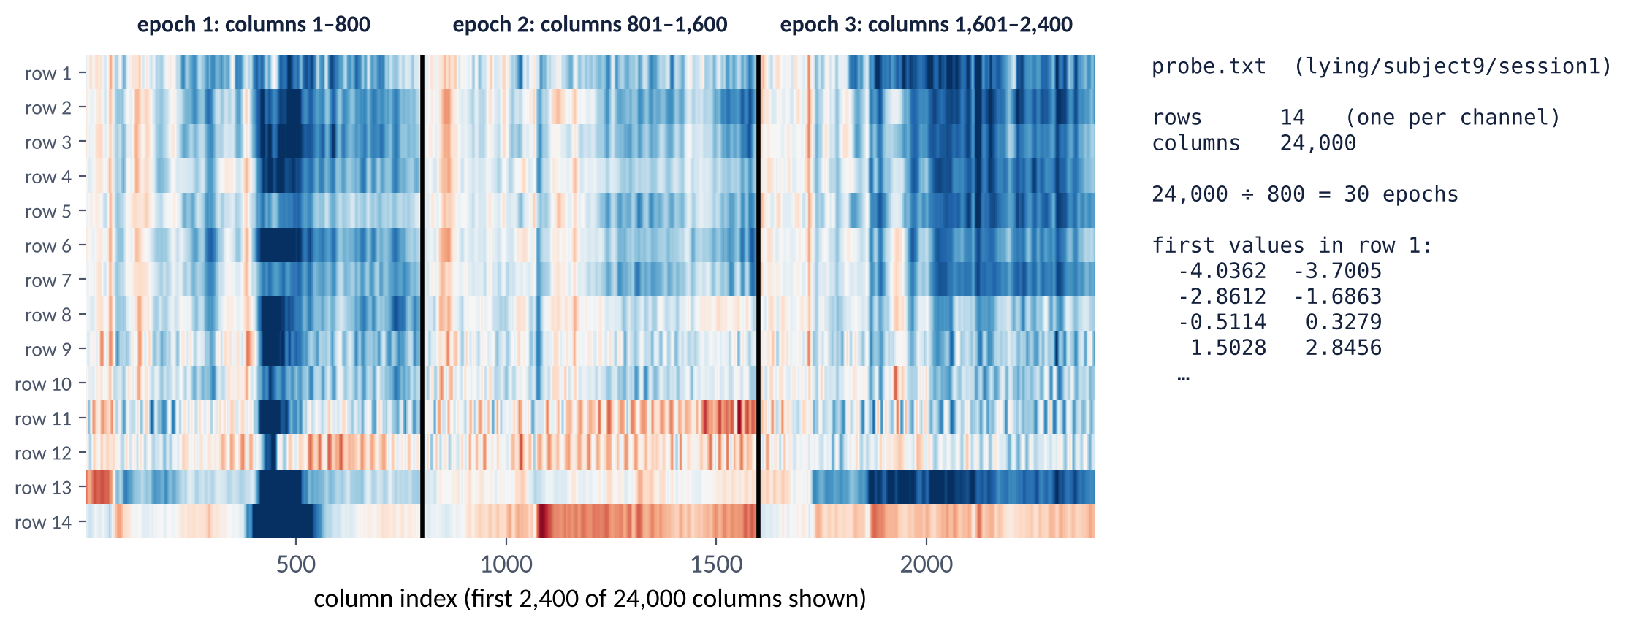
Inside One Text File: What the Numbers Are
III · DATASET
Why open a file: a row of bare numbers is useless until its rows, columns and units are known.
Sources: Own inspection of Dryad doi:10.5061/dryad.2qc64 (README and data files) · channel order and µV unit verified against the raw .cnt header
Notes:
One file is opened here and read the way a data scientist reads it. At first sight, it is just a large rectangular array of values. But its interpretation depends on identifying the channel axis, the time axis, and the boundaries between consecutive trials.
A file of bare numbers becomes data only when its rows, columns and units are known, so one file is opened and decoded here. The example is the probe file of the knowledgeable participant lying subject nine, session one. It has 14 rows and 24,000 tab-separated columns, with no header. Each row is one recording channel. Each column is one time sample, and the epochs are placed side by side: columns 1 to 800 are the first epoch, 801 to 1,600 the second, and so on. 24,000 divided by 800 gives 30 epochs, exactly the 30 probe presentations of one session. The irrelevant file of the same session has 95,200 columns, which is 119 epochs: one of the 120 irrelevant trials was removed by the authors. In the image each epoch starts near zero, the pale band at its left edge, because the baseline has been subtracted. The values are voltages in microvolts: the readme does not state the unit, but the one raw recording in the release has a calibration of 0.168 microvolts per digital step, exactly the smallest step seen in the text files. The next slide decodes each part of the matrix and marks which parts are verified and which are assumed.
The example is deliberately concrete: 24,000 samples divided by 800 samples per epoch gives 30 probe trials. This simple arithmetic is a reproducibility check, not merely a formatting observation. Channel order and physical units are not self-describing in the text files; they are verified here against the one raw recording in the release.

Slide 48
Decoding the File: Rows, Columns, Values, Labels
III · DATASET
Why decode each part: every later step depends on reading the matrix correctly, and two parts are not self-describing.
Rows = 14 channels
Columns = time samples
Verified*
Verified
Exactly 14 rows in every file
No channel names in the text files
Order from the raw .cnt header: Oz Pz P4 C4 P3 Cz C3 Fz F4 F3 Fp2 Fp1, HEOG, VEOG
Epochs placed side by side, 800 columns each
probe.txt: 24,000 = 30 epochs (one per presentation)
irrelevant.txt: 95,200 = 119 epochs (1 of 120 rejected)
Values = voltage
No labels inside
Verified*
Verified
Unit not stated in the README; raw .cnt step = 0.168 µV
Text values equal the raw recording in µV
No header, no time axis, no trial labels
Group, person, session and stimulus come only from the folder path
Sources: Own inspection of Dryad doi:10.5061/dryad.2qc64 (README and data files) · *verified against the one raw .cnt file (L12, session 1); same export assumed for all files
Notes:
The central point here is that the file is not one 24,000-sample response to a single picture. It is a sequence of short responses stored end to end. It must be reshaped into trials before asking any event-related question.
The file matrix has four parts, and each is decoded separately because two of them, channels and units, are not self-describing in the text files. Rows are channels: every file has exactly 14 rows, matching the 14 recorded channels, but the text files store no channel names. The release also contains one raw continuous Neuroscan recording, for participant L12, whose header names the channels. Its epochs match the released session-1 files sample for sample, which fixes the row order: Oz, Pz, P4, C4, P3, Cz, C3, Fz, F4, F3, Fp2, Fp1, then the horizontal and vertical eye channels. Physiology agrees: the target P300 is largest in the row labelled Pz, alpha power is highest in the posterior rows, and the frontal rows correlate with the vertical eye channel. The same export is assumed for all other files. Columns are time samples, with the epochs placed side by side, 800 columns each. The probe file has 24,000 columns, which is 30 epochs, one per probe presentation; the irrelevant file of the same session has 95,200 columns, which is 119 epochs, because one of the 120 irrelevant trials was rejected by the authors. Values are voltages in microvolts: they equal the raw recording, whose calibration is 0.168 microvolts per digital step. Finally, there is no header, no time axis and no trial label inside any file. The folder path is the only label, which is why the conversion on the following slides reads the labels from the path.
A second distinction is equally important: a file path gives the stimulus category, but not which specific bracelet or pendant was shown on each trial. Category labels and object identity are not interchangeable.

Slide 49
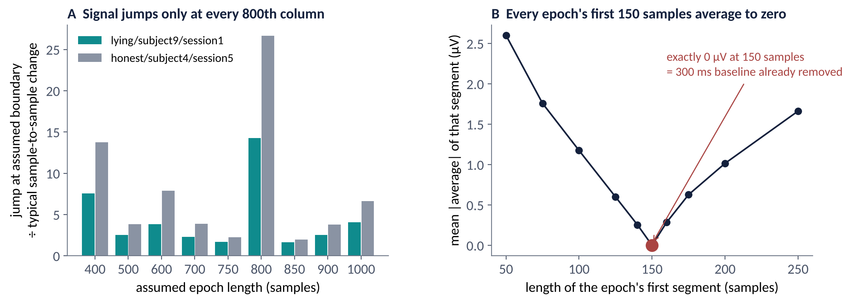
How the 800-Sample Epoch Length Was Established
III · DATASET
Why verify: the README never states the epoch length, and a wrong length would scramble every epoch.
Three checks agree
Column counts are multiples of 800 (24,000 · 95,200 · 21,600)
Jumps occur at every 800th column (A)
First 150 samples average exactly 0 (B) → onset at sample 151
800 × 2 ms = 1.6 s: matches the README interval numerically (corroboration only)
Epoch = 800 samples: −300 to +1298 ms, onset at sample 151
Files inspected: lying/subject9/session1 and honest/subject4/session5 (all three stimulus files of each). The full set of usable files is cut with the same 800-sample rule; time zero is checked on the next slide.
Sources: Own inspection of Dryad doi:10.5061/dryad.2qc64 (README and data files)
Notes:
The README does not give the epoch length, so it has to be established empirically and reproducibly, by inspecting the structure of the released matrices, their trial-count divisibility, and the alignment of their pre-stimulus baselines.
The readme never states how long an epoch is, and cutting the columns with the wrong length would mix the end of one trial with the start of the next, so the length is established from the data themselves with three independent checks. First, every file inspected has a column count that is an exact multiple of 800: 24,000, 95,200 and 21,600 columns, for example, correspond to 30, 119 and 27 epochs. Second, panel A measures how much the signal jumps at an assumed epoch boundary relative to its normal sample-to-sample change. Inside a continuous epoch, neighbouring samples are similar; at the boundary between two different trials the signal jumps. The jump is by far the largest for a length of 800 samples, about 14 to 27 times the normal change. The bar at 400 is also raised only because every second 400-sample boundary is an 800-sample boundary. Third, panel B cuts every epoch at 800 samples and averages its first stretch of samples. That average is exactly zero when the stretch is 150 samples long and non-zero for any other length. This shows that a 300-millisecond baseline correction was applied, which places stimulus onset at sample 151. With 2 milliseconds per sample, 800 samples cover 1.6 seconds, from minus 300 to plus 1298 milliseconds. This numerically matches the 1.6-second interval reported in the readme, but stimulus duration, onset-to-onset interval and analysis window are different quantities, so the match is corroboration rather than proof; the epoch length rests primarily on the file structure and on the comparison with the raw recording. How the readme's interval is defined remains unresolved.
The next slide checks the inferred onset against the raw recording and against the article. The slide separates documented metadata from a property verified in the data. The 800-sample segmentation is supported by file inspection; it should not be presented as though it were quoted directly from the README.

Slide 50
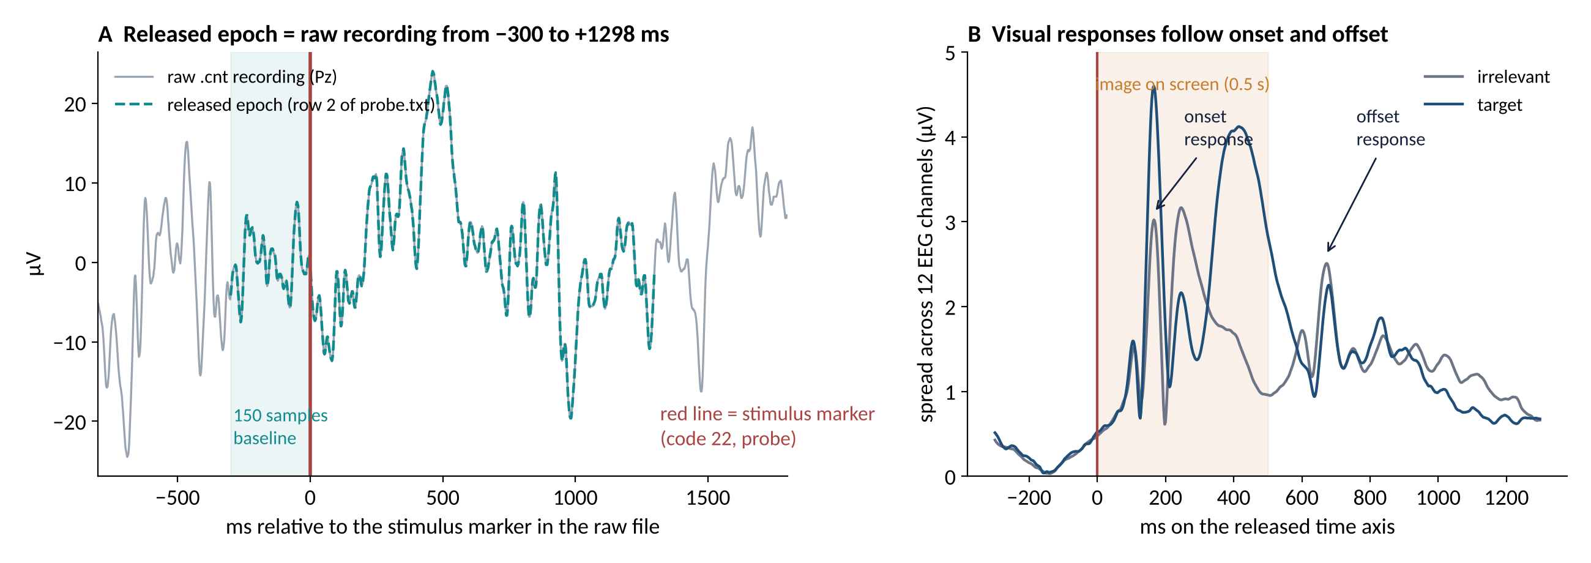
Time Zero: Article Description vs Released Files
III · DATASET
Why check: every latency and window in this deck depends on where 0 ms sits in the released epochs.
Article [37]: −500 to +1100 ms
Released files (used here): −300 to +1298 ms, marker at sample 151
Sources: [37] · raw file lying/subject12/session4/xiaowushuang1.cnt (= session 1) · B: all 30 participants, epochs > ±100 µV removed
Notes:
This slide resolves a discrepancy between the article and the released files, because every latency, window and time axis in the deck depends on where zero lies. The article describes epochs from minus 500 to plus 1100 milliseconds. The released files, however, behave as epochs from minus 300 to plus 1298 milliseconds, with the stimulus at sample 151. Two independent checks support the released-file axis. Panel A uses the one raw continuous recording in the release, from participant L12. Every released epoch of that session equals the raw recording sample for sample when it starts exactly 150 samples, 300 milliseconds, before the stimulus marker in the raw file's event table; the dashed released epoch lies exactly on the raw trace. Panel B is a physiological check on all thirty participants. The spread of the grand-average signal across the twelve EEG channels rises sharply about 100 to 170 milliseconds after zero, the expected latency of early visual responses, and rises again about 170 milliseconds after the image disappears at 500 milliseconds. On the article's axis these responses would fall implausibly late. This deck therefore uses the released-file axis, and the article's description is noted as a discrepancy. The next slide turns the files into one labelled dataset on this time axis.

Slide 51
From Text Files to a Labelled Dataset
III · DATASET
Why spell it out: this conversion is the first step of every analysis in Section IV, and it creates two different kinds of label.
1
2
3
4
from pathlib import Path
import numpy as np
f = Path('lying/subject9/session1/probe/probe.txt')
X = np.loadtxt(f) # 14 × 24000
n = X.shape[1] // 800 # 30 epochs
ep = X.reshape(14, n, 800)
ep = ep.transpose(1, 0, 2) # 30 × 14 × 800
group, subj, sess, stim = f.parts[-5:-1]
# 'lying', 'subject9', 'session1', 'probe'
Read file
Cut
Reshape
Label
14 × (n·800)
matrix
n = columns ÷ 800
n × 14 × 800
epochs
group · subject ·
session · stimulus
Result
Verified*
25,740 epochs, each 14 × 800, with four labels
Channel order and µV unit from the raw .cnt (previous slides)
Two kinds of label: stimulus type = trial label (what was on screen) · group = person label (what the participant knew). Trial accuracy ≠ person accuracy.
Sources: Own processing of Dryad doi:10.5061/dryad.2qc64 (README and data files)
Notes:
At this point the experiment can be represented computationally. The task is to turn separate text files into a consistent collection of trials without losing the hierarchy that created them.
Every later analysis, including the machine-learning pipelines of the next section, starts by turning the 450 text files into one labelled dataset, so the conversion is spelled out. Each file is read as a matrix of 14 rows and n times 800 columns. Dividing the number of columns by 800 gives the number of epochs n. The matrix is then reshaped so that each epoch becomes its own block of 14 channels by 800 samples, giving an array of n epochs. Finally, the labels are copied from the folder path: the group from the first folder, then the participant, the session and the stimulus type. Repeated over all files, this yields 25,740 usable epochs, each a 14 by 800 matrix with four labels. Two of those labels belong to different levels. The stimulus type is a trial label: it says what was on the screen. The group is a person label: it says what the participant knew. Predicting the first is a trial-level problem, predicting the second is a person-level problem, and the two must not be confused when accuracy is reported. The code on the right is a minimal illustration in Python; any EEG toolbox can perform the same steps. The counts behind the 25,740 epochs are examined next.
This is also where leakage can begin. Any later model must preserve participant IDs and split by person before fitting data-dependent transformations. A very large number of epochs does not make recordings from the same individual statistically independent.

Slide 52
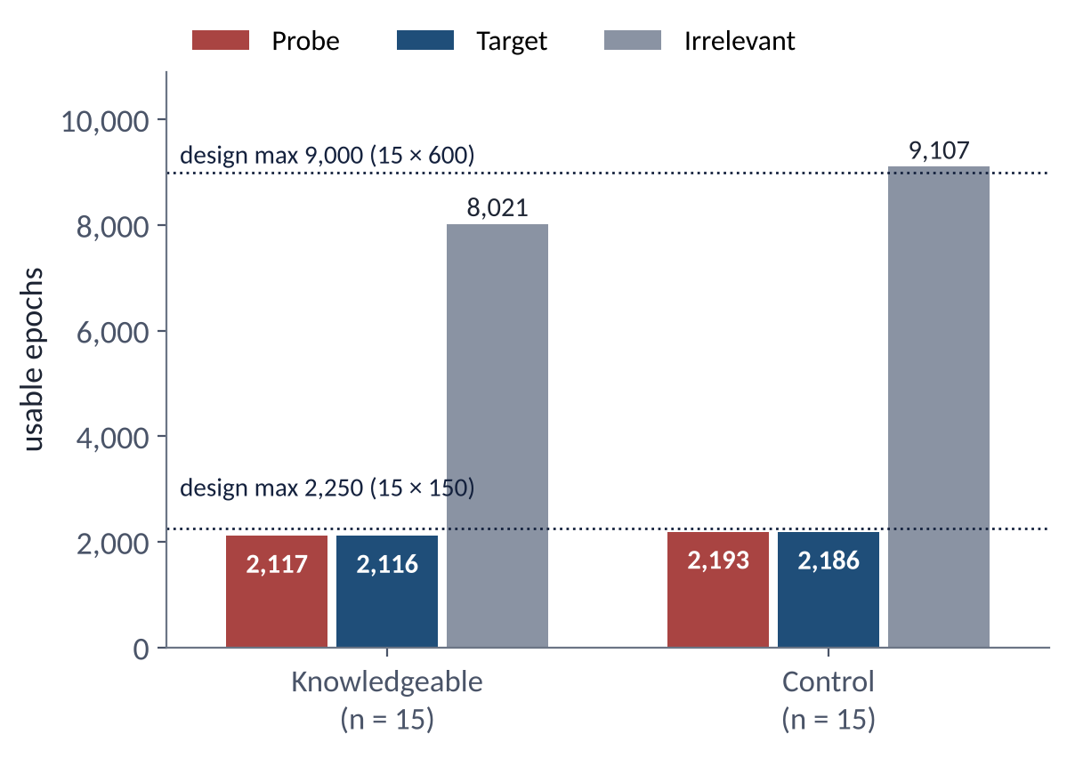
Released vs Usable Data: Trial Counts
III · DATASET
Why count: missing or unequal trials can create or hide a probe–irrelevant difference.
Released state
Epochs had already passed the authors' trial rejection [37]
9 defective files excluded first (empty, not epoched, duplicated, conflicting labels, mis-filed)
Usable data
25,740 epochs: 12,254 knowledgeable · 13,486 control
Probe and target counts near the design maximum
Flags to keep in mind
3 control files exceed 600 irrelevants (H09, H12, H15); origin unresolved
16.7% of released epochs still exceed ±75 µV on ≥ 1 EEG channel
25,740 epochs — but only 30 independent people
Sources: [37] · Data: Dryad doi:10.5061/dryad.2qc64 · own file audit (no classification) · file manifest with MD5 checksums supplied separately
Notes:
Before an average is interpreted, the amount of usable data that actually remains must be known. The planned number of presentations is a property of the experimental schedule; the observed number of epochs is a property of the released, quality-controlled files.
Trial counts are checked because missing or unequal trials can create or hide a probe–irrelevant difference. The released epochs had already passed the authors' trial rejection, so this is not untouched raw data. Before any analysis, nine defective files were excluded: files that were empty, continuous rather than epoched, duplicated across participants, carrying conflicting labels or mis-filed. These counts come from an own audit; a file manifest with MD5 checksums, the exclusion rules and the scripts are supplied separately so that every number can be reproduced. What remains are 25,740 usable epochs: 12,254 from the knowledgeable group and 13,486 from the control group. The chart compares these counts with the design maxima of 15 times 150 for probe and target and 15 times 600 for irrelevants. Probe and target counts are close to the maximum in both groups. The control irrelevant count slightly exceeds its maximum because three control files, H09, H12 and H15, contain more than 600 irrelevant epochs, a discrepancy whose origin is not resolved. In addition, 16.7 percent of released epochs still exceed plus or minus 75 microvolts on at least one EEG channel, despite the authors' rejection. The most important number is not 25,740 but 30. Thousands of epochs from one person are correlated observations of the same brain, so for any statement about people the sample size is 30. The first look at the data starts by fixing the analysis rules before any result is shown.
Missing or rejected epochs are not the same as missing participants. These are different forms of data loss with different implications, and neither should be silently filled in to make the design appear perfectly balanced.

Slide 53
Analysis Rules, Fixed Before Looking at Results
III · FIRST LOOK AT THE DATA
Why state them: a result is interpretable only if site, window and measure were not chosen after seeing the data.
1
Site
2
Window
3
Measure
4
Uncertainty
Pz — classic P300 site; all 12 channels on a later slide
300–800 ms, fixed in advance; not taken from [37]
Per participant: mean probe − mean irrelevant amplitude (µV)
95% bootstrap interval over that participant's trials
Deliberately not done
No threshold · no classifier · no accuracy · peak latencies reported only as exploratory, never reused as windows
Descriptive analysis: it shows the pattern in one dataset; it does not test a detection method
Sources: [37] · Data: Dryad doi:10.5061/dryad.2qc64 · own descriptive analysis (no classification)
Notes:
The analysis rules are made explicit before any result. There is no search over electrodes and time windows for the largest difference; a fixed, interpretable descriptive comparison is used so that the figures can be read without hidden optimization.
Results are interpretable only if the site, the time window and the measure were fixed before the data were inspected; choosing them afterwards can manufacture an effect. The primary site is Pz, the classic site of the P300, chosen before any data were inspected. The time window runs from 300 to 800 milliseconds and was fixed in advance; it is not taken from Gao and colleagues, who specified no amplitude window. For each participant the measure is the mean amplitude of the probe average minus the mean amplitude of the irrelevant average inside that window, in microvolts. Its uncertainty is a 95 percent bootstrap interval obtained by resampling that participant's own trials. Some things are deliberately not done: no detection threshold is set, no classifier is trained, and therefore no accuracy is reported. Peak latencies are reported only as exploratory descriptions, never as tuned windows. The analysis therefore describes the pattern in this dataset; it does not test a detection method. The first result shows the raw recording itself.
A bootstrap interval describes uncertainty in a participant's estimated trial-level contrast under the resampling assumptions. It does not turn that estimate into an externally validated person-level diagnosis.

Slide 54
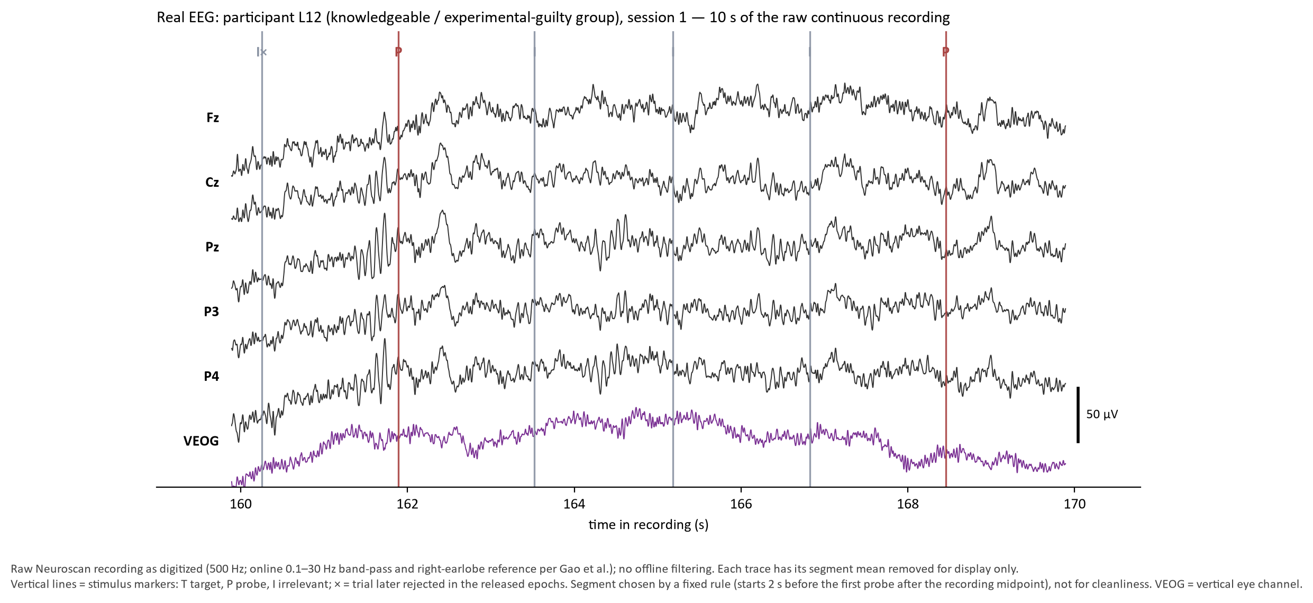
Real Data: Raw Multichannel EEG
III · FIRST LOOK AT THE DATA
Why show it: every average and every model starts from this raw signal — 10 s from L12, session 1, with stimulus markers.
Sources: [37] · raw file in the Dryad release: lying/subject12/session4/xiaowushuang1.cnt (= session 1; matches the released epochs sample for sample) · markers from its event table
Notes:
The raw recording comes first because every average and every model in this seminar starts from it. The Dryad release is mostly pre-cut epochs, but it also contains one raw continuous Neuroscan file, stored in the session-4 folder of lying subject 12. Its epochs match the released session-1 files of that participant sample for sample, so it is the session-1 recording, and its event table gives the true marker times. The figure shows ten seconds of that recording at Fz, Cz, Pz, P3, P4 and the vertical eye channel, with the stimulus markers. The segment was chosen by a fixed rule, two seconds before the first probe after the recording midpoint, so it was not picked for looking clean. The first irrelevant trial in it is missing from the released epochs, which means the authors rejected it, and it is marked with a cross. Ongoing EEG varies continuously, and no textbook ERP is visible in the raw scalp signal before averaging. The next slide follows one channel, Pz, from this recording to an ERP.

Slide 55
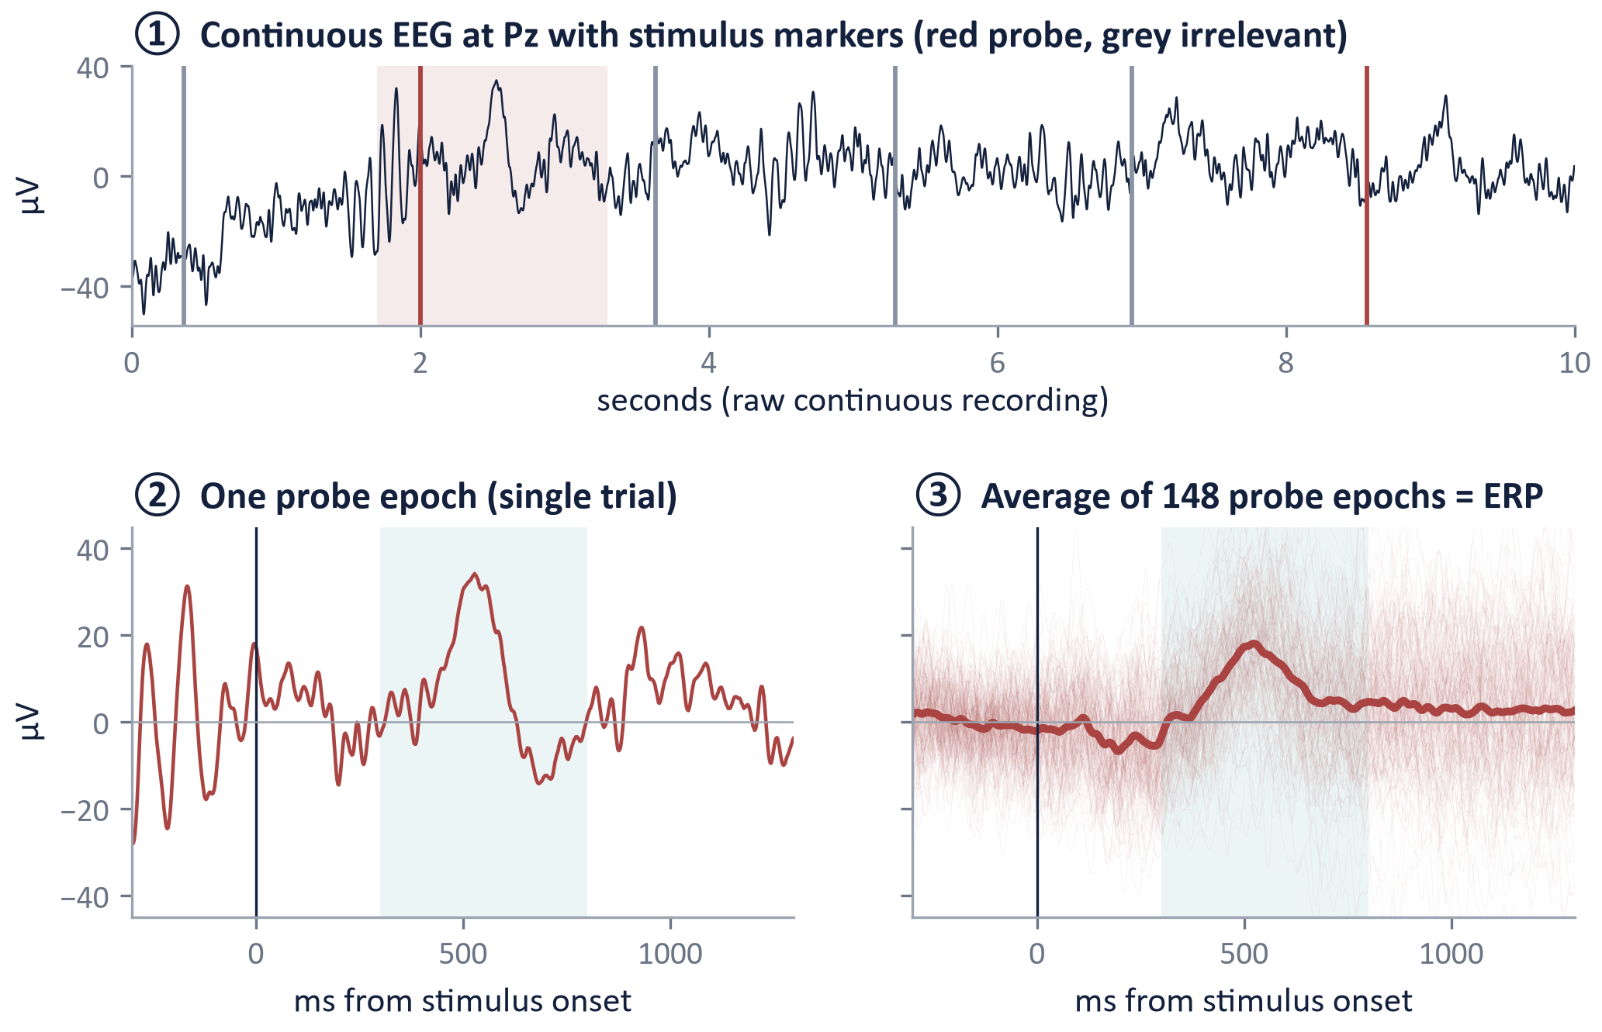
Real Data: From Continuous EEG to an ERP
III · FIRST LOOK AT THE DATA
Why show it: a recognition-related ERP is hard to see by eye in single noisy trials; averaging makes it clearer.
How to read the three panels
① Continuous Pz recording; red and grey lines mark probe and irrelevant onsets
② One probe epoch cut from −300 to +1298 ms: no P300 visible by eye
③ Average of this participant's 148 probe epochs: a late positivity appears in the shaded window
Point
For this participant and illustration, averaging makes the late positivity clearer; single-trial models can still learn from individual epochs
Sources: [37] · Dryad doi:10.5061/dryad.2qc64 · panel ① from the raw .cnt file in the release · own descriptive analysis (no classification)
Notes:
The three panels are read in order: the first shows activity over time, the second isolates one event, and the third combines many similarly labelled events.
The first result shows how an ERP emerges from the recording, because a recognition-related response is difficult to distinguish by eye in a single noisy trial. Panel one shows the continuous recording at Pz from the one raw file in the release, with red and grey lines marking probe and irrelevant onsets taken from its event table. Panel two shows one probe epoch, cut from minus 300 to plus 1298 milliseconds around onset; the voltage swings widely and no P300 can be identified by eye, because the response is embedded in ongoing brain activity, eye and muscle activity. Panel three overlays this participant's 148 probe epochs and their average. In the average, a late positivity appears in the shaded window. The number 148 is simply the number of probe epochs available for this participant, not a general requirement. For this participant and this illustration, averaging improves the signal-to-noise ratio and makes the late positivity clearer, which is why classic CIT analysis works with averages. Single-trial models in Section IV still learn from individual epochs, by combining many weak cues across channels and time. The next slide compares the averages of all three stimulus types across the two groups.
An ERP is an estimate obtained by aligning and averaging trials. It is not a separate sensor measurement and it is not a neural signature visible with certainty on every individual trial. This distinction motivates the harder single-trial learning problem in the next section.

Slide 56
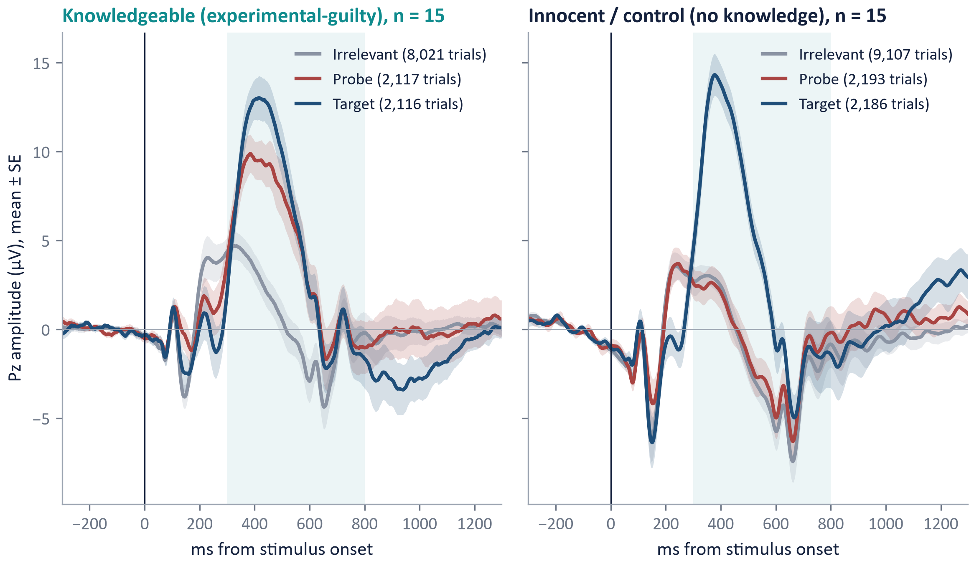
Real ERPs: Do Probe and Irrelevant Differ?
III · FIRST LOOK AT THE DATA
Why test it: the conceptual ERPs made a prediction that real data can confirm or contradict.
Knowledgeable (experimental-guilty)
Probe and target both exceed irrelevants
Probe − irrelevant +3.9 µV (300–800 ms)
Largest mean difference at Pz among recorded channels
Innocent / control
Probe resembles irrelevants (+0.5 µV)
Target P300 intact
Caution
Window fixed in advance, not from [37]; one laboratory study
Conceptual prediction → observed pattern: the information is the conditional probe–irrelevant contrast, not the mere presence of a P300
Sources: [37] · Data: Dryad doi:10.5061/dryad.2qc64 · own descriptive analysis (no classification) · predeclared: Pz, 300–800 ms; peaks exploratory
Notes:
The question for which the experiment was designed can now be asked: does the probe produce a different event-related response when the participant has encountered it in the mock theft? The two groups provide the crucial contrast.
This slide tests the prediction stated in the methods section: in knowledgeable participants the probe should behave like the target, while in controls it should behave like an irrelevant. The left panel shows the knowledgeable group, the right panel the controls, each averaged over 15 participants at Pz, with the number of trials in the legend. In the knowledgeable group, both probe and target rise clearly above the irrelevants. In the control group, the probe follows the irrelevants closely, while the target P300 remains large. In the window fixed in advance, from 300 to 800 milliseconds, the probe-minus-irrelevant difference is about 3.9 microvolts in the knowledgeable group and about 0.5 microvolts in controls, and among the recorded channels the difference is largest at Pz. These are descriptive values for this dataset and window, not general constants. The target P300 in both groups is a built-in check: a large positivity can reflect task relevance alone, so the information lies in the conditional probe-versus-irrelevant contrast, not in the mere presence of a P300. The next two slides ask where on the scalp and when the difference appears.
Read the target traces as a useful reference for task engagement, not as proof of concealment. The group difference is encouraging for a recognition account, but it is one descriptive analysis of one laboratory dataset and does not establish diagnostic performance in an unseen population.

Slide 57
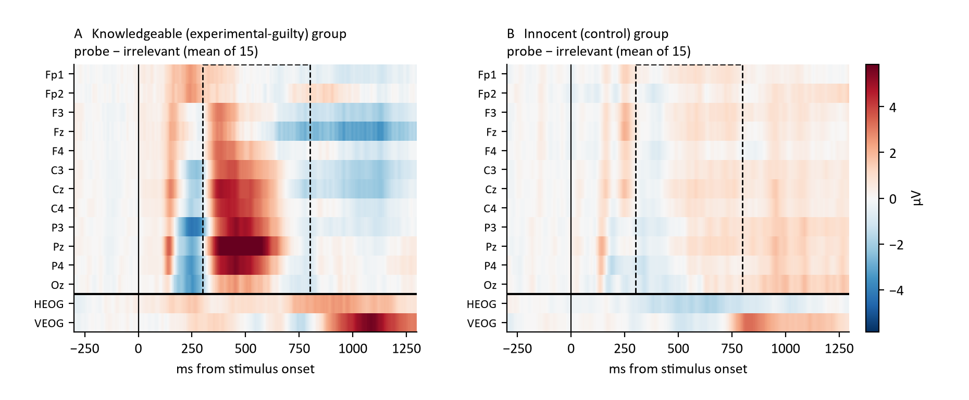
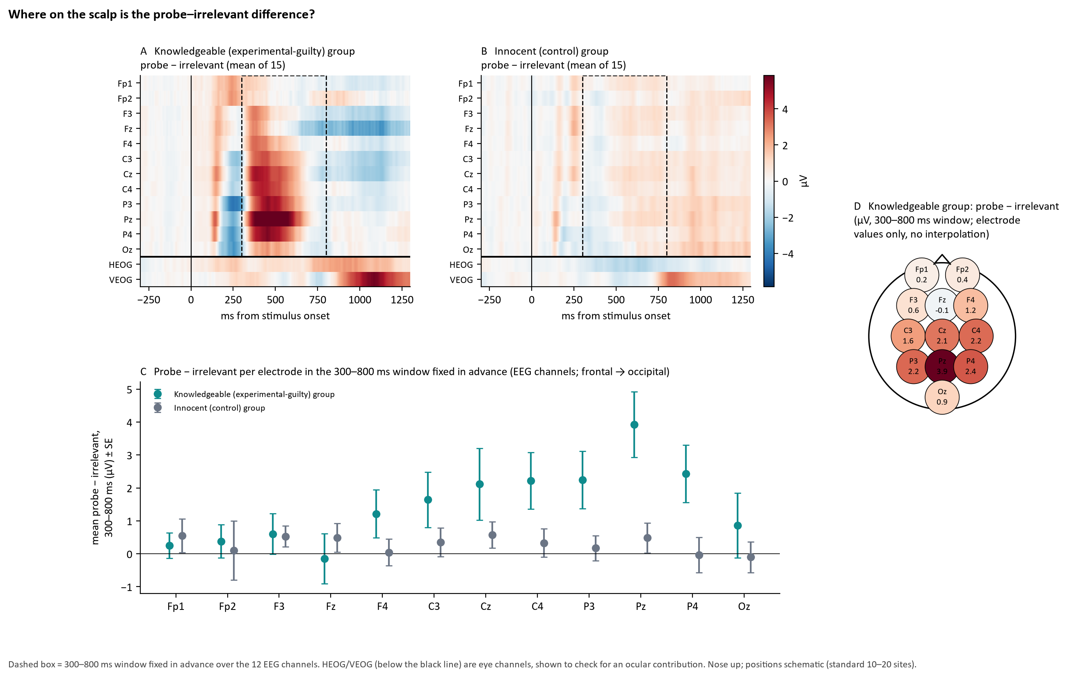
Real Data: Probe − Irrelevant by Channel and Time
III · FIRST LOOK AT THE DATA
Why look at every channel and time point first: the map shows where and when the probe differs before any summary is computed.
Both groups share one colour scale · dashed box: 300–800 ms window fixed in advance · HEOG / VEOG below the black line are eye channels · rows front to back
Sources: [37] · Data: Dryad doi:10.5061/dryad.2qc64 · own descriptive analysis (no classification) · predeclared: Pz, 300–800 ms; peaks exploratory
Notes:
Before any summary is computed, the probe-minus-irrelevant difference can be inspected at every channel and every time point. Each row is one channel, ordered from the front of the head to the back, with the two eye channels below the black line; each column is a time point, and red means that the probe response is more positive than the irrelevant response, averaged over the fifteen people of the group. Panel A shows the knowledgeable group. A positive difference appears shortly after 300 milliseconds and is strongest over central and parietal channels, with Pz the darkest row inside the dashed 300 to 800 millisecond window fixed in advance; frontal rows are close to zero, and Fz turns negative later. Panel B shows the control group: the map stays pale, without a comparable structured effect in the window. The eye channels are small inside the window in both groups, so the parietal effect is not simply eye activity; a later effect on the vertical eye channel after about 900 milliseconds in the knowledgeable group shows stimulus-related eye activity that any frontal or multichannel model must handle. The next slide summarises the window electrode by electrode.

Slide 58
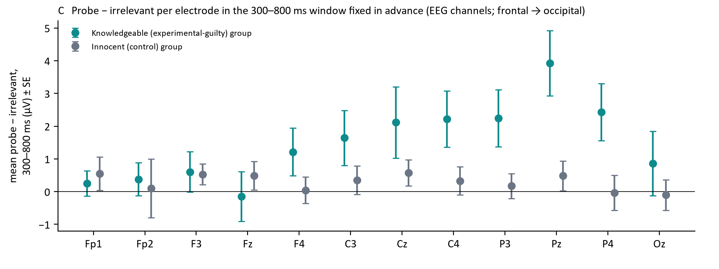
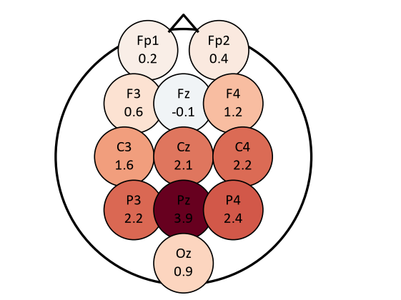
Real Data: Where on the Scalp Is the Difference?
III · FIRST LOOK AT THE DATA
Why summarise per electrode: one number per site shows whether the effect has a P300-like scalp distribution.
Schematic 10–20 positions · electrode values only
Knowledgeable
Controls and frontal sites
Pz 3.9 µV; P4, P3, C4, Cz 2.1–2.4 µV
Controls ≤ 0.6 µV everywhere; frontal ≈ 0
Eye channels
Small in the window; late VEOG effect > 900 ms
Sources: [37] · Data: Dryad doi:10.5061/dryad.2qc64 · own descriptive analysis (no classification) · predeclared: Pz, 300–800 ms; peaks exploratory
Notes:
One number per electrode and group shows whether the probe effect has the scalp distribution expected of a P300 or looks like eye activity. Panel C gives the mean probe-minus-irrelevant difference in the 300 to 800 millisecond window fixed in advance, with its standard error across the fifteen people of each group, ordered from frontal to occipital electrodes. In the knowledgeable group the difference is largest at Pz, at 3.9 microvolts, followed by P4, P3, C4 and Cz at 2.1 to 2.4 microvolts, and close to zero at the frontopolar and frontal sites. In the control group it stays at or below 0.6 microvolts at every electrode. Panel D places the knowledgeable group's values on a schematic head, with one circle per electrode and no interpolation between them, which makes the centro-parietal maximum visible at a glance. This is the classic scalp distribution of a P300, and the near-zero frontopolar values argue against an eye-movement explanation inside the window, although a later vertical eye effect after 900 milliseconds remains. The next slide asks when the difference is largest.

Slide 59
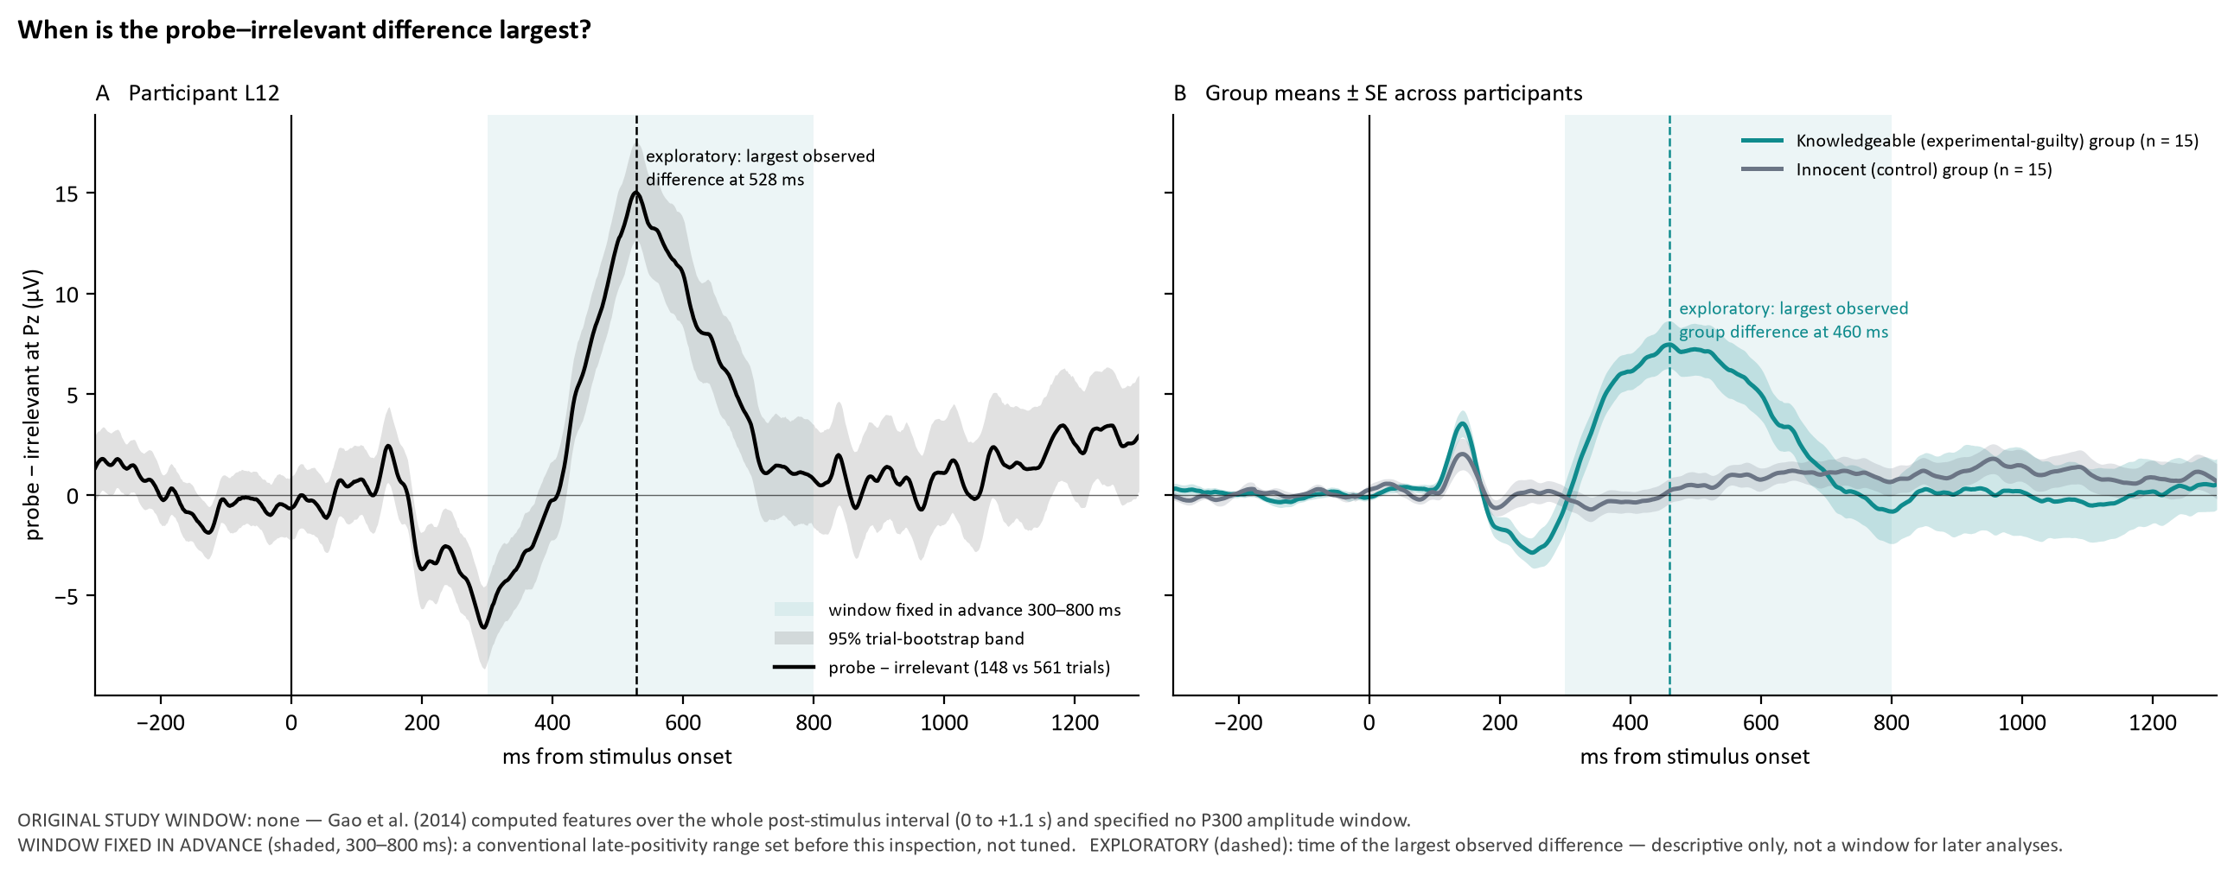
Real Data: When Is the Probe–Irrelevant Difference Largest?
III · FIRST LOOK AT THE DATA
Why separate them: the window fixed in advance (shaded) is not the exploratory peak (dashed).
Sources: [37] · Data: Dryad doi:10.5061/dryad.2qc64 · own descriptive analysis (no classification)
Notes:
Timing is shown separately because a window chosen after seeing the data would overstate the effect. The figure shows the probe-minus-irrelevant difference wave for participant L12 and for both groups. Gao and colleagues specified no amplitude window; the shaded 300 to 800 millisecond window was fixed in advance for this descriptive inspection. The dashed line marks the exploratory peak, 460 milliseconds in the knowledgeable group and 528 milliseconds for L12, which must not be reused as a tuned window. A small early bump near 140 milliseconds appears in both groups; it cannot reflect recognition in innocent participants and is probably a stimulus-specific visual difference. Latency varies between people, which is one reason fixed single-point features can be fragile. Group averages can also hide individual variation, which the next slide shows.

Slide 60
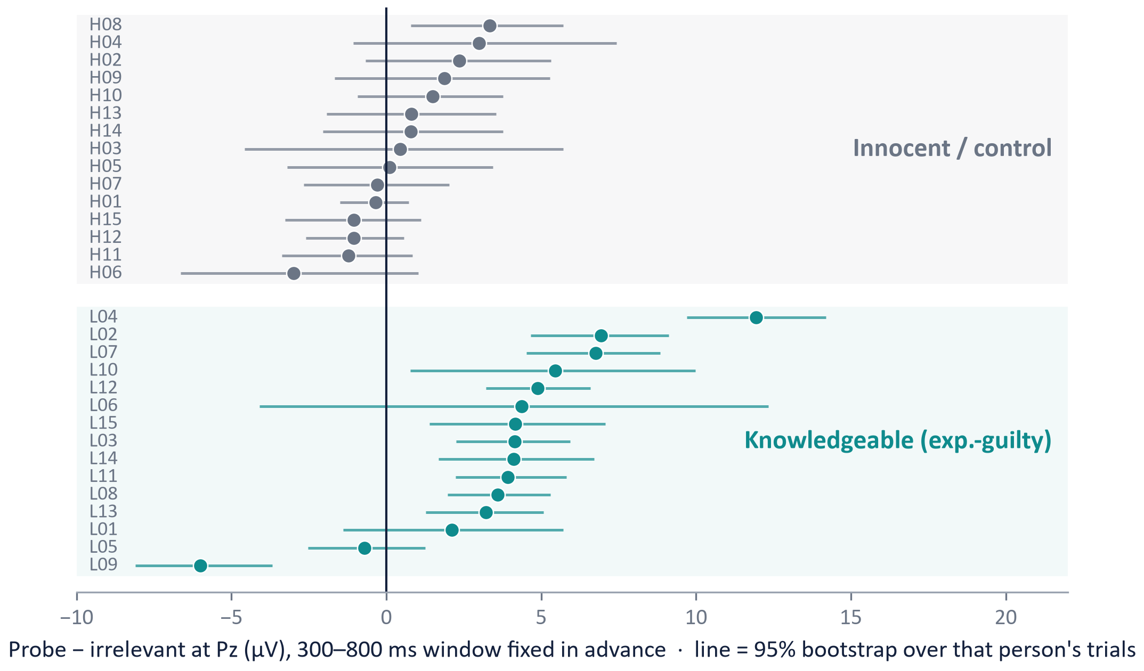
Real Data: Group Effect vs Individual Variability
III · FIRST LOOK AT THE DATA
Why individuals: a group effect does not mean that every person shows it.
How to read
One row per participant; dot = probe − irrelevant at Pz, 300–800 ms
Line = 95% bootstrap interval; right of 0 = probe larger
What it shows
Knowledgeable: 13/15 positive, median +4.1 µV (−6.0 to +11.9); L09 reversed
Control: 9/15 positive, median +0.4 µV (−3.0 to +3.3) — ranges overlap
Descriptive only: no threshold, no accuracy; N = 30
Computational question: can multichannel, temporal and single-trial information improve person-level discrimination beyond one mean Pz amplitude?
Sources: [37] · Data: Dryad doi:10.5061/dryad.2qc64 · own descriptive analysis (no classification) · predeclared: Pz, 300–800 ms; peaks exploratory
Notes:
The group curves are attractive because averaging suppresses noise, but they can conceal the most important practical issue: people are different. Here each dot represents one human participant rather than thousands of trials pooled together.
This slide shows, with real data, that a reliable group difference does not mean that every person shows it. Each row is one participant, controls in the upper block and knowledgeable participants in the lower block. The dot is that participant's probe-minus-irrelevant difference at Pz in the 300 to 800 millisecond window, and the horizontal line is a 95 percent bootstrap (Bootstrap is a statistical technique used to estimate how uncertain a result is by repeatedly resampling the available data.) interval over that participant's own trials. A dot to the right of zero means the probe response was larger than the irrelevant response. In the knowledgeable group, 13 of 15 participants are positive, with a median of 4.1 microvolts, but the values range from minus 6.0 to plus 11.9; participant L09 shows a clear reversal and two others are near zero. In the control group, 9 of 15 are positive, with a median of 0.4 microvolts and a range from minus 3.0 to plus 3.3. The two ranges overlap between roughly zero and three microvolts, so any threshold on this single measure would misclassify some people in one direction or the other. No threshold is applied and no accuracy is computed, because a threshold chosen after seeing these values would overstate performance. The obvious objection is that the exceptions are simply bad recordings; the next slide tests that objection.
The overlap is the key lesson. 'Positive probe-minus-irrelevant amplitude' cannot be equated with 'knowledgeable person', because some controls are positive too. Nor can an exceptional participant be labelled a failed recording without examining quality evidence.

Slide 61
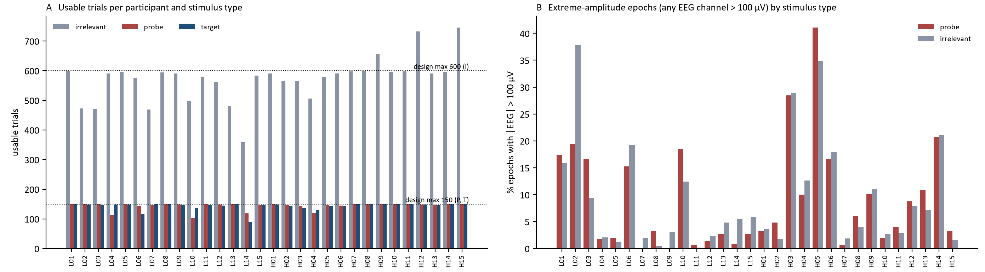
Data Quality: Are Trials Equal Across Stimulus Types?
III · FIRST LOOK AT THE DATA
Why check: if probe trials were fewer or noisier than irrelevant trials, the difference could be an artifact.
How to read A
How to read B
Takeaway
Bars = usable trials per participant and stimulus type; dotted lines = design maxima
Per participant: % of probe and irrelevant epochs with any EEG channel > 100 µV
Artifact rates vary strongly across people; probe and irrelevant rates look broadly similar here — descriptive, not a test of equivalence
Sources: [37] · Data: Dryad doi:10.5061/dryad.2qc64 · own descriptive analysis (no classification)
Notes:
Before brain responses are interpreted, a difference between probe and irrelevant stimuli must be shown not to arise from unequal amounts of usable data or from excess noise. Graph A shows the number of usable trials per participant: gray bars are irrelevant trials, red bars probe trials and blue bars target trials, with dotted lines at the design maxima. Irrelevant trials are more numerous by design, but the count also varies between people: L14, a knowledgeable participant, has roughly 360 irrelevant and 120 probe trials, whereas H14, a control, has roughly 740 irrelevant and 150 probe trials. Fewer trials make a person's average less stable. Graph B shows, for each participant, the percentage of probe and irrelevant epochs in which any EEG channel exceeds 100 microvolts, a flag for possible contamination. H05, a control, has about 41 percent of probe and 35 percent of irrelevant epochs flagged; L11, a knowledgeable participant, has almost none. The threshold flags potentially problematic epochs; it does not prove that every flagged epoch is an artifact. Together, the two graphs show that data quantity and quality vary strongly between people, in both groups, while probe and irrelevant rates appear broadly similar in this dataset. The plot is descriptive and does not by itself establish statistical equivalence. This does not prove that data quality has no effect on the findings; it means that quality must be accounted for before a neural response is read as evidence of recognition.

Slide 62
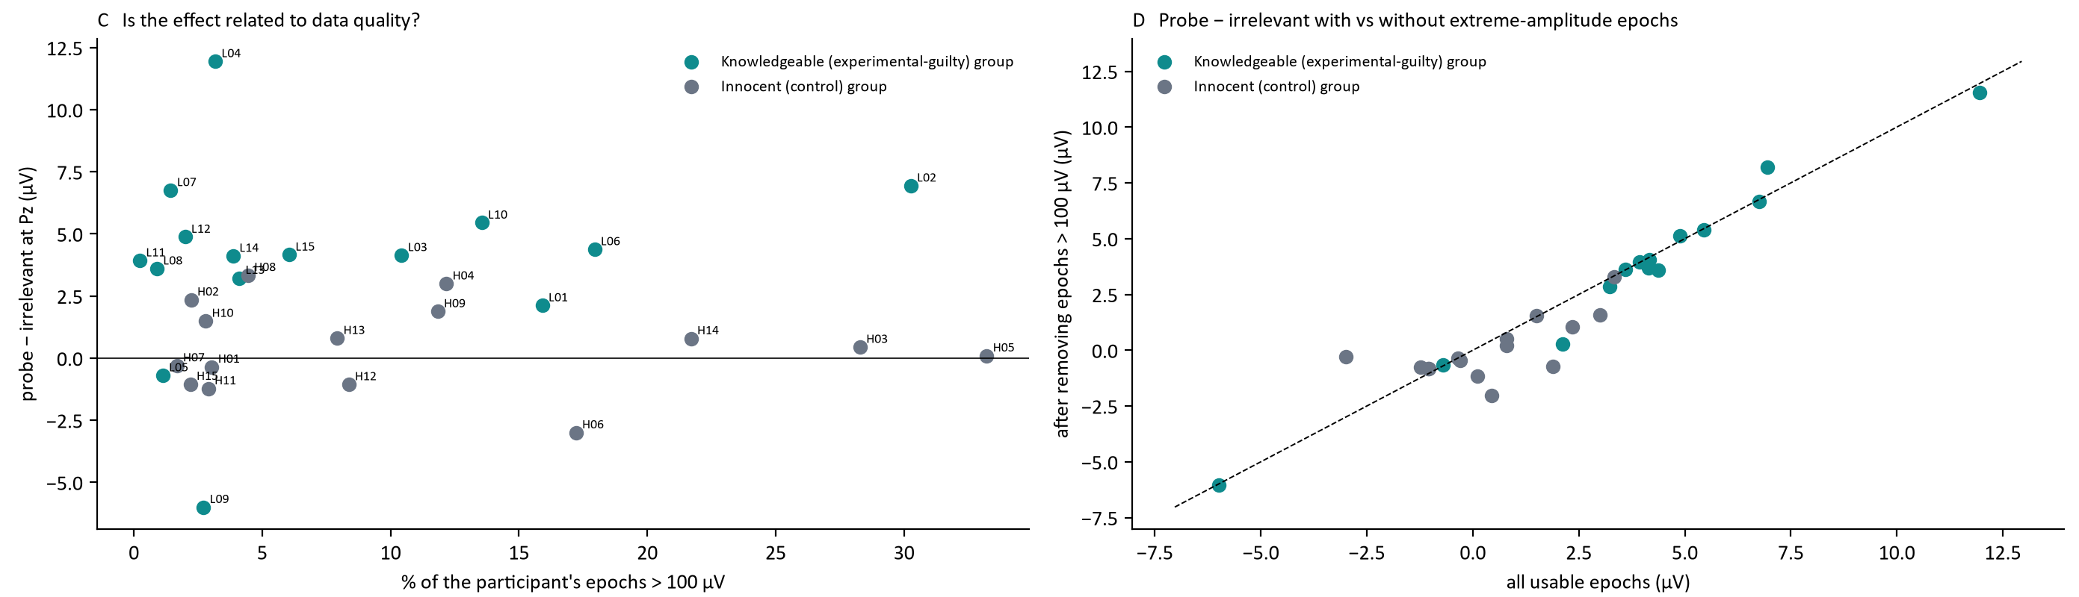
Data Quality (2): Does Noise Explain the Exceptions?
III · FIRST LOOK AT THE DATA
Why check: if the exceptions were simply noisy recordings, cleaning would remove them — the real-data test of that idea.
How to read C
How to read D
Takeaway
Each dot = one participant: artifact rate (x) vs probe − irrelevant effect (y)
Effect after removing epochs > 100 µV vs original; diagonal = unchanged
ρ = 0.30 / 0.03; mean 3.9 → 3.7 µV; 13/15 still positive; L09 is clean
Sources: [37] · Data: Dryad doi:10.5061/dryad.2qc64 · own descriptive analysis (no classification)
Notes:
This is the second half of the quality audit. If the most unusual participant-level effects were driven mainly by extreme-amplitude epochs, they would shrink or reverse when those epochs are removed. The figure tests that possibility directly.
The individual exceptions on the earlier slide could simply be noisy recordings; this slide tests that idea in two ways. Panel C plots each participant's probe-minus-irrelevant effect at Pz against the percentage of that participant's epochs above 100 microvolts. There is little relation: the rank correlation is 0.30 in one group and 0.03 in the other. The clearest exception, L09, has one of the cleanest recordings, at about three percent, so its reversed effect is not a noise artifact. Panel D recomputes every participant's effect after removing all epochs above 100 microvolts and plots it against the original value. Points on the dashed diagonal are unchanged, and nearly all points lie close to it. The knowledgeable-group mean moves only from 3.9 to 3.7 microvolts, and 13 of 15 knowledgeable participants remain positive. Data quality must always be checked before modelling, but here it does not explain the individual differences. The heterogeneity is a property of the people, through attention, memory, latency or strategy, and the computational methods in Section IV have to cope with it rather than clean it away.
The conclusion must remain proportionate: this particular amplitude-based sensitivity analysis does not explain away the observed heterogeneity. It does not establish why each participant differs. The section ends with a clear computational motivation: how can richer temporal and multichannel information be used while preserving participant-level validation and avoiding shortcuts?

Slide 63
SECTION IV OF VI
Computational Methods: From ERP Statistics to AI
Data structure · features and classical ML · deep learning · training and validation · person-level decisions · results on the Gao data and what they mean.
I · What & why
II · Methods
III · Experiment & data
IV · Computation
V · Limitations
VI · Future
Notes:
Section four covers the computational methods: how the data are structured, how EEG becomes model input, classical machine learning and the Gao pipeline, deep learning, and above all how models must be trained, validated and turned into person-level decisions. It ends by applying a classical P300 test and four models to the Gao data and interpreting the results before the limitations in Section V.

Slide 64
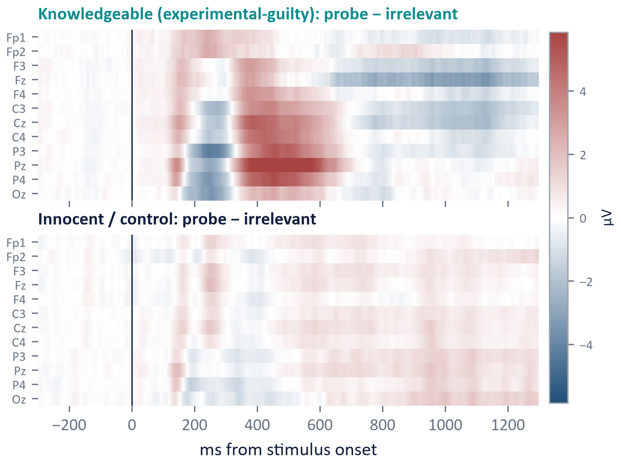
What Does the Real Dataset Turn Into Computationally?
IV · FROM REAL DATA TO COMPUTATION
The AI question: can models learn recognition-related EEG patterns that generalize to unseen individuals and conditions?
OBSERVATION IN THE REAL DATA
COMPUTATIONAL PROBLEM
Single trials are noisy
→
Signal enhancement · robust representations
Peak timing varies (exploratory: median 454 ms, range 316–670 ms)
→
Temporal features or learned temporal filters
Effect spans centro-parietal channels
→
Multichannel spatial modelling, not one Pz value
Participants differ greatly (−6 to +12 µV)
→
Subject-independent generalization
Groups overlap at the edges
→
Probabilistic decisions with calibrated uncertainty
Goal: a representation that generalizes to an unseen person — without learning participant identity, artifacts or experimental shortcuts
Sources: [37] · Data: Dryad doi:10.5061/dryad.2qc64 · own descriptive analysis (no classification) · peak timing exploratory
Notes:
The real-data observations can now be translated into computational requirements. Single trials are noisy, so the model needs a representation that is robust to trial-level variability. P300 timing is not identical across people; in this exploratory analysis the peak timing varies substantially, so a method that assumes one exact latency may be brittle. The effect is distributed across centroparietal channels rather than existing at one magical electrode, which motivates multichannel modeling. Participant effects also span a wide range, meaning that a model must generalize across people rather than simply memorize person-specific voltage patterns. Finally, knowledgeable and control participants overlap on a simple mean Pz measure, so a useful system should produce calibrated evidence and uncertainty rather than a falsely absolute label. These observations motivate richer temporal, spatial and multivariate representations, but they do not guarantee that a more complex model will perform better. The goal is therefore not maximum within-dataset accuracy; it is a representation that captures task-relevant structure and survives evaluation on people who were not used to fit the model. The size and structure of the dataset itself show why this is difficult.

Slide 65
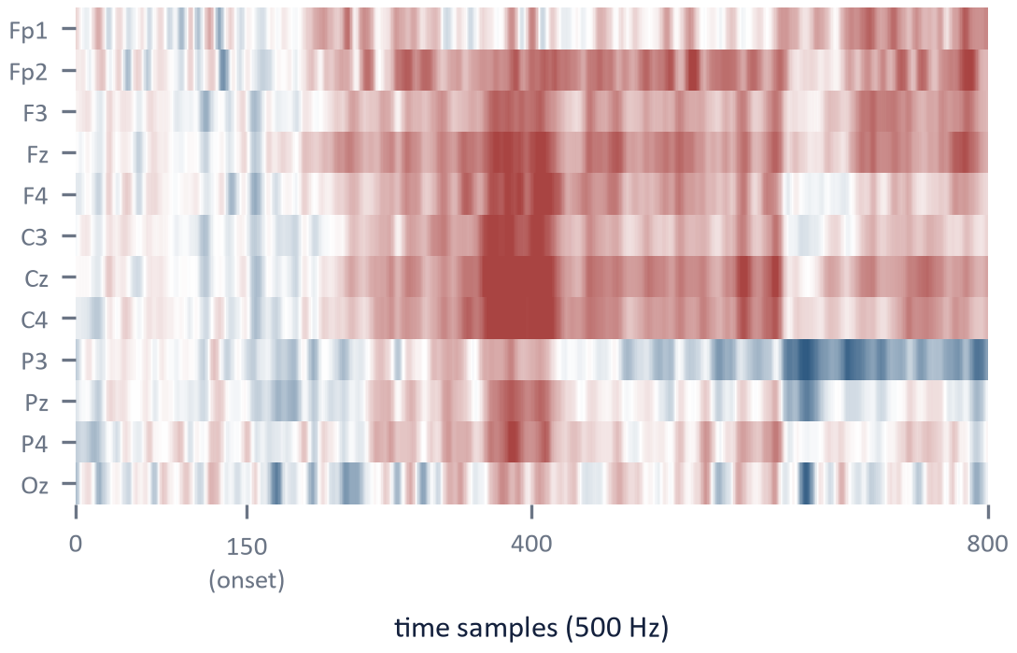
What Does an EEG Dataset Actually Contain?
IV · DATA STRUCTURE
Why show this: a model sees tensors plus metadata, and CIT data carry two different kinds of label.
From participant to epoch
One real epoch: a 12 × 800 matrix
The dataset as a tensor
Epochs × channels × time
25,740 × 12 × 800
≈ 247 million values
…from only 30 participants
Participant (30: 15 knowledgeable, 15 control)
↓
5 sessions per participant
↓
Recording: 14 channels (12 EEG + 2 EOG), 500 Hz — released as epochs
↓
Stimulus events: probe · target · irrelevant
Each epoch carries metadata
↓
Subject
Group
Stimulus
Trial
EEG matrix
Two labels
Trial: stimulus type
Person: knowledgeable / control
Epoch: 12 EEG channels × 800 samples (−300 to +1298 ms)
L12
knowledgeable
probe
17
12 × 800
↓
H03
control
irrelevant
204
12 × 800
Dataset: 25,740 usable epochs
L04
knowledgeable
target
88
12 × 800
25,740 epochs, but only 30 independent people: model complexity must match the number of people
Sources: [37] · Data: Dryad doi:10.5061/dryad.2qc64 (Gao et al. [37]) · own descriptive analysis · example rows illustrative
Notes:
This slide makes the statistical structure of the Gao dataset explicit. There are 30 participants: 15 in the knowledgeable or experimental-guilty condition and 15 controls. Each participant contributes many epochs across five sessions, giving 25,740 usable epochs. Each epoch can be represented as 12 EEG channels by 800 time samples, so the numerical tensor contains roughly a quarter-billion voltage values. That sounds like a large dataset computationally, but it is not a large dataset for person-level generalization. The thousands of epochs from one participant are correlated observations from the same human being; they do not create thousands of independent people. This distinction also produces two different label levels: a trial has a stimulus type such as target, probe or irrelevant, whereas a person has a condition label such as knowledgeable or control. Trial accuracy and person-level accuracy are therefore not interchangeable. The key sentence is: computationally there are more than 25,000 epochs, but statistically, for unseen-person inference, there are effectively only 30 independent participants. That fact should govern every later choice about splitting, validation and model complexity.

Slide 66
The Complete Computational EEG-CIT Pipeline
IV · END-TO-END PIPELINE
Why one view: every later slide is one stage; the person-level question is whether accumulated evidence supports recognition.
Experimental design: probe · target · irrelevant
→
EEG acquisition: participants × channels × time
→
Event synchronization: stimulus markers
→
Preprocessing: filter · artifacts · epoch · baseline
↓ three parallel routes, not a ranking: each answers a different question ↓
Statistical (CIT tradition)
Does the average probe response differ from the irrelevants?
Average by stimulus type
→
P300 amplitude
→
Bootstrap: probe vs irrelevant
→
Within-person test
Classical ML
Can engineered features predict the condition?
Engineered features
→
Feature vector
→
LDA · SVM · LR · RF
→
Trial scores
Deep learning
Can a learned representation predict the condition?
Channel × time tensor
→
EEGNet · DeepConvNet · Conformer
→
Learned representation
→
Trial scores
↓
Participant-level aggregation
→
Evaluation: sens · spec · AUC · F1 · calibration
→
Interpretation: recognition evidence
→
Application context
Recognition evidence ≠ deception ≠ guilt
Sources: [3], [21], [37], [47] · architectures: [S1]–[S3] · conceptual map; four of these models are evaluated on the Gao data at the end of Section IV
Notes:
This is the main computational map of the seminar. The experimental design and event synchronization come first because no analytical method can recover information that the paradigm failed to create. After preprocessing, there are three broad analytical routes, shown in parallel rather than as a ranking. The traditional statistical CIT route averages by stimulus type, quantifies a P300-related measure and can use a within-person bootstrap or related decision procedure. Classical machine learning converts each epoch or participant response into engineered features and applies models such as LDA, SVM, logistic regression or random forest. Deep learning instead receives a richer channel-by-time or related representation and learns part of the feature extraction jointly with the classifier. Regardless of route, trial-level outputs eventually have to be aggregated into participant-level evidence if the scientific question concerns whether a person recognizes the probe. Evaluation should then address sensitivity, specificity, discrimination, calibration and uncertainty. The final interpretation is still recognition evidence under the experimental conditions; the computational sophistication does not change the construct being inferred. Each stage is examined next, beginning with preprocessing for machine learning.

Slide 67
Preprocessing for ML: Why Does the Model Care?
IV · PREPROCESSING FOR ML
Why ask: each preprocessing step changes what a model can learn — including shortcuts.
STEP
WHAT IT DOES
WHY THE MODEL CARES
Filtering
Controls frequency content
Removes drift and line noise a model could exploit
Bad-channel handling
Repairs or removes failed electrodes
Prevents learning electrode failure instead of brain activity
Artifact handling
Removes blinks, eye movements, muscle
Reduces ocular and muscle shortcuts
Epoching
Cuts stimulus-locked segments
Creates the model's samples
Baseline correction
Removes the pre-stimulus offset
Expresses stimulus-related change, not the DC level
Normalization / standardization
Rescales channels or features
Stabilizes training; parameters must come from training data
Split participants first → fit pooled transformations (normalization, group ICA, feature selection) on training people only → per-person artifact correction is allowed if fixed in advance and blind to labels
Sources: [21], [25], [37] · general ML methodology
Notes:
The preprocessing steps from the foundations section look different through a machine-learning lens: each one changes what the model can learn, including shortcuts. Filtering controls frequency content and removes slow drift or line noise. Bad-channel handling prevents a model from learning that an electrode failed. Artifact handling reduces blink and muscle shortcuts; in the audit of the released Gao epochs in Section III, 16.7 percent still exceed plus or minus 75 microvolts on at least one EEG channel even though the authors had already rejected trials. Epoching creates the samples. Baseline correction expresses the stimulus-related change rather than the DC level. Normalization stabilizes training, and it is new here, because classical ERP analysis rarely needs it. The banner is the rule that connects this slide to leakage. Transformations whose parameters are estimated across people, such as normalization statistics, a group-level ICA or feature selection, must be fitted on the training participants only and then applied unchanged. Unsupervised artifact correction within one person, such as an ICA fitted to that person's own recording, is acceptable as long as the procedure is specified in advance and uses neither the test labels nor any outcome. This slide is where leakage prevention begins.

Slide 68
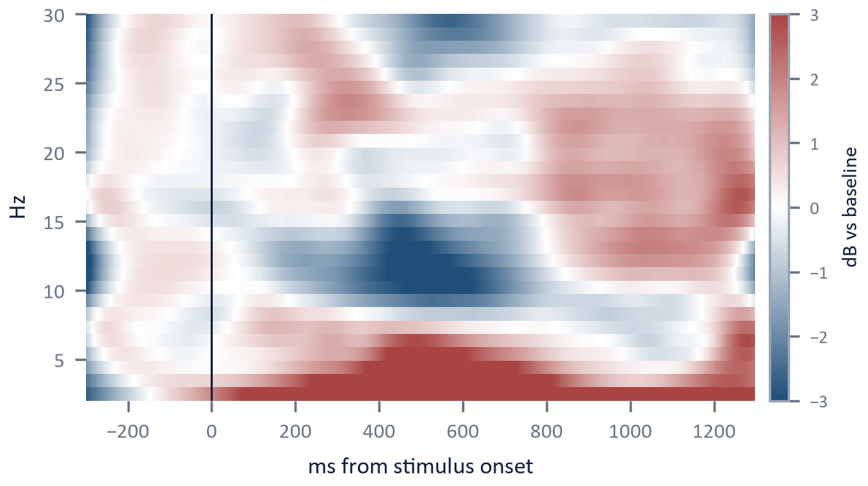
Three Ways to Feed EEG into a Model
IV · MODEL INPUT
Why show this: the same epoch can enter a model as a feature vector, a matrix, or a time-frequency tensor.
A Handcrafted feature vector
B Raw / preprocessed epoch
C Time-frequency representation
x₁ … xₚ
P300 amplitude, latency, area, band power, wavelet energy
x = [x₁ … xₚ]: p engineered features
→ LDA / SVM
X ∈ ℝ^(C×T), C = 12 channels, T = 800 samples
Network learns its own features
→ CNN / EEGNet
Wavelet or STFT per channel
Channel × frequency × time tensor
→ CNN or other network
One epoch = 12 × 800 = 9,600 values, but only 30 participants: a high-dimensional signal with very few people
Sources: [25], [37], [46] · thumbnails: real L12 probe data — B: one single epoch; C: mean Pz power over 148 probe epochs (not the same trial) · Dryad
Notes:
There are three common ways for the same epoch to enter a model. In A, a handful of physiologically motivated features, such as P300 amplitude, latency, area, band power or wavelet energy, gives a short vector for an LDA or SVM. In B, the epoch itself, a matrix of twelve channels by 800 samples, is the input, and the network learns its own features; the thumbnail is a real probe epoch from participant L12. In C, each channel is first transformed into a time-frequency map, giving a channel by frequency by time tensor; the thumbnail shows real power changes at Pz averaged over L12's 148 probe epochs, so it is not the same single trial as in B. The banner is the core computational difficulty: each epoch has 9,600 numbers, yet the number of independent people is thirty. That is why feature selection matters, why compact models are attractive, why large networks are risky, and why subject-independent validation and transfer learning become central.

Slide 69
From a 12 × 800 Epoch to 96 Features
IV · MODEL INPUT · WORKED EXAMPLE
Why 96 features: LDA and SVM take a fixed-length vector per trial; 96 interpretable window means replace the 6,000 raw samples.
0–1,000 ms: 12 channels × 8 windows of 125 ms
96 features: x₁ … x₉₆
Step 0 · select the segment
Oz
Released epoch: −300 to +1,298 ms (800 samples). Keep 0–1,000 ms: 500 samples at 500 Hz.
Pz
P4
C4
Σ wᵢxᵢ + b
96 weights
P3
average
each cell
score
per trial
Cz
C3
Fz
F4
F3
Fp2
One cell = a window mean
Fp1
x = (v₁ + … + vₙ) / n · 125 ms = 62.5 samples at 500 Hz (bins alternate 62/63); exactly 16 at 128 Hz, as in the results
0 ms 1000 ms
(24 of 96 shown)
Kept: coarse shape and scalp pattern · lost: timing within 125 ms and frequency content
Sources: [25], [37] · illustrative windows, not an optimised feature set · the same 96 features feed LDA and SVM in the results slides
Notes:
LDA and SVM require a fixed-length numerical vector per trial. A flattened epoch of all raw samples would also qualify; here each epoch is deliberately summarised into 96 interpretable time-window features instead, and this slide shows how. A released epoch has 12 EEG channels and 800 samples, from minus 300 to plus 1,298 milliseconds. The first step selects a segment: for this example, the first 1,000 milliseconds after stimulus onset are retained, which is 500 samples at 500 hertz, and the remaining 600 milliseconds are set aside. This segment is divided into eight successive windows of 125 milliseconds, and one mean is calculated per channel and window, 12 times 8, which gives 96 features written as one row x1 to x96. A window mean is simply the sum of the samples inside the window divided by their number: at 500 hertz a 125-millisecond window spans 62.5 sampling intervals, so a binning convention is needed, for example windows that alternate between 62 and 63 samples; after resampling to 128 hertz, as in the results slides, every window holds exactly 16 samples. A linear classifier computes one weighted sum of these 96 numbers plus a bias, which gives the score for that trial; training chooses the 96 weights. The summary keeps the coarse shape and scalp distribution of the response, which is where a P300 lives, but discards timing finer than 125 milliseconds and most frequency information. The window layout is illustrative, a common and transparent choice rather than a validated optimal feature set. With only thirty people, even 96 weights must be fitted on training people only. The same 96 features are used by the LDA and SVM models in the results at the end of this section.

Slide 70
Feature Engineering in EEG-CIT
IV · FEATURE ENGINEERING
Why its own slide: in small EEG datasets, feature choice often matters as much as the classifier.
Handcrafted physiological features
Data-driven feature selection
P300 amplitude, latency, area, window means
P3 combined with frontal EEG asymmetry [31]
P300-based feature extraction for classification [25]
Grounded in prior knowledge of the component
Many candidate features from channels, time windows or coefficients
Features ranked by a criterion, e.g. F-score [37]
Top-ranked subset passed to the classifier
Grounded in the training data
Interpretability
Handcrafted: higher
Data-driven: lower
Rule
Flexibility
Handcrafted: lower
Data-driven: higher
Fit selection inside each training fold
Overfitting risk in small samples
Handcrafted: grows with features tried
Data-driven: high unless nested
Sources: [25], [31], [37]
Notes:
In small EEG datasets, the choice of features often shapes results as much as the choice of classifier, so feature engineering deserves explicit treatment. Handcrafted physiological features encode prior knowledge: P300 amplitude, latency and area, or the combination of the P3 with frontal EEG asymmetry examined by Matsuda and colleagues. Abootalebi and colleagues proposed a feature-extraction approach for P300-based detection. Data-driven selection instead ranks many candidate features by a criterion; Gao and colleagues used an F-score to select features before a support vector machine. Handcrafted features are easier to interpret physiologically, whereas data-driven selection is more flexible but easier to overfit. Whatever the method, feature selection must be fitted on training data only, a point the leakage slide returns to. The features then need a decision rule, which classical classifiers provide.

Slide 71
Classical Classifiers: LDA vs SVM
IV · CLASSICAL MACHINE LEARNING
Why explain, not just name: the classifier's geometry determines what kind of separation it can find.
LDA — maximize class separation along a projection
SVM — maximize the margin around a boundary
Arrow: projection direction w · dashed: threshold. Maximizes between-class / within-class variance.
Solid: boundary · dashed: margin · ringed: support vectors. Kernels allow curved boundaries.
EEG feature vector
LDA / SVM
Score or label
Recognized / not recognized
Schematic; general ML background. In the reviewed literature: LDA [46], SVM [37]
Sources: [37], [46]
Notes:
Naming a classifier says little; its geometry determines what kind of separation it can find in the feature space. Linear discriminant analysis seeks a projection direction that maximizes the separation between class means relative to the spread within classes, and then thresholds the projected value. A support vector machine seeks the boundary with the largest margin between the classes, defined by the training points closest to it, the support vectors; kernel versions allow curved boundaries. Both output a score or label that is then mapped to a decision such as recognized or not recognized. In the reviewed literature, LDA appears in a related EEG and deception study and SVM in a P300-CIT study; the panels are schematic illustrations of the general methods, not data from either study. Before asking how well such classifiers perform, it helps to see one complete pipeline in detail.

Slide 72
An End-to-End Pipeline: Gao et al. [37]
IV · CASE STUDY
Why one case in depth: a complete pipeline shows where each design decision enters — and where validity can fail.
3-stimulus P300-CIT: probe · target · irrelevant
Why it counts as P300-CIT
Multichannel EEG + preprocessing
Probe, target and irrelevant stimuli; guilty and innocent groups; P300 measured and enhanced.
ICA-based spatial denoising → single-trial P300
Feature extraction
Computational contribution
Single-trial P300 enhancement before classification.
F-score feature selection
SVM classifier
Caution
Subject-wise CV (1 guilty + 1 innocent per fold); trials are averaged in groups of five first. Nesting of F-score selection and the 90% threshold is not fully reported: a leakage risk, not a shown flaw.
Individual diagnosis (as reported)
Sources: [37]
Notes:
Gao et al. provide a useful published example of an end-to-end computational pipeline. Their three-stimulus P300-CIT data pass through multichannel EEG preprocessing and an ICA-based spatial denoising procedure intended to enhance single-trial P300 information. Features are then extracted, ranked using an F-score criterion, and classified with an SVM before an individual-level diagnosis is produced. The paper is valuable because it demonstrates the full chain from experimental trials to a computational decision rather than stopping at an averaged ERP. At the same time, its validation details deserve careful reading. The cross-validation is subject-wise, holding out one knowledgeable and one control participant per fold, which is preferable to randomly mixing epochs from the same people across training and test sets. The published methods also average trials in groups of five before reconstruction, so the classified units are not single trials. The paper reports a single F-score feature table and a 90% diagnosis threshold, and it does not fully state whether feature selection and the threshold were recomputed inside each training fold. This is a leakage risk to be checked, not a demonstrated flaw. The study therefore serves as an important historical computational case study, not as proof of leakage-free contemporary validation. The broader lesson is that subject-wise splitting is necessary but not sufficient: every data-dependent step, including feature selection and thresholds, has to respect the training/test boundary.

Slide 73
Another Route: Wavelet-Based EEG Features
IV · AN ALTERNATIVE REPRESENTATION
Why include it: it shows what a time-frequency representation adds beyond a single P300 amplitude value.
EEG epoch
What a wavelet representation adds
Energy localized in both time and frequency
Can describe oscillatory activity and its timing
Retains information that one peak-amplitude value discards
Low band
High band
LL
LH
HL
HH
Wavelet packet decomposition (schematic, two levels)
Status in this seminar
Coefficients
Features
LDA
Classification
Related EEG/deception study [46] — not established here as classical P300-CIT. Shown as a methodological example; no performance reported.
Sources: [46]
Notes:
This route matters because it shows what a time-frequency representation can add beyond a single amplitude value. A wavelet packet transform repeatedly splits the signal into lower and higher frequency bands, producing coefficients that are localized in both time and frequency. Features derived from these coefficients can describe oscillatory activity and its timing, information that a single peak-amplitude value discards. Dodia and colleagues combined wavelet packet features with linear discriminant analysis on EEG labelled for deceit identification. Its experimental paradigm has not been confirmed as a classical P300-CIT, so it serves here as a methodological example and its performance is not reported. The next slide contrasts such designed representations with representations learned from the data.

Slide 74
From Handcrafted Features to Representation Learning
IV · REPRESENTATION LEARNING
Why include it: modern EEG analysis increasingly learns the representation instead of designing it.
Handcrafted route (as in Gao et al. [37])
EEG epoch
→
P300 amplitude, latency, wavelet
→
Feature selection (F-score)
→
LDA / SVM
→
Decision
Representation learning
EEG epoch (channels × time)
→
Learned temporal filters
→
Learned spatial filters
→
Classifier head
→
Decision
Candidate architectures
Compact EEG CNNs
CNN + temporal modelling
Attention / transformer models
Self-supervised pretraining
What changes
Features are learned from data, not designed
Needs more data and strict subject-independent validation
Interpretation requires explainable AI
Caution
Promising in EEG generally; CIT-specific validation remains limited
With N = 30, shortcuts (participant identity, artifacts, stimulus differences) are a real risk
General EEG / machine-learning background — not drawn from the reviewed CIT literature · illustrative
Notes:
The classical route, as in Gao et al., designs the representation: P300 amplitude, latency and wavelet coefficients, then feature selection and an LDA or SVM. Representation learning instead feeds the multichannel epoch to a model that learns its own spatial and temporal filters and a classifier on top. Typical candidates in EEG research are compact convolutional networks, convolutional networks combined with temporal modelling, attention or transformer models, and self-supervised pretraining on unlabelled EEG. This is general EEG and machine-learning background rather than drawn from the reviewed CIT literature: these methods are promising in EEG generally, but strong CIT-specific validation remains limited. With datasets of thirty people, learned models can easily pick up shortcuts, such as participant identity, artifacts or stimulus-specific differences, which is exactly why the evaluation design on the following slides matters more than the choice of classifier. This slide marks the conceptual shift from feature engineering to representation learning. In the handcrafted route, the researcher decides which summaries to compute before classification. In deep learning, convolutional layers learn filters and intermediate representations that are optimized for the prediction task. The benefit is flexibility; the cost is greater data demand, more opportunities for shortcut learning, and a stronger need for external validation and interpretability. The next slide shows exactly which numbers such a network receives.

Slide 75
One Epoch, One Tensor: What the Network Receives
IV · DEEP LEARNING · MODEL INPUT
Why first: before any filter, it must be clear which numbers enter the network and how they are arranged.
Released epoch
12 × 800
−300 to +1,298 ms · 500 Hz
Select 0–1,000 ms
12 × 500
500 samples at 500 Hz
Resample to 128 Hz
12 × 128
one trial: the network input
Mini-batch
64 × 12 × 128
64 epochs per training step
View
Shape
Meaning
One trial
12 × 128
12 simultaneous time series (rows = electrodes), 128 samples each, ≈ 7.8 ms apart
Mini-batch
64 × 12 × 128
64 epochs processed together in one training step
Inside EEGNet
64 × 1 × 12 × 128
a singleton axis for the 2-D convolution layers — not an extra electrode
Not a flattened vector: unlike the 96 LDA features, channels stay rows and time stays columns
The network receives 12 × 128 numbers per trial: the same epoch, cropped and resampled — not a second recording
Sources: [S1], [37] · shapes of the evaluated EEGNet and CNN-LSTM
Notes:
Before any filter is applied, the input has to be clear: which numbers enter the network and how they are arranged. A released epoch is a matrix of 12 EEG channels by 800 samples, from minus 300 to plus 1,298 milliseconds at 500 hertz. The evaluated networks keep the first 1,000 milliseconds after onset, 12 by 500 samples, and resample that segment to 128 hertz, which leaves 12 by 128 numbers per trial. This is the same epoch, cropped and resampled, not a second recording. One trial is therefore twelve simultaneous time series, one row per electrode, each with 128 samples about 7.8 milliseconds apart. During training, 64 such epochs are processed together as one mini-batch of 64 by 12 by 128. Inside EEGNet the framework adds a singleton axis, giving 64 by 1 by 12 by 128, because the layers are implemented as two-dimensional convolutions; that axis is a technical convenience, not an extra electrode. Unlike the 96 window means used by LDA and SVM, the epoch is not flattened into one long vector: channels stay rows and time stays columns, so the network can learn patterns in time and across electrodes separately. The next slide slides the first filter along these rows.

Slide 76
What a 1D Convolution Does to EEG
IV · DEEP LEARNING · WORKED EXAMPLE
Why a toy example: convolution is a sliding weighted sum, and five samples are enough to see it.
1 EEGNet-style: one temporal kernel applied to each channel
2 Spatial weights mix the channels
Kernel
0.5
1
0.5
0.8 × channel 1 (8, 10, 8)
+ 0.3 × channel 2 (0, −1, 0)
Channel 1
2
4
6
4
2
8
10
8
= virtual channel
6.4
7.7
6.4
Channel 2
1
0
−1
0
1
0
−1
0
Two kinds of weight
Channel 1, first output: 2·0.5 + 4·1 + 6·0.5 = 8; the window then slides one sample
Temporal: one shape, reused everywhere
Spatial: one weight per channel
Generic multichannel Conv1D: a filter may hold a distinct set of weights for each channel and combine them into one feature map.
Temporal weights learn what the response looks like; spatial weights learn where it appears
Sources: General deep-learning methodology · EEGNet-style illustration [S1] · illustrative fixed weights, not learned values
Notes:
A convolution is a sliding weighted sum, and this toy example with two channels and five samples shows the two kinds of weight a compact EEG network such as EEGNet learns. The example is an illustrative EEGNet-style temporal convolution: one temporal kernel is applied separately to each channel. The kernel has three weights, 0.5, 1 and 0.5. It slides along channel 1, whose samples are 2, 4, 6, 4 and 2: at the first position it computes 2 times 0.5 plus 4 times 1 plus 6 times 0.5, which is 8, and the next two positions give 10 and 8. The same three weights slide along channel 2, whose samples are 1, 0, minus 1, 0 and 1, giving 0, minus 1 and 0. In this design the temporal weights are shared across time and across channels: the kernel learns one waveform shape and looks for it everywhere. This is a specific design choice, not a definition of all one-dimensional convolution. In a general multichannel Conv1D, the input is arranged as channels by time, and each output filter contains a distinct temporal weight vector for every channel; the filter multiplies each channel by its own weights and adds all channels into one feature map. The example on this slide is therefore an EEGNet-style factorisation, not a universal rule of convolutional networks. A spatial filter then gives each channel its own weight, here 0.8 for channel 1 and 0.3 for channel 2, and adds the filtered channels into one virtual channel: 6.4, 7.7 and 6.4. Temporal weights capture what the response looks like over time; spatial weights capture where on the scalp it appears. The weights here are fixed for illustration; in a trained network they are estimated from the training people by gradient-based optimisation. Strictly, the sliding weighted sum is a cross-correlation, which deep-learning libraries call convolution. The next two slides add a second filter and then follow the numbers all the way to a score.

Slide 77
More Filters, More Feature Maps
IV · DEEP LEARNING · WORKED EXAMPLE
Why more than one: one waveform template cannot capture every relevant EEG pattern, so networks learn several.
Filter
Temporal kernel
Channel 1 map
Channel 2 map
Spatial mix
Feature map
A
[0.5, 1, 0.5]
[8, 10, 8]
[0, −1, 0]
0.8·Ch1 + 0.3·Ch2
[6.4, 7.7, 6.4]
B
[−1, 0, 1]
[4, 0, −4]
[−2, 0, 2]
0.4·Ch1 − 0.2·Ch2
[2, 0, −2]
Operation
Weights per output filter (C = 12 channels, K = 3)
EEGNet-style temporal filter
K = 3 weights, reused along every channel; the spatial step adds 12 channel weights per map
Generic multichannel Conv1D
C × K = 12 × 3 = 36 weights (+ bias): all channels and 3 time points in one sum
More filters (either design)
each filter has its own learned weights; filters do not share one set
Evaluated EEGNet: 8 temporal filters × 64 samples = 512 weights · 16 spatial filters × 12 electrodes = 192 weights
Two filters give two feature maps: learned patterns, not new electrodes
Sources: General deep-learning methodology · EEGNet-style illustration [S1] · illustrative fixed weights
Notes:
One waveform template cannot capture every relevant EEG pattern, so a network learns several filters, and this slide adds a second one to the same two channels. Filter A is the kernel from the previous slide, 0.5, 1 and 0.5, a smoothing shape. Filter B has the weights minus 1, 0 and plus 1, which responds to rising and falling slopes. On channel 1, whose samples are 2, 4, 6, 4 and 2, filter B gives 4, 0 and minus 4: minus 2 plus 6 is 4, minus 4 plus 4 is 0, and minus 6 plus 2 is minus 4. On channel 2 it gives minus 2, 0 and 2. Each filter then gets its own spatial mix: 0.8 times channel 1 plus 0.3 times channel 2 for filter A, giving 6.4, 7.7 and 6.4, and 0.4 times channel 1 minus 0.2 times channel 2 for filter B, giving 2, 0 and minus 2. Both filters slide along the same five time points, and the result is two different feature maps, not two new electrodes. The lower table separates three ideas that are easy to confuse. In the EEGNet-style design, one temporal filter of width 3 has only three weights, reused along every channel, and a separate spatial step adds one weight per channel. A generic multichannel one-dimensional convolution instead gives each output filter its own weight for every channel and time position: with 12 channels and width 3, that is 36 weights plus a bias. In both designs, every additional filter has its own weights. In the evaluated EEGNet, eight temporal filters of 64 samples hold 512 weights, and sixteen spatial filters over twelve electrodes hold 192 weights. The next slide follows the two feature maps to a single score.

Slide 78
From Feature Maps to a Score
IV · DEEP LEARNING · WORKED EXAMPLE
Why follow the numbers: the feature maps still have to be compressed and combined before a single score exists.
Step
Operation
Output
Stage
Size
1 Feature maps
A = [6.4, 7.7, 6.4] · B = [2, 0, −2]
2 maps × 3
Input
2 × 5
2 Nonlinearity
ReLU(x) = max(0, x)
A same · B = [2, 0, 0]
1 temporal filter, K = 3
2 × 3
Spatial mix
1 × 3
3 Pooling
global max over time
[7.7, 2.0]
2 filters
2 × 3
4 Dense layer
z = 0.4·7.7 − 0.2·2.0 − 2
z = 0.68
Global pool
2
5 Score
sigmoid(z) = 1 / (1 + e⁻ᶻ)
≈ 0.66
Dense → score
1
The evaluated EEGNet differs in detail
ELU instead of ReLU · average pooling · a separable convolution · a dense layer over 64 numbers — same logic, different choices
An uncalibrated score for the trained label (target-like) — not a statement about deception or guilt
Sources: General deep-learning methodology · illustrative generic CNN head, not the evaluated EEGNet
Notes:
The two feature maps still have to be compressed and combined before a single score exists, and this slide follows the numbers with a deliberately simple head. Step one starts from the two maps of the previous slide, map A, 6.4, 7.7 and 6.4, and map B, 2, 0 and minus 2: two maps with three time positions each. Step two applies a nonlinearity, here ReLU, which keeps positive values and sets negative values to zero, so map A is unchanged and map B becomes 2, 0 and 0. Step three pools over time; a global maximum keeps the largest value of each map, which leaves two numbers, 7.7 and 2.0. Step four is a dense layer, one weighted sum with a bias: 0.4 times 7.7 minus 0.2 times 2.0 minus 2 gives 0.68. Step five passes this through the sigmoid function, 1 divided by 1 plus e to the minus z, which gives about 0.66. The right-hand table tracks the dimensions: two electrodes by five samples become two by three after one temporal filter, one by three after the spatial mix, two by three with two filters, two numbers after pooling, and one score. The evaluated EEGNet follows the same logic with different choices: an ELU nonlinearity, average pooling, a separable convolution and a dense layer over 64 numbers. The final number is an uncalibrated score for the trained label, how target-like the epoch is; it is not a probability of deception or guilt. The architecture families that build on these steps follow.

Slide 79
Deep Learning for EEG: Three Architecture Families
IV · DEEP LEARNING FOR EEG
Why these three: they are established EEG-decoding architectures — not established P300-CIT solutions.
EEGNet [S1], step by step
Original released epoch: 12 × 800 (500 Hz) · evaluated network input: 12 × 128 (0–1 s, resampled to 128 Hz)
Input epoch C × T
→
Temporal convolution: learns temporal filters that can capture frequency-selective structure
→
Depthwise spatial convolution: channel patterns per filter
→
Separable convolution: combines temporal features
→
Classifier: class probabilities
DeepConvNet / ShallowConvNet [S2]
End-to-end decoding from raw EEG
Visualized the spectral and spatial features it learned
Evaluated on imagined or executed movement
EEGNet [S1]
Compact CNN: depthwise + separable convolutions
Four paradigms, including P300 visual-evoked potentials
Within- and cross-subject comparisons
EEG Conformer [S3]
Convolution for local temporal / spatial features
Self-attention for global dependencies
Evaluated on motor imagery and emotion recognition
Deep learning does not remove preprocessing or experimental design — it changes how the representation is learned
Supplementary references (outside the main reference list): [S1] Lawhern et al. 2018 · [S2] Schirrmeister et al. 2017 · [S3] Song et al. 2023 · EEGNet-type models are evaluated in the results slides
Notes:
This slide introduces three representative architecture families from general EEG decoding, not three established P300-CIT solutions. EEGNet is especially useful pedagogically because it is compact and was designed to learn from multichannel EEG with relatively few parameters. The original released epoch is 12 by 800 samples at 500 hertz; the evaluated network receives 12 by 128 samples after the 0 to 1 second segment is selected and resampled to 128 hertz. Its temporal convolution learns temporal filters that can capture frequency-selective structure; depthwise spatial convolution then learns how information is combined across electrodes, and separable convolution builds higher-level representations before classification. DeepConvNet and ShallowConvNet represent earlier convolutional approaches to raw EEG, while EEG Conformer combines convolutional feature extraction with self-attention to model broader temporal relationships. These architectures show what representation learning can look like when the model receives a channel-by-time signal rather than a manually selected set of P300 features. But their success in motor imagery, P300 visual-evoked potential tasks, emotion or other EEG paradigms does not establish their performance in concealed-information testing. With only 30 participants in the Gao dataset, model capacity and validation discipline become especially important. Deep learning also does not eliminate preprocessing, experimental design or the need to interpret what the model has learned. Of these families, an EEGNet configuration and an EEGNet-style CNN-LSTM are later trained on the Gao data. The next two slides trace EEGNet layer by layer and compare it with the other families; how a network is trained and then used on an unseen person follows after them.

Slide 80
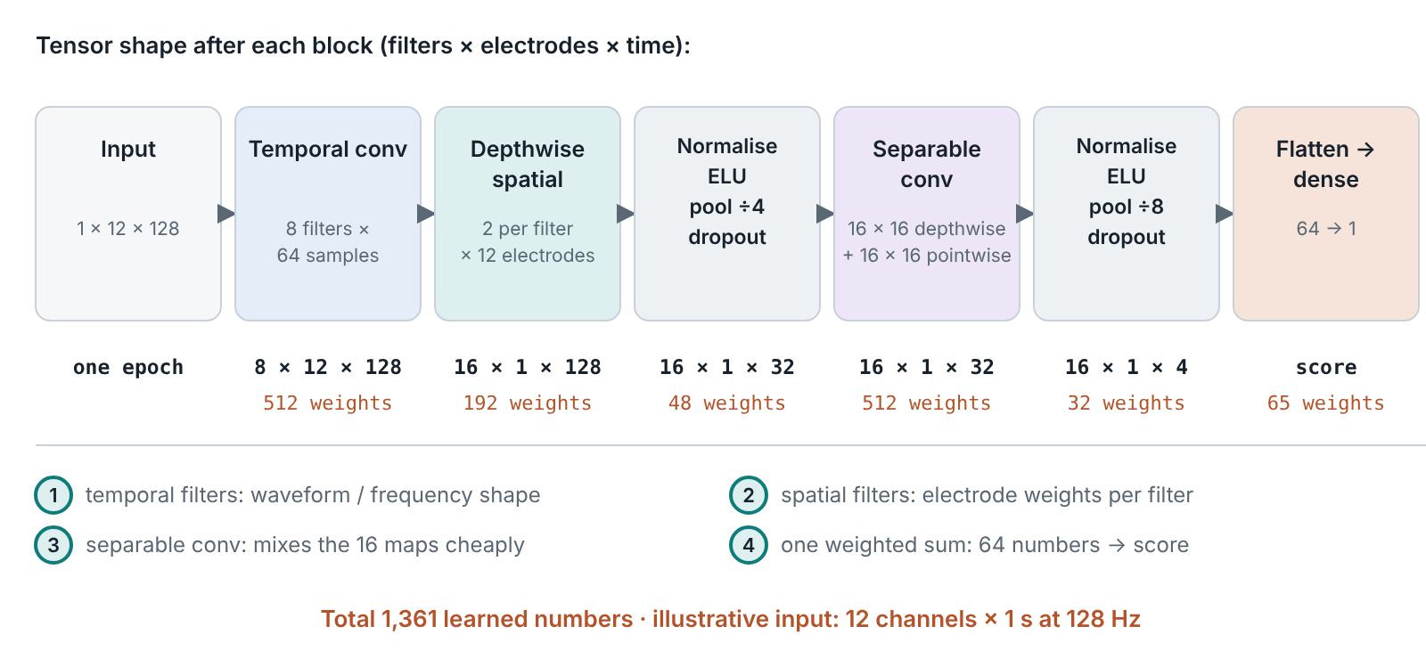
EEGNet Layer by Layer, With Tensor Shapes
IV · DEEP LEARNING · ARCHITECTURE
Why trace the shapes: each block is a temporal filter, a spatial filter or a weighted sum seen on the previous slide.
Illustrative compact network: 12 channels × 128 samples (1 s at 128 Hz), distinct from the original 12 × 800-sample released epoch
Sources: [S1] Lawhern et al. 2018 · this configuration is trained on the 0–1 s, 128-Hz epochs in the results slides
Notes:
The toy example used one three-point filter on two channels; this slide shows the same ideas at the size of the evaluated network. This slide traces one EEGNet configuration block by block, because every block is an operation already introduced: temporal filters, spatial filters and weighted sums. The input is an illustrative compact network input of 12 channels by 128 samples, one second at 128 hertz. It is distinct from the original released epoch of 12 by 800 samples: the first 1,000 milliseconds after onset are kept, and that segment is resampled from 500 to 128 hertz, which shortens the input and keeps the network small. The input is one matrix of 12 channels by 128 samples. The first block learns eight temporal filters, each 64 samples long, giving eight filtered copies of the epoch. The second block, a depthwise spatial convolution, gives each temporal filter two spatial filters across the twelve electrodes, so sixteen virtual channels remain, each a single row in time. Normalisation, a non-linearity, average pooling by four and dropout reduce time to 32 steps. A separable convolution then combines the sixteen maps cheaply, and a second pooling by eight leaves four time steps. The final 64 numbers are combined by one weighted sum into the score. The whole configuration has 1,361 learned numbers, small enough to be trained on modest datasets. Exactly this configuration is trained and evaluated on the Gao data in the results slides at the end of this section.

Slide 81
CNN vs EEGNet vs CNN-LSTM: What Changes?
IV · DEEP LEARNING · COMPARISON
Why compare: the three families differ in what they assume about EEG, not just in size.
Model
Core operation
What it assumes about EEG
Learned numbers
Evaluated here?
Generic CNN (e.g. ShallowConvNet [S2])
Temporal + spatial convolution, full filter weights
Useful information is a local pattern in time and across electrodes
Design-dependent
No
EEGNet [S1]
Temporal filters → depthwise spatial filters → separable convolution
A few filters suffice; each temporal filter has its own spatial pattern
1,361 (shown config.)
Yes (results)
CNN-LSTM
EEGNet-style front end → LSTM over 32 time steps
Models the sequence of CNN-derived feature vectors: how informative EEG patterns evolve across time within the epoch
6,929 (shown config.)
Yes (results)
For a P300
Status
A fixed scalp pattern at a fairly fixed latency: convolution captures it; recurrence may add little.
EEGNet and CNN-LSTM, as configured here, are trained and evaluated in the results slides; the generic CNN is not.
Sources: [S1], [S2] · own configurations for a 12 × 128 epoch (0–1 s at 128 Hz)
Notes:
The three families differ in what they assume about EEG, not merely in size, so they are compared side by side. A generic convolutional network such as ShallowConvNet learns temporal and spatial filters with full weight matrices; it assumes that the useful information is a local pattern in time and across electrodes, and its size depends heavily on the design. EEGNet keeps the same two ideas but restricts them: every temporal filter gets its own small set of spatial filters, and a separable convolution mixes the maps, which encodes the assumption that a few filters are enough and keeps the configuration shown at 1,361 learned numbers. A CNN-LSTM uses an EEGNet-style front end and then passes the resulting sequence of 32 time steps to a long short-term memory layer, which models the sequence of CNN-derived feature vectors to capture how informative EEG patterns evolve across time within the epoch. Each epoch still describes the response to a single stimulus; the sequence is the evolution of the extracted representation, not a series of events. Most of its 6,929 learned numbers sit in the recurrent layer. For a P300, a fixed spatial pattern at a fairly fixed latency, convolution already captures the main structure, and recurrence may add little. EEGNet and the CNN-LSTM, in exactly the configurations counted here, are trained and evaluated on the Gao data in the results slides; the generic CNN is shown only for comparison. The counts refer to a 12-channel, 1-second epoch at 128 samples per second. How such networks are trained and then used on a new person follows.

Slide 82
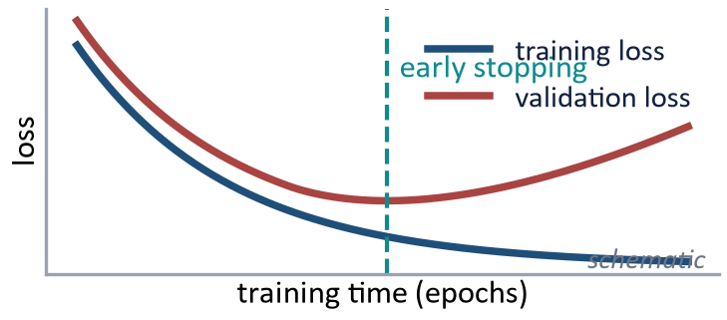
How a Network Learns — and How It Is Used
IV · TRAINING AND INFERENCE
Why separate them: the model learns from labelled people, then is applied, frozen, to a new person.
Training: learn from labelled participants
Inference: apply the frozen model to a new person
Batch 64 × 12 × 128
→
Model f_θ
→
Prediction ŷ
New person's epochs (never seen in training)
↓
Frozen trained model
↑
↓
↓
Update weights θ
←
Backpropagation
←
Loss L(y, ŷ) vs epoch label y
Trial scores, e.g. 0.82: target-like vs not (uncalibrated)
↓
Aggregate over that person's trials
Overfitting: training loss keeps falling while validation loss rises
Mitigations, not guarantees: early stopping, regularization, compact models
↓
Participant-level recognition score
A trial score describes a target-like brain response — not a calibrated probability, and never a probability of guilt
Training label y: target (1) vs irrelevant (0) for each epoch · knowledgeable/control labels evaluate person-level decisions; they are never the epoch training target
General machine-learning methodology · batch shape as in the evaluated models (64 epochs, 12 channels, 128 samples)
Notes:
During training, the network receives batches of EEG examples; in the evaluated models a batch holds 64 epochs of 12 channels by 128 samples, the 0 to 1 second segment at 128 hertz described in the analysis setup. The network produces predictions, compares them with the epoch labels through a loss function, and updates its parameters by backpropagation. The label y is 1 for a target epoch and 0 for an irrelevant epoch; the knowledgeable or control status of a participant is never the training target and is used only afterwards, to evaluate the person-level decisions. Repeating this process reduces training error, but lower training loss does not automatically mean better generalization. If training loss continues to fall while validation loss begins to rise, the model is fitting details of the training participants that do not transfer well to new participants; this is overfitting. Compact architectures, regularization and early stopping can help, but the most important safeguard is an honest validation design. At inference time the situation is different: the model is frozen, an unseen person's trials are passed through it, and the resulting trial scores can be aggregated into participant-level recognition evidence. No parameter fitting, normalization fitting, feature selection or threshold tuning should be performed using the final test participant unless the study explicitly defines an adaptation protocol. A model output such as 0.82 is a score for the trained class, for example target versus irrelevant epochs; it becomes a probability only if its calibration has been checked, and it is never an 82 percent probability that the person is guilty. Classifying trials and deciding about a knowledgeable or control person are also two different problems. This distinction leads directly to how training, validation and testing must be separated by participant.

Slide 83
Training, Validation and Testing
IV · EVALUATION DESIGN
Why first: how the data are split decides what a performance number means.
Training set
Learns the model weights
Validation set
Hyperparameters, early stopping, model and threshold selection
Test set
Used once, for the final unbiased estimate
Correct: split by participant
S01
S02
S03
S04
S05
S06
S07
S08
S09
S10
S11
S12
S13
S14
S15
S16
S17
S18
S19
S20
S21
S22
S23
S24
S25
S26
S27
S28
S29
S30
S01–S20 train · S21–S24 validation · S25–S30 test (balance knowledgeable and control participants in each set)
Wrong: split one participant's epochs at random
S07
S07
S07
S07
S07
S07
S07
S07
S07
S07
S07
S07
S07
S07
S07
S07
✗ the same person on both sides → the model can learn the person, not recognition
With N = 30: repeated stratified participant-wise CV or leave-one-pair-out (1 knowledgeable + 1 control held out), with preprocessing, feature selection, hyperparameters and thresholds fitted inside each training fold
General machine-learning methodology · subject IDs schematic
Notes:
The most important rule on this slide is that the split must respect the unit of generalization. If the intended claim is that the method works on a new person, then all epochs from that person must remain together. The training set is used to fit model parameters and any data-dependent preprocessing; the validation set is used for model selection, hyperparameters, early stopping and threshold choices; the test set is reserved for the final unbiased evaluation. Randomly splitting epochs is inappropriate here because epochs from the same participant share anatomy, electrode placement, noise characteristics and stable individual EEG patterns. A model can exploit those person-specific signatures and appear highly accurate even when it has learned little that transfers to a new person. With only 15 knowledgeable and 15 control participants, a single fixed split would also be unstable. Repeated stratified participant-wise cross-validation or a leave-one-pair-out design, with one knowledgeable and one control participant held out, is more defensible. Crucially, preprocessing parameters, normalization, ICA if learned from pooled data, feature selection, hyperparameter tuning and decision thresholds must all be fitted inside the training portion of each fold. This is the methodological foundation for any credible generalization claim. Splitting by participant is also the first defence against data leakage: feature selection fitted on all data, normalization or ICA estimated with test data, and hyperparameters or thresholds tuned on the test set leak information in the same way, so every data-dependent step stays inside the training fold.

Slide 84
The Generalization Problem
IV · GENERALIZATION
Why decisive: a real examinee is always someone the model has never seen.
SUBJECT-DEPENDENT
SUBJECT-INDEPENDENT
EXTERNAL / CROSS-DATASET
Same people in training and test
Held-out people (e.g. leave-one-subject-out)
Different lab, sample or protocol
S1
S2
S3
S4
S5
S6
S1
S2
S3
S4
S5
S6
S1
S2
S3
S4
S5
S6
New dataset (test)
Weakest test
Stronger test
Strongest test
Train
Test
Columns = subjects; rows = trial blocks. The reviewed literature does not show that CIT research has solved generalization.
Sources: [37], [46], [49]
Notes:
A real examinee is always a new person, so the decisive test of a classifier is performance on people it has never seen. In subject-dependent evaluation, data from the same individuals appear in both training and test sets, and a model can exploit person-specific signal characteristics. Subject-independent evaluation, such as leave-one-subject-out, holds entire individuals out of training. External or cross-dataset validation goes further by testing on data from a different laboratory, sample or protocol. Each step is a progressively stronger test of generalization. The reviewed literature does not show that the CIT literature has solved this problem. Once the split is right, the next question is what to measure.

Slide 85
How Should an EEG-CIT Classifier Be Evaluated?
IV · EVALUATION METRICS
Why not accuracy alone: false positives and false negatives have very different consequences.
Participant-level confusion matrix
Threshold-based
Sensitivity = TP / (TP + FN): knowledgeable participants detected
Specificity = TN / (TN + FP): controls correctly not flagged
Precision = TP / (TP + FP); F1 = 2 · precision · recall / (precision + recall)
Balanced accuracy = (sensitivity + specificity) / 2
Predicted: recognition
Predicted: none
Knowledgeable
TP
FN
Control
FP
TN
Imbalance, uncertainty and stakes
In the Gao dataset: 1 probe per 4 irrelevants, so trial accuracy misleads
Report confidence intervals and class-aware metrics
Specificity matters: false recognition is costly
Threshold-free and probabilistic
ROC-AUC: discrimination across all thresholds
Calibration / Brier score: do probabilities match observed frequencies?
Report participant-level metrics when the inference concerns participants · with 15 + 15 people, one error moves sensitivity or specificity by 6.7 points
General ML methodology · Gao et al. report sensitivity, specificity and balanced accuracy [37]
Notes:
A classifier should be evaluated at the level that matches the scientific claim. At the participant level, sensitivity asks how often knowledgeable participants are correctly identified, while specificity asks how often controls are correctly rejected. Precision and F1 describe different aspects of positive predictions, balanced accuracy prevents one class from dominating the summary, and ROC-AUC describes ranking or discrimination across thresholds. Calibration asks a different question: whether predicted probabilities correspond to observed frequencies, for which a Brier score or calibration plot can be useful. In the Gao dataset there is one probe for every four irrelevants at the trial level, so ordinary trial accuracy can be misleading because a classifier can obtain a superficially high value by favoring the majority class. More importantly, the person-level sample is only 15 versus 15, so one participant changes sensitivity or specificity by about 6.7 percentage points. Confidence intervals and the actual confusion matrix are therefore essential; a single headline accuracy hides substantial uncertainty. The metric set should also reflect the application, because in a high-stakes context false positives may be especially consequential. The next slide addresses another source of confusion: even good trial-level metrics do not automatically say how to make a decision about a person.

Slide 86
From Trial Classification to Person-Level Decision
IV · UNIT OF DECISION
Why decisive: an investigation asks about a person, but most classifiers score trials.
Trial 1
classifier
Trial 2
classifier
Evidence aggregation / statistical decision
Participant-level recognition evidence
Trial 3
classifier
Trial 4
classifier
⋮
Trial N
classifier
What is classified?
Report the unit
a trial
a stimulus type
a probe response
the person
Trial-level accuracy ≠ person-level accuracy. Statistical route: within-person bootstrap on averaged ERPs [21], [24], [47].
trial scores
Sources: [21], [24], [37], [47]
Notes:
An investigation asks about a person, but most classifiers score individual trials, so the link between the two must be made explicit. A participant may contribute dozens or hundreds of epochs, and a trial-level classifier assigns each a score. Those scores must then be aggregated, for example by averaging, voting or a statistical test, into one decision about whether this person recognizes the probe. Accuracy at the trial level and accuracy at the person level are different quantities and can differ substantially, so any reported figure must state its unit. The statistical route reaches a person-level decision differently, by testing the averaged probe–irrelevant difference within each individual, for example with bootstrap procedures. Gao and colleagues report an individual diagnosis built from single-trial analysis; how the aggregation affects validity depends on the evaluation design. The endpoint of the pipeline, its interpretation, comes next.

Slide 87
From Model Output to Application
IV · INTERPRETATION
Why end here: the endpoint of the pipeline is an inference about recognition, not about guilt.
EEG model output
→
Recognition score (calibrated only if checked)
→
Participant-level evidence
→
Research or application context
Possible research and application contexts
Concealed-information research
Recognition-memory assessment
Forensic research under controlled conditions
BCI and cognitive-state decoding methods
Human-factors and security research
Multimodal behavioural research
Model output supports an inference about recognition. It does not independently determine deception, criminal responsibility or guilt.
Sources: [11], [14], [53]
Notes:
At the application stage it is essential to keep the model output connected to the construct that was actually measured. The pipeline may produce a trial score, an aggregated participant score or a probability-like output, but the strongest interpretation is evidence consistent with recognition of the probe under the experimental conditions. That evidence may be useful in concealed-information research, recognition-memory assessment, BCI or cognitive-state decoding, human-factors and security research, or multimodal behavioral studies. A forensic application would require much stronger evidence because the costs of error, informed innocents, countermeasures, memory failure and contextual contamination become more serious. The output should therefore not be relabelled as a probability of deception, criminal responsibility or guilt. This is not merely a semantic caution: changing the label changes the scientific claim. Before the limitations, the whole pipeline is applied to the Gao data, starting with the analysis plan that was fixed before any result.

Slide 88
Analysis Setup: Fixed Before Any Result
IV · RESULTS ON THE GAO DATA
Why show the setup first: a result is only as credible as the split, the settings and the decision rule behind it.
Data
Validation
Training task
30 people: 15 knowledgeable, 15 control
23,388 epochs after rejecting > ±100 µV
0–1 s · 12 EEG channels · 500 → 128 Hz
Leave-one-pair-out: 15 folds, 1 knowledgeable + 1 control held out
Standardisation, weights, early stopping fitted on training people only
Target vs irrelevant epochs
Probe epochs never used in training
Methods
Decision rule (all methods)
Metrics
Classical Pz test (no ML): mean 300–800 ms
LDA, linear SVM: 96 window means
EEGNet, CNN-LSTM: 12 × 128 epochs [S1]
Knowledgeable if probe scores > irrelevant scores
One-sided permutation test, p < 0.05
Trial AUC (target vs irrelevant)
Person AUC, sensitivity, specificity, balanced accuracy, 95% CIs
Plan fixed before results · the only later change: Pz read from the true row (channel order from the raw .cnt header)
Sources: Own analysis · data: Gao et al. public Dryad release [37], doi:10.5061/dryad.2qc64 · plan fixed before results; no tuning on test persons · [S1]
Notes:
This slide states the analysis plan, because a performance number means little without the split, the settings and the decision rule behind it. The data are the 30 released participants, 15 in the lying folder, here called knowledgeable, and 15 in the honest folder, the controls. After the file checks of Section III and rejection of epochs exceeding 100 microvolts on any EEG channel, 23,388 epochs remain. Each epoch is cut to the first second after onset, the 12 EEG channels are kept, and the signal is resampled from 500 to 128 hertz. Validation is leave-one-pair-out: each of the 15 folds holds out one knowledgeable and one control person, and everything data-dependent, channel standardisation, model weights and early stopping, is fitted on the training people only. The training task is deliberately indirect: models learn to separate target epochs from irrelevant epochs, and probe epochs are never used in training. For a held-out person, the trained model then scores probe and irrelevant epochs, and the person is called knowledgeable if probe scores exceed irrelevant scores in a one-sided permutation test at p below 0.05. Five methods share this rule: a classical Pz test without machine learning, using the mean amplitude from 300 to 800 milliseconds; LDA and a linear SVM on the 96 window means; and EEGNet and a CNN-LSTM on the 12 by 128 epochs. The plan was fixed before the results. One later change corrected labelling, not settings: the raw recording header showed the true channel order, so the classical test now reads the row that is Pz. The next slide gives the numbers.

Slide 89
Results: Metrics, Uncertainty and Errors
IV · RESULTS ON THE GAO DATA
Why this table: it gives the exact numbers, how wide the uncertainty is, and which kind of error each method makes.
Method
Trial AUC
Person AUC
Person AUC perm. p¹
Detected
TP / FN
Cleared
TN / FP
Sensitivity [95% CI]
Specificity [95% CI]
Balanced accuracy
Classical Pz test (no ML)
0.62
0.87
< 0.001
12 / 3
13 / 2
0.80 [0.55, 0.93]
0.87 [0.62, 0.96]
0.83
LDA
0.90
0.94
< 0.001
14 / 1
13 / 2
0.93 [0.70, 0.99]
0.87 [0.62, 0.96]
0.90
SVM
0.90
0.94
< 0.001
14 / 1
12 / 3
0.93 [0.70, 0.99]
0.80 [0.55, 0.93]
0.87
EEGNet
0.91
0.92
< 0.001
14 / 1
13 / 2
0.93 [0.70, 0.99]
0.87 [0.62, 0.96]
0.90
CNN-LSTM
0.91
0.94
< 0.001
14 / 1
14 / 1
0.93 [0.70, 0.99]
0.93 [0.70, 0.99]
0.93
¹ Group labels of the 30 people shuffled 10,000 times; null: person AUC = 0.5. Separate from each person's decision: probe/irrelevant labels of that person's epoch scores shuffled 2,000 times, one-sided, p < 0.05.
Trial vs person
Uncertainty
Errors
Trial AUC: target vs irrelevant epochs
Person AUC: knowledgeable vs control people
95% Wilson CIs, 15 people per group
One person = 6.7 points of sensitivity or specificity; CIs overlap
All five: L01 missed, H08 flagged
Pz test also: L05, L09 missed; H04 flagged
H14: LDA, SVM, EEGNet · H15: SVM
Sources: Own analysis · data: Gao et al. public Dryad release [37], doi:10.5061/dryad.2qc64 · plan fixed before results; no tuning on test persons
Notes:
The table gives the main results for all five methods. The classical Pz test, without any machine learning, already performs well at the person level: it detects 12 of the 15 knowledgeable people and clears 13 of the 15 controls, a balanced accuracy of 0.83, with a person-level AUC of 0.87. Its trial AUC is only 0.62, because a single-trial mean amplitude at one electrode is noisy; averaging over many trials within a person is what makes the decision work. The four trained models separate single target and irrelevant epochs much better, with trial AUCs of 0.90 to 0.91, and all four detect 14 of 15 knowledgeable people. They differ only in the controls: SVM flags three, LDA and EEGNet two, and the CNN-LSTM one, which gives balanced accuracies between 0.87 and 0.93. All person-level AUCs differ from chance, with p below 0.001. That p-value comes from shuffling the knowledgeable and control labels of the thirty people 10,000 times and asking how often a shuffled person AUC reaches the observed one; the null hypothesis is a person AUC of 0.5. It is a different quantity from the per-person decision, which shuffles the probe and irrelevant labels of one person's epoch scores 2,000 times and calls the person knowledgeable at a one-sided p below 0.05. The two p-values answer different questions and are not interchangeable. The confidence intervals are wide because the unit of inference is the person: with 15 people per group, one person moves sensitivity or specificity by 6.7 percentage points, and the intervals of all five methods overlap. The errors are informative. Every method misses L01 and flags H08. The classical test also misses L05 and L09 and flags H04; H14 is flagged by LDA, SVM and EEGNet, and H15 by SVM. The participant-by-participant view makes this pattern visible.

Slide 90
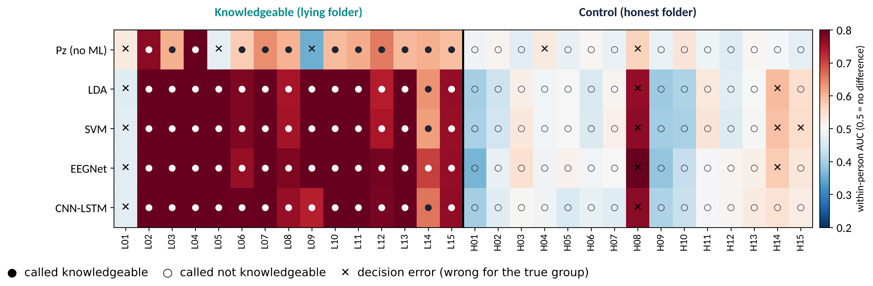
Every Person, Every Method
IV · RESULTS ON THE GAO DATA
Why this view: a single accuracy hides who is misclassified; the grid shows whether errors belong to the methods or to particular people.
All five methods miss L01 and flag H08 — some errors follow the person, not the algorithm
Sources: Own analysis · data: Gao et al. public Dryad release [37], doi:10.5061/dryad.2qc64 · plan fixed before results; no tuning on test persons
Notes:
Each column is one participant and each row one method; the colour is that person's within-person AUC, the probability that a probe epoch scores higher than an irrelevant epoch, so 0.5 means no difference. Filled dots are people called knowledgeable, open dots people called not knowledgeable, and crosses mark errors for the true group. In the left block, the knowledgeable people, the four trained models are dark red almost everywhere: their probe scores clearly exceed irrelevant scores. The classical Pz row is paler, because a single electrode and a single window give smaller within-person effects, yet it still reaches significance for 12 of 15 people. In the right block, the controls are mostly close to 0.5, as expected when the probe is just another irrelevant item. Two columns stand out across every row. L01 is missed by all five methods, and H08 is flagged by all five; H08 shows a probe effect that looks like recognition. L09, the participant without a clear probe effect in Section III, is missed by the classical test but detected by all four trained models. Errors therefore follow particular people more than particular algorithms: a different classifier does not repair a person whose data look like the other group. The next slides ask what the trained network relies on.

Slide 91
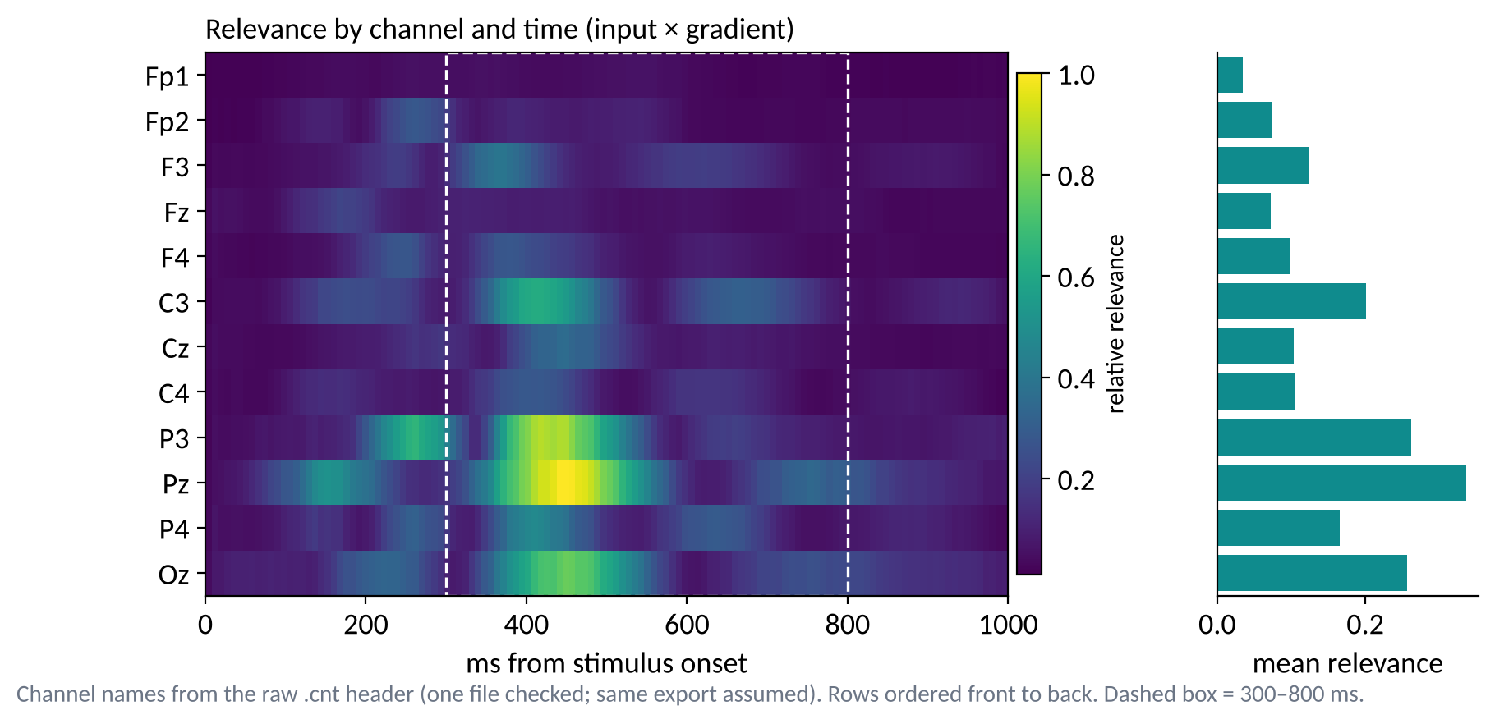
EEGNet Relevance on Held-Out Target Epochs
IV · RESULTS ON THE GAO DATA
Why check: a model that scores well for the wrong reason, such as eye activity or noise, would fail on new data.
How to read
Colour: output sensitivity to each channel and time
Bars: mean relevance per channel
What it shows
Largest at Pz, then P3, Oz, C3
Peak ≈ 414 ms; 65% in 300–800 ms
Scope
Target-vs-irrelevant predictions only; not a cortical source
Target predictions depend most on parietal inputs in the P300 window; Fp1/Fp2 contribute least
Sources: Own analysis · data: Gao et al. public Dryad release [37], doi:10.5061/dryad.2qc64 · plan fixed before results; no tuning on test persons · input × gradient, held-out target epochs
Notes:
A high score does not show that a model uses brain activity related to recognition; it could exploit eye movements, noise or artifacts. This relevance map is a first check, and it concerns one specific question: which inputs drive EEGNet's predictions on held-out target epochs, the class it was trained to recognise against irrelevant epochs. For every held-out target epoch, the gradient of EEGNet's output is multiplied by the input, which estimates how sensitive the output is to each channel and time point, and the result is averaged over all 15 folds. Rows run from the front of the head, Fp1, to the back, Oz. Relevance is concentrated over parietal and occipital electrodes: Pz carries the most, followed by P3 and Oz, with C3 next. In time it peaks at about 414 milliseconds, and 65 percent of the total relevance falls inside the 300 to 800 millisecond window marked by the dashed box, the P300 window. The frontopolar channels Fp1 and Fp2, which also record eye movements and blinks, carry the least. The target predictions therefore depend mostly on posterior scalp activity in the P300 latency range. Three limits apply. The map identifies inputs associated with target-versus-irrelevant predictions; it is not, on its own, an explanation of the probe-based decisions about people. Attribution measures model sensitivity, not a cortical source. And the channel names come from the header of the one raw recording in the release, with the same order assumed for the other files. The next slide repeats the analysis on the epochs that actually decide about a person: probe and irrelevant epochs of held-out people.

Slide 92
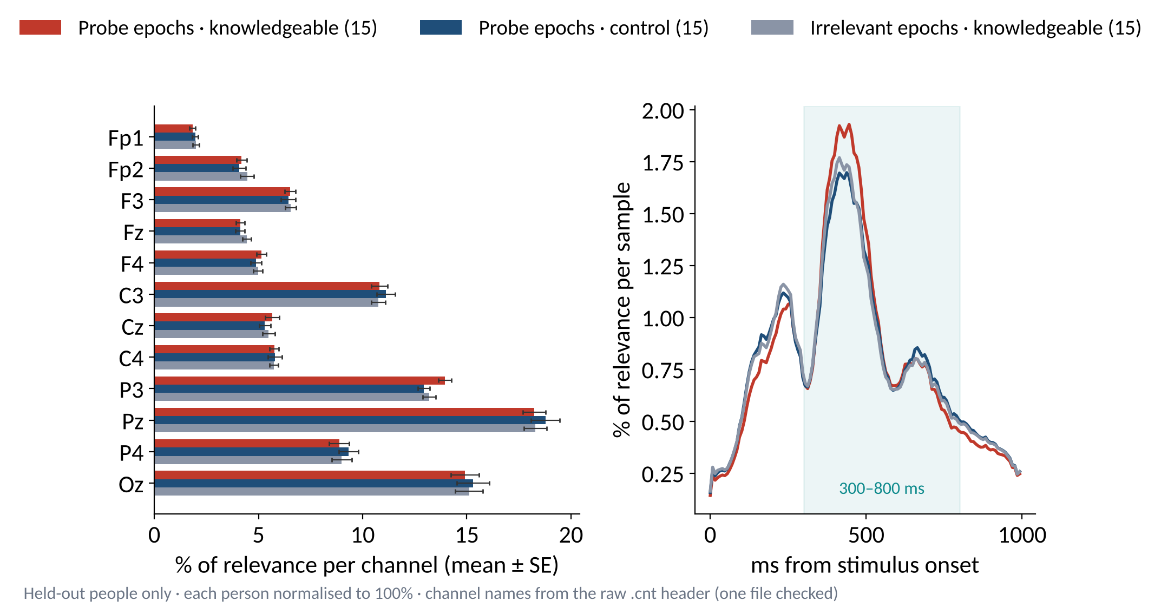
Does the Same Pattern Hold for Probe Epochs?
IV · RESULTS ON THE GAO DATA
Why test it: people are judged on their probe scores, so the explanation has to be checked on probe epochs, not only on targets.
What it shows
Same pattern for probe and irrelevant epochs, in both groups
Pz largest; parietal-occipital ≈ 56%; Fp1 + Fp2 ≈ 6%
Per person
Top channel posterior: 15/15 per group · 63–66% in 300–800 ms
Limits
Shows which inputs influence scores under this method — not a cortical source, unique mechanism or causal dependence
Probe scores rely on the same posterior, P300-window inputs as target scores, in both groups
Sources: Own analysis · data: Gao et al. public Dryad release [37], doi:10.5061/dryad.2qc64 · plan fixed before results; no tuning on test persons · input × gradient, each fold's model on its own two held-out people
Notes:
The person-level decision rests on probe and irrelevant scores, so the attribution has to be repeated on those epochs rather than inferred from targets. Each fold's trained EEGNet is applied to its own two held-out people, one knowledgeable and one control, and input-times-gradient relevance is computed separately for their probe epochs and their irrelevant epochs. Each person's map is normalised to 100 percent, so every person counts equally, and the bars show the mean share per channel with its standard error across the fifteen people of each group. The pattern is the same in every condition. Pz carries the largest share, about 18 to 19 percent, followed by Oz and P3; the four parietal and occipital electrodes together carry about 56 percent, and Fp1 and Fp2 together only about 6 percent. For every one of the fifteen people in each group, the most relevant channel on probe epochs is a parietal or occipital electrode. In time, 63 to 66 percent of the relevance falls between 300 and 800 milliseconds, with a peak near 414 to 438 milliseconds. The curves differ mainly in height inside the P300 window, where knowledgeable people's probe epochs carry the largest share. The probe scores of both groups therefore depend on the same posterior, P300-window inputs as the target scores; what separates knowledgeable from control people is how target-like the activity there is, not a different region. Input times gradient indicates which EEG inputs influence the model scores under this particular attribution method. Relevance is not evidence of a cortical source, of a unique physiological mechanism, or of causal dependence: other attribution methods can distribute relevance differently, and a sensitive input is not necessarily the origin of the signal. The eye channels were neither used nor corrected, so ocular influence is reduced here but not excluded. One model per electrode measures each site's information directly, on the next slide.

Slide 93
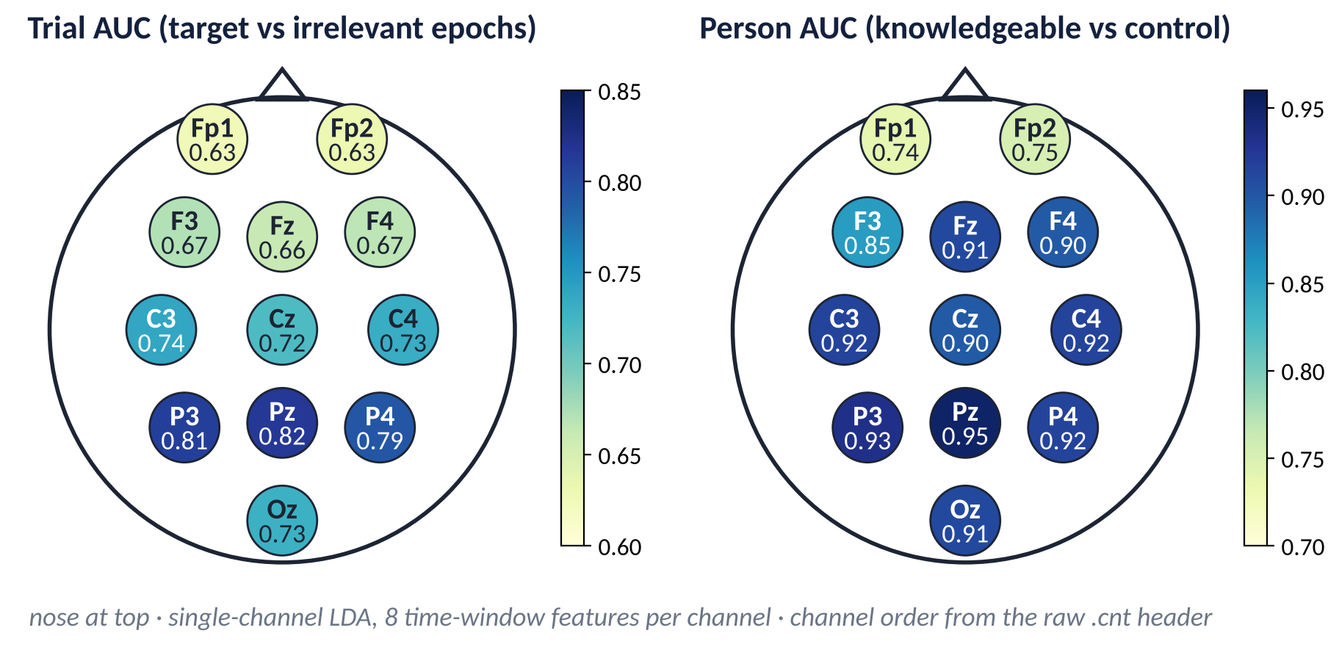
Which Electrodes Carry the Information?
IV · RESULTS ON THE GAO DATA
Why test it: a relevance map shows what one network uses; one model per electrode measures what each site carries on its own.
How it works
Same LDA, folds and decision rule
Input: one electrode, 8 window means (0–1 s)
What it shows
Trial AUC highest at Pz, P3, P4 (0.79–0.82)
Person AUC: Pz 0.95; ≥ 0.85 everywhere except Fp1, Fp2
Predictive information peaks over parietal electrodes, where the P300 is largest; frontopolar sites carry least
Sources: Own analysis · data: Gao et al. public Dryad release [37], doi:10.5061/dryad.2qc64 · plan fixed before results; no tuning on test persons · same folds and decision rule as the main results
Notes:
The relevance maps show what one trained network is sensitive to; they do not measure how much information each electrode carries on its own. The direct test trains a separate model for every electrode. Each model is the same shrinkage LDA as in the main analysis, with the same leave-one-pair-out folds, the same training task, target versus irrelevant epochs, and the same permutation decision for each held-out person. The only change is the input: one electrode, summarised by eight window means of 125 milliseconds over the first second. The left map shows trial AUC, how well each electrode separates single target from irrelevant epochs. It is highest at the parietal electrodes, Pz at 0.82, P3 at 0.81 and P4 at 0.79, and lowest at the frontopolar electrodes Fp1 and Fp2, at 0.63. The right map shows person AUC, how well each electrode's within-person scores separate the fifteen knowledgeable people from the fifteen controls. Pz reaches 0.95, slightly above the 0.94 of all twelve channels together, and every electrode except Fp1 and Fp2 reaches at least 0.85. The map agrees with the relevance analyses and with the classic P300 scalp distribution, which is largest over parietal midline electrodes. The channel names come from the raw recording header; consistency of the other exported files with that one file is assumed. The table on the next slide gives every metric per electrode.

Slide 94
Single Electrodes: Person-Level Metrics
IV · RESULTS ON THE GAO DATA
Why every metric: one error in a 15-person group moves sensitivity or specificity by 6.7 points; precision and F1 depend on the whole matrix.
Electrode
Region
Trial AUC
Person AUC
Detected
Cleared
Accuracy
Precision
Sensitivity
Specificity
F1
Fp1
Frontopolar
0.63
0.74
10/15
11/15
0.70
0.71
0.67
0.73
0.69
Fp2
Frontopolar
0.63
0.75
9/15
11/15
0.67
0.69
0.60
0.73
0.64
F3
Frontal
0.67
0.85
11/15
14/15
0.83
0.92
0.73
0.93
0.81
Fz
Frontal
0.66
0.91
12/15
13/15
0.83
0.86
0.80
0.87
0.83
F4
Frontal
0.67
0.90
11/15
13/15
0.80
0.85
0.73
0.87
0.79
C3
Central
0.74
0.92
11/15
13/15
0.80
0.85
0.73
0.87
0.79
Cz
Central
0.72
0.90
12/15
13/15
0.83
0.86
0.80
0.87
0.83
C4
Central
0.73
0.92
13/15
12/15
0.83
0.81
0.87
0.80
0.84
P3
Parietal
0.81
0.93
14/15
13/15
0.90
0.88
0.93
0.87
0.90
Pz
Parietal
0.82
0.95
14/15
13/15
0.90
0.88
0.93
0.87
0.90
P4
Parietal
0.79
0.92
14/15
11/15
0.83
0.78
0.93
0.73
0.85
Oz
Occipital
0.73
0.91
14/15
13/15
0.90
0.88
0.93
0.87
0.90
All 12 channels
Reference
0.90
0.94
14/15
13/15
0.90
0.88
0.93
0.87
0.90
Shaded: Pz, highest single-electrode trial and person AUC · 15 knowledgeable + 15 control people · decision: permutation test p < 0.05 · channel names from the raw .cnt header (one file checked)
Sources: Own analysis · data: Gao et al. public Dryad release [37], doi:10.5061/dryad.2qc64 · plan fixed before results; no tuning on test persons · same folds and decision rule as the main results
Notes:
The table gives the person-level metrics for each single-electrode model, with the twelve-channel LDA as the reference row at the bottom. Detected is the number of the fifteen knowledgeable people called knowledgeable; cleared is the number of the fifteen controls correctly not flagged. Accuracy is the proportion of all thirty decisions that are correct. Precision is the proportion of flagged people who are truly knowledgeable, sensitivity the proportion of knowledgeable people detected, specificity the proportion of controls cleared, and F1 combines precision and sensitivity. Three posterior electrodes, P3, Pz and Oz, each give the same observed person-level decisions as the twelve-channel model: 14 of 15 detected, 13 of 15 cleared, accuracy and F1 of 0.90. Pz, shaded, has the highest trial and person AUC of any single electrode. P4 detects as many people but flags four controls. F3 clears the most controls, 14 of 15, but detects only 11. The frontopolar electrodes Fp1 and Fp2 are clearly the weakest, with F1 below 0.70. A trained LDA at Pz alone detects 14 of 15, whereas the classical Pz test detects 12 of 15; the difference is the trained detector, which uses the whole time course in eight windows and learns from target epochs, not the electrode. Sensitivity and specificity each change by about 6.7 percentage points for one additional error within a 15-person group, because their denominators are fixed at 15. Precision and F1 change by amounts determined by the full confusion matrix: with 14 true positives and 2 false positives, precision is 14 of 16, 87.5 percent, and one more false positive gives 14 of 17, about 82.4 percent, a change of 5.1 points. Precision also depends on the equal numbers of knowledgeable and control people in this dataset; with a different base rate, the same sensitivity and specificity would give a different precision. Grouping neighbouring electrodes into regions follows.

Slide 95
Electrode Regions: Where Is the Effect?
IV · RESULTS ON THE GAO DATA
Why regions: single electrodes are noisy; grouping neighbours tests whether a scalp region, not one site, carries the effect.
Region
Electrodes
Trial AUC
Person AUC
Detected
Cleared
Accuracy
Precision
Sensitivity
Specificity
F1
Frontal
Fp1 Fp2 F3 Fz F4
0.75
0.92
12/15
12/15
0.80
0.80
0.80
0.80
0.80
Frontal without Fp1/Fp2
F3 Fz F4
0.69
0.93
12/15
13/15
0.83
0.86
0.80
0.87
0.83
Central
C3 Cz C4
0.76
0.92
13/15
13/15
0.87
0.87
0.87
0.87
0.87
Parietal-occipital
P3 Pz P4 Oz
0.87
0.94
14/15
13/15
0.90
0.88
0.93
0.87
0.90
All 12 without Fp1/Fp2
10 channels
0.90
0.94
14/15
13/15
0.90
0.88
0.93
0.87
0.90
All 12 channels
Reference
0.90
0.94
14/15
13/15
0.90
0.88
0.93
0.87
0.90
Reading
Cautions
Meaning
Parietal-occipital vs all 12: identical decisions, person by person
Trial AUC 0.87 vs 0.90 — not equivalence
Without Fp1/Fp2: same observed metrics
18 sets, 30 people: 1–2-decision gaps may be sampling variability
Ocular artifacts not ruled out by this alone
Posterior, P300-compatible scalp pattern
Scalp data do not localise generators
Predictive information is concentrated over parietal electrodes, where the P300 is largest
Sources: Own analysis · data: Gao et al. public Dryad release [37], doi:10.5061/dryad.2qc64 · plan fixed before results; no tuning on test persons · same folds and decision rule as the main results
Notes:
Grouping neighbouring electrodes tests whether a scalp region, rather than one site, carries the discriminating information. Each row is again a separate LDA with the same folds and decision rule. The parietal-occipital group, P3, Pz, P4 and Oz, has the highest trial AUC of any region, 0.87, and gives the same observed person-level decisions as the full twelve-channel montage: 14 of 15 detected, 13 of 15 cleared, F1 of 0.90. The match was verified participant by participant, not only in the counts: both sets make exactly the same three errors, missing L01 and flagging H08 and H14, as does the twelve-channel montage without Fp1 and Fp2. Its trial AUC is lower than that of the full montage, 0.87 against 0.90, and identical decisions for thirty people do not establish equivalence. The central trio follows with 13 of 15 in each group. The frontal group is weakest, with 12 of 15 in each group; removing Fp1 and Fp2 from it leaves detection unchanged. Removing Fp1 and Fp2 from the full montage leaves the observed metrics of this dataset unchanged: 14 of 15 and 13 of 15, with a trial AUC of 0.90. A posterior, P300-compatible scalp pattern is therefore observed. Performance is unchanged after excluding Fp1 and Fp2, but ocular artifacts cannot be ruled out solely from this comparison: eye activity also spreads to other electrodes, the eye channels were not used, and no ocular correction was applied. Two further cautions limit the interpretation. Eighteen electrode sets are compared on the same thirty people, so differences of one or two decisions may reflect sampling variability, and an optimal electrode subset is not established without a formal comparison. And the channel names rest on the header of one raw recording, with the same order assumed for the other files. Scalp data of this kind show where predictive information is recorded; they do not localise its neural generators. The results now need interpretation.

Slide 96
Interpreting the Results (1): How Much Does ML Add?
IV · DISCUSSION OF RESULTS
Why ask: the classical Pz test is the baseline that every model has to beat before its complexity is justified.
Correct person-level decisions out of 30
Trial level: large gain
Classical Pz test (no ML)
25/30
Trial AUC 0.62 (Pz test) → 0.90–0.91 (trained models)
LDA, 12 channels
27/30 (+2)
Person level: small, uncertain gain
SVM, 12 channels
26/30 (+1)
vs Pz test: SVM +1 · LDA, EEGNet +2 · CNN-LSTM +3
EEGNet
27/30 (+2)
CNN-LSTM
28/30 (+3)
Similar, not proven equal
Deep networks ≈ LDA here; overlapping CIs do not prove equivalence
LDA, Pz only
27/30 (+2)
Knowledgeable detected + controls cleared · bars start at 0
Gains of one to three people over the classical test are small and uncertain with 30 people
Sources: Own analysis · data: Gao et al. public Dryad release [37], doi:10.5061/dryad.2qc64 · plan fixed before results; no tuning on test persons
Notes:
The first interpretive question is how much machine learning adds over the classical test, because added complexity is justified only by a measurable gain. The bars count correct person-level decisions out of thirty. Relative to the classical Pz test, with 25 correct decisions, LDA and EEGNet make two more, SVM one more and the CNN-LSTM three more; a single-electrode LDA at Pz also makes two more, the same as the twelve-channel LDA. Three conclusions follow. First, the gain is large at the trial level, where trial AUC rises from 0.62 to about 0.90, but small at the person level, where averaging over many trials already does much of the work. With thirty people, differences of one to three decisions are small and uncertain; the confidence intervals of all methods overlap, and overlap shows that the data cannot separate the methods, not that the methods are equivalent. Second, the deep networks show performance similar to the linear models: EEGNet and the CNN-LSTM add no measurable gain over LDA in this dataset, which is an observation about this sample, not proven statistical equivalence. Third, most of the gain appears to come from the trained detector, which uses the whole time course and learns the shape of a target response, rather than from more electrodes or more depth. For thirty people, a simple and transparent model is therefore a defensible choice, and the deep models remain useful mainly as a check. The next slide turns to where the information is recorded and who is misclassified.

Slide 97
Interpreting the Results (2): Scalp Pattern and Errors
IV · DISCUSSION OF RESULTS
Why both: a credible result needs a plausible scalp pattern and an honest account of the people it fails on.
A posterior scalp pattern
Errors follow people
What the score means
Relevance, single electrodes and regions all point to parietal electrodes
Peak ≈ 414 ms, inside the P300 window
Scalp data do not localise neural generators
L01 missed by all five: probe scores not target-like
H08 flagged by all five: target-like probe scores in a control
L09: missed by the Pz test, found by all four models
Models learn targets; probes are never trained on
Flag = probe scores resemble target scores
Not deception; not proof of recognition in one person
Compatible with a recognition-enhanced P300 (Section II)
A different classifier does not repair these people
Evidence compatible with recognition, not proof of it
The models find target-like probe scores over parietal electrodes — compatible with recognition, not proof
Sources: Own analysis · data: Gao et al. public Dryad release [37], doi:10.5061/dryad.2qc64 · plan fixed before results; no tuning on test persons
Notes:
Three observations connect the results with the earlier sections. First, the scalp pattern is plausible. The relevance maps for target and probe epochs, the single-electrode maps and the regional analysis all point to parietal electrodes in the P300 latency range, with a relevance peak near 414 milliseconds. This is compatible with the recognition-enhanced P300 described in Section II. It is a statement about where predictive information is recorded on the scalp; these data do not localise the neural generators. Second, the errors follow people. L01 is missed by every method: that person's probe scores are not target-like, whether because of weak encoding of the probe, inattention or poor data; the files cannot say which. H08 is flagged by every method: a control whose probe scores are target-like. That is the pattern an informed innocent would produce, a case discussed in Section V, but the files cannot say whether H08 knew the item, so the result does not establish recognition in this person. L09, the participant without a clear averaged probe effect in Section III, is missed by the classical test but classified as knowledgeable by all four models, so a trained detector can pick up a response that a fixed window misses. Third, the training task matters for interpretation. The models never see a probe during training; they learn what a target response looks like, and a person is flagged when that person's probe scores resemble target scores. A high score is therefore evidence compatible with recognition of the probe. It does not measure deception, it does not prove recognition in an individual, and it says nothing about how any knowledge was acquired. What these results do and do not show follows.

Slide 98
What These Results Show — and What They Do Not
IV · DISCUSSION OF RESULTS
Why end the section here: the boundary of the claim decides how the limitations in Section V should be read.
The results show
They do not show
Within one dataset, held-out knowledgeable people: 14 of 15 detected
Best methods flag 1–2 of 15 controls
Predictive information over parietal electrodes, P300 window
LDA and deep networks: similar observed performance
Deception or guilt: a control (H08) can look recognised [11], [52]
Transfer to other labs, stimuli or people (1 dataset, 30 people)
Robustness to countermeasures, delay or real base rates
Neural generators: scalp patterns do not localise sources
A replication of Gao et al.'s accuracy: their pipeline differs [37]
Channel order beyond the one raw file checked
Claim level: recognition-compatible responses of people, within one lab dataset
Each gap is a question for Section V or VI
Recognition evidence under laboratory conditions; Section V asks what limits its value
Sources: Own analysis · data: Gao et al. public Dryad release [37], doi:10.5061/dryad.2qc64 · plan fixed before results; no tuning on test persons · [11], [52]
Notes:
This slide sets the boundary of the claim before the limitations. Within one public dataset, under a person-wise validation plan fixed in advance, held-out people's probe scores are target-like for 14 of 15 knowledgeable participants, and only one or two of 15 controls are flagged by the best methods. Predictive information is concentrated over parietal scalp electrodes in the P300 window, and LDA and the deep networks show similar observed performance, which is not the same as proven statistical equivalence. These are statements about recognition-compatible responses at the person level in a laboratory mock crime. The results do not show deception or guilt: the score measures how target-like the probe response is, and a control such as H08 can produce it. They do not show transfer: one dataset, one lab, one protocol and thirty people leave generalisation to other labs, stimuli and populations untested, which is the question of Section VI. They do not show robustness to countermeasures, to long delays between the act and the test, or to realistic base rates of knowledgeable people, which change precision directly. They do not localise neural generators, because scalp patterns and attribution maps show where predictive information is recorded, not where it arises. Nor are they a replication of the accuracy reported by Gao et al., whose pipeline averages groups of five trials and applies ICA-based denoising before classification; the two analyses answer related but different questions. Finally, the channel names rest on one raw recording, with the same order assumed for the other exported files. Section V turns to these limits.

Slide 99
SECTION V OF VI
Limitations: What Prevents Real-World Use?
Recognition vs guilt · memory · countermeasures and variability · methodological limits · a synthesis · ethics and law.
I · What & why
II · Methods
III · Experiment & data
IV · Computation
V · Limitations
VI · Future
Notes:
Section five gathers the limitations: recognition versus guilt, memory, countermeasures and individual variability, the methodological limits of the literature, one synthesis of what prevents forensic use today, and the ethical and legal questions.

Slide 100
Recognition ≠ Guilt, Revisited
V · LIMITATIONS
Why return here: the opening distinction is the limitation that no method in this seminar removes.
Actual involvement
Media exposure
Investigator leakage
What safeguards do
Careful item selection [44], [51]
Target stimuli and memory manipulations [11], [52]
Recognition of the red toolbox
What they cannot do
Turn recognition into guilt. That inference remains legal and investigative [14].
Previous questioning
Legitimate familiarity
Incidental exposure
Sources: [11], [14], [20], [36], [44], [51], [52]
Notes:
The opening distinction returns here because it is the one limitation no method in the seminar removes. Recognition of the red toolbox could come from involvement, but also from a news report, from details mentioned during earlier questioning, from legitimate familiarity, or from incidental exposure. P300 research shows that incidentally acquired and real-world information can be recognized, which strengthens the point: recognition does not require intentional learning. Procedural safeguards such as item selection and controlling leaked details can reduce but not remove the problem. Interpretation therefore remains a legal and investigative task. Memory raises the complementary problem of failures in the other direction.

Slide 101
Memory Is Not Perfect
V · LIMITATIONS
Why it matters: the test can only detect what was encoded and is still accessible.
Attention
Encoding
Retention interval
Forgetting & interference
Repeated exposure
Retrieval at test
Encoding
Retention
Implication
Peripheral details may never be stored
Arousal and alcohol can alter encoding [6]
Delay can reduce memory for crime details [15]
Interference changes P300-CIT outcomes [52]
Failure to detect recognition does not demonstrate absence of prior knowledge.
Sources: [6], [15], [20], [36], [52]
Notes:
The test can only detect information that was encoded and remains accessible, so memory sets the upper limit on detection. Memory is a necessary link in the CIT chain: the person must attend to the critical detail, encode it, retain it and retrieve it when the probe appears. Peripheral details may never be stored, and arousal or intoxication at encoding can change what is stored. Delay, interference and repeated exposure can weaken or distort what remains; mock-crime research shows that memory for crime details can decline over delays, and that interference can alter P300-based outcomes. A failure to detect recognition therefore does not demonstrate absence of prior knowledge, just as a positive response does not prove guilt. Individual differences add a further source of uncertainty, which the next slide takes up.

Slide 102
Countermeasures and Human Variability
V · LIMITATIONS
Why it matters: individuals are not interchangeable signal generators.
Deliberate countermeasures
Motivation and strategy
Attention and fatigue
Example of a cost
Pretest screening improved diagnosticity but left about one third of participants undiagnosed in one autonomic study [38].
[8], [18]
Individual ERP variability
Physiological reactivity
Traits, e.g. psychopathic traits
[38]
[19]
Individuals are not interchangeable signal generators
Sources: [8], [18], [19], [38], [57]
Notes:
Individuals differ in ways that change both the signal and the strategy, so a single fixed rule can perform unevenly across people. Deliberate countermeasures remain a threat: a participant may make irrelevant items salient, shift attention, move, count or use other mental strategies. Motivation, attention, fatigue and strategy vary within and across sessions, and baseline physiology and ERP morphology vary between people. Personality-related traits have been examined in a prison sample, and pretest screening of low-reactivity individuals improved diagnosticity but left about one third of participants undiagnosed in one autonomic study. Countermeasures and motivation complicate computation as well as physiology: a model trained on cooperative laboratory data may learn a pattern that disappears under strategic behaviour, so countermeasure resistance has to be demonstrated empirically rather than inferred from model complexity. Individuals are not interchangeable signal generators. Limitations at the level of the published literature follow.

Slide 103
Methodological Limitations in the Literature
V · LIMITATIONS
Why list them: they explain why reported performance can exceed validated performance.
Small samples
Laboratory paradigms
Heterogeneous protocols
Preprocessing variation
Decision-rule variation
Potential data leakage
Subject-dependent evaluation
Limited external validation
Publication bias risk
Limited real-world datasets
Fair reading
Consequence
Not every study has every weakness
Some studies state limitations explicitly, e.g. not preregistered [58]
Synthesis shows moderators, not uniform quality [34], [57]
Reported performance ≠ credibly validated performance.
Sources: [21], [34], [37], [46], [57], [58]
Notes:
These limitations explain why reported performance can differ from validated performance. Many studies use small samples and laboratory paradigms, and protocols, preprocessing and decision rules vary widely, which complicates comparison. In computational work, data leakage and subject-dependent evaluation can inflate accuracy, and external validation is rare. Meta-analyses depend on what is published, so selective publication is a general risk for any synthesis. Real-world datasets are scarce. Not every study has every weakness; some authors explicitly note limitations, for example that a study was not preregistered. The next slide gathers all these cautions into one answer; the remedies form the agenda of Section VI.

Slide 104
What Prevents Forensic Use Today?
V · LIMITATIONS SYNTHESIS
Why a matrix: each threat changes the signal or the decision in a specific way, and every mitigation leaves some uncertainty.
Threat
Effect on signal or decision
Mitigation
Residual uncertainty
Informed innocents, leaked details [11], [52]
Recognition without involvement → false positive
Nonpublic, detailed items [51]; targets, memory manipulations [11], [52]
Leakage never fully excluded
Memory failure [15], [52]
Weak or absent probe response → false negative
Short retention; salient details
Negative ≠ no knowledge
Countermeasures [8], [18]
Irrelevants made salient → smaller difference
Protocols such as the CTP [24]
Shown only for tested strategies
Individual variability [19], [38]
One rule performs unevenly across people (e.g. L09)
Within-person tests; person-level validation
Some people stay undetected
Artifacts and shortcuts
Eye or muscle activity mimics a probe effect
Artifact handling; eye channels; relevance checks
Stimulus-locked artifacts remain
Small samples, leakage [34], [57]
Optimistic accuracy
Person-wise splits; nested selection; external data
Few external replications
Mock-crime realism [15], [40]
Lab effects may not transfer to real cases
Self-initiated acts, real memories [36], [42]
Little operational evidence
Together these explain why EEG-based GKT is not yet a reliable real-world forensic tool
Sources: [8], [11], [15], [18], [19], [24], [34], [36], [38], [40], [42], [51], [52], [57]
Notes:
Cautions have appeared all through the seminar; this matrix gathers them into one answer to the question of what prevents forensic use today, and it adds what each mitigation can and cannot achieve. Informed innocents and leaked details produce recognition without involvement, a false positive; nonpublic, detailed items and target stimuli or memory manipulations reduce the risk, but leakage can never be fully excluded. Memory failure weakens or removes the probe response, a false negative; short retention and salient details help, but a negative result never shows absence of knowledge. Countermeasures make irrelevant items salient and shrink the probe–irrelevant difference; protocols such as the Complex Trial Protocol resist some strategies, but resistance is shown only for the strategies tested. Individual variability, as participant L09 showed, makes one fixed rule perform unevenly; within-person tests and person-level validation help, but some people remain undetectable. Artifacts can mimic a probe effect and give models shortcuts; artifact handling, eye channels and relevance checks reduce this, but stimulus-locked artifacts can remain. Small samples and leakage inflate accuracy; person-wise splitting, nested selection and external datasets help, but few external replications exist. Finally, mock crimes differ from real ones; self-initiated acts and field studies help, but operational evidence is scarce. Together these explain why EEG-based GKT is not yet a reliable real-world forensic tool. The ethical and legal questions follow.

Slide 105
Ethical and Legal Questions
V · ETHICS AND LAW
Why include them: a test about concealed knowledge in people raises questions that accuracy alone cannot answer.
Legal admissibility
Use of GKT evidence in court is contested [14]
Known error rates are needed for the protocol and population used
Consequences of error
A false recognition inference can harm an innocent person
Leaked details make false positives more likely [11], [52]
Consent and mental privacy
The test probes information a person may not wish to reveal
Voluntariness and data protection need explicit safeguards
Scope of the claim
Results support recognition, not deception or guilt [14], [53]
Model scores need calibrated uncertainty, not verdicts
Scientific validity is necessary, not sufficient: real-world use also needs legal, ethical and procedural safeguards
Sources: [11], [14], [52], [53] · consent and privacy points are general ethical considerations, not drawn from the reviewed literature
Notes:
Even a perfectly valid test would raise questions that accuracy cannot answer. Legally, whether guilty knowledge evidence belongs in court is contested, as Ben-Shakhar and colleagues argued, and any use would require known error rates for the specific protocol and population. Errors have consequences: a false recognition inference can harm an innocent person, and leaked case details make false positives more likely. The test also probes information a person may not wish to reveal, so voluntariness, consent and data protection need explicit safeguards; these points are general ethical considerations rather than findings from the reviewed literature. And the scope of the claim must stay narrow: results support recognition, not deception or guilt, and model scores should come with calibrated uncertainty rather than verdicts.

Slide 106
SECTION VI OF VI
Future Directions: What Is Needed for Translation?
Better experiments · better computational science · AI research opportunities · a ladder toward responsible translation.
I · What & why
II · Methods
III · Experiment & data
IV · Computation
V · Limitations
VI · Future
Notes:
Section six looks ahead: what better experiments and better computational science would look like, which AI methods are research opportunities rather than established capabilities, one concrete design for testing transfer, and a ladder of evidence toward responsible translation.

Slide 107
Better Experimental Science
VI · FUTURE DIRECTIONS
Why first: no analysis method can recover validity that the experiment did not build in.
1
Larger samples
Stable individual-level estimates
2
Multi-site studies
Independence from one laboratory
3
Standardized protocols
Comparable results
4
Transparent reporting
Reproducible pipelines
5
Preregistration
Less analytic flexibility
6
Realistic scenarios
Self-initiated acts, real memories [36], [42]
7
Careful probe construction
Encoding-matched items [44]
8
Informed-innocent controls
Leakage tested, not assumed [11], [52]
9
Countermeasure conditions
Robustness under strategy
10
Longer retention intervals
Memory under realistic delay [15]
Sources: [11], [15], [36], [40], [42], [44], [52], [58]
Notes:
No analysis method can recover validity that the experiment did not build in, so experimental design comes first. Larger samples and multi-site studies reduce the influence of single laboratories. Standardized protocols, transparent reporting and preregistration make results comparable and reduce analytic flexibility. Realistic scenarios, careful probe construction and informed-innocent control groups test the assumptions the inference rests on. Countermeasure conditions and longer retention intervals test robustness under conditions closer to real use. These recommendations follow directly from the limitations already identified, and better data can be more valuable than a more complex model. Computational recommendations follow next.

Slide 108
Better Computational Science: A Research Roadmap
VI · FUTURE DIRECTIONS
Why staged: each stage depends on the one before; better models cannot compensate for weaker validation.
1
Stage 1
2
Stage 2
3
Stage 3
4
Stage 4
Better representations
Better validation
Better adaptation
Better trust
Single-trial ERP features
Time-frequency features
Multichannel learned representations
Subject-independent evaluation
Stratified participant-wise or leave-one-pair-out validation
External datasets
Transfer learning
Domain adaptation
Few-shot personalization
Explainable AI
Uncertainty estimation
Physiological validation
Reproducible pipelines throughout
“The objective should be generalization, not merely maximizing within-dataset accuracy.” Proposed directions — not completed work.
Notes:
For computational research, the central objective should be generalization rather than maximizing within-dataset accuracy. The first stage is to build better representations, but those representations should be justified by the physiology and compared with simple baselines. The second stage is stronger validation: stratified participant-wise or leave-one-pair-out evaluation, nested feature selection and hyperparameter tuning, and clear separation of calibration from final testing. The third stage is transfer and domain adaptation, including external datasets and few-shot settings, because a model that works only on the dataset on which it was developed has limited scientific value. The fourth stage adds explainability, uncertainty and physiological validation so that research asks not only whether the model predicts but also what signal it relies on and how confident it should be. None of these stages requires abandoning traditional statistical CIT methods; those methods provide important baselines and often have stronger interpretability. The research question is whether modern computation adds robust, externally valid information beyond those baselines. The next slide separates the modern AI methods that are research opportunities from established capabilities.

Slide 109
Modern AI: What Could Come Next
VI · RESEARCH OPPORTUNITIES
Why frame as gaps: the reviewed literature contains no strong CIT-specific evidence for these methods.
Representation learning
Generalization
Trustworthiness
Deep learning on EEG
Transfer learning
Explainable AI
Temporal / convolutional networks
Domain adaptation
Uncertainty estimation
Learned features
Few-shot personalization
Physiological plausibility
Multimodal fusion
Cross-dataset validation
Calibrated decisions
Research opportunities / evidence gaps — not established EEG-CIT capabilities
Notes:
This slide separates research opportunities from established capabilities. Representation learning may reduce dependence on manually selected features; temporal and convolutional networks may exploit waveform structure; multimodal fusion may combine complementary physiological evidence; and transfer learning, domain adaptation or few-shot methods may help when target datasets are small. Explainable AI could help test whether a model relies on physiologically plausible channels and time windows, while uncertainty estimation and calibration could make participant-level outputs more interpretable. However, the current CIT-specific evidence for these approaches is much thinner than the general EEG literature. Deep learning, transfer learning and XAI are therefore not presented as solved improvements over traditional P300-CIT methods. They are hypotheses to be tested under rigorous participant-wise and external validation. The research objective should be better generalization and better understanding, not simply a higher within-dataset accuracy. The next slide turns one of these gaps, cross-dataset transfer, into a concrete future study design.

Slide 110
A Research Design for Testing Transfer
VI · RESEARCH OPPORTUNITY
Why sketch it: it turns the generalization gap into a testable question — without claiming an answer.
Dataset A
Representation learning
Transfer / adaptation
Dataset B (different lab or protocol)
External evaluation
Prerequisite: audit each dataset
What would count as success
CONCEPT ONLY
Paradigm: is it really a CIT?
Labels: what was concealed?
Markers, timing, channels, reference, units
Deception-labelled ≠ CIT [46]
Person-level AUC and balanced accuracy on B (95% CI), only if A and B have comparable knowledgeable/control ground truth
Otherwise, trial-level recognition results reported separately
Threshold fixed on A; Brier checked on B
Features consistent with physiology
A design for future work — not performed, not evidence.
Sources: [46]
Notes:
This is explicitly a proposed research design, not a result. The idea is to learn a representation from Dataset A, transfer or adapt it to Dataset B, and then evaluate performance externally. Before doing that, the two datasets must be audited at the paradigm level: are they both genuinely concealed-information tasks, what exactly is concealed, how are probe and irrelevant events defined, are event markers and timing available, and do the labels represent comparable constructs? A dataset labelled 'deception' is not automatically interchangeable with a P300-CIT dataset. Baselines should include training from scratch, frozen feature extraction, fine-tuning and, if justified, domain-adaptation methods. Zero-shot external evaluation should be separated from few-shot adaptation because they answer different questions. Participant-level cross-dataset discrimination is evaluated only when both datasets provide comparable knowledgeable/control ground truth; otherwise trial-level recognition results are reported separately. Success should not be defined only by classification accuracy; it also requires calibrated participant-level decisions and evidence that the transferred representation relies on physiologically plausible temporal and spatial features. Direction may matter, so A-to-B and B-to-A should be tested separately. The purpose of this design is to ask whether EEG-CIT representations contain transferable information rather than dataset-specific shortcuts.

Slide 111
A Translation Ladder for EEG-Based CIT
VI · FUTURE DIRECTIONS
Why a ladder: each rung is a distinct claim that requires its own evidence.
7. Operational / forensic evaluation
Support in the reviewed literature
Well supported in the laboratory
6. Realistic field evaluation
Demonstrated in controlled settings
5. External / cross-dataset validation
Limited / not established
4. Unseen-subject validation
Gap
Not established
3. Individual-level detection
2. Independent replication
Do not jump directly from laboratory accuracy to forensic deployment
1. Laboratory physiological effect
Sources: [14], [34], [36], [40], [57]
Notes:
This translation ladder is a reminder that evidence accumulates in stages. The first level asks whether a physiological effect exists in controlled laboratory conditions. The next steps require independent replication and then reliable individual-level detection, because a group effect alone is not enough for decision making. After that comes unseen-subject validation, where the method must work on people who were not used to fit it, followed by external or cross-dataset validation across laboratories, equipment or paradigms. Only then does realistic field evaluation become meaningful, and operational or forensic evaluation is a further step beyond that. The reviewed literature provides strong support for laboratory effects and substantial methodological development, but the higher rungs are much less established, particularly real operational criminal-case evidence. The purpose of the ladder is to prevent a common logical jump from 'this effect exists' or 'this classifier achieved high accuracy in one dataset' directly to 'this is ready for forensic deployment.' Each rung introduces new sources of variability and potential failure. The conclusion therefore needs to reflect both the scientific promise and the current limits of the evidence.

Slide 112
Five Take-Home Messages
CONCLUSION
Why five: each message corresponds to one stage of the scientific story.
1
GKT/CIT is fundamentally a recognition-based paradigm.
2
Concealed information can influence autonomic, behavioral, ocular and neural responses.
3
P300 is an important neural marker for concealed-information research — but it is not a lie signal.
4
Signal processing and AI expand analytical capability but do not remove experimental and interpretive limitations.
5
Real-world translation requires rigorous individual-level, subject-independent, externally validated and ecologically meaningful evaluation.
Sources: [1], [3], [34], [47], [57]
Notes:
Five points summarise the seminar. First, the GKT or CIT is fundamentally a recognition-based paradigm: its logic is a differential response to a meaningful probe relative to plausible alternatives. Second, concealed information can influence several response systems, including autonomic, behavioral, ocular and neural measures, but no single response is a unique signature of lying. Third, the P300 is an important event-related marker because recognition, attention, probability and task relevance can alter late positive activity, but it is not a lie signal. Fourth, signal processing and AI expand what can be extracted from noisy multichannel EEG, yet they do not remove limitations in experimental design, memory, probe validity, countermeasures or interpretation. Fifth, translation requires rigorous individual-level, participant-independent, external and ecologically realistic validation. The scientific opportunity is therefore real, but the correct target is robust recognition evidence rather than technological claims of mind reading or guilt detection. The central message compresses the seminar into one sentence.

Slide 113
EEG-Based GKT Does Not Read Lies
CONCLUSION · CENTRAL MESSAGE
Why end on one sentence: every result in this seminar fits inside this boundary.
“EEG-based GKT does not read lies.”
It measures neural responses that may be consistent with recognition of concealed information.
RECOGNITION ≠ GUILT
Notes:
The central message is intentionally simple: EEG-based GKT does not read lies. What it can measure is a pattern of neural activity that may be consistent with recognition of information that has been designated as a meaningful probe. Whether that recognition reflects involvement, legitimate familiarity, leakage, media exposure, prior questioning or another route is not contained in the EEG waveform itself. A computational model can make the recognition evidence easier to quantify, combine information across channels and time, or improve prediction under some conditions, but it cannot change that interpretive boundary. Therefore, the most scientifically defensible statement is recognition evidence under a carefully designed concealed-information paradigm. This is why the equation at the beginning of the seminar still applies at the end: recognition is not deception, and recognition is not guilt. With that boundary fixed, the useful discussion is not whether EEG is a magical lie detector, but what evidence would be required to make concealed-information detection scientifically robust and responsibly usable.

Slide 114
Where Should EEG-Based GKT Go Next?
DISCUSSION
“Can concealed-information detection become scientifically robust enough for responsible real-world use?”
Methods
Evidence
Generalization
Ethics
Translation
Thank You
Questions & Discussion
Notes:
The seminar ends with an open scientific question rather than a claim of readiness: can concealed-information detection become robust enough for responsible real-world use? Five dimensions organise the discussion. Methodologically, are the probes, controls, countermeasures and memory conditions sufficiently rigorous? Empirically, do effects replicate at the individual level rather than only in group averages? Computationally, do models generalise to unseen people and external datasets without leakage or shortcut learning? Interpretively, can the distinction between recognition evidence and stronger claims about deception or guilt be preserved? Ethically and operationally, what error rates, transparency, safeguards and evidential standards would be acceptable in a high-stakes setting? The literature reviewed here supports the view that laboratory evidence is meaningful and computational opportunities are substantial, but translation remains a research problem rather than an accomplished fact. Questions about both the neuroscience and the computational methodology are welcome.

Slide 115
References (1/4)
REFERENCES
† Further reading: listed for context, not cited on a slide.
[1] D. T. Lykken, “The GSR in the detection of guilt,” Journal of Applied Psychology, vol. 43, no. 6, pp. 385–388, 1959. doi: 10.1037/h0046060.
[2]† E. Elaad and G. Ben-Shakhar, “Effects of mental countermeasures on psychophysiological detection in the guilty knowledge test,” International Journal of Psychophysiology, vol. 11, no. 2, pp. 99–108, 1991. doi: 10.1016/0167-8760(91)90001-E.
[3] L. A. Farwell and E. Donchin, “The truth will out: Interrogative polygraphy ('lie detection') with event-related brain potentials,” Psychophysiology, vol. 28, pp. 531–547, 1991. doi: 10.1111/j.1469-8986.1991.tb01990.x.
[4]† J. Allen, W. G. Iacono, and K. D. Danielson, “The identification of concealed memories using the event-related potential and implicit behavioral measures: A methodology for prediction in the face of individual differences,” Psychophysiology, vol. 29, pp. 504–522, 1992. doi: 10.1111/j.1469-8986.1992.tb02024.x.
[5]† E. Elaad, “The role of guessing and verbal response type in psychophysiological detection of concealed information,” The Journal of Psychology, vol. 127, pp. 455–464, 1993. doi: 10.1080/00223980.1993.9915582.
[6] D. O'Toole, J. C. Yuille, C. J. Patrick, and W. G. Iacono, “Alcohol and the physiological detection of deception: Arousal and memory influences,” Psychophysiology, vol. 31, 1994. doi: 10.1111/j.1469-8986.1994.tb02214.x.
[7] E. Elaad, “The accuracy of human decisions and objective measurements in psychophysiological detection of knowledge,” The Journal of Psychology, vol. 128, no. 3, pp. 267–280, 1994. doi: 10.1080/00223980.1994.9712729.
[8] C. R. Honts, M. K. Devitt, M. Winbush, and J. C. Kircher, “Mental and physical countermeasures reduce the accuracy of the concealed knowledge test,” Psychophysiology, vol. 33, pp. 84–92, 1996. doi: 10.1111/j.1469-8986.1996.tb02111.x.
[9] G. Ben-Shakhar and K. Dolev, “Psychophysiological detection through the guilty knowledge technique: Effects of mental countermeasures,” Journal of Applied Psychology, vol. 81, no. 3, pp. 273–281, 1996. doi: 10.1037/0021-9010.81.3.273.
[10] E. Elaad and G. Ben-Shakhar, “Effects of item repetitions and variations on the efficiency of the guilty knowledge test,” Psychophysiology, 1997. doi: 10.1111/j.1469-8986.1997.tb01745.x.
[11] G. Ben-Shakhar, N. Gronau, and E. Elaad, “Leakage of relevant information to innocent examinees in the GKT: An attempt to reduce false-positive outcomes by introducing target stimuli,” Journal of Applied Psychology, vol. 84, no. 5, pp. 651–660, 1999. doi: 10.1037/0021-9010.84.5.651.
[12] T. L. Seymour, C. M. Seifert, M. G. Shafto, and A. L. Mosmann, “Using response time measures to assess 'guilty knowledge',” Journal of Applied Psychology, vol. 85, no. 1, pp. 30–37, 2000. doi: 10.1037/0021-9010.85.1.30.
[13]† G. Ben-Shakhar and E. Elaad, “Effects of questions' repetition and variation on the efficiency of the guilty knowledge test: A reexamination,” Journal of Applied Psychology, vol. 87, no. 5, pp. 972–977, 2002. doi: 10.1037/0021-9010.87.5.972.
[14] G. Ben-Shakhar, M. Bar-Hillel, and M. Kremnitzer, “Trial by polygraph: Reconsidering the use of the guilty knowledge technique in court,” Law and Human Behavior, 2002. doi: 10.1023/A:1020204005730.
[15] D. Carmel, E. Dayan, A. Naveh, O. Raveh, and G. Ben-Shakhar, “Estimating the validity of the guilty knowledge test from simulated experiments: The external validity of mock crime studies,” Journal of Experimental Psychology: Applied, vol. 9, no. 4, pp. 261–269, 2003. doi: 10.1037/1076-898X.9.4.261.
Notes:
Reference slide; it is not narrated in the main talk. It ties the claims to the seminar reference list and lets the audience locate each cited study. Reference numbers are fixed across the seminar so that citations on the content slides remain stable.

Slide 116
References (2/4)
REFERENCES
† Further reading: listed for context, not cited on a slide.
[16] G. Ben-Shakhar and E. Elaad, “The validity of psychophysiological detection of information with the Guilty Knowledge Test: A meta-analytic review,” Journal of Applied Psychology, vol. 88, no. 1, pp. 131–151, 2003. doi: 10.1037/0021-9010.88.1.131.
[17] B. Verschuere, G. Crombez, A. De Clercq, and E. H. W. Koster, “Autonomic and behavioral responding to concealed information: Differentiating orienting and defensive responses,” Psychophysiology, 2004. doi: 10.1111/j.1469-8986.2004.00167.x.
[18] J. P. Rosenfeld, M. Soskins, G. Bosh, and A. Ryan, “Simple, effective countermeasures to P300-based tests of detection of concealed information,” Psychophysiology, vol. 41, pp. 205–219, 2004. doi: 10.1111/j.1469-8986.2004.00158.x.
[19] B. Verschuere, G. Crombez, A. De Clercq, and E. H. W. Koster, “Psychopathic traits and autonomic responding to concealed information in a prison sample,” Psychophysiology, 2005. doi: 10.1111/j.1469-8986.2005.00279.x.
[20] J. P. Rosenfeld, J. R. Biroschak, and J. J. Furedy, “P300-based detection of concealed autobiographical versus incidentally acquired information in target and non-target paradigms,” International Journal of Psychophysiology, vol. 60, pp. 251–259, 2006. doi: 10.1016/j.ijpsycho.2005.06.002.
[21] V. Abootalebi, M. H. Moradi, and M. A. Khalilzadeh, “A comparison of methods for ERP assessment in a P300-based GKT,” International Journal of Psychophysiology, vol. 62, pp. 309–320, 2006. doi: 10.1016/j.ijpsycho.2006.05.009.
[22]† E. H. Meijer, F. T. Y. Smulders, H. L. G. J. Merckelbach, and A. G. Wolf, “The P300 is sensitive to concealed face recognition,” International Journal of Psychophysiology, vol. 66, pp. 231–237, 2007. doi: 10.1016/j.ijpsycho.2007.08.001.
[23]† J. P. Rosenfeld, E. Shue, and E. Singer, “Single versus multiple probe blocks of P300-based concealed information tests for self-referring versus incidentally obtained information,” Biological Psychology, 2007. doi: 10.1016/j.biopsycho.2006.10.002.
[24] J. P. Rosenfeld et al., “The Complex Trial Protocol (CTP): A new, countermeasure-resistant, accurate P300-based method for detection of concealed information,” Psychophysiology, vol. 45, pp. 906–919, 2008. doi: 10.1111/j.1469-8986.2008.00708.x.
[25] V. Abootalebi, M. H. Moradi, and M. A. Khalilzadeh, “A new approach for EEG feature extraction in P300-based lie detection,” Computer Methods and Programs in Biomedicine, 2009. doi: 10.1016/j.cmpb.2008.10.001.
[26] B. Verschuere, G. Crombez, S. Degrootte, and Y. Rosseel, “Detecting concealed information with reaction times: Validity and comparison with the polygraph,” Applied Cognitive Psychology, vol. 24, pp. 991–1002, 2010. doi: 10.1002/acp.1601.
[27]† W. Ambach, S. Bursch, R. Stark, and D. Vaitl, “A Concealed Information Test with multimodal measurement,” International Journal of Psychophysiology, 2010. doi: 10.1016/j.ijpsycho.2009.12.007.
[28]† M. R. Winograd and J. P. Rosenfeld, “Mock crime application of the Complex Trial Protocol (CTP) P300-based concealed information test,” Psychophysiology, 2011. doi: 10.1111/j.1469-8986.2010.01054.x.
[29] M. Gamer and S. Berti, “P300 amplitudes in the concealed information test are less affected by depth of processing than electrodermal responses,” Frontiers in Human Neuroscience, vol. 6, Art. no. 308, 2012. doi: 10.3389/fnhum.2012.00308.
[30] X. Hu and J. P. Rosenfeld, “Combining the P300-complex trial-based Concealed Information Test and the reaction time-based autobiographical Implicit Association Test in concealed memory detection,” Psychophysiology, vol. 49, pp. 1090–1100, 2012. doi: 10.1111/j.1469-8986.2012.01389.x.
[31] I. Matsuda, H. Nittono, and J. J. B. Allen, “Detection of concealed information by P3 and frontal EEG asymmetry,” Neuroscience Letters, 2013. doi: 10.1016/j.neulet.2013.01.029.
Notes:
Reference slide; it is not narrated in the main talk. It ties the claims to the seminar reference list and lets the audience locate each cited study. Reference numbers are fixed across the seminar so that citations on the content slides remain stable.

Slide 117
References (3/4)
REFERENCES
† Further reading: listed for context, not cited on a slide.
[32]† I. Matsuda, H. Nittono, and T. Ogawa, “Identifying concealment-related responses in the concealed information test,” Psychophysiology, vol. 50, pp. 617–626, 2013. doi: 10.1111/psyp.12046.
[33] X. Hu, N. Pornpattananangkul, and J. P. Rosenfeld, “N200 and P300 as orthogonal and integrable indicators of distinct awareness and recognition processes in memory detection,” Psychophysiology, 2013. doi: 10.1111/psyp.12018.
[34] E. H. Meijer et al., “Memory detection with the Concealed Information Test: A meta analysis of skin conductance, respiration, heart rate, and P300 data,” Psychophysiology, vol. 51, pp. 879–904, 2014. doi: 10.1111/psyp.12239.
[35]† H. Bowman, M. Filetti, A. Alsufyani, D. Janssen, and L. Su, “Countering countermeasures: Detecting identity lies by detecting conscious breakthrough,” PLOS ONE, vol. 9, no. 3, Art. no. e90595, 2014. doi: 10.1371/journal.pone.0090595.
[36] J. B. Meixner and J. P. Rosenfeld, “Detecting knowledge of incidentally acquired, real-world memories using a P300-based concealed-information test,” Psychological Science, vol. 25, no. 11, pp. 1994–2005, 2014. doi: 10.1177/0956797614547278.
[37] J. Gao et al., “A Novel Algorithm to Enhance P300 in Single Trials: Application to Lie Detection Using F-Score and SVM,” PLOS ONE, vol. 9, no. 11, Art. no. e109700, 2014. doi: 10.1371/journal.pone.0109700.
[38] I. Matsuda, T. Ogawa, M. Tsuneoka, and B. Verschuere, “Using pretest data to screen low-reactivity individuals in the autonomic-based concealed information test,” Psychophysiology, 2015. doi: 10.1111/psyp.12328.
[39] N. klein Selle et al., “Orienting versus inhibition in the Concealed Information Test: Different cognitive processes drive different physiological measures,” Psychophysiology, vol. 53, no. 4, pp. 579–590, 2016. doi: 10.1111/psyp.12583.
[40] W. Zaitsu, “External validity of Concealed Information Test experiment: Comparison of respiration, skin conductance, and heart rate between experimental and field card tests,” Psychophysiology, 2016. doi: 10.1111/psyp.12650.
[41] N. klein Selle et al., “Unraveling the roles of orienting and inhibition in the Concealed Information Test,” Psychophysiology, vol. 54, no. 4, pp. 628–639, 2017. doi: 10.1111/psyp.12825.
[42] L. M. Geven et al., “Self-initiated versus instructed cheating in the physiological Concealed Information Test,” Biological Psychology, 2018. doi: 10.1016/j.biopsycho.2018.09.005.
[43]† X. A. Lin, L. Sai, and Z. Yuan, “Detecting Concealed Information with Fused Electroencephalography and Functional Near-infrared Spectroscopy,” Neuroscience, 2018. doi: 10.1016/j.neuroscience.2018.06.049.
[44] L. M. Geven, G. Ben-Shakhar, M. Kindt, and B. Verschuere, “It's a match!? Appropriate item selection in the Concealed Information Test,” Cognitive Research: Principles and Implications, vol. 4, no. 1, 2019. doi: 10.1186/s41235-019-0161-8.
[45] N. klein Selle, N. Agari, and G. Ben-Shakhar, “Hide or Seek? Physiological Responses Reflect Both the Decision and the Attempt to Conceal Information,” Psychological Science, 2019. doi: 10.1177/0956797619864598.
[46] S. Dodia et al., “An efficient EEG based deceit identification test using wavelet packet transform and linear discriminant analysis,” Journal of Neuroscience Methods, vol. 314, pp. 31–40, 2019. doi: 10.1016/j.jneumeth.2019.01.007.
Notes:
Reference slide; it is not narrated in the main talk. It ties the claims to the seminar reference list and lets the audience locate each cited study. Reference numbers are fixed across the seminar so that citations on the content slides remain stable.

Slide 118
References (4/4)
REFERENCES
† Further reading: listed for context, not cited on a slide.
[47] J. P. Rosenfeld, “P300 in detecting concealed information and deception: A review,” Psychophysiology, Art. no. e13362, 2020. doi: 10.1111/psyp.13362.
[48] L. Sai et al., “Feedback does not influence the recognition-related P300 in a novel concealed information test while feedback-evoked P300 shows promising diagnostic accuracy,” International Journal of Psychophysiology, vol. 157, pp. 32–41, 2020. doi: 10.1016/j.ijpsycho.2020.08.003.
[49] N. klein Selle et al., “Brain-based concealed memory detection is driven mainly by orientation to salient items,” Cortex, pp. 41–55, 2021. doi: 10.1016/j.cortex.2020.12.010.
[50] T. Ogawa et al., “Different psychophysiological responses induced by a stimulus change during the orienting task and the Concealed Information Test,” Biological Psychology, Art. no. 108211, 2021. doi: 10.1016/j.biopsycho.2021.108211.
[51] L. M. Geven et al., “Countering information leakage in the Concealed Information Test: The effects of item detailedness,” Psychophysiology, vol. 59, no. 2, Art. no. e13957, 2022. doi: 10.1111/psyp.13957.
[52] S. C. Kim et al., “Retroactive memory interference reduces false positive outcomes of informed innocents in the P300-based concealed information test,” International Journal of Psychophysiology, vol. 173, pp. 9–19, 2022. doi: 10.1016/j.ijpsycho.2022.01.002.
[53] N. klein Selle and G. Ben-Shakhar, “A new theoretical perspective on concealed information detection,” Psychophysiology, vol. 60, no. 3, Art. no. e14187, 2023. doi: 10.1111/psyp.14187.
[54] N. klein Selle, K. Suchotzki, Y. Pertzov, and M. Gamer, “Orienting versus inhibition: The theory behind the ocular-based Concealed Information Test,” Psychophysiology, vol. 60, no. 3, Art. no. e14186, 2023. doi: 10.1111/psyp.14186.
[55] R. Takahashi, Y. Shibuya, M. Tsuneoka, and T. Ogawa, “Area measure of skin conductance in the Concealed Information Test,” International Journal of Psychophysiology, vol. 202, Art. no. 112375, 2024. doi: 10.1016/j.ijpsycho.2024.112375.
[56] X. A. Lin, H. Li, T. Sheng, G. Fu, and L. Sai, “Combining recognition, conflict-monitoring and feedback-related ERPs to detect concealed autobiographical information,” Psychophysiology, vol. 61, no. 12, Art. no. e14664, 2024. doi: 10.1111/psyp.14664.
[57] L. Knappe, M. Ullsperger, and H. Kirschner, “Decoding deception with the P300: A meta-analysis of the Concealed Information Test,” International Journal of Psychophysiology, vol. 215, Art. no. 113236, 2025. doi: 10.1016/j.ijpsycho.2025.113236.
[58] L. N. Wolsink, E. H. Meijer, F. T. Y. Smulders, and R. Orthey, “The concealed information test with a continuously moving stimulus,” Psychophysiology, vol. 62, no. 2, Art. no. e14714, 2025. doi: 10.1111/psyp.14714.
[59]† S. Wang, R. van der Mijn, A. Karabay, and E. G. Akyürek, “Multimodal detection of concealed information in rapid serial visual presentation using EEG and pupillometry,” Neuropsychologia, vol. 225, Art. no. 109418, 2026. doi: 10.1016/j.neuropsychologia.2026.109418.
Notes:
Reference slide; it is not narrated in the main talk. It ties the claims to the seminar reference list and lets the audience locate each cited study. Reference numbers are fixed across the seminar so that citations on the content slides remain stable.

Slide 119
References (Supplementary)
REFERENCES
Added for the deep-learning slides, plus the dataset used for the real-data slides.
[S1] V. J. Lawhern, A. J. Solon, N. R. Waytowich, S. M. Gordon, C. P. Hung, and B. J. Lance, “EEGNet: A compact convolutional neural network for EEG-based brain–computer interfaces,” Journal of Neural Engineering, vol. 15, no. 5, Art. no. 056013, 2018. doi: 10.1088/1741-2552/aace8c.
[S2] R. T. Schirrmeister, J. T. Springenberg, L. D. J. Fiederer, M. Glasstetter, K. Eggensperger, M. Tangermann, F. Hutter, W. Burgard, and T. Ball, “Deep learning with convolutional neural networks for EEG decoding and visualization,” Human Brain Mapping, vol. 38, no. 11, pp. 5391–5420, 2017. doi: 10.1002/hbm.23730.
[S3] Y. Song, Q. Zheng, B. Liu, and X. Gao, “EEG Conformer: Convolutional transformer for EEG decoding and visualization,” IEEE Transactions on Neural Systems and Rehabilitation Engineering, vol. 31, pp. 710–719, 2023. doi: 10.1109/TNSRE.2022.3230250.
Dataset: J. Gao, H. Tian, Y. Yang, X. Yu, C. Li, and N. Rao, “Data from: A novel algorithm to enhance P300 in single trials: application to lie detection using F-score and SVM,” Dryad, 2015. doi: 10.5061/dryad.2qc64.
Notes:
Supplementary references outside the main reference list: the three deep-learning architecture papers used in Section IV, [S1] to [S3], and the Dryad dataset of Gao and colleagues. They are listed separately so that the numbering of the main list stays unchanged.

