Slide 1

Big Data-Based Social Media Sentiment
Analytics Platform
CSA1522- CLOUD COMPUTING AND BIG DATA ANALYTICS
GUIDED BY: Dr.P.Rajaram
PRESENTED BY: Atmakuri Sai Mrudula (192372087)
Kanmani L(192511414) G.Hima Bindu(192511377)

Slide 2
INTRODUCTION
Social media platforms generate large volumes of unstructured data through posts, comments, hashtags, and other user-generated content.
Analyzing such large-scale data manually is time-consuming and inefficient.
Big Data technologies enable efficient processing of large volumes of social media data.
Natural Language Processing (NLP) is used to analyze textual content and identify user sentiment.
The system classifies social media content into Positive, Negative, and Neutral categories.
The analyzed results are presented through a cloud-based visualization dashboard to identify sentiment patterns and trends.

Slide 3
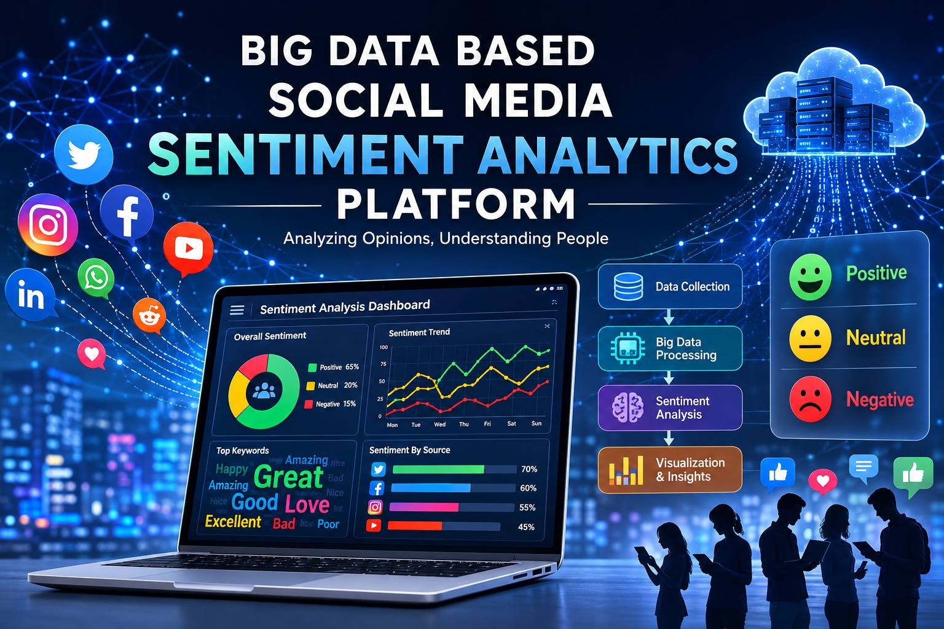
PROBLEM STATEMENT
Social media platforms generate massive volumes of unstructured data every day.
Manually analyzing large-scale social media data is time-consuming and inefficient.
Organizations need to identify public opinions and emerging trends quickly.
Traditional systems may face challenges in storing and processing large datasets efficiently.
A scalable solution is required to automate sentiment analysis and extract meaningful insights from social media data.

Slide 4
OBJECTIVES
To collect large volumes of social media data efficiently.
To preprocess and clean unstructured social media text.
To perform sentiment classification using Natural Language Processing (NLP).
To utilize Apache Spark and Big Data technologies for efficient large-scale data processing.
To identify sentiment patterns and trends from analyzed data.
To present meaningful insights through an interactive cloud-based visualization dashboard.
To develop a scalable end-to-end sentiment analytics platform.

Slide 5
LITERATURE REVIEW
Paper / Research | Year | Research Focus | Approach | Limitation | Gap Addressed by Our Project
Role of Large-Scale Data Analytics Risk Information Systems in Addressing Social Disruptions in Infrastructure Development | 2026 | Big-data analytics for social disruptions | Large-scale data analytics | Infrastructure-specific focus | Applies analytics to general social-media sentiment
AI Sentiment Analysis-Based Brand Reputation Management Strategy in Responding to Social and Ethical Issues on Social Media | 2026 | Brand reputation and social-media sentiment | AI-based sentiment analysis | Focused on brand reputation | Provides broader sentiment analytics across topics
Scalable Vortex Search-Tuned Intelligent Adaptive Boosting for Sentiment Analysis of Social Media Data Using Natural Language Processing | 2025 | Scalable social-media sentiment analysis | NLP + Adaptive Boosting | Mainly focuses on model optimization | Combines NLP with big-data processing and visualization
Deep Learning Approaches to Sentiment Analysis and Text Classification in Social Media Data | 2025 | Sentiment and text classification | Deep learning + NLP | Computationally intensive | Provides a scalable end-to-end analytics platform
Integrating Sentiment Analysis and Reinforcement Learning for Equitable Disaster Response: A Novel Approach | 2025 | Sentiment analysis for disaster response | Sentiment analysis + reinforcement learning | Limited to disaster-response scenarios | Supports general-purpose social-media sentiment analysis

Slide 6
METHODOLOGY
Data Collection
Collects posts, comments , hastags and relevant data
Big data processing process large scale dataset using apache spark
Sentiment Analysis Apply NLP techniques to classify text as Positive, Negative, Neutral
Data Aggregation Calculate Sentiment counts, percentage, trends, and keywords
Visualisation Present the processed insights
Preprocessing clean and normalise the collected data

Slide 7
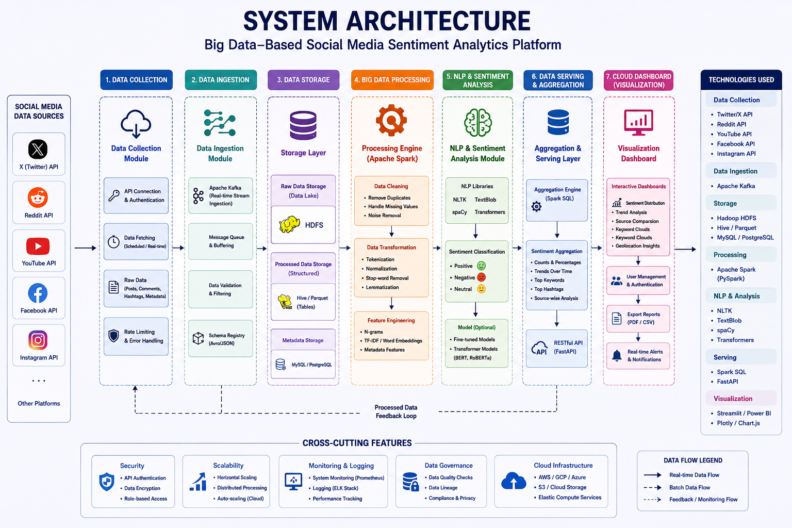
SYSTEM ARCHITECTURE

Slide 8
PROJECT MODULES
MODULE 1: Social Media Data Collection Module
MODULE 2: Sentiment Analysis & Big Data Processing Engine
MODULE 3: Cloud-based Visualization Dashboard

Slide 9
MODULE 1: SOCIAL MEDIA DATA COLLECTION MODULE
Purpose
Collect social-media posts, comments, hashtags, timestamps, and relevant metadata.
Organize the collected data for further analysis.
Prepare the data for Big Data processing and sentiment analysis.
Process
Data collection from available social-media sources/APIs.
Data validation and basic cleaning.
Storage of collected data in a structured format.
Input
Social Media Data
Output
Structured Dataset

Slide 10
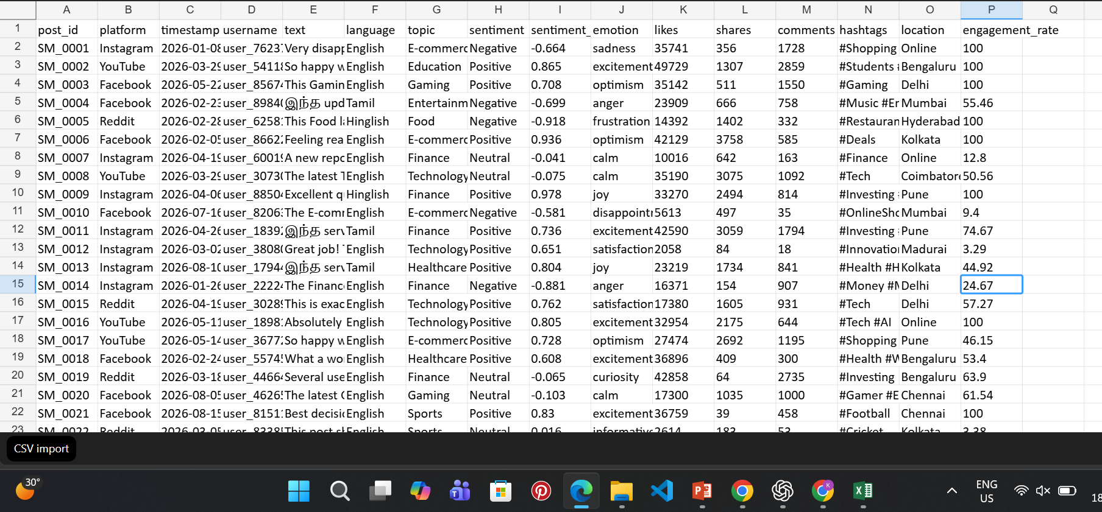
MODULE 1 IMPLEMENTATION

Slide 11
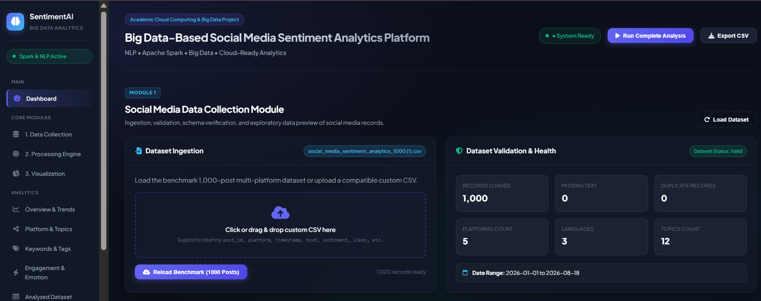
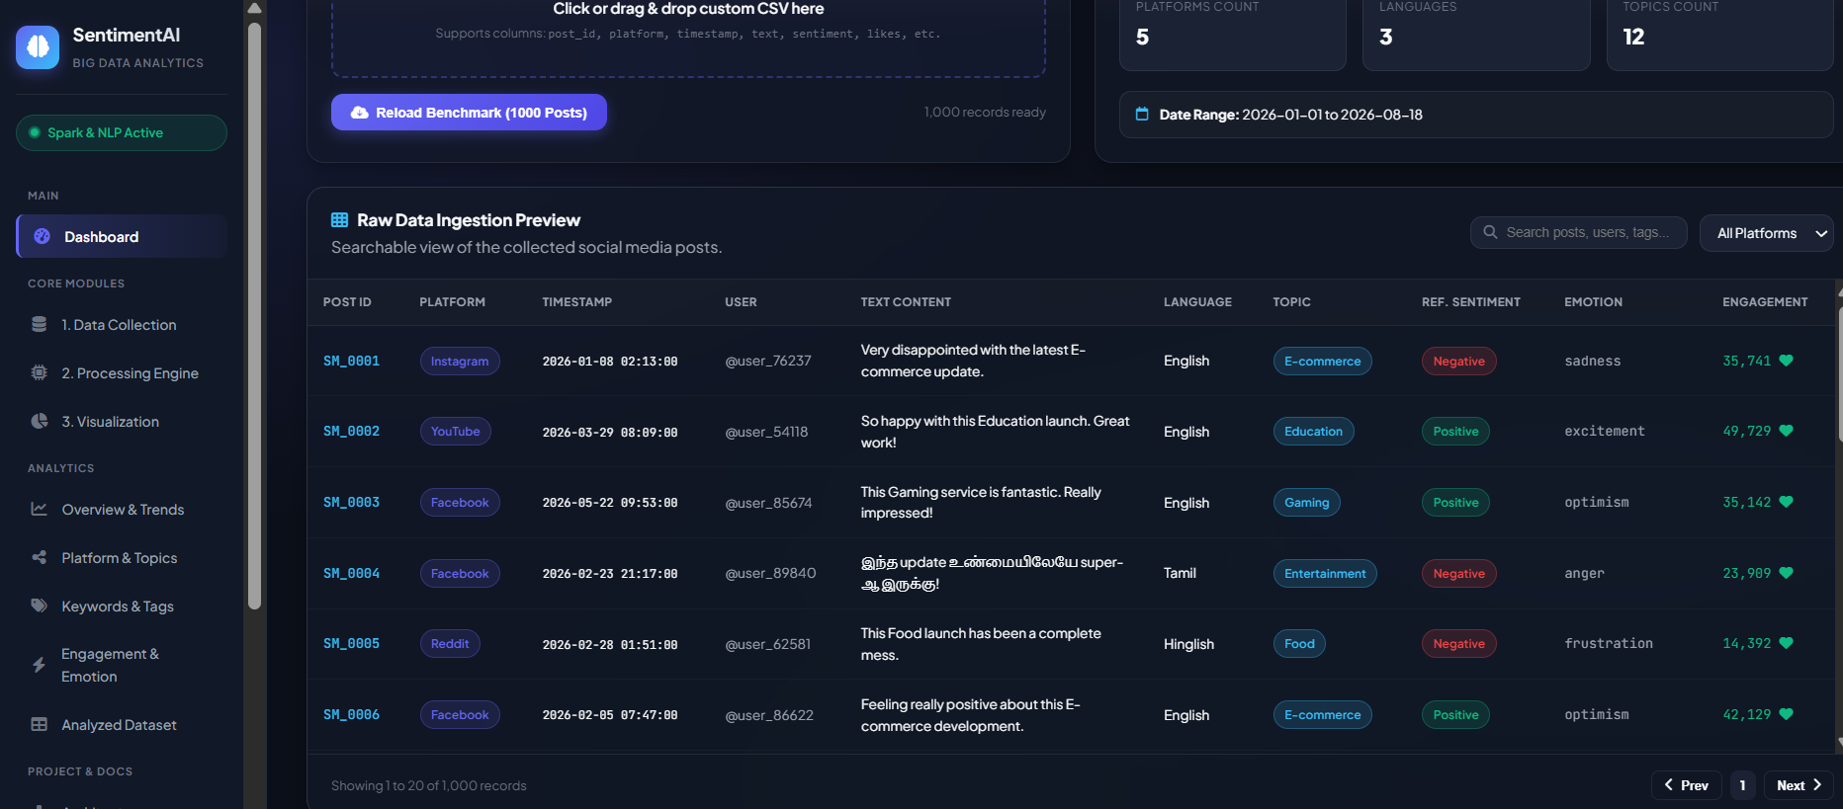

Slide 12
MODULE 2: SENTIMENT ANALYSIS & BIG DATA PROCESSING ENGINE
Purpose:
Process large volumes of collected social-media text efficiently.
Prepare the data for automated sentiment analysis.
Identify the sentiment expressed in each social-media post.
Process:
Clean and preprocess the collected text.
Perform tokenization and stop-word removal.
Use Apache Spark for large-scale data processing.
Apply NLP-based sentiment analysis.
Classify posts into Positive, Negative, or Neutral categories.
Input
Collected & Structured Social Media Data
Output
Analyzed Sentiment Results

Slide 13
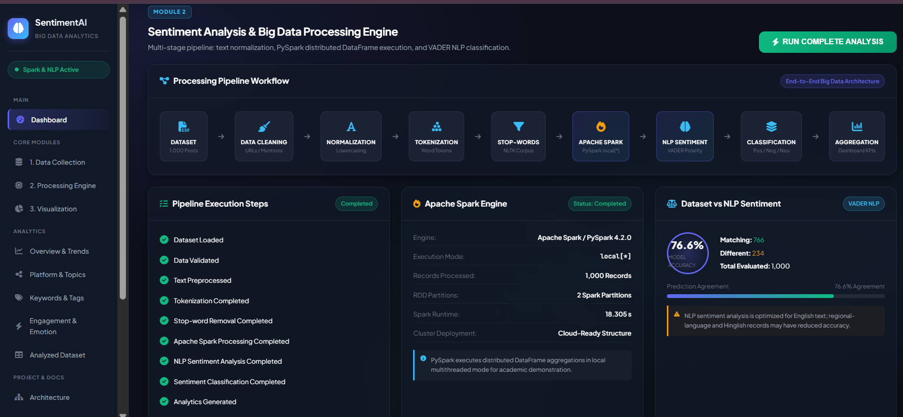
MODULE 2 IMPLEMENTATION

Slide 14
MODULE 3:CLOUD-BASED VISUALIZATION DASHBOARD
Purpose:
Present the analyzed sentiment results through an interactive dashboard.
Provide a clear view of sentiment patterns and trends.
Enable easy interpretation of the analyzed social-media data.
Process:
Receive analyzed sentiment results from Module 2.
Aggregate sentiment data into meaningful metrics.
Generate charts, graphs, and tables.
Display sentiment distribution, trends, keywords, and hashtags.
Provide an interactive interface for exploring the results.
Input:
Analyzed Sentiment Results
Output:
Interactive Cloud-Based Dashboard → Sentiment Insights

Slide 15
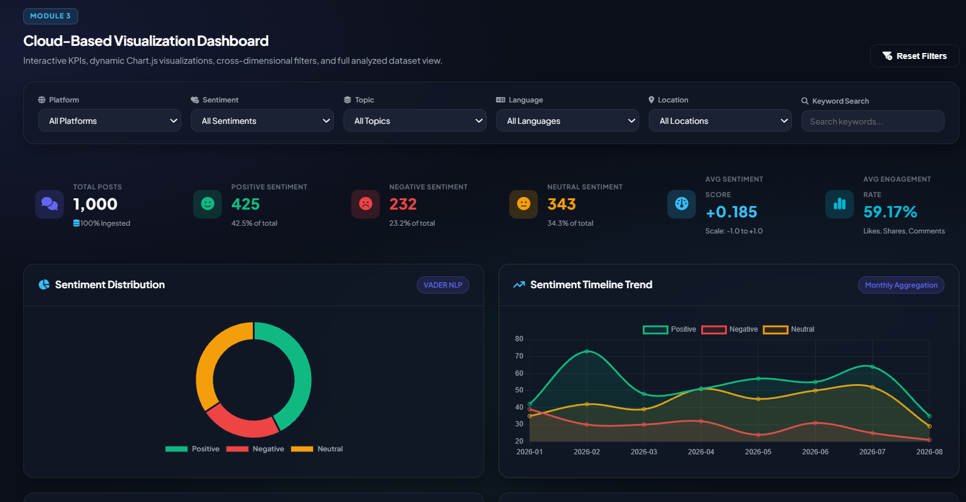
MODULE 3 IMPLEMENTATION

Slide 16
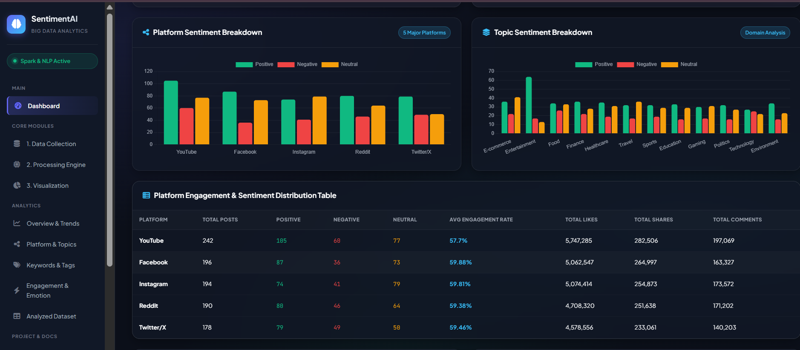
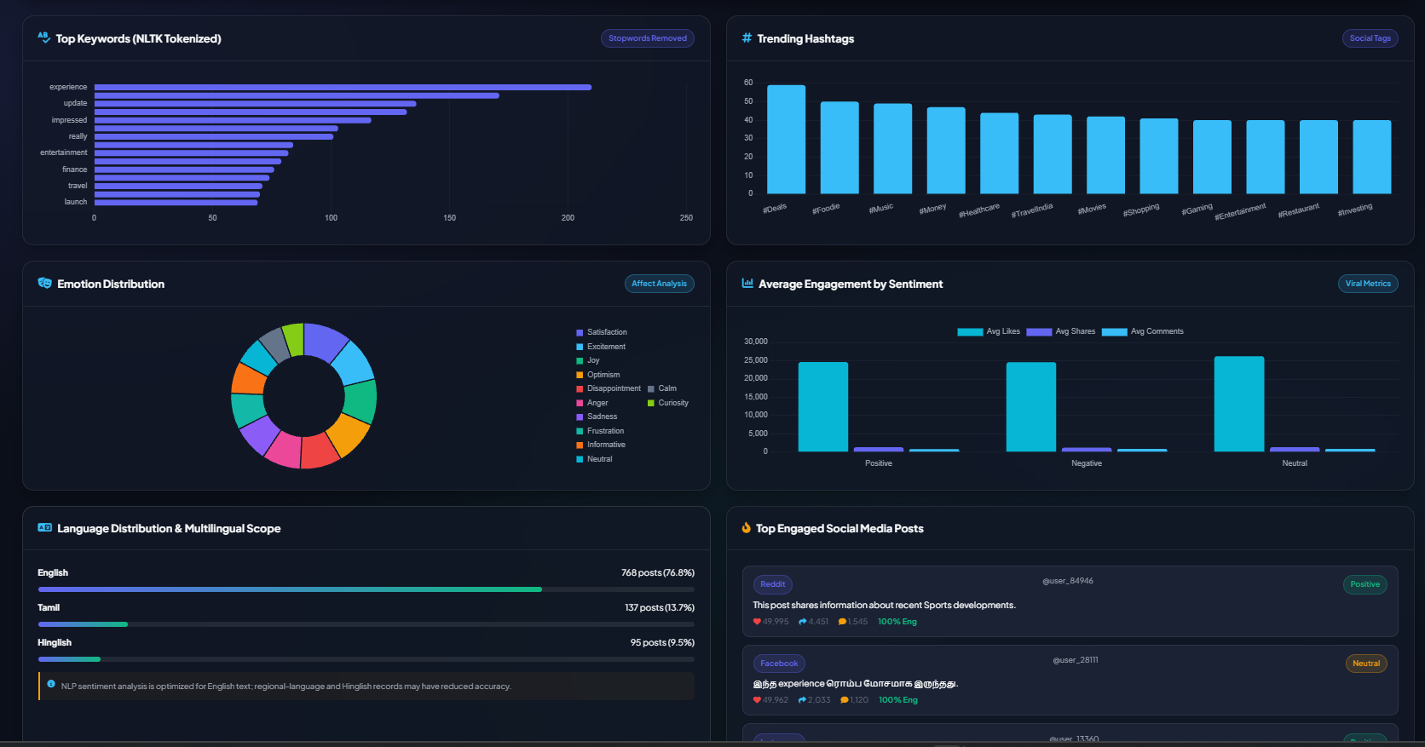

Slide 17
RESULTS AND DISCUSSION
The proposed platform establishes an end-to-end workflow for collecting, processing, and analyzing social-media data.
The system processes social-media text using NLP and Apache Spark and classifies posts into Positive, Negative, and Neutral sentiments.
The integration of Big Data processing and sentiment analysis enables scalable analysis of large volumes of social-media content.
The cloud-based dashboard presents the analyzed results through interactive charts, graphs, and tables for easier interpretation.
The complete implementation will be further evaluated using actual datasets and performance metrics

Slide 18
CHALLENGES AND LIMITATIONS
Handling large volumes of unstructured social-media data can increase processing and storage requirements.
Noisy text, slang, abbreviations, and informal language can affect sentiment classification.
Sarcasm and context-dependent expressions are difficult for sentiment models to interpret accurately.
Social-media API availability and access restrictions can affect continuous data collection.
The accuracy of the analysis depends on the quality and representativeness of the dataset.
The initial implementation may be limited to selected social-media platforms and languages.

Slide 19
FUTURE SCOPE
Real-time sentiment analysis to monitor social-media opinions and detect sudden changes instantly.
Multilingual and emotion analysis to support regional languages and identify emotions like happiness, anger, and sadness.
AI-based prediction to predict future sentiment trends and public opinion using advanced ML models.
Fake news and misinformation detection to identify misleading content and spam on social-media platforms.
Advanced visualization and alerts to provide interactive dashboards, geographical insights, and real-time notifications.

Slide 20
CONCLUSION
The proposed platform provides an end-to-end solution for social-media sentiment analytics.
NLP-based sentiment analysis classifies social-media content into Positive, Negative, and Neutral categories.
The system integrates data collection, processing, sentiment analysis, and visualization into a unified platform.
The cloud-based dashboard presents sentiment patterns, trends, keywords, and hashtags as meaningful visual insights.
The platform provides a scalable foundation for future real-time and advanced sentiment analytics.

Slide 21
REFERENCES
1.Khayru, R.K. and Qader, K.S., 2026. Role of Large-Scale Data Analytics Risk Information Systems in Addressing Social Disruptions in Infrastructure Development. Bulletin of Science, Technology and Society, 5(2), pp.101-112.
2.Al Hakim, Y.R. and Irfan, M., 2026. AI Sentiment Analysis-Based Brand Reputation Management Strategy in Responding to Social and Ethical Issues on Social Media. Bulletin of Science, Technology and Society, 5(2), pp.11-128.
3.Ye, F. and Zhao, Z., 2025. Scalable vortex search-tuned intelligent adaptive boosting for sentiment analysis of social media data using natural language processing. Systems and Soft Computing, p.200403.
4.Parveen, S., Zaheen, U. and Khan, S.A., 2026. Deep Learning Approaches to Sentiment Analysis and Text Classification in Social Media Data. The Critical Review of Social Sciences Studies, 4(1), pp.1168-1182.
5.Alqithami, S., 2025. Integrating sentiment analysis and reinforcement learning for equitable disaster response: A novel approach. Sustainability, 17(3), p.1072.

Slide 22
THANKYOU

