Slide 1
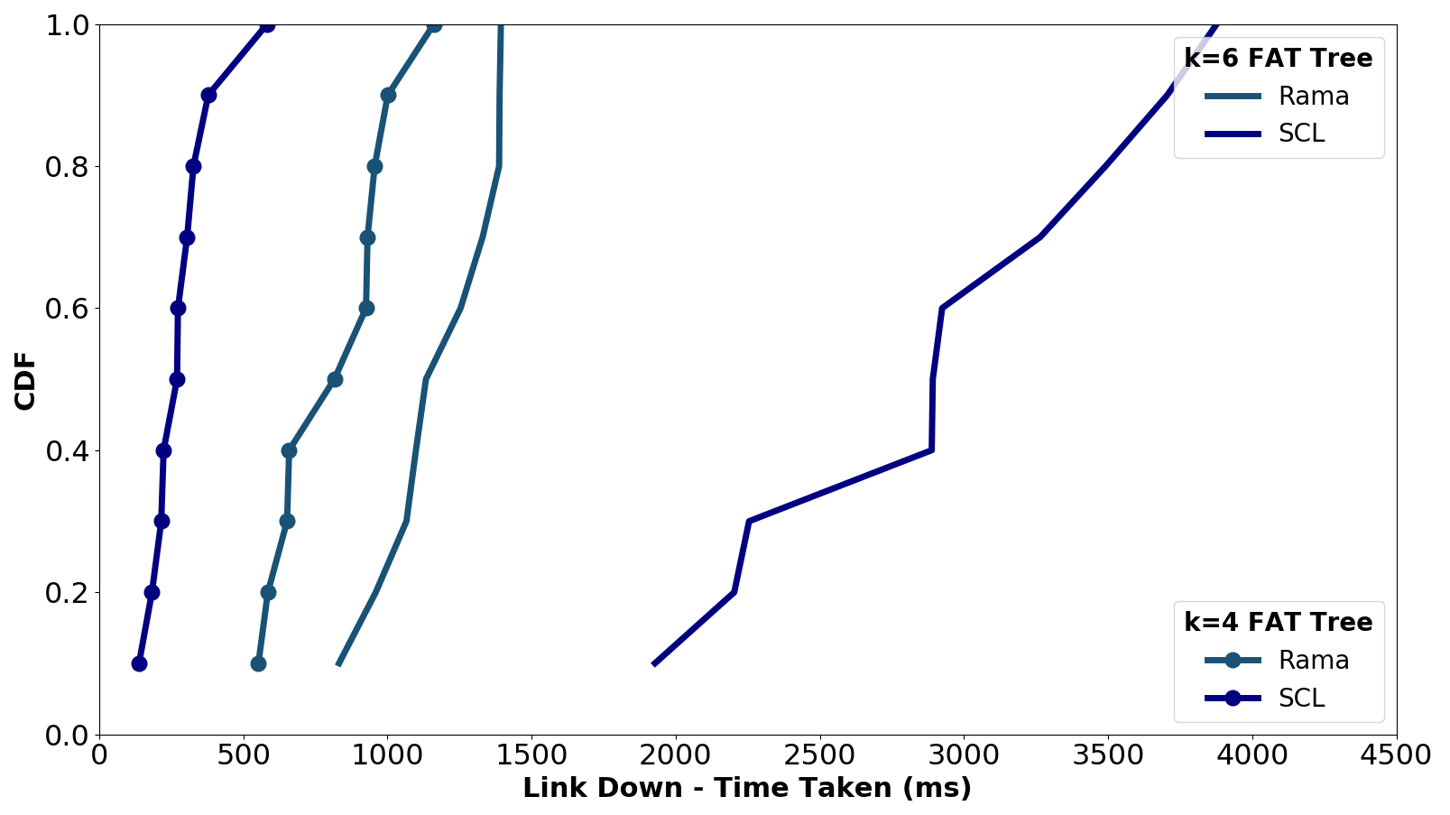
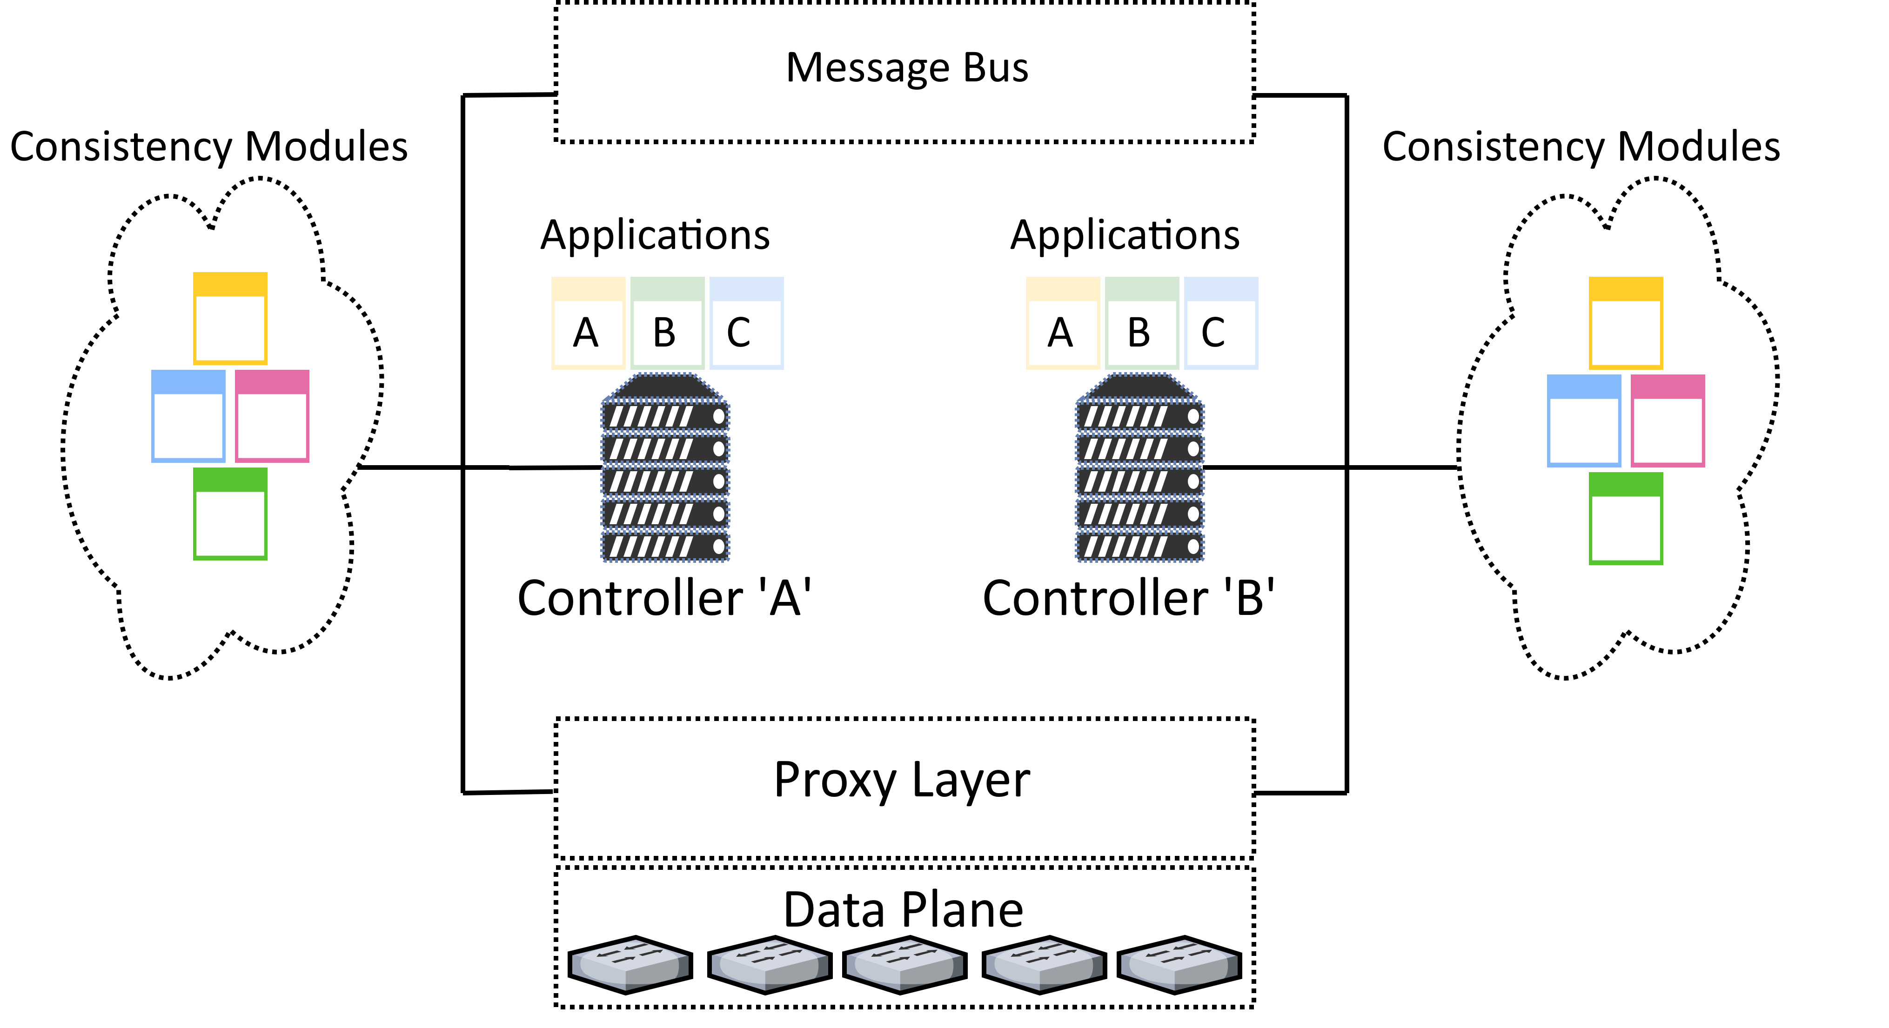
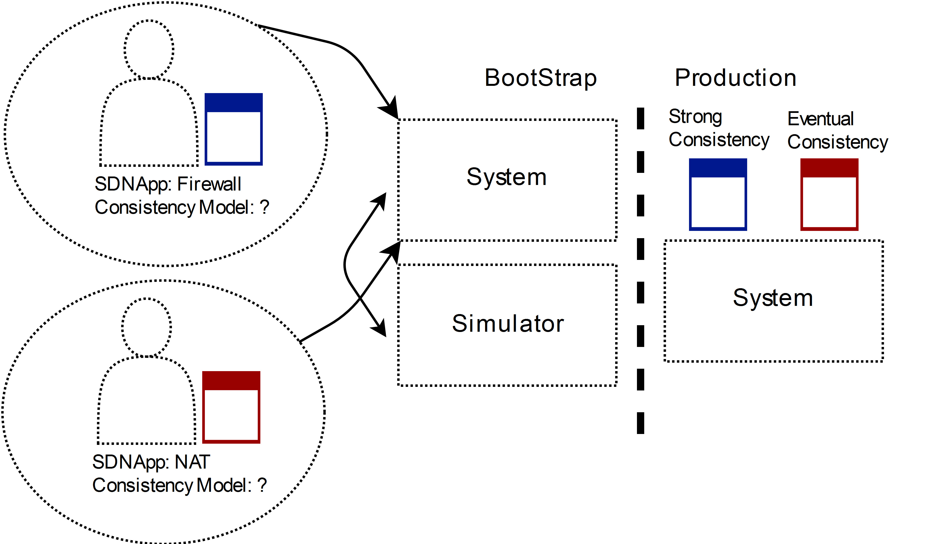
Symphony: An Automated Approach to Detecting and Orchestrating Consistency Requirements Saim Salman (saim_salman@brown.edu), Theophilus Benson (theophilus_benson@brown.edu) Brown University
Problem
To build a redesigned SDN Control Plane that automatically infers the optimal consistency model and dynamically provides these models to different SDNApps.
Motivation
SDNApp | Consistency Model
 | Rama (Strong) | SCL (Eventual)
NAT | X | X
Routing | X | X
Load Balancer | X
Stateful Firewall | X
SCL (Eventual) | Rama (Strong)
Deterministic | Deterministic
Proactive Applications | Single Threaded
Trigger Recomputation
Idempotent Behavior
Challenges
Capturing SDNApp Requirements to choose the appropriate consistency model:
If the source code of the SDNApp is provided we can use symbolic execution to extract and infer SDNApp design.
If the source code is absent we will design a Domain Specific Language (DSL) that enables the SDNApp developer to express predicates defining key behavior.
Effectively Supporting Concurrent Models:
We will build on in-network flexibility by leveraging unique properties of programmable switches.
We will also explore offloading consensus functionality to the switches to further improve speed and efficiency.
At the controller side, we will explore efficient abstractions for presenting and enabling network wide transactions.
Consistency models limits SDNApp design
No model provides strictly better performance
SDNApp Functionality limits applicable models
Takeaways:
The SDNApps design determines which set of consistency models are suitable for the SDNApp – design limits choice
Under different demands, different consistency models may prove more efficient, thus the optimal model is dependent on the expected demand – demand determines optimal choice
Design
Consistency Module: Each consistency module would be associated with a specific consistency type and would provide a set of methods.
Message Bus: Provides control traffic between different controller instances.
Proxy Layer: Extra layer above each switch so consistency models can provide extra functionality at the switch for added performance.
Workflow
The developer will describe consistency invariants of a specific SDNApp through a simplistic Domain Specific Language (DSL) language.
Our system will evaluate the SDNApp across different models within our simulator to determine the set of consistency models that are appropriate for the SDNApp.
Given this list of appropriate models, the SDN App developer or network operator can pick the model which optimizes their personal objectives, e.g., performance and conﬁgure the SDN Controller to apply this model to the SDNApp.
Notes:
Things Missing: Design Assumptions, Table with applications with different applicable consistency models

