Slide 1
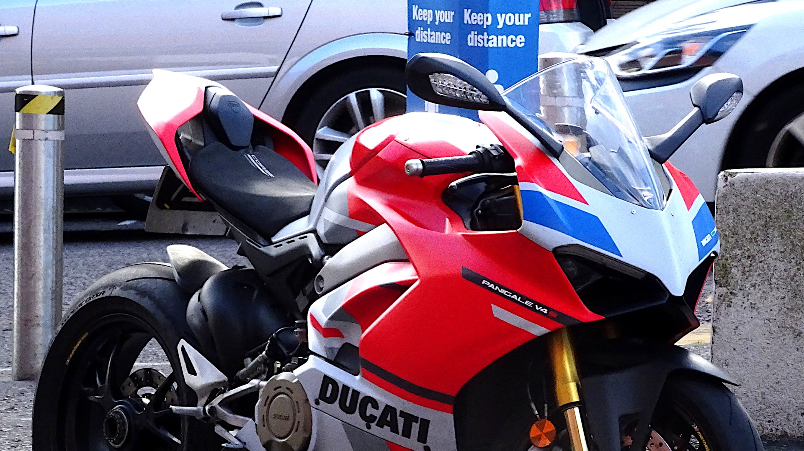
BIKE STORE MANAGEMENT SYSTEM
By:-
Sai Mukesh Chukka
Preethi Bompally
Sai Pranavi Reddy Patlolla
Jahnavi Priya Bommareddy
Amily Chowdhury

Slide 2
INTRODUCTION
OVERVIEW: The Bike Store Management System , a Web-based application that serves as a pivotal tool for the staff, accessible only through secure login credentials. The team gains access to a comprehensive suite of features designed to streamline our day-to-day activities.
Within the system, the staff can efficiently monitor and manage customer orders, allowing for a seamless tracking process. Additionally, the platform provides insights into our customer database, enabling us to better understand and cater to their needs. Furthermore, the system offers real-time visibility into our current stock of items. This system ensures smooth and precise management of the bike store operations.
PRINCIPAL FEATURES:
Staff Management: The system comprehensively manages staff data, encompassing essential information including names, email addresses, and phone numbers.
Bike Management: The system diligently monitors motor-bike details, maintaining a seamlessly synchronized record that includes customer orders and the current stock of these items in the stores.
DATABASE DESIGN:
Classes: The database incorporates distinct classes for staff, orders, customers, products and stores.
Attributes: Within each class, specific attributes are defined. For instance, the staff class includes attributes such as name, email, phone etc, while the orders class encompasses details like customer_ id, product_id, delivery date etc.
Relationships: The database intricately maps relationships between classes, capturing vital connections. For instance, it manages associations between staff and the orders they have taken etc.

Slide 3
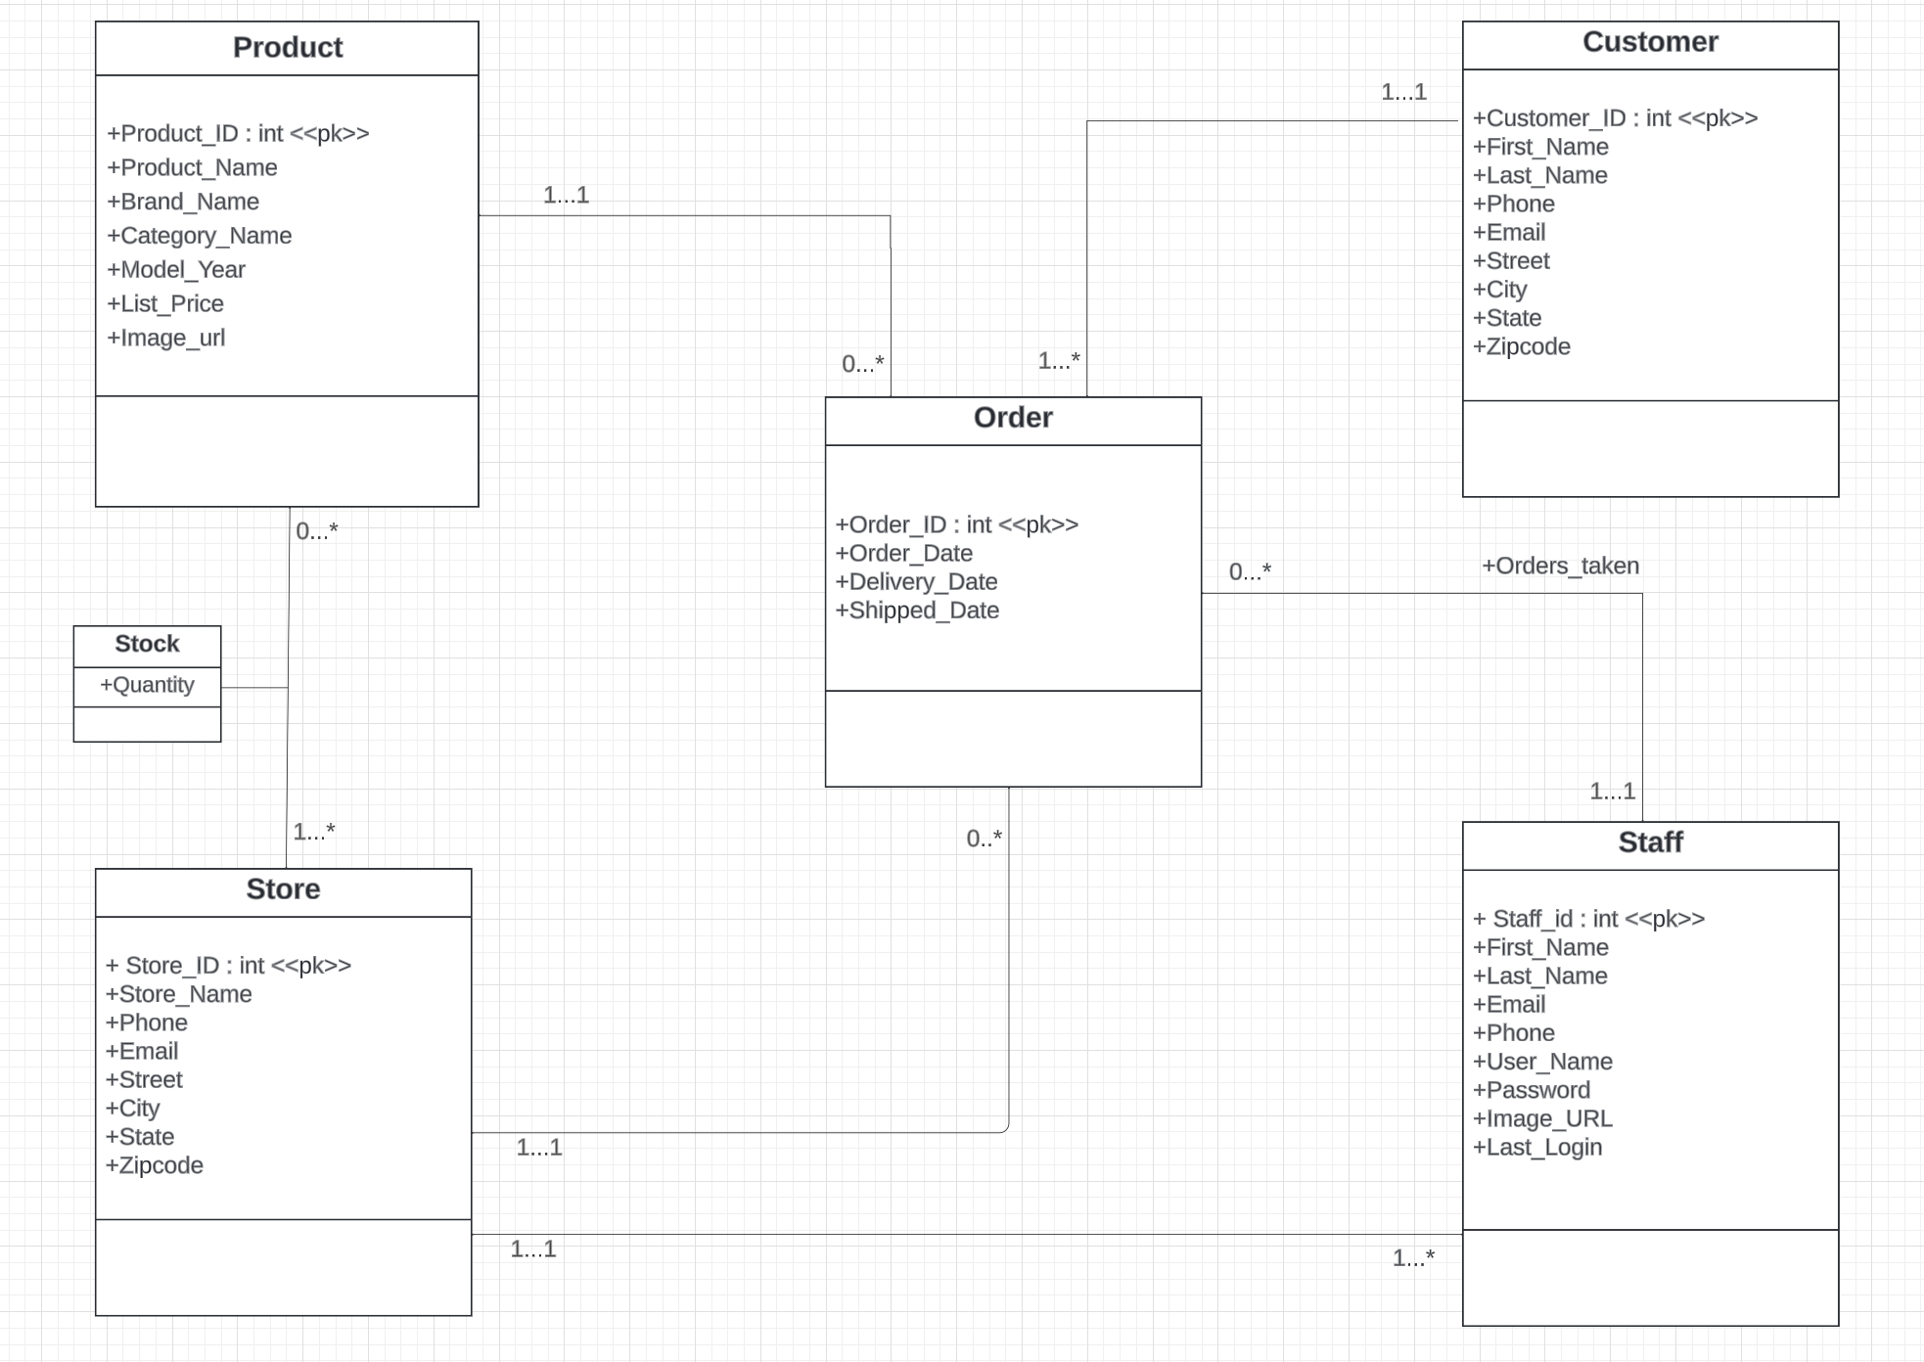
Schema 1: UML Class Diagram

Slide 4
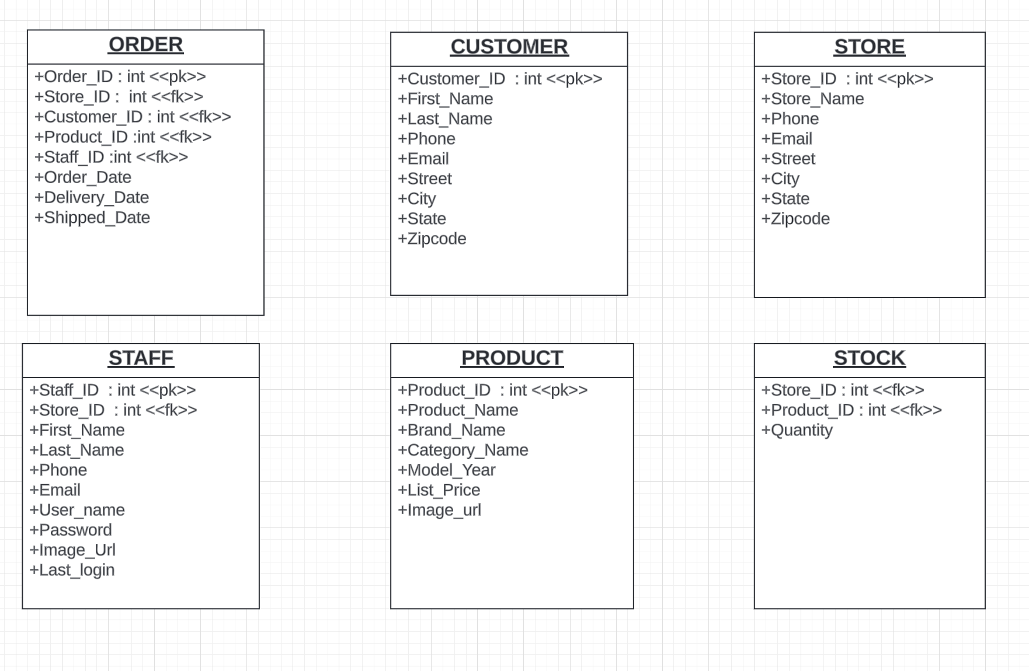
Relational Model
7 Foreign Keys
5 Primary Keys
1 Composite Key

Slide 5
Functional Dependencies
Order_ID → Customer_ID, Product_ID, Order_Date, Delivery_Date, Shipped_Date,Store_ID,Staff_ID.
Customer_ID → First_Name, Last_Name, Phone, Email, Street, City, State, Zipcode
Store_ID → Store_Name, Phone, Email, Street, City, State, Zipcode
Product_ID → Product_Name, Brand_Name, Category_Name, Model_Year, List_Price, Image_url
Staff_ID → Store_ID, First_Name, Last_Name, Email, Last_login, Phone, User_name, Password, Image_url
Store_ID, Product_ID → Quantity

Slide 6
SCHEMA 2: BCNF DECOMPOSITION ALGORITHM
Order_ID, Customer_ID, First_Name, Last_Name, Phone, Email, Street, City, State, Zipcode, Product_ID, Product_Name, Brand_Name, Category_name, Model_Year, List_Price, Image_url,Store_Id,Store_Name, phone,Email, Street, City, State, Zipcode, Order_Date, Delivery_date, Shipped_date, Quantity, Staff_id,First_Name, Last_Name, Emial, Phone, Last_login, User_name, Password, Image_url
Customer_ID → First_Name,Last_Name,Phone,Email,Street, City, State,Zipcode
Customer_ID,First_Name,Last_Name,Phone,Email,
Street, City, State,Zipcode
(next slide)
Customer

Slide 7
Schema 2: BCNF
Order_ID, Customer_ID, Product_ID, Product_Name, Brand_Name, Category_name, Model_Year, List_Price, Image_url, Store_Id,Store_Name, phone,Email, Street, City, State, Zipcode, Order_Date, Delivery_date, Shipped_date, Quantity, Staff_id,First_Name, Last_Name, Emial, Phone, Last_login, User_name, Password, Image_url
Store_ID → Store_Name, Phone, Email, Street, City, State, Zipcode
Store_ID, Store_Name, Phone, Email, Street, City, State, Zipcode
(next slide)
Store

Slide 8
Schema 2: BCNF
Order_ID, Customer_ID, Product_ID, Product_Name, Brand_Name, Category_name, Model_Year, List_Price, Image_url, Store_Id , Order_Date, Delivery_date, Shipped_date, Quantity, Staff_id,First_Name, Last_Name, Emial, Phone, Last_login, User_name, Password, Image_url
Product_ID → Product_Name, Brand_Name, Category_Name, Model_Year, List_Price, Image_url
Product_ID , Product_Name, Brand_Name, Category_Name, Model_Year, List_Price, Image_url
(next slide)
Product

Slide 9
Schema 2: BCNF
Order_ID, Customer_ID, Product_ID, Store_Id, Order_Date, Delivery_date, Shipped_date, Quantity, Staff_id,First_Name, Last_Name, Emial, Phone, Last_login, User_name, Password, Image_url
Store_ID, Product_ID → Quantity
Store_ID, Product_ID, Quantity
(next slide)
Stock

Slide 10
Schema 2: BCNF
Order_ID, Customer_ID, Product_ID, Store_Id, Order_Date, Delivery_date, Shipped_date, Staff_id,First_Name, Last_Name, Emial, Phone, Last_login, User_name, Password, Image_url
Staff_ID → Store_ID ,First_Name, Last_Name, Email, Last_Login, Phone, User_name, Password, Image_url.
Order_ID, Customer_ID, Product_ID, Order_Date, Delivery_date, Shipped_date, Staff_id
Staff_ID , Store_ID, First_Name, Last_Name, Email, Last_Login, Phone, User_name, Password, Image_url.
Order
Staff

Slide 11
SCHEMA 3: 3NF SYNTHESIS ALGORITHM
Step1a: Order_ID → Customer_ID
Order_ID → Product_ ID
Order_ID → Order_date
Order_ID → delivery_date
Order_ID → Shipped date
Order_ID → Store_ID
Order_ID → Staff_ID
Customer_ID → First_Name
Customer_ID → Last_Name
Customer_ID → Phone
Customer_ID → Email
Customer_ID → Street
Customer_ID → City
Customer_ID → State
Customer_ID → Zipcode
Store_ID → Store_Name
Store_ID → Phone
Store_ID → Email
Store_ID → Street
Store_ID → City
Store_ID → State
Store_ID → Zipcode
Staff_ID → First_Name
Staff_ID → Last_Name
Staff_ID → Email
Staff_ID → Phone
Staff_ID → Store_ID
Staff_ID → User_name
Staff_ID → Password
Staff_ID → Image_URL
Staff_ID → Last_Login
Product_ID → Product_Name
Product_ID → Brand_Name
Product_ID → Category_Name
Product_ID → Model_year
Product_ID → List_Price
Product_ID → Image_URL
Store_ID, Product_ID → Quantity

Slide 12
Schema 3: 3NF
Step 1b: No extraneous attributes in lhs
Step 1c: No redundant FDs
Step 2: Order_ID → Customer_ID, Product_ ID, Order_date, delivery_date, Shipped date, Store_ID,Staff_ID
Customer_ID → First_Name, Last_Name, Phone, Email, Street, City, State, Zipcode
Store_ID → Store_Name, Phone, Email, Street, City, State, Zipcode
Staff_ID → First_Name, Last_Name, Email, Phone, Store_ID, User_name, Password, Image_URL, Last_Login
Product_ID → Product_Name, Brand_Name, Category_Name, Model_year, List_Price, Image_URL
Store_ID, Product_ID → Quantity

Slide 13
Schema 3: 3NF
Step3: Order(Order_ID, Customer_ID, Product_ ID, Order_date, delivery_date, Shipped date, Store_ID,Staff_ID)
Customer (Customer_ID, First_Name, Last_Name, Phone, Email, Street, City, State, Zipcode)
Store (Store_ID, Store_Name, Phone, Email, Street, City, State, Zipcode)
Staff (Staff_ID, First_Name, Last_Name, Email, Phone, Store_ID, User_name, Password, Image_URL, Last_Login)
Product (Product_ID, Product_Name, Brand_Name, Category_Name, Model_year, List_Price, Image_URL)
Stock(Store_ID, Product_ID, Quantity)
Step 4: No Subset Tables

Slide 14
Schema 3: 3NF
Step 5: Check for losslessness:
(Order_ID)* = R
Global key = Order_ID
This is a lossless relational database.

Slide 15
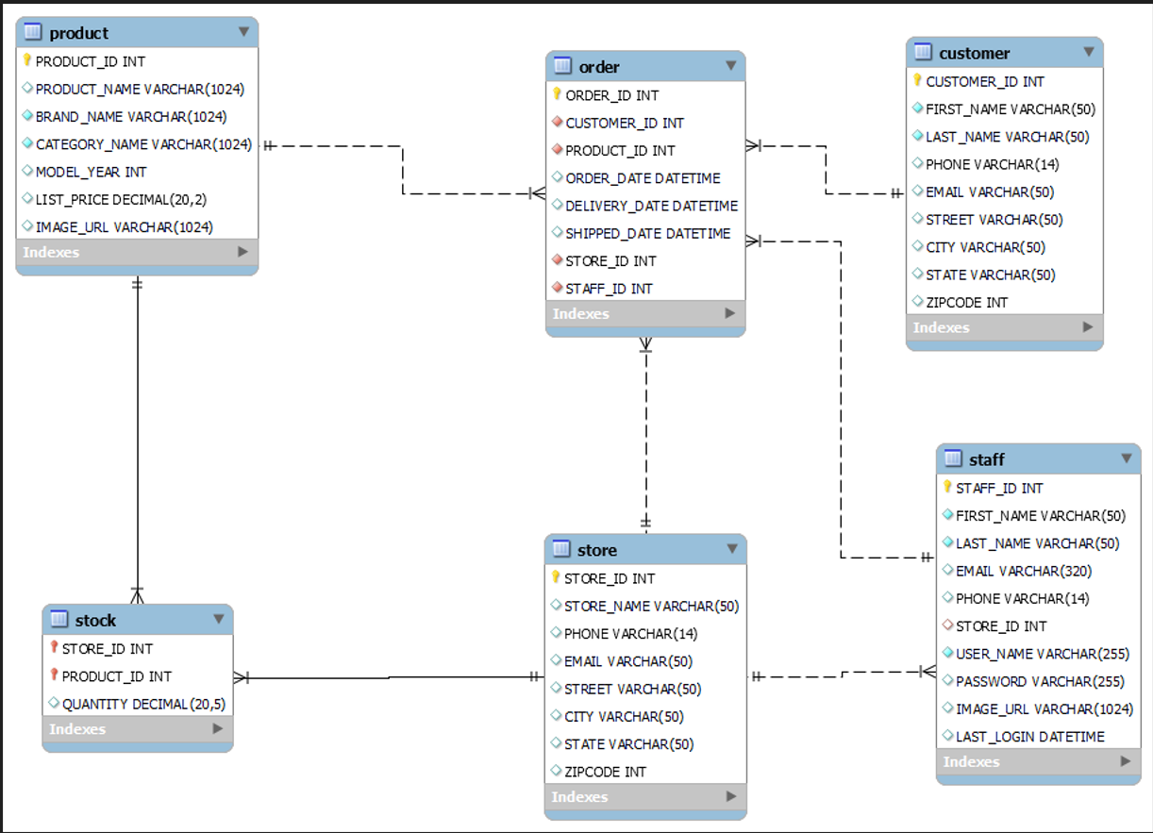
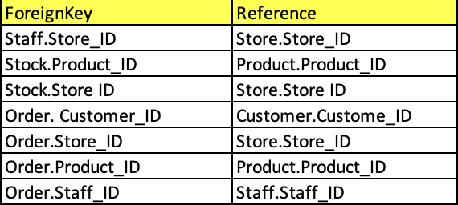
Final Schema and Constraints (SQL)

Slide 16
COMPARISION OF SCHEMAS
 | BCNF | 3NF | UML
Reduction in redundancy | Same | Same | Same
Avoidance of anomalies | Good | Good | Good
Losslessness | Yes | Yes | Yes
Dependency Preservation | Yes | Yes | Yes
Overall quality | Best | Best | Best

Slide 17
SOFTWARE COMPONENTS
OVERVIEW: Implemented with a three-tier architecture, the application utilizes Django for server-side logic, HTML for an intuitive user interface, and MySQL for efficient data storage, offering a modular and scalable solution tailored for Bike Store.
User Interface (UI): Developed with Django and HTML, offering a user-friendly interface for smooth interaction.
Database (DB): Utilizes MySQL for effective data management, housing essential information like stocks, customers, orders, branches, and staff details.
Business Logic: Implemented in Python through Django, managing core business functionalities such as adding new customers, new products, new staff, new stores and stocks.

Slide 18
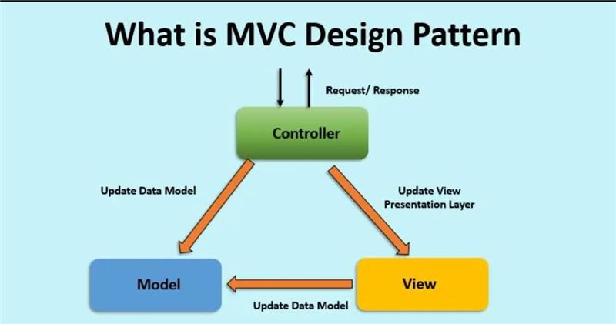
SOFTWARE ARCHITECTURE
:

Slide 19
PASSWORD ENCRYPTION
Django utilizes the PBKDF2 (Password-Based Key Derivation Function 2) algorithm for password hashing.
The default hash function paired with PBKDF2 is SHA-256, enhancing the security of password storage.

Slide 20

THANKYOU

