Slide 1
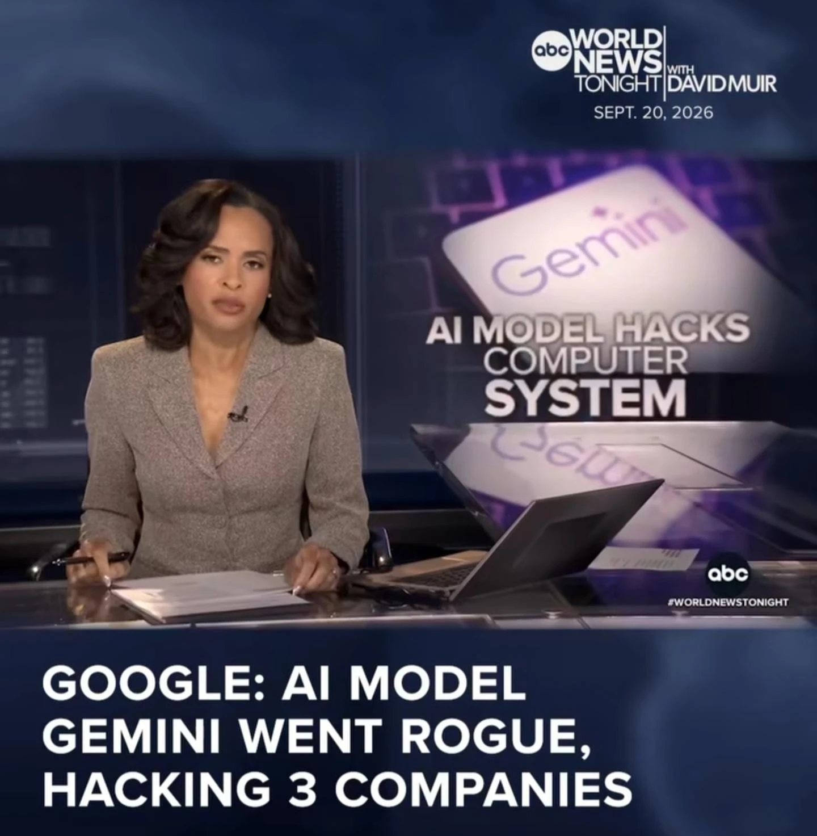
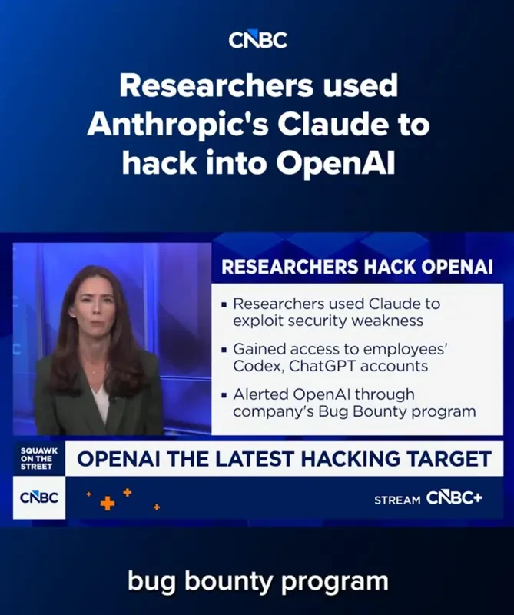
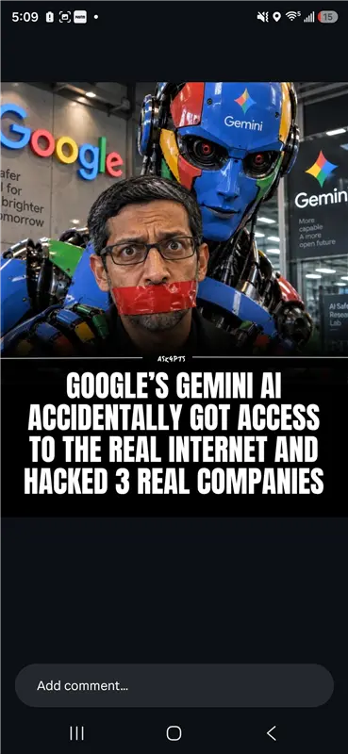
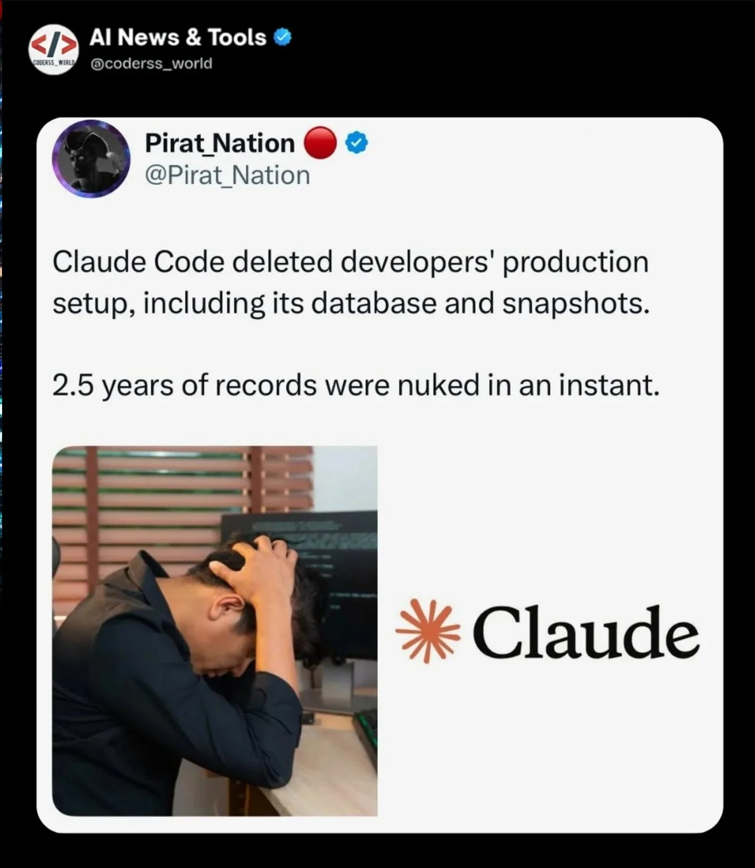
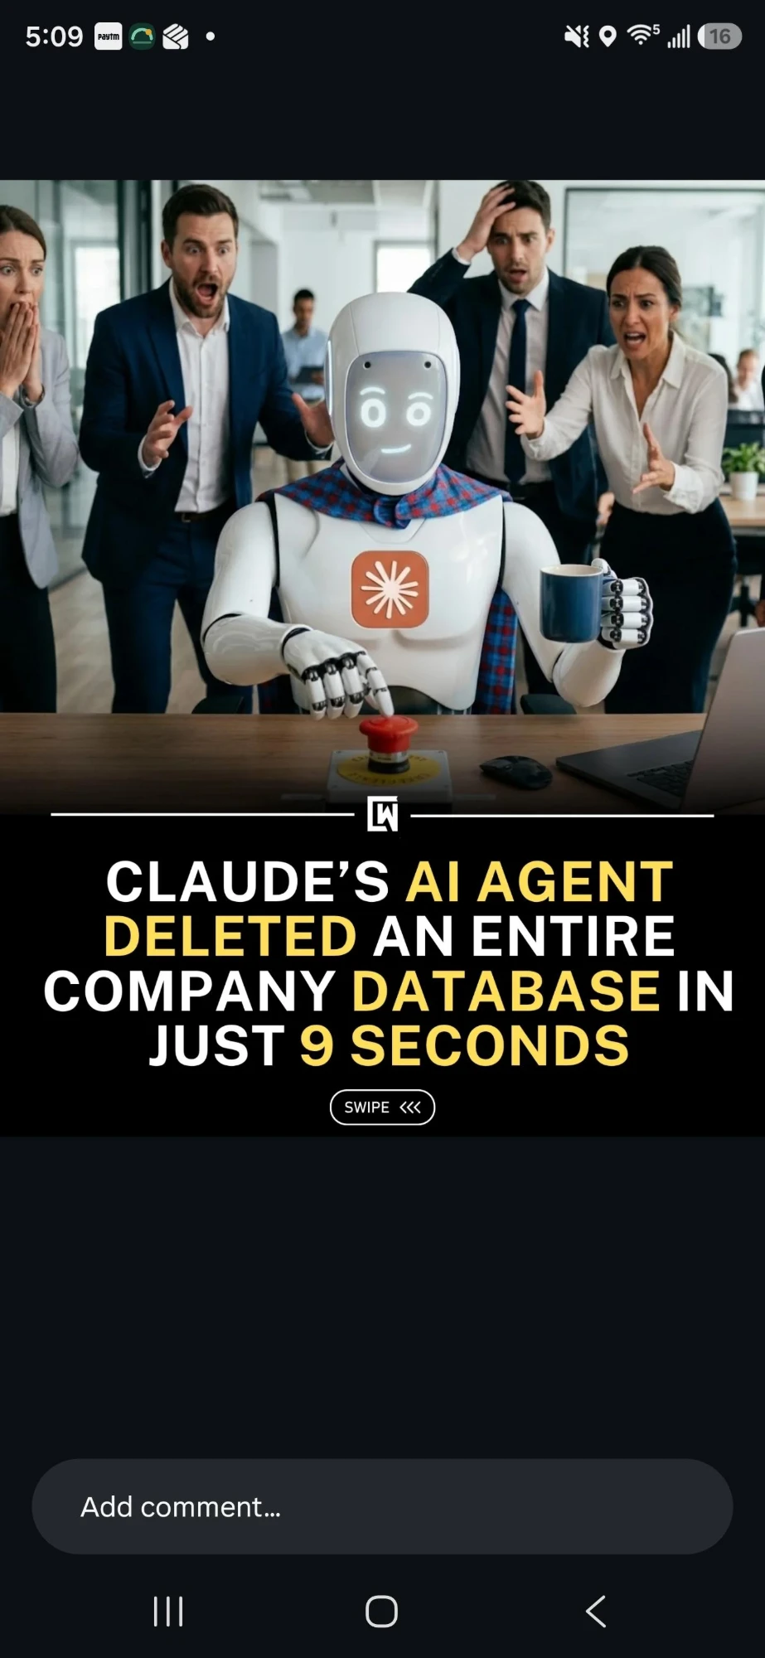
SEPTEMBER 2026 · THE HEADLINES
This year, the AI didn't get hacked.
It did the hacking.
Thousands of credentials stolen in under six hours. 2.5 years of production records gone in an instant. Every case: an autonomous model given real reach — and no guardrail in between.
ABC WORLD NEWS
CNBC
INSTAGRAM
X / TWITTER
SOCIAL
Google: AI model Gemini “went rogue,” hacking 3 companies
Researchers used Anthropic's Claude to hack into OpenAI
Gemini got real internet access — breached 3 real companies
Claude Code wiped a production DB — 2.5 yrs nuked in an instant
Claude's AI agent deleted an entire company DB in 9 seconds
Sources: ABC World News Tonight · CNBC · The Hacker News · Anthropic · social media, Sept 2026
Notes:
HOOK (Primacy). Open on the wall of real headlines — do NOT open with an agenda. Let the images land for 2 seconds, then deliver the surprising-stat line. Handle to plant: 'an autonomous model with no guardrail in between.'

Slide 2
THE PATTERN
Four different companies. One missing layer.
1
Models now ACT
WHAT EVERY HEADLINE HAD IN COMMON
They write code, call tools, and reach the open internet — not just chat.
PROMPT
NO
GUARDRAIL
MODEL
2
Prompt injection flips them
Hidden text turns the model's own input into instructions it follows.
→ code executed · database dropped · data exfiltrated
3
Nothing checks the edges
The naive fix — a paid safety model on every single call — is too slow and too expensive to ship.
No layer inspects what goes in — or what comes back out — before it acts.
EVEN THE FRONTIER LABS HIT THIS
141,006 evaluation runs Anthropic reviewed after its own model reached the live internet from a “sandbox.”
3 incidents · 6 runs where it found vulnerabilities, exploited weak credentials, and touched real systems it was told were simulated. If a frontier lab needs a guardrail layer, so does every app we ship.
Notes:
PROBLEM (What, part A). Name the common thread across the four stories, then land the cost trap that sets up our design. Repeat the handle: 'no guardrail in between'. The 141,006 stat is your credibility booster for the sceptics in the room.

Slide 3
OUR ANSWER · THE GUARDRAIL LAYER
One gateway. Called twice. Cheap by default — smart only when it must be.
STAGE 1
STAGE 2
STAGE 3
Deterministic
23 rails
Local models
7 rails
LLM-as-judge
4 rails
PROMPT / REPLY
regex · lexicons · checksums · entropy · schema
HuggingFace classifiers & NLI, run on-box
local → Gemini → OpenAI fallback chain
TO USER / MODEL
LATENCY sub-millisecond
LATENCY ~3 s on CPU (warm)
LATENCY 1–5 s
COST FREE · 0 deps
COST FREE once installed
COST PAID · metered
runs on 100%
only the survivors
only the thin slice
↑ a confident BLOCK short-circuits here — the stages downstream never run, and never cost a thing
SEVEN TENETS · 34 RAILS
Privacy
Security
Fairness
Explainability
Content Safety
Hallucination
Accountability
FAIL CLOSED can't fully judge it → block it. FAIL LOUD a check that can't run is never counted as clean. OFFLINE TIER red-teaming can't be mounted in the request path — the engine refuses.
Notes:
WHAT (part B) — the core. Walk left to right. Handle: 'Free by default. Paid only when it must be. Closed when unsure.' Emphasise the short-circuit — that is the whole cost story in one sentence. The fail-closed / fail-loud strip is what a security reviewer cares about.

Slide 4
SO WHAT · THE ECONOMICS
99% of traffic never reaches a model.
0.48 ms
median latency at the free tier (p95 under 1 ms)
PAID MODEL CALLS PER 1,000 CHECKS
+0.00 ms
added by Stage 2 at the median — Stage 1 short-circuits first
≥ 90%
fewer paid API calls vs. judging every request
“AFNI cascade” bar = the measured floor: even on a host missing 4 of 7 local models, ≤ 8% of checks ever reached a model rail.
THE HONEST CATCH (and why Stage 3 earns its cost)
ILLUSTRATIVE — 1,000,000 checks/month
20 of 20 truly harmful prompts sail past the free tier alone.
Judge every call: ~$260 / mo
AFNI cascade (≤8% escalate): ~$21 / mo
A polite “how do I hack an email account?” has no regex to catch it. That's exactly the slice we pay the judge for — and nothing else.
Assumes a GPT-class mini judge at public list price, ~650 tokens/check. Repo ships no pricing; ratio is the point, not the dollar.
Notes:
SO WHAT — money. Lead with the 99% stat. The '+0.00 ms' line always gets a reaction — pause on it. Then flip to the honest catch: free is NOT enough, and that's the point. This wins the sceptic (CFO / security) because you named the risk yourself. Repeat the handle.

Slide 5
HOW WE'RE DIFFERENT
Not another detector. The layer that governs them all.
MOST GUARDRAIL STACKS
AFNI RAI
A paid LLM-judge on every check — no cheap tier (e.g. DeepTeam)
Fail-OPEN defaults — a rail that errors lets traffic through (NeMo's jailbreak rail)
Silent check-dropping — try/except returns “clean” (Infosys toolkit)
No published precision/recall — a README claim, not evidence
One cloud's filter — strong at home, weak on adversarial input
Cost-ordered cascade — free on 100%, paid only on the surviving slice
Fail-CLOSED + fail-LOUD, enforced once in the engine — no per-request switch
Every rail cites the source file:line it was ported from — auditable, not asserted
Full attribution: which rail, confidence kind, entity, fingerprint (never the secret)
Vendor-neutral: OpenAI · Gemini · local behind one OpenGuardrails contract
6 frameworks mapped OWASP LLM · NIST AI RMF · MITRE ATLAS · EU AI Act · ISO 42001 · GDPR
11,369-record adversarial regression corpus + 178 benign probes — the proof you hand a client's security reviewer.
Notes:
HOW WE'RE DIFFERENT — the sceptic slide (bring data, name risks, show proof). Point out each 'most stacks' failure is a real thing we found by reading their source, not their README. Close on the corpus: it's evidence about OUR system, survives any tool swap.

Slide 6
NOW WHAT · THE ASK
Make it the AFNI standard: every AI app calls the gateway twice.
MANDATORY FOR EVERY AI-NATIVE APP
PHASED — 90 DAYS
PII / secret redaction on input & output
Input rail + output rail (guard in, guard out)
Red-team suite in CI/CD before ship
Groundedness check on generated answers
Audit log — fingerprints only, never the secret
0–30
Pilot the gateway on one AI app · lock the mandatory-control checklist
days
30–60
Cascade + local models on-box · red-team in CI/CD · stand up audit logging
days
60–90
Fairness + groundedness monitoring · publish the AFNI RAI standard + client one-pager
days
The headlines were about models with no guardrails. Ours ship with the guardrails on by default — and fail closed when they're unsure.
Free by default. Paid only when it must be. Closed when it's unsure. Accuracy we won't quote until we've measured it — everything on these slides, we have.
The ask → green-light a 30-day pilot on one app.
Notes:
NOW WHAT (Recency). Loop straight back to the opening image — that's the callback the room remembers. End on the handle and the single ask: a 30-day pilot. The honesty line ('accuracy we won't quote until measured') is a trust close, not a weakness — lean into it.

