Slide 1
Halcyon DeliveryLens
Why 29% of deliveries are late, and why the $680K routing engine is not the main fix
Team InfinityStacks · Sravan Kumar D · Sai M · Dinesh K · EvoHack 2026, Problem 2
Notes:
Open as advisers to Halcyon's COO and CFO. One sentence: before you sign the routing contract, here is what the data says.

Slide 2
1 · Discovery insights & the key problem
What we were told, what we asked, what the data says

Slide 3
The brief: "routing is broken, sign the vendor"
71.0%
34
$14.2M
$680K
On-time today (benchmark 94%)
Formal complaints in 90 days
Annual revenue at risk (9 clients)
Routing vendor budget, 2 weeks to sign
Leadership's view: carrier routing and selection is inefficient; a smarter routing engine will fix on-time delivery and stop churn
The stakeholder's warning (Swarna): don't assume. Map the whole chain, find where lateness really starts, prove each fix with numbers
Our job as FDEs: establish what is really happening, with evidence, before the contract is signed
Notes:
Discovery: we asked 12 data-driven questions through the L&D log (docs/working). Main reframe: lateness starts before the truck.

Slide 4
Five causes explain the gap, not one
96.6%
On-time for deliveries with none of the 5 problems (already above 94%)
48,340 deliveries, Apr–Sep 2026; causes found by tagging every delivery
Holds on unseen months: rules picked on Apr–Jun give 96.3% on Jul–Sep
Biggest single cause: incomplete addresses, 28% of email orders
Notes:
Fair share = Shapley split, so overlapping causes are not double counted. The five sum from 71.0% to 96.6%.

Slide 5
2 · Solution approach & architecture
One fix per cause, on AWS

Slide 6
DeliveryLens: one fix for each cause
Cause (points lost) | Fix in DeliveryLens
Incomplete address (6.8) | Order Intake Agent reads the order, flags missing fields, drafts a request to the client
Weak carrier on a lane (5.7) | Carrier Advisor: best carrier per region (e.g. not F to the Southeast)
Same-day after 08:00 (5.3) | Promise check at intake: next-day or second pick wave
Stock not at nearest warehouse (4.8) | Stock placement view: regions that run out most
Route deviation (3.0) | Route deviation watch: the part routing software fixes
"Nobody told us" (12 of 34 complaints) | Delay Alert Agent drafts a proactive message, a person approves

Slide 7
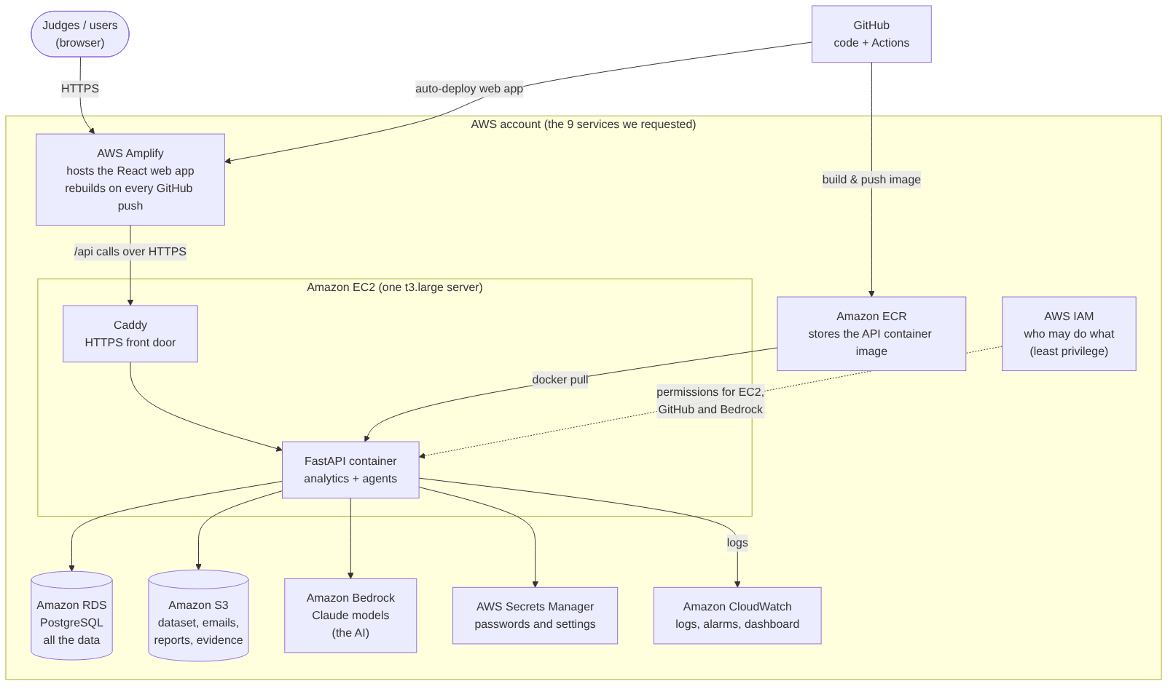
Architecture: only the 9 AWS services we requested
Amplify hosts the React web app
EC2 runs the FastAPI container (image from ECR), HTTPS via Caddy
RDS PostgreSQL holds data and every AI call
Bedrock (Claude) powers the agents
S3, Secrets Manager, CloudWatch, IAM least privilege

Slide 8
3 · AI agents used
Inside the product, and across every role that built it

Slide 9
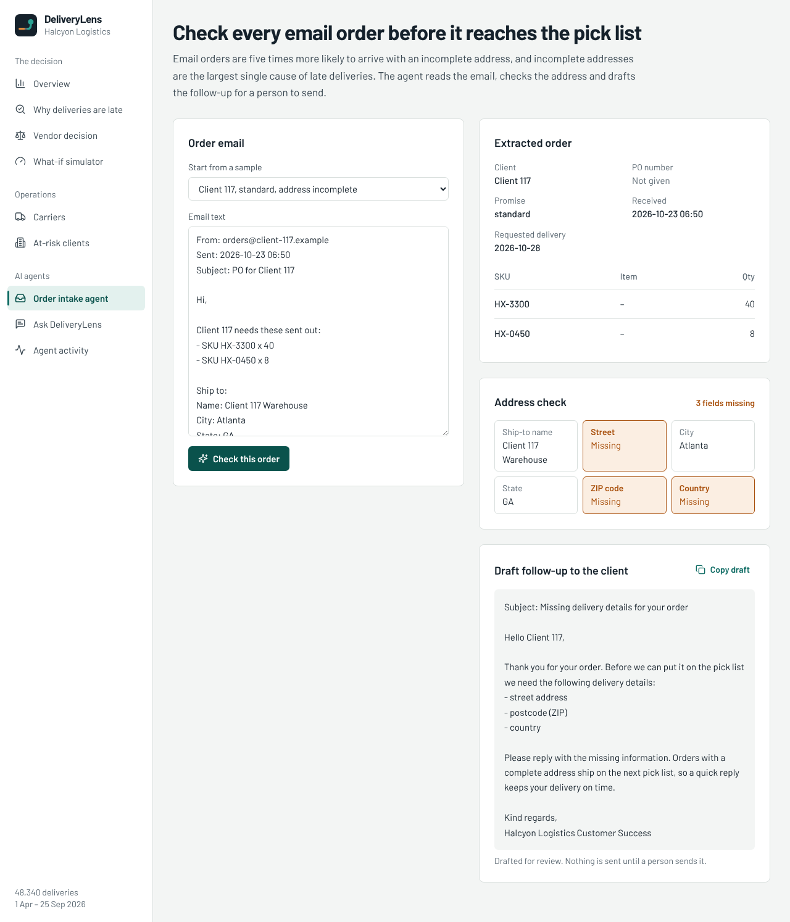
AI agents inside DeliveryLens
Order Intake Agent
Reads an email order, finds the missing postcode, drafts the follow-up. Rules check the result.
Delay Alert Agent
Tells the client before they chase: what is late, why, the new date. A person approves.
Ask DeliveryLens
Leaders ask in plain English; answers quote the numbers from our analysis.
Notes:
Guardrails: PII redacted in logs, prompt injection blocked, AI never computes KPIs, every call logged in agent_runs.

Slide 10
AI-first delivery: an agent in every role
Business analyst: transcripts → assumptions and 12 discovery questions
Data analyst: found and sized the 5 causes; holdout check
Architect: C4 + AWS design · DevOps: AWS scripts, CI/CD
Backend and frontend developer agents built in parallel; test agent wrote E2E tests
Reality Checker reviewed the solution like a judge · every session logged in ai-logs/

Slide 11
4 · Quality, validation & security
Evidence, not claims

Slide 12
Tested, validated and secured
48
12
96.3%
0
Backend tests (numbers match the analysis exactly)
Frontend tests + browser E2E on every screen
Out-of-time check (Jul–Sep)
High-severity bandit findings
CI on every push: tests, security scan, and a re-run of the analysis that must reproduce 71.0% / 96.6%
AI guardrails: personal data hidden in logs, prompt injection blocked, human approval before any client message
AWS: HTTPS only, database not public, least-privilege IAM, secrets in Secrets Manager, synthetic data only

Slide 13
5 · Metrics & business impact
What each option buys Halcyon

Slide 14
Routing alone: 78.6%. Fixing the causes: 96.6%
$2.39M / yr
Penalties + redelivery avoided if all 5 are fixed
$1.52M / yr
From the 3 process fixes alone (no new software)
$0.70M / yr
From routing-related fixes (vs $680K budget)
Notes:
Money = 6 months of penalties and redelivery costs x2, for late deliveries that become on time. Revenue protected (9 clients, $14.2M) comes on top.

Slide 15
Our recommendation: don't sign as scoped, reshape it
1
Weeks 1–4
2
Weeks 2–6
3
Then
Fix the process causes
Choose carriers by region
Small routing pilot
Address check at intake, same-day promise rule or second pick wave, monthly stock rebalancing → about 87%
Stop the 5 weak carrier–region pairs; no new software → most of the remaining gap
Only on lanes with high route deviation; measure before scaling → last ~3 points
Target: above 94% on time. Protects the $14.2M at risk and avoids ~$2.4M a year in penalties and redeliveries, while spending less than the $680K routing contract on the smallest cause.

Slide 16
6 · Future scope
From hackathon slice to Halcyon rollout

Slide 17
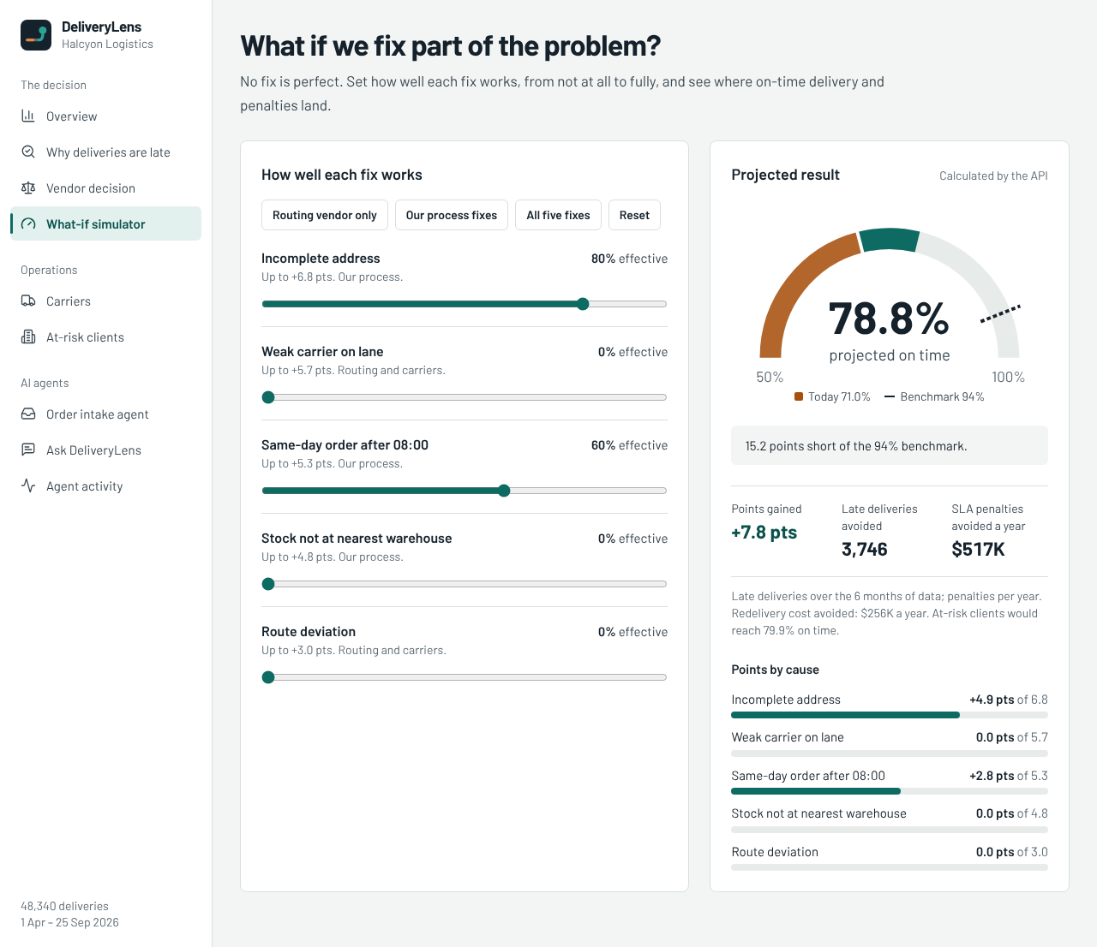
Next 90 days and beyond
Live feeds: WMS orders and carrier events (APIs for A–C; portal/batch for D–F) instead of CSV exports
Order Intake Agent in the email inbox itself, before orders reach the pick list
Daily at-risk shipment scoring and automatic delay alerts with approval
Measure weekly: on-time %, penalties, complaints, for the 9 at-risk clients first
Reusable for other Evoke logistics and manufacturing clients: same causes, same agents

Slide 18
7 · Live demo
Running on AWS with Claude on Bedrock

Slide 19
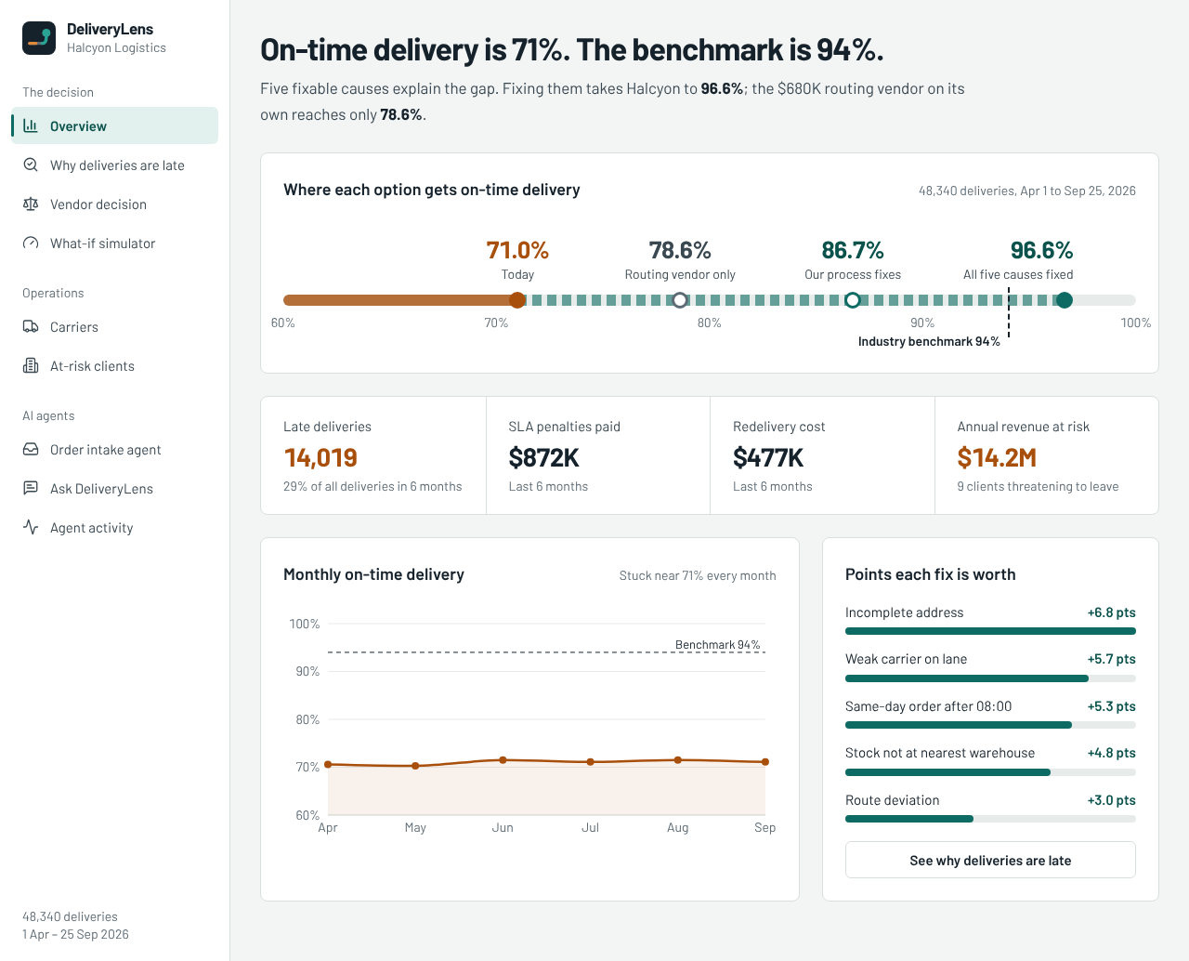
Demo path (6 minutes)
Overview: 71% today vs 96.6% possible
Why late: waterfall → click a cause → open a delivery → Draft delay alert (AI)
Vendor decision: routing only 78.6%
Order intake: paste an email with a missing postcode → flagged + follow-up drafted (AI)
What-if: switch on the 3 process fixes → about 87%
Ask DeliveryLens: "Which carrier is worst in the Southeast?"

Slide 20
Fix the five causes, not just the routes
71% → 96.6% on time · $2.4M a year in penalties and redeliveries avoided · $14.2M of revenue protected

