Slide 1

Using explainers to refine data pre-processing Name: Sai Muttavarapu
Supervisor : Michel Riveill
Subject: Research Project

Slide 2
Introduction
Types of explainability
Existing explainers
Proposed work
Experiments
Results
Conclusion
2

Slide 3

Introduction
Its hard explain the decisions of black-box model.
Not acceptable giving the importance based on the repetitions.
Specifically in medical decisions.
Explainer can do this job.
Extraction and projecting the important features.
3

Slide 4
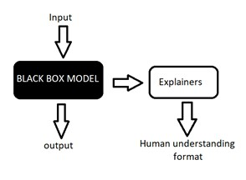
Introduction
4

Slide 5
Introduction
Explainability:
Global explainability: The model gets explained whole
Local explainability: The model will be judged on a particular the samples in the data
Explainers:
Model – agnostic: For any type of the models.
Model – specific: For specific type of models.
5

Slide 6
Existing explainers
Explainer's predictions and classifications on given text.
Text: name -year-old evaluated and examined pediatric oncology clinic today accompanied his mother name was last seen this clinic date for chemotherapy name does not report vomiting after his chemotherapy one day ago and new problems name has been adherent with oral chemotherapy home with prednisone tablets times day.
6

Slide 7
Existing explainers
SHAP (SHapley Additive exPlanations):
Optimal credit allocation with local explanations using the classic Shapley values from game theory.
A game theory is a decision-making strategy among the competing players(features) for payoffs( importance) as per the contribution in the game (model decision).
Shapley values: In a game, the shapley value is the average of the marginal contribution across all possible permutations.
7

Slide 8

Existing explainers
SHAP (SHapley Additive exPlanations):
8

Slide 9
Existing explainers
LIME (Local Interpretable Model-Agnostic Explanations):
LIME tweaks the input. By presenting the features in the model decision and removing to estimate the feature importance.
LIME works more accurately for linear models compared to nonlinear functions.
LIME more complex for nonlinear functions because it assumes the function as linear.
9

Slide 10
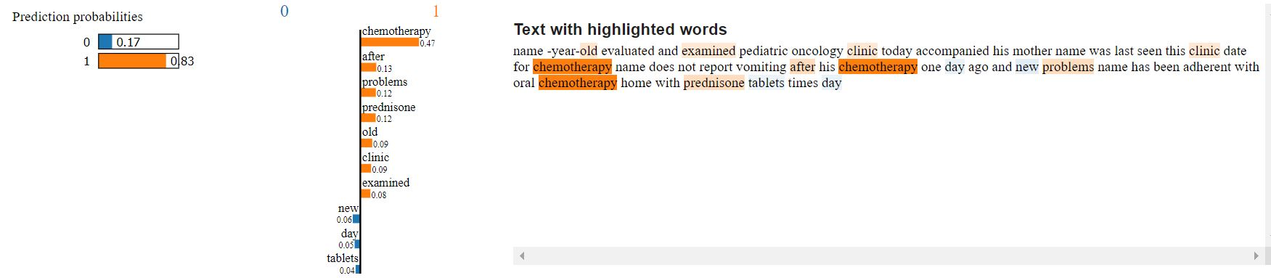
Existing explainers
LIME (Local Interpretable Model-Agnostic Explanations):
10

Slide 11
Existing explainers
ELI5 (explain like I am 5):
ELI5 provides the contribution weights to explain the features which impacts the model outcomes.
This is model agnostics which supports multiple type of model’s explanations.
ELI5 uses the scikit-learn.
11

Slide 12
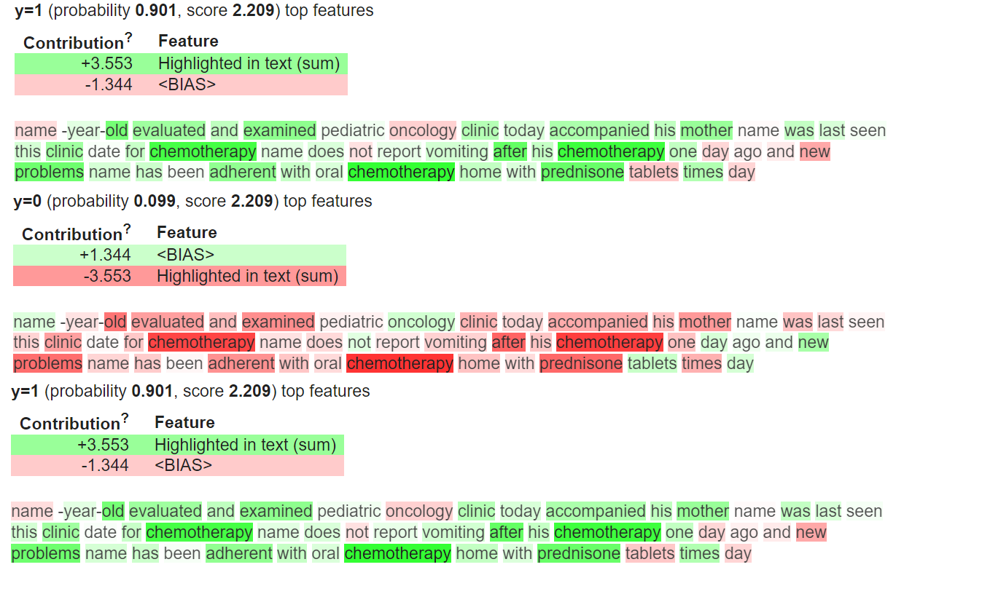
Existing explainers
ELI5 (explain like I am 5):
12

Slide 13
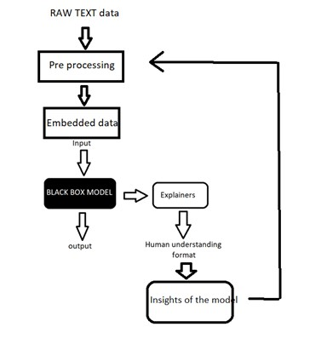
Proposed architecture
13

Slide 14
Experiments
Data set: Medical Adverse Drug Reaction(MADE).
Text data transformation with Word embeddings.
Train the model and form confusion matrix.
Our main concentration is on False positive and False negative.
Process the observations with explainers and extract the probabilities.
14

Slide 15
Experiment-1
Process all False positive and False negative observations.
Extract important features from all observations.
Negative probabilities represent on category.
Positive probabilities represent another category.
We consider only opposite categories from False positive and False negative observations.
15

Slide 16
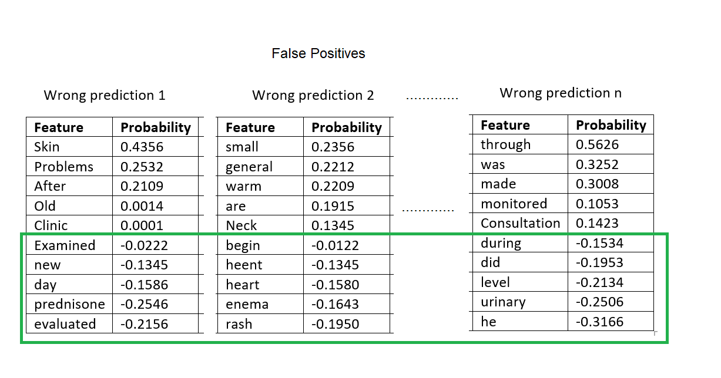
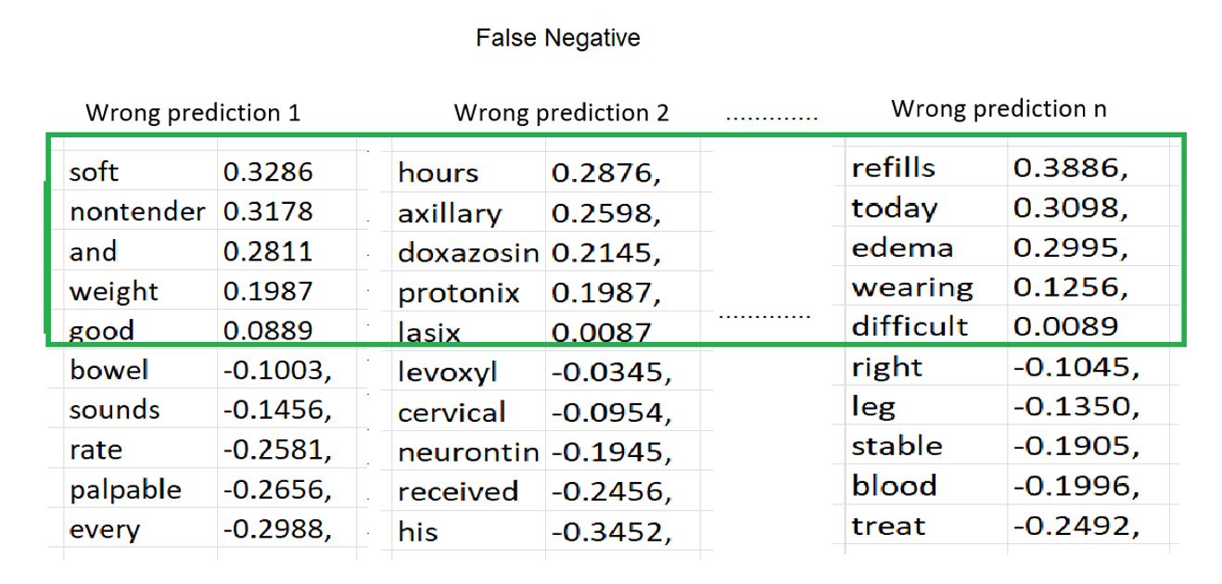
Experiment-1
16

Slide 17
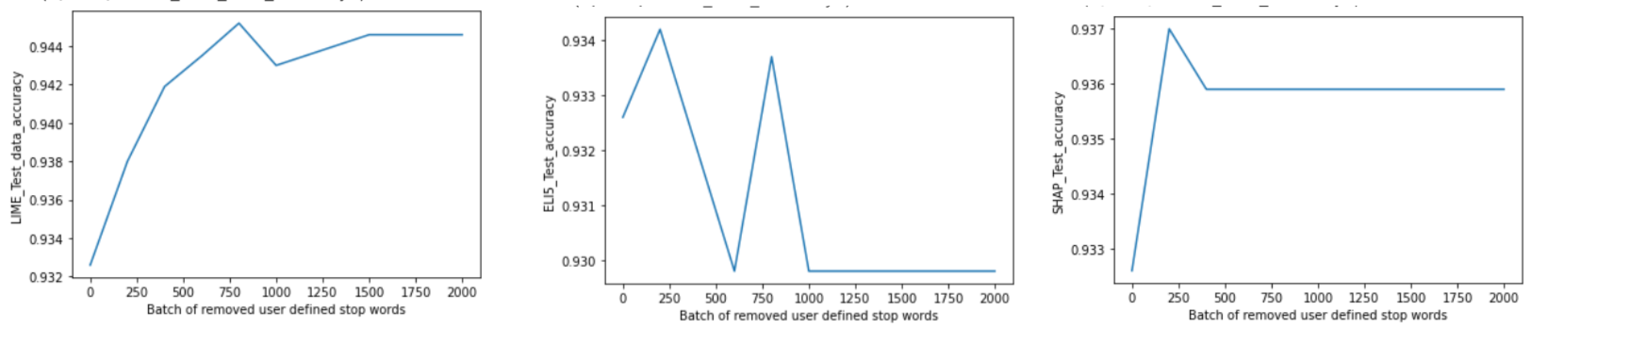
Experiment-1
17

Slide 18
Experiment-2
Same as experiment-1 process all False positive and False negative observations.
Extract important features from all observations.
The main difference is train the model on each iteration and update the list of FP and FN.
This experiment is mainly to reduce the one category( FP or FN) of observations.
18

Slide 19
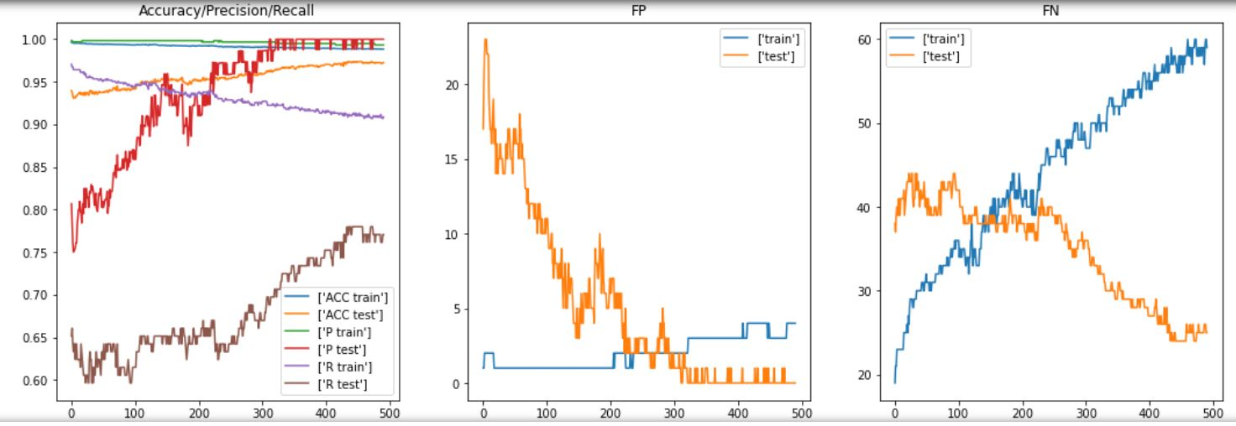
Experiment-2
19

Slide 20
Conclusion
This is one of the research directions which can helps to improve the model performance.
There are multiple possibilities are available to experiment based on the dataset and requirements.
Thanks to existing explainers which plays crucial role in these experiments.
With the explainers not only black box models can be explained but also helps in improving the performance.
20

Slide 21
Thank you
21

Slide 22
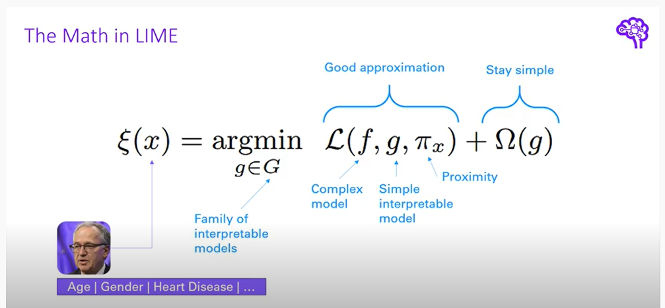
Thank you
22

Slide 23
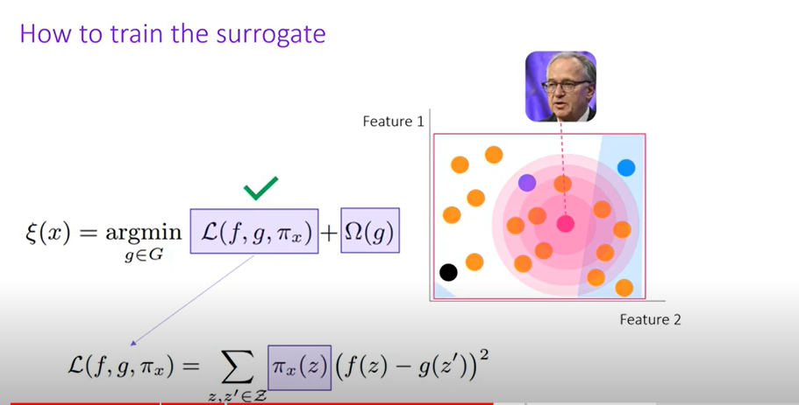
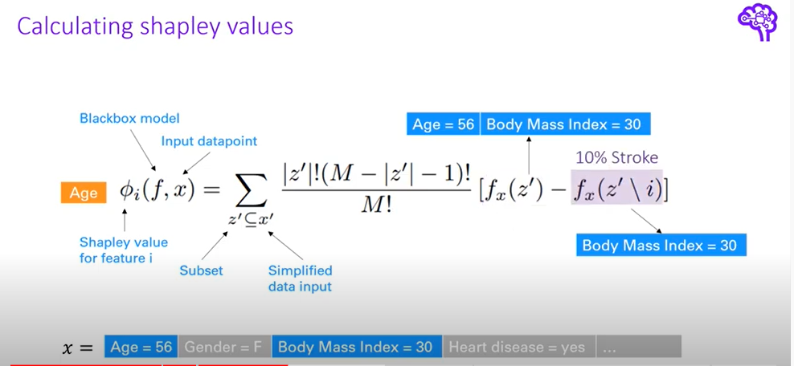
Thank you
23

Slide 24
Thank you
24

