Slide 1
RETAIL ANALYTICS • PYTHON • MYSQL • POWER BI
Customer Shopping Behavior Analysis
Turning 3,900 transactions into a growth strategy for sales, engagement, and loyalty
Presentation | July 2026

Slide 2
AGENDA
What we'll cover
01
Business Problem
Why this analysis matters to the business
02
Methodology
Python → MySQL → Power BI pipeline
03
Key Findings
What the data reveals about customers
04
Recommendations
Actions to drive growth and loyalty
05
Next Steps
Turning insight into an ongoing process
2 / 14

Slide 3
THE CHALLENGE
Business Problem
Management has noticed shifting purchasing patterns across demographics, categories, and channels.
“How can the company leverage consumer shopping data to identify trends, improve customer engagement, and optimize marketing and product strategies?”
Leadership wants to know which factors — discounts, reviews, seasonality, payment method — drive purchase decisions.
The goal: identify what drives repeat purchases and long-term loyalty, not just a single sale.
3 / 14

Slide 4
METHODOLOGY
One pipeline, three tools
PY
MY
PO
PYTHON
MYSQL
POWER BI
Data Preparation
Data Analysis
Visualization
Cleaned 3,900 records: imputed missing ratings, standardized schema, engineered age_group and purchase_frequency_days features.
12 SQL queries covering revenue, segmentation, product performance, and loyalty — run against the customer table.
Two-page interactive dashboard with slicers for category, season, subscription, and gender.
4 / 14

Slide 5
METHODOLOGY — PYTHON
Cleaning & feature engineering
Missing values
37 blank Review Rating entries filled using the median rating within each product category.
Schema cleanup
Columns lower-cased & snake_cased; “Purchase Amount (USD)” renamed to purchase_amount.
age_group feature
Age split into 4 quartile bins: Young Adult, Adult, Middle-aged, Senior.
purchase_frequency_days
Frequency labels (Weekly, Monthly, ...) mapped to numeric day counts for recency analysis.
Redundancy removed
promo_code_used found identical to discount_applied in every row — dropped to avoid duplicate signals.
5 / 14

Slide 6
METHODOLOGY — MYSQL
12 queries answering real business questions
Revenue by gender & age group
High-value discount shoppers
Who drives the most revenue?
Which customers spend big and expect a deal?
Top 5 rated products
Subscriber vs. non-subscriber economics
What should we merchandise as customer favorites?
Count, avg spend & revenue by subscription status
New / Returning / Loyal segmentation
Top 3 items per category & repeat buyers
Where is each customer in their lifecycle?
What are the hero SKUs, and who keeps coming back?
6 / 14

Slide 7
KEY METRICS
The business, at a glance
3.9K
$59.76
$233K
3.75
Customers Analyzed
Avg. Purchase Amount
Total Revenue
Avg. Review Rating (/5)
Source: cleaned customer_shopping_behavior dataset (3,900 rows) — KPI cards from the Power BI dashboard
7 / 14

Slide 8
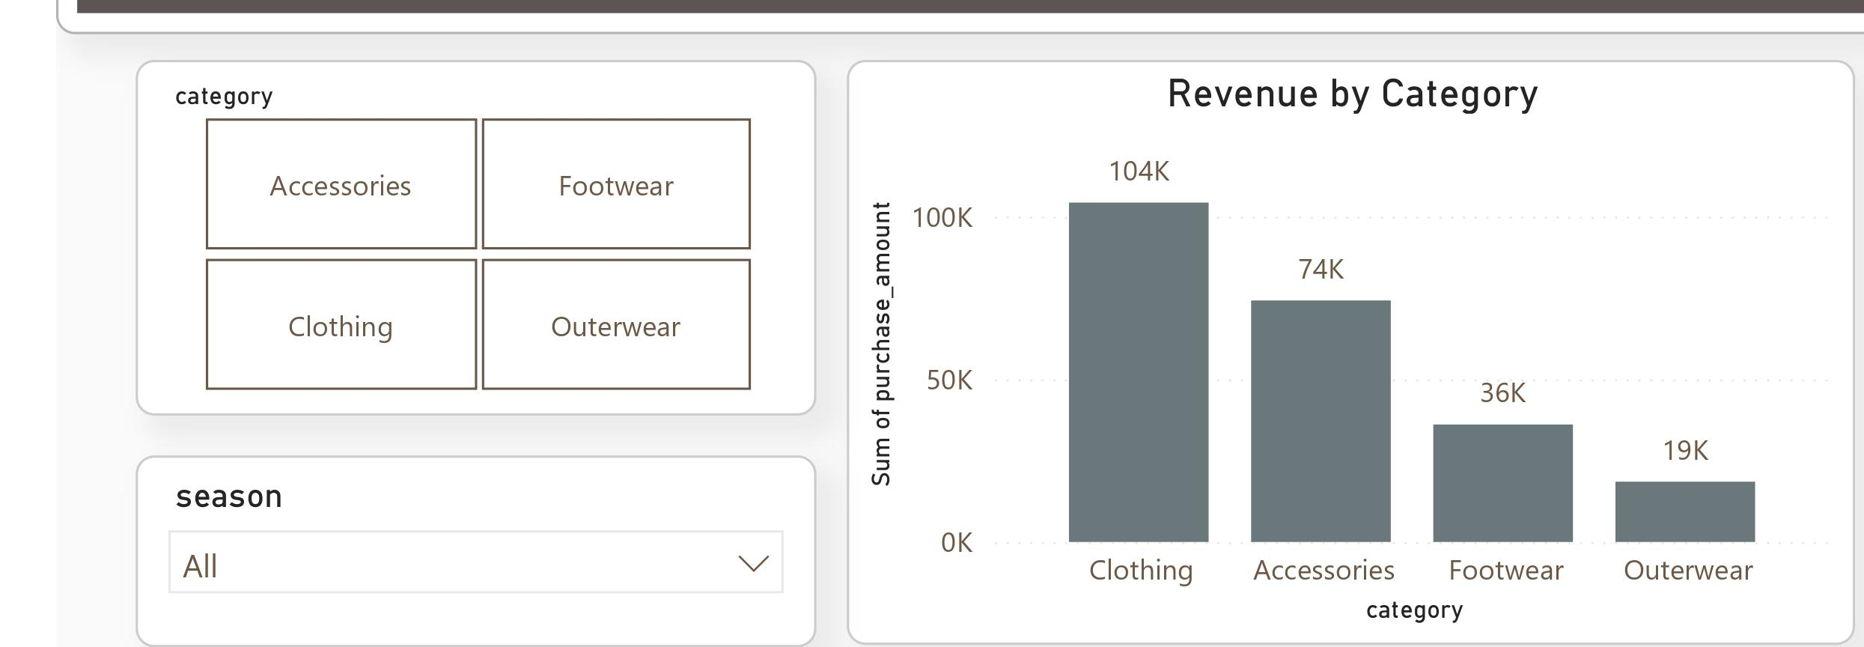
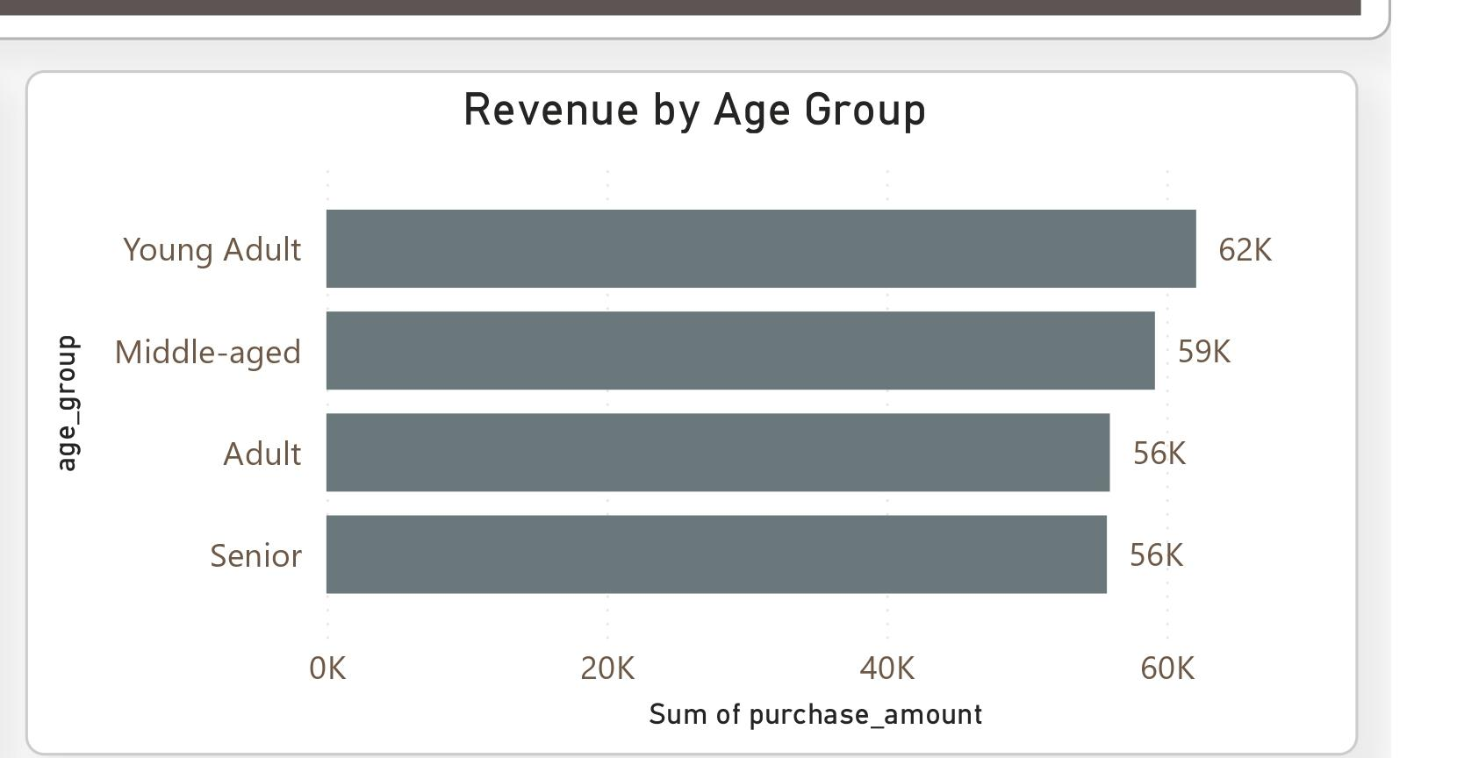
KEY FINDINGS
Clothing leads; age groups spend evenly
Clothing generates $104K — about 45% of total revenue — more than Accessories, Footwear, and Outerwear combined.
Young Adults lead at $62K, but revenue is fairly balanced across all four age bands ($56–$62K each).
8 / 14

Slide 9
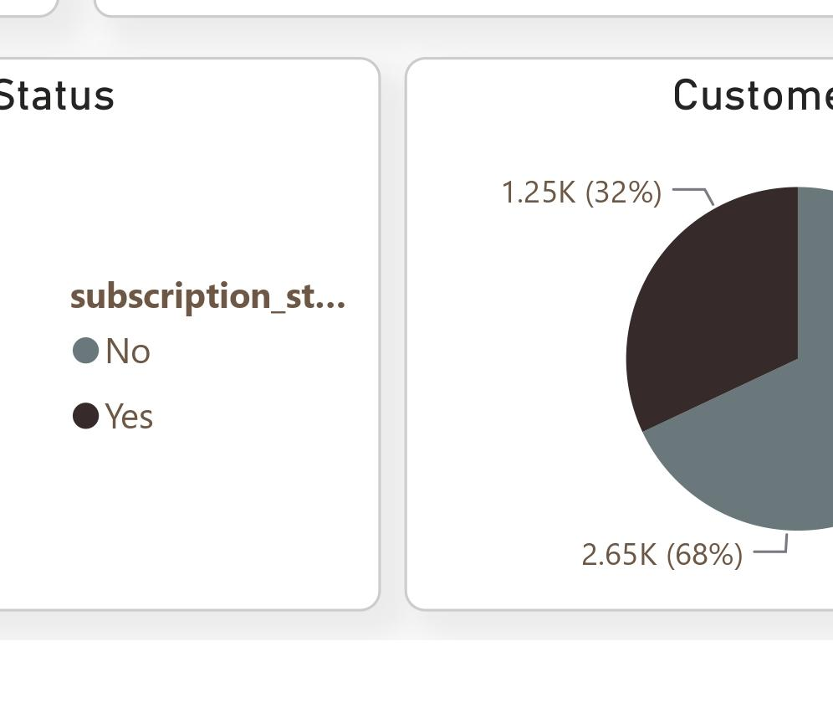
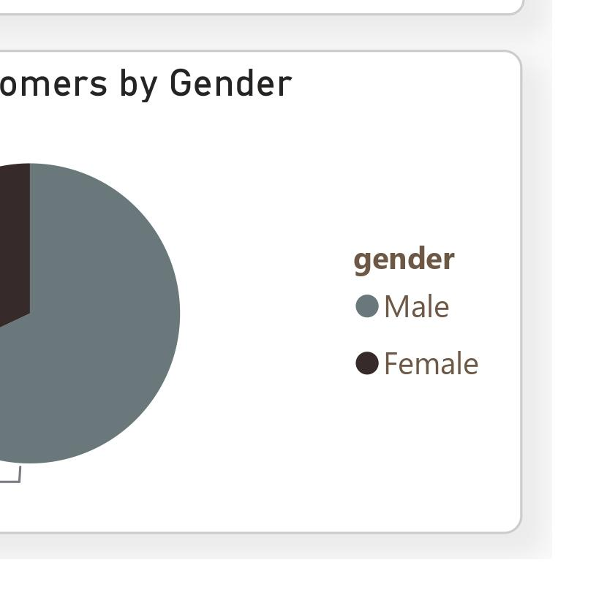
KEY FINDINGS
The biggest growth lever: subscriptions
73%
of customers are NOT enrolled in the subscription program — the single largest untapped growth opportunity in this analysis.
68% / 32%
male-to-female split — an opportunity to broaden reach with female shoppers.
9 / 14

Slide 10
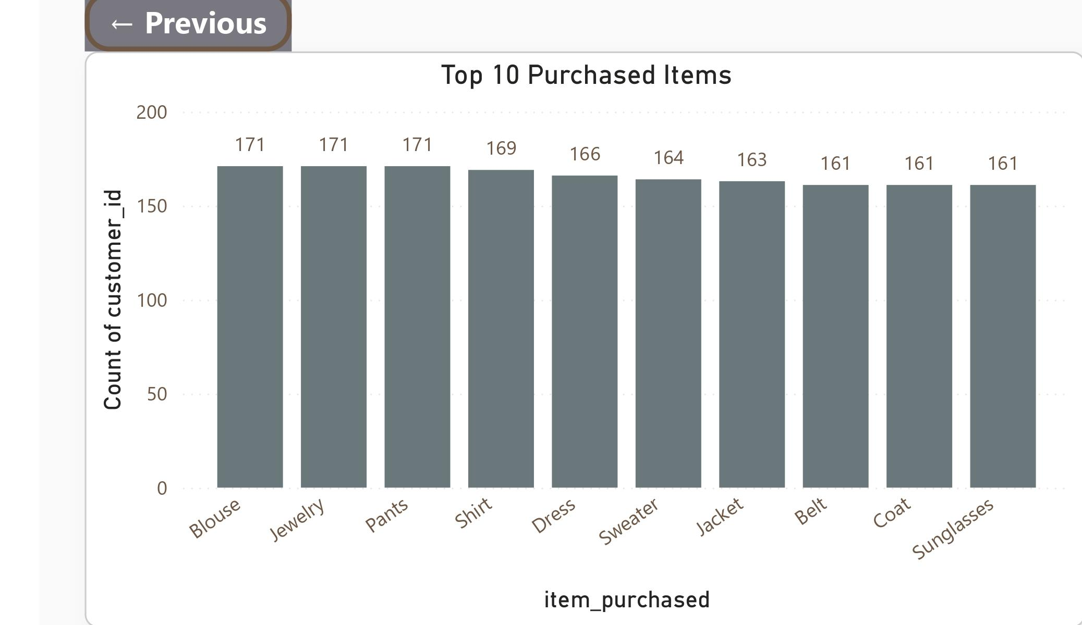
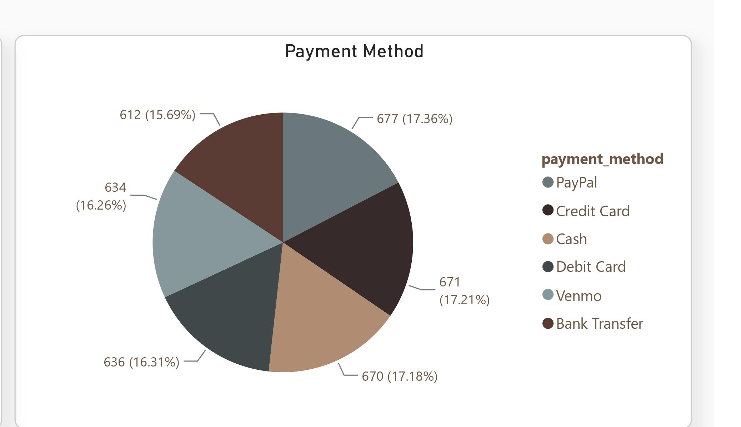
KEY FINDINGS
A balanced product & payment mix
Payment methods are used almost equally (15.7%–17.4% each) — every channel must be supported without friction.
Blouse, Jewelry, and Pants lead at 171 units each — the top 10 items cluster tightly (161–171 units), showing a broad product mix with no single dependency.
10 / 14

Slide 11
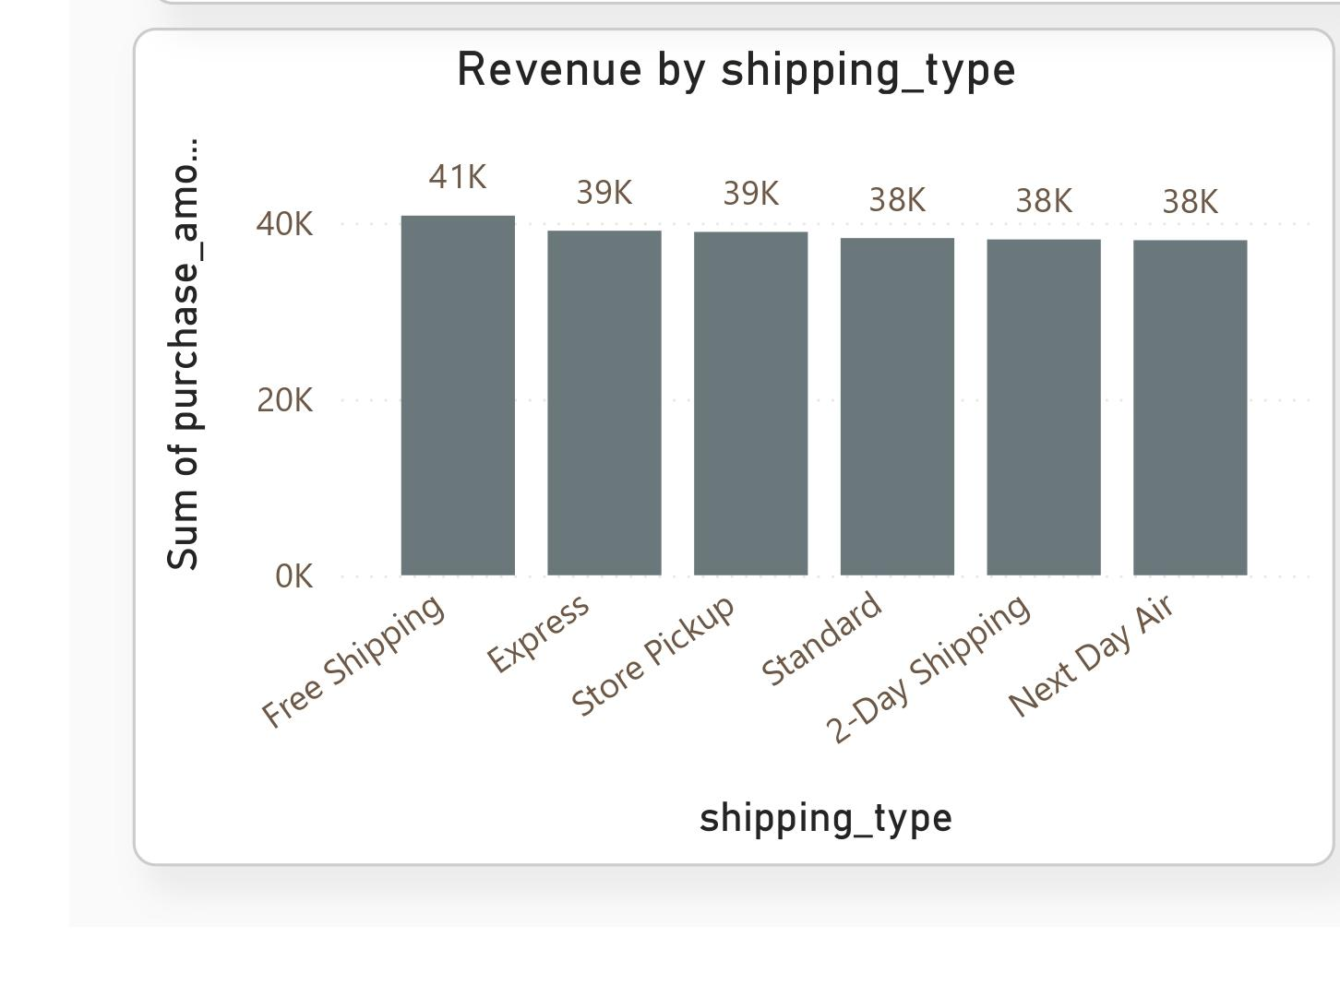
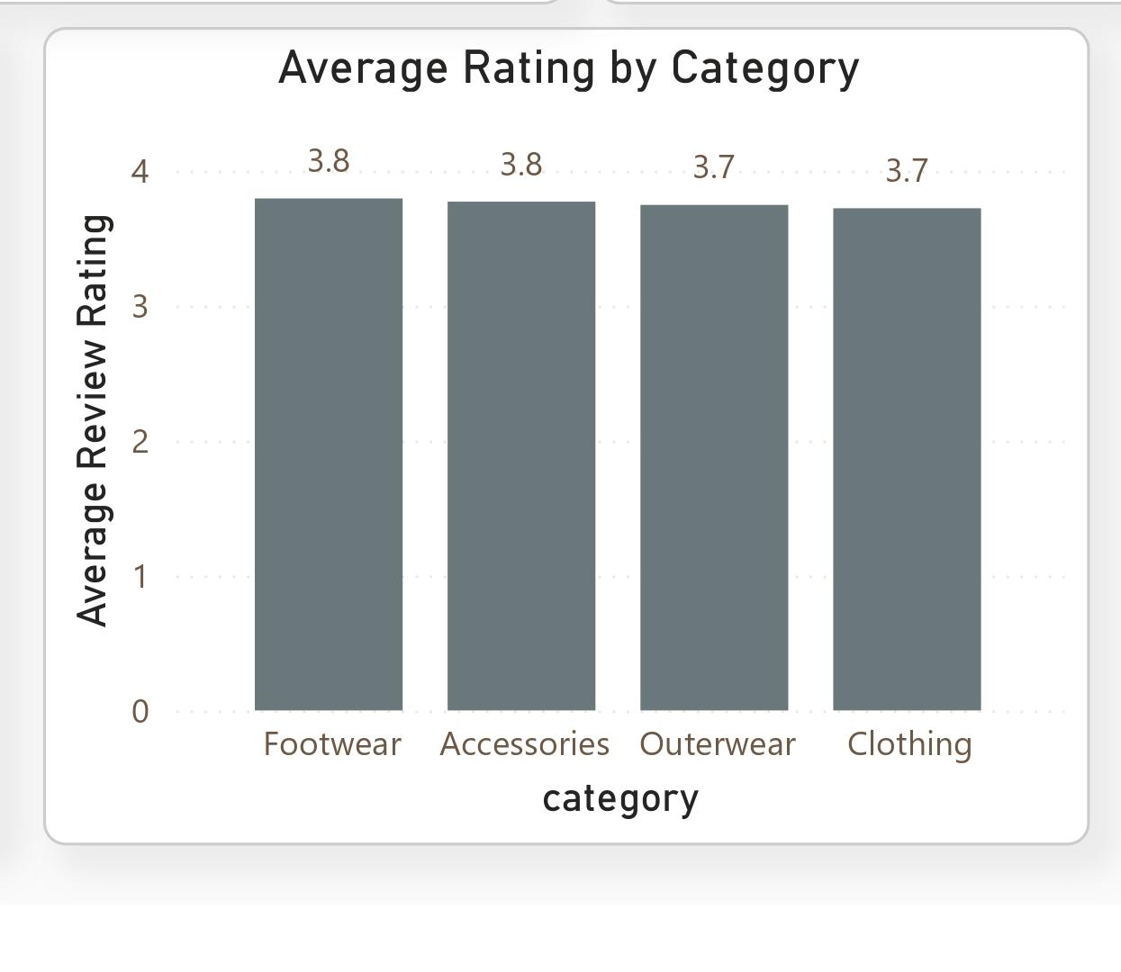
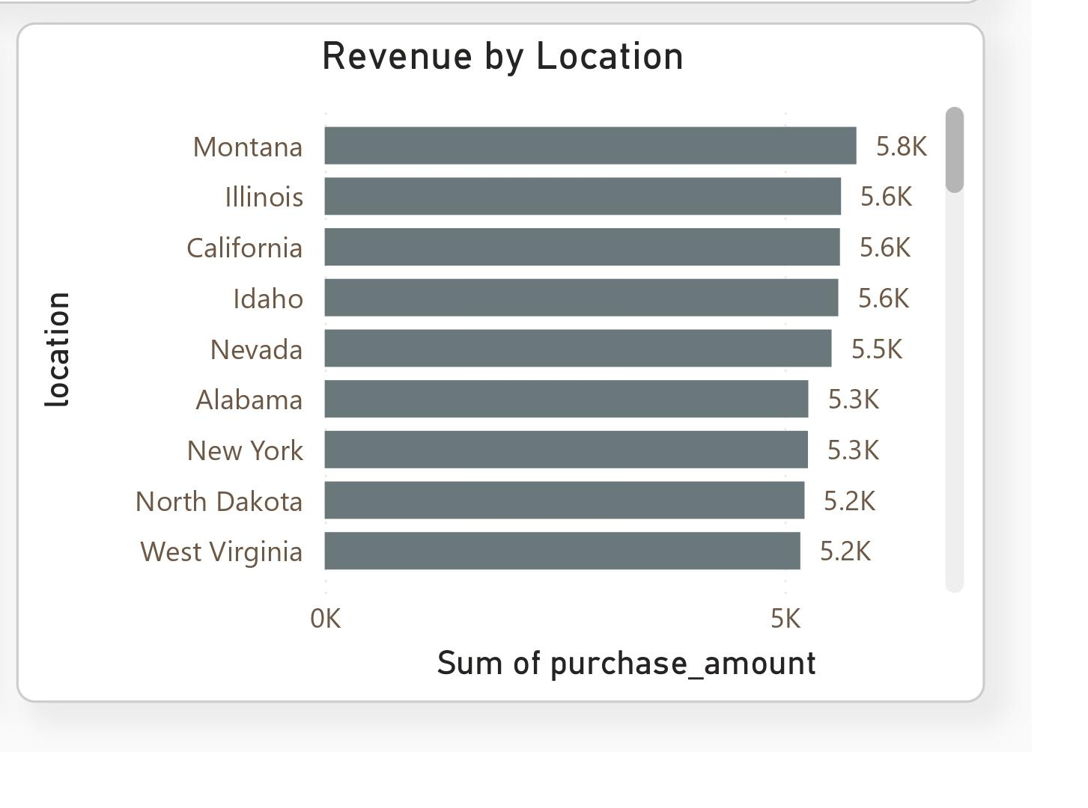
KEY FINDINGS
Shipping, satisfaction & geography
Free Shipping leads revenue ($41K)
Revenue is broadly national — top 10 states range only $5.2–$5.8K
Ratings are consistent across categories (3.7–3.8)
11 / 14

Slide 12
RECOMMENDATIONS
Five moves to grow sales & loyalty
1
Grow subscriptions
Target the 73% unsubscribed base with an enrollment incentive — the single biggest lever.
2
Protect & extend categories
Keep Clothing strong; test bundling/promotion to lift Footwear & Outerwear.
3
Broaden gender reach
Evaluate assortment and campaigns to grow the under-represented female segment.
4
Support every channel
Maintain frictionless payment & shipping options across all six payment methods.
5
Merchandise by data
Feature top-rated products; run lifecycle campaigns for New, Returning, and Loyal segments.
12 / 14

Slide 13
NEXT STEPS
From insight to an ongoing process
1
2
3
4
A/B test subscription incentive
Add cohort/retention SQL query
Layer in marketing spend data
Automate the pipeline
Measure lift in repeat-purchase rate from a conversion offer.
Track subscriber vs. non-subscriber purchase frequency over time.
Compute ROI per campaign, category, and demographic segment.
Schedule Python → MySQL → Power BI refresh so the dashboard stays current.
13 / 14

Slide 14
Thank You
Questions & discussion welcome
Full detail available in the Project Report, SQL scripts, notebook, and Power BI dashboard.

