Slide 1
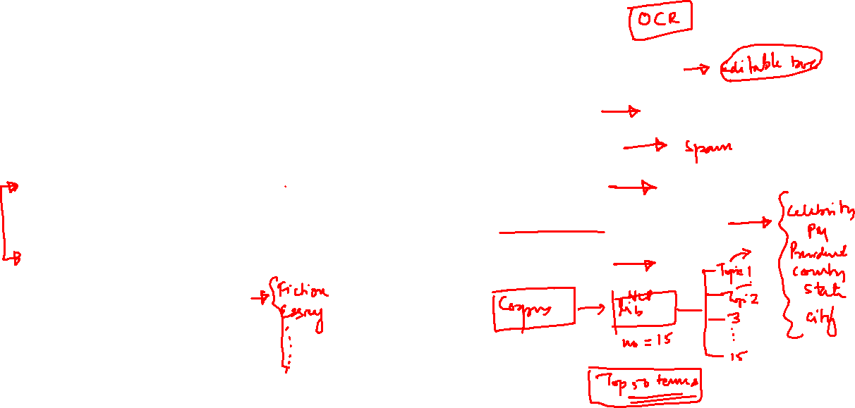
Applications of NLP
Machine Translation.
Speech Recognition
Sentiment Analysis
Question Answering
Summarization of Text
Chatbots
Text Classifications
Character Recognition
Spell Checking
Spam Detection
Autocomplete
Named Entity Recognition
TopicModelling

Slide 2
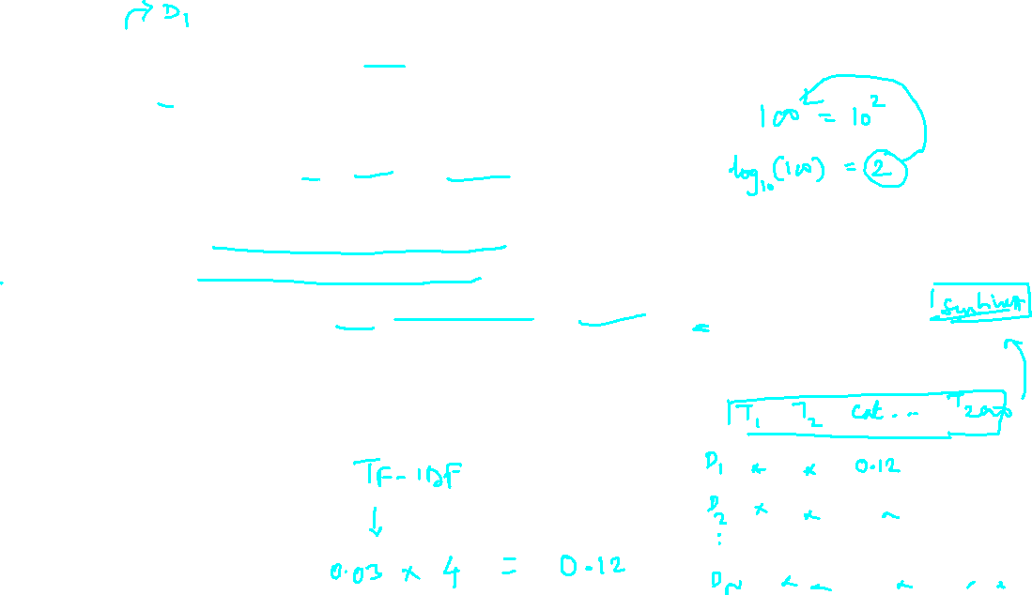
Consider a document containing 100 words wherein the word cat appears 3 times.
TERM FREQUENCY(TF) is (3 / 100) = 0.03.
Now, assume we have 10 million documents and the word cat appears in one thousand of these. The inverse document frequency IDF is calculated as log(10,000,000 / 1,000) = 4.
Thus, the Tf-idf weight is the product of these quantities: 0.03 * 4 = 0.12.

Slide 3
