Slide 1
Unsupervised Learning - Clustering

Slide 2








Agenda - Clustering
Fundamentals of unsupervised learning
Case study1 walkthrough
Fundamentals of clustering
Hierarchical clustering
Data pre- processing for clustering
Ca s e study 2
walkthrough
K-means
clustering
Clustering –
hands on

Slide 3


What is unsupervised learning?
No defined dependent and independent variables.
Patterns in the data are used to identify
/ group similar
observations

Slide 4





Supervised vs unsupervised learning
Supervised learning
Unsupervised learning
Clearly defined X and Y variables
Predict a continuous response (Regression)
categorical response (classification)
Unlabelled data
Emerging patterns based on similarity identified
Clustering
Association rules (market basket analysis)
6

Slide 5




What is clustering?
Heterogeneity between groups
SSB > SSW
Grouping objects
Homogeneity within groups
9

Slide 6



What is clustering?
Inter-cluster distances are maximized
Intra-cluster distances are minimized
This is classic case of Unsupervised learning

Slide 7





Why do we cluster?
Group records such that
Clustering results are used:
Similar to one another within the same cluster
Dissimilar to the objects in other clusters
As a stand-alone tool to get insight into data distribution
Visualization of clusters may unveil important information
As a preprocessing step for other algorithms

Slide 8





Cluster Analysis – Use cases
Image processing
Web
Market Segmentation
Market structure analysis
Finance
cluster images based on their visual content
Cluster groups of users based on their access patterns on webpages
Cluster webpages based on their content
customers are segmented based on demographic and transaction history information, and a marketing strategy is tailored for each segment
identifying groups of similar products according to competitive measures of similarity
cluster analysis can be used for creating balanced portfolios

Slide 9



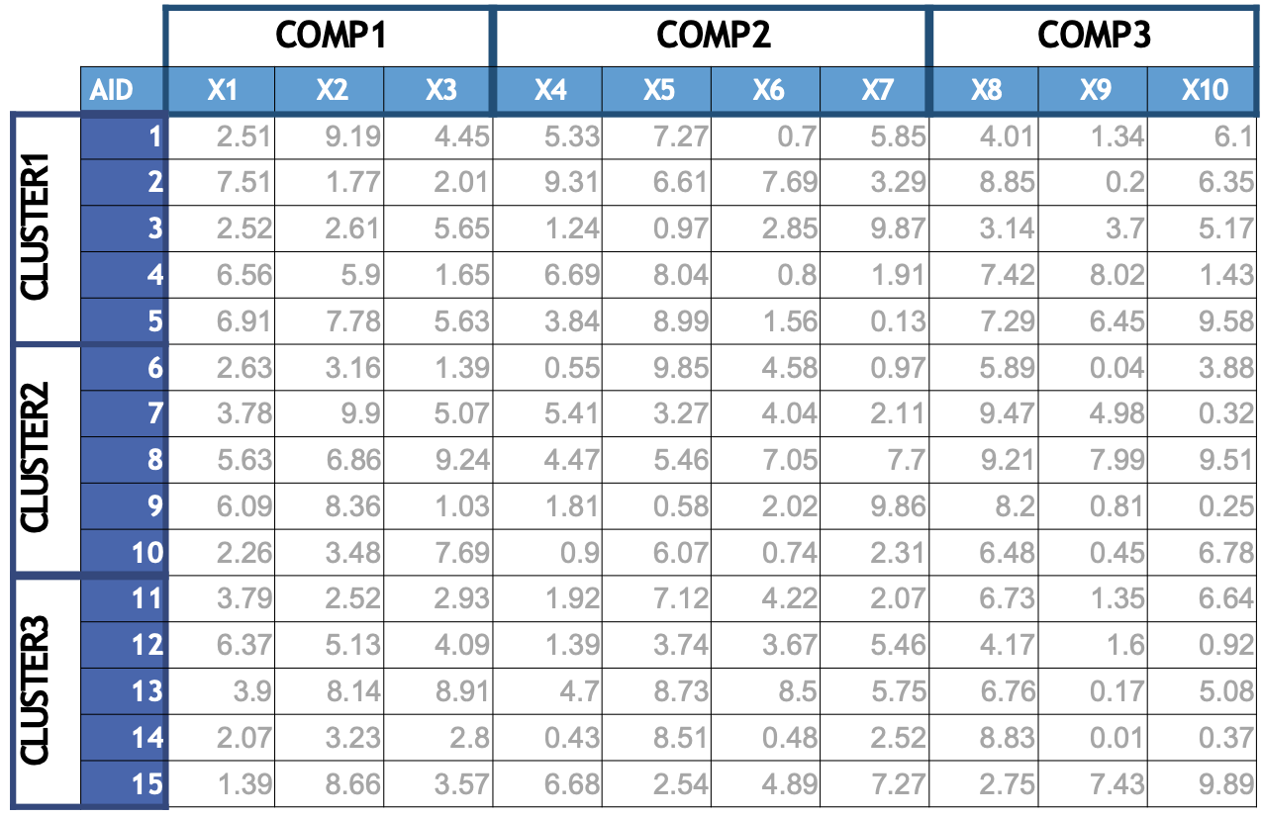



Clustering vs PCA
PCA – grouping variables that relate to each other
Clustering – Segment variables according to the distance between them.
Clustering
Grouping of similar rows
14

Slide 10






Role of cluster analysis
Data Reduction
Taxonomy description
Influence of cluster on Y variable
Classify observations into manageable groups
Exploratory
Confirmatory
What is the average sales from each customer segment?
How does churn % vary for each customer segment
15

Slide 11
The clustering task
Group observations so that the observations belonging in the same group are similar, whereas observations in different groups are dissimilar.

Slide 12
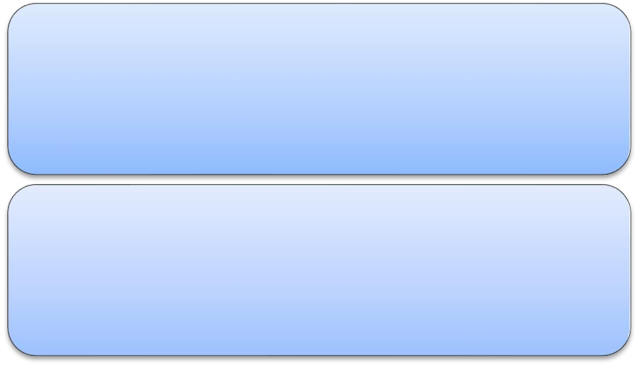


Observations to cluster - dimensions
Real-value attributes
Binary attributes
Nominal (categorical) attributes
Ordinal/Ranked attributes
salary, height
gender (M/F), has_cancer(T/F)
religion (Christian, Muslim, Buddhist, Hindu, etc.)
military rank (soldier, sergeant, lutenant, captain,
etc.)

Slide 13
Measuring similarity - Distances
Eucledian distance
Manhattan distance
Chebyshev distance

Slide 14
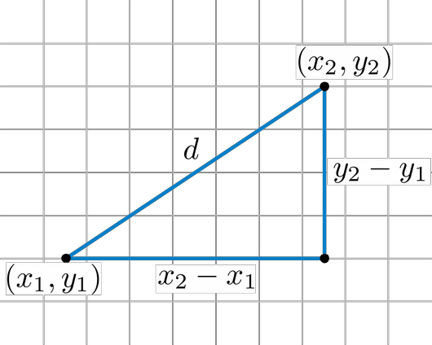
Euclidean distance
Where x₁ to x_{p} are the independent variables of i and j

Slide 15
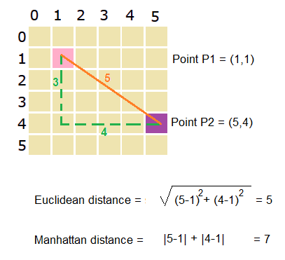
Manhattan distance (city –block distance)
Distance between the projection of points on the axis.

Slide 16
Chebyshev Distance (chessboard distance)
Max ( |x1-x2|, |y1-y2|, |z1-z2|, ….)

Slide 17
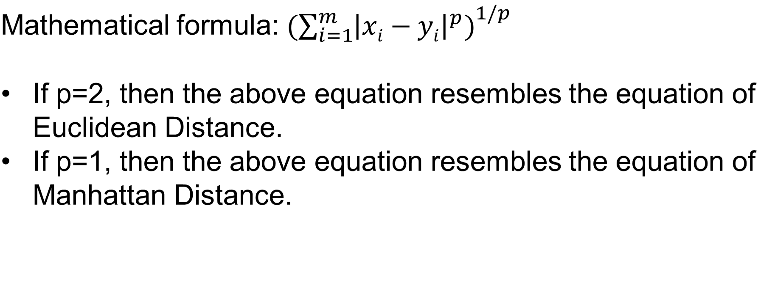
Minkowski Distance

Slide 18






Types of clustering
Agglomerative
Hierarchical
Divisive
Clustering
Partitioning
K-means

Slide 19




Clustering types
Agglomerative
clustering
Divisive approach
Partitioning
Bottom up approach
start with each object forming a separate group
It keeps on merging the objects or groups that are close to one another
Top down approach
start with all of the objects in the same cluster
a cluster is split up
into smaller clusters
constructs ‘k’ partition
of data
Each partition will represent a cluster and k ≤ n

Slide 20
Hierarchical clustering
Records are sequentially grouped to create clusters, based on distances between records and distances between clusters.
Hierarchical clustering also produces a useful graphical display of the clustering process and results, called a dendrogram.

Slide 21
Strengths of Hierarchical Clustering
No assumptions on the number of clusters
Any desired number of clusters can be obtained by ‘cutting’
the dendrogram at the proper level
Hierarchical clustering may correspond to meaningful taxonomies

Slide 22
Disadvantages of Hierarchical clustering
Time complexity: not suitable for larger data sets.
Very sensitive to outliers

Slide 23




Hierarchical clustering - Steps
Start with n clusters where each record will be a cluster
Two closest records are merged into a cluster
At every step, two closest clusters with smallest distance are merged
Either single records are added to existing clusters or
Two existing clusters are combined
Repeat till there is a single cluster that includes all the records

Slide 24
Dendrograms
A dendrogram is a treelike diagram that summarizes the process of clustering
On the x-axis are the records
Similar records are joined by lines whose vertical length reflects the distance between the records
the greater the difference in height, the more dissimilarity
By choosing a cutoff distance on the y-axis, a set of clusters is created

Slide 25
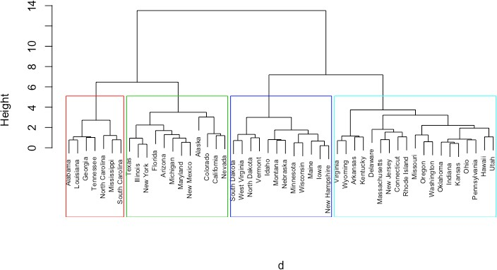

Dendrograms
31

Slide 26
Distance between two clusters
Each cluster is a set of points
How do we define distance between two sets of points

Slide 27
Hierarchical clustering – Distance between clusters
Linkage types
Single linkage
Complete linkage
Average linkage
Centroid linkage
Ward’s Method

Slide 28
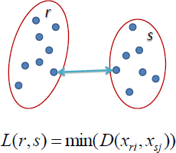
Single Linkage
Distance between two clusters is defined as
the shortest distance between two points in each cluster.

Slide 29
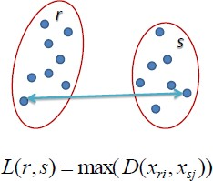
Complete linkage
Distance between two clusters is defined as
the longest distance between two points in each cluster.

Slide 30
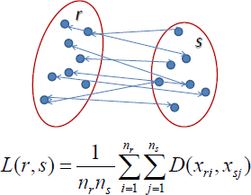
Average linkage
Distance between two clusters is defined as the average distance between each point in one cluster to every point in the other cluster.

Slide 31

Centroid linkage
Based on centroid distance. clusters are represented by their mean values for each variable, which forms a vector of means.
Distance between 2 clusters is distance between the 2 vectors

Slide 32

Ward’s linkage
Similar to group average and centroid distance
joins records and clusters together progressively to produce larger and larger clusters, but operates slightly differently from the general approach.

Slide 33
Hierarchical Clustering: Comparison
5
1
4
1
3
2
5
5
5
2
1
2
MIN
MAX
2
3
6
3
6
3
1
4
4
4
5
1
2
5
2
3
6
Group Average
3
1
4
4

Slide 34
K-MEANS CLUSTERING

Slide 35
K-means Clustering
A non-hierarchical approach to forming good clusters is to pre-specify a desired number of clusters, k
Assign each record to one of the k clusters, according to their distance from each cluster
So as to minimize a measure of dispersion within the clusters
The ‘means’ in the K-means refers to averaging of the data; that is, finding the centroid
K-means clustering is widely used in large dataset applications

Slide 36













How does k-means clustering work?
Derive # of clusters
using scree plot
Specify value of K
Partition dataset to K initial clusters
Assign each record to cluster with nearest centroid
Yes
Recalculate centroids for losing and receiving clusters
Do reassignments occur?
No
Finalise clusters

Slide 37





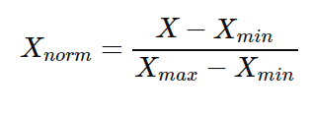
Scaling – Z scaling & Min-max scaling
Z Scaling
Min Max scaling
Features will be rescaled
Have the properties of a standard normal distribution
μ=0 and σ=1
The data is scaled to a fixed range - 0 to 1.
The cost of having this bounded range - smaller standard deviations, which can suppress the effect of outliers

Slide 38



Where is scaling used?
k-nearest neighbors
Perceptron, Neural networks
k-means
Principal component analysis

Slide 39
Validating Clusters
The resulting clusters should be valid to generate insights
Cluster interpretability
Cluster stability
Cluster separation
Number of clusters

Slide 40


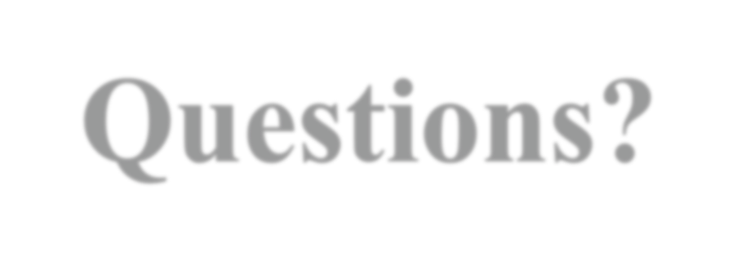
Questions?

