Slide 1
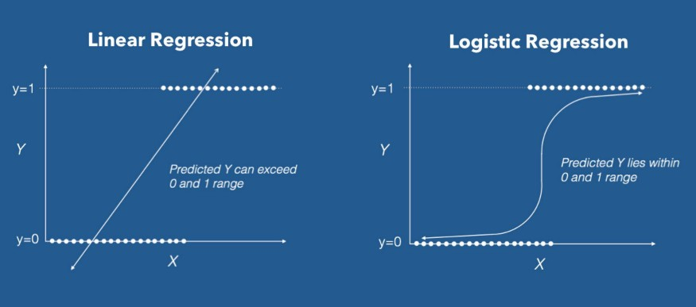

Slide 2
Assumptions of Logistic Regression
Dependent Variable is Categorical
Log odds should be linearly related to independent variables
Independent variables should not be correlated(no/low multi collinearity
Linear regression requirements like homscedasticity, normal distribution of error terms, linear relation between target feature and independent features are not required here.

Slide 3
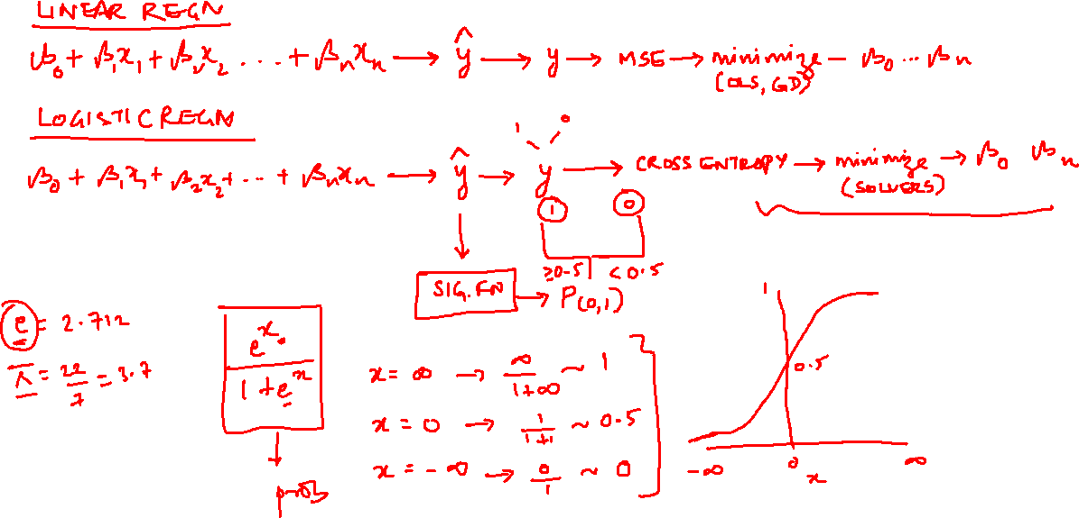

Slide 4
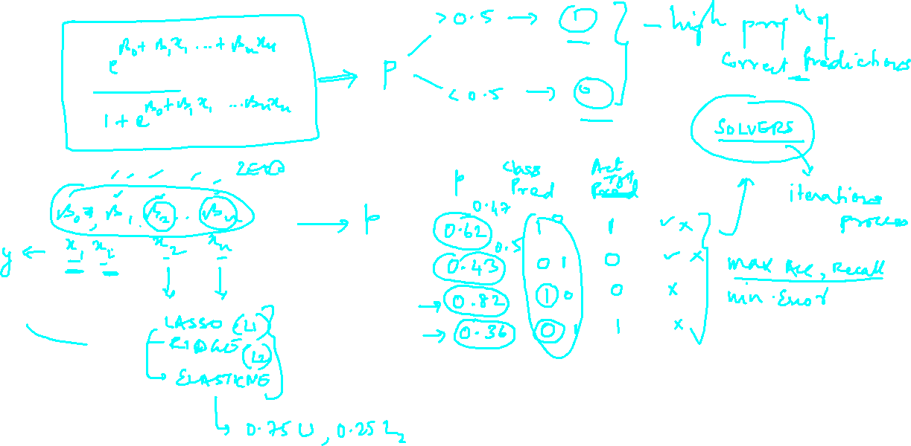

Slide 5
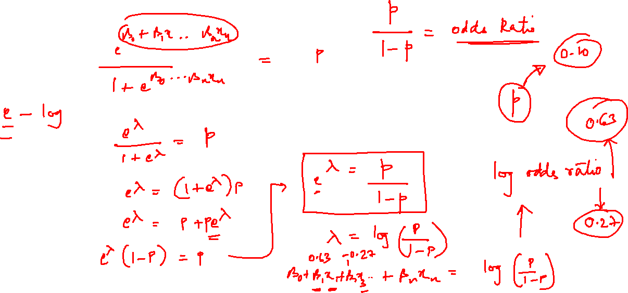

Slide 6
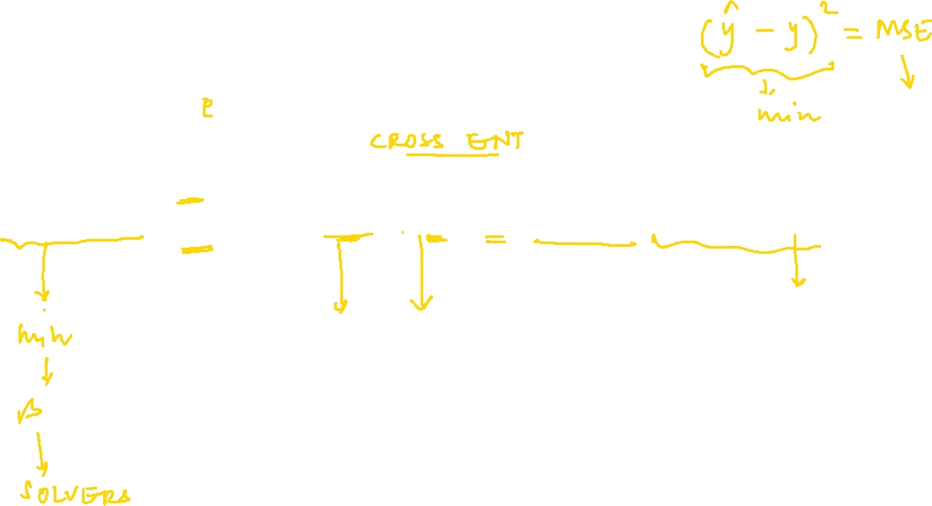
Assumptions of Logistic Regression

