Slide 1
Statement of Work
ByteXL-Parul University-Project execution

Slide 2
Financial Analysis
Team Name : Team Blue
Mentor : Prof Pravindra Kumar Gole
Team Members: 1. Kamutam Sainandu
2. Kotha Vishwak
3. Chinthapula Sharath Kumar
4. Kanneganti Neharsha Vishnu
5. Kamparaju Siddharth
6. Janjanam Nithin Teja
Team Lead : Kamutam Sainandu

Slide 3
Summary
The financial Analysis project aims to develop a comprehensive system to centralize, retrieve, and manage financial data and transaction history. The system ensures data accuracy and integrity, supports real-time transaction tracking, and provides robust reporting and analytics capabilities.
By using latest technologies and best practices in data management and compliance, the project reduces risk, reducing and managing expenditure , graphical representation of profit and loss and supports decision-making. The outcomes include improved financial decision making, enhanced user satisfaction, ultimately contributing to the organization's strategic objectives and competitive advantage.

Slide 4
Project Scope
Realtime Transaction Tracking
Data Centralization
Financial Analysis
Graphical Representation
Security and Access Control
Simple User Interface
Integration with Existing System

Slide 5
Work Breakdown
Name | Roles & Responsibilities
K. Sainandu | Backend, Creating dummy data and Integration
K. Vishwak | Backend, Collecting data and Documentation
K. Neharsha Vishnu | Providing insights and Analysis
Ch. Sharath Kumar | Frontend and Documentation
K. Siddharth | Frontend- Developing User Interface
J. Nithin Teja | Frontend- Developing Graph Visualization

Slide 6
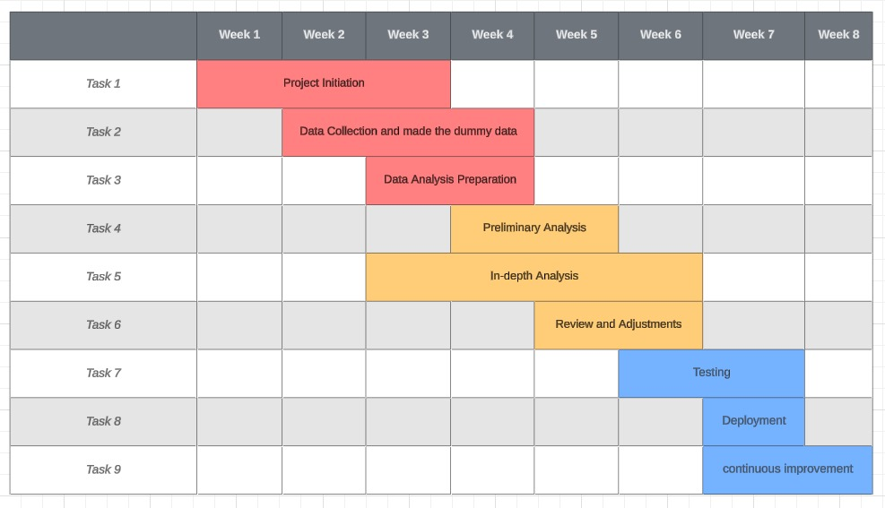
Milestones

Slide 7
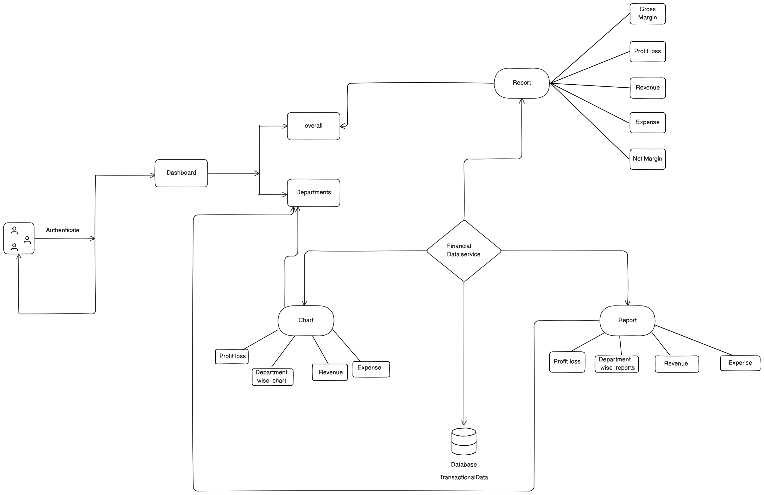
System Design/ Architecture

Slide 8
System Requirements
Software Requirements :
Database Management System : MySQL
Programming Language : Python (backend), React(FrontEnd)
Frameworks : Flask
Middleware
Monitoring Tools
Hardware Requirements :
Storage
Digital Device
Backup Systems

Slide 9
Deliverables
Internal
External
Bug report Gantt chart | Internal client onboarding Initial design project and project management plan for clients to review
Complete content strategy Finalized blueprint | Fully developed webapp Monitoring and improvements
Process
Product

Slide 10
User Requirements
Roles and Permissions
User Interface
Notifications and Alerts
Accessibility
Easy Data manipulation
Graphical display
Security

Slide 11
Functional Requirements
Extract ,collect and Load
Transaction Tracking
Reporting and Analytics
Compliance and Auditing
Data Integration
Authentication and Authorization
Backup and Recovery
Data Privacy

Slide 12
List of All Inputs
User Inputs
Data Inputs
Data Entry
User Commands
User Preferences
Authentication Information
Financial Transactions
Account Information
Customer Data
Vendor Data
Historical Data
Development Inputs
Project plans
Design Specifications
Testing Plans

Slide 13
List of All Outputs
Financial Reports
Transaction Reports
Performance Reports
Profit and Loss Reports

Slide 14
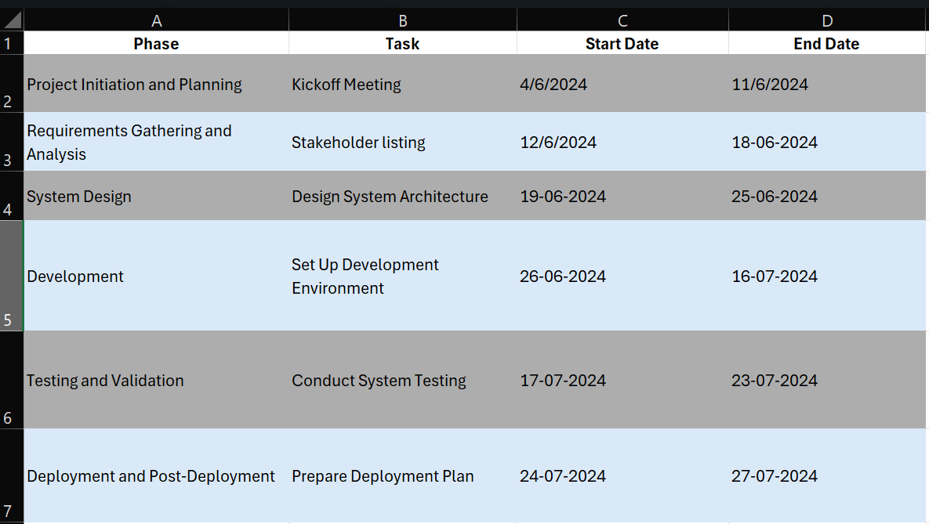
Schedule and Delivery plan
https://docs.google.com/spreadsheets/d/1LiL3LVLmr0IfnACWLJWhtdICsuCq5GsRwpKW1JyJOhc/edit?usp=sharing

