Slide 1
SMART WATER FOUNTAIN BY USING IOT
TEAM MEMBERS :-
1, SAINANTHAN.J(Leader)
2, YOGESH.A
3, RAGHUL PRASATH.SM
4, SUJITH.
5, SOUNDER.

Slide 2
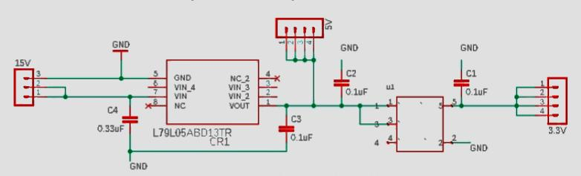
Circuit Diagram:

Slide 3
Certainly! A smart water fountain system typically involves several components to function effectively. Here's a simplified circuit diagram explanation of a basic smart water fountain system:
Water Pump: The heart of the system, the water pump, is responsible for circulating water through the fountain.
Water Level Sensor: A sensor is used to detect the water level in the fountain. It ensures that the pump operates only when the water level is above a certain threshold to prevent damage.
Microcontroller (e.g., Arduino or Raspberry Pi): The brain of the system, the microcontroller processes data from sensors and controls the operation of the water pump and other components.

Slide 4
Wi-Fi Module (e.g., ESP8266 or ESP32): This module enables the system to connect to the internet and communicate with other devices or applications, allowing for remote control and monitoring.
Mobile App/Cloud Server: The user interacts with the system through a mobile app or a web interface, allowing them to control the fountain remotely, monitor water levels, and set various parameters.
Relay Module: A relay module acts as a switch controlled by the microcontroller. It's used to turn the water pump on or off based on the input from the water level sensor and user commands from the app.
Power Supply: Provides the necessary power to the components in the circuit, usually with appropriate voltage and current ratings.

Slide 5
Program
class SmartWaterFountain: def __init__(self): self.water_level = 100 # Initial water level in the fountain def refill_fountain(self, amount): self.water_level += amount print(f"Water fountain refilled with {amount} liters. Current water level: {self.water_level} liters") def dispense_water(self, amount): if self.water_level >= amount: self.water_level -= amount print(f"Dispensed {amount} liters of water. Current water level: {self.water_level} liters") else: print("Not enough water to dispense.") if __name__ == "__main__": fountain = SmartWaterFountain()

Slide 6
while True: print("\n1. Refill Fountain") print("2. Dispense Water") print("3. Exit") choice = input("Enter your choice: ") if choice == '1': amount = int(input("Enter the amount to refill (liters): ")) fountain.refill_fountain(amount) elif choice == '2': amount = int(input("Enter the amount to dispense (liters): ")) fountain.dispense_water(amount) elif choice == '3': print("Exiting the program.") break else: print("Invalid choice. Please try again.")

Slide 7
Output
1. Refill Fountain 2. Dispense Water 3. Exit Enter your choice: 1 Enter the amount to refill (liters): 50 Water fountain refilled with 50 liters. Current water level: 150 liters 1. Refill Fountain 2. Dispense Water 3. Exit Enter your choice: 2 Enter the amount to dispense (liters): 30 Dispensed 30 liters of water. Current water level: 120 liters

Slide 8
1. Refill Fountain 2. Dispense Water 3. Exit Enter your choice: 2 Enter the amount to dispense (liters): 100 Not enough water to dispense. 1. Refill Fountain 2. Dispense Water 3. Exit Enter your choice: 3 Exiting the program.

Slide 9
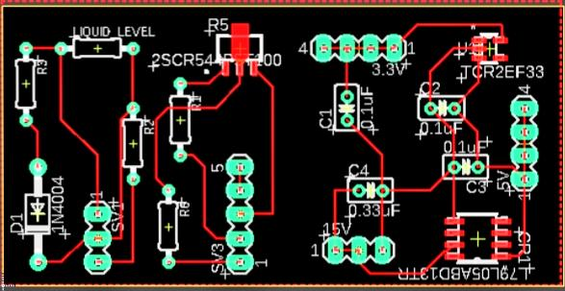
Mechanical Unit PCB Design:

Slide 10


