Slide 1
Product sales analysis Using Data analyst

Slide 2
Table of contents
Introduction
Project objective
Design thinking process
Development phase
Analysis objectives
Data collection
Data visualisation using IBM cognos
Derived actionable insights
Conclusion

Slide 3

Introduction
Product sales analysis is a critical process for businesses to understand how their products are performing in the market. Data analysts play a crucial role in this by collecting, processing, and interpreting data related to product sales. Here’s an overview of how product sales analysis is conducted by data analysts.
Product sales analysis is an ongoing process that helps businesses adapt to changing market conditions and make informed decisions to drive sales growth and profitability. Data analysts play a vital role in translating data into actionable insights that support the business's goals and strategies.

Slide 4

Project objective
These project objectives help guide the data analyst's work, ensuring that the analysis provides valuable insights and actionable recommendations to improve product sales and contribute to the overall success of the business.
When conducting a product sales analysis project with the involvement of a data analyst, it’s essential to define clear project objectives to ensure that the analysis serves its intended purpose effectively. Here are some typical project objectives for a product sales analysis.

Slide 5
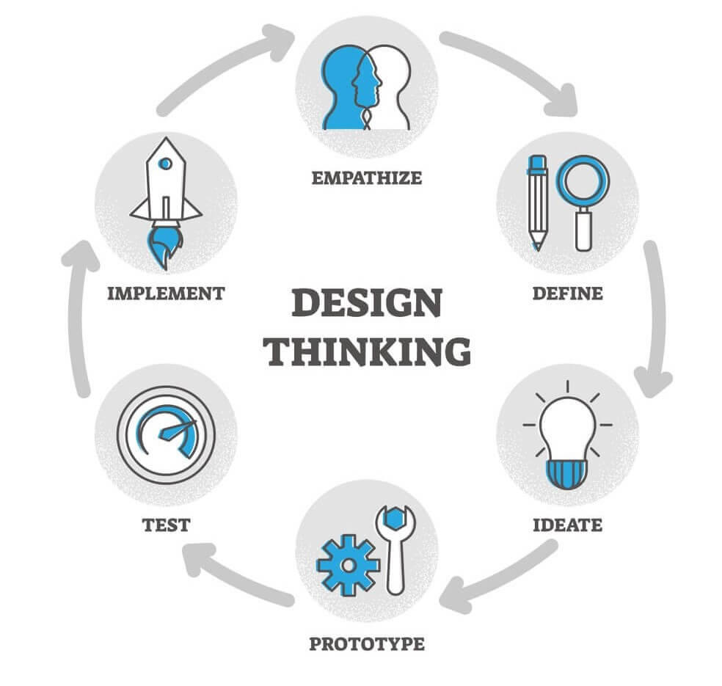
Design thinking process
Design thinking is a problem-solving and innovation methodology that focuses on understanding and addressing user needs and challenges in a creative and user-centric way. It is a structured, human-centered approach that encourages collaboration, empathy, and iterative thinking.
The design thinking process typically consists of several stages
Empathize
Define
Ideate
Prototype
Test
Implementation

Slide 6

Stage 1 :Empathize
“Empathize” is the first stage in the design thinking process, a human-centered approach to problem-solving and innovation. This stage involves understanding and empathizing with the people for whom you are designing a product, service, or solution.
The goal of the empathize stage is to gain a deep and genuine understanding of the users’ needs, desires, challenges, and motivations.
In this initial stage, the focus is on understanding the problem from the user’s perspectiveDesign thinkers engage in empathetic activities, such as conducting interviews, surveys, and observations, to gain deep insights into the user’s experiences, emotions, and pain points. The goal is to develop a genuine understanding of the user’s needs and motivations.

Slide 7

Stage 2 :Define
Once a comprehensive understanding of the user’s perspective is established, the next step is to define the problem. This involves synthesizing the information gathered during the empathy stage and framing it as a clear and concise problem statement or design challenge. It sets the foundation for the rest of the process.
“Define” is the second stage in the design thinking process. In this stage, the focus is on precisely defining the problem or challenge that you aim to address.
While the “Empathize” stage is about understanding the users and their needs, “Define” involves synthesizing the insights gathered during empathy to create a clear and actionable problem statement. Here’s a more detailed explanation of the “Define” stage.

Slide 8

Stage 3 : Ideate
Ideation is the creative phase where design thinkers brainstorm and generate a wide range of potential solutions to the defined problem. This stage encourages thinking outside the box, and no idea is considered too wild or unfeasible. Techniques like brainstorming, mind mapping, and sketching are commonly used to facilitate idea generation.
Ideate” is the third stage in the design thinking process, following “Empathize” and “Define.”
During this stage, the primary focus is on generating creative and innovative solutions to the problem or challenge defined in the “Define” stage. Ideation involves brainstorming, idea generation, and thinking outside the box to develop a wide range of possible solutions. Here’s a more detailed explanation of the “Ideate” stage.

Slide 9

Stage 4 : Prototype
In the design thinking process, “Prototype” is the fourth stage. It involves creating tangible representations of your ideas to test and evaluate them in a real-world context. Prototypes can take various forms, from simple paper sketches to interactive models or functional digital representations.
The primary purpose of prototyping is to refine and improve the proposed solutions before moving forward with full-scale development. Here’s a more detailed explanation of the “Prototype” stage.
In this stage, design thinkers build tangible representations of their ideas. Prototypes can take various forms, from simple sketches or paper mock-ups to interactive models or digital prototypes. The goal is to create a means for testing and evaluating potential solutions in a real-world context.

Slide 10

Stage 5 : Test
In the design thinking process, “Test” is the fifth stage, following “Empathize,” “Define,” “Ideate,” and “Prototype.” The “Test” stage involves putting the prototype or proposed solution to the test in a real-world context to gather feedback, identify potential issues, and ensure that it meets the needs and expectations of users. Here’s a more detailed explanation of the “Test” stage.
Testing involves getting feedback on the prototypes from actual users. Design thinkers gather user feedback to evaluate the effectiveness of their solutions. This stage is critical in validating assumptions, identifying issues, and refining the ideas. Iterative testing is often performed to refine the design.
The “Test” stage is a pivotal step in the design thinking process, as it helps ensure that the proposed solution is validated by real users and fine-tuned to address their needs and expectations.

Slide 11
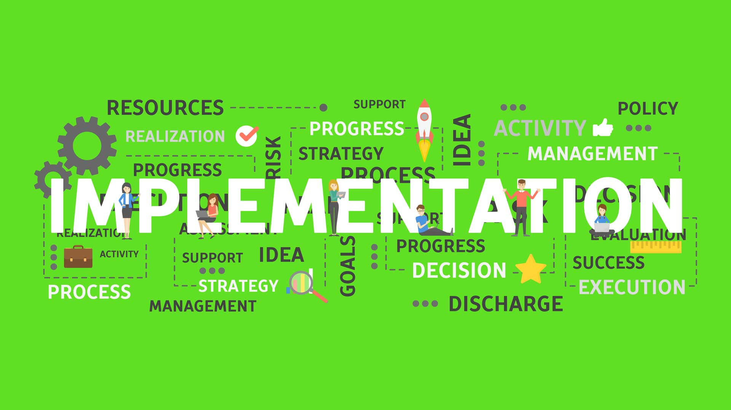
Stage 6 : Implementation
Ithe “Implementation” stage is the sixth and final stage in the design thinking process. In this stage, the focus shifts from creating prototypes and testing ideas to bringing the fully refined and validated solution to life. Implementation is the process of turning the concept or prototype into a real and functional product, service, or system that can be used by the intended audience. Here’s a more detailed explanation of the “Implementation” stage.
After successful testing and iterations, the chosen solution is implemented or delivered to the intended audience or market. This could involve developing a final product, service, or experience based on the prototype that has been validated through testing.
The “Implementation” stage is the final step in the design thinking process, where the proposed solution becomes a reality and is deployed for use by the intended audience.

Slide 12

Development phase
The development phase in a product sales analysis is a dynamic and evolving process that focuses on improving sales performance and achieving sales-related goals. It involves a combination of strategic planning, tactical execution, and continuous assessment to enhance product sales and drive business growth.
Successful implementation of the development phase can result in increased revenue, improved customer satisfaction, and a stronger market presence.
Present the key phases of your analysis project: Data Collection,Data Preprocessing, Data Analysis, Reporting, Recommendations

Slide 13

Stage 1 : Data collection
Data collection is a fundamental step in product sales analysis. It involves gathering relevant information and data points related to sales, customers, products, and various market factors. This data serves as the foundation for analyzing and making informed decisions to improve sales strategies and performance. Here’s an overview of data collection in product sales analysis.
Data collection is a critical component of product sales analysis, as the quality and completeness of the data collected directly impact the accuracy and effectiveness of your sales analysis. Well-collected and maintained data enables you to gain insights, identify trends, and make data-driven decisions to optimize sales strategies, increase revenue, and enhance customer satisfaction.

Slide 14

Stage 2 : data processing
Data processing is a crucial step in product sales analysis, as it involves transforming raw data into meaningful insights and actionable information. Effective data processing enables businesses to make informed decisions, optimize sales strategies, and improve overall sales performance. Here’s an overview of data processing in product sales analysis.
Data processing is a critical component of product sales analysis, enabling businesses to extract valuable insights from their sales data. The quality and accuracy of data processing significantly influence the effectiveness of sales strategies and the ability to make data-driven decisions that lead to increased revenue and improved customer satisfaction.

Slide 15

Stage 3 : data analysis
Data analysis in product sales analysis involves the examination and interpretation of sales-related data to gain insights, identify trends, and make informed decisions to enhance sales strategies and performance. It is a critical component of the overall process that allows businesses to assess the effectiveness of their sales efforts and optimize their approach. Here’s an overview of data analysis in the context of product sales.
Data analysis in product sales analysis is a continuous process that provides valuable insights for optimizing sales strategies, improving product offerings, and enhancing customer experiences. It empowers businesses to make data-driven decisions, identify growth opportunities, and address challenges to drive revenue and profitability.

Slide 16

Stage 4 : reporting
Reporting in product sales analysis involves the presentation of data and insights related to sales performance in a structured and organized manner. It is a critical step in the sales analysis process, as it enables organizations to communicate findings, make data-driven decisions, and track progress toward sales goals. Here’s a more detailed explanation of reporting in product sales analysis.
Sales reports play a critical role in informing decision-makers and sales teams, helping them understand performance, identify areas for improvement, and take actions that enhance sales outcomes. Well-structured and insightful reports provide a valuable resource for tracking progress, setting goals, and optimizing sales strategies.

Slide 17

Stage 5 : recommendation
In product sales analysis, recommendations refer to actionable insights and suggestions based on the findings of the analysis. These recommendations are designed to help organizations make informed decisions and take specific actions to improve their sales performance, increase revenue, and enhance the effectiveness of their sales strategies. Here’s a closer look at the concept of recommendations in product sales analysis.
Recommendations in product sales analysis serve as a bridge between data analysis and action. They provide a roadmap for organizations to leverage their sales data and insights to drive positive change, adapt to market dynamics, and ultimately achieve their sales-related objectives.

Slide 18

Data collection
Data collection is a fundamental step in product sales analysis. It involves gathering relevant information and data points related to sales, customers, products, and various market factors. This data serves as the foundation for analyzing and making informed decisions to improve sales strategies and performance. Here’s an overview of data collection in product sales analysis.
Data collection is a critical component of product sales analysis, as the quality and completeness of the data collected directly impact the accuracy and effectiveness of your sales analysis. Well-collected and maintained data enables you to gain insights, identify trends, and make data-driven decisions to optimize sales strategies, increase revenue, and enhance customer satisfaction.

Slide 19
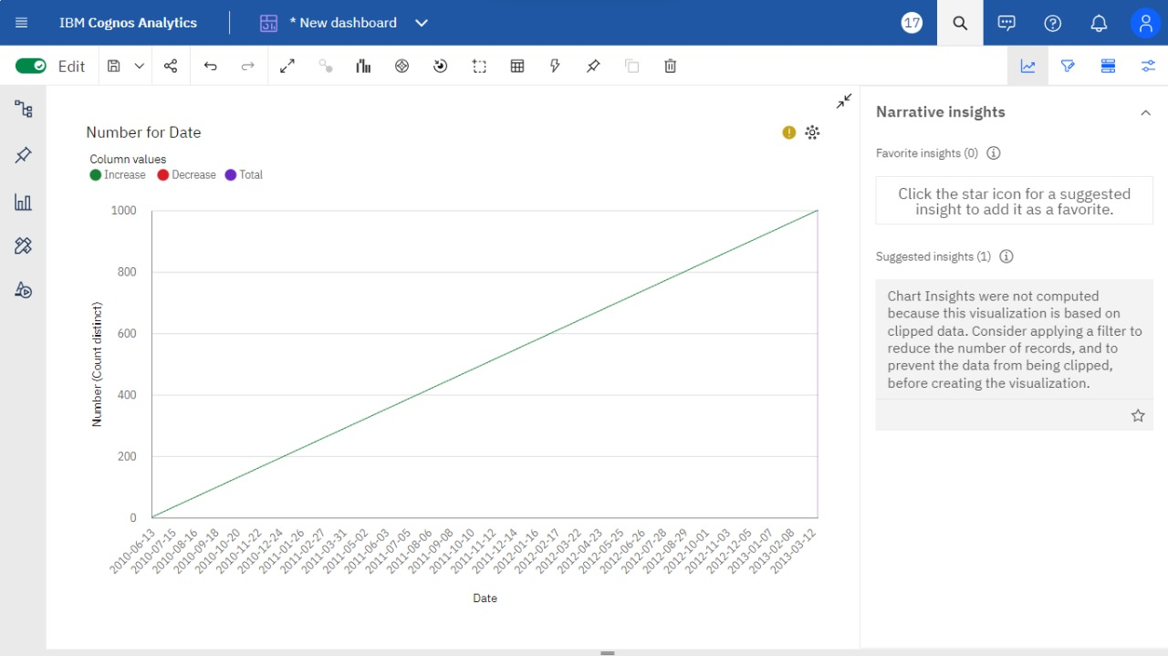

Slide 20
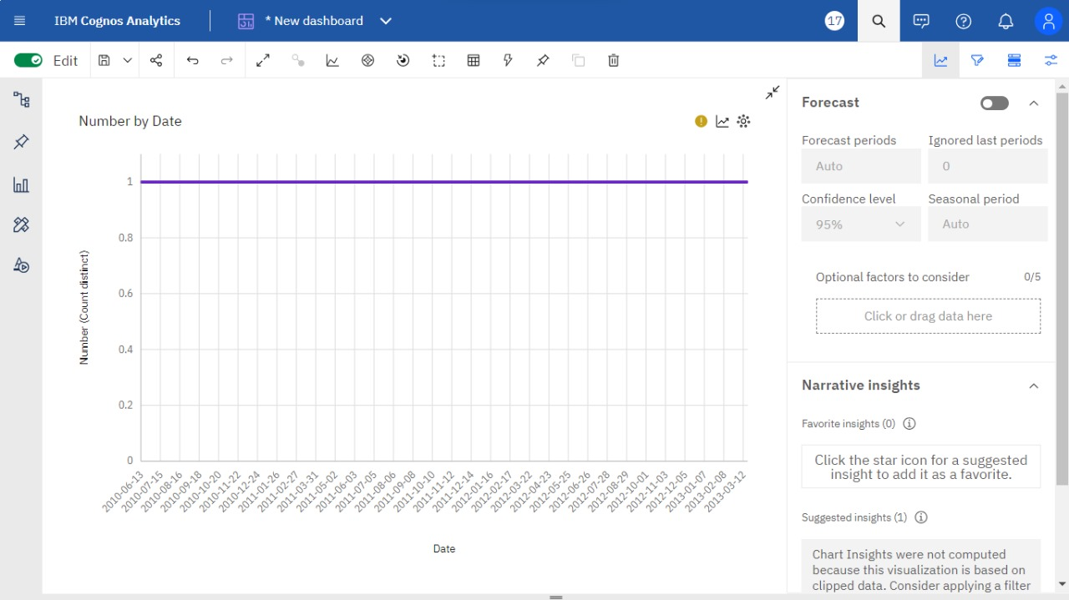

Slide 21
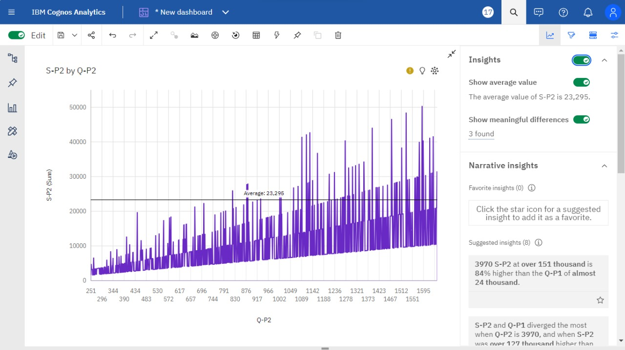

Slide 22
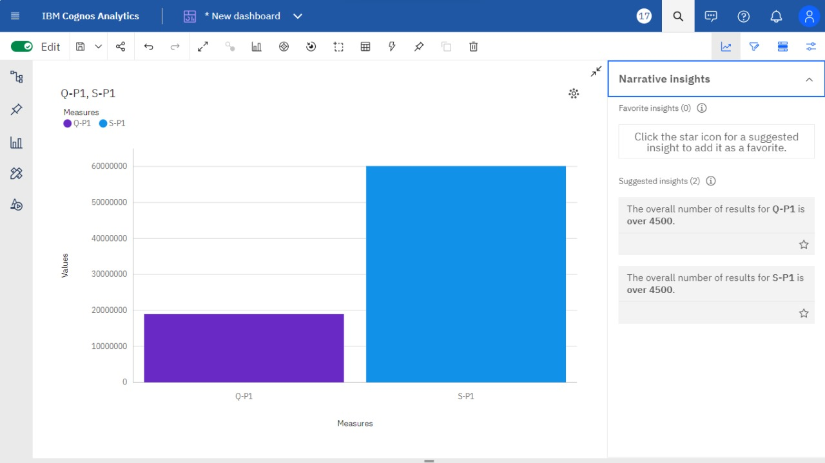

Slide 23
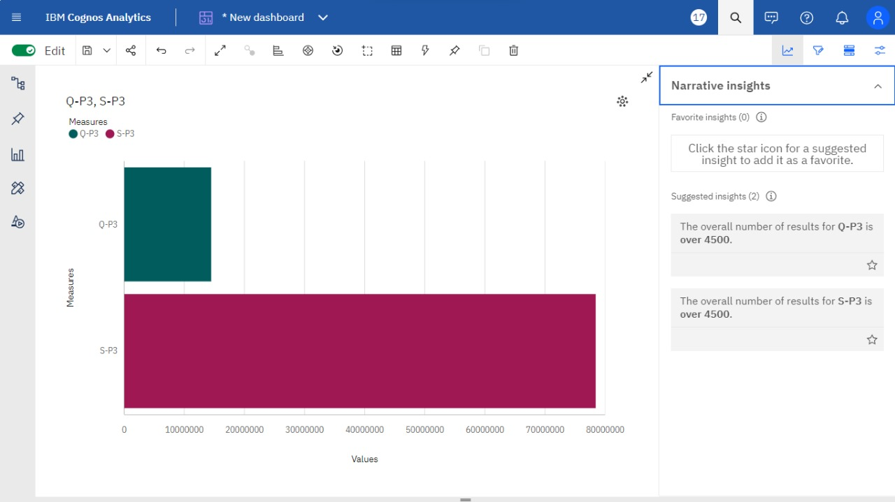

Slide 24
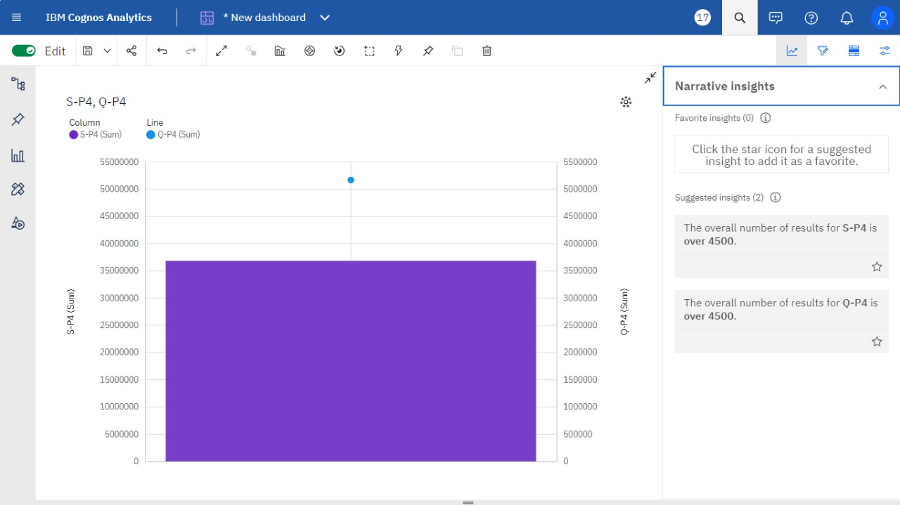

Slide 25
Data visualization using IBM cognos
Data visualization using IBM Cognos in product sales analysis allows businesses to transform their sales data into interactive and informative visual reports and dashboards.
Here’s how data visualization is applied in the context of product sales analysis using IBM Cognos.
Using IBM Cognos for data visualization in product sales analysis empowers organizations to make data-driven decisions, monitor sales performance, identify trends, and develop actionable recommendations.
The interactive and visually appealing reports and dashboards created with IBM Cognos enhance the understanding of sales data and support more effective sales strategies and decision-making.

Slide 26
Derived actionable insights
Derived actionable insights in product sales analysis refer to the valuable and practical conclusions and recommendations that are drawn from the analysis of sales data.
These insights are not just descriptive observations but rather actionable recommendations that guide decision-making and strategies to improve product sales. Here’s how derived actionable insights work in the context of product sales analysis.
Examples of derived actionable insights in product sales analysis might include recommendations to launch targeted marketing campaigns, optimize pricing strategies, introduce new product features, improve customer service, expand into new markets, or enhance customer loyalty programs.
These insights are not theoretical observations but practical guidance that organizations can act upon to enhance their product sales performance.

Slide 27

Conclusion
In product sales analysis, the conclusion is the summary of the key findings and insights drawn from the analysis of sales data.
It serves as the final section of a sales analysis report or presentation and is essential for summarizing the results and providing a clear takeaway for decision-makers. Here’s how to understand the conclusion in product sales analysis.
In summary, the conclusion in product sales analysis is the culmination of the analysis process, presenting the main findings and insights in a clear and actionable manner.
It is a critical section that informs decision-makers and helps drive improvements in sales performance and strategies.

