Slide 1

The AI-Powered Alumni Platform
Presented by Team no 23 | Hackathon 2025

Slide 2

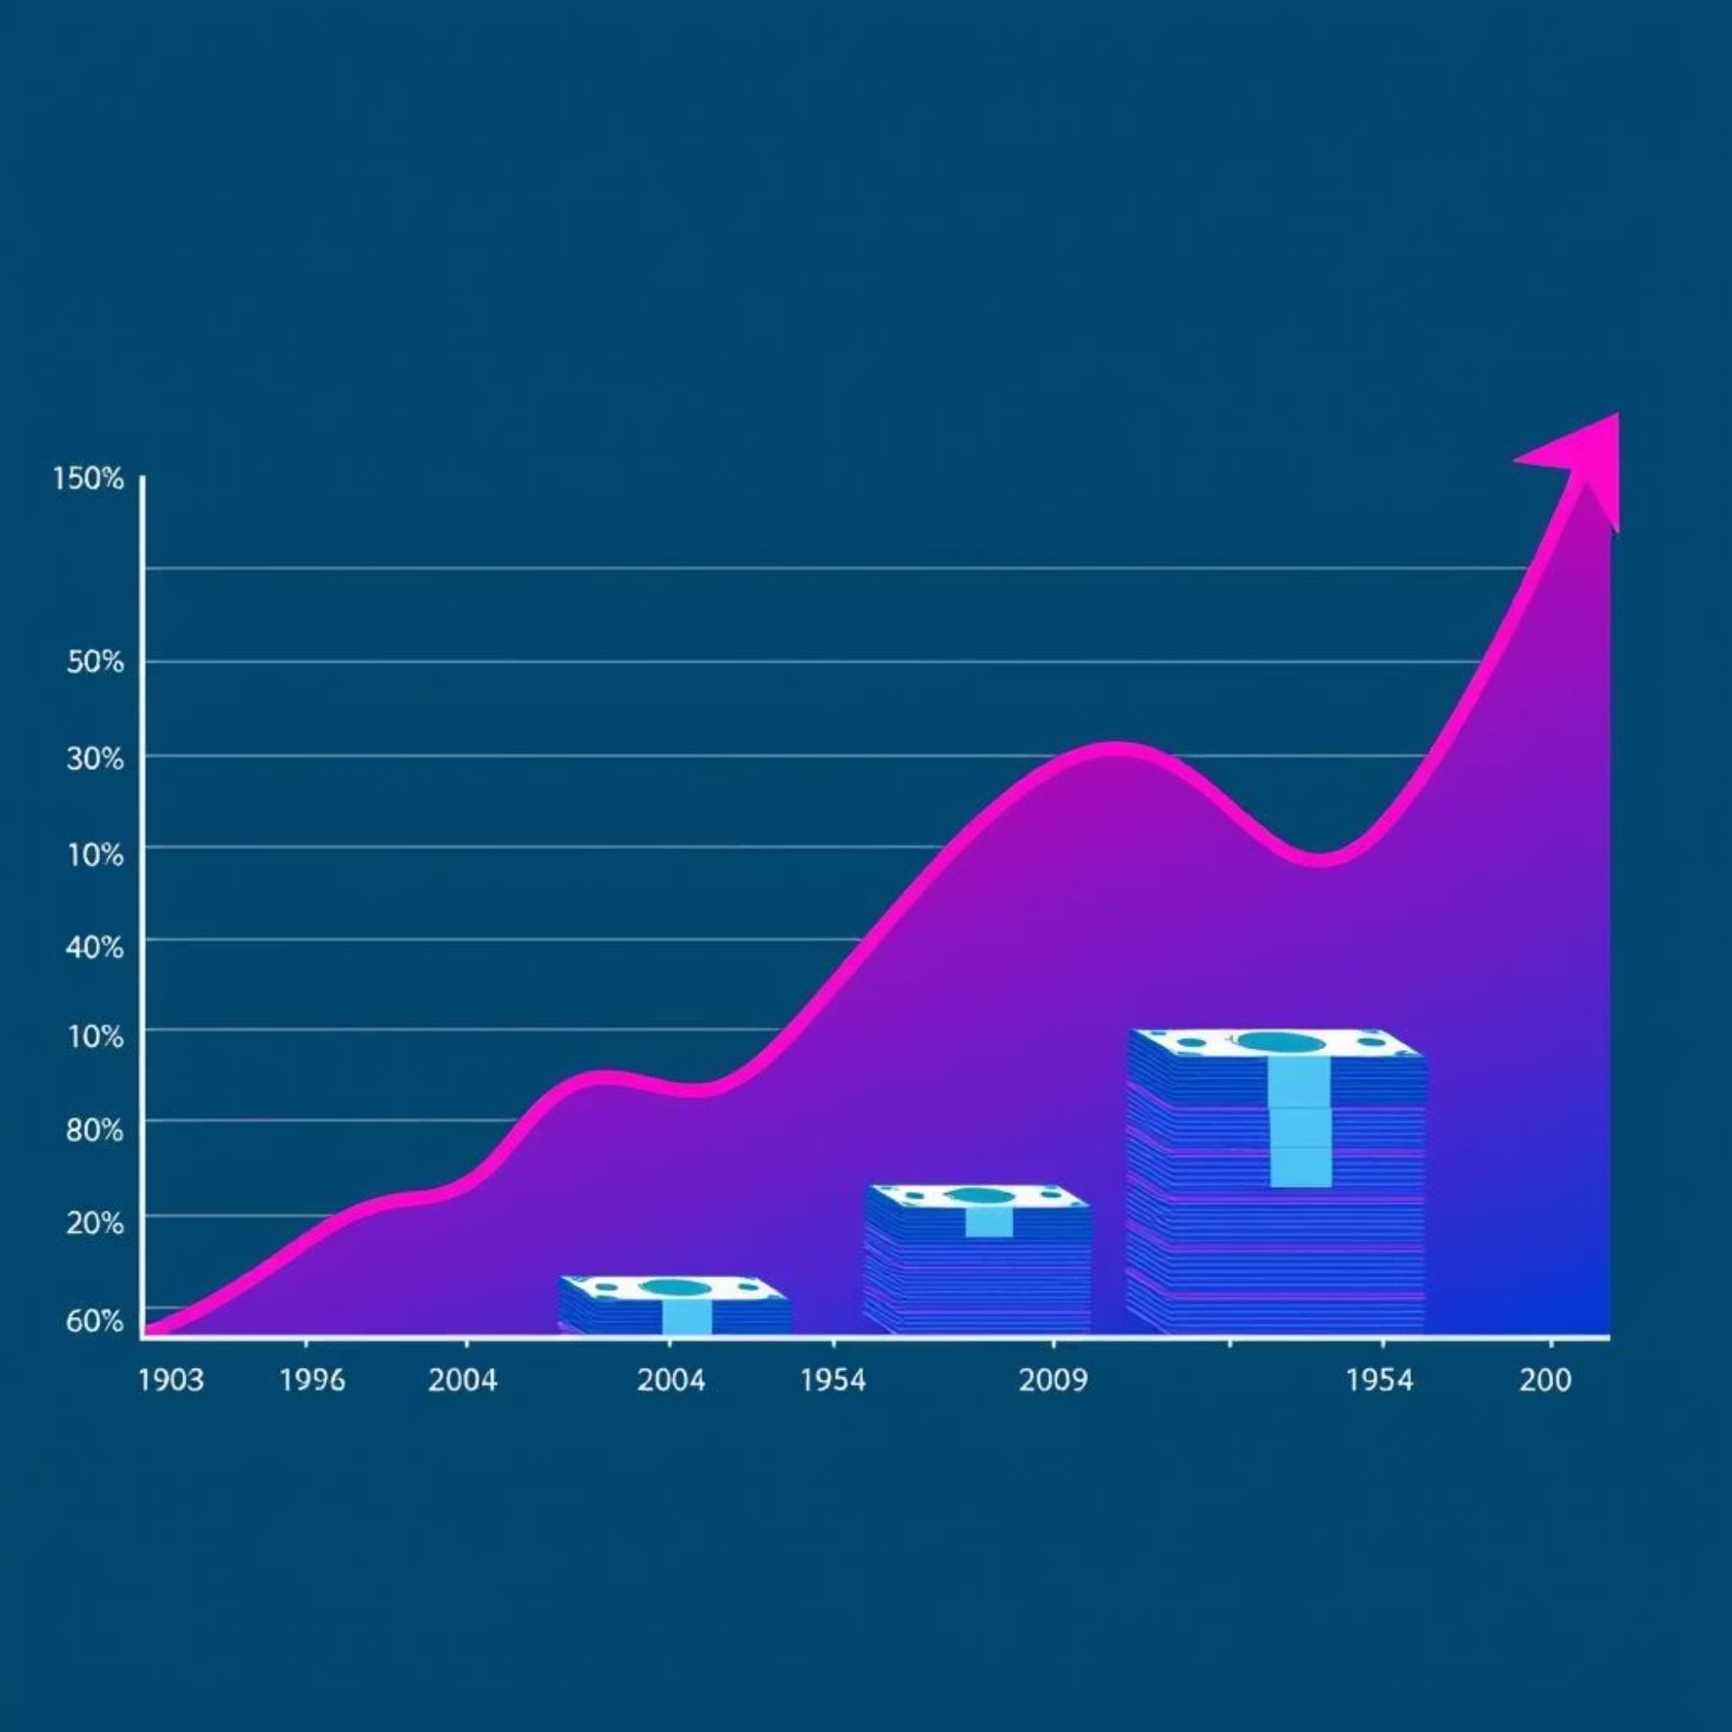
The Problem: Fragmented Connections, Lost Value
Fragmented Data
Lost Value
Universities struggle with alumni data spread across messy spreadsheets, outdated databases, and siloed systems. This leads to:
The inability to effectively reach and engage alumni translates into significant losses:
Missed mentorships and career opportunities
Inaccessible alumni information
Reduced donations and fundraising potential
Inefficient communication efforts
Weakened institutional networks and brand ambassadors
Missed opportunities for engagement
78% of universities can't effectively reach their own alumni, resulting in an estimated ₹2,000+ Crore lost yearly in India alone.

Slide 3




The Intelligent Solution
It is a secure, AI-powered platform designed to revolutionize alumni engagement by unifying data and fostering meaningful connections, all while prioritizing privacy.
Centralized & Secure Profiles
AI-Powered Matching
A single source of truth for alumni data, protected with robust security measures.
Intelligent algorithms connect alumni for mentorship, jobs, and events based on shared interests and goals.
Seamless Mobile Experience
Privacy-First Design
Engage alumni on the go with a user-friendly and intuitive mobile interface.
Built with privacy at its core, ensuring data protection and regulatory compliance.

Slide 4





AI & ML in Action: The Brain Behind
Our AI isn't just a buzzword; it's a sophisticated engine that transforms raw data into actionable insights and meaningful connections.
Semantic Search
Intelligent Job Recommendations
Go beyond keywords. Find "AI engineer in Bangalore" and our AI understands intent, leading you to the right professional.
Matches alumni skills and aspirations with relevant job roles, fostering career growth and talent placement.
Predictive Dashboards
Forecast donations, event attendance, and sentiment. Act on insights, don't just react to data.

Slide 5
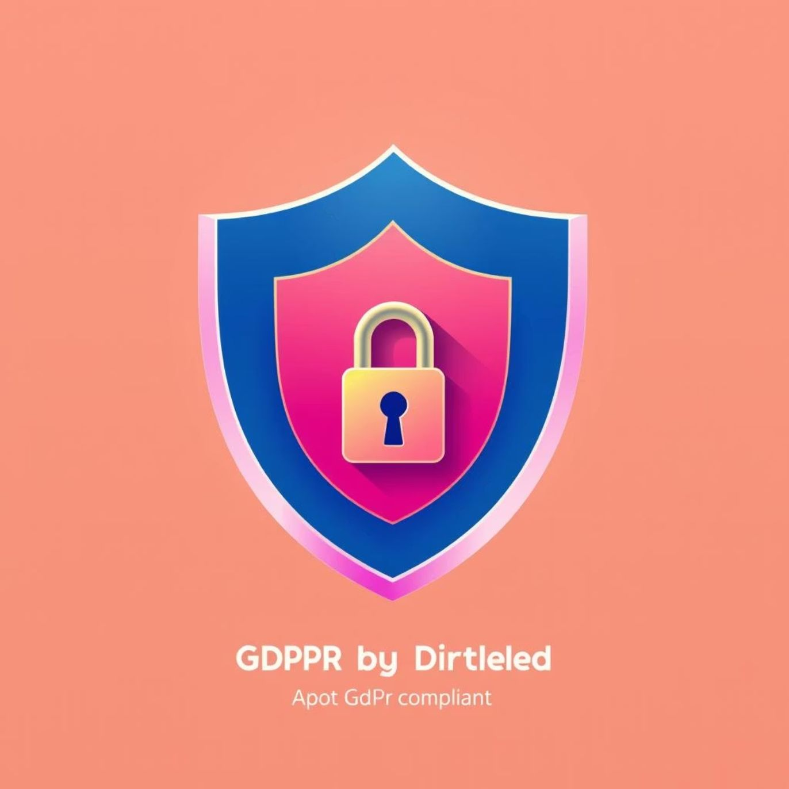






Privacy & Compliance: Our Superpower
At DQAI_5, we believe trust is the foundation of engagement. Our platform is built with Privacy by Design, ensuring alumni data is treated with the utmost respect and security.
Data Flow: Hashing for Absolute Privacy
Apply SHA-256
One-way cryptographic hashing
No Admin Access
Original email never visible
Receive Email
Store Hash
Incoming raw email content
Persist hashed value only
DPDP Act 2023 Compliant
Fully compliant with India's Digital Personal Data Protection Act, 2023, setting a new standard for data security.
Emails are hashed using SHA-256 before storage. This means not even administrators can view the raw email addresses, ensuring unparalleled user privacy.

Slide 6
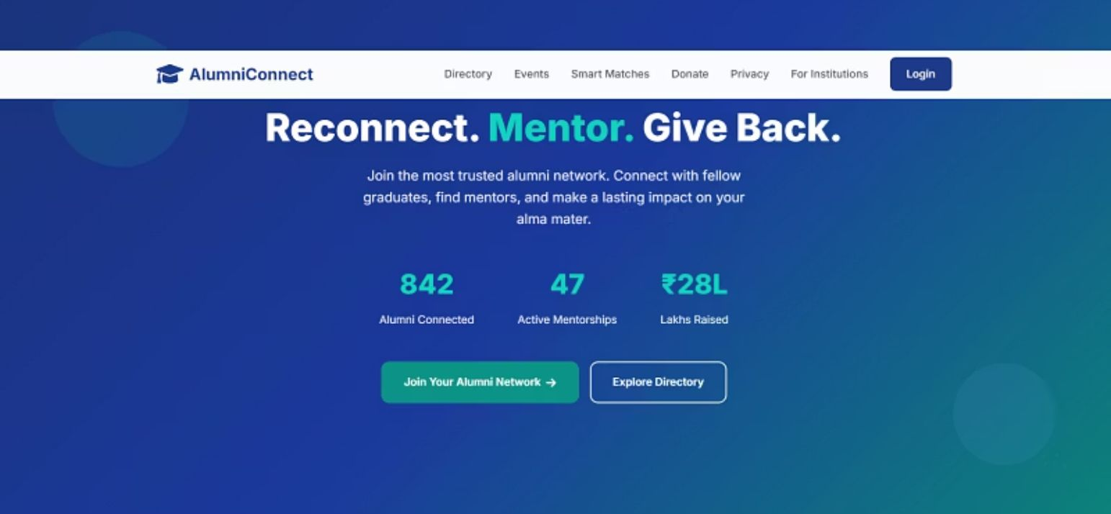
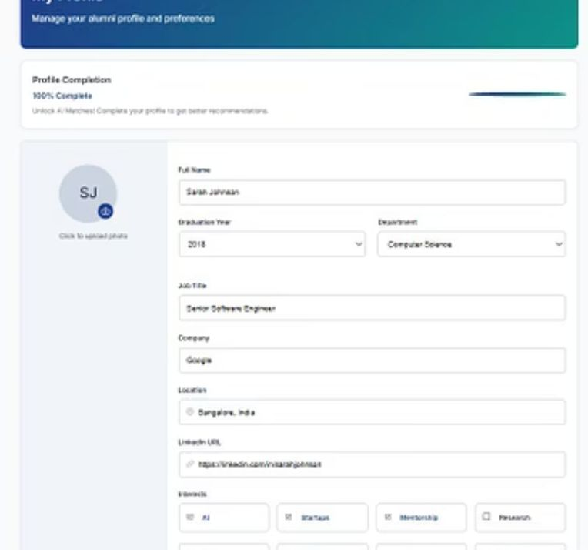
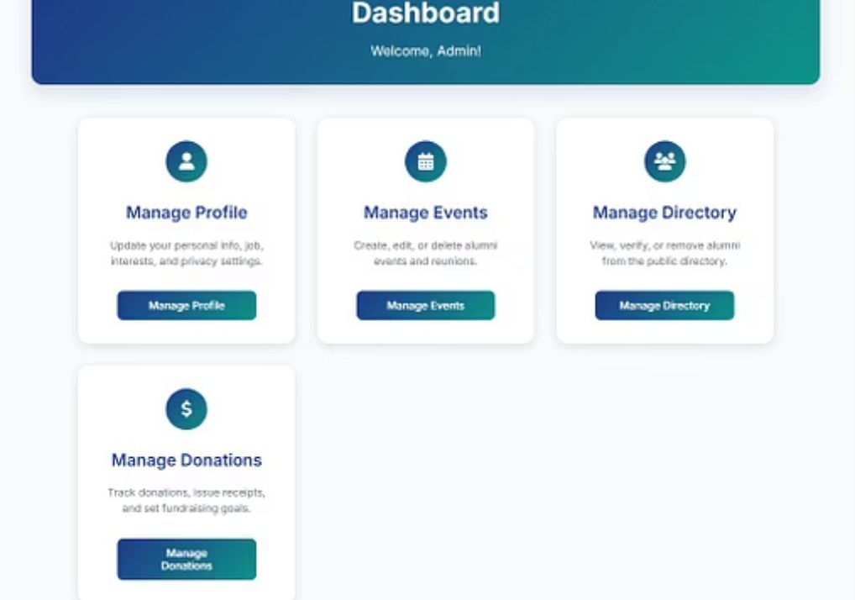
Demo: See it in Action
\

Slide 7


Impact & Roadmap: Scaling Trust and Engagement
Our pilot program has already demonstrated significant results, and we're poised for exponential growth to build a national alumni network.
Pilot Results (3 Months)
Strategic Roadmap
74%
₹28L
Phase 1: 5 Colleges
Onboarding initial university partners (e.g., VIT, SRM).
Profile Completion
Funds Raised
High engagement from alumni in completing their profiles.
Significant donations secured through targeted campaigns.
Phase 2: 100+ Colleges
Expand reach with federated learning, ensuring data remains on campus.
212
Phase 3: National Network
Mentorships Created
Vision to create India's most trusted and impactful national alumni network.
Successful connections between mentors and mentees.

Slide 8

Our Vision: Rebuilding Trust, Nation Building
We're not just building an app. We're rebuilding the social fabric of Indian higher education — one alumni connection at a time.

Slide 9








The Advantage: Why We Win
Our platform stands out by uniquely combining advanced AI with an unwavering commitment to privacy and user experience.
Explainable AI
Uncompromising Privacy
Transparent algorithms build user confidence and foster adoption.
Beyond compliance, we engineer trust with features like email hashing.
Intuitive Experience
Proven Impact
Designed for ease of use, ensuring high engagement and retention.
Pilot results demonstrate tangible value in fundraising and mentorship.

