Slide 1
Travel Pattern Analysis

Slide 2
We referred to the study conducted in the paper:
“Alteration of Travel Patterns With Vision Loss From Glaucoma and Macular Degeneration”
Used the sample location data of one participant collected from PROMPT.

Slide 3
Scripts
MapPlot.py
HomeCluster.py
DistanceCalculator.py

Slide 4
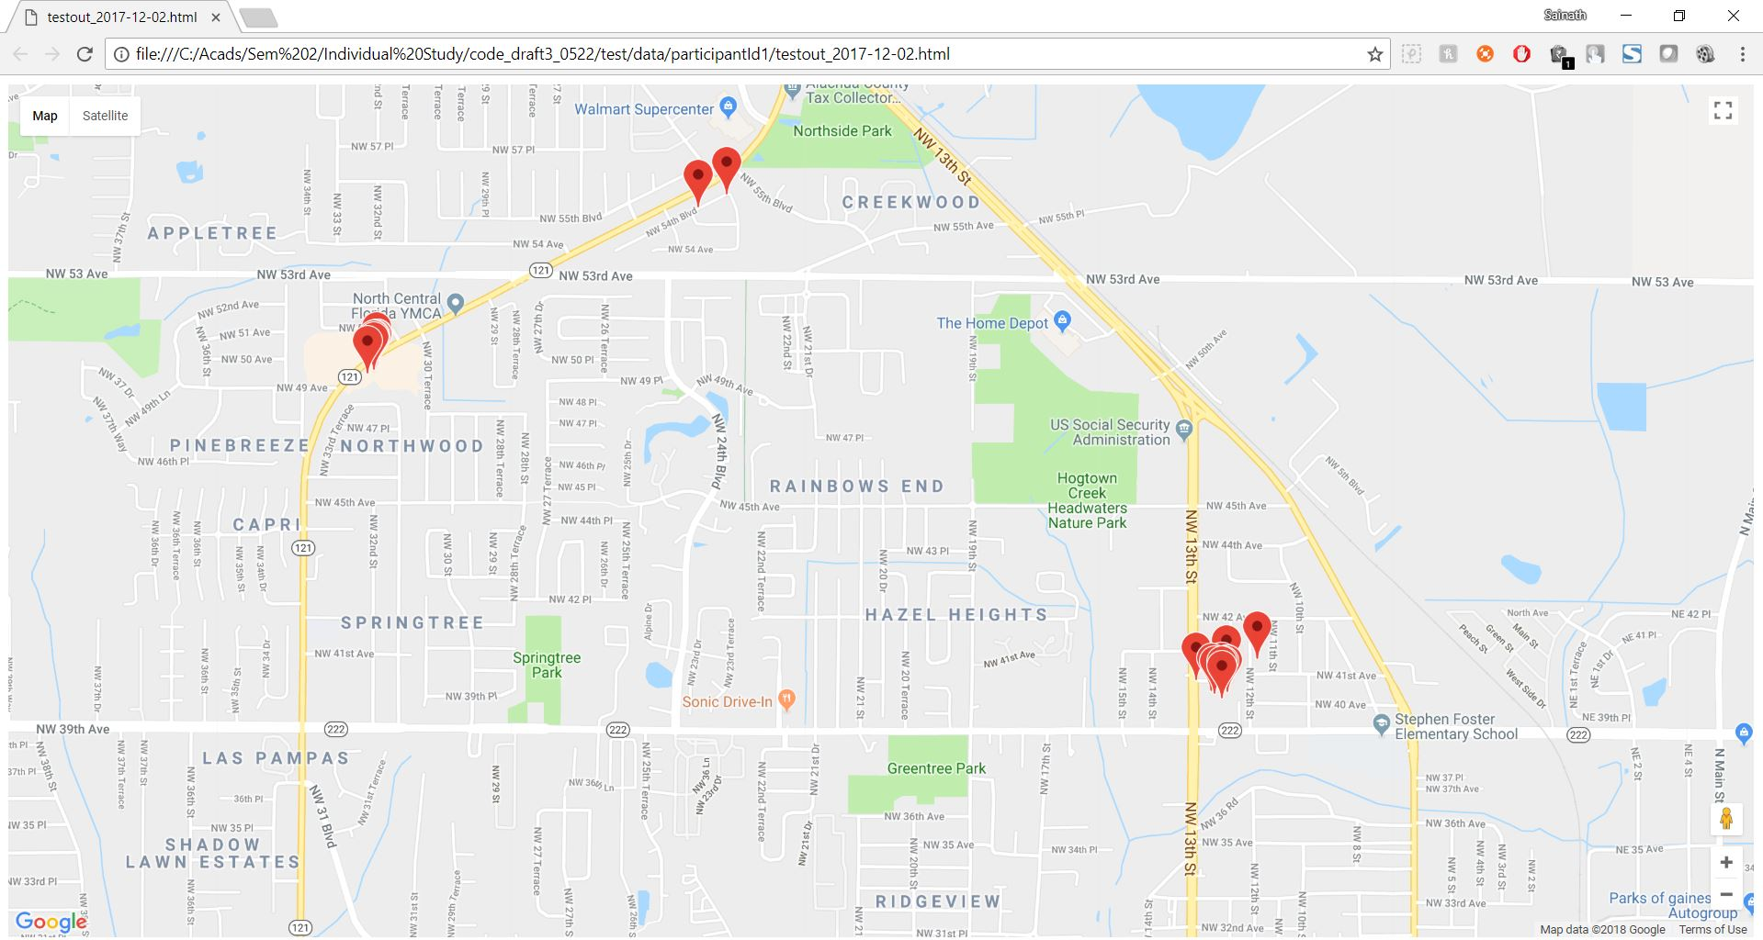
MapPlot.py
Plots the coordinates for each day in the sample data and also for the entire period.

Slide 5
HomeCluster.py
Identifies the clusters from the data using DBSCAN algorithm.
Get the cluster with the most number of points.(We assumed that this cluster represents home based on the plots)
Calculate the mean of this cluster and mark it as home location.

Slide 6
DistanceCalculator.py
Calculates the haversine distance from point to point starting from home location based on the time stamp.
Plots the total distance travelled per day and gives the mean distance.
We have ignored the points which are close to the home location for this calculation. I have used 0.25 miles but it can be passed as a parameter to this function.

Slide 7
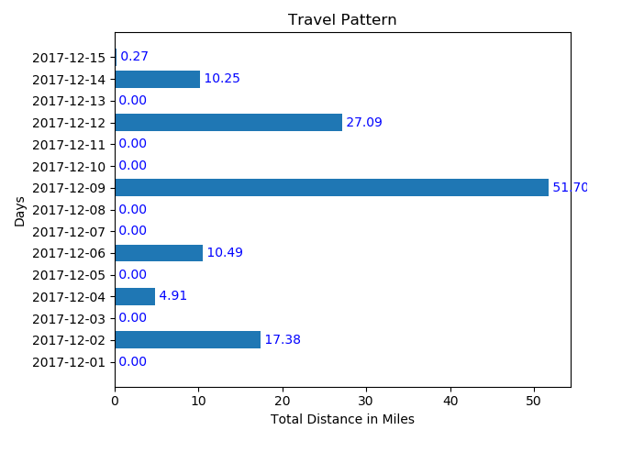
Total distance travelled per each day plot
Mean distance = 8.14195 miles

