Slide 1
Exploratory Data Analysis
SAINATH JAGABATHUNI

Slide 2
Business Problem
Ore is a naturally occurring solid material from which a metal or valuable mineral can be extracted profitably. The ore comes with naturally occurring impurities. One of such impurities is “Silica”. During the extraction of minerals from Ore, impurity is measured every hour. If we can predict how much silica (impurity) is in the ore concentrate, then we can provide such early information to the engineering team for corrective action. Basis the early information the engineering team will be able to reduce/control the impurity ensuring quality output through extraction from ore. It is also helpful for the environment as we reduce the amount of ore that goes into tailings (are the by-products left over from mining and extracting resources).
Goal
The main goal is to use the data at hand to predict how much impurity is in the ore concentrate. In this case the impurity is silica. So we have to predict the percentage of Silica in the concentrate which is our output variable of interest.

Slide 3
Project columns.
%Iron Feed : % of Iron that comes from the iron ore that is being fed into the flotation cells.
%Silica Feed: % of silica (impurity) that comes from the iron ore that is being fed into the flotation cells.
Starch Flow : Starch (reagent) Flow measured in m3/h.
Amina Flow : Amina (reagent) Flow measured in m3/h. We can consider, amine is used as collector.
Ore Pulp pH : pH scale from 0 to 14
Ore Pulp Density : Density scale from 1 to 3 kg/cm³.
Ore Pulp Flow : mass flow rate t/h
Flotation Column Air Flow : Air flow that goes into the flotation cell measured in Nm³/h

Slide 4
Flotation Column Level : Froth level in the flotation cell measured in mm (millimeters).
% Iron Concentrate : % of Iron which represents how much iron is presented in the end of the flotation process (0-100%, lab measurement).
% Silica Concentrate : % of silica which represents how much silica is presented in the end of the flotation process (0-100%, lab measurement).
Null values
There are no null values in the dataset.

Slide 5
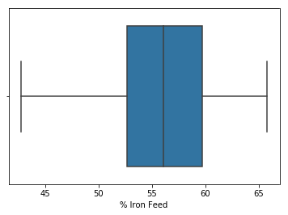
Univariate Analysis
%iron feed
Mean = 56.2947
STD = 5.1577
No outliers in %iron feed variable.
There are no outliers. The same as the result of code.
Left skewed.(subjective) but mean is approximately equal to median.

Slide 6
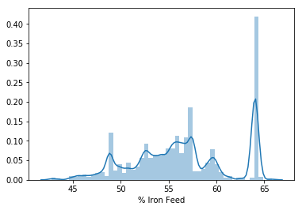
Left skewed
Not normally distributed and there is huge spike at around 63%-64% of iron feed.
Most of the iron ore has 63%-64% iron which is fed in the flotation cell.

Slide 7
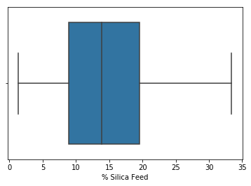
% Silica Feed.
No outliers in % Silica Feed.
Mean = 14.6517
STD = 6.8074
There are no outliers, and the data is slightly right skewed(subjective).
From summary it is right skewed as mean>median

Slide 8
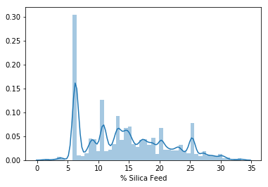
Right skewed
Data is not normally distributed and there is a huge spike in between 5%-7%. This range of % of silica which is feed to flotation cell most number of times.

Slide 9
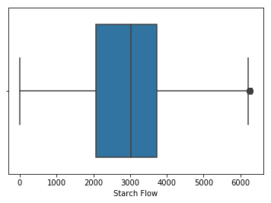
Starch flow
There are 1137 outliers in Starch flow
Mean = 2,869.1406
STD = 1,215.2037
There are outliers above the upper wisker. It shows slighlty left skewed (subjective).
From summary it is left skewed as mean<median

Slide 10
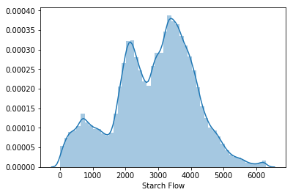
Slightly left skewed.
Not normally distributed. Most of the data falls between 2000 to 4200m3/h. This range of Starch flow is considered most number of times.

Slide 11
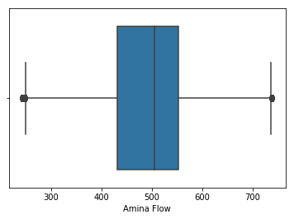
Amina flow
There are 8627 outliers in Amina flow.
Mean = 488.1447
STD = 91.2305
There are outliers and data is left skewed(subjective).
From the summary we can also say that it is left skewed as mean<median

Slide 12
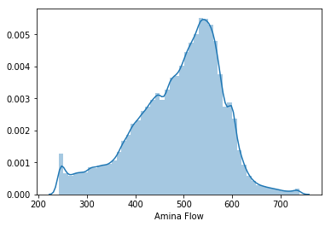
Data is left skewed.
Not normally distributed
More number of times amina flow of 500-570 m3/h is used.

Slide 13
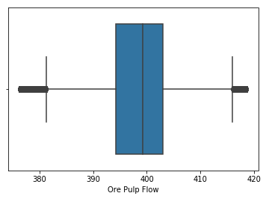
Ore Pulp Flow
There are 109043 outliers in Ore Pulp Flow
Mean = 397.5784
STD = 9.6998
There are outliers and the visualization shows that there is left skewness(subjective).
From the summary we can say that left skewed as mean<median

Slide 14
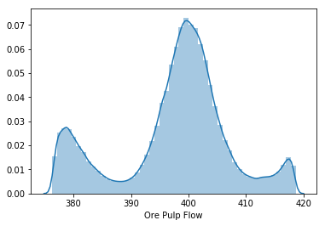
Data is left skewed. Data is not normal.
More number of times the ore pulp flow is maintained around 400t/h.
There are actually 3 peaks if we see, around 380t/h, 400t/h and 417t/h. These are ore pulp which is being maintained more times.

Slide 15
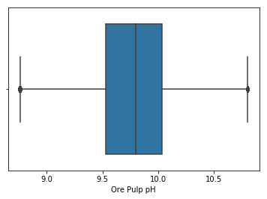
Ore Pulp pH
Mean = 9.7676
STD = 0.3870
There are 11002 outliers in ore pulp pH.
There are outliers and there is slightly left skewness (subjective).
From summary we can say that it is left skewed as mean<median

Slide 16
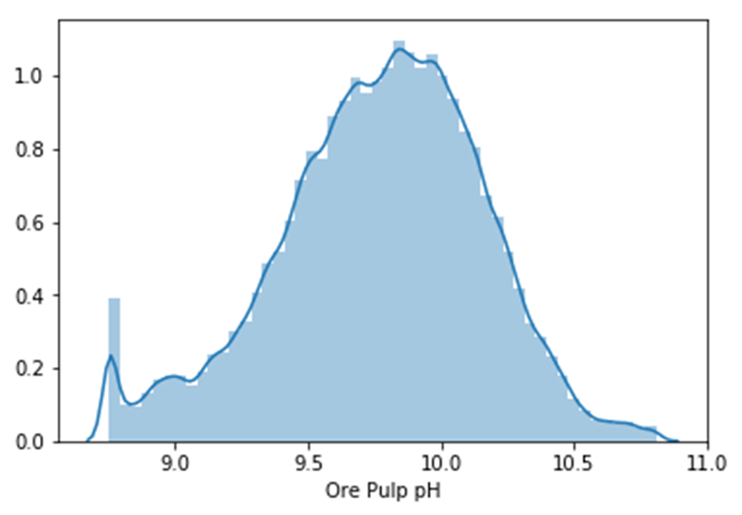
Slightly left skewed and data looks slightly normally distributed.
Most of the times the pH maintained is between 9.5 to 10.3. Most number of times the pH maintained is around 9.7 (peak).
There is a spike at the starting of the plot. Mostly it is around 8.5.

Slide 17
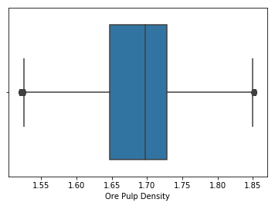
Ore Pulp Density
Mean = 1.6804
STD = 0.0692
There are 43058 outliers in Ore Pulp Density.
There are outliers and by the boxplot there is left skewness(subjective) as the median is near to 3rd quartile.
From summary we can say that it is mean<median

Slide 18
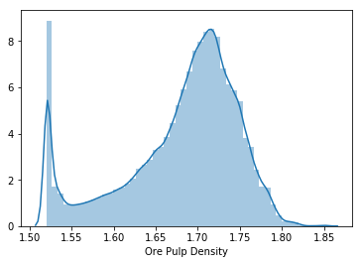
Data is left skewed and there is a huge spike at the beginning of the plot 1.52kg/cm³.
The ore pulp density is maintained between 1.67kg/cm³ to 1.74kg/cm³.
The Density maintained more number of times is around 1.52kg/cm³ and also 1.71-1.72kg/cm³.
Not normally Distributed

Slide 19
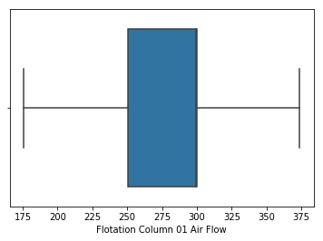
Flotation Column 01 Air Flow
There are no outliers in Flotation Column 01 Air Flow.
Mean = 280.1519
STD = 29.6213
There are no outliers and the data is left Skewed i.e negative skewed(subjective) as the median is towards the 3rd quartile.
From the summary we can say that it is left skewed as mean<median.

Slide 20
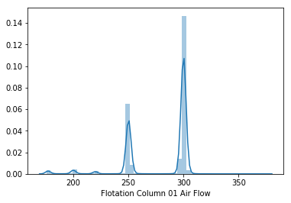
Data is left skewed and The Air flow at column 01 is maintained between 249Nm³/h to 250Nm³/h and also 299 to 310Nm³/h.
Most is between 280 to 310Nm³/h.
Not normally distributed.

Slide 21
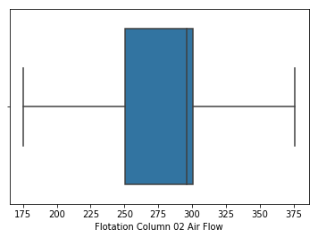
Flotation Column 02 Air Flow
There are no outliers in Flotation Column 02 Air Flow.
Mean = 277.1600
STD = 30.1494
There are no outliers the data is Left skewed i.e negative skewed (subjective) as the median is towards the 3rd quartile.
From summary we can say that it is left skewed as mean<median

Slide 22
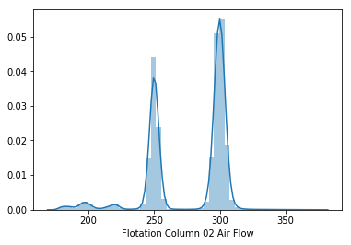
Data is left skewed and The Air flow at column 02 is maintained between 240Nm³/h to 250Nm³/h and also 290 to 310Nm³/h most of the times.

Slide 23
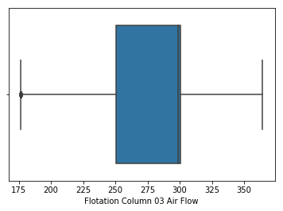
Flotation Column 03 Air Flow
There are 33 outliers in Flotation Column 03 Air Flow
Mean = 281.0824
STD = 28.5583
There are outliers and the data is left skewed i.e negative skewed (subjective) as the median is towards the 3rd quartile.
From summary we can say that it is left skewed as mean<median

Slide 24
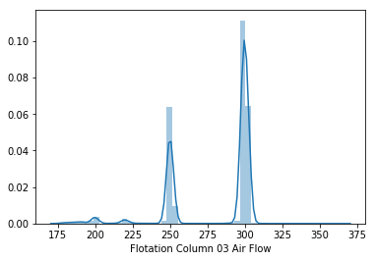
Data is left skewed and The Air flow at column 03 is maintained between 240Nm³/h to 250Nm³/h and also 290 to 310Nm³/h most number of times.
Data is not normally distributed

Slide 25
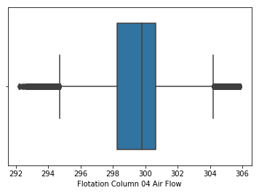
Flotation Column 04 Air Flow.
There are 54191 outliers in Flotation Column 04 Air Flow.
Mean = 299.4478
STD = 2.5725
There are outliers and it may be slight left skewed(subjective) as the median is towards 3rd quartile.
From summary we can say that it is left skewed as mean<median(very minimual decrease)

Slide 26
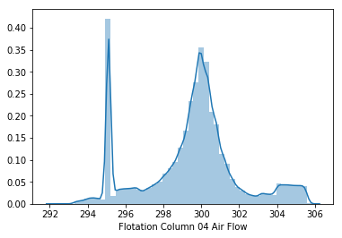
Data is left skewed. Not normally distributed
There is huge spike at around 295Nm³/h and most of times the air flow maintained is 299.7 to 300.3Nm³/h and also at 295Nm³/h.

Slide 27
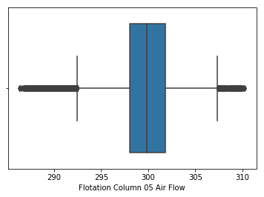
Flotation Column 05 Air Flow
There are 29474 outliers in Flotation Column 05 Air Flow.
Mean = 299.9178
STD = 3.6366
There are many outliers and no skewness(subjective).
Even in summary mean is approx. equal to median.

Slide 28
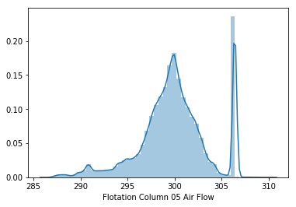
Data is left skewed and in this case there is a spike at around 306Nm³/h to 307Nm³/h. Most of the times it is maintained around 297Nm³/h to 302Nm³/h and 306Nm³/h to 307Nm³/h.
Data is not normally distributed.

Slide 29
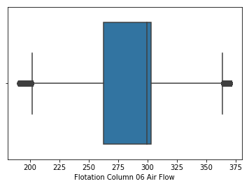
Flotation Column 06 Air Flow
There are 9432 outliers in Flotation Column 06 Air Flow
Mean = 292.0715
STD = 30.2178
There are outliers and left skewed i.e. negative skewed(subjective) as the median is towards the 3rd quartile.
From summary we can say that it is left skewed as mean<median.

Slide 30
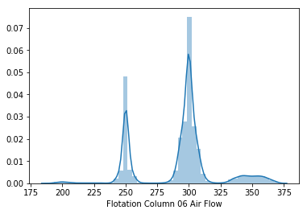
Data is left skewed and data is not normal
There are two peaks and these peaks shows that most times these air flow is maintained .i.e. first peak - 247Nm³/h to 250Nm³/h, second peak - 278Nm³/h to 300Nm³/h. Most number these Air flow is actually maintained in cell 06.

Slide 31
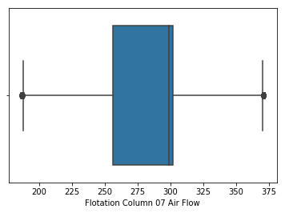
Flotation Column 07 Air Flow
There are 276 outliers in Flotation Column 07 Air Flow.
Mean = 290.7549
STD = 28.6701
There are outliers and sightly left skewed (subjective )as the median is towards the 3rd quartile
From summary we can it is left skewed as it is mean<median

Slide 32
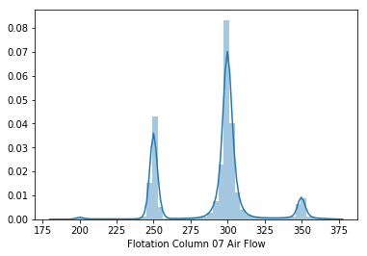
Data is left skewed .Data is not normally distributed. There are three peaks and these indicates most times these airflow is maintained. First peak - 249Nm³/h to 250Nm³/h, Second peak - 278Nm³/h to 307Nm³/h. Third peak is a small peak and it is around 350Nm³/h. Most of the times 278Nm³/h to 307Nm³/h air flow is maintained.

Slide 33
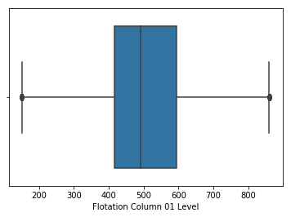
Flotation Column 01 Level
There are 854 outliers in Flotation Column 01 Level.
Mean = 520.2448
STD = 131.0149
There are outliers and slightly right skewed (Subjective) as median is towards 1st quartile.
From the summary we can sat that it is right skewed as mean>median

Slide 34
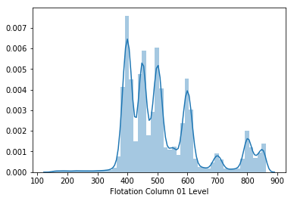
Data is right skewed and it is multimodal distribution. Data is not normally distributed.
Most of the times the froth level formed is around, 380mm to 410mm, 430mm to460mm, 490mm to510mm, 570mm to 610mm.
There are three smaller peaks of around 700mm, 800mm and 860mm, these are also the froth level formed most of the times but the frequency is lesser than the previously mentioned.

Slide 35
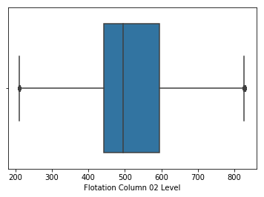
Flotation Column 02 Level
There are 1564 outliers in Flotation Column 02 Level.
Mean = 522.6496
STD = 128.1651
There are outliers and it is slightly right skewed (Subjective) as the median is towards the 1st quartile
From the summary we can say that data is right skewed as mean>median.

Slide 36
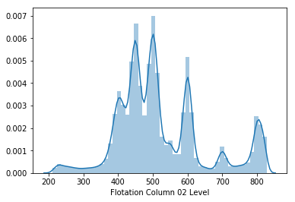
Data is right skewed and data is not normally distributed.
In flotation cell 02 around 400mm,440mm to 460mm,500m,600mm700mm and 800mm of froth level is formed most number of times.

Slide 37
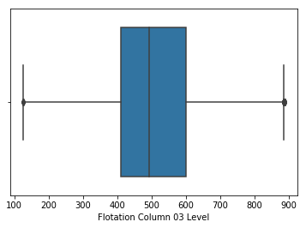
Flotation Column 03 Level
There are 531 outliers in Flotation Column 03 Level
Mean = 531.3527
STD = 150.8422
There are outliers and data is slightly right skewed(Subjective) as the median is towards the 1st quartile.
From summary we see that the data is right skewed as mean>median.

Slide 38
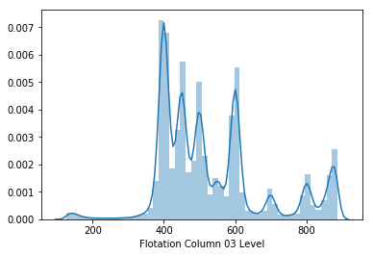
Data is slightly right skewed. Data is not normal
In flotation cell 03 around 390mm to 410mm,450mm to 460mm,500m, 590mm to 610mm,800mm(small peaks) and also 850mm (smallpeaks) of froth level is formed most number of times.

Slide 39
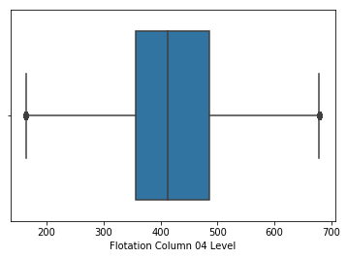
Flotation Column 04 Level
There are 462 outliers in Flotation Column 04 Level.
Mean = 420.3210
STD = 91.7944
There are outliers and data is slightly right skewed(subjective)i.e can say very less, as the median is towards the 1st quartile.
From summary also it looks right skewed as the mean>median.

Slide 40
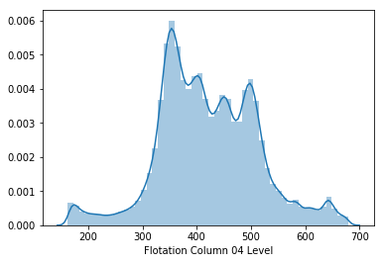
Data is slightly right skewed. Data is not normal.
In flotation cell 04 around 340mm to 370mm, 390mm to 410mm, 440mm to 460mm, 490mm to 505mm of froth level is formed most number of times.

Slide 41
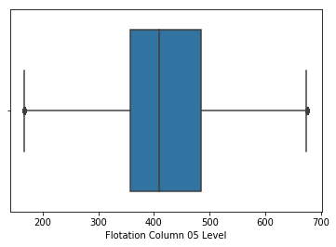
Flotation Column 05 Level.
There are 236 outliers in Flotation Column 05 Level.
Mean = 425.2517
STD = 84.5358
There are outliers and data is right skewed(subjective) as the median is towards 1st quartile.
From summary we can say right skewed as the mean>median.

Slide 42
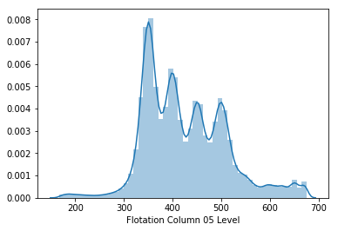
Data is slightly right skewed and data is not normal.
In flotation cell 05 around 340mm to 360mm, 380mm to 410mm, 440mm to 460mm, 490mm to 510mm of froth level is formed most number of times.

Slide 43
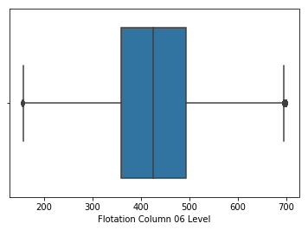
Flotation Column 06 Level
There are 2740 outliers in Flotation Column 06 Level.
Mean = 429.9410
STD =89.8622
There are outliers and no skewness (Subjective) from boxplot. If we look at the summary mean> median which shows it is: slightly right skewed.

Slide 44
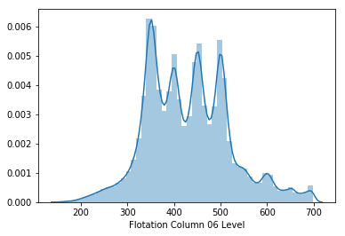
Data is slightly right skewed. Data is not normally distributed
In flotation cell 06 around 340mm to 360mm, 390mm to 410mm, 440mm to 460mm, 490mm to 520mm of froth level is formed most number of times.

Slide 45
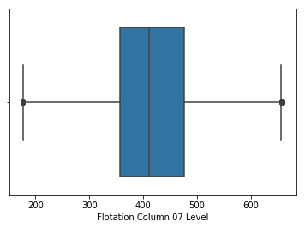
Flotation Column 07 Level
There are 467 outliers In Flotation Column 07 Level.
Mean = 421.0212
STD =84.8915
There are outliers and as mean>median(from summary) we can say that it is right skewed(Subjective) and also the median is towards 1st quartile.

Slide 46
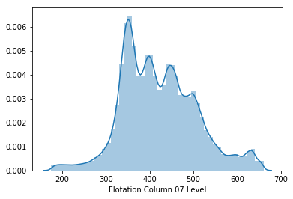
Data is right skewed and data is not normally distributed
In flotation cell 07 around 340mm to 370mm, 390mm to 410mm, 440mm to 460mm,500mm of froth level is formed most number of times.

Slide 47
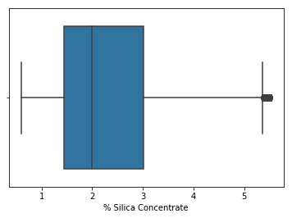
% Silica Concentrate
There are 4757 outliers in % Silica Concentrate
Mean = 2.3268
STD =1.1256
There are outliers and data is clearly right skewed

Slide 48
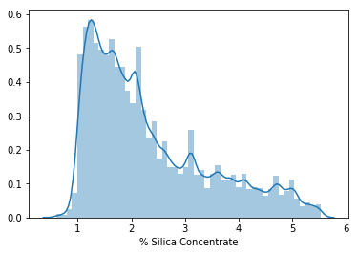
Data is highly right skewed and data is not normal.
The final % Silica Concentrate in iron is 1% to 2% most number of times.

Slide 49
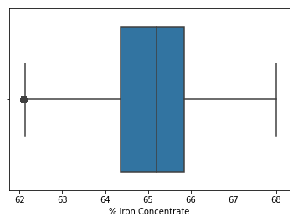
% Iron Concentrate
There are 1590 outliers in % Iron Concentrate.
Mean = 65.0501
STD =1.1186
There are outliers and data is left skewed from boxplot as median is towards third quantile.
And mean<median(aprroximately equal) from summary shows left skewed.

Slide 50
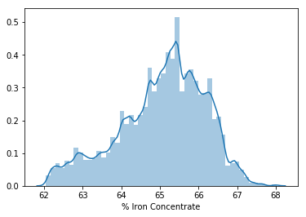
Data is left skewed and data is not normal
The final %iron concentrate in iron ore is 65% to 66% most number of times.

Slide 51
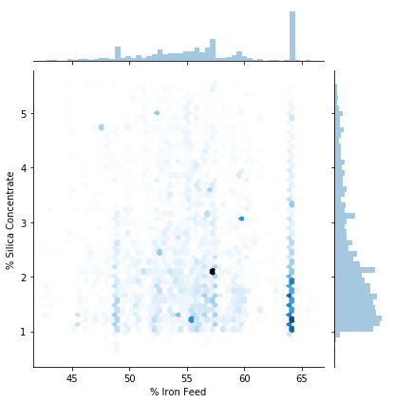
Bivariate Analysis
Plotting Hexbin plot between "% Iron Feed" and "% Silica Concentrate
Most of the data falls in 64% - 65% of iron feed for 1%-2% of silica concentrate. Figure shows, there is no linear relationship.

Slide 52
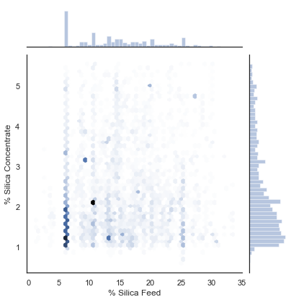
Plotting Hexbin plot between "% Silica Feed and "% Silica Concentrate"
Most of the data falls in 6%-7% of Silica feed for 1%-2% of silica concentrate. And there are dark points at 10% of silica feed and 2.1%-2.3% silica concentrate. This is even visible at the respective histograms.

Slide 53
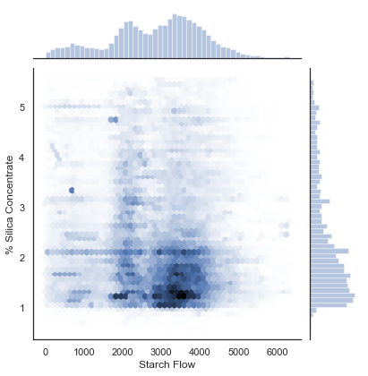
Plotting Hexbin plot between "Starch Flow " and "% Silica Concentrate"
Most of the data falls in 1800 m3/h- 4000m3/h of starch flow for 1%-2.2% of silica concentrate. The respective histograms also show the same.

Slide 54
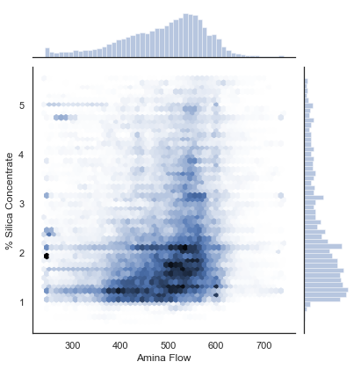
Plotting Hexbin plot between "Amina Flow " and "% Silica Concentrate"
Most of the data falls in 380 m3/h- 600m3/h of amina flow for 1%-2.2% of silica concentrate. The respective histograms also show the same.

Slide 55

Plotting Hexbin plot between "Ore Pulp pH" and "% Silica Concentrate"
Most of the data falls in 9.5 - 10.4 of pH for 1%-2.2% of silica concentrate. The respective histograms also show the same.

Slide 56

Plotting Hexbin plot between "Ore Pulp Flow" and "% Silica Concentrate"
Most of the data falls in 393t/h- 408t/h of ore pulp flow for 1%-2.2% of silica concentrate. The respective histograms also show the same.

Slide 57

Plotting Hexbin plot between "Ore Pulp Density" and"% Silica Concentrate"
Most of the data falls in 1.67kg/cm³.
- 1.75kg/cm³ of ore pulp density for 1%-2.2% of silica concentrate. The respective histograms also show the same. There are few dark points at 1.52kg/cm³ of density and 5%, 4.8%, 1.2% - 2.4% of silica concentrate.

Slide 58

Plotting Hexbin plot between "Flotation Column 01 Air Flow" and"% Silica Concentrate"
Most of the data falls in 300 Nm³/h and
250 Nm³/h of Air Flow for 1%-2.2% of silica concentrate. The respective histograms also show the same.

Slide 59

Plotting Hexbin plot between "Flotation Column 02 Air Flow" and"% Silica Concentrate"
Most of the data falls in 290Nm³/h and
- 310 Nm³/h of Air Flow for 1.2%-2.4% of silica concentrate. The respective histograms also show the same.

Slide 60

Plotting Hexbin plot between "Flotation Column 03 Air Flow" and"% Silica Concentrate"
Most of the data falls in 290Nm³/h and
- 310 Nm³/h of Air Flow for 1%-2.2% of silica concentrate. The respective histograms also show the same.

Slide 61

Plotting Hexbin plot between "Flotation Column 04 Air Flow" and"% Silica Concentrate"
Most of the data falls in 299Nm³/h and
- 301 Nm³/h of Air Flow for 1%-2.2% of silica concentrate. The respective histograms also show the same. There are also dark spots at 295Nm³/h of Air flow for 1%-2.2% of Silica concentrate and also at 3.2% of silica concentrate.

Slide 62

Plotting Hexbin plot between "Flotation Column 05 Air Flow" and"% Silica Concentrate"
Most of the data falls in 296Nm³/h and
- 302 Nm³/h of Air Flow for 1%-2.2% of silica concentrate. The respective histograms also show the same. There are also dark spots at 306 Nm³/h of Air flow for 1%-2.2% of Silica concentrate and also at 3% of silica concentrate.

Slide 63

Plotting Hexbin plot between "Flotation Column 06 Air Flow" and"% Silica Concentrate"
Most of the data falls in 300Nm³/h of Air Flow for 1%-2.2% of silica concentrate. The respective histograms also show the same. There are also dark spots at 250 Nm³/h of Air flow for 1%-2.2% of Silica concentrate and also at 3.2% of silica concentrate.

Slide 64

Plotting Hexbin plot between "Flotation Column 07 Air Flow" and"% Silica Concentrate"
Most of the data falls in 300Nm³/h of Air Flow for 1%-2.2% of silica concentrate. The respective histograms also show the same. There are also slight dark spots at 250 Nm³/h of Air flow for 1%-2.2% of Silica concentrate.

Slide 65
In these Hexplots between Flotation columns Air flow in each column and the percentage silica concentrate, most of the times data lies on 250 Nm³/h and 300 Nm³/h for 1% - 2.2% of silica concentrate. Except in Flotation column 04 and Flotation column 05 we see the Air flow maintained is 295Nm³/h and 296Nm³/h and - 302Nm³/h for the same percentage silica concentrate.

Slide 66

Plotting Hexbin plot between "Flotation Column 01 Level" and"% Silica Concentrate"
Most of the data falls in 400mm, 450mm, 600mm, 500mm of froth level for 1%-2.2% of silica concentrate. The respective histograms also show the same. There are few dark spots at 850mm.

Slide 67

Plotting Hexbin plot between "Flotation Column 02 Level" and"% Silica Concentrate"
Most of the data falls in 390mm- 450mm, 500mm and 600mm of froth level for 1%-2.2% of silica concentrate. The respective histograms also show the same. There are few dark spots at 810mm – 820mm of froth level for 1.2% - 1.4% and 3% of silica concentrate.

Slide 68

Plotting Hexbin plot between "Flotation Column 03 Level" and"% Silica Concentrate"
Most of the data falls in 400mm, 450mm, 500mm and 600mm of froth level for 1%-2.2% of silica concentrate. The respective histograms also show the same. There are few dark spots at 900mm of froth level.

Slide 69

Plotting Hexbin plot between "Flotation Column 04 Level" and"% Silica Concentrate"
Most of the data falls in 320mm – 520mm of froth level for 1%-2.2% of silica concentrate. The respective histograms also show the same. There are few dark spots at 640mm of froth level.

Slide 70

Plotting Hexbin plot between "Flotation Column 05 Level" and"% Silica Concentrate"
Most of the data falls in 320mm – 520mm of froth level for 1%-2.7% of silica concentrate. The respective histograms also show the same. There are few dark spots at 680mm of froth level.

Slide 71

Plotting Hexbin plot between "Flotation Column 06 Level" and"% Silica Concentrate"
Most of the data falls in 350mm, 400mm, 440mm - 450mm and 500mm of froth level for 1%-2.2% of silica concentrate. The respective histograms also show the same.

Slide 72

Plotting Hexbin plot between "Flotation Column 07 Level" and"% Silica Concentrate"
Most of the data falls in 320mm - 520mm of froth level for 1%-2.2% of silica concentrate. The respective histograms also show the same. There are few dark points at 620mm – 640mm of froth level for 1.2% of silica concentrate.

Slide 73

Plotting Hexbin plot between "% Iron Concentrate" and"% Silica Concentrate"
Most of the data falls in 65% -66.7% of Silica concentrate for 1%-2.4% of silica concentrate. The respective histograms also show the same. There are few dark point at 65.4 -65.5% of silica concentrate for 2.2% of silica concentrate. This point is darker than all, which shows that most of the data points lie there.
If we see clearly, we can see that these two variables have negative linear relationship

Slide 74
If we look at these Hexbin plots of Flotation Column level of each column, which tells about the froth level in each flotation column. In column 01, column 02 and column 03 the formed froth level is from 400mm – 600mm which gave 1%-2.2% silica concentrate. If we look at column 04, column,05, column 06 and column 07 the froth level is 320mm – 500mm which gives 1%-2.2% silica concentrate.

Slide 75

Multivariate Analysis
Plotting Starch Flow, Iron concentrate and Silica concentrate to see overall behaviour of the reagent on Iron and silica in ore.

Slide 76
If we look at the previous plot, here on a whole if we see for 24 hours, as the Starch Flow is decreasing till 10 hours , the percentage iron concentrate is also decreasing till 11 hours and after that both are increasing( except in few hours where the inference is violating).
The same way if we look as a whole for 24 hours, the starch flow is decreasing till 10 hours and the percentage silica concentrate is increasing at 10 hours and starch flow is increasing and the percentage silica concentrate is decreasing.( except for few hours where the inference is violating

Slide 77

Plotting Amina Flow, Iron concentrate and Silica concentrate to see overall behaviour of the reagent on Iron and silica in ore.

Slide 78
If we look at the previous graph and on whole if we see for 24 hours, the amina flow is increasing till 7 hours, the percentage silica concentrate is increasing and also percentage iron concentrate is increasing . After that, amina flow is decreasing till 11 hours and also the percentage iron concentrate is also decreasing till 10 hours. At, the same time till 10 hours percentage silica concentrate is increasing. ( except in few hours where the inference is violating).
After 10 hours, there is increase in Amina flow and also percentage iron concentrate but percentage silica concentrate is decreasing. ( except in few hours where the inference is violating).

Slide 79

Plotting correlation matrix to see the relationship between the input and output variables

Slide 80
Inference and Observations
Most of the variables are not strongly correlated with the output variable in fact many of the variables are not at all correlated. Only %iron concentrate is strongly negatively correlated to the %silica concentrate.
It is evident that iron concentrate and silica concentrate are complimentary to each other, one increases and the other decreases.

Slide 81

Checking for the correlation between input and input variables.

Slide 82
The Input variables which are correlated with each other:
Negative relationship between independent variables.(Above 0.60)
%ironfeed vs %silica feed = -0.97
Positive relationship between independent variables.(Above 0.60)
Ore Pulp density vs Amina flow = 0.66
Flotation column 01 Air flow vs Flotation column 02 Air Flow = 0.85
Flotation columns 03 Air Flow vs Flotation column 01 Air Flow = 0.95
Flotation columns 03 Air Flow vs Flotation column 02 Air Flow =0.86
Flotation columns 06 Air Flow vs Flotation column 01 Air Flow = 0.66
Flotation columns 07 Air Flow vs Flotation column 01 Air Flow = 0.65
Flotation columns 06 Air Flow vs Flotation column 03 Air Flow = 0.66
Flotation columns 07 Air Flow vs Flotation column 03 Air Flow = 0.65
Flotation columns 07 Air Flow vs Flotation column 06 Air Flow = 0.85
Flotation column 02 level vs Flotation column 01 level = 0.72
Flotation column 03 level vs Flotation column 01 level = 0.73
Flotation column 03 level vs Flotation column 02 level = 0.65
Flotation column 05 level vs Flotation column 04 level = 0.68
Flotation column 07 level vs Flotation column 04 level = 0.62
Flotation column 07 level vs Flotation column 05 level = 0.71
Flotation column 07 level vs Flotation column 06 level = 0.61

Slide 83

Checking the scatter plots between the correlated input variables
Flotation column 01 Air flow v/s Flotation column 02 Air Flow
We can see that these two variables are correlated with each other. So, have strong linear relationship which is confirmed with the correlation matrix as well.

Slide 84

Flotation columns 03 Air Flow v/s Flotation column 01 Air Flow
We can see that these two variables are correlated with each other. So, have strong linear relationship which is confirmed with the correlation matrix as well

Slide 85

Flotation columns 03 Air Flow v/s Flotation column 02 Air Flow
We can see that these two variables are correlated with each other. So, have strong linear relationship which is confirmed with the correlation matrix as well

Slide 86

Flotation columns 06 Air Flow v/s Flotation column 01 Air Flow
We can see that these two variables are correlated with each other. So, have medium linear relationship which is confirmed with the correlation matrix as well

Slide 87

Flotation columns 07 Air Flow v/s Flotation column 01 Air Flow
We can see that these two variables are correlated with each other. So, have medium linear relationship which is confirmed with the correlation matrix as well

Slide 88

Flotation columns 06 Air Flow v/s Flotation column 03 Air Flow
We can see that these two variables are correlated with each other. So, have medium linear relationship which is confirmed with the correlation matrix as well.

Slide 89

Flotation columns 07 Air Flow v/s Flotation column 03 Air Flow
We can see that these two variables are correlated with each other. So, have medium linear relationship which is confirmed with the correlation matrix as well.

Slide 90

Flotation columns 07 Air Flow v/s Flotation column 06 Air Flow
We can see that these two variables are correlated with each other. So, have Strong linear relationship which is confirmed with the correlation matrix as well.

Slide 91

Flotation column 02 level v/s Flotation column 01 level
Cant, say anything with this scatter plot but the regression line shows that there is a linear relationship between these two variables. Even, the correlation visualization shows that these two variables are moderately in linear relationship.

Slide 92

Flotation column 03 level v/s Flotation column 01 level
Cant, say anything with this scatter plot but the regression line shows that there is a linear relationship between these two variables. Even, the correlation visualization shows that these two variables are moderately in linear relationship.

Slide 93

Flotation column 03 level v/s Flotation column 02 level
Cant, say anything with this scatter plot but the regression line shows that there is a linear relationship between these two variables. Even, the correlation visualization shows that these two variables are moderately in linear relationship.

Slide 94

Flotation column 05 level v/s Flotation column 04 level
Cant, say anything with this scatter plot but the regression line shows that there is a linear relationship between these two variables. Even, the correlation visualization shows that these two variables are moderately in linear relationship.

Slide 95

Flotation column 07 level v/s Flotation column 04 level
Cant, say anything with this scatter plot but the regression line shows that there is a linear relationship between these two variables. Even, the correlation visualization shows that these two variables are moderately in linear relationship.

Slide 96

Flotation column 07 level v/s Flotation column 05 level
Cant, say anything with this scatter plot but the regression line shows that there is a linear relationship between these two variables. Even, the correlation visualization shows that these two variables are moderately in linear relationship.

Slide 97

Ore Pulp density v/s Amina flow
Plot shows that there is medium linear relationship between these two variables.

Slide 98

Iron feed v/s Silica feed
The plot shows us that these two variables are strongly negatively correlated with each other and even the correlation matrix says the same.

