Slide 1
Normalisation
Normalisation is a 'fancy' term for a
set of rules, designed to make sure that
a database is organised in the best way possible
This allows the data to be processed more efficiently and any query to be processed.
These rules depend on relationships being established between the entities to create a functional dependency between them.
Notes:
Copy

Slide 2
The normalisation process involves:
Finding and grouping together all the entities and their attributes.
Removing repeating groups of data.
Providing unique keys for each entity in the database system.
Notes:
Copy by stage

Slide 3
The Three Major Stages of Normalisation:
First Normal Form
1NF is the first level of normalisation. An entity (table) is in First Normal form if it contains no repeating attributes (fields) or groups of attributes.
Second Normal Form
An entity is in 2NF if no attribute (not part of the primary key) is dependent on only part of the primary key. This only applies to entities with concatenated primary keys.
Third Normal Form
An entity is in 3NF if all attributes are entirely dependent on the primary key and not on any attribute that is not part of the primary key.
In a relational schema, each tuple is divided into fields called Domains.
Notes:
Copy by stage

Slide 4
Functional Dependency
Functional dependency means that there must be only a one-to-one dependency for each attribute mapped from a primary key to that attribute.
It defines a relationship in which the existence of one entity/attribute is entirely dependent on the existence of another (one-to-one).
Notes:
Copy Note

Slide 5
Functional Dependency - Practical Example
Order Number is the primary key.
The value for each attribute of SALES,
except Item Price, depends upon the value
of the primary key.
All attributes of SALES, except Item Price,
are Functionally Dependent on the
primary key
Item Price is Functionally Dependent on the
the attribute Item
Notes:
Transactions table for video shop
Transaction No is primary key
Value for each attribute changes as Primary key changes
All attributes of transaction can be said to be functionally dependent upon the primary key

Slide 6
To produce a set of entities in First Normal Form (1NF):
Remove repeating (multiple) groups within the primary entities (tables) so that each record (row) within the entity is the same length.
Repeating groups then become new entities, linked together by a one-to-many relationship.
Relationships are created by including a primary key from one entity as a foreign key in another entity
Notes:
Copy by stage

Slide 7
Al's Baker Shop
Notes:
Table for a video bakers shop - describe attributes
For 1NF we require fixed length records

Slide 8
Al's Baker Shop
Notes:
We can see that Order No. 7823 has repeating (multiple) entries for Item, Quantity & Item Price, and so on...

Slide 9
Al's Baker Shop
Orders
Items Purchased
Notes:
Remove repeating groups
Form new entities (tables)

Slide 10
Al's Baker Shop
Orders
Items Purchased
Notes:
To complete 1NF we need to create the relationship between the tables -
this is achieved by repeating the Order No. field in each table.

Slide 11
Al's Baker Shop
Orders Table:
Order No. can be used to uniquely identify each record and can
therefore be made the primary key.
Orders (Order No.
Acc. No.
Customer
Address
Date
Total Cost)
Notes:
Assign primary key to each table
Orders - Order No uniquely identifies each record.

Slide 12
Al's Baker Shop
Items Purchased Table:
No one attribute can be used to
uniquely identify a record.
Concatenated key is required
Order No. and Item together can
uniquely identify a record.
Items (*Order No.
Purchased Item
Quantity
Item Price)
Notes:
Items purchased - no one attribute can be used to uniquely identify a single record.
If we choose Order No. there is no unique association
If we choose Item. there is no unique association etc
We must therefore create a CONCATENATED KEY - so what do we need to find each record in the entity?
We can use Order No. AND Item to uniquely identify each record

Slide 13
Al's Baker Shop First Normal Form
Orders (Order No.
Acc. No.
Customer
Address
Date
Total Cost)
Items (*Order No.
Purchased Item
Quantity
Item Price
Notes:
Tables in 1NF

Slide 14
Q & A
What is Normalisation?
What does Normalisation process involves?
What is Ist Normal Form?
In a relational schema, each tuple is divided into fields called Domains. T/F
Notes:
Tables in 1NF

Slide 15
The Three Major Stages of Normalisation:
First Normal Form
1NF is the first level of normalisation. An entity (table) is in First Normal form if it contains no repeating attributes (fields) or groups of attributes.
Second Normal Form
An entity is in 2NF if no attribute (not part of the primary key) is dependent on only part of the primary key. This only applies to entries with concatenated primary keys.
Third Normal Form
An entity is in 3NF if all attributes are entirely dependent on the primary key and not on any attribute that is not part of the primary key.
Notes:
Copy by stage

Slide 16
To produce a set of entities in Second Normal Form (2NF):
Test for dependency by testing each particular attribute in turn to check that it can be uniquely identified by making use of all the primary key. This test need not be completed unless you have at least one table which requires a concatenated Primary Key
Remove all partially dependent attributes to a new entity.
N.B. – A concatenated key occurs when you need two fields together in order to uniquely identify a record
Notes:
Copy by stage

Slide 17
Al's Baker Shop First Normal Form
Orders (Order No.
Acc. No.
Customer
Address
Date
Total Cost)
Items (*Order No.
Purchased Item
Quantity
Item Price)
Notes:
Tables in 1NF

Slide 18
Al's Baker Shop
Orders Table:
Because this entity has a single attribute as the primary key
there can be no partial dependencies and therefore the entity
is already in 2NF.
Notes:
Assign primary key to each table
Orders - Order No uniquely identifies each record.

Slide 19
Al's Baker Shop (2NF Step 1)
Items Purchased Table:
Primary key is Order No. and Item
Test for dependency by testing each
particular attribute.
Primary Key Attribute Functionally Dependent?
Notes:
Items purchased - no one attribute can be used to uniquely identify a single record.
If we choose Order No. there is no unique association
If we choose Item. there is no unique association etc
We must therefore create a CONCATENATED KEY - so what do we need to find each record in the entity?
We can use Order No. AND Item to uniquely identify each record

Slide 20
Al's Baker Shop (2NF Step 1)
Items Purchased Table:
Primary key is Order No. and Item
Test for dependency by testing each
particular attribute.
Primary Key Attribute Functionally Dependent?
Order No Quantity YES
Item Quantity is functionally dependent
on Order No. and Item.
Notes:
Items purchased - no one attribute can be used to uniquely identify a single record.
If we choose Order No. there is no unique association
If we choose Item. there is no unique association etc
We must therefore create a CONCATENATED KEY - so what do we need to find each record in the entity?
We can use Order No. AND Item to uniquely identify each record

Slide 21
Al's Baker Shop (2NF Step 1)
Items Purchased Table:
Primary key is Order No. and Item
Test for dependency by testing each
particular attribute.
Primary Key Attribute Functionally Dependent?
Order No Quantity YES
Item Quantity is functionally dependent
on Order No. and Item.
Order No Item Price NO
Item Item price is functionally dependent
Item, but not on Order No. and Item
Notes:
Items purchased - no one attribute can be used to uniquely identify a single record.
If we choose Order No. there is no unique association
If we choose Item. there is no unique association etc
We must therefore create a CONCATENATED KEY - so what do we need to find each record in the entity?
We can use Order No. AND Item to uniquely identify each record

Slide 22
Al's Baker Shop (2NF Step 2)
Remove any partially dependent attributes to a new entity
Notes:
Items purchased - no one attribute can be used to uniquely identify a single record.
If we choose Order No. there is no unique association
If we choose Item. there is no unique association etc
We must therefore create a CONCATENATED KEY - so what do we need to find each record in the entity?
We can use Order No. AND Item to uniquely identify each record

Slide 23
Al's Baker Shop (2NF Step 2)
Remove any partially dependent attributes to a new entity
Part Order
Price List
Notes:
Items purchased - no one attribute can be used to uniquely identify a single record.
If we choose Order No. there is no unique association
If we choose Item. there is no unique association etc
We must therefore create a CONCATENATED KEY - so what do we need to find each record in the entity?
We can use Order No. AND Item to uniquely identify each record

Slide 24
Al's Baker Shop (2NF Step 2)
Create a relationship between the tables
and assign Primary Keys
Part Order
Price List
Primary Key: Order No.
and *Item
Primary Key: Item
Notes:
Items purchased - no one attribute can be used to uniquely identify a single record.
If we choose Order No. there is no unique association
If we choose Item. there is no unique association etc
We must therefore create a CONCATENATED KEY - so what do we need to find each record in the entity?
We can use Order No. AND Item to uniquely identify each record

Slide 25
Al's Baker Shop Second Normal Form
Orders (Order No.
Acc. No.
Customer
Address
Date
Total Cost)
Price List (Item
Item Price)
Part Order (*Order No.
*Item
Quantity)
Notes:
Tables in 1NF

Slide 26
The Three Major Stages of Normalisation:
First Normal Form
1NF is the first level of normalisation. An entity (table) is in First Normal form if it contains no repeating attributes (fields) or groups of attributes.
Second Normal Form
An entity is in 2NF if no attribute (not part of the primary key) is dependent on only part of the primary key. This only applies to entries with concatenated primary keys.
Third Normal Form
An entity is in 3NF if all attributes are entirely dependent on the primary key and not on any attribute that is not part of the primary key.
Notes:
Copy by stage

Slide 27
To produce a set of entities in Third Normal Form (3NF):
Test each attribute in turn to check for dependency on the primary key.
Remove all transitive dependencies to a new entity.
A transitive dependency is where an attribute is dependent on another attribute (or attributes) that is (are) NOT the primary key
Notes:
Copy by stage

Slide 28
Al's Baker Shop Second Normal Form
Orders (Order No.
Acc. No.
Customer
Address
Date
Total Cost)
Price List (Item
Item Price)
Part Order (*Order No.
*Item
Quantity)
Notes:
Tables in 1NF

Slide 29
Al's Baker Shop - 3NF Step1
Test for
dependency
Notes:
Assign primary key to each table
Orders - Order No uniquely identifies each record.

Slide 30
Al's Baker Shop - 3NF Step1
Test for
dependency
Notes:
Assign primary key to each table
Orders - Order No uniquely identifies each record.

Slide 31
Al's Baker Shop - 3NF Step1
Test for
dependency
Notes:
Assign primary key to each table
Orders - Order No uniquely identifies each record.

Slide 32
Al's Baker Shop - 3NF Step1
Test for
dependency
Notes:
Assign primary key to each table
Orders - Order No uniquely identifies each record.

Slide 33
Al's Baker Shop - 3NF Step1
Test for
dependency
Notes:
Assign primary key to each table
Orders - Order No uniquely identifies each record.

Slide 34
Al's Baker Shop - 3NF Step1
Test for
dependency
Notes:
Assign primary key to each table
Orders - Order No uniquely identifies each record.

Slide 35
Al's Baker Shop - 3NF Step2
Remove transitive dependencies to a new entity
Notes:
Assign primary key to each table
Orders - Order No uniquely identifies each record.

Slide 36
Al's Baker Shop - 3NF Step2
Remove transitive dependencies to a new entity
Orders
Customers
Notes:
Assign primary key to each table
Orders - Order No uniquely identifies each record.

Slide 37
Al's Baker Shop - 3NF Step2
Create a relationship between the tables
and assign Primary Keys
Orders
Customers
Primary Key:
Order No.
Primary Key:
Acc.No.
Notes:
Assign primary key to each table
Orders - Order No uniquely identifies each record.

Slide 38
Al's Baker Shop Third Normal Form
Customers (Acc. No.
Customer
Address)
Orders (Order No.
*Acc. No.
Date
Total Cost)
Part Order (*Order No.
*Item
Quantity)
Price List (Item
Item Price)
Normalisation Complete
Notes:
Tables in 1NF

Slide 39
The Six Point Plan
Normalisation -
1. Remove repeating groups to create a new entity
2. Create a relationship using one of the attributes that are left [Usually the primary key]
1NF
3.‘Check out’ entities with concatenated keys. If any attribute is not fully dependent on both parts of the primary key remove it to create a new entity.
4. Create a relationship using one of the attributes that are left [Usually the primary key]
2NF
5.‘Check out’ every entity. If any attribute is dependent on any attribute other than the primary key, remove it into a new entity.
6. Create a relationship using one of the attributes
3NF

Slide 40
Model
A data model is a collection of objects that can be used to represent a set of data and operations to manipulate the data
Conceptual models are tools for representing reality at a very high-level of abstraction
Logical models are data descriptions that can be processed by computers

Slide 41
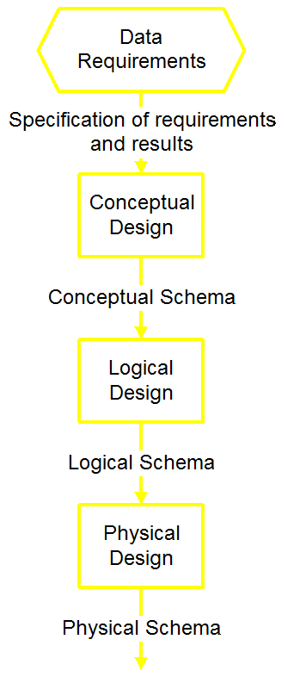
Database Design

Slide 42
Database Design….
Schema is the structure of the database that defines the objects in the database
Schemas are generally stored in a data dictionary.
a schema is defined in text database language, the term is often used to refer to a graphical depiction of the database structure.
In a relational database, the schema defines the tables, fields, relationships, views, indexes, packages, procedures, functions, queues, triggers, types,
sequences, materialized views, synonyms,database links, directories, XML schemas, and other elements.

Slide 43
Database Design….
Conceptual design begins with the collection of requirements and results needed from the database (ER Diag.)
Logical Schema is a description of the structure of the database (Relational, Network, etc.)
Physical Schema is a description of the implementation (programs, tables, dictionaries, catalogs)

Slide 44
Conceptual model: Entity-Relationship Diagrams
Entities represent classes of real-world objects. Person, Students, Projects, Courses are entities of a University database
Relationships represent interactions between two or more entities.

Slide 45
Entity-Relationship Diagrams…
E-R diagrams uses several geometric shapes, but we use only a few of them here
Rectangles represent entity sets
Ellipses represent attributes
Diamonds represent relationship sets
Lines link attributes to entity sets and link entity sets to relationships sets.

Slide 46
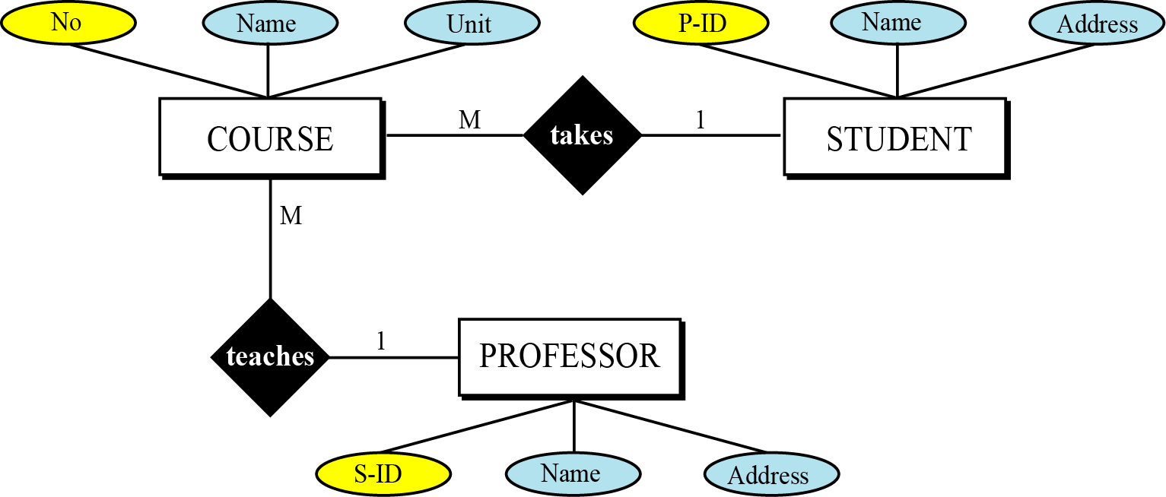
Example of ER Diagram

