Slide 1
Risk Management

Slide 2
What is a risk ?
The likelihood of something happening and the severity of it’s consequences.
Could it happen and would it hurt ?
The effect of uncertainty on our objectives.

Slide 3
What is risk management ?
Risk Management is about managing threats
It is about good management:
  Managers being aware of what could stop them achieving their objectives
  Leadership recognising potential exceptional / unexpected events that could disrupt activities
To be effective, it should be at the forefront of daily business and decision making
It is also about opportunities

Slide 4
Risk Management
Risk Management is NOT about eliminating all risks
Risk Management IS about gaining a better understanding of the nature, scale and potential effects
And then
Taking appropriate action to reduce or mitigate threats and maximise opportunities
What is the appetite of the organisation towards risk ?

Slide 5
History of the emergence of
Risk Management
Over the years there have been several high profile corporate failures and disasters such as:
Corporate failures eg Baby P, Victoria Climbe, Rotherham CSE
Financial Failures eg Lehmen Brothers, HBOS, Icelandic Bank
Major safety disasters eg Hillsborough, Herald of Free Enterprise, Bradford fire
Threats to business continuity eg Adverse weather such as 2007 floods, Passport Agency Delays
Severe reputational damage …………………….

Slide 6
Remember Gerald Ratner ?
It was supposed to be one of the greatest days of his life - the then 41-year-old North Londoner, who'd left school with no qualifications and had worked in the family business for 20 years, was addressing 5,000 members of the Institute of Directors at the Royal Albert Hall. All of them there, to listen to his pearls of wisdom.
He showed his speech to one of his own Company Directors.
‘Not bad’, he said, ‘but why no jokes ?’ So he included a joke or two:

Slide 7
Gerald Ratner – the speech
"We do cut-glass sherry decanters complete with six glasses on a silver-plated tray your butler can serve you drinks on, all for £4.95. People say how can you sell this for such a low price? I say because it’s total c**p."
Then another:
"We even sell a pair of gold earrings for under £1, which is cheaper than a prawn sandwich from Marks & Spencer. But I have to say that the sandwich will probably last longer than the earrings."
Boom boom! Two jokes……. And his world fell apart.

Slide 8
Gerald Ratner – the aftermath
Customers exacted their revenge by staying away from Ratners shops. After the speech, the value of the Ratner group plummeted by around £500 million, which very nearly resulted in the firm's collapse.
Ratner sold a majority of the company's shares in an attempt to save his business, but was subsequently fired by the new company leader in November 1992.

Slide 9
Why do we need to manage risks ?
Risk Management protects and adds value to the organisation and it’s stakeholders through supporting the organisation’s objectives.
It should be about the management, not avoidance of risk
It should help to prioritise work in a fast moving context
RISK MANAGEMENT NEEDS TO BECOME A STYLE OF THOUGHT, AND SHOULD DEFINITELY NOT BE A MERE PAPER CHASE

Slide 10
What could happen if we don’t manage our risks effectively in CYPS ?
High profile case failure
Adverse inspection results / prosecution
Unfavourable press
Financial implications
Severe reputational damage
To name but a few !!

Slide 11
The Casey Report
We looked at the Council’s processes for identifying and reporting on risks … On paper, arrangements are much as we would have expected. However, we were told that risks were not really discussed and owned by management teams.
the Senior Leadership Team did not sufficiently look at the quality of operational delivery, operational service risks or issues.
The risk of continuing to fail children should have been the Council’s highest priority. But it was not. This goes to the heart of the culture of the Council.

Slide 12
The Casey Report
CSE does not appear to feature strategically, operationally or even as a risk until 2013/14. From 2010, each annual report notes pressures on the Children’s Services budget... But the senior leadership team did not take corporate responsibility for ensuring issues were addressed.
The failure to properly challenge and scrutinise data, and to intervene where services were in decline, has had significant consequences for children and young people in Rotherham.

Slide 13
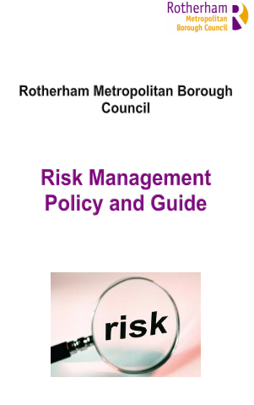
Rotherham – a new approach
Refreshed Policy and Guide produced
Shows how we will ‘do’ Risk Management
Incorporates the principles of effective risk management into all planning and management processes
Provide appropriate training and guidance for all parties involved in risk management roles, to enable them to fulfil their responsibilities
Ensure that all parties understand their roles and responsibilities
Promote a culture of risk management at all levels

Slide 14
Rotherham – a new approach
The new format risk register has ten areas of consideration:
1. Objective
2. Risks
3. Consequences
4. Existing actions and controls
5. Risk rating score (probability / impact assessment)
6. Further management controls needed and progress position
7. Post action risk score (probability / impact assessment)
8. Costs
9. Owner(s) of the risk
10. Review period

Slide 15
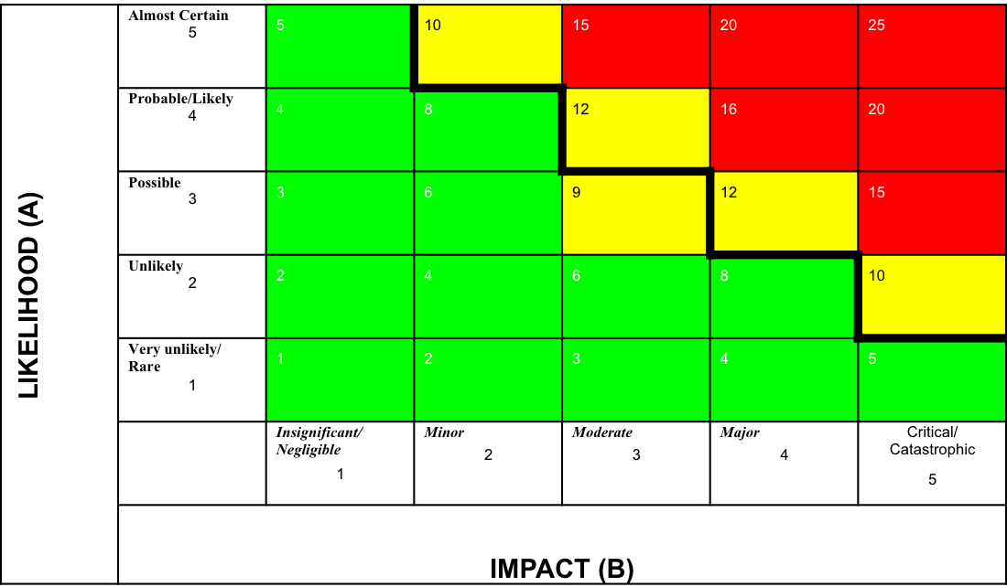
How risks are score (RAG) rated
Likelihood v Impact - or could it happen and would it hurt

Slide 16
CYPS Risk Register includes all of the following risks:
1. Sustainable improvement in Children’s Services
2. Delivery of an effective Children’s Services within budget
3. Tackling Family poverty
4. Reduce the number of Children Looked After (LAC)
5. Ensure effective education for all pupils in a rapidly changing landscape
6. Keeping Children and Young People safe
7. Ensure effective Local Authority support and challenge to schools and academies
8. Ensuring an effective Children and Young People’s Services workforce

Slide 17
Future considerations for register inclusion and upcoming activity
Has the risk of fraud been considered and adequately mitigated by your Service ?
Counter Fraud Fund project
Fraud survey
Workshops to be facilitated by John Baker, Moore Stephens UK (January 2016 onwards)
Update of e-learning training module

Slide 18
Risk Management
Responsibilities
Directorate Management Teams
Responsibility for leading and managing the identification of significant operational risks from all operational areas.
Ensuring that the measures to mitigate these risks are identified, managed and completed within agreed timescales.
Lead in promoting a risk management culture within the Directorate.
Assistant Directors
Escalate risks / issues to the relevant Strategic Directors, where appropriate.
Embed risk management within service areas they are responsible for.
Ensure that all employees, volunteers, contractors and partners are made aware of their responsibilities for risk management .

Slide 19
Risk Management
Responsibilities
All Employees
Have an understanding of risk and their role in managing risks in their daily activities, including the identification and reporting of risks.
Support and undertake risk management activities as required.
Attend relevant training courses focussing on risk and risk management
All Councillors
To consider and challenge risk management implications as part of their roles.

Slide 20
Governance of Risk
Management
Corporate Governance is:
The system by which public bodies direct and control their functions and relate to their communities.
In other words:
The way in which we manage our business, determine strategy and prioritise and go about achieving those priorities.
The fundamental principles are openness, integrity and accountability.

Slide 21
Governance of Risk Management
In CYPS
Risk owners and managers review their risks and mitigations on a frequent basis.
Risk management activity is reported to and by DLT corporately to SLT, Commissioners, Advisory Cabinet and Audit Committee.
Risk management is subject to internal / external audit.

Slide 22
Next Steps include:
  A programme of general awareness and development events
  Appointment of a Corporate Risk Manager to work with services on developing directorate operational risk registers
  Fraud workshops scheduled for Jan to March 2016
  Directorate Management Team meetings to have Risk Management / Risk Registers as a regular item, i.e. monthly
  Directorate Risk Registers to be updated on an ongoing basis and submitted every quarter for review by SLT
  Links with the developing performance management and service planning framework and anti-fraud arrangements

Slide 23
In summary:
RISK MANAGEMENT NEEDS TO BECOME A STYLE OF THOUGHT, AND SHOULD DEFINITELY NOT BE A MERE PAPER CHASE ……….

Slide 24
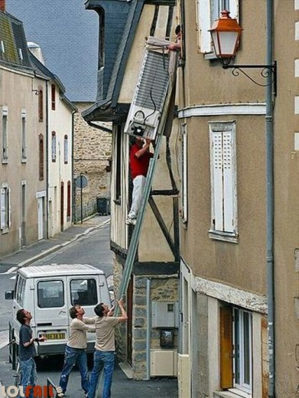
And finally
RISK MANAGEMENT NEEDS TO
BECOME A STYLE OF THOUGHT, AND SHOULD DEFINITELY
NOT BE A MERE PAPER CHASE …………………………………….

Slide 25
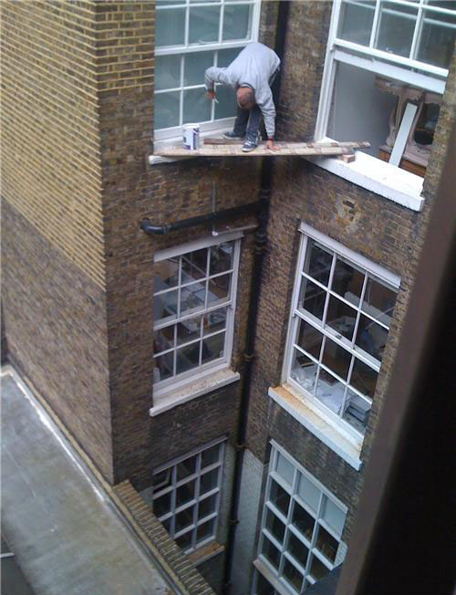
RISK MANAGEMENT NEEDS TO BECOME
A STYLE OF THOUGHT …………..

Slide 26
Our Service Wide Risk Register:
See individual Service Risk Register

