Slide 1
HANDS-ON TUTORIAL
RAG & Agentic RAG
Build both from scratch — line by line
LangChain
Groq API
LangGraph
100% Free
LangChain + Groq · no credit card, no paid keys
Notes:
Hook: What if your AI could read your documents before answering — and even decide for itself when to search and double-check its own answer? That's RAG vs Agentic RAG. We'll build both, free.

Slide 2
THE PLAN
What you'll walk away with
1
2
3
No setup cost
Free & fast stack
Theory → Code
No paid API keys and no credit card. Groq's free tier + local embeddings.
LangChain as the framework, Groq running Llama 3 for blazing-fast answers.
Explain it with a diagram, then every box becomes one real line of code.
Notes:
No paid API keys, no credit card. LangChain + Groq. Theory first with diagrams, then every box maps to a line of code.

Slide 3
WHY RAG EXISTS
The problem with a plain LLM
!
Frozen knowledge
It only knows what it saw during training — nothing after that.
?
Blind to your data
Private docs, last week's news, niche topics: it simply hasn't seen them.
×
Hallucinations
Worst case, it invents an answer that sounds right but is wrong.
Notes:
A normal model only knows its training data. It doesn't know your private or recent data. And it hallucinates — confident but wrong.

Slide 4
THE FIX
Retrieve, then Generate
Give the model the right documents BEFORE it answers.
1
Retrieve
2
Generate
→
Search a knowledge base for the chunks most similar to the question.
The LLM writes an answer grounded in exactly those chunks.
Notes:
RAG = Retrieval-Augmented Generation. Retrieve the relevant info, then generate a grounded answer. That's the whole trick.

Slide 5
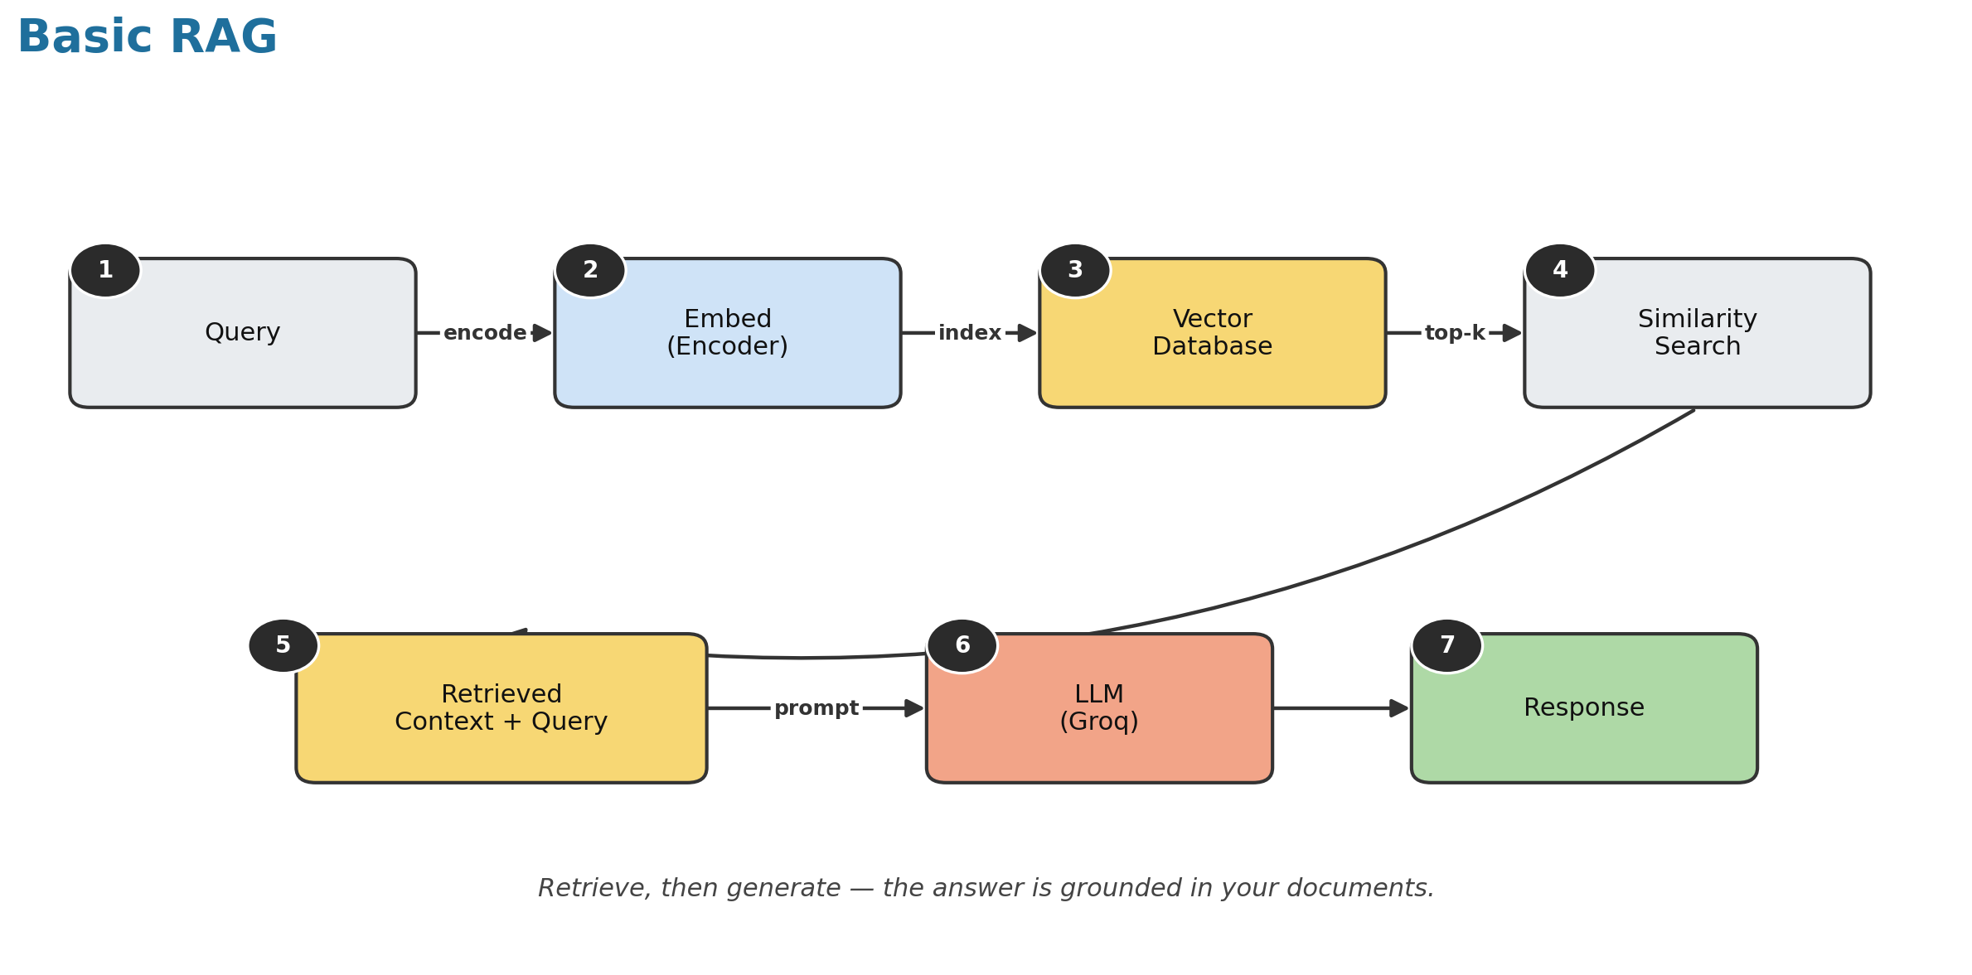
Basic RAG — seven steps, one straight line
Notes:
Follow the numbers: 1 query, 2 embed to vectors, 3 vector DB, 4 similarity search, 5 context+query, 6 LLM, 7 grounded response. Seven steps — that's Basic RAG.

Slide 6
THE LIMITATION
Powerful — but it can't think
Always retrieves
Always one source
Never checks itself
Even for a simple question it doesn't need to look up.
No choice between your notes, tools, or the live internet.
It never asks whether the answer was actually any good.
So it's a straight line. It can't reason or self-correct.
Notes:
Basic RAG is a straight line: always retrieves, same source, never checks its answer. It can't think. That's what Agentic RAG fixes.

Slide 7
AGENTIC RAG
Add a brain: decisions + a loop
?
?
?
Do I need to retrieve?
Which source?
Is my answer relevant?
For easy questions, skip the search and just answer.
Pick your private notes, a tool/API, or the open internet.
Grade its own answer — if not, loop back and try again.
That self-correcting loop is what makes it 'agentic'.
Notes:
Agentic RAG adds decisions and loops: do I need to retrieve? which source? is my answer relevant? If not, it loops back. Self-correction makes it agentic.

Slide 8
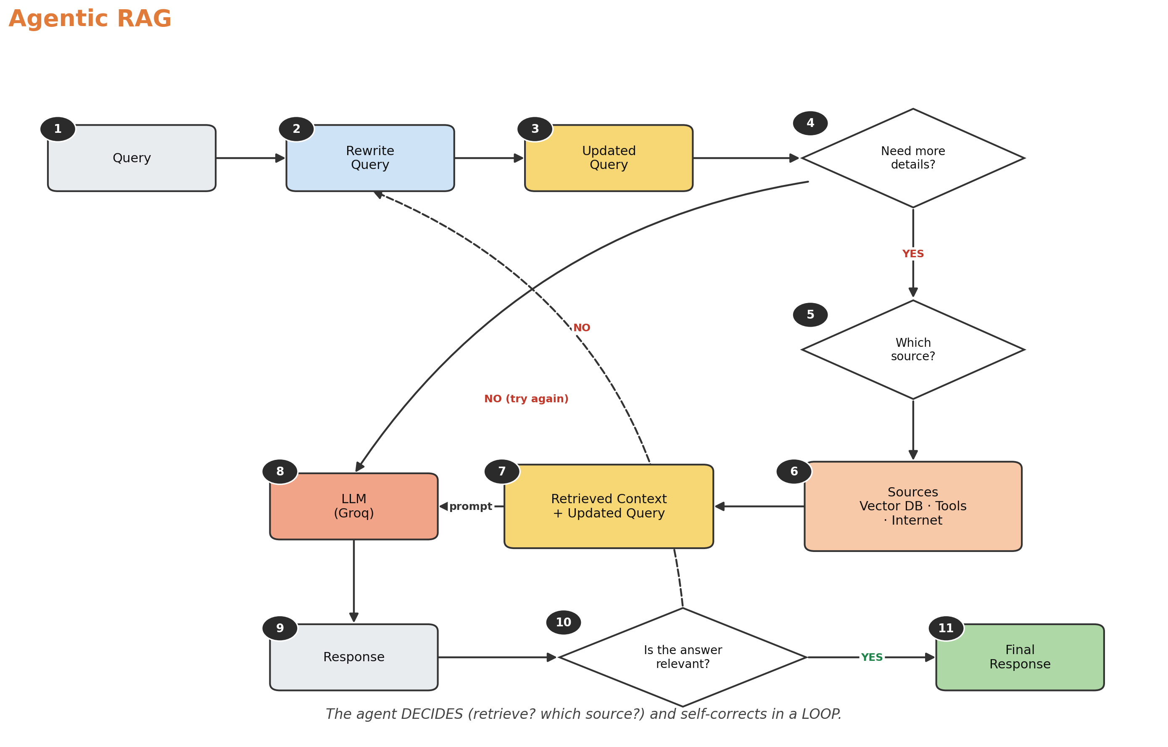
Agentic RAG — eleven steps, with decisions & a loop
Notes:
Same start, but now the agent decides whether to retrieve, picks a source, and grades its own answer — looping back on a NO. Eleven steps total.

Slide 9
NOW THE FUN PART
Let's build it in code
Basic RAG first, then upgrade it into an agent — every box you just saw becomes one line.
01_basic_rag.py
02_agentic_rag.py
The 7-step pipeline
The agent (LangGraph)
Open the editor →
Notes:
Now let's build it. Start with 01_basic_rag.py, then 02_agentic_rag.py. Every diagram box becomes a line of code.

