Slide 1
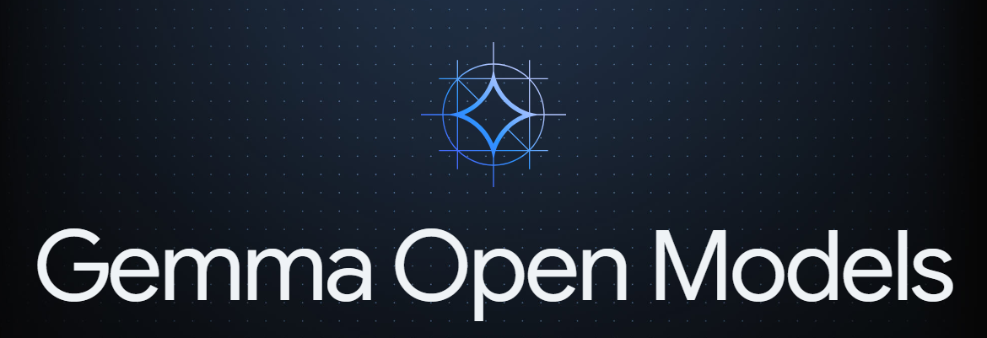

Slide 2
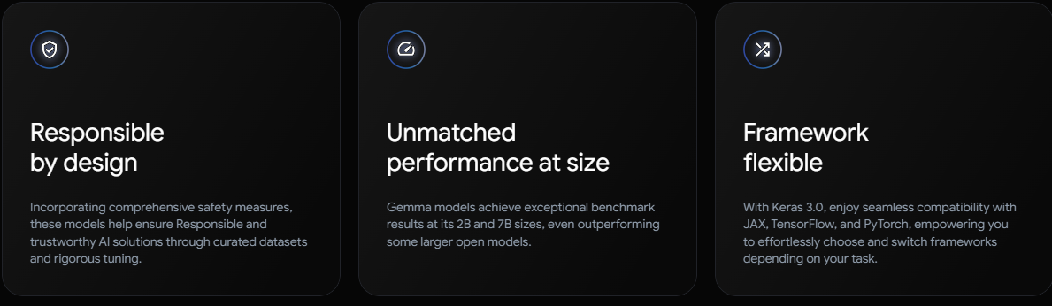
INTRODUCTION
= A family of Lightweight, SOTA open model
= from Same research and technology used to create the Gemini Model
Source https://ai.google.dev/gemma

Slide 3
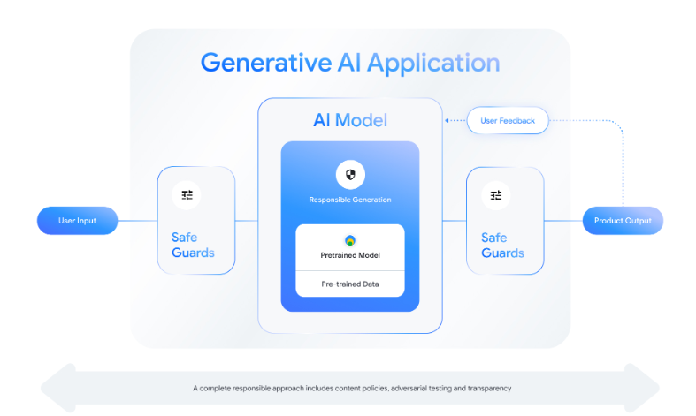

Slide 4
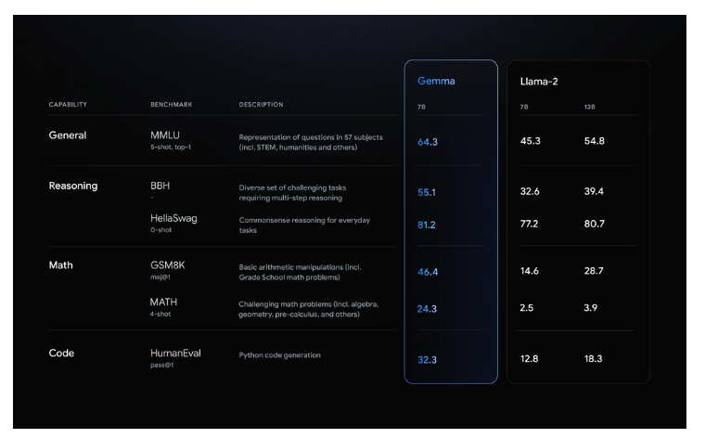

Slide 5
Continue…
Gemma - 2B & 7B
Ready to use Colab , Kaggle Notebook. Integration with HuggingFace, Nvidia Nemo, Maxtext, TensorRT-LLM
Pre-trained and instruction-tuned Gemma models can run on your laptop, workstation, or Google Cloud with easy deployment on Vertex AI and Google Kubernetes Engine (GKE).
Optimization across multiple AI hardware platforms ensures industry-leading performance, including NVIDIA GPUs and Google Cloud TPUs.
Terms of use permit responsible commercial usage and distribution for all organizations, regardless of size

Slide 6
SFT - Large corpus text
Finetune any downstream task (domain specific, sentiment analysis)
Pretrained, fine tuning (Update Parameter)
LORA - - (Reduces the number of trainable parameter for downstream task)
LORA Fine Tuning of Gemma 2B model - Databricks Dolly 15K dataset
Notes:
Low Rank Adaptation (LoRA){:.external} is a fine-tuning technique which greatly reduces the number of trainable parameters for downstream tasks by freezing the weights of the model and inserting a smaller number of new weights into the model. This makes training with LoRA much faster and more memory-efficient, and produces smaller model weights (a few hundred MBs), all while maintaining the quality of the model outputs.

Slide 7
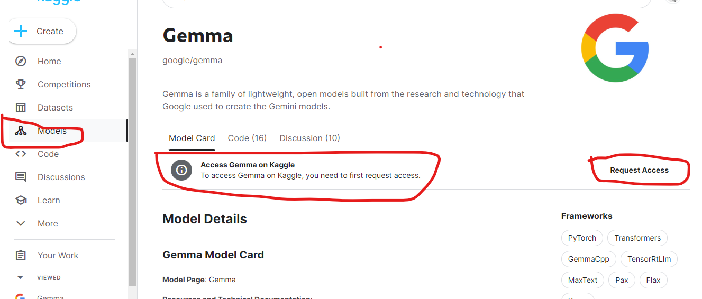
Setup
Kaggle.com
https://ai.google.dev/gemma/docs/setup

Slide 8
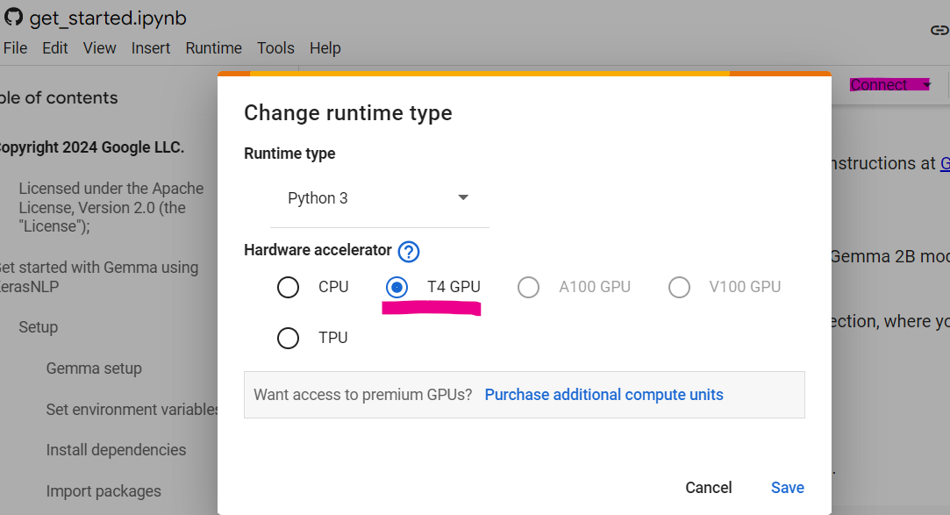
Colab Runtime

Slide 9
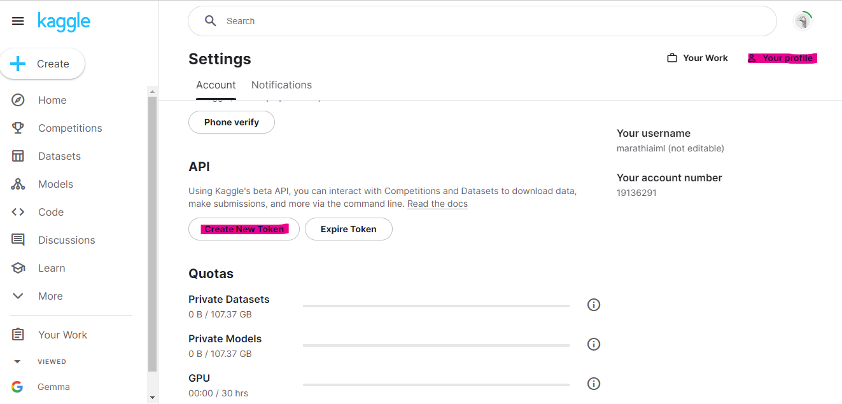

Configure API Key
Kaggle.json

