Slide 1
chatGPT
https://chat.openai.com

Slide 2
What we cover
What is chatGPT
Demo
Drawback of existing bot
How Language model works
How chatGPT model trained
Shortcomings
Other tools like chatGPT

Slide 3
What is chatGPT?
Language models for Dialogue
It is sibling model to InstructGPT (Language models to follow Instructions)
Latest release - chatGPT Jan 30 Version (Trained with 175 billion Parameter)
No official API / Python package is available.
No Voice assistant.
No Image support
I do not have the ability to browse the internet or access current information
Currently free research preview. No Pricing model decided.

Slide 4
Demo
https://chat.openai.com/chat

Slide 5
Drawback of existing bot
humans generate language by choosing text sequences that are best for the given situation, using our background knowledge and common sense to guide this process. - Drawback of intelligent bot
Lack of helpfulness
Hallucinations
Lack of interpretability
Generating biased or toxic output
Next-token-prediction and masked-language-modeling are the core techniques used for training language models, such as transformers

Slide 6
How Language model works
Next-token-prediction and masked-language-modeling are the core techniques used for training language models, such as transformers
Next-token-prediction
For ex. "The cat sat on the"
Next word may be “mat", "chair", or "floor"
Most of the model estimate the likelihood of each possible word (in its vocabulary) given the previous sequence.
Masked-language-modeling
variant of next token prediction
"The [MASK] sat on the
It might predict the next word as "cat", "dog", or "rabbit".
allows the model to learn the statistical structure of language
essential step in the pre-training phase of every language model.

Slide 7
Disadvantage of LM approach
LM model is not capable of distinguishing between an important error and an unimportant one.
"The Roman Empire [MASK] with the reign of Augustus."
it might predict "began" or “ended”, as both words score high likelihood of occurrence.
Hence the model struggles to generalize to tasks or contexts that require a deeper understanding of language.

Slide 8
How chatGPT model Trained
Trained using Reinforcement Learning from Human Feedback (RLHF). Same as Instrucut GPT.
Slight differences in data collection setup. (InstructGPT dataset + Dialogue dataset)
Fine tune model using proximal policy optimization.

Slide 9
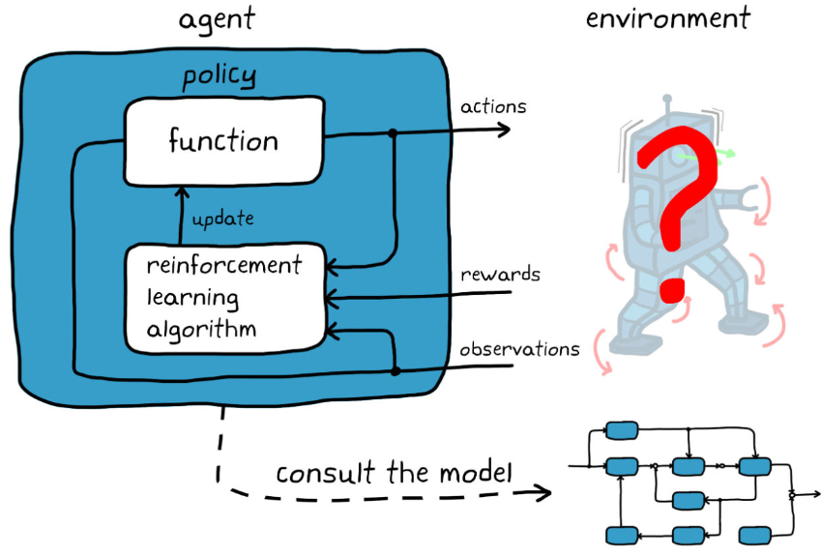
Reinforcement Learning

Slide 10
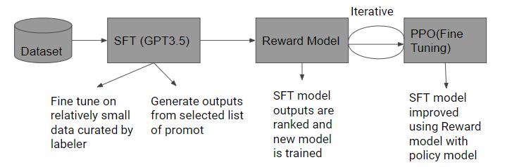
Component of chatGPT

Slide 11
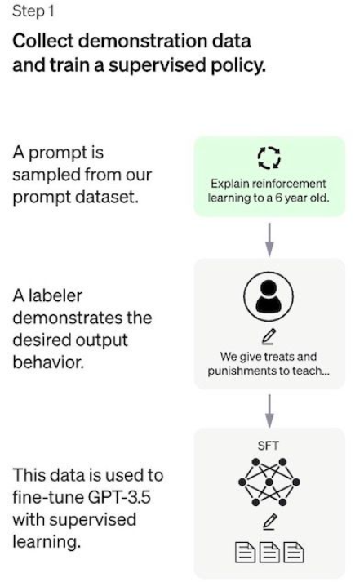
SFT
List of Prompt is selected and group of human labelers are asked to write down expected output
Open API request
12-15k datapoint
GPT3.5 ( text-davinci-003) - baseline model

Slide 12
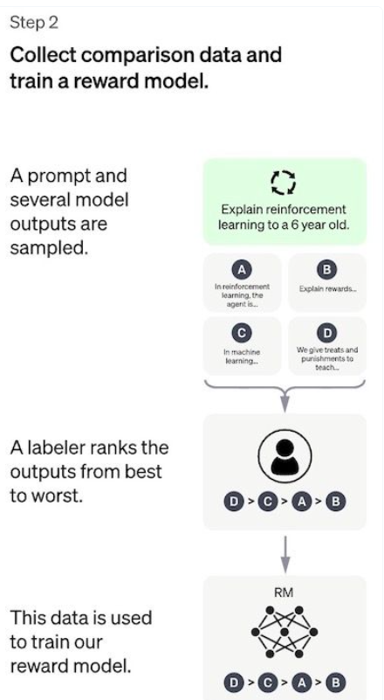
Reward Model
give a score to the SFT model outputs. This will mimic human preference.

Slide 13
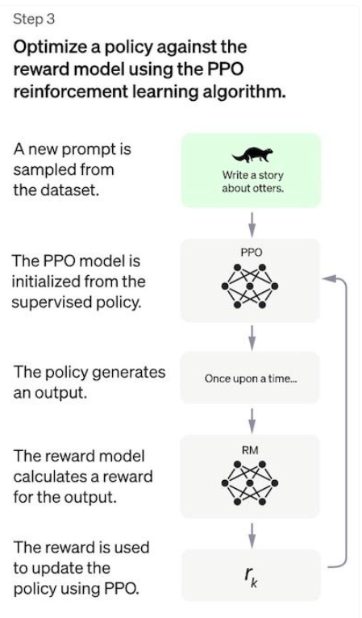
PPO (Proximal Policy optimization)
On policy algorithm(Learn from & update current policy directly)
PPO used trust region optimization method
Uses value function to estimate the expected return of given state or action.
In chatGPT value function initialized from the reward model.
KL penalty is added from SFT model at each token to mitigate over optimization of the reward model.

Slide 14
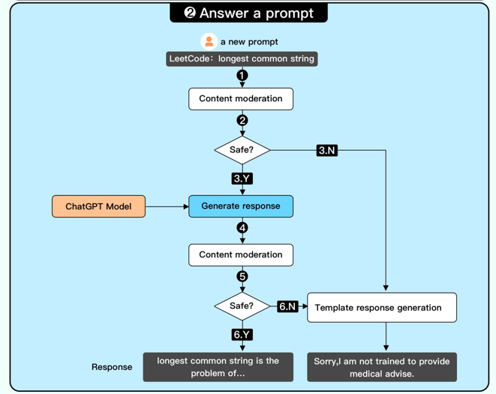
Answer a prompt

Slide 15
Shortcomings
The preferences of the labelers who produce the demonstration data.
The researchers who design the study and write the labeling instructions.
The choice of prompts crafted by the developers or provided by the OpenAI customers.
The labelers bias is both included in the reward model training (by ranking outputs) and in the model evaluation.

Slide 16
Application
Any programming languages code with line by line code
Twitter Thread
Q&A
Translation
Summarization
Respond to mail/review
Content creation
AI assistants
Personalization AI

Slide 17
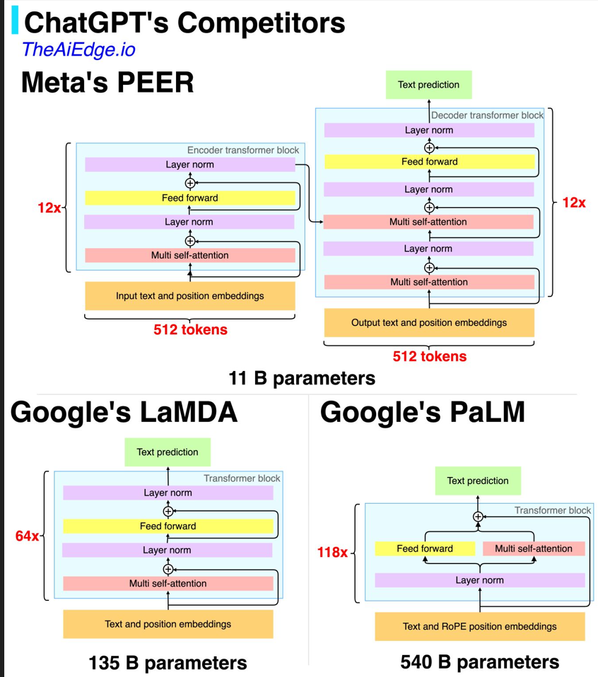
Other tools like ChatGPT
LAION-AI/Open-Assistant
OpenAssistant is a chat-based assistant that understands tasks, can interact with third-party systems, and retrieve information dynamically to do so
Follow Instruct GPT
Minimum Viable Prototype will release in Jan 2023
lucidrains/PaLM-rlhf-pytorch
based on RHLF . WIP

Slide 18
Resources:
https://www.assemblyai.com/blog/how-chatgpt-actually-works/
https://arxiv.org/pdf/2203.02155.pdf
https://huggingface.co/blog/rlhf
https://openai.com/blog/chatgpt/
ByteByteGo.com – Linkedin post

