Slide 1
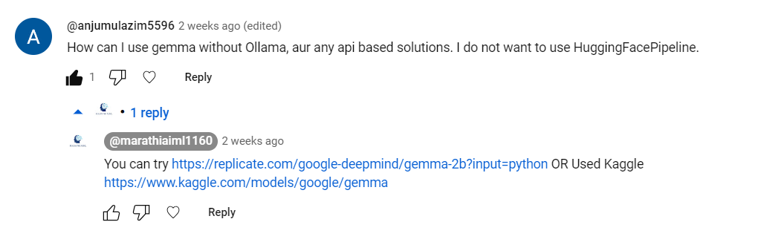

Slide 2
How to use Open Source LLM Locally
Groq

Slide 3
Groq LPU
Language Processing Unit - Fastest inference for computationally intensive application
Greater Compute capacity than GPU and CPU
Faster time per word generation. Allowing faster text generation.
Does not support ML training
Request a cloud access - https://console.groq.com/
Paper to read in detail - https://wow.groq.com/inference-speed-is-the-key-to-unleashing-ai-potential/

Slide 4
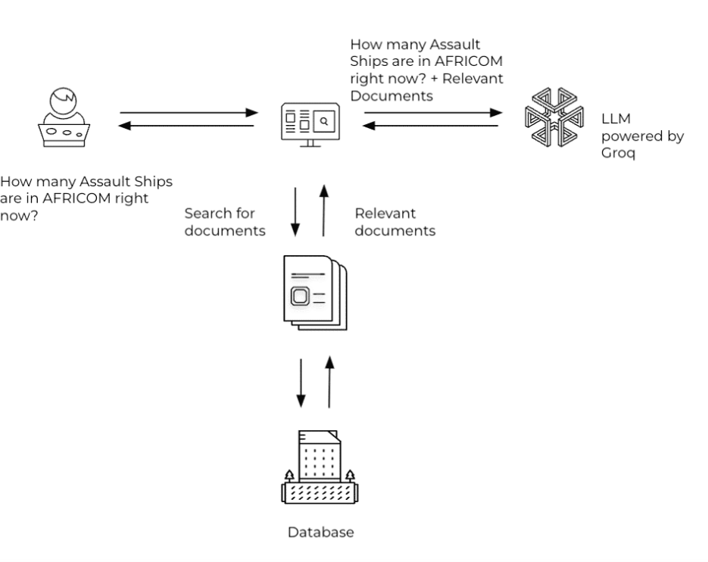

Slide 5





Google Notebook

Slide 6
Reference
https://wow.groq.com/retrieval-augmented-generation-with-groq-api/
https://python.langchain.com/docs/integrations/chat/groq
https://www.linkedin.com/pulse/build-lightning-fast-rag-chatbot-powered-groqs-lpu-ollama-multani-ssloc
https://github.com/langchain-ai/langsmith-cookbook/blob/main/hub-examples/retrieval-qa-chain/retrieval-qa.ipynb

