Slide 1
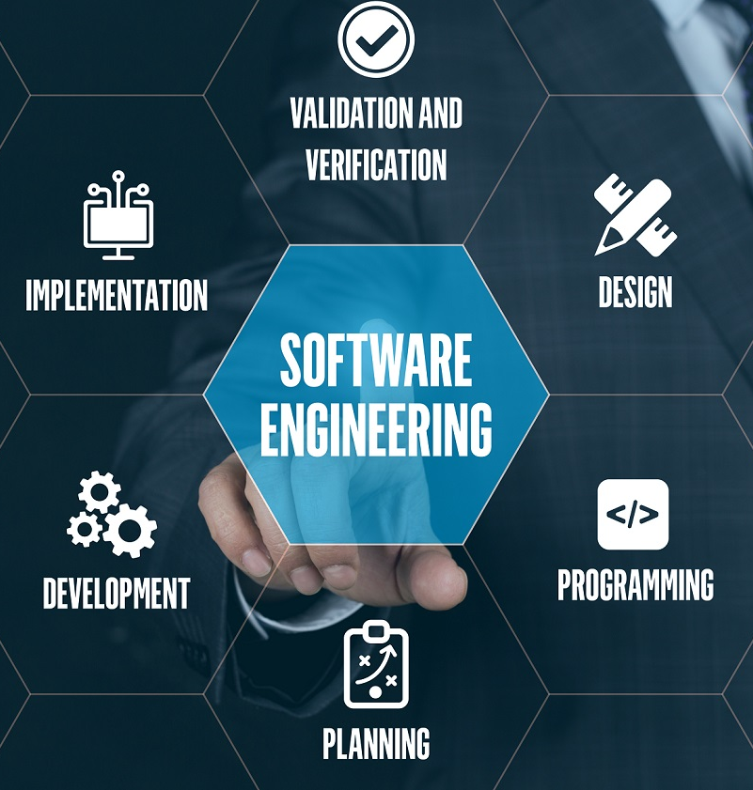
Introduction to Software Engineering
P. V. S. S. Neeraj
211FA04615
Batch: 7
Section: H
Branch: CSE

Slide 2
What is Software Engineering?
The software is a collection of integrated programs.
Software Engineering is the process of designing, developing, testing and maintaining software.
, developing, testing, and maintaining software.
Software Engineering is the process of designing, developing, testing, and maintaining software.

Slide 3
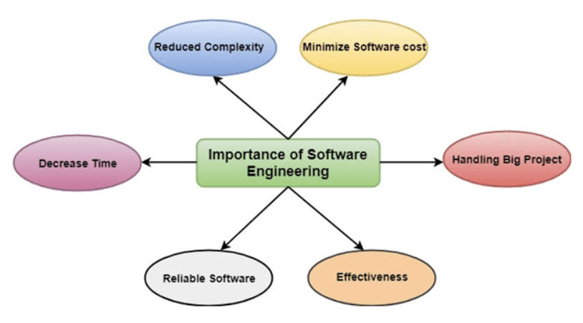
Importance of Software Engineering

Slide 4
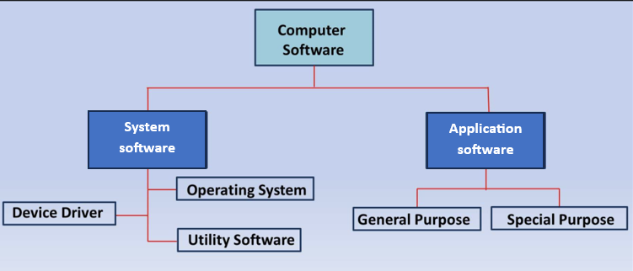
Types of Software

Slide 5
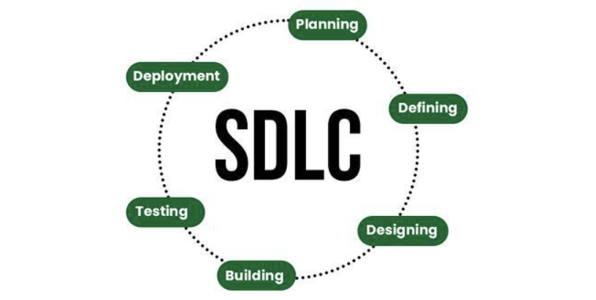
Software Development Life Cycle (SDLC)

Slide 6


