Slide 1
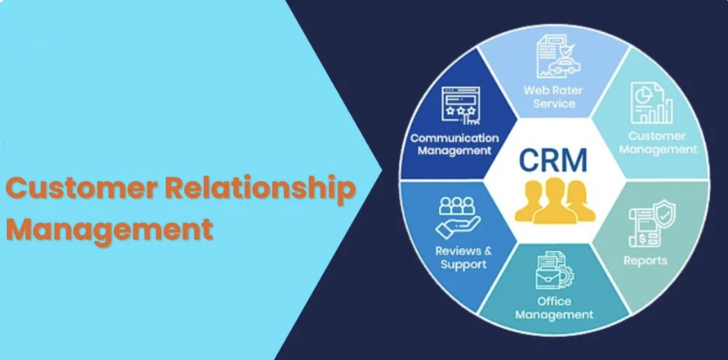
Customer Relationship Management (CRM)
P. V. S. S. Neeraj
211FA04615
Year: 4
Section: F
Branch: CSE

Slide 2

Application of CRM: Salesforce

Slide 3
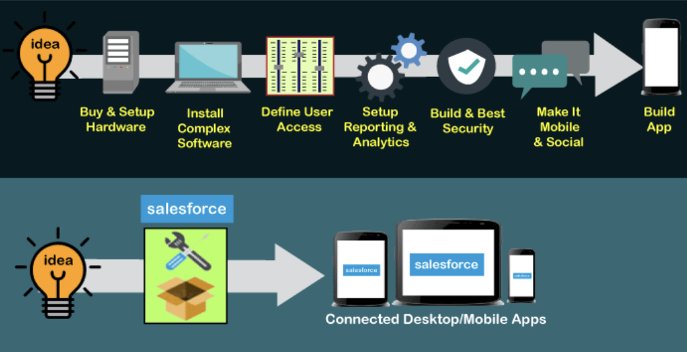
Why Should we use Salesforce?
Traditional
Setup
Salesforce Cloud Approach
Source: https://www.javatpoint.com/salesforce

Slide 4
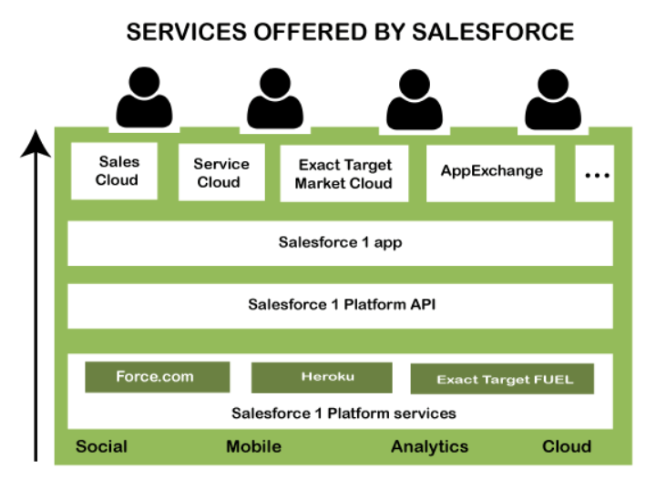
Salesforce Service Architecture
Source: https://www.javatpoint.com/salesforce-architecture

Slide 5
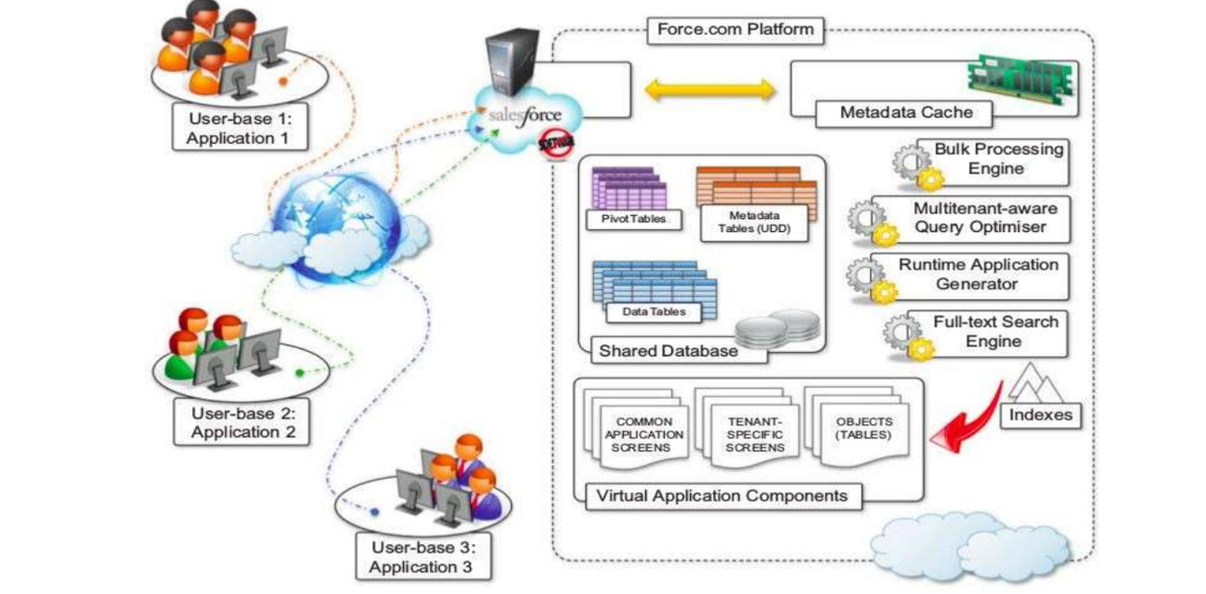
Salesforce Platform Architecture

Slide 6


