Slide 1
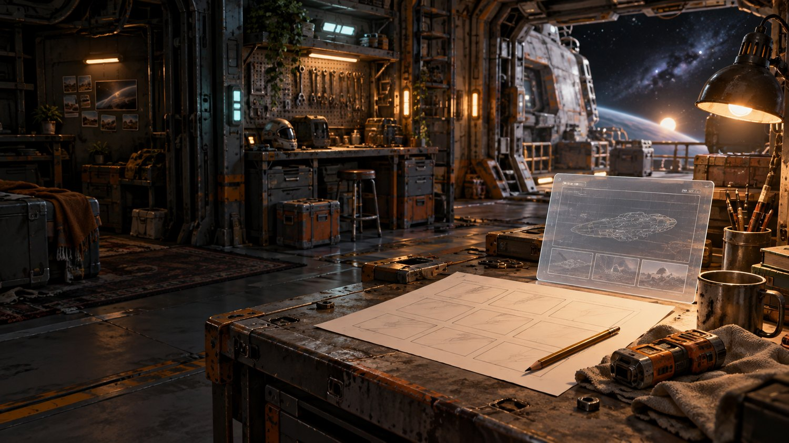
CS077 / WEEK 06
CAPTURE
WHAT MATTERS.
One need. One Windows Forms utility. One tested GitHub handoff.
6A Need + interface
6B Capture + test
The story explains why. The engineering proves how.
CS077 / WEEK 6 / APP DEVELOPMENT 01
01
Notes:
Week 6 Quick Start cover. Visual source: course-owned CS077 Week 5 workshop art.

Slide 2
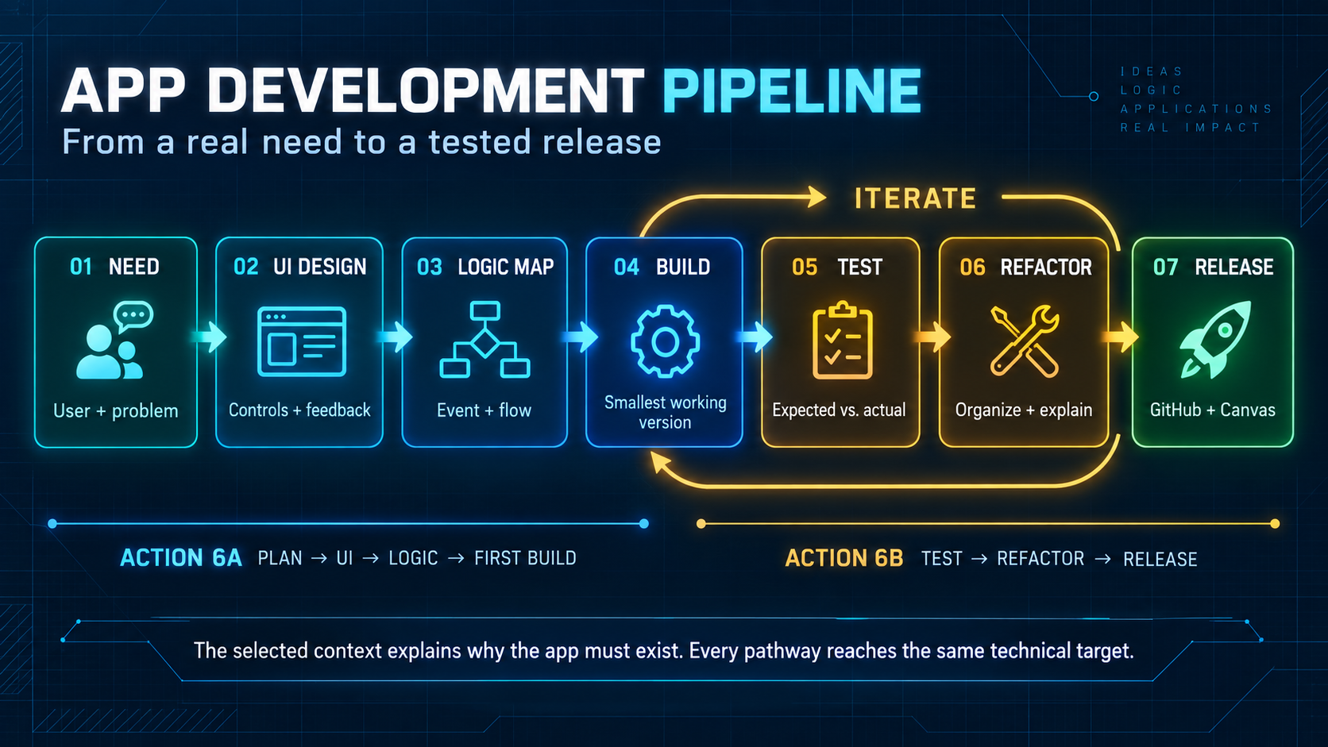
THE PIPELINE
A need becomes a tested utility.
Build, Test, and Refactor form an iteration loop—not a one-way finish line.
ACTION 6A
ACTION 6B
WEEK 6
CS077 / WEEK 6 / APP DEVELOPMENT 01
02
Notes:
Course-created pipeline illustration. Action 6A establishes need, UI, logic, and first interaction. Action 6B completes capture, save, testing, and refactoring.

Slide 3


CHOOSE ONE CONTEXT
Three reasons. One technical target.
Your choice changes the purpose, labels, documentation, and ethical boundary.
VOID RUNNERS
ORIGINAL STORY
TECHNICAL ROUTE
Preserve an unstable Ashwake terminal record before it resets or changes.
Protect visual information that matters to someone in your own world.
Document software behavior, a test result, or a support problem.
Shared target: C# Windows Forms + primary-screen capture + PNG save + visible status + tested GitHub repository
CS077 / WEEK 6 / APP DEVELOPMENT 01
03
Notes:
Course-owned CS077 character and workshop art. Selection receipt records the pathway and requirements, not completion or a grade.

Slide 4
START CLEAN
Run the empty form before adding capture code.
This separates environment trouble from code trouble.
01
Create
02
Run
03
Checkpoint
Choose C# Windows Forms App—not WPF—and use the framework approved in class.
Launch the untouched form. The blank window proves the template and workload work.
Create or connect Git. Commit and push the empty working form before editing.
Project
Form
Controls
Recovery
ScreenCaptureUtility
MainForm
btnCapture
btnSave
picPreview
lblStatus
Missing template?
Check .NET desktop
development workload.
CS077 / WEEK 6 / APP DEVELOPMENT 01
04
Notes:
Official tutorial: https://learn.microsoft.com/en-us/dotnet/desktop/winforms/get-started/create-app-visual-studio

Slide 5
DESIGN THE FIRST ROUTE
The user should know what to do and what happened.
Use the Visual hat before the Logical hat.
1
CAPTURE SCREEN
2
PREVIEW IMAGE
3
SAVE PNG
4
READ STATUS
[ Capture screen ] [ Save PNG ] Ready. Choose Capture screen.
PICTURE PREVIEW
Names explain roles: btnCapture · btnSave · picPreview · lblStatus
CS077 / WEEK 6 / APP DEVELOPMENT 01
05
Notes:
Control prefixes are a course/team naming convention, not a C# language rule. Use labels beside imagery and preserve a keyboard route.

Slide 6
TRACE THE CLICK
The button asks. A method does the work.
The form handles interaction; the service handles capture.
1
Button click
→
2
Click handler
→
3
Capture method
→
4
Bitmap
→
5
Preview
→
6
Save choice
→
7
Status
MainForm
ScreenCaptureService
btnCapture_Click(...)
{
currentCapture = captureService
.CapturePrimaryScreen();
picPreview.Image = currentCapture;
}
CapturePrimaryScreen()
{
read screen bounds
create Bitmap + Graphics
CopyFromScreen(...)
return image
}
CS077 / WEEK 6 / APP DEVELOPMENT 01
06
Notes:
Keep event handlers small. The instructor-only working-core verification project demonstrates this separation; the learner starter remains raw.

Slide 7
CAPTURE THE SCREEN
Move pixels into a bitmap—and release temporary resources.
Explain each object before copying code.
A
Primary screen bounds
B
Bitmap
C
Graphics
D
CopyFromScreen
Provides the primary display location and size.
Stores the captured pixels in memory.
Creates a temporary drawing surface connected to the bitmap.
Copies visible pixels from the screen into the bitmap.
using Graphics graphics = Graphics.FromImage(image);
graphics.CopyFromScreen(bounds.Left, bounds.Top, 0, 0, bounds.Size);
return image;
WHY USING? Graphics is temporary. Dispose it when the capture method ends.
CS077 / WEEK 6 / APP DEVELOPMENT 01
07
Notes:
Official API: https://learn.microsoft.com/en-us/dotnet/api/system.drawing.graphics.copyfromscreen

Slide 8
SAVE WITH A VISIBLE RESULT
Success, cancellation, and failure are different routes.
SaveFileDialog gives the user control of location and file name.
SUCCESS
CANCEL
FAILURE
Save PNG; show the file name.
Keep the capture; say that save was cancelled.
Show the exact problem; keep the app usable.
Filter = "PNG image (*.png)|*.png" DefaultExt = "png" currentCapture.Save(dialog.FileName, ImageFormat.Png);
PRIVACY GATE Never submit passwords, tokens, private messages, grades, or unrelated personal information.
CS077 / WEEK 6 / APP DEVELOPMENT 01
08
Notes:
Official docs: https://learn.microsoft.com/en-us/dotnet/desktop/winforms/controls/how-to-save-files-using-the-savefiledialog-component and https://learn.microsoft.com/en-us/dotnet/api/system.drawing.image.save

Slide 9
TEST. ASK. DECIDE.
AI advice becomes evidence only after you verify it.
Keep the request narrow and preserve the working core.
1
ASK ONE QUESTION
→
2
PREDICT
→
3
TEST ONE CHANGE
→
4
OBSERVE
→
5
KEEP / CHANGE / REJECT
BEGINNER AI PROMPT
Explain ONE selected method line by line. Identify variables, objects, inputs, output, and disposable resources. Suggest ONE small error-feedback improvement and ONE test. Preserve my working core. Do not replace the project.
TEST ROUTES
successful save · cancelled save · blocked destination · second capture
CS077 / WEEK 6 / APP DEVELOPMENT 01
09
Notes:
No-paid fallback: test the supplied cancellation-message change, record the observed result, and label it supplied-response evidence.

Slide 10
BRING BACK ONE TESTED REPOSITORY
6A and 6B advance the same weekly build.
Reuse class evidence. Do not create duplicate reports.
A
Need + interface
B
Capture + test
W
Final handoff
Context map, reading start, ethics boundary, prototype, first event, peer check, commit and push.
Capture and PNG save, AI record, test routes, refactor, README peer run, commit and push.
Brief, workbook page 117, reused class evidence, README, screenshots, receipt, final push.
1 COMMIT 2 PUSH 3 OPEN GITHUB 4 VERIFY FILES + ACCESS 5 SUBMIT URL IN CANVAS
Both Action 6A and Action 6B must be accepted before the weekly assignment is accepted for grading, subject to the syllabus and approved accommodations.
CS077 / WEEK 6 / APP DEVELOPMENT 01
10
Notes:
Official Git guide: https://learn.microsoft.com/en-us/visualstudio/version-control/git-create-repository?view=visualstudio. Canvas is the official submission and grading location.

