Slide 1
Big Data Project
Open Weather - Air Pollution API concept
Mandeep Saini

Slide 2
Air Pollution API Concept
Air Pollution API provides current, forecast and historical air pollution data for any coordinates on the globe
Besides basic Air Quality Index, the API returns data about polluting gases, such as Carbon monoxide (CO), Nitrogen monoxide (NO), Nitrogen dioxide (NO₂), Ozone (O₃), Sulphur dioxide (SO₂), Ammonia (NH₃), and particulates (PM_{2.5} and PM₁₀).
Air pollution forecast is available for 5 days with hourly granularity. Historical data is accessible from 27th November 2020.
API URL: https://openweathermap.org/api/air-pollution

Slide 3
Use Cases
Some of the use cases include:
Streaming processing
Created producer to call open weather API and write response data to the Kafka topic
Gathered a year worth of data
Flatten the data before writing to topic
Created consumer to read the data from Kafka topic
Clean and formatted the data after reading from consumer
Tracking user activity, log aggregation, etc
Data analysis of streamed data
Calculate average index of polluted gases of each city for every month of year
Compare cities air quality index of cities for one week
Compare the air pollution index by city for one week.

Slide 4
Streaming Process
Request to API
Source (open weather)
Producer
Response from API
Kafka
Broker
Consumer
Topic
Partition
0 | 1 | 2

Slide 5
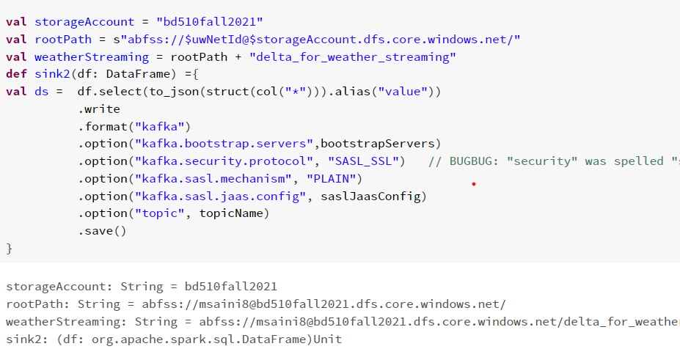
Code Sample
Producer code sample:

Slide 6
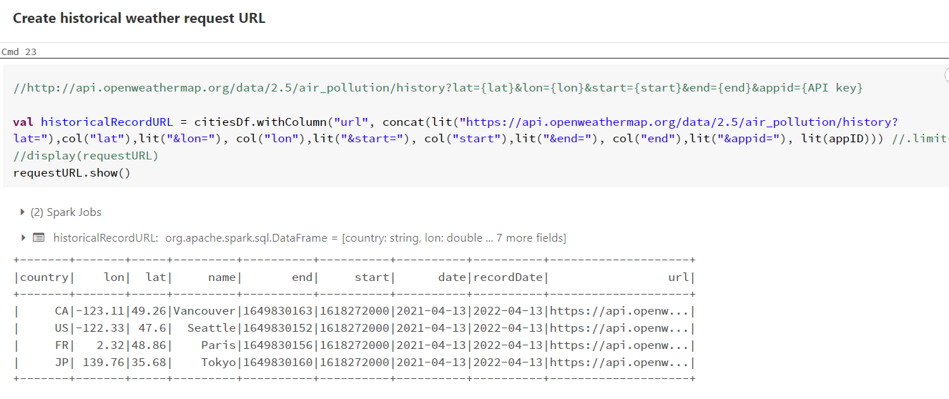

Slide 7
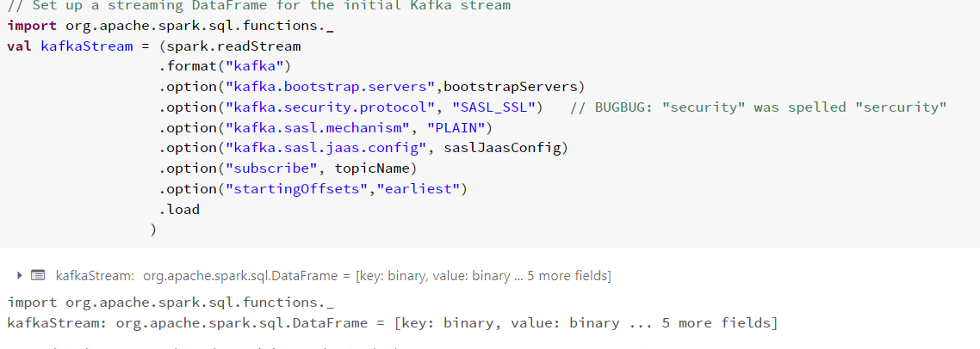
Consumer Code Sample

Slide 8
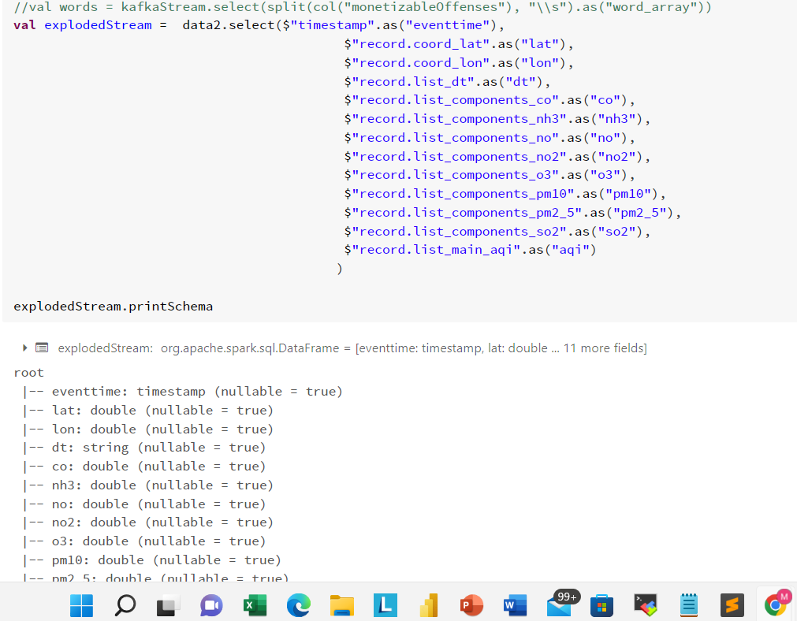

Slide 9
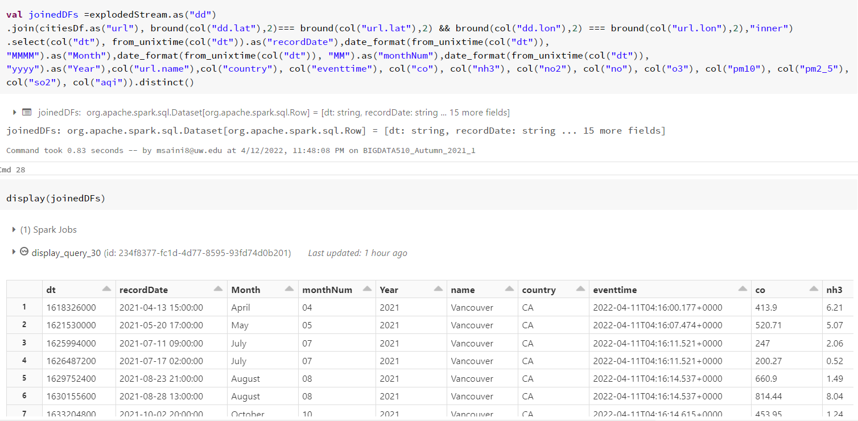

Slide 10
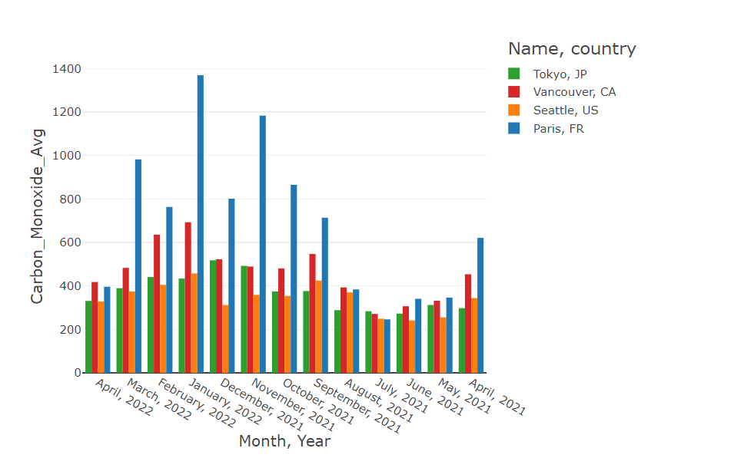
Analysis Samples
Average Air polluting gases index of each city by month

Slide 11
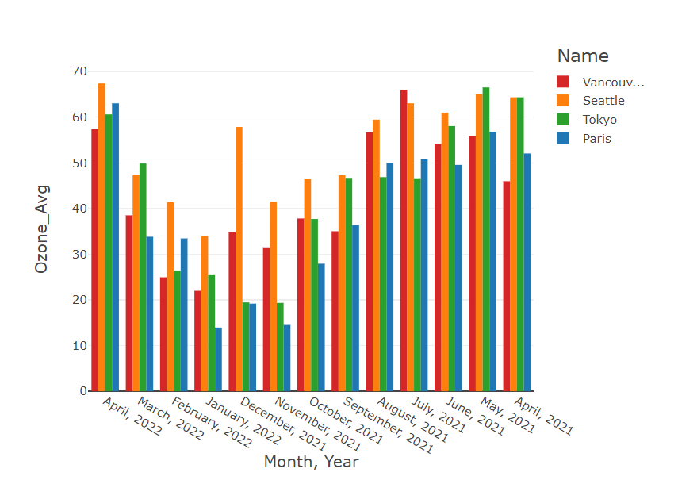

Slide 12
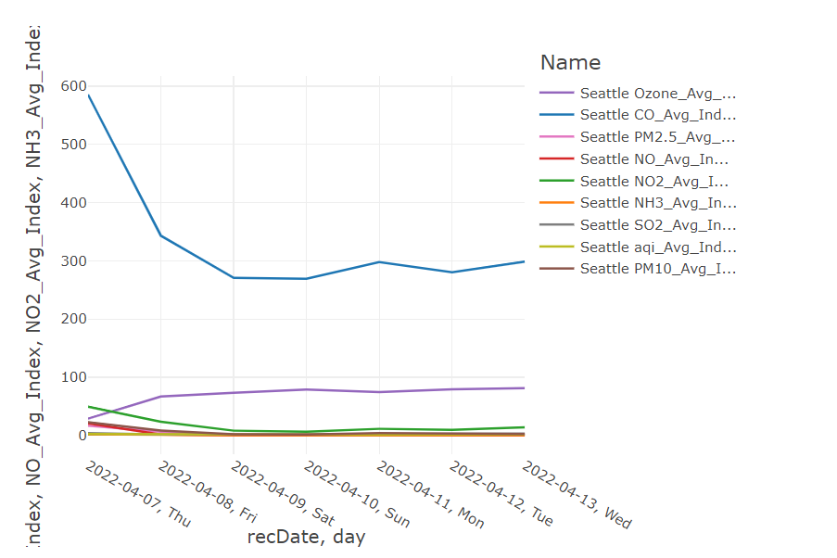
Weekly average air pollution index of One city

Slide 13
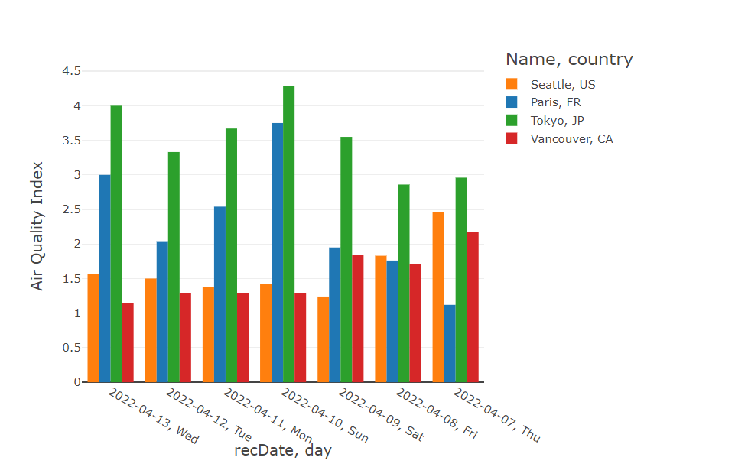
Weekly Air quality comparison of cities

Slide 14
Challenges and Learning Curves
Finding the starting point of the project was little challenging
There was little bit learning curves to create the API request URL for each city by finding the longitude and latitude of each city
Fatten the response data was little bit challenging specially dealing with UNIX timestamp date
No issue creating consumer, only data formatting was little tedious specially group by day, month, and year
Weekly grouping was little challenging while again dealing with dates.

